Slide 1

By: Justin Melville, Lifu Zhang, Steven Tong, Jack Halberian, Paul Stephen Hutchinson Maltaghati, Zhaoze Wang

Slide 2
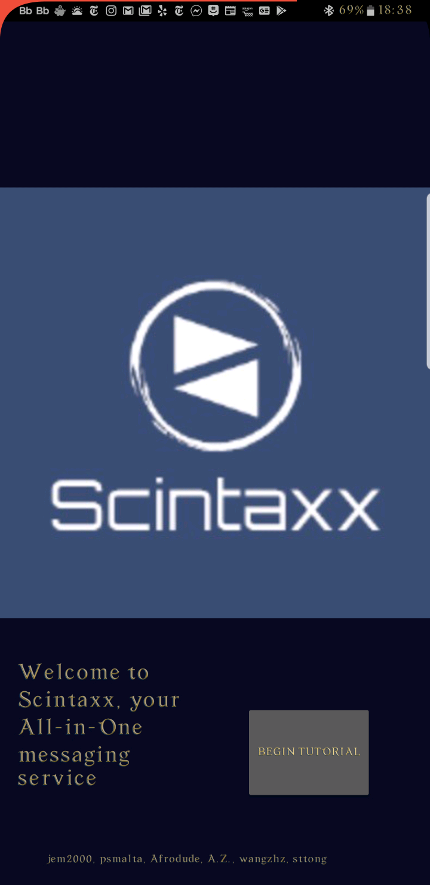
Introduction
This is the introductory page of our app. Click “Begin Tutorial” to start our app.

Slide 3
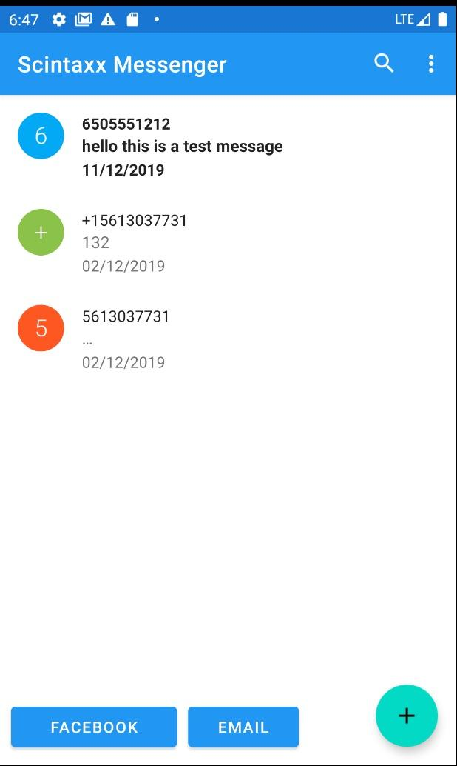
SMS List Page
After the introduction, this is the SMS page that shows all of the conversations you have with people. Also, on the bottom left hand corner there are two buttons, one for Facebook and the other for Email.

Slide 4
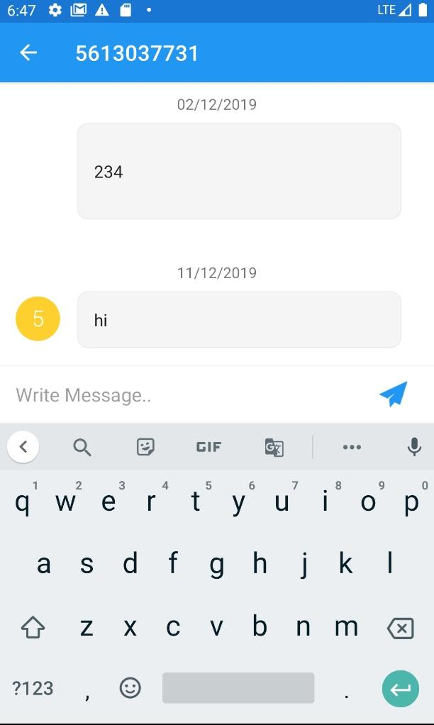
Conversation
When selecting a conversation, this is what the layout looks like. Our app will make sure to import all the conversations from your SMS into the app as seen here.

Slide 5
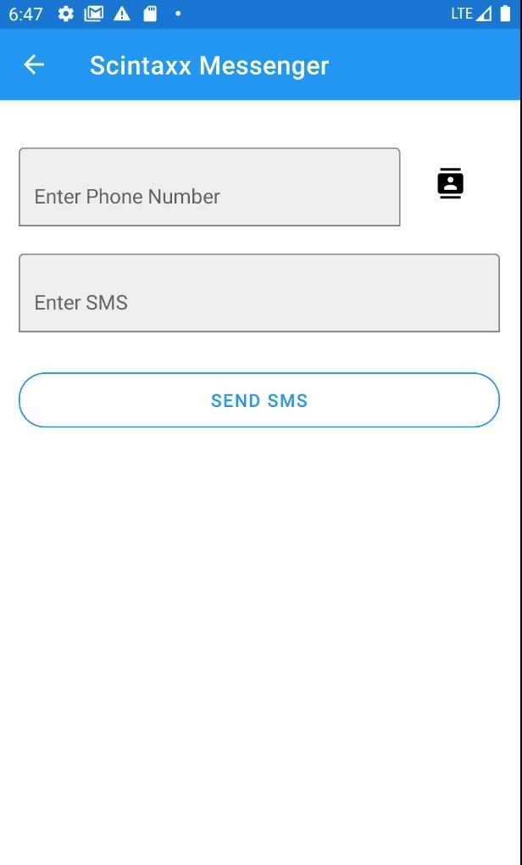
Creating New Conversation
We also provide the user the option to start a new conversation either from contacts by clicking the contacts icon or by typing in a number.

Slide 6
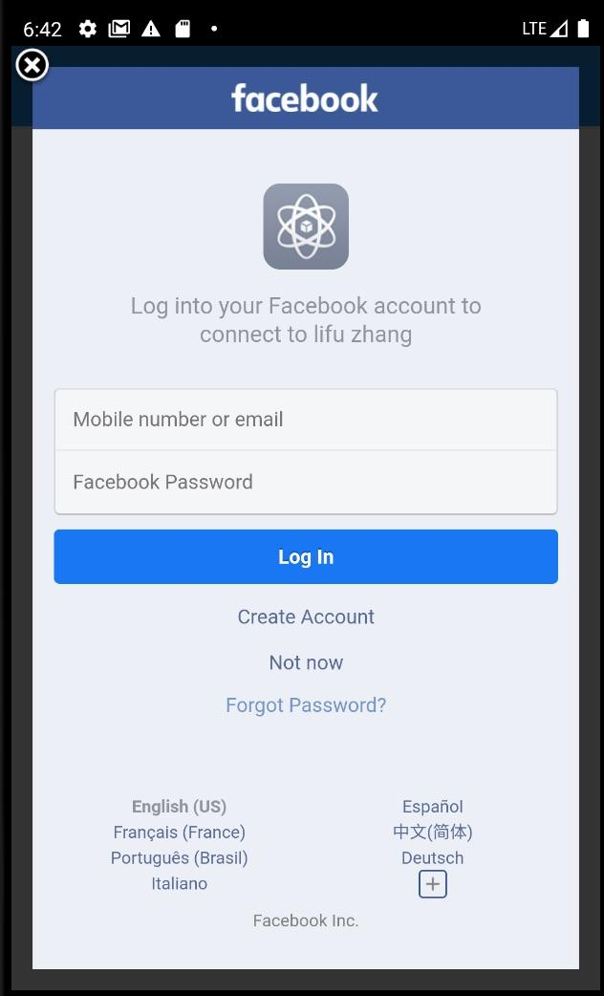
Facebook Functionality
If the “Facebook” button is clicked it will direct the user to login.

Slide 7
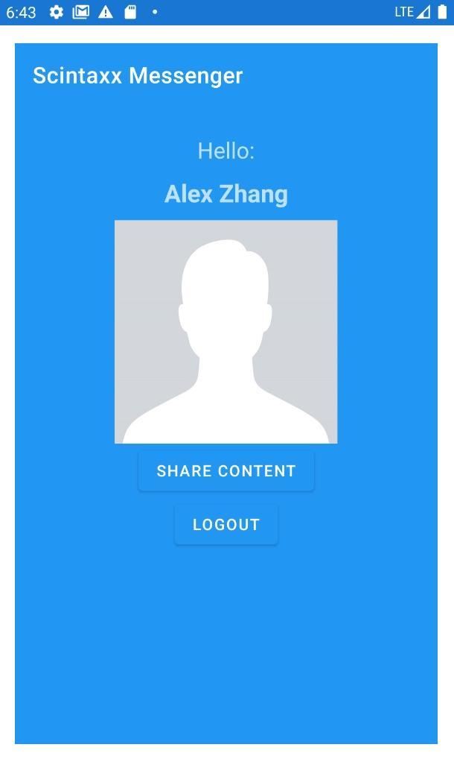
Facebook Functionality
After logging in, it will direct the user to this page.

Slide 8
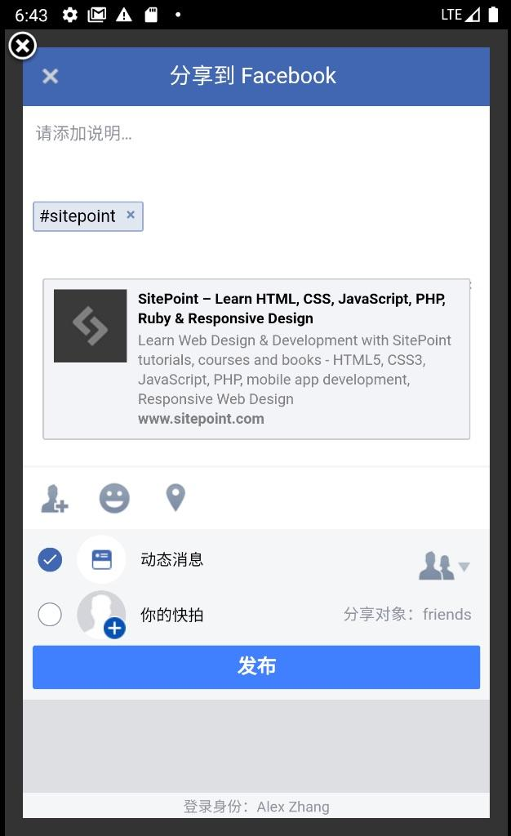
Facebook Functionality
After signing in, our app will allow users to post whatever they would like onto their Facebook wall.

Slide 9
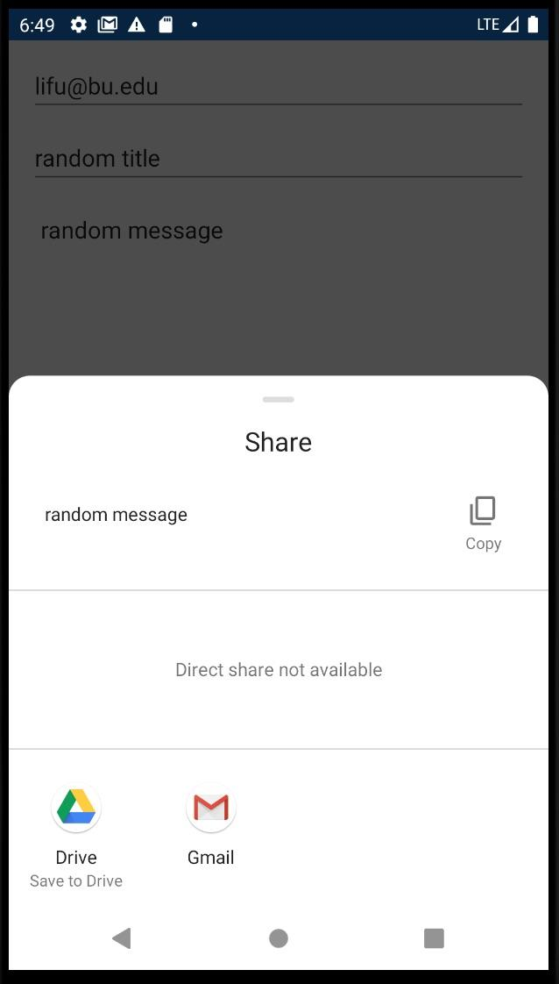
Email Functionality
In order to make use of the JavaMail within the app, you must be logged into a valid email address.

Slide 10
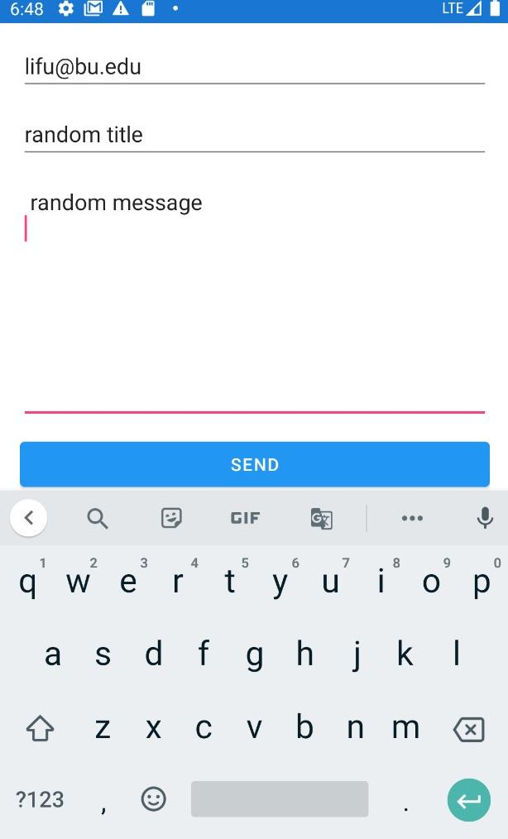
Email Functionality
After logging in, the user can write their message and send it.

