Slide 1
Agenda Date: Oct 17, 2019 Time: 13:30 Location: Yagura A
Background of VA Printing Project
Files and File Transfer Solution
EDP Team’s Opinions and Solutions
Follow-up Actions
Notes:
Title

Slide 2
Background of VA Printing Project
VA Div needs to generate and distribute notifications and reports to customers for some of its products.
Currently this business is outsourced to an external vendor in a volume-based pricing model, with minimum fees applied.
As these products are being discontinued, it seems financially preferable for NN to bring back the business. Otherwise, the minimum fees look too expensive.
Notes:
Title

Slide 3
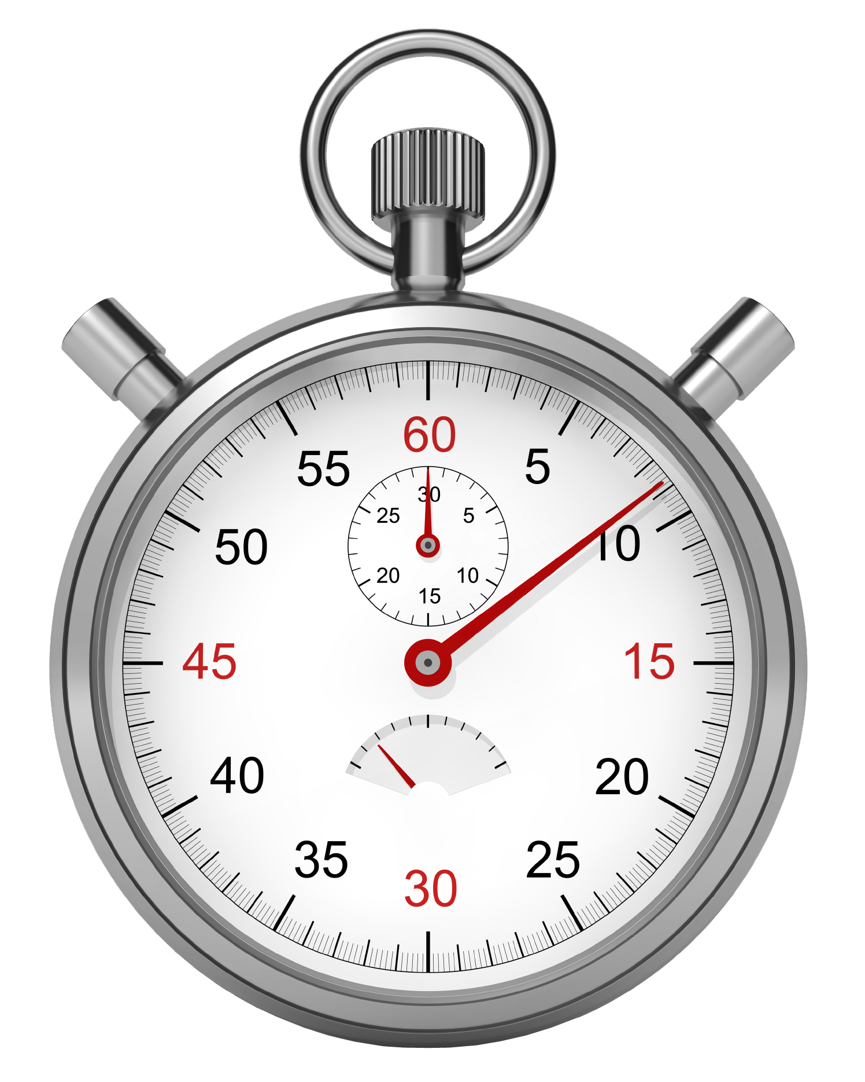


AS-IS Solution
Borrowed Slide
NN Life
Toppan
LIFE/J(AS/400)
Win
HULFT
Server
Win
HULFT
Server
Toppan Form Printing System
Timer
Use HULFTID to start
HULFT
2
3
4
5
2
NNJDTA
SENDTA
1
Error Check
Mapping Data
Auto Distribute
Copy/Send Data(Daily)
Printing
Copy
1
Daily Batch
6
Error
Form with error data will send back to NN CSD
Staffs in CSD will manually check the data, recreate the form and send out ※
NN Side Tasks: ① Run Daily batch to create data ② Send Data from NN to Toppan using HULFT (this is daily task, use Timer to trigger) | Toppan Side Tasks: ① Receive data using HULFT ② Check error for each filed(just mark the error field, the data will print out even with error) ③ Mapping data for printing purpose ④ Printing ⑤ Automatically distribute forms using matching key ⑥ Send the forms with error data to NN Customer Service Division
※ User requests to have same level error check in the new solution, also use requests to have reprint function.

Slide 4




TO-BE Solution（Proposal １）
Project Scope
NN Life
LIFE/J(AS/400)
Runbook
Bulk printing
Staffs will manually do distribution work
NNJDTA
Data Factory
4
Java Application
Printing Data
JasperReports
Library
Print Out
Error Log
5
1
Daily Batch
2
Template.jrxml
Data Factory
Error
Enterprise Data Store
3
Form template will be created using JasperReport studio
Tasks: ① Run Daily batch to create data Copy data from LifeJ to Azure Enterprise Data Store Use Data Factory to do error check and map data to printing data table. (error data saves into Error Log file) ④ User Azure Runbook to automatically trigger bulk printing java application Classify and distribute the forms into envelops will be manual works. ※ Have to manually re-run java job in case user request to re-print forms. ①and ② are out of scope of this project Error report will be sent to CSD
Borrowed Slide
※

Slide 5
Files and File Transfer Solution
Files: Same flat files as shown in AS-IS solution slide
File Transfer Solution:
From on-premises file server to the specified blob container of my Azure storage account
*Nice to have file transfer services
1. Transfer the files generated on Azure cloud back to YYYYMMDD folder of on-premises file server
2. Rotate the file folders so that up to latest seven days folders are kept
3. Send email notifications for every successful or failure file transfer.
Notes:
Title

Slide 6
Follow-up Actions
File server info (Dev, Prod, approval)
Info or support from Life/J team for file transfer
ETA
Notes:
Title

Slide 7
Notes:
Closing slide

