Slide 1
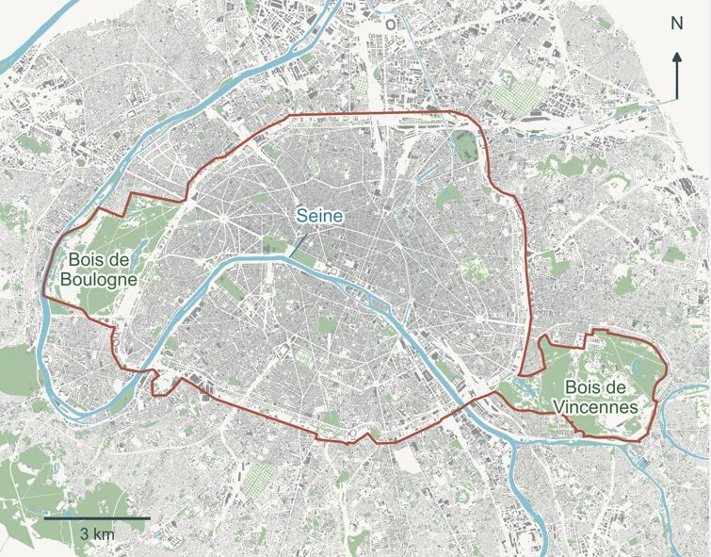
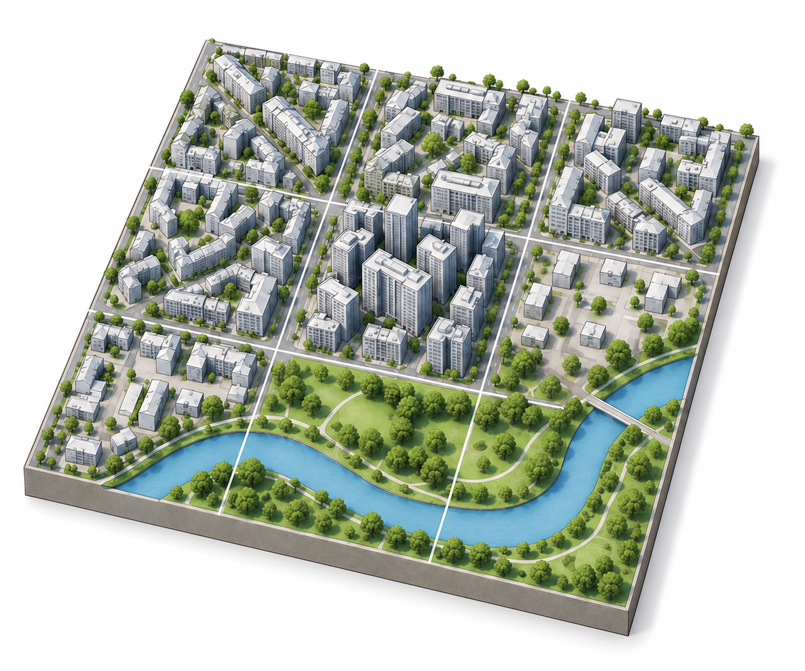
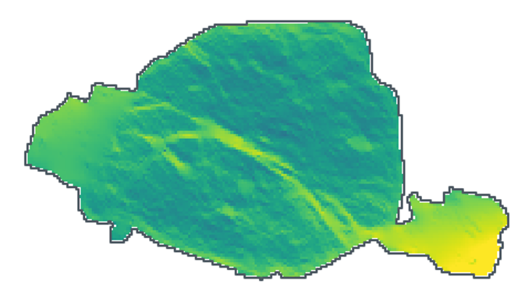
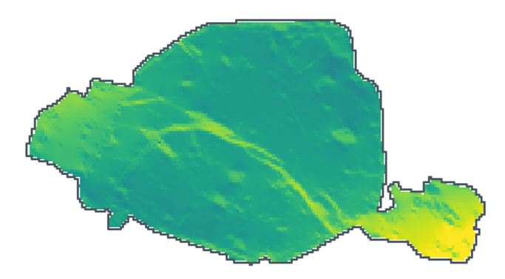
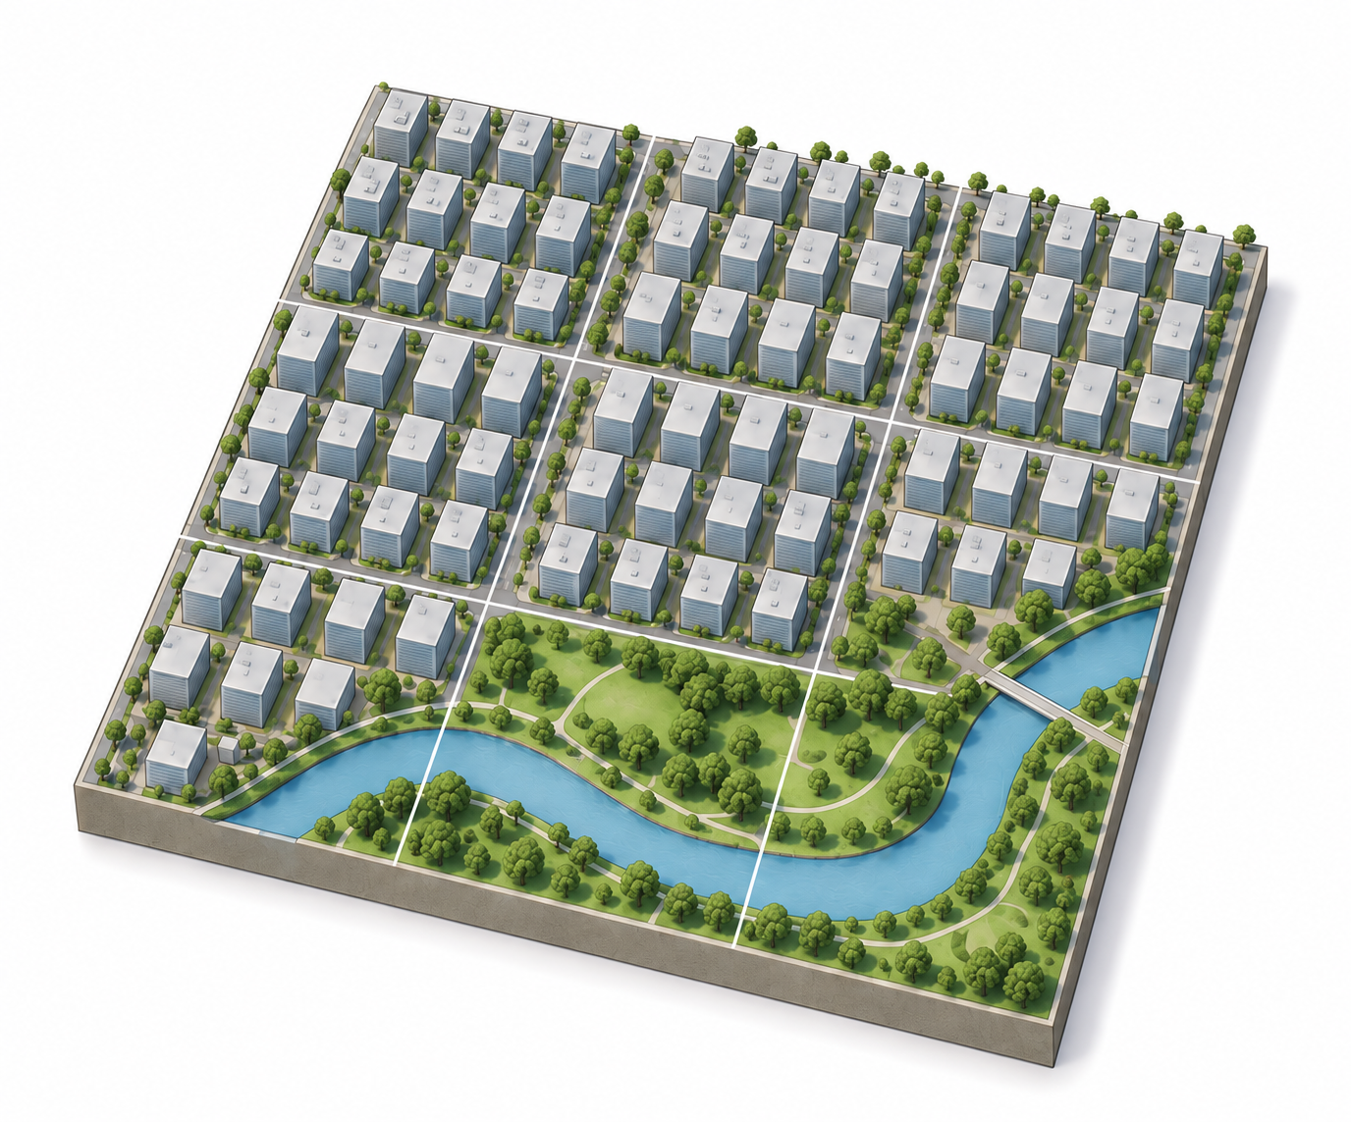
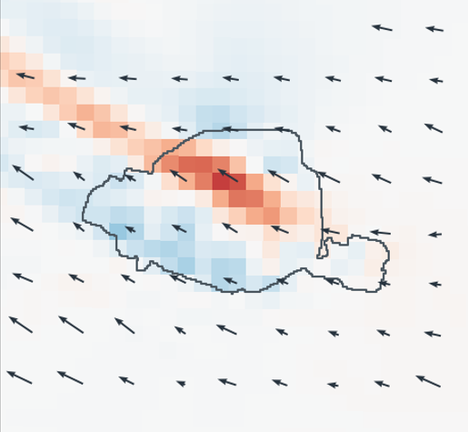
1 Data sources
2 REAL–HOMO experiments
3 Network value and air quality
Urban geometry
Paired scenarios
Circuit connectivity
Network added-value test
100 m building morphology
Directional FAI resistance
Direction-matched inputs
Height, coverage,
16-direction FAI
Rᵢ(θ) = 1 + FAIᵢ(θ) / q
Predictors
Building- or LCZ-derived ΔC
Edge current Cᵢⱼ = (φᵢ − φⱼ) / rᵢⱼ
WRF target
Mean ΔU within each inflow class
REAL
REAL
HOMO
Baseline morphology X
BD TOPO 2022
Local, neighborhood and upwind
Footprints and heights
Water, parks and urban extent
X vs. X + ΔC (3D)
X vs. X + ΔC (LCZ)
ΔC
3D
= C
REAL
− C
HOMO
Meteorology
Observed heterogeneity
LCZ benchmark
Repeated spatial block CV
ERA5 + static geography
HOMO
Paris class-median FAI
Same resistance settings and HOMO reference
Held-out RMSE reduction (%)
WRF forcing
Paired WRF response
Q2.
Added value of 3D and LCZ networks
7 surface stations and
Trappes radiosonde
WRF + SLUCM • 9 / 3 / 1 km
Robustness
Vertical range, nonlinear model,
permutation and resistance scale
Shared forcing and static geography
LCZ and air quality
Uniform built-area parameters
H, λₚ, scalar FAI, z₀ and d
Air-quality association
10–1000 m layer-mean
along-wind velocity
Hourly WRF ΔU
+
Airparif background stations
Cerema LCZ 2022
Held constant
Airparif
Urban extent, water, parks,
periphery and morphology totals
Matched by station and hour
ΔU
= U
REAL
− U
HOMO
Two-way demeaning by station and hour
NO₂, O₃ and Ox
Paris, July 2022
Spearman ρ with time-block bootstrap
Q1.
Connectivity and airflow redistribution
Q3. Associations with NO₂, O₃ and Ox
Notes:
Paired REAL–HOMO study in Paris. The original schematic illustrations are conceptual. Two independent added-value comparisons share the baseline and target. LCZ connectivity uses the same HOMO reference. The Airparif analysis uses hourly responses.

