Slide 1
carvana-image-masking-challenge
---Michael

Slide 2
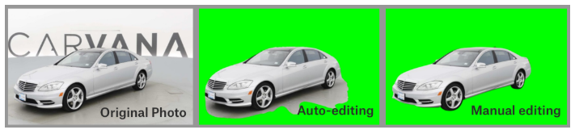
Background
In this competition, you’re challenged to develop an algorithm that automatically removes the photo studio background.

Slide 3
Background – Data Files
/train/ - this folder contains the training set images
/test/ - this folder contains the test set images. You must predict the mask (in run-length encoded format) for each of the images in this folder
/train_masks/ - this folder contains the training set masks in .gif format
train_masks.csv - for convenience, this files gives a run-length encoded version of the training set masks.
sample_submission.csv - shows the correct submission format
metadata.csv - contains basic information about all the cars in the dataset. Note that some values are missing.

Slide 4
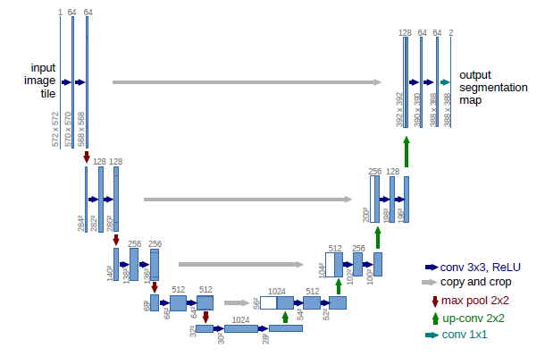
U-Net Architecture

Slide 5
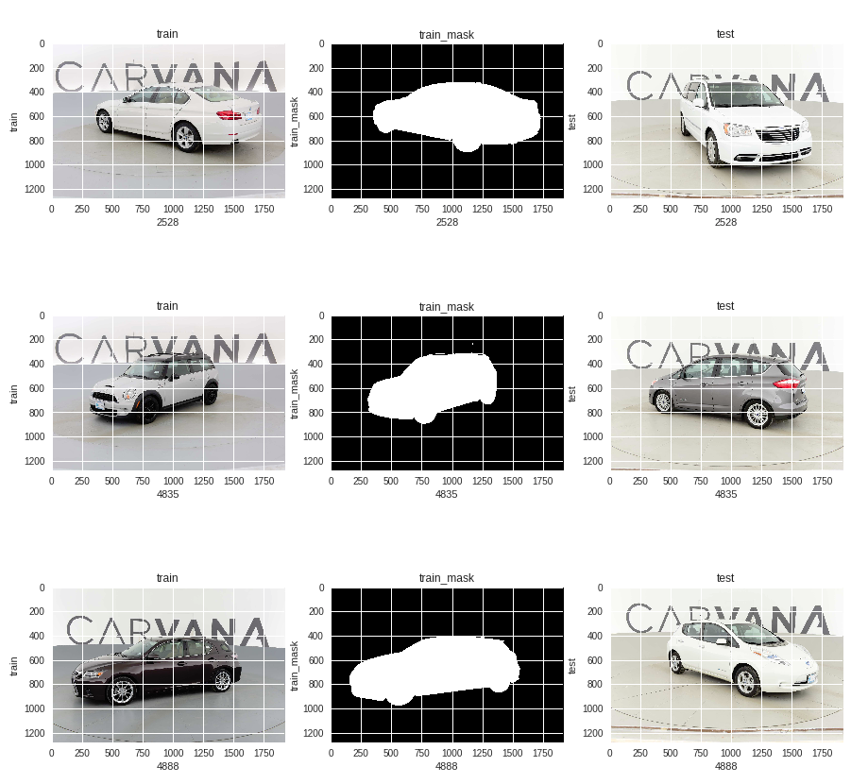
Training/Test Data Visualization

Slide 6
Data Summary
Number of training examples = 4071
Number of valid examples = 1018
Number of testing examples = 100064
Image data shape = (1280, 1918, 3)

Slide 7
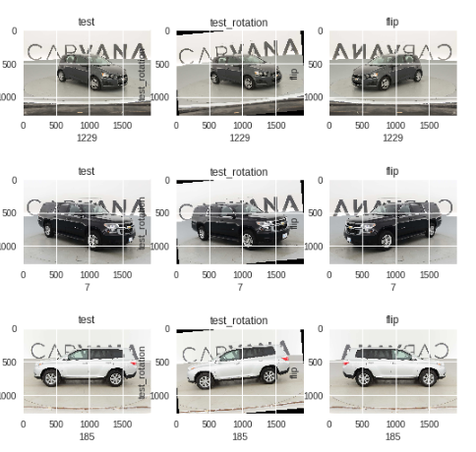
Data Augmentation

Slide 8
Keras Generator
If we pre-process all images directly, it will consume a lot memory and will be a limitation if we need tons of images to train. The generator is here to help.
checkpoint = ModelCheckpoint('model.h5', monitor='loss',verbose=1, save_best_only=True , mode='min')
early_stop = EarlyStopping(monitor='loss', patience=2, verbose=1, mode='min')
callbacks_list = [checkpoint, early_stop]
history = model.fit_generator(train_generator, steps_per_epoch= len(train_samples)/16+1, validation_data=validation_generator, validation_steps=len(validation_samples)/16+1, epochs=100,callbacks=callbacks_list, verbose=1)

Slide 9
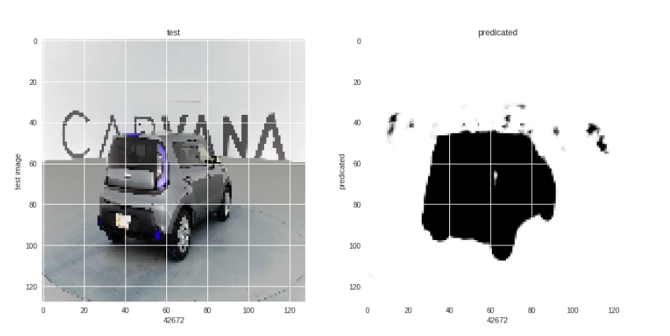
Test Prediction
Based on the training model, I predicated the test image and could find that there some false positives and need to to more data augmentation to increase the training data size and also need to try different training model to compare the result. Here is the predicated test image label based on the training model.

Slide 10

Performance

Slide 11

Loss
Dice Coefficient
Dice Loss = 1- Dice Coefficient
bce_dice_loss (Binary Cross Entropy + Dice Loss)

Slide 12
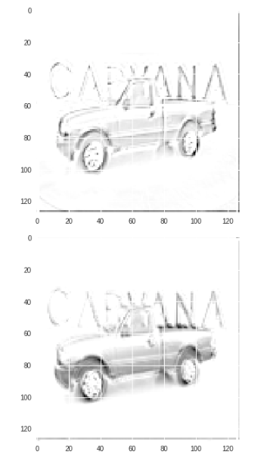
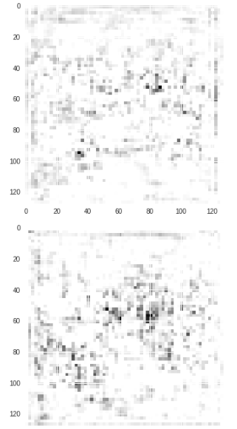
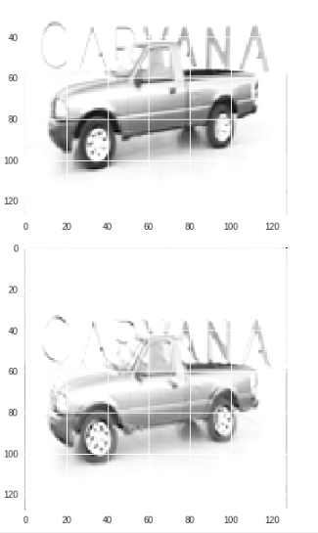
View Middle Layer

Slide 13
The End

