Slide 1
carvana-image-masking-challenge
---Michael

Slide 2
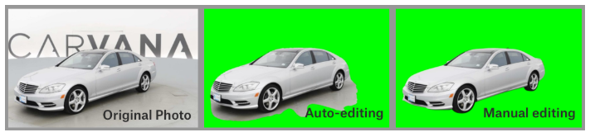
Tasks
In this competition, you’re challenged to develop an algorithm that automatically removes the photo studio background.

Slide 3
Data Files
/train/ - this folder contains the training set images
/test/ - this folder contains the test set images. You must predict the mask (in run-length encoded format) for each of the images in this folder
/train_masks/ - this folder contains the training set masks in .gif format
train_masks.csv - for convenience, this files gives a run-length encoded version of the training set masks.
sample_submission.csv - shows the correct submission format
metadata.csv - contains basic information about all the cars in the dataset. Note that some values are missing.

Slide 4
Project Description
Image Segmentation with fully connected network
Keras functional API will be used
The goal is to predicate masks for test image set of cars
U-Net network will be used to train the model
Training image size will be 128*128 due to GPU memory limitation
Gradient Descent Optimiser will be using RMSProp. RMS prop also takes away the need to adjust learning rate, and does it automatically. More so, RMSProp choses a different learning rate for each parameter.
Loss function will use: Binary Cross Entropy + Coefficient
Google CoLab Free GPU will be used to train

Slide 5

Loss
Dice Coefficient
Dice Loss = 1- Dice Coefficient
bce_dice_loss (Binary Cross Entropy + Dice Loss)

Slide 6
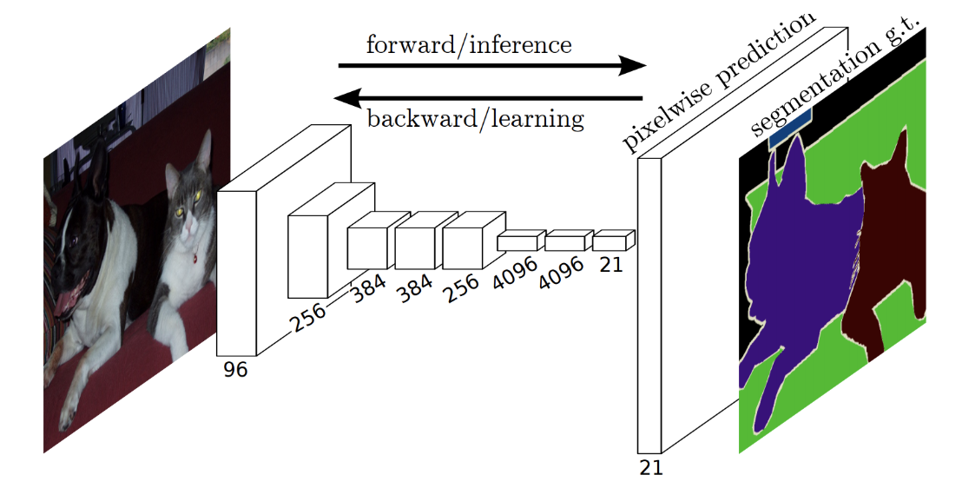
Image Segmentation
Segmentation task is different from classification task because it requires predicting a class for each pixel of the input image,
instead of only 1 class for the whole input. Classification needs to understand what is in the input. However, in order to predict what is in the input for each pixel, segmentation needs to recover not only what is in the input, but also where.

Slide 7
Fully Convolutional Network
Fully convolutional network is that it is “fully convolutional”, all of its layers are convolutional layers.
Fully convolutional network don’t have any of the fully-connected layers at the end, which are typically use for classification. Instead, FCNs use convolutional layers to classify each pixel in the image.
Too much spatial information had been lost by all the downsampling in the network.
So they combined upsampling from that final intermediate tensor with upsampling from
earlier tensors, to get more precise spatial information.

Slide 8
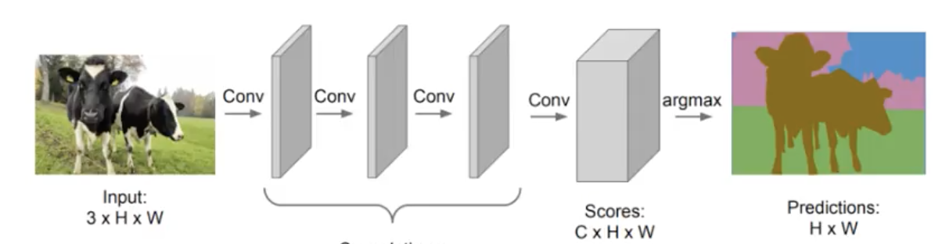
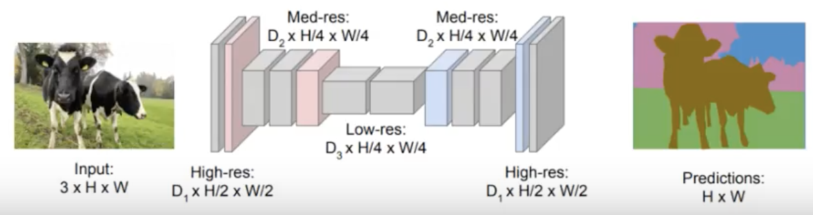
Fully Convolutional Network
Without Down Sampling Layer
With Down Sampling and Up Sampling

Slide 9
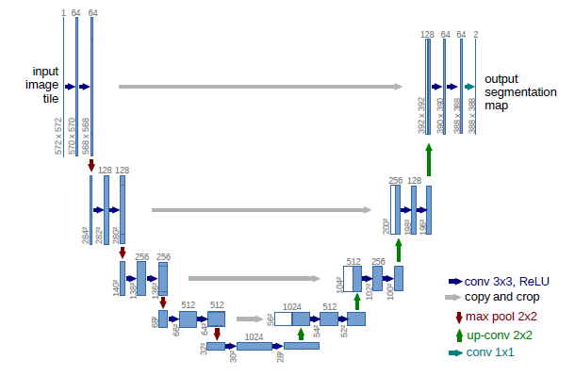
U-Net Architecture
Layer Types
Conv2D. — With Padding and 3X3 kernal
MaxPooling2D — Decrease the image size with 2X2 kernel
Concatenate Layer. — Used to Concatenate feature maps from corresponding feature maps from downsampling layer to get the spatial / context information
UpSampling2D — It’s used to increase the size of feature map

Slide 10
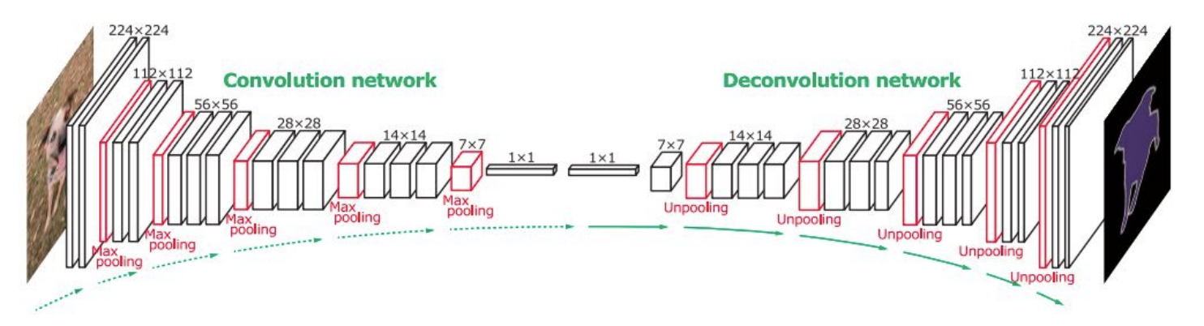
U-Net Architecture

Slide 11
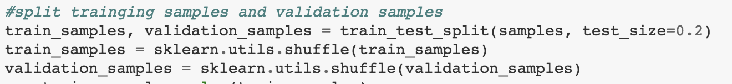
Split Training and Validation Samples

Slide 12
Data Summary
Number of training examples = 4071
Number of valid examples = 1018
Number of testing examples = 100064
Image data shape = (1280, 1918, 3)

Slide 13
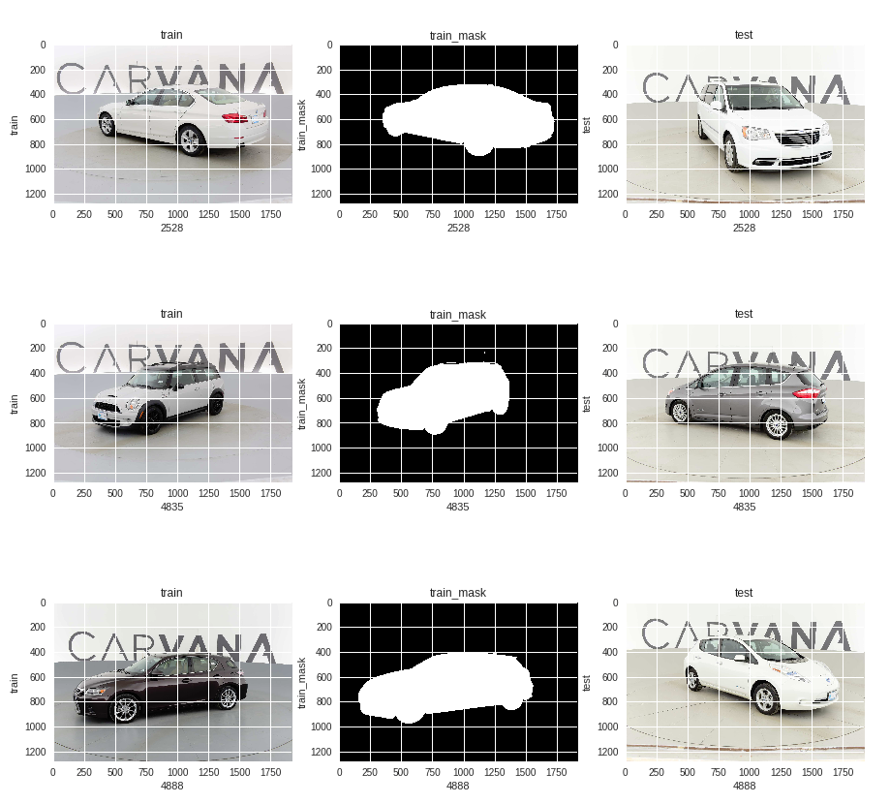
Training/Test Data Visualization

Slide 14
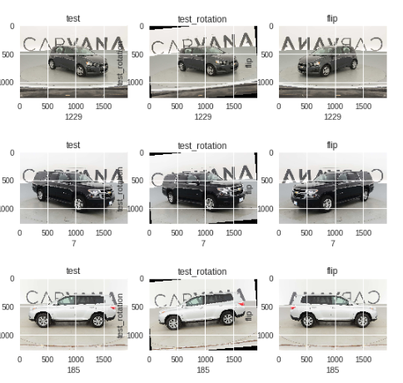
Data Augmentation
Potential Improvements
Add elastic deformation to training example for advanced data augmentation
Change Car colour to enhance data augmentation

Slide 15
Keras Generator
If we pre-process all images directly, it will consume a lot memory and will be a limitation if we need tons of images to train. The generator is here to help.
checkpoint = ModelCheckpoint('model.h5', monitor='loss',verbose=1, save_best_only=True , mode='min')
early_stop = EarlyStopping(monitor='loss', patience=2, verbose=1, mode='min')
callbacks_list = [checkpoint, early_stop]
history = model.fit_generator(train_generator, steps_per_epoch= len(train_samples)/16+1, validation_data=validation_generator, validation_steps=len(validation_samples)/16+1, epochs=100,callbacks=callbacks_list, verbose=1)

Slide 16
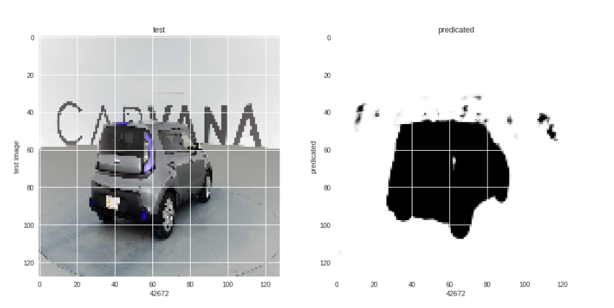
Test Prediction
Based on the training model, I predicated the test image and could find that there some false positives and need to to more data augmentation to increase the training data size and also need to try different training model to compare the result. Here is the predicated test image label based on the training model.

Slide 17

Performance

Slide 18
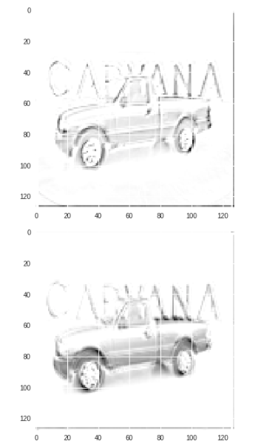
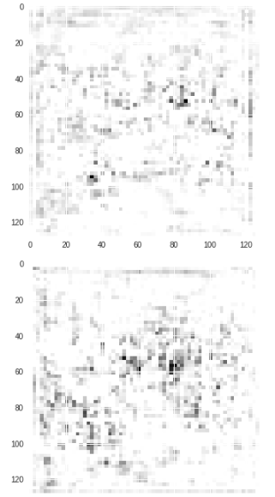
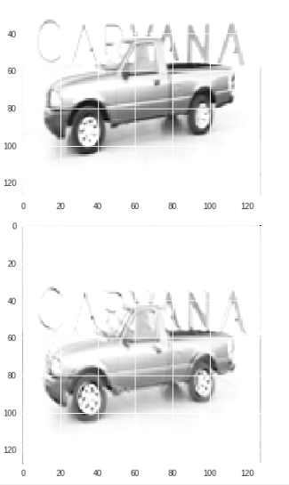
Visualize Middle Layer

Slide 19
The End

