Slide 1
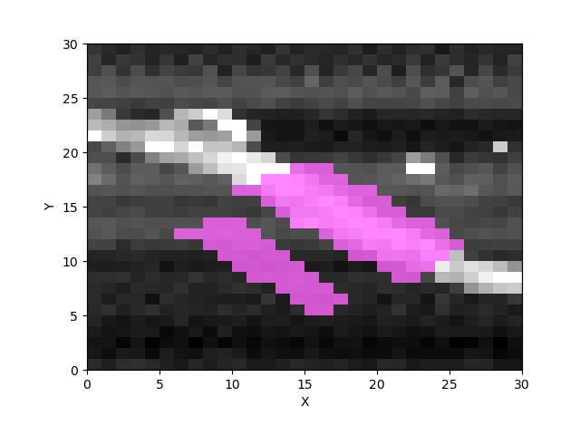
Fiber was scanned. Then the pattern averaged from highlighted region subtracting the correlated background region.
Different regions of same fiber were scanned under different humidity condition.
The humidity condition was determined by the flowing the humidity air, of which the percentage is determined by the ratio of dry air and air go through the distill water.

Slide 2
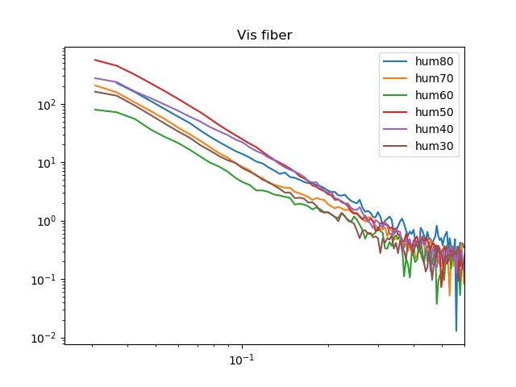
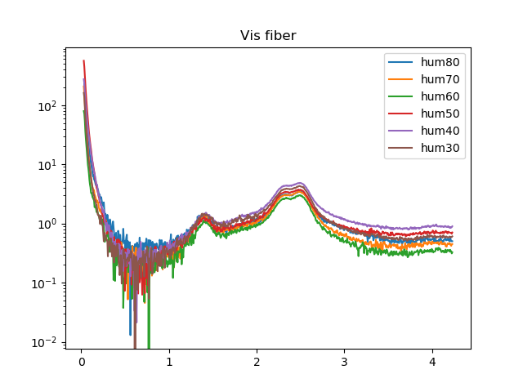
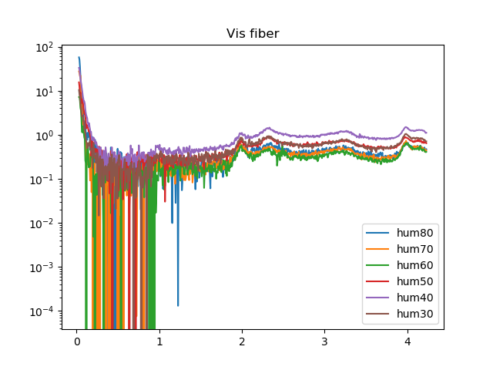
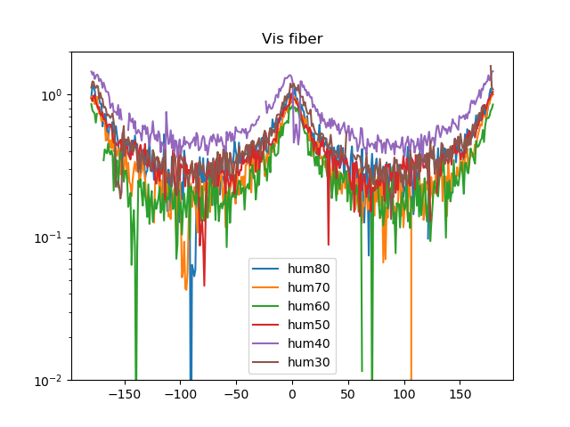
Here are the intensity profiles of the SAXS and WAXS region of equatorial direction and meridional direction and the azimuthal distribution of intensity of q range between 1.46 ad 1.53 nm-1
The sample is vis fiber, and is examined under 60 different humidity condition, from 30% - 80%.

Slide 3
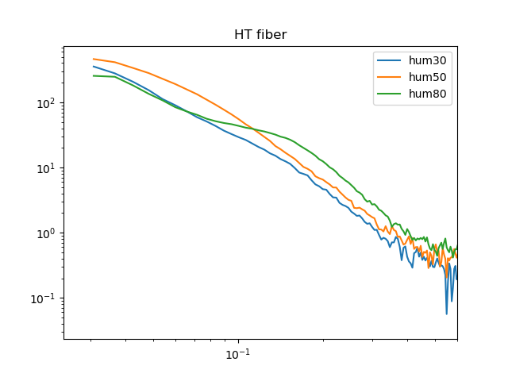
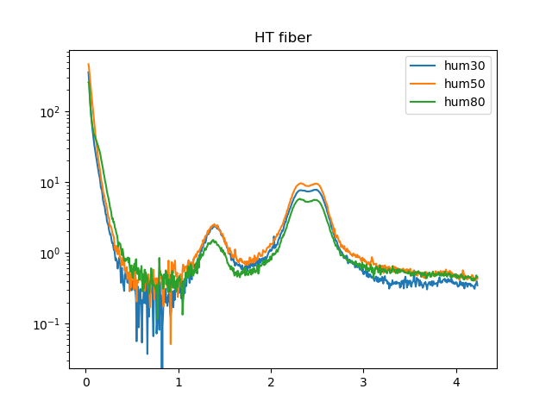
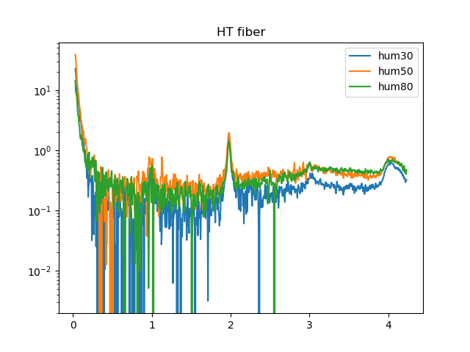
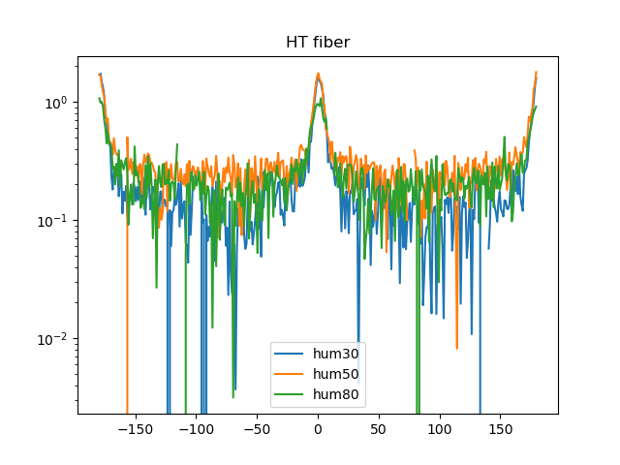
The sample is vis fiber at three different humidity condition

Slide 4
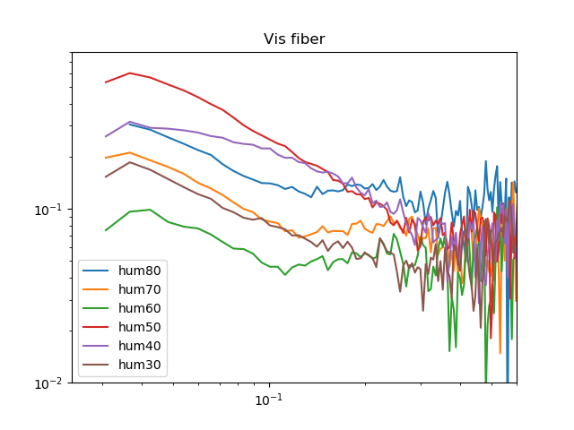
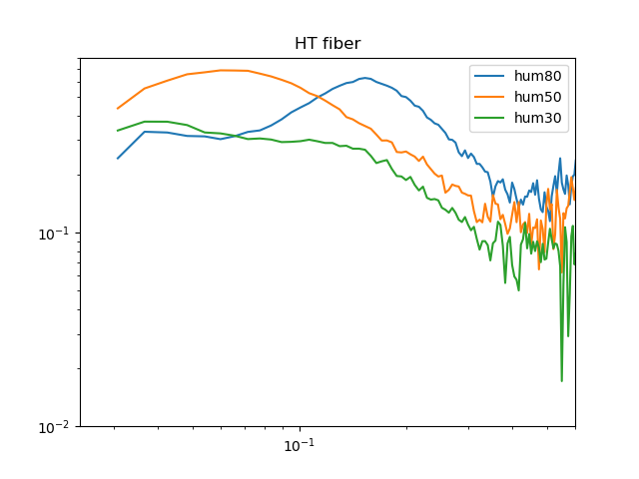
To exemplify the structure factor effect, the plot has been shown as q vs I*q**2. An bump was appearing when the humidity was increasing for both Vis and HT fiber. But the q of maximum of bump is different fro HT and Vis
I*q**2
q
q

Slide 5
The change of humidity rate does not cause a significant variation of order of orientation. But HT fiber shows better orientation feature than Vis fiber

Slide 6
The intuitive difference of the equatorial intensity of WAXS seems the crystallinity of HT maybe higher.

Slide 7
The intuitive difference of the meridional intensity of WAXS also indicates the crystallinity of HT maybe higher.

