Slide 1
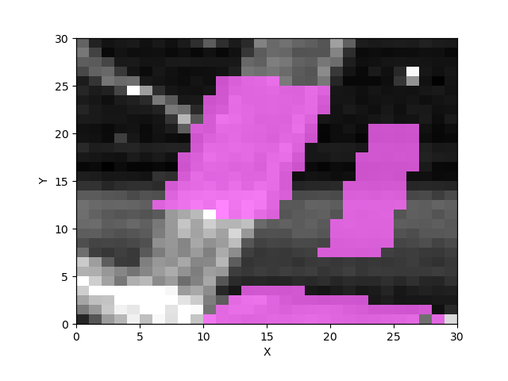
Hum 30 with 00 min

Slide 2
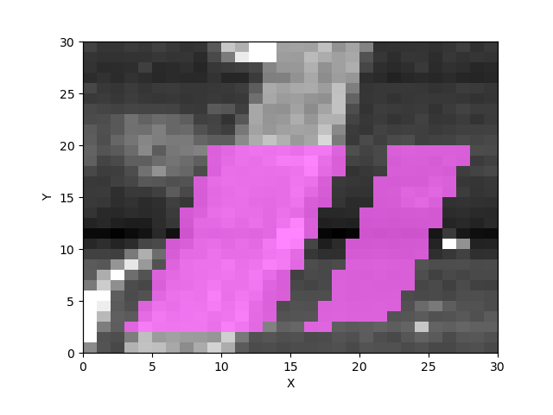
Hum 30 with 10 min

Slide 3
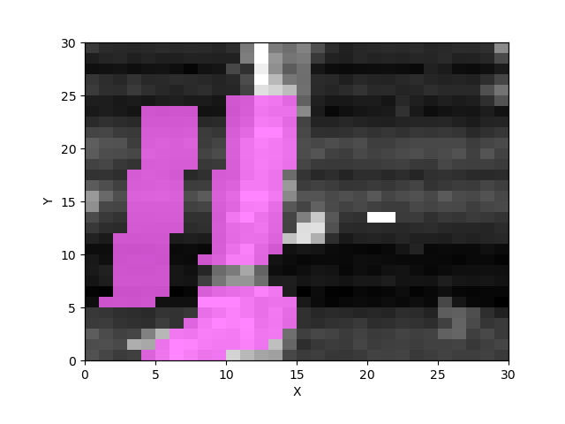
Hum 30 with 30 min

Slide 4
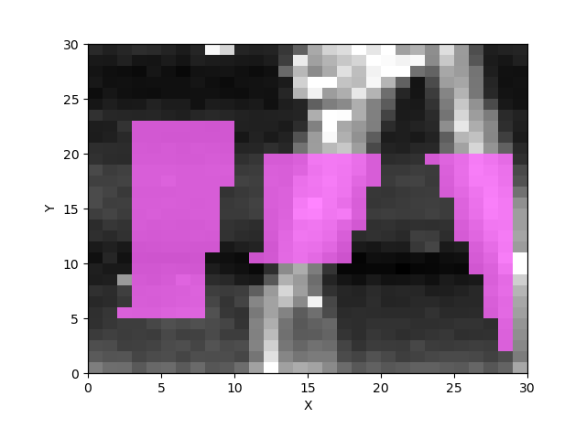
Hum 30 with 60 min

Slide 5
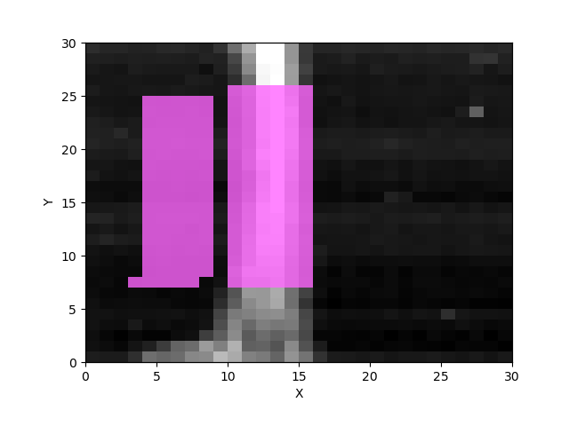
Hum 40 with 0 min

Slide 6
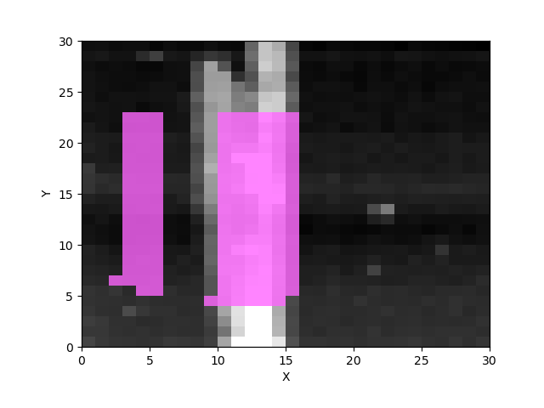
Hum 40 with 10 min

Slide 7
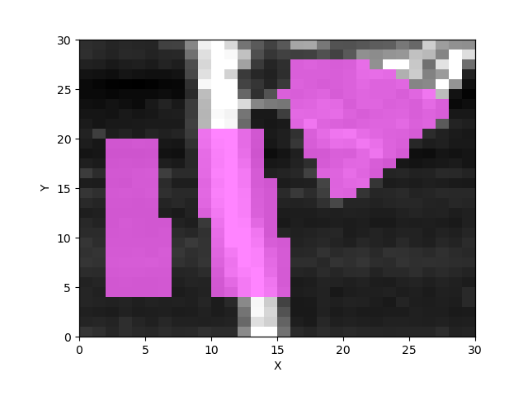
Hum 40 with 30 min

Slide 8
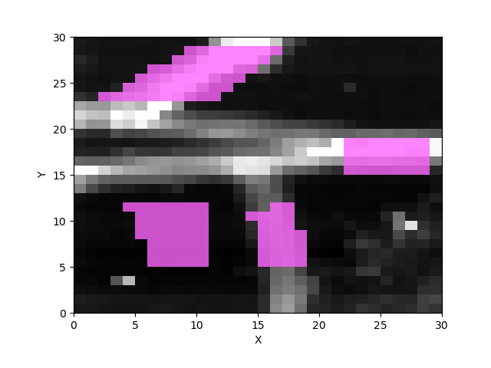
Hum 40 with 60 min

Slide 9
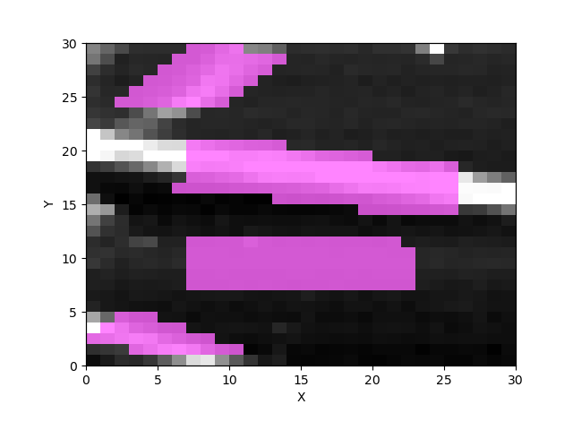
Hum 50 with 0 min

Slide 10
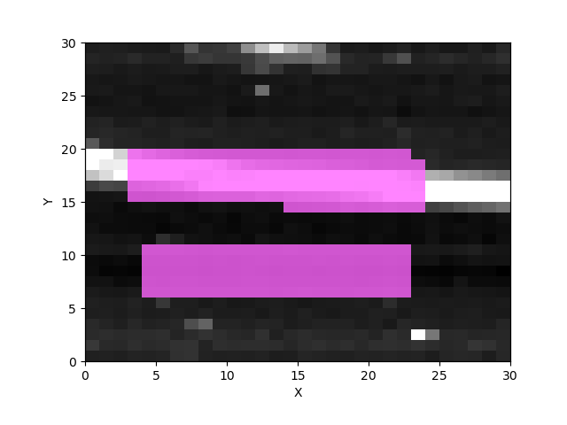
Hum 50 with 10 min

Slide 11
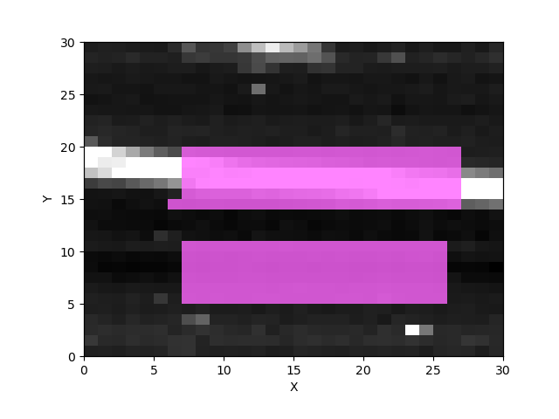
Hum 50 with 30 min

Slide 12
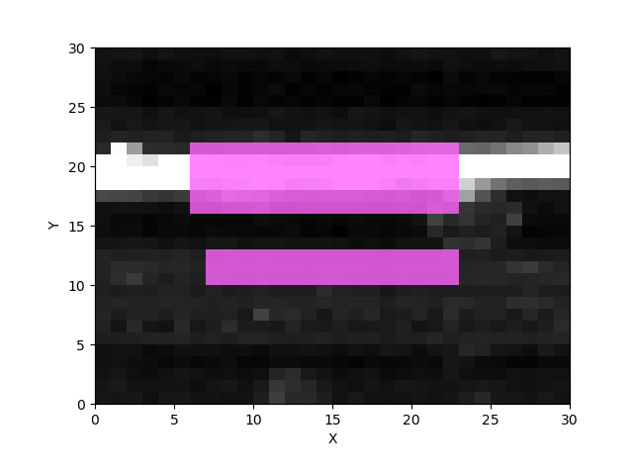
Hum 50 with 30 min

Slide 13
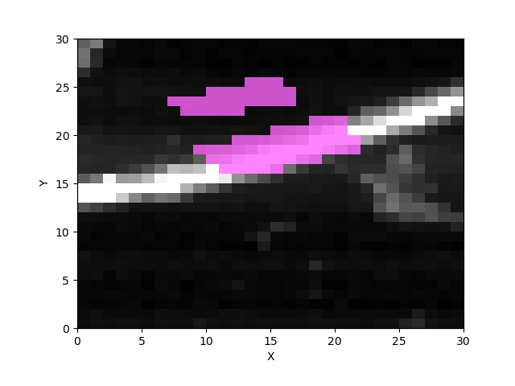
Hum 50 with 60 min

Slide 14
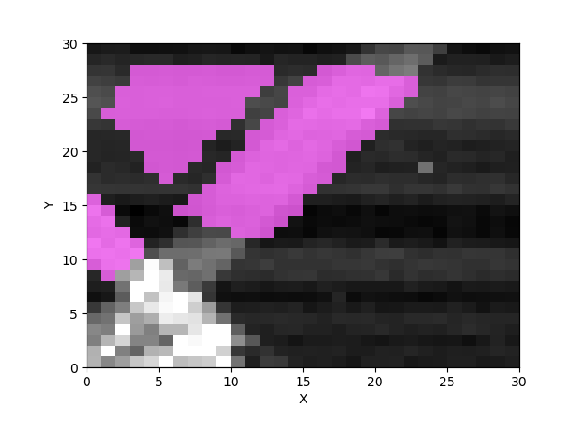
Hum 60 with 0 min

Slide 15
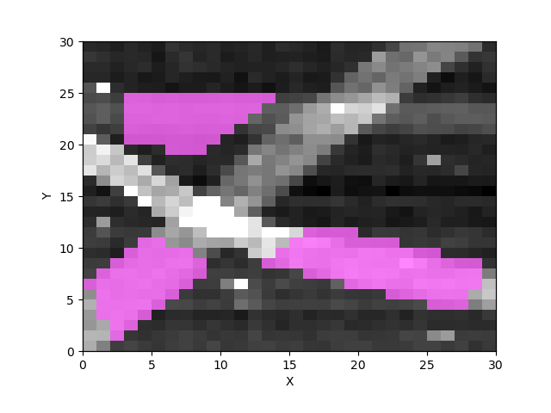
Hum 60 with 10 min

Slide 16
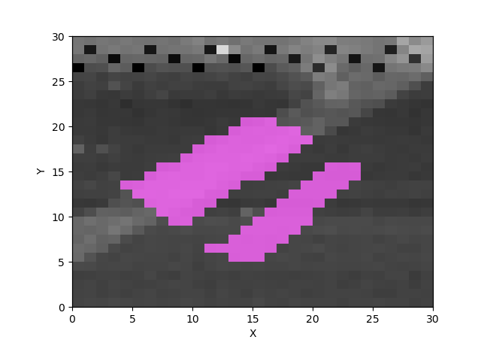
Hum 60 with 30 min

Slide 17
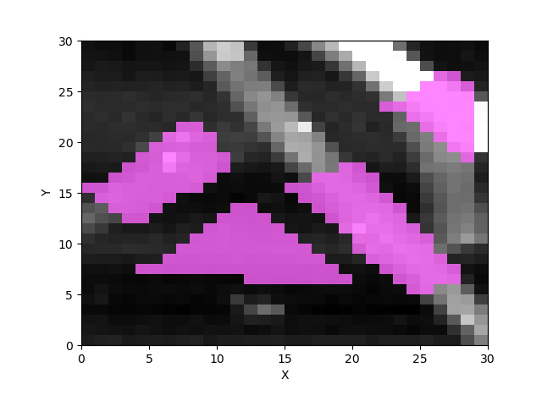
Hum 60 with 60 min

Slide 18
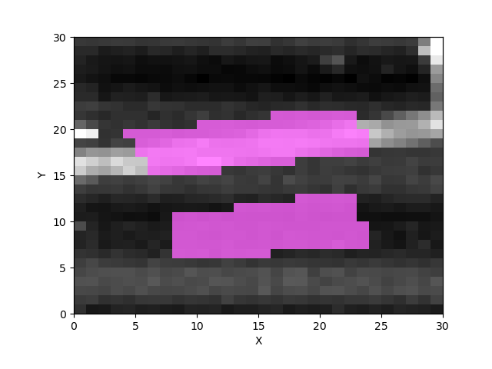
Hum 70 with 0 min

Slide 19
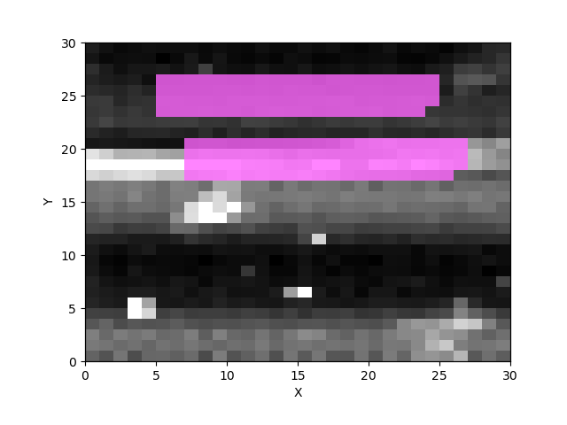
Hum 70 with 10 min

Slide 20
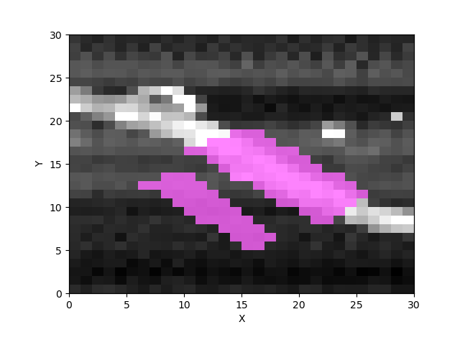
Hum 70 with 30 min

Slide 21
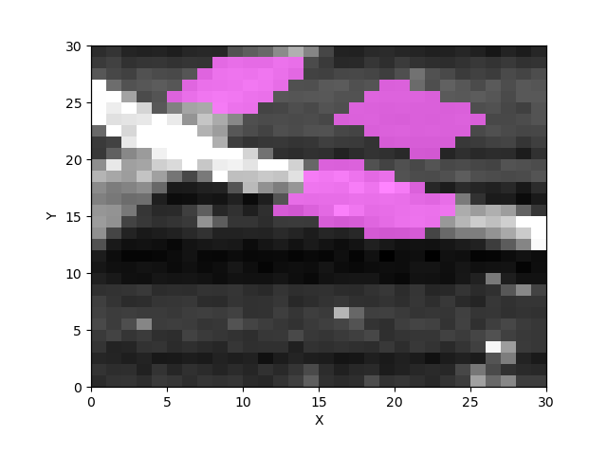
Hum 70 with 60 min

Slide 22
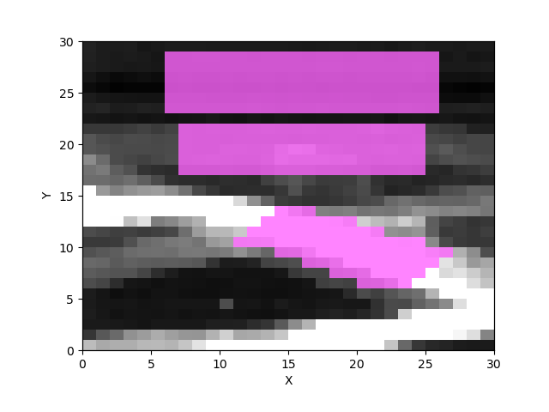
Hum 80 with 0 min

Slide 23
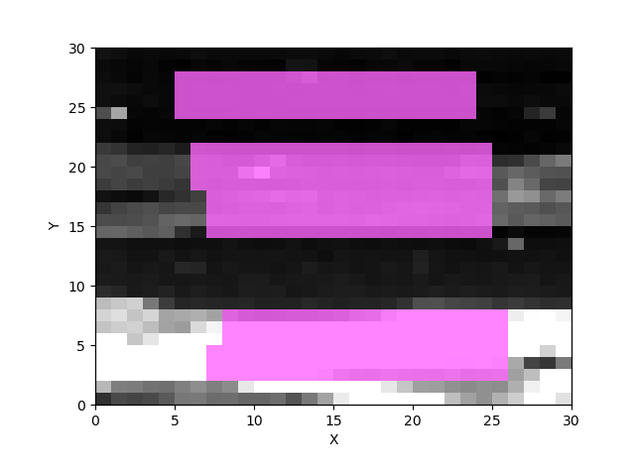
Hum 80 with 10 min

Slide 24
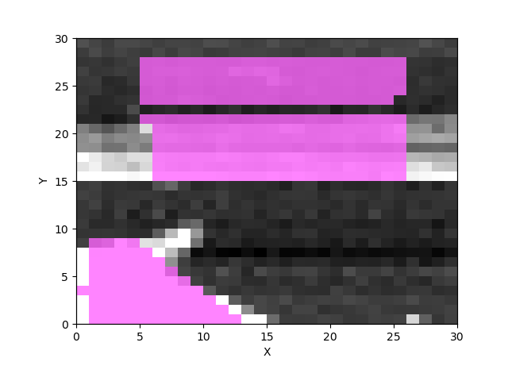
Hum 80 with 30 min

Slide 25
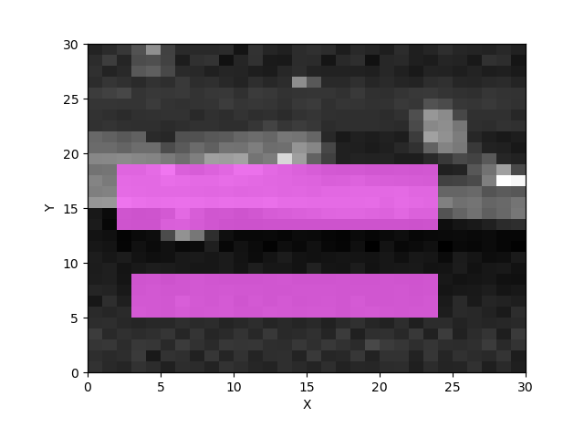
Hum 80 with 30 min

