Slide 1
Taking advantage of within-group and between-group information in linear regressions: Multilevel modeling and partial pooling
Michael Maltese
27 Sep. 2013
Notes:
I’m going to start off with an example from a paper I read, because it makes more sense that way and I don’t actually understand the math very well and the graphs are pretty.

Slide 2
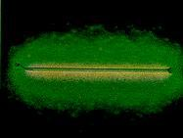
Let’s talk about radon!
Notes:
What is radon? It’s a radioactive gas, caused by the decay of thorium and uranium. Gets in your house and kills you. According to the EPA, it causes 21,000 lung cancer deaths per year, making it the second most frequent cause of lung cancer and the number one cause among non-cigarette smokers.

Slide 3
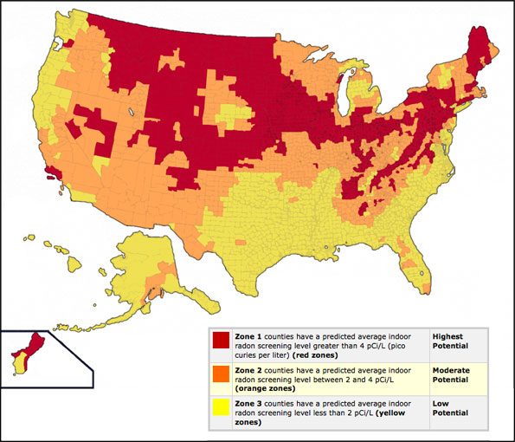
Where is it??
Notes:
So, obviously, we’d like to figure out where it’s most common. To make this easy, we’ll focus on Minnesota.

Slide 4
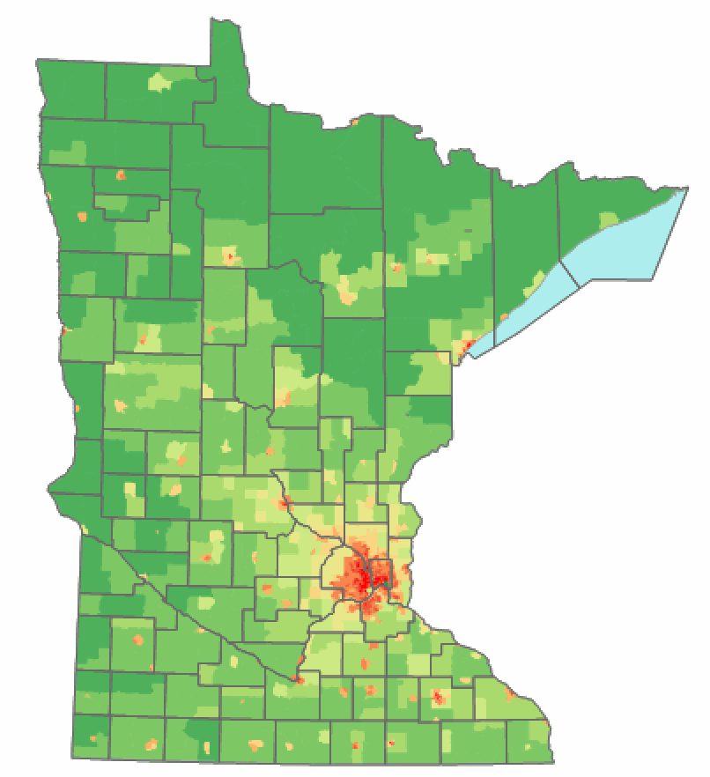

Minnesota
Notes:
I assume these are counties in Minnesota? I’ve never been there.

Slide 5
Data: The HIGH-RADON Project
From Lawrence Berkeley National Laboratory
Radon measurements in houses for every county in the contiguous 48 states
IMPORTANT: Do you have a basement? Radon
often comes in through your basement. If you
have a basement get rid of it.
Where do you not want to live?
Notes:
The data set I’m gonna use. Basically, we have radon measurements in different counties. Don’t build basements they’re deadly. Want to say, where shouldn’t you live?

Slide 6
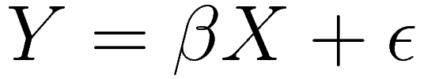
What is a regression?
Idea: some data is function of other data. To take an example from economics, wage might be a function of how old you are and how much education you have. Seems sort of reasonable, right?
Notes:
So the idea is, if you have Y and X, you can estimate beta to minimize the error term. Sort of like saying, each Y is taken from a normal distribution with mean beta times the corresponding X.

Slide 7
Pooled: all of Minnesota
Question: do you want to live in Minnesota?
Except that this ignores differences between counties.
Notes:
We can just estimate this for all of Minnesota at once. Do you want to live in Minnesota? This ignores differences between counties. Presumably there are different levels of Radon in different parts of Minnesota (it’s a big place). Also violates this thing called homoscedasticity, which means: we don’t want error terms to be correlated. Errors from measurements in the same county will have some correlation.

Slide 8
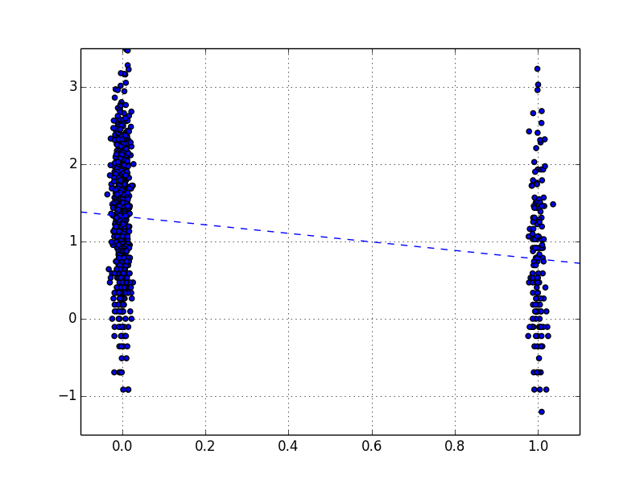
Pooled: all of Minnesota
Notes:
Basements on the left, no basements on the right. Radon on y axis.

Slide 9
Hierarchical models
Minnesota
Counties
Houses
Notes:
Data is organized into groups. Measurements inside counties should be more similar with each other than with measurements from a county on the other side of the state.

Slide 10
Unpooled: each county
Question: do you want to live in Aitkin / Lac Qui Parle / St. Louis / wherever?
Different averages / badness-of-having-a-basement in each county.
Notes:
We can just estimate this for all of Minnesota at once. Do you want to live in Minnesota? This ignores differences between counties. Presumably there are different levels of Radon in different parts of Minnesota (it’s a big place). Also violates this thing called homoscedasticity, which means: we don’t want error terms to be correlated. Errors from measurements in the same county will have some correlation.

Slide 11
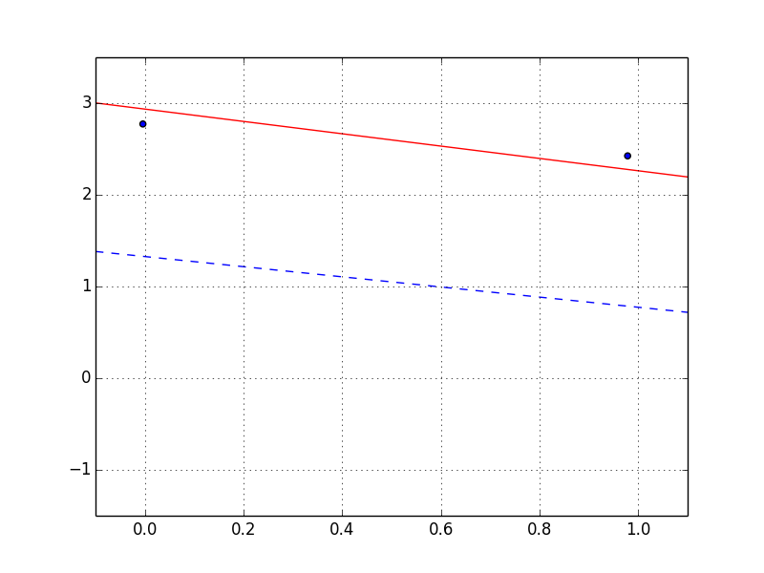
Unpooled: small samples
Notes:
Lac Qui Parle. Same as before. Blue line is from completely pooled, red line is just Lac Qui Parle. Does this county really have more radon than the average in Minnesota? It only has two data points!
Counties with small samples have less reliable estimates. It would be great if we could move this towards the average for all of Minnesota!

Slide 12
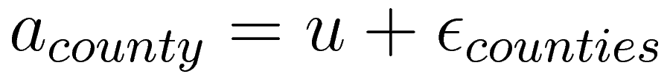
Partial pooling: combination
Mixture of the two. Estimate two error terms: one for counties, and one for houses.
Not a linear problem, need to use computer-aided methods.
Notes:
Luckily there’s a way to do this. Note the different error terms: we make u the value that minimizes error between counties, and that makes all of the a_county’s minimize error between houses. Complicated.
Use Expectation-Maximization, Bayesian methods, or other things. R modules.

Slide 13
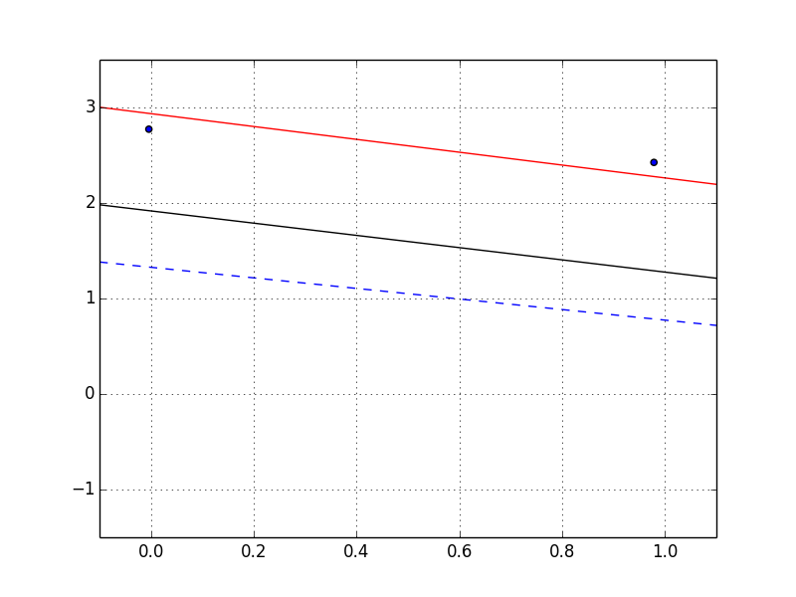
Partial pooling: combination
Notes:
The black line is the new one. We can see it’s been moved towards the mean for Minnesota. Lac Qui Parle still seems like a bad place to live, but not as bad as it did before.
Counties with small samples will move more towards the state mean, while counties with large samples won’t move much. This is what we wanted!

Slide 14
Other uses
“Shrinkage estimation” moving group means towards an overall mean. A sample mean is a special case of linear regression.
Education policy: students < classes/teachers < school
Political science: voters < states < U.S.A.

