Slide 1
Title: Construction and measurement etool
Amrita Ligga
Intern at : Aptara New Media Pvt Ltd
Faculty Mentor :Mr. Sachin Chavan

Slide 2
Roadmap
Introduction
About the Organization
About the Department
Project Details
Learning and Experience
Comments and Future Plan

Slide 3
Introduction
Intern at Aptara New Media PVT LTD , Pune
Industry Mentor : Amit Jain
Construction and measurement etool
allows students to explore construction and measurement through a web browser with the help of virtual instruments namely,
Ruler
Protractor
Line Tool
Point Tool
Compass
Technologies used: HTML CSS and Javascript
Software used : Sublime text editor

Slide 4
About the Organization
Aptara, Inc. is a US-based media company specializing in digital content development. It is headquartered in Falls Church, Virginia. The company has operations in Noida, Sec-60, Pune, Dehradun and Trivandrum, India
Aptara’s wide-ranging subject matter experts deploy smart content technologies across every aspect of production—and produce the entire spectrum of digital end products, including eBooks, apps, websites, and eMagazines.
Aptara is considered one of the leading knowledge process outsourcing (KPO) companies in India.

Slide 5
About the Department
Digital Learning Group
Digital learning is any type of learning that is facilitated by technology or by instructional practice that makes effective use of technology.
This department is responsible for the conceptualization and development of next-generation digital learning products—adaptive courseware, immersive eBooks, virtual learning labs, animations, interactive simulations, and game-based learning.

Slide 6
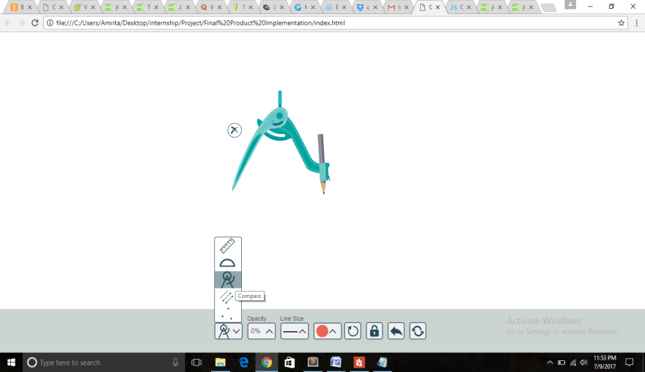
Project Details
Compass
User can move the compass around the canvas and modify the width.
User can lock the width of the compass with the Lock button.
User can draw full or partial circles.
User can draw a quick circle using a Quick Circle button.
User can modify thickness and color of line drawn by pencil.
User can modify the transparency of the arc drawn by compass.
Line Tool Study
To study how line tool was implemented

Slide 7
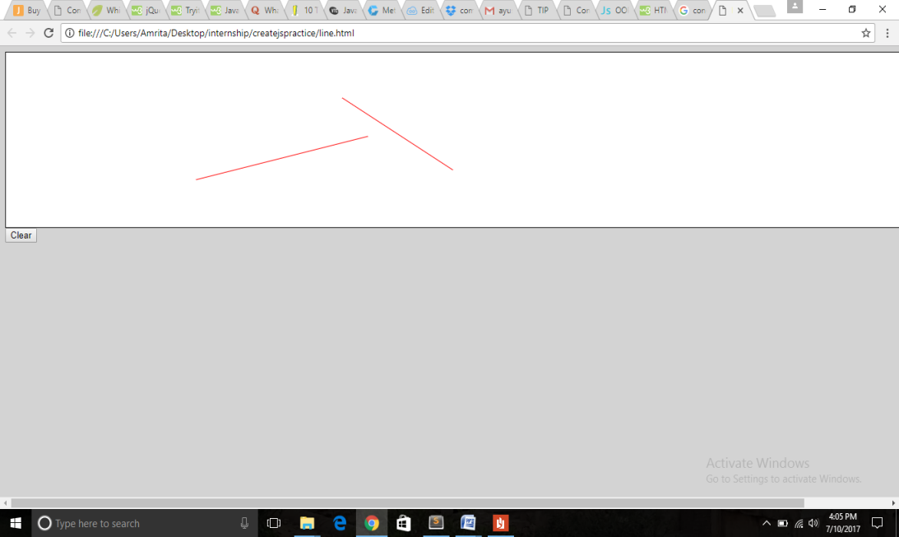
Project Details
Line Tool
What is createjs
Line creation with createjs:
Canvas element
Stage class
Shape class
Properties of line
Graphics class :moveTo() , lineTo()
Mouse events and event listener

Slide 8
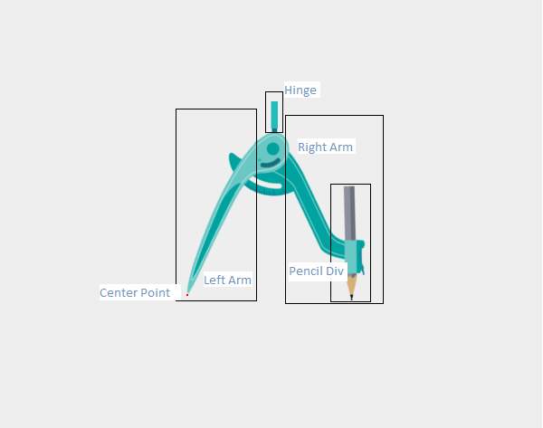
Project Details
Compass Introduction:
The compass was not seen as a single piece . Since by clicking on different regions(DIV) different events were supposed to get triggered:
Click and drag left arm/hinge: Whole compass gets dragged
Click and drag right arm: the radius of compass gets changed
Click and drag pencil : arc gets drawn.
The entire module was divided into following sub tasks:
Rendering Compass image on screen
Handling mouse events
Making the compass draggable
Handle dragging functionality/changing radius
Pencil dragging functionality/drawing arc
Lock radius functionality
Quick circle functionality
Altering the transparency of arcs drawn

Slide 9
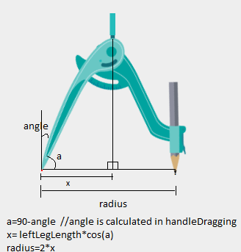
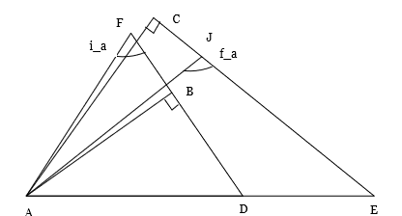
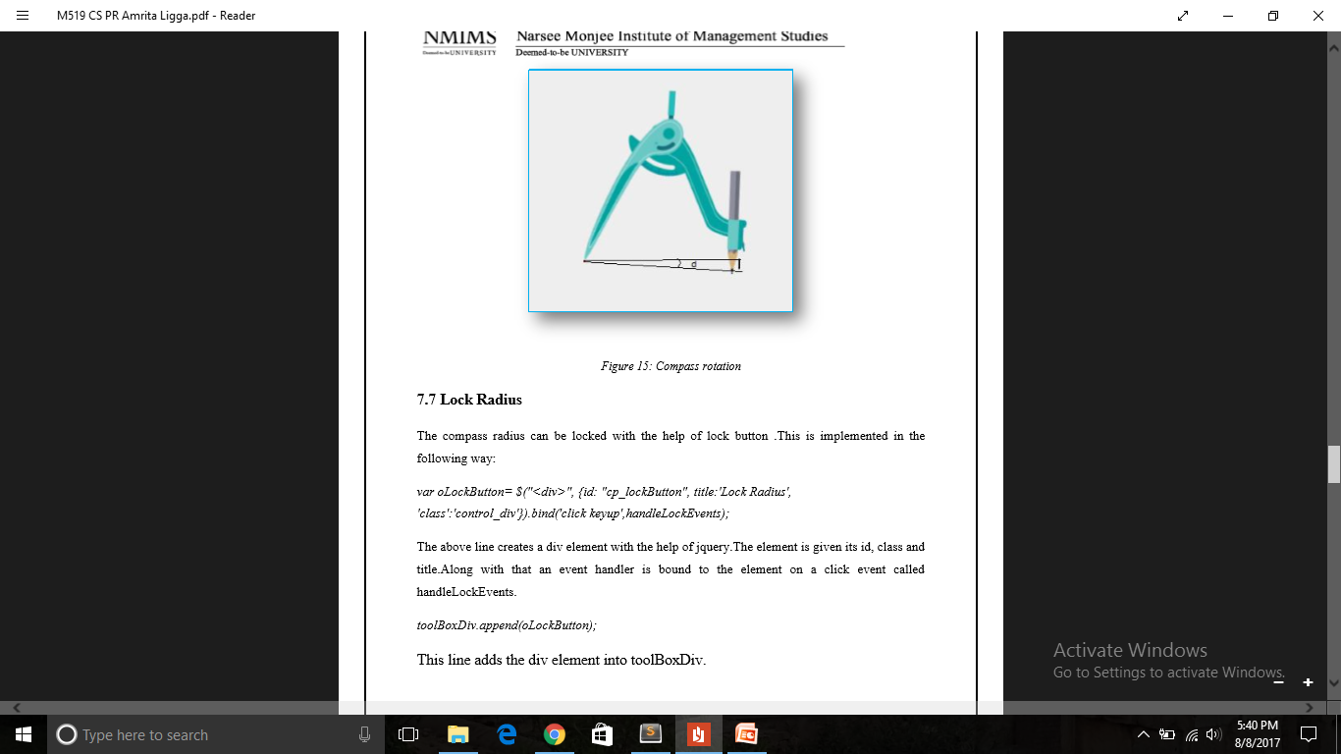
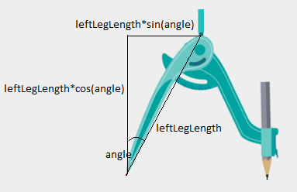
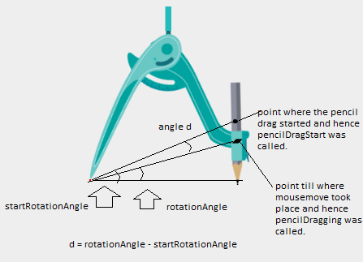
Project Details
Calculation of Radius
Calculation of angle
Calculation of hinge position
Calculation of rotation angle

Slide 10
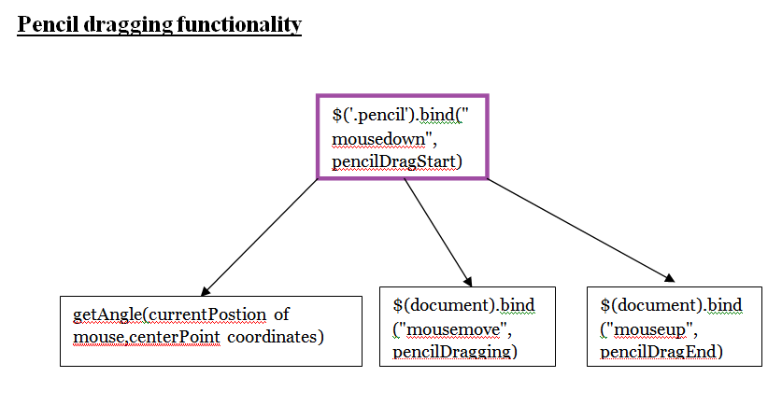
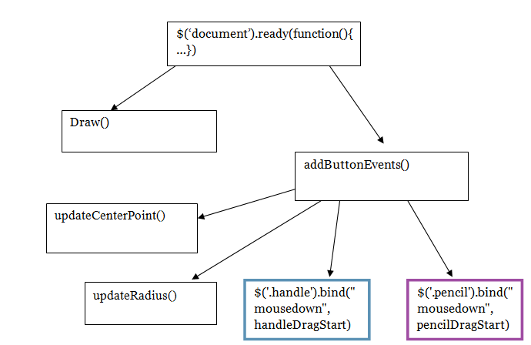
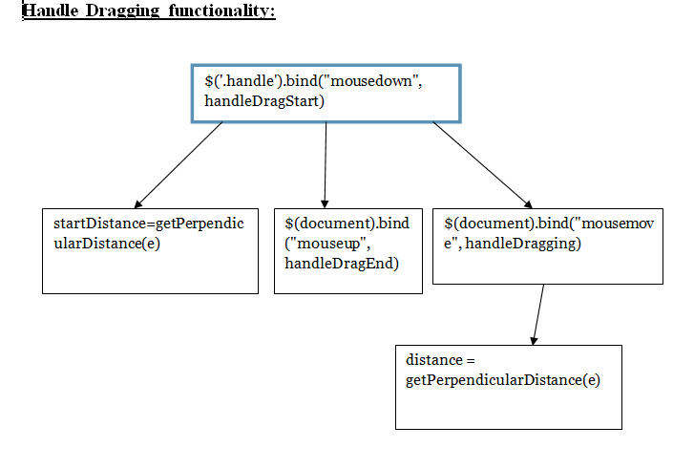
Control flow

Slide 11
Learning and Experience
This internship program has enhanced my practical knowledge .Here I have learnt how to visualize things in the first place and how all of these things can be implemented with the help of programming. As an intern, the entire project was not assigned to me but one of the most intriguing and challenging module of the etool namely compass was. The compass tool was challenging because the compass movement along with arc creation had to be dealt with mouse events.
I have understood that learning is a continuous process .We need to learn new concepts and technology to keep up with clients’ demand irrespective of how much we already know.
Another major attribute I have learned over here is professionalism .In the premises you need to work and only work.
During the development of the tool I have learnt various new concepts and have got my first exposure to the industrial world. This project/training also required to put all the concepts already known through academic education into action and hence has bridged the gap between the academic institution and corporate world.

Slide 12
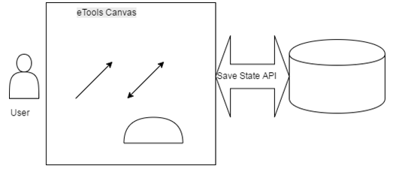
Comments and Future Plan
This application fulfills the major requirements of the client but following advancements can still be made:
Advancement in features could be seen if users are able to upload their own images or provide URL of the images so that they can be rendered on the canvas and then use the ruler protractor and compass on them.
If the user accidently closes the window, then the previous state of the canvas can be restored and user can continue working.

Slide 13
Questions??

