Slide 1


NPG GROUP MEETING • WEDNESDAY, AUGUST 26, 2026
π/K/p Spectra Analysis
Status Update: O+O Collisions & Space Radiation Physics
Andrew Liggett

Slide 2
THIS WEEK'S UPDATES
Summary of Key Updates
1.
LFSUPC deck updated with new physics-motivation figures
Added two new Mars-regolith figures with full methodology captions: Total Neutron Penetration Depth (Geant4 first-interaction depth + toy stopping-chain model) and Fractional Energy Dose by Centrality (real NBD-Glauber Npart/Nspec, not literature).
2.
Embedding build system split by STAR_LEVEL
Renamed the build macros to makeLibs_SL24y.C / makeLibs_SL23c.C and built a dedicated PicoDstReader_SL23c tree so the RCF embedding build can't clobber SL24y; RCF submission scripts now have real RCF paths filled in -- ready to submit.
3.
Mars regolith neutron-shielding Geant4 campaign produced output
The neutron-attenuation and GCR dose-vs-depth Geant4 runs that were in progress as of the 12th have produced plots (dose-vs-depth, attenuation length, total penetration depth) now feeding the LFSUPC motivation slides.
Andrew Liggett • August 26, 2026
2

Slide 3
NEXT STEPS
Next: eTOF Calibrations
1.
eTOF calibration in progress
Calibration pass remains underway; this will be the first use of eTOF at 200 GeV.
2.
Submit the SL23c embedding batch jobs at RCF
Build macros (makeLibs_SL23c.C), the PicoDstReader_SL23c build tree, and RCF submission scripts are all in place -- next is building libStPicoDst_SL23c.so at RCF and submitting the P23ic/SL23c embedding batch.
Andrew Liggett • August 26, 2026
3

Slide 4
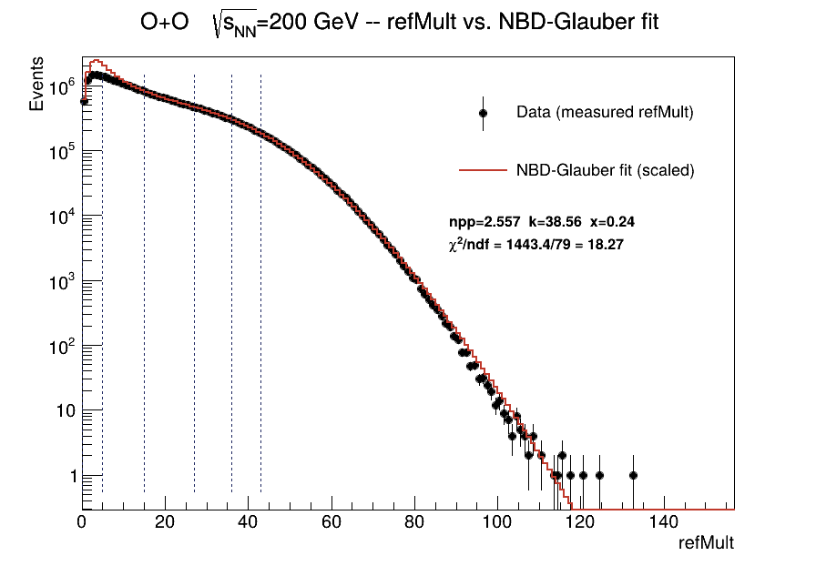
BACKUP
NBD-Glauber Fit to O+O RefMult
Two-component NBD-Glauber fit to the measured refMult distribution -- feeds the energy-weighted dose-fraction centrality calibration.
Fits npp, k, x (soft/hard particle-production mix + NBD shape) so predicted multiplicity matches data in the trigger-unbiased refMult range; centrality edges and <Npart>/<Nspec>/<Ncoll> are read off the fit model extrapolated to refMult=0, not off the raw truncated histogram. See FitGlauberNBDToRefMult_OO200.C.
Andrew Liggett • August 26, 2026
4

Slide 5
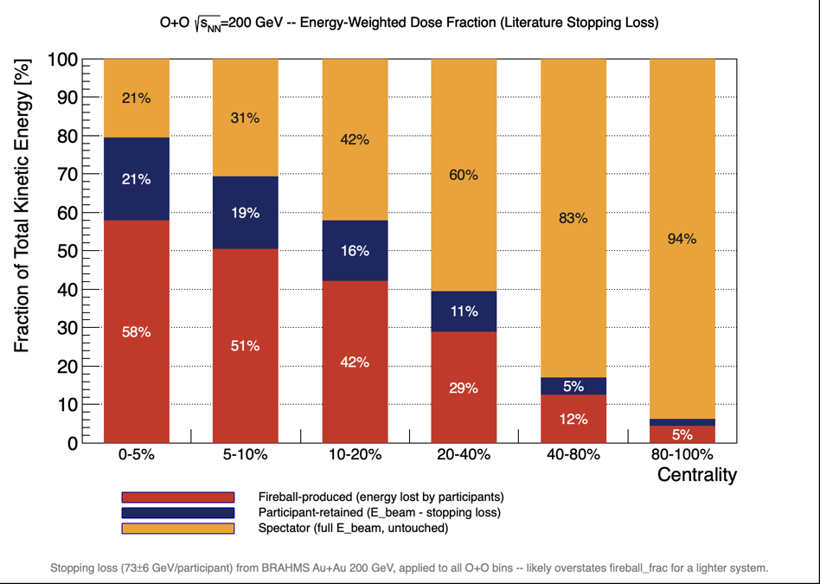
BACKUP
Fractional Energy Dose by Centrality
Energy-conservation split by centrality: spectators near beam rapidity keep full beam energy, setting the forward dose.
Npart/Nspec: real NBD-Glauber fit to O+O RefMult (not literature); E_beam=100 GeV/nucleon (√s_NN/2); E_loss/participant=73±6 GeV, BRAHMS central Au+Au 200 GeV (PRL 93,102301), applied to all bins (centrality-independence assumed) -- likely overstates fireball_frac for lighter O+O. See EstimateEnergyDoseFraction_OO200_LiteratureStopping.C.
Andrew Liggett • August 26, 2026
5

Slide 6
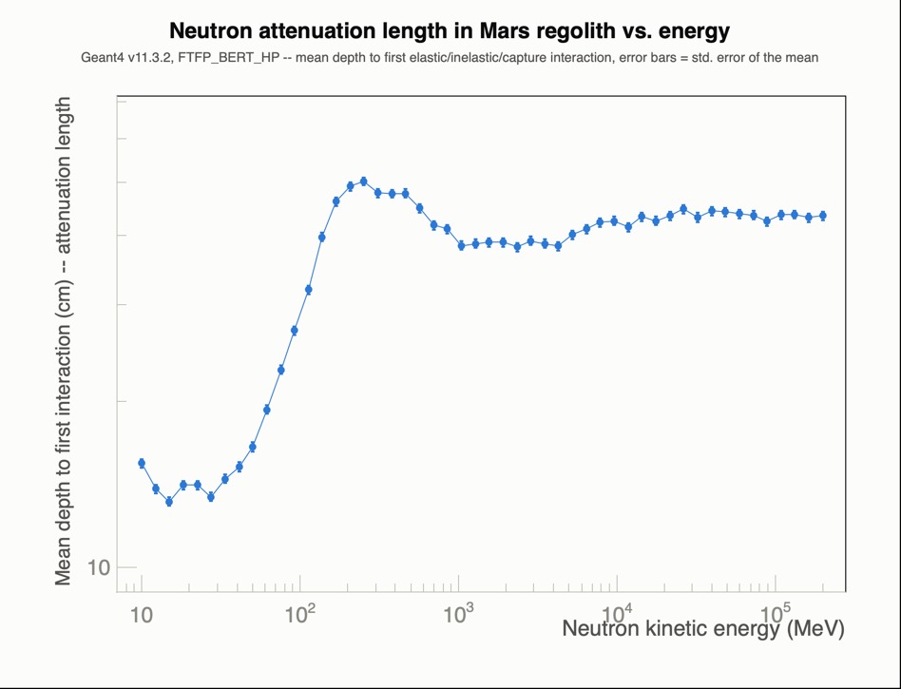
BACKUP
Neutron Attenuation Length in Mars Regolith
Geant4 first-interaction depth vs. neutron energy -- the raw simulation result underlying the total-penetration-depth toy model.
Geant4 v11.3.2 (FTFP_BERT_HP), mono-energetic neutrons through a 400 g/cm² regolith slab (NASA NTRS 20170005414 composition, ρ=1.52 g/cm³); error bars are the standard error of the mean per energy point. See PlotNeutronAttenuationLength.C.
Andrew Liggett • August 26, 2026
6

Slide 7
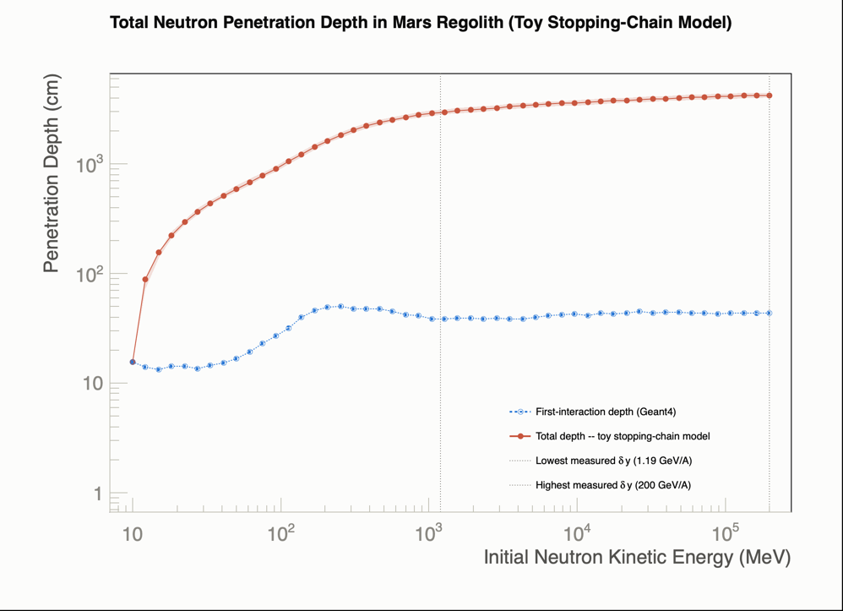
BACKUP
Neutron Penetration Depth in Mars Regolith
Toy stopping-chain model combining Geant4's first-interaction depth with literature baryon-stopping loss estimates total penetration depth.
Geant4 v11.3.2 (FTFP_BERT_HP) simulates first-interaction depth (10 MeV-200 GeV) in Mars regolith (NASA NTRS 20170005414 composition, ρ=1.52 g/cm³); total-depth chain adds a per-interaction energy loss from heavy-ion rapidity-shift data (AGS E917, Gao et al., NA35 SPS) via Glauber <ν>≈6.2 -- order-of-magnitude toy estimate, not validated. See CalculateTotalPenetrationDepth.C.
Andrew Liggett • August 26, 2026
7

Slide 8
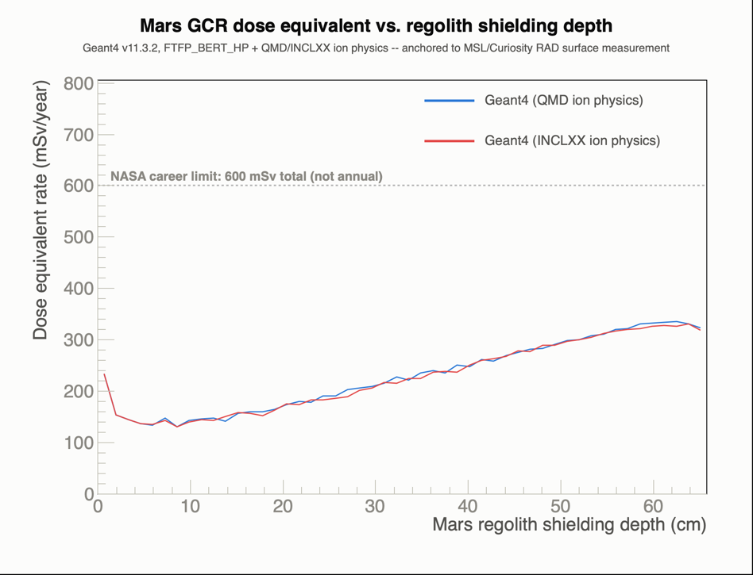
BACKUP
Mars GCR Dose vs. Regolith Shielding Depth
Direct Mars-regolith replacement for the borrowed Norbury & Slaba aluminum-shielding figure -- dose dips, then rises with depth.
Geant4 (QMD/INCLXX ion physics) gives the depth-dependent shape, PDG-abundance + equal-log-energy-weighted over 8 GCR ions x 50 energies; rescaled so the unshielded value matches the real MSL/RAD-measured Mars-surface rate (0.64±0.12 mSv/day, Hassler et al. 2014). See AnalyzeMarsGCRDose.C.
Andrew Liggett • August 26, 2026
8

Slide 9
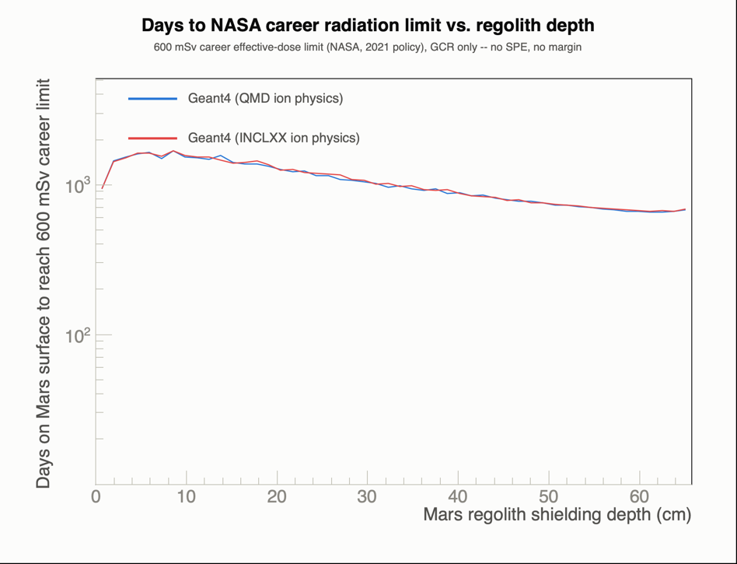
BACKUP
Days to NASA Career Limit vs. Depth
Derived from the dose-vs-depth curve: how long an astronaut could stay at a given shielding depth before hitting the career limit.
Days = 600 mSv (NASA's 2021 flat career limit, all astronauts) × 365.25 / dose-equivalent rate at that depth; same Geant4 QMD/INCLXX curves and RAD anchor as the dose-vs-depth plot. See AnalyzeMarsGCRDose.C.
Andrew Liggett • August 26, 2026
9

