Slide 1


LFSUPC PHYSICS WORKING GROUP • MONDAY, AUGUST 24, 2026
π/K/p Spectra Analysis
√s_{NN}=200 GeV O+O Collisions for Space Radiation Studies
Andrew Liggett

Slide 2
AGENDA
What We'll Cover
1.
Physics motivation for O+O
Oxygen as a galactic cosmic ray proxy -- why O+O collisions matter for space radiation and shielding models.
2.
Detector, tracking, and event-quality checks
Acceptance, PID, dE/dx and BTOF fit diagnostics, and event QA.
3.
Yield extraction and corrected spectra
From raw TPC/BTOF yields through corrected mT-m0 spectra -- now complete for π/K/p.
4.
Status and next steps
Where the analysis stands -- eTOF calibration ongoing, corrected spectra underway.
Andrew Liggett • August 24, 2026
1

Slide 3
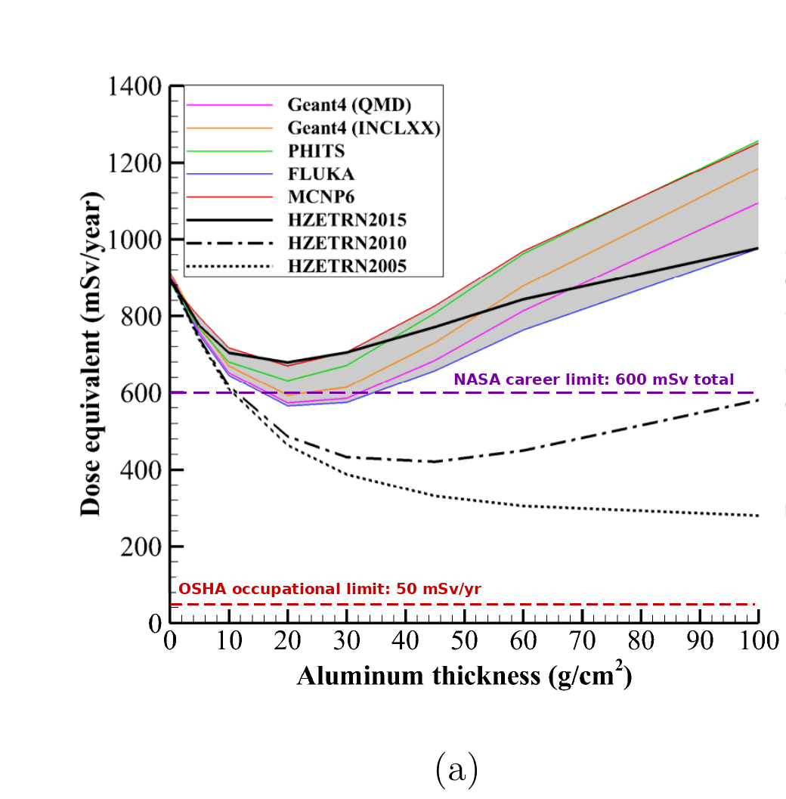
PHYSICS MOTIVATION
Space Radiation Motivation
1.
Oxygen as a galactic cosmic ray proxy
Oxygen is a major heavy-ion component of galactic cosmic rays -- O+O collisions probe the same nuclear fragmentation GCRs undergo in spacecraft shielding and human tissue.
2.
Benchmarking models and shielding design
Identified π/K/p yields benchmark hadronic models (FLUKA, GEANT4, PHITS) and feed into shielding design and astronaut dose/risk estimates for long-duration missions.
3.
Quantifying the fractional dose
Rapidity stopping and pT spectra measure participants and fireball energy; spectators near beam rapidity set the forward dose.
Dose equivalent vs. aluminum shielding -- Monte Carlo codes (incl. FLUKA) vs. HZETRN versions. Norbury, Slaba et al. (2019); OSHA and NASA limit lines added (NASA's is a career total, not annual).
Andrew Liggett • August 24, 2026
2

Slide 4
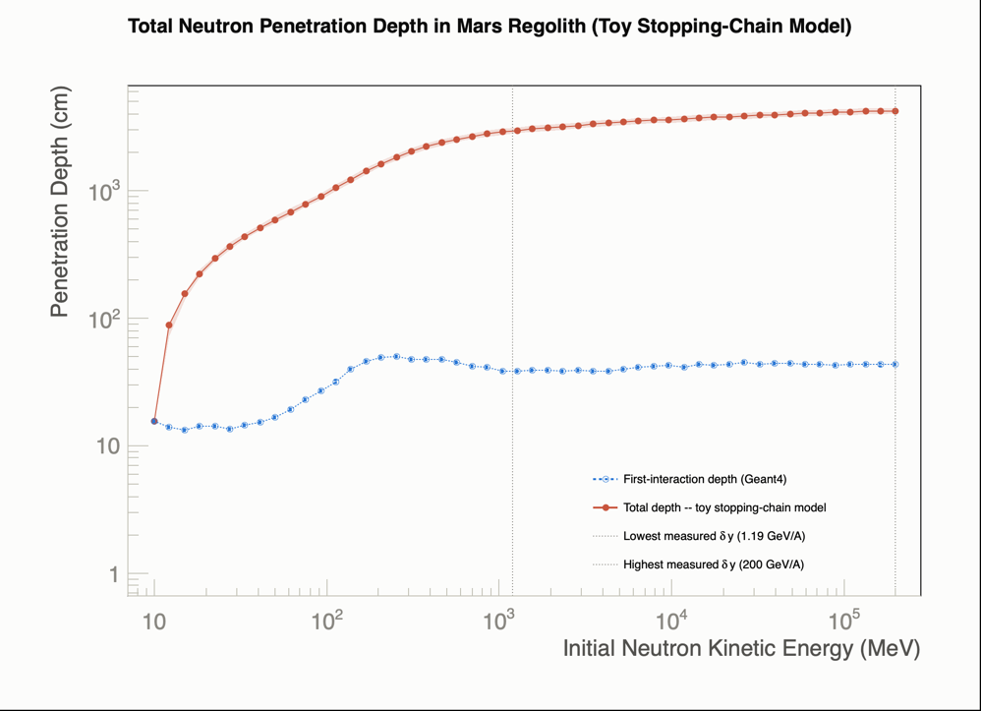
PHYSICS MOTIVATION
Neutron Penetration Depth in Mars Regolith
Toy stopping-chain model combining Geant4's first-interaction depth with literature baryon-stopping loss estimates total penetration depth.
Geant4 v11.3.2 (FTFP_BERT_HP) simulates first-interaction depth (10 MeV-200 GeV) in Mars regolith (NASA NTRS 20170005414 composition, ρ=1.52 g/cm³); total-depth chain adds a per-interaction energy loss from heavy-ion rapidity-shift data (AGS E917, Gao et al., NA35 SPS) via Glauber <ν>≈6.2 -- order-of-magnitude toy estimate, not validated. See CalculateTotalPenetrationDepth.C.
Andrew Liggett • August 24, 2026
3

Slide 5
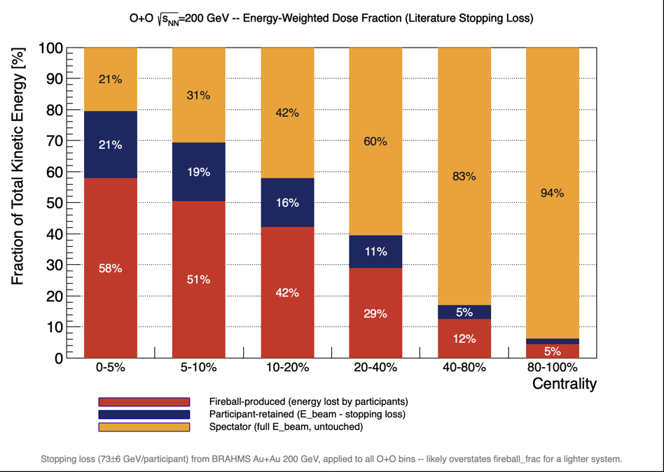
PHYSICS MOTIVATION
Fractional Energy Dose by Centrality
Energy-conservation split by centrality: spectators near beam rapidity keep full beam energy, setting the forward dose.
Npart/Nspec: real NBD-Glauber fit to O+O RefMult (not literature); E_beam=100 GeV/nucleon (√s_NN/2); E_loss/participant=73±6 GeV, BRAHMS central Au+Au 200 GeV (PRL 93,102301), applied to all bins (centrality-independence assumed) -- likely overstates fireball_frac for lighter O+O. See EstimateEnergyDoseFraction_OO200_LiteratureStopping.C.
Andrew Liggett • August 24, 2026
4

Slide 6
DATA QUALITY
Event Selection Cuts
Cut | Value
Vertex Vz | [-2, 2] cm
Vertex Vr | <= 1.0 cm
Trigger ID | 860003
Global DCA | <= 1.0 cm
Eta Range (TPC) | [-2.05, 2.05]
nHits Fit | >= 10
nHits dE/dx | >= 10
Fit Max Ratio | >= 0.52 (nHitsFit / nHitsPoss)
Centrality Bins | 0-5%, 5-10%, 10-20%, 20-40%, 40-80%, 80-100% (raw refMult)
Andrew Liggett • August 24, 2026
5

Slide 7
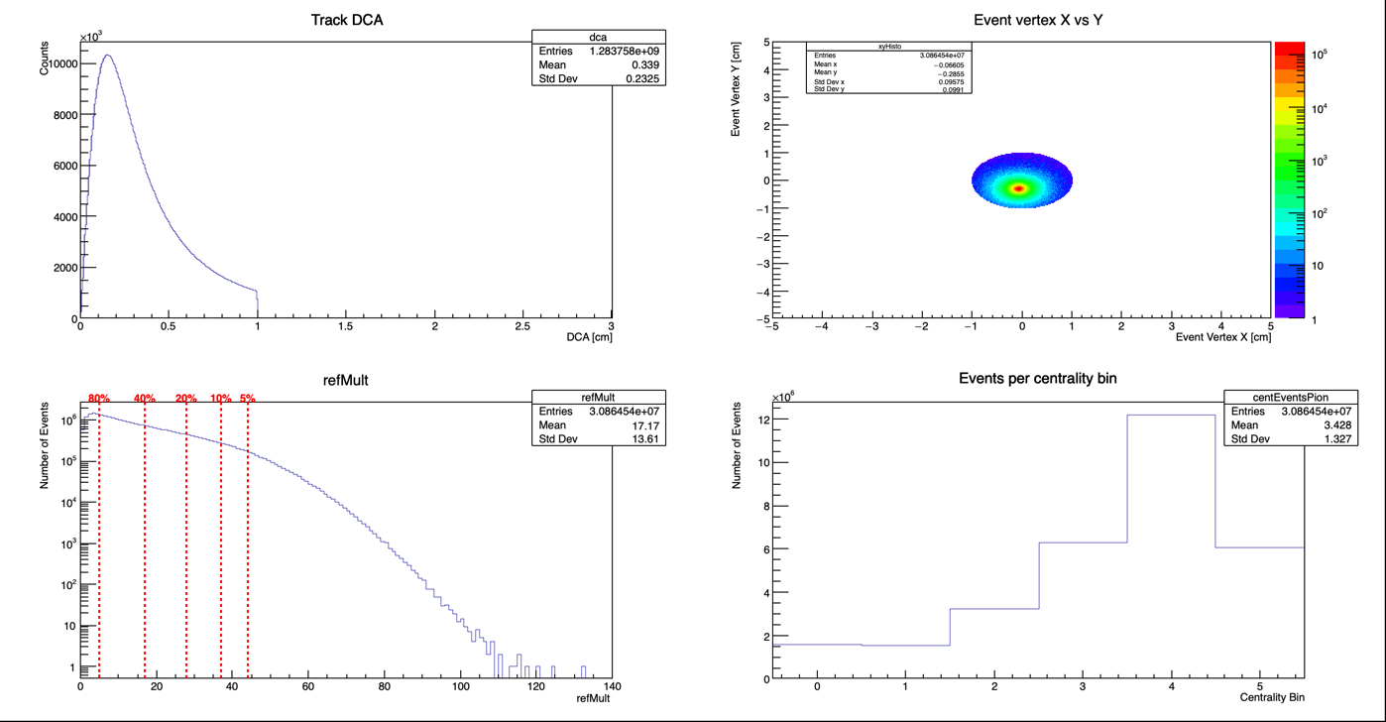
DATA QUALITY
Event QA: Trigger Cut Verified
PION event QA: DCA, vertex XY, refMult centrality cuts, and events per centrality bin.
Andrew Liggett • August 24, 2026
6

Slide 8
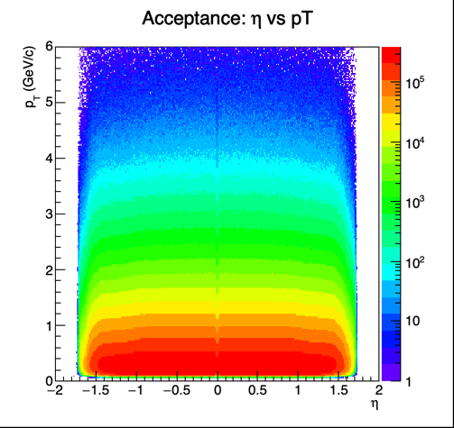
DETECTOR & TRACKING QA
Acceptance: η vs pT
TPC-only acceptance in pseudorapidity (eta) vs pT -- defines the kinematic reach of the analysis.
Andrew Liggett • August 24, 2026
7

Slide 9
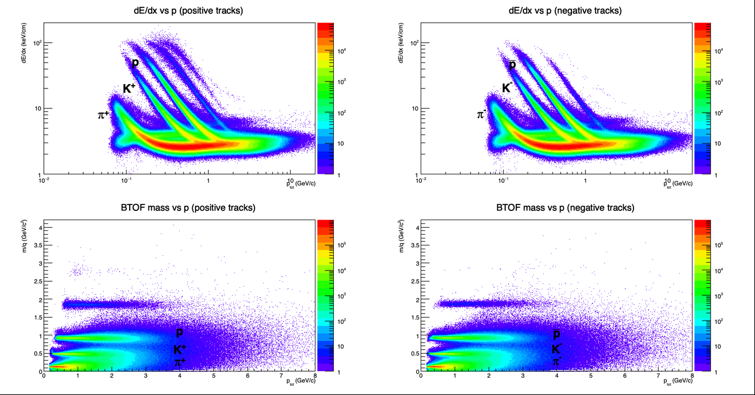
DETECTOR & TRACKING QA
Particle ID: dE/dx and BTOF Mass
TPC-to-BTOF PID handoff momenta (pi/K/p): 2.71/2.0/4.0 GeV/c (+), 4.0/1.56/0.0 GeV/c (-) -- pi/K/p bands are cleanly separated.
Andrew Liggett • August 24, 2026
8

Slide 10
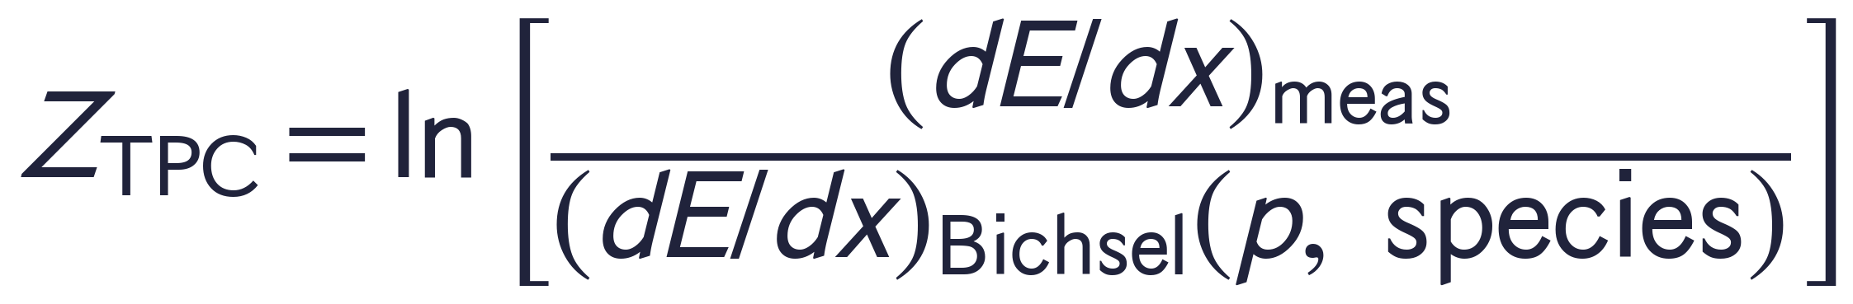
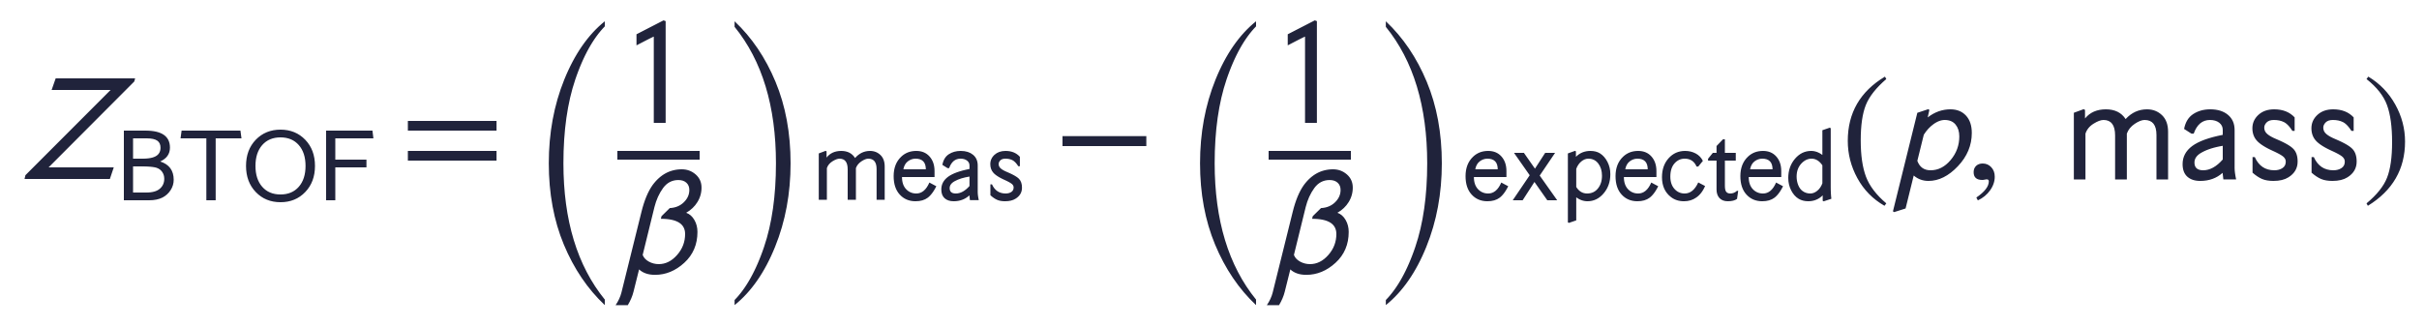
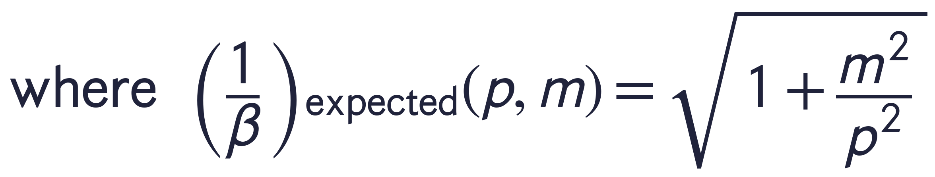
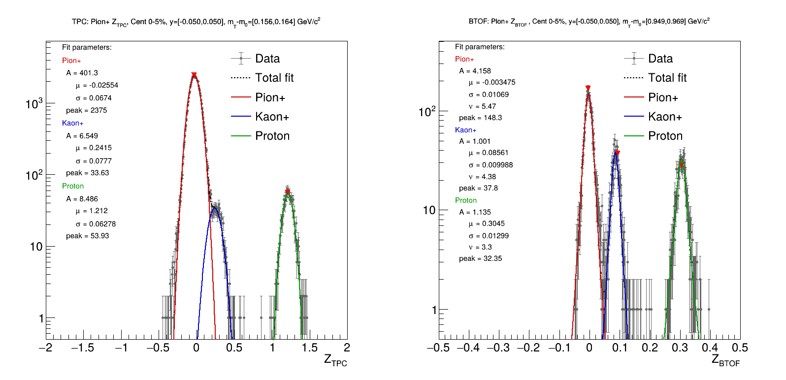
DETECTOR & TRACKING QA
Extracting Yields: dE/dx & Inverse-Beta Fits
Gaussian (TPC) and Student's-t (BTOF) fits, pion+/kaon+/proton, 0-5% centrality. TPC pi+K fit range: p <= 0.75 GeV/c.
Andrew Liggett • August 24, 2026
9

Slide 11
SPECTRA PRODUCTION
Spectra Corrections: Status
Correction | Status | Notes
BTOF efficiency | Done | Data-driven: ratio of TPC-identified tracks with a matching BTOF hit to all TPC-identified tracks, fit vs mT-m0.
TPC efficiency | Not yet applied | Will use the embedding already produced in P23ic (library SL23c) to derive the efficiency correction.
Energy loss | Not yet applied | Uses the same P23ic/SL23c embedding as TPC efficiency -- applied in the same call.
Hybrid feed-down | Not yet applied | Also draws on the same P23ic/SL23c embedding; will be enabled once the correction is applied.
Andrew Liggett • August 24, 2026
10

Slide 12
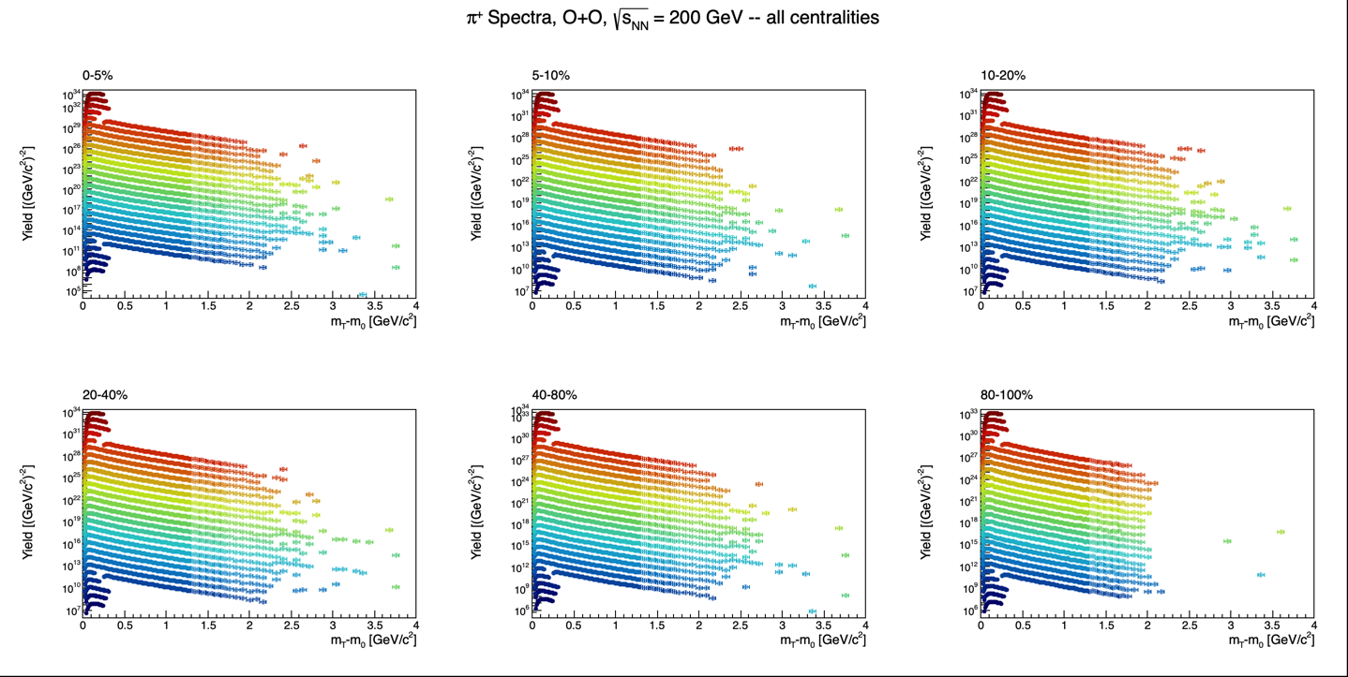
BTOF-CORRECTED SPECTRA
Pion+: Combined All-Centralities Spectra View
BTOF-corrected pion+ mT-m0 spectra, TPC+BTOF combined, all six centrality bins, all rapidity bins together.
Andrew Liggett • August 24, 2026
11

Slide 13
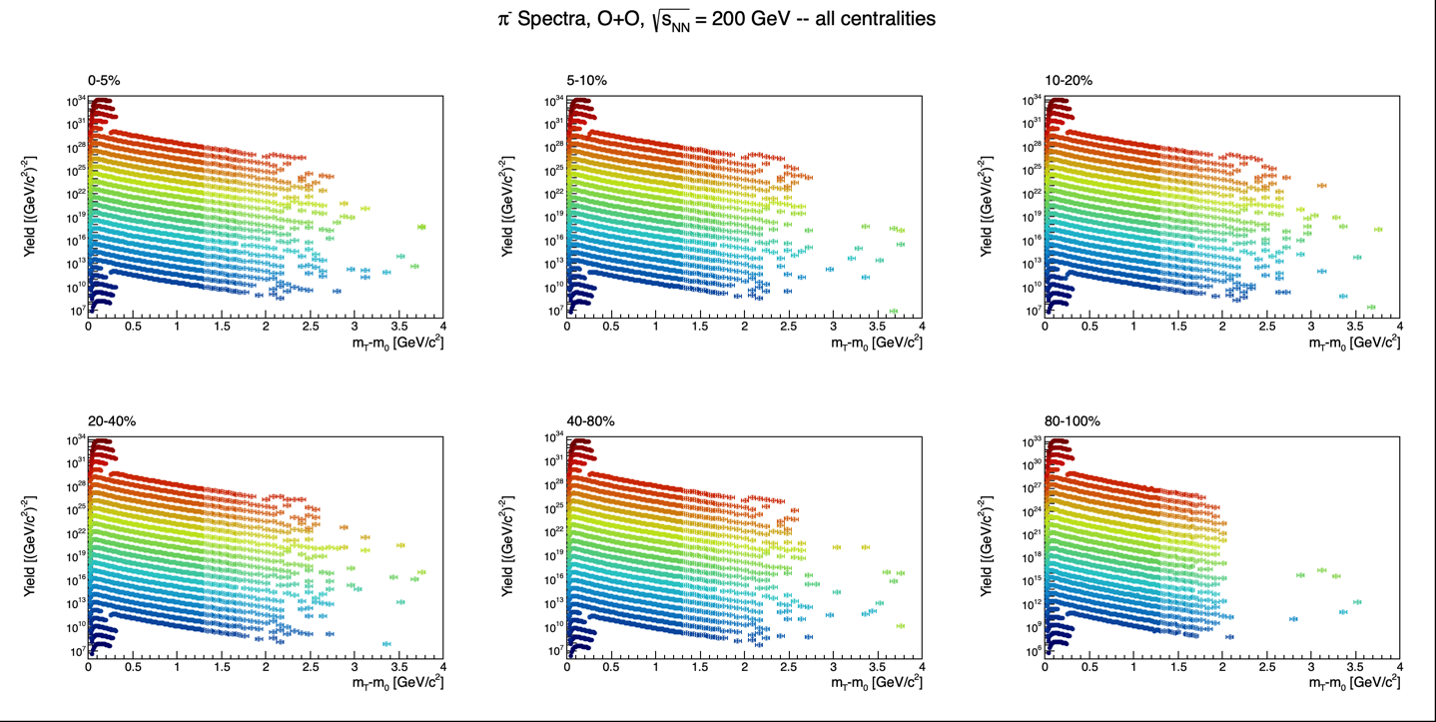
BTOF-CORRECTED SPECTRA
Pion-: Combined All-Centralities Spectra View
BTOF-corrected pion- mT-m0 spectra, TPC+BTOF combined, all six centrality bins, all rapidity bins together.
Andrew Liggett • August 24, 2026
12

Slide 14
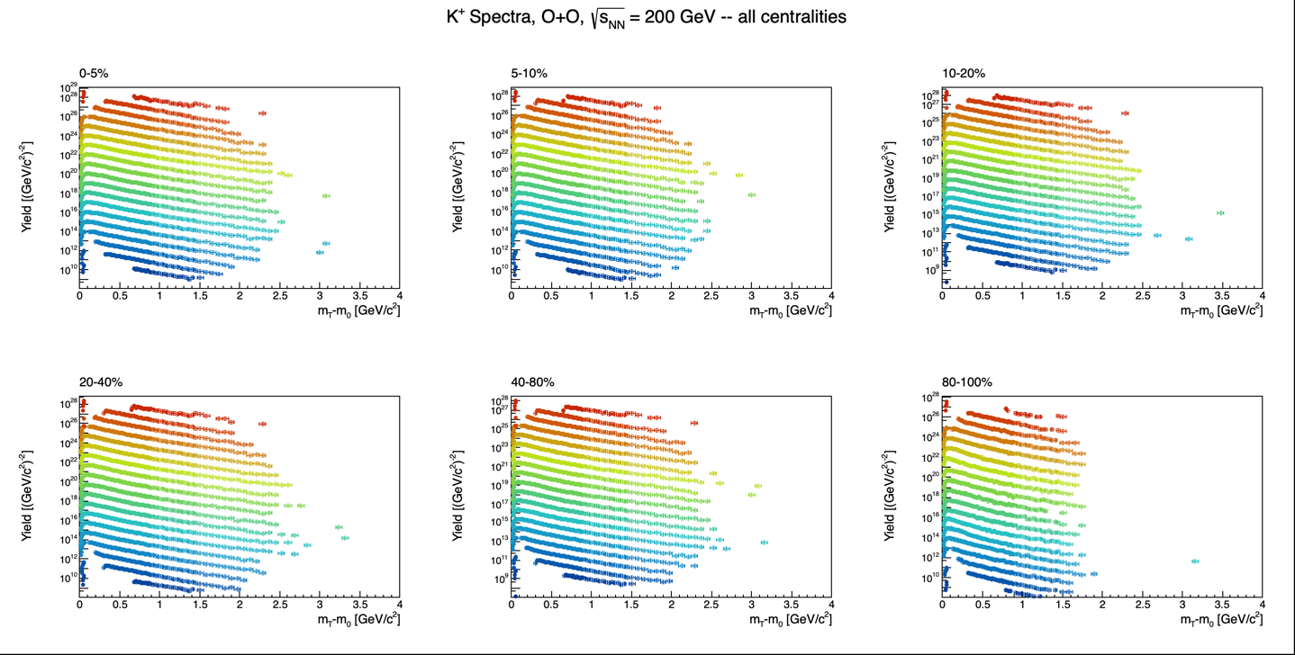
BTOF-CORRECTED SPECTRA
Kaon+: Combined All-Centralities Spectra View
BTOF-corrected kaon+ mT-m0 spectra, TPC+BTOF combined, all six centrality bins, all rapidity bins together.
Andrew Liggett • August 24, 2026
13

Slide 15
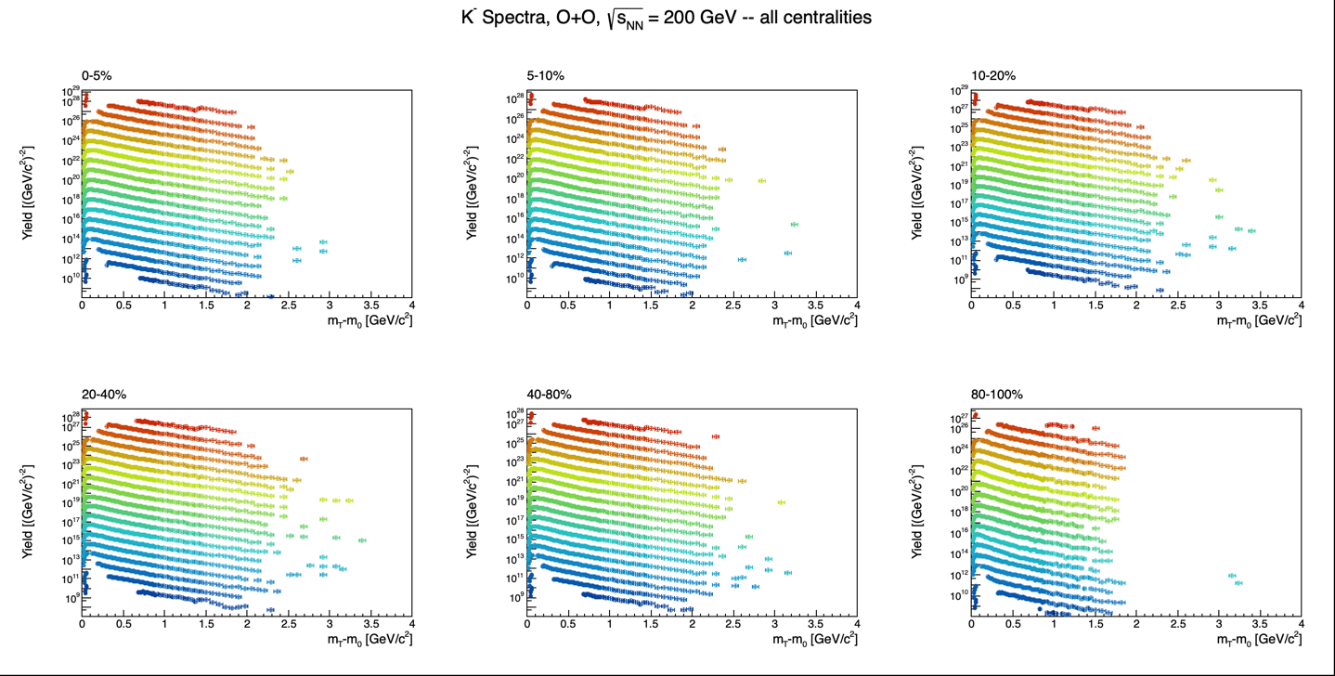
BTOF-CORRECTED SPECTRA
Kaon-: Combined All-Centralities Spectra View
BTOF-corrected kaon- mT-m0 spectra, TPC+BTOF combined, all six centrality bins, all rapidity bins together.
Andrew Liggett • August 24, 2026
14

Slide 16
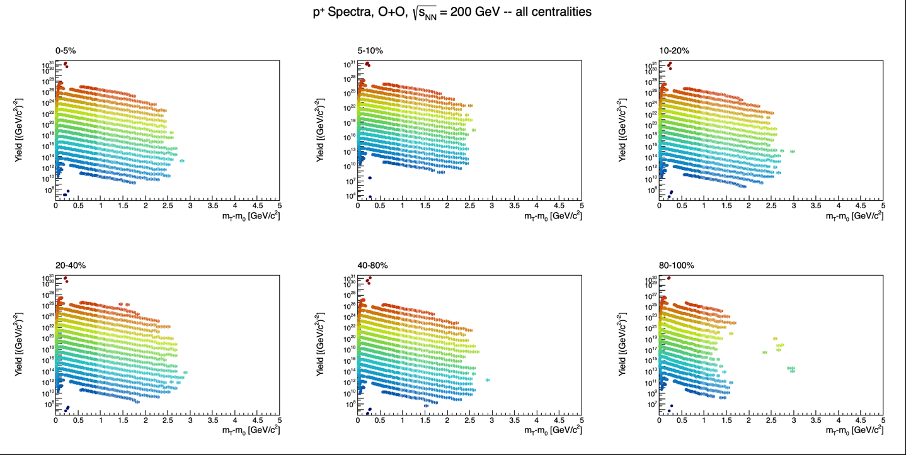
BTOF-CORRECTED SPECTRA
Proton+: Combined All-Centralities Spectra View
BTOF-corrected proton+ mT-m0 spectra, TPC+BTOF combined, all six centrality bins, all rapidity bins together.
Andrew Liggett • August 24, 2026
15

Slide 17
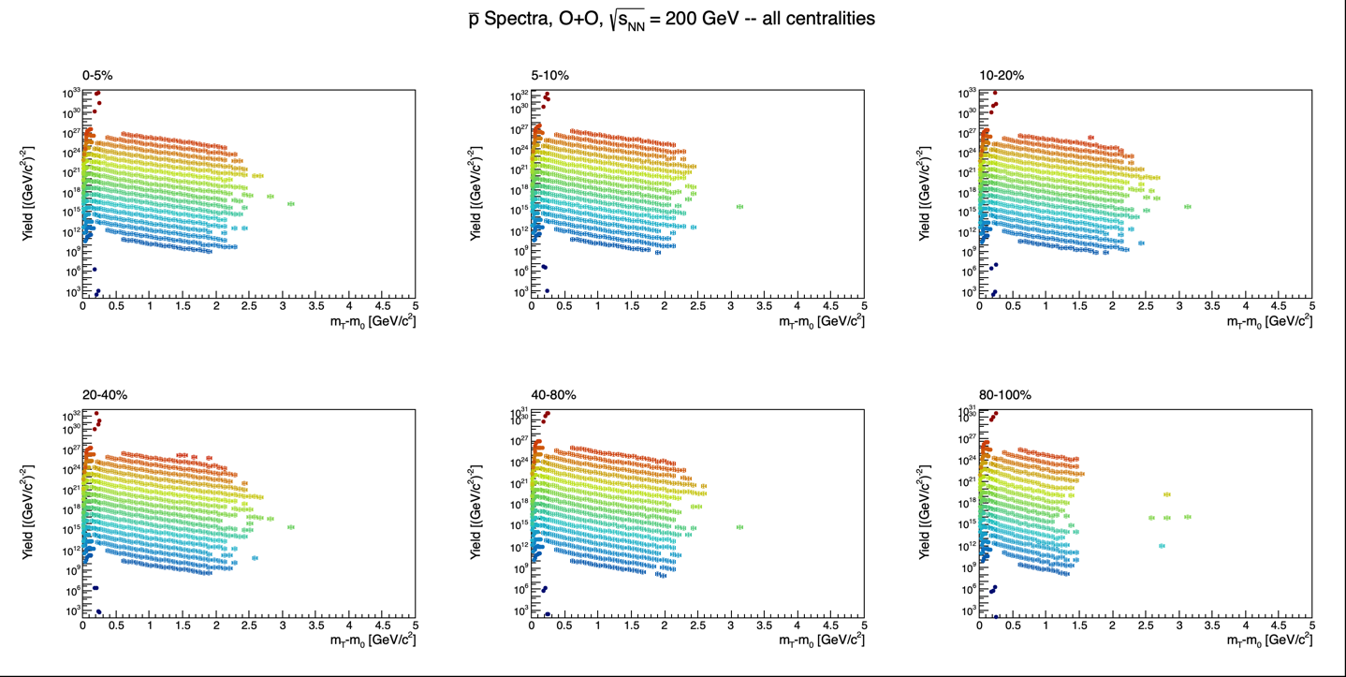
BTOF-CORRECTED SPECTRA
Antiproton: All-Centralities Spectra View
BTOF-corrected antiproton mT-m0 spectra, TPC+BTOF combined, all six centrality bins, all rapidity bins together.
Andrew Liggett • August 24, 2026
16

Slide 18
STATUS
Summary & Next Steps
Motivation -- O+O collisions as a galactic cosmic ray proxy for space radiation and shielding studies.
BTOF-corrected spectra produced for π/K/p -- all six centrality bins, TPC+BTOF combined.
Currently working on eTOF calibrations -- MuDsts restored, calibration pass underway; this would be the first use of eTOF at 200 GeV.
Embedding build system ready for SL23c -- build macros split by STAR_LEVEL (makeLibs_SL24y.C / makeLibs_SL23c.C), a dedicated PicoDstReader_SL23c build tree, and RCF paths filled in for the embedding submission scripts -- next: submit the P23ic/SL23c embedding batch jobs at RCF.
Open question -- does an StRefMultCorr exist for O+O in the SL23c library? Previous O+O analyses have used the EPD instead of refmult for centrality determination.
Andrew Liggett • August 24, 2026
17

Slide 19
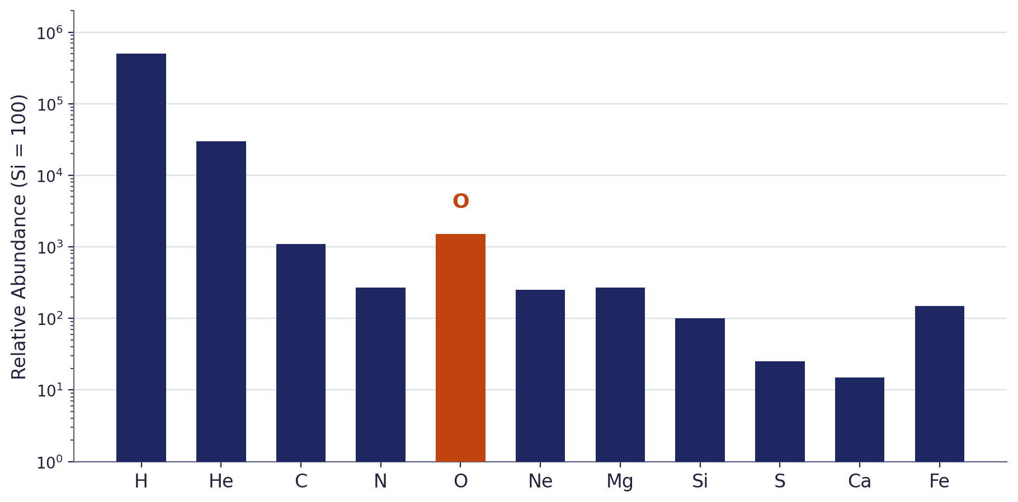
BACKUP
GCR Elemental Composition
Oxygen is a major primary GCR component and spallation parent -- directly relevant to the O+O system studied here.
Source: Simpson (1983), Ann. Rev. Nucl. Part. Sci. 33:323; ACE-CRIS (Caltech ACE News #83). Representative reconstruction, not a digitized figure.
Andrew Liggett • August 24, 2026
18

Slide 20
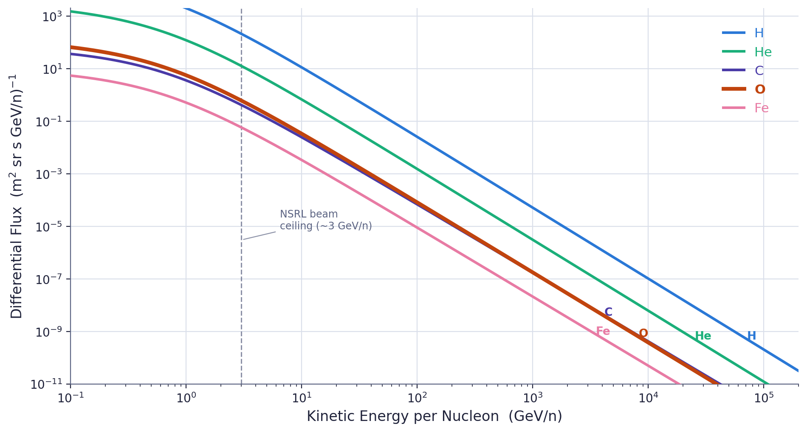
BACKUP
GCR Energy Spectrum by Element
Sources: PDG "Cosmic Rays" review; Ahn et al. 2009, ApJ 707:593 (CREAM); Simpson (1983) abundances. Representative reconstruction, not a digitized figure.
Andrew Liggett • August 24, 2026
19

Slide 21
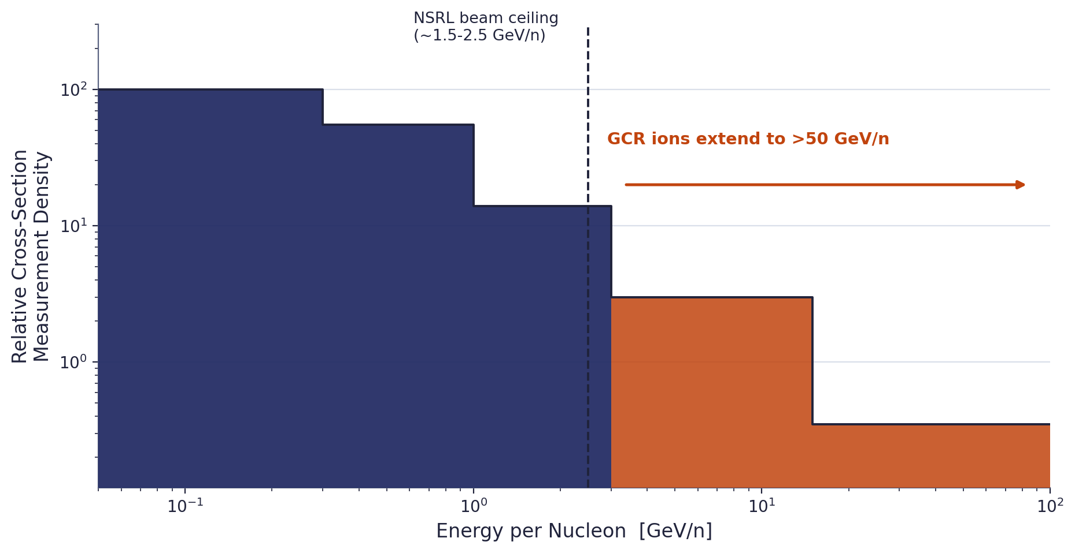
BACKUP
Nuclear Data Coverage Gap
FLUKA/GEANT4/PHITS are tuned to measured cross sections -- data thins sharply above ~3 GeV/n, beyond NSRL's beam ceiling.
Source: Norbury & Losekamm, NASA NTRS 20240015733; NSRL beam specs, BNL. Representative reconstruction, not a digitized figure.
Andrew Liggett • August 24, 2026
20

Slide 22
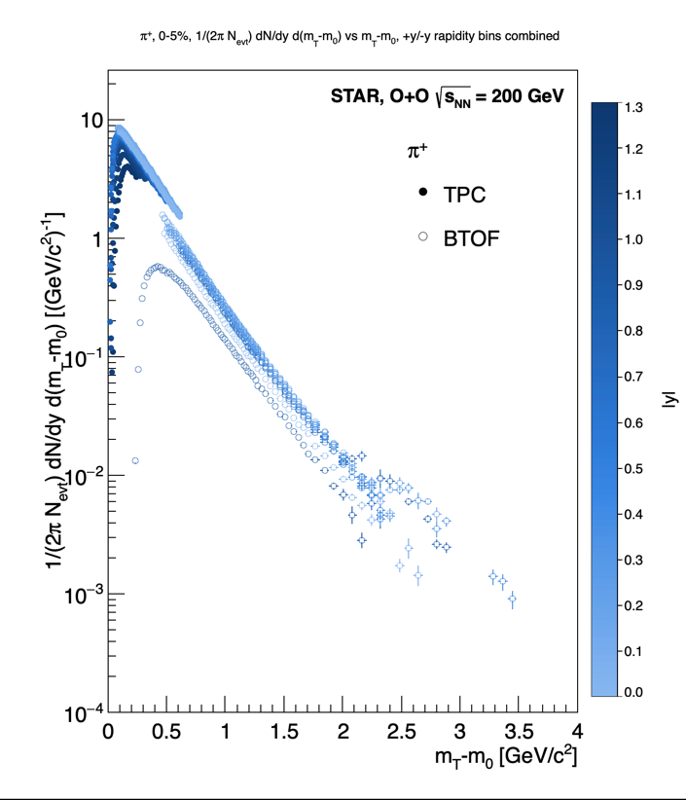
BACKUP
Raw Yield Extraction: Z-Fitter Output (π+)
TPC vs BTOF raw dN/dy vs mT-m0 for pion+, 0-5% centrality -- before the two detectors are merged and corrected.
Andrew Liggett • August 24, 2026
21

Slide 23
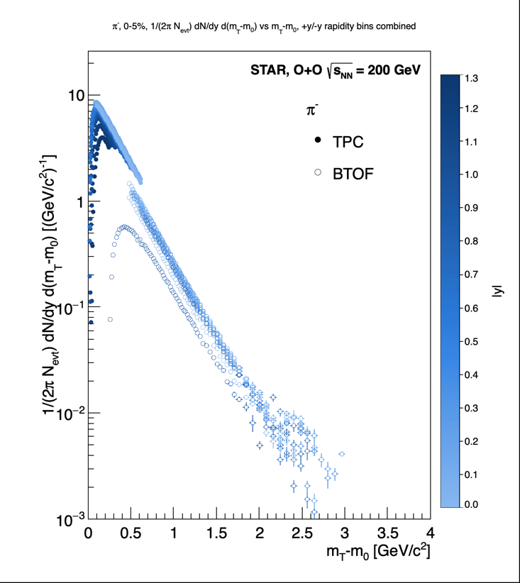
BACKUP
Raw Yield Extraction: Z-Fitter Output (π−)
TPC vs BTOF raw dN/dy vs mT-m0 for pion-, 0-5% centrality -- before the two detectors are merged and corrected.
Andrew Liggett • August 24, 2026
22

Slide 24
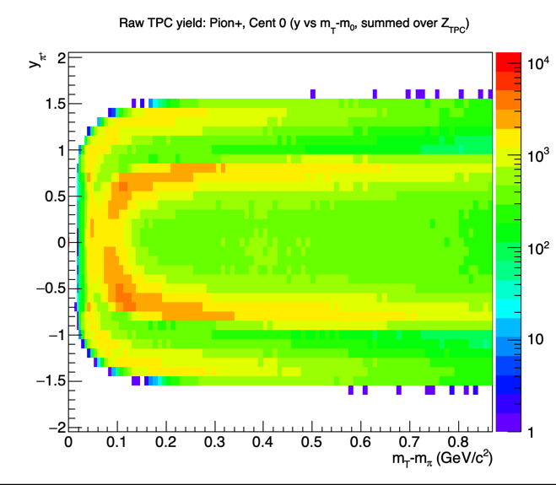
BACKUP
Raw TPC Yield: Rapidity vs mT-m0 (π+)
Pion+ raw TPC yield vs rapidity and mT-m0, 0-5% centrality, summed over Z_TPC -- input to the corrections.
Andrew Liggett • August 24, 2026
23

Slide 25
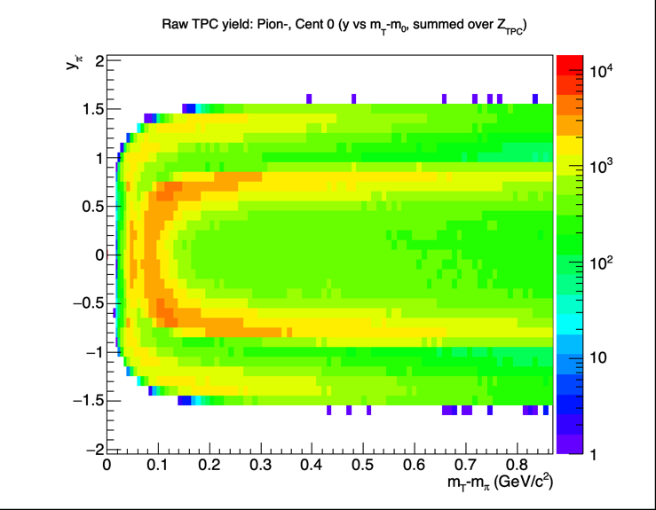
BACKUP
Raw TPC Yield: Rapidity vs mT-m0 (π−)
Pion- raw TPC yield vs rapidity and mT-m0, 0-5% centrality, summed over Z_TPC -- input to the corrections.
Andrew Liggett • August 24, 2026
24

Slide 26
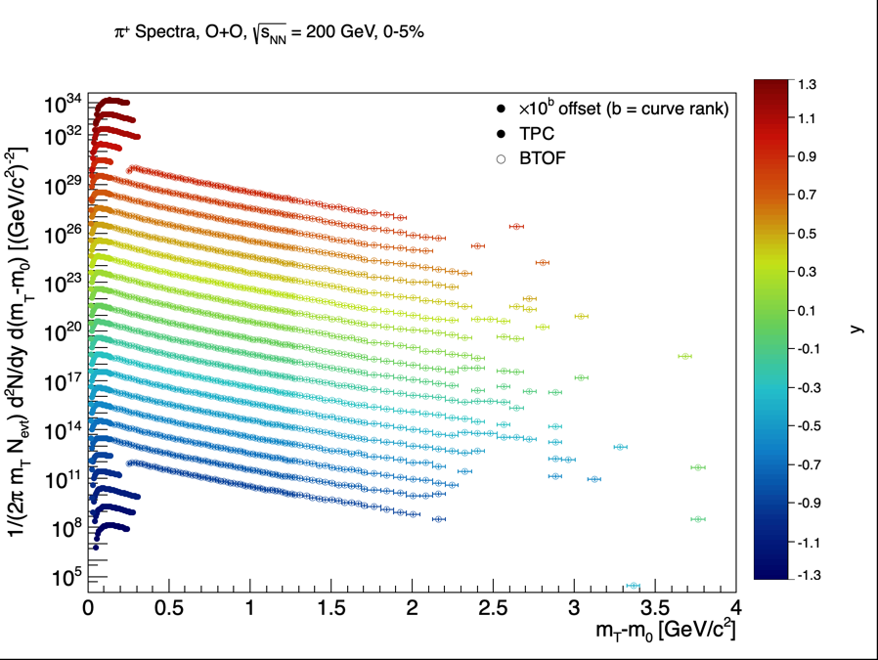
BACKUP
Pion+: 0-5% Centrality
BTOF-corrected pion+ mT-m0 spectra, 0-5% centrality, TPC+BTOF, all rapidity bins.
Andrew Liggett • August 24, 2026
25

Slide 27
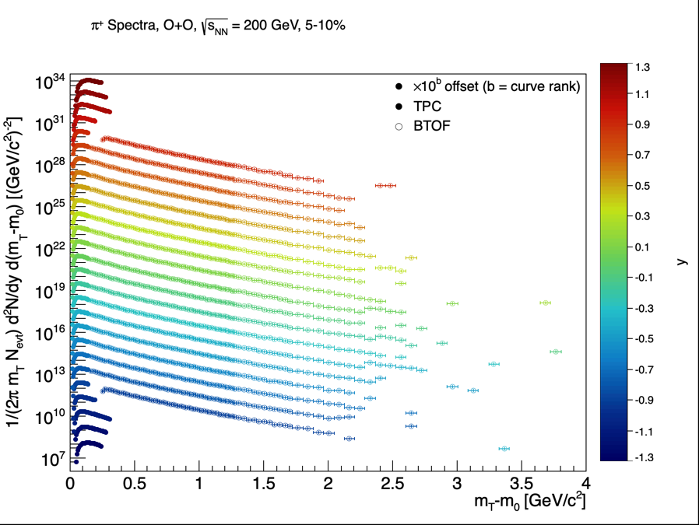
BACKUP
Pion+: 5-10% Centrality
BTOF-corrected pion+ mT-m0 spectra, 5-10% centrality, TPC+BTOF, all rapidity bins.
Andrew Liggett • August 24, 2026
26

Slide 28

BACKUP
Pion+: 10-20% Centrality
BTOF-corrected pion+ mT-m0 spectra, 10-20% centrality, TPC+BTOF, all rapidity bins.
Andrew Liggett • August 24, 2026
27

Slide 29
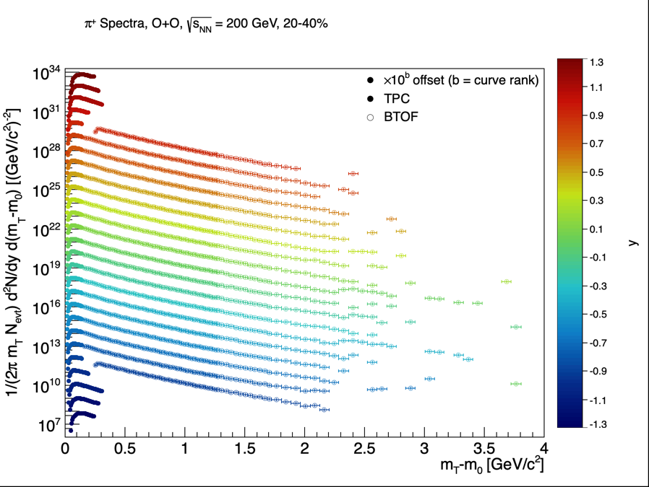
BACKUP
Pion+: 20-40% Centrality
BTOF-corrected pion+ mT-m0 spectra, 20-40% centrality, TPC+BTOF, all rapidity bins.
Andrew Liggett • August 24, 2026
28

Slide 30

BACKUP
Pion+: 40-80% Centrality
BTOF-corrected pion+ mT-m0 spectra, 40-80% centrality, TPC+BTOF, all rapidity bins.
Andrew Liggett • August 24, 2026
29

Slide 31
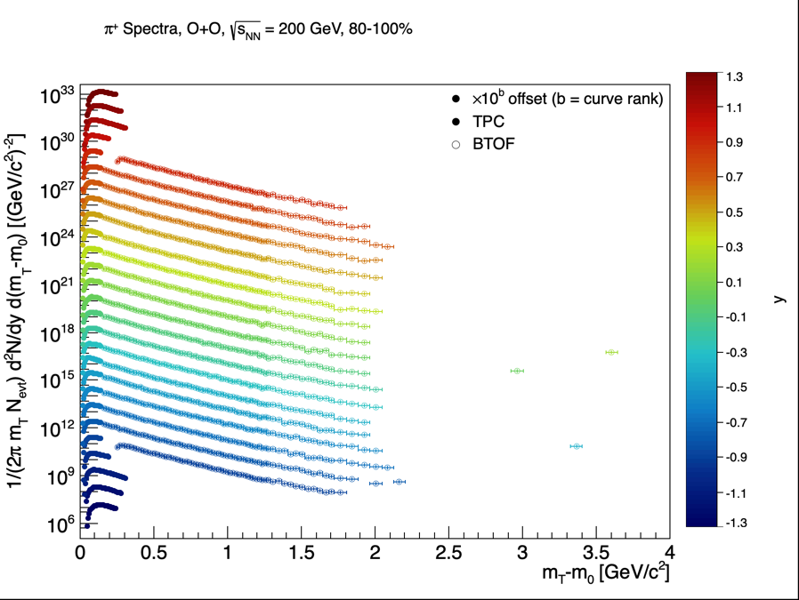
BACKUP
Pion+: 80-100% Centrality
BTOF-corrected pion+ mT-m0 spectra, 80-100% centrality, TPC+BTOF, all rapidity bins.
Andrew Liggett • August 24, 2026
30

Slide 32
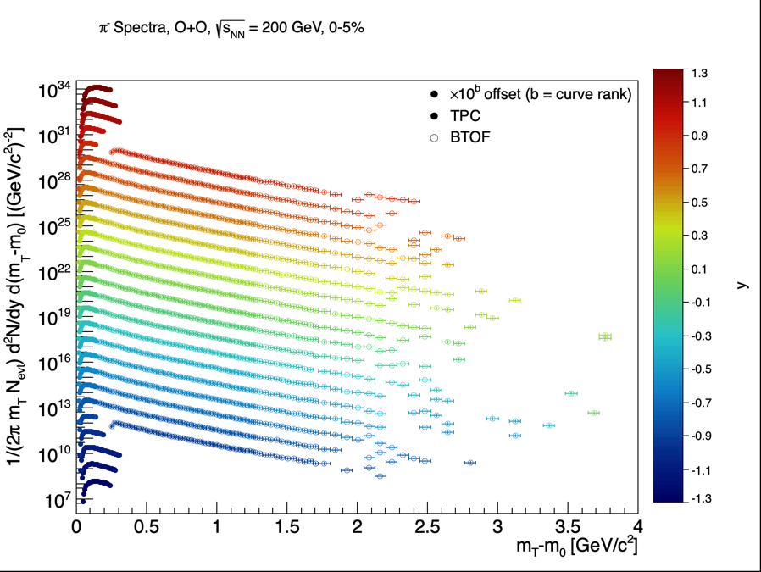
BACKUP
Pion-: 0-5% Centrality
BTOF-corrected pion- mT-m0 spectra, 0-5% centrality, TPC+BTOF, all rapidity bins.
Andrew Liggett • August 24, 2026
31

Slide 33
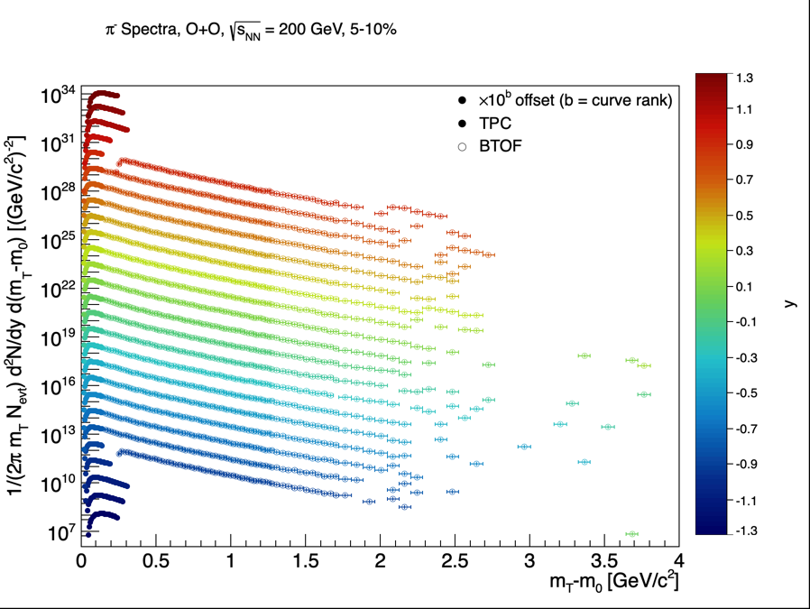
BACKUP
Pion-: 5-10% Centrality
BTOF-corrected pion- mT-m0 spectra, 5-10% centrality, TPC+BTOF, all rapidity bins.
Andrew Liggett • August 24, 2026
32

Slide 34
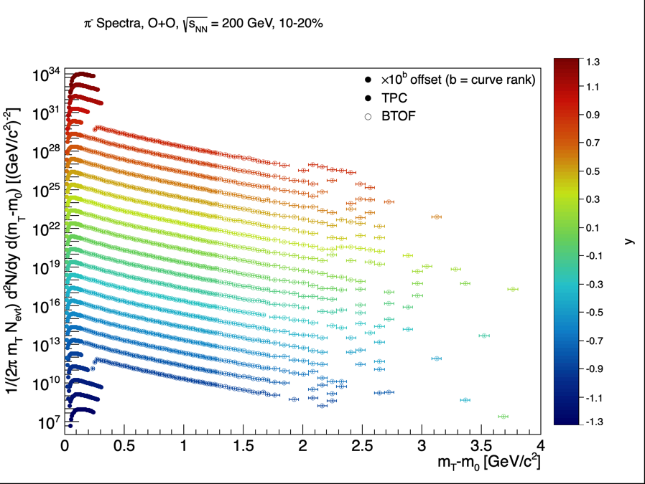
BACKUP
Pion-: 10-20% Centrality
BTOF-corrected pion- mT-m0 spectra, 10-20% centrality, TPC+BTOF, all rapidity bins.
Andrew Liggett • August 24, 2026
33

Slide 35

BACKUP
Pion-: 20-40% Centrality
BTOF-corrected pion- mT-m0 spectra, 20-40% centrality, TPC+BTOF, all rapidity bins.
Andrew Liggett • August 24, 2026
34

Slide 36
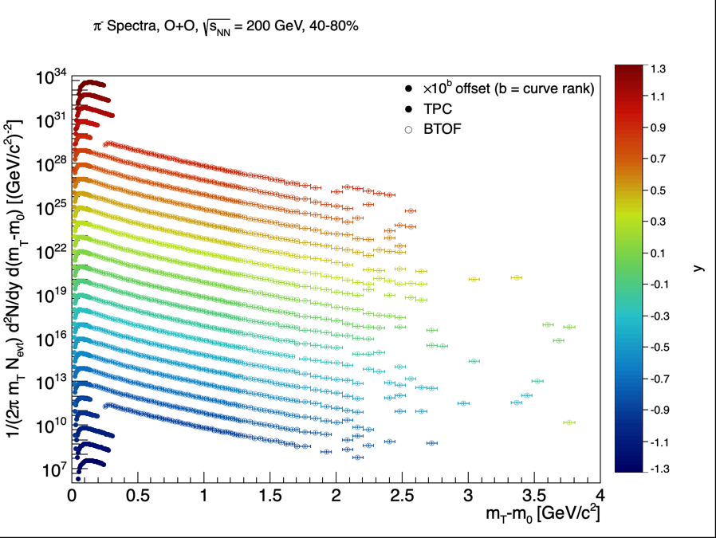
BACKUP
Pion-: 40-80% Centrality
BTOF-corrected pion- mT-m0 spectra, 40-80% centrality, TPC+BTOF, all rapidity bins.
Andrew Liggett • August 24, 2026
35

Slide 37

BACKUP
Pion-: 80-100% Centrality
BTOF-corrected pion- mT-m0 spectra, 80-100% centrality, TPC+BTOF, all rapidity bins.
Andrew Liggett • August 24, 2026
36

Slide 38
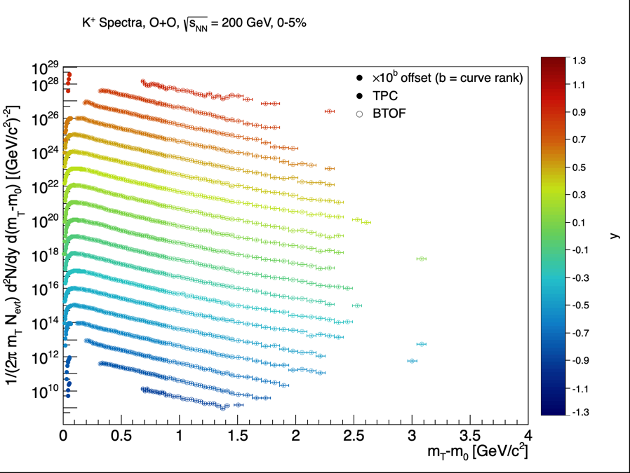
BACKUP
Kaon+: 0-5% Centrality
BTOF-corrected kaon+ mT-m0 spectra, 0-5% centrality, TPC+BTOF, all rapidity bins.
Andrew Liggett • August 24, 2026
37

Slide 39

BACKUP
Kaon+: 5-10% Centrality
BTOF-corrected kaon+ mT-m0 spectra, 5-10% centrality, TPC+BTOF, all rapidity bins.
Andrew Liggett • August 24, 2026
38

Slide 40
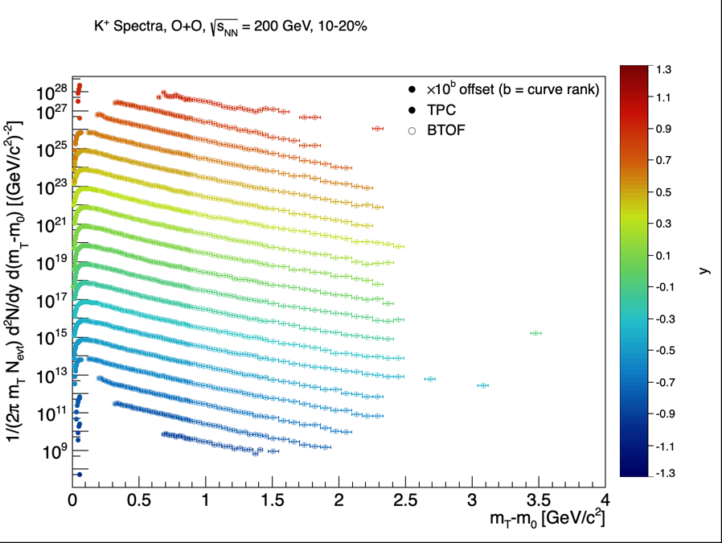
BACKUP
Kaon+: 10-20% Centrality
BTOF-corrected kaon+ mT-m0 spectra, 10-20% centrality, TPC+BTOF, all rapidity bins.
Andrew Liggett • August 24, 2026
39

Slide 41
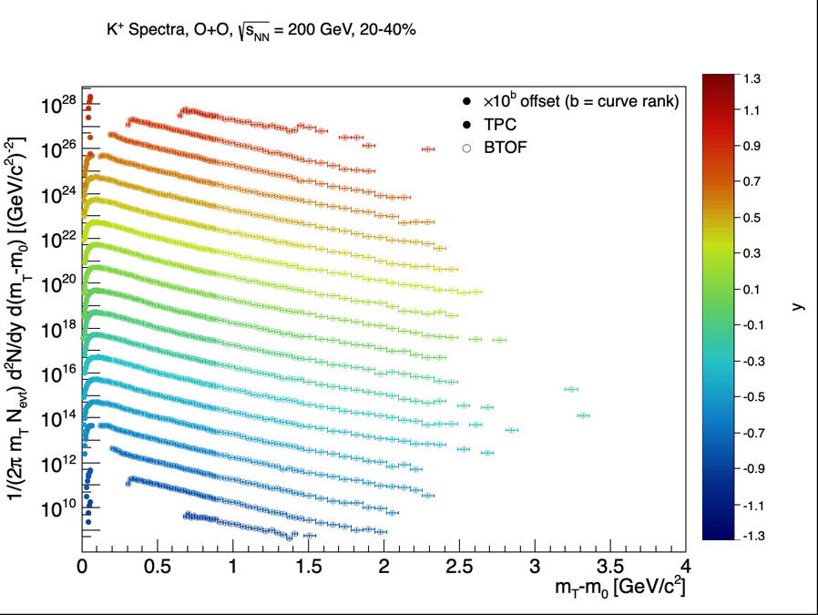
BACKUP
Kaon+: 20-40% Centrality
BTOF-corrected kaon+ mT-m0 spectra, 20-40% centrality, TPC+BTOF, all rapidity bins.
Andrew Liggett • August 24, 2026
40

Slide 42
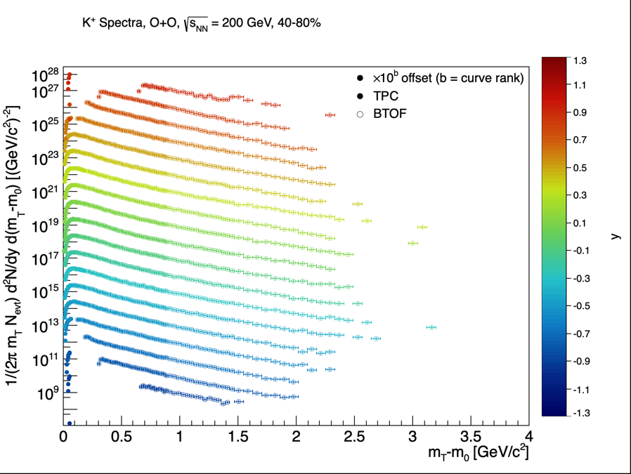
BACKUP
Kaon+: 40-80% Centrality
BTOF-corrected kaon+ mT-m0 spectra, 40-80% centrality, TPC+BTOF, all rapidity bins.
Andrew Liggett • August 24, 2026
41

Slide 43
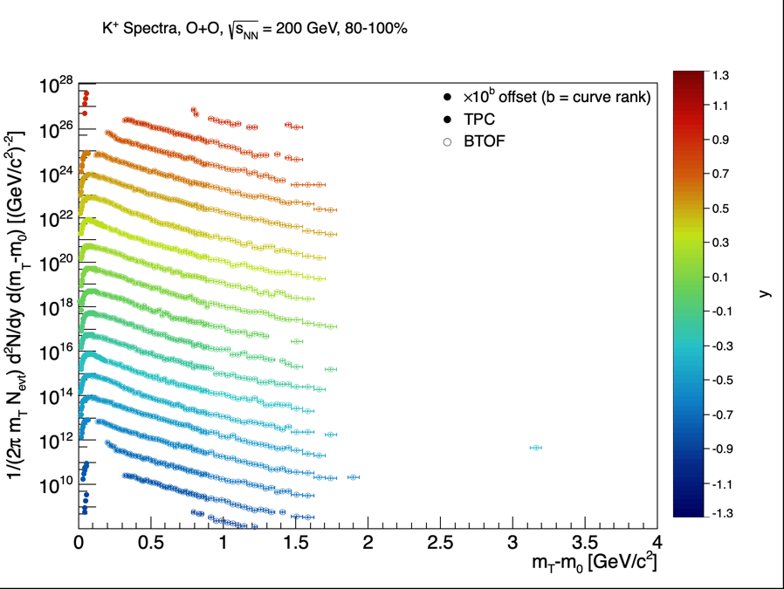
BACKUP
Kaon+: 80-100% Centrality
BTOF-corrected kaon+ mT-m0 spectra, 80-100% centrality, TPC+BTOF, all rapidity bins.
Andrew Liggett • August 24, 2026
42

Slide 44

BACKUP
Kaon-: 0-5% Centrality
BTOF-corrected kaon- mT-m0 spectra, 0-5% centrality, TPC+BTOF, all rapidity bins.
Andrew Liggett • August 24, 2026
43

Slide 45

BACKUP
Kaon-: 5-10% Centrality
BTOF-corrected kaon- mT-m0 spectra, 5-10% centrality, TPC+BTOF, all rapidity bins.
Andrew Liggett • August 24, 2026
44

Slide 46
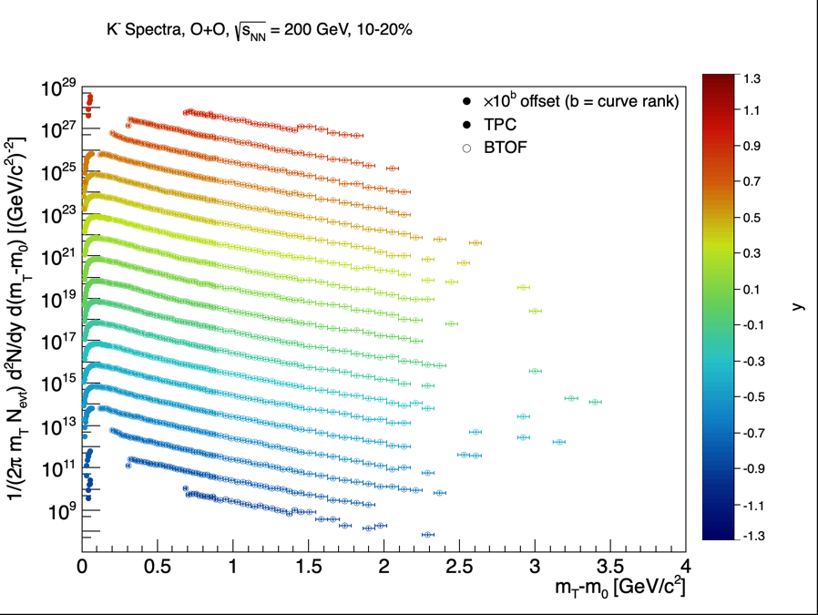
BACKUP
Kaon-: 10-20% Centrality
BTOF-corrected kaon- mT-m0 spectra, 10-20% centrality, TPC+BTOF, all rapidity bins.
Andrew Liggett • August 24, 2026
45

Slide 47

BACKUP
Kaon-: 20-40% Centrality
BTOF-corrected kaon- mT-m0 spectra, 20-40% centrality, TPC+BTOF, all rapidity bins.
Andrew Liggett • August 24, 2026
46

Slide 48
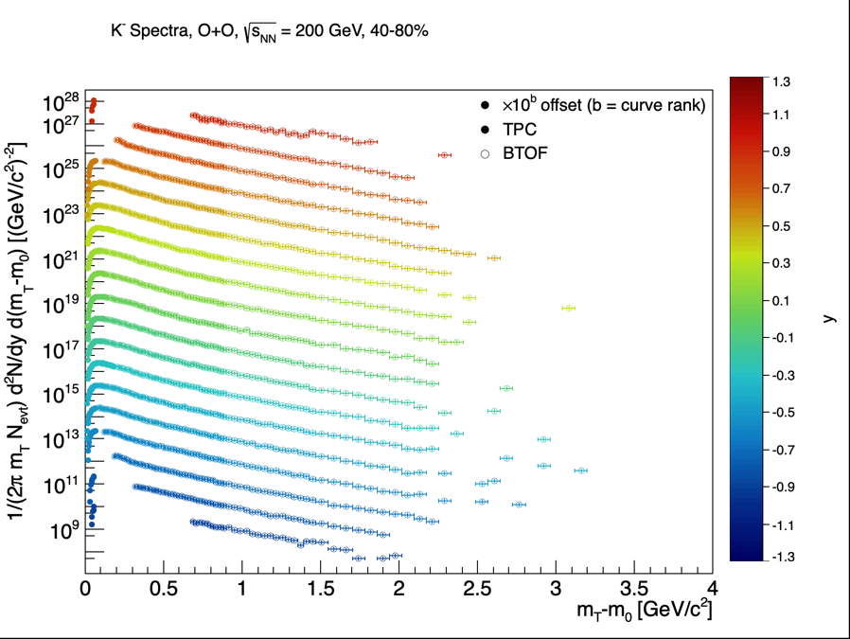
BACKUP
Kaon-: 40-80% Centrality
BTOF-corrected kaon- mT-m0 spectra, 40-80% centrality, TPC+BTOF, all rapidity bins.
Andrew Liggett • August 24, 2026
47

Slide 49
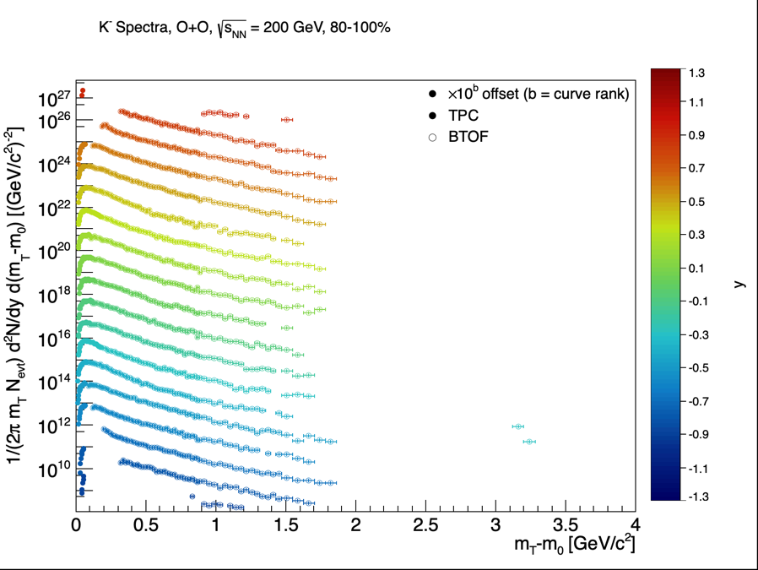
BACKUP
Kaon-: 80-100% Centrality
BTOF-corrected kaon- mT-m0 spectra, 80-100% centrality, TPC+BTOF, all rapidity bins.
Andrew Liggett • August 24, 2026
48

Slide 50
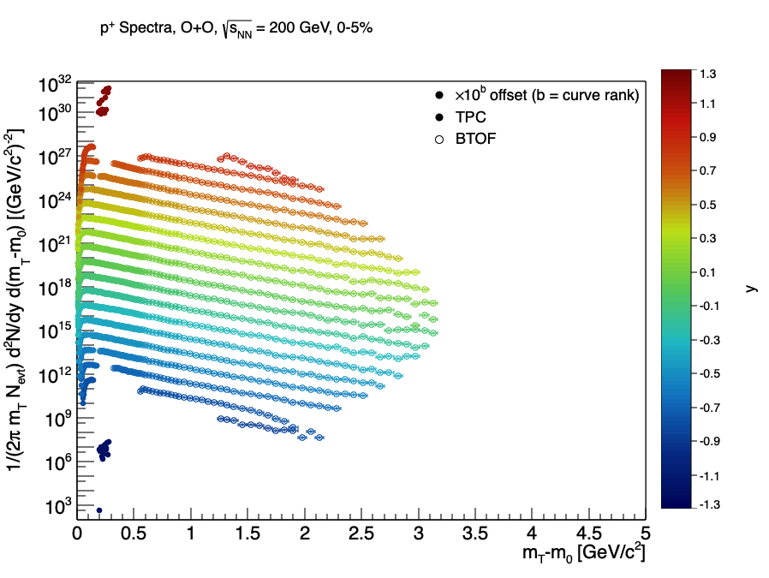
BACKUP
Proton+: 0-5% Centrality
BTOF-corrected proton+ mT-m0 spectra, 0-5% centrality, TPC+BTOF, all rapidity bins.
Andrew Liggett • August 24, 2026
49

Slide 51
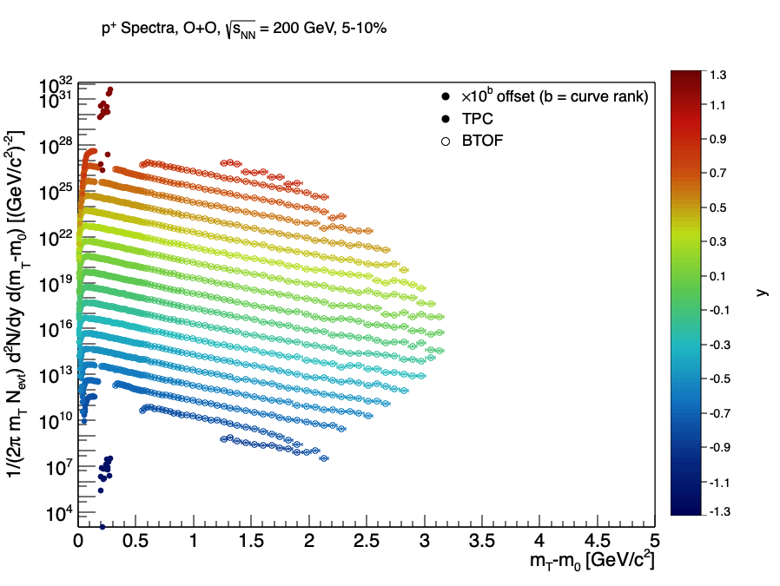
BACKUP
Proton+: 5-10% Centrality
BTOF-corrected proton+ mT-m0 spectra, 5-10% centrality, TPC+BTOF, all rapidity bins.
Andrew Liggett • August 24, 2026
50

Slide 52

BACKUP
Proton+: 10-20% Centrality
BTOF-corrected proton+ mT-m0 spectra, 10-20% centrality, TPC+BTOF, all rapidity bins.
Andrew Liggett • August 24, 2026
51

Slide 53
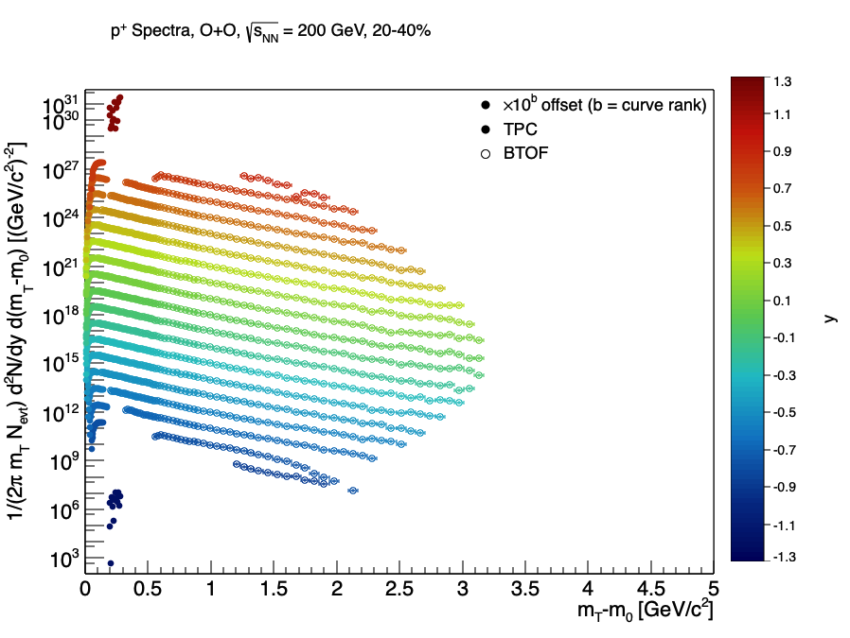
BACKUP
Proton+: 20-40% Centrality
BTOF-corrected proton+ mT-m0 spectra, 20-40% centrality, TPC+BTOF, all rapidity bins.
Andrew Liggett • August 24, 2026
52

Slide 54
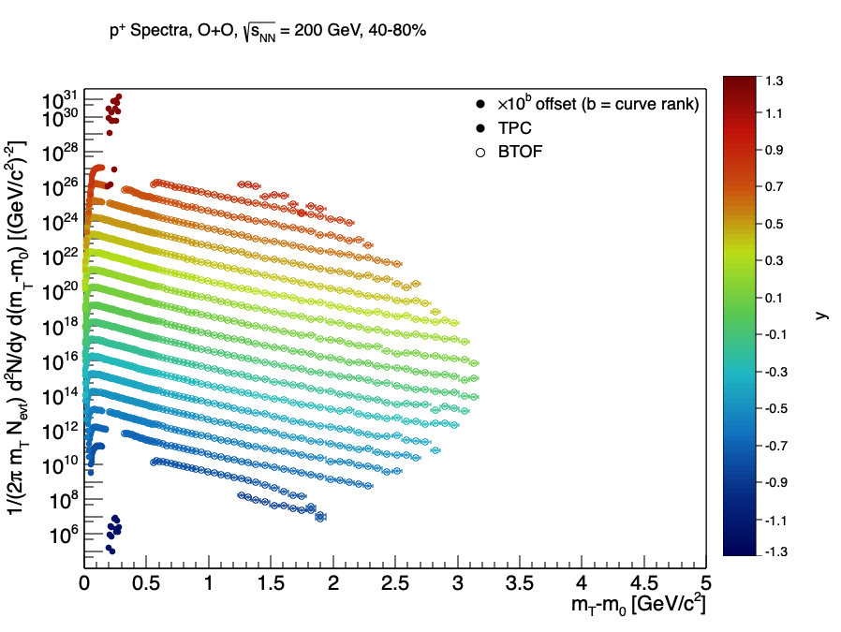
BACKUP
Proton+: 40-80% Centrality
BTOF-corrected proton+ mT-m0 spectra, 40-80% centrality, TPC+BTOF, all rapidity bins.
Andrew Liggett • August 24, 2026
53

Slide 55
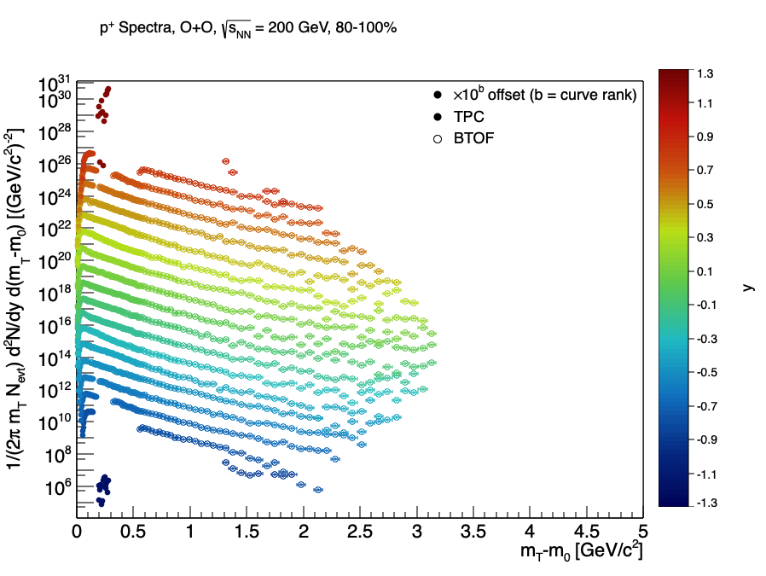
BACKUP
Proton+: 80-100% Centrality
BTOF-corrected proton+ mT-m0 spectra, 80-100% centrality, TPC+BTOF, all rapidity bins.
Andrew Liggett • August 24, 2026
54

Slide 56
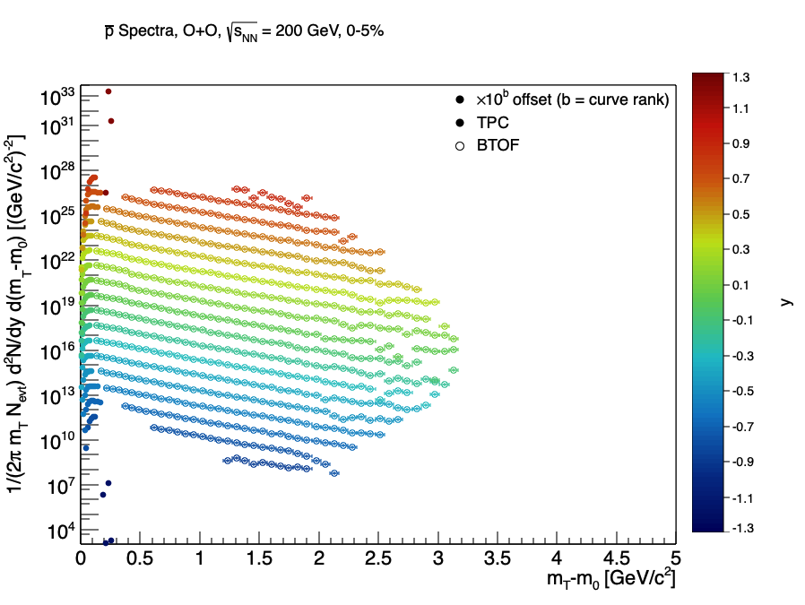
BACKUP
Antiproton: 0-5% Centrality
BTOF-corrected antiproton mT-m0 spectra, 0-5% centrality, TPC+BTOF, all rapidity bins.
Andrew Liggett • August 24, 2026
55

Slide 57
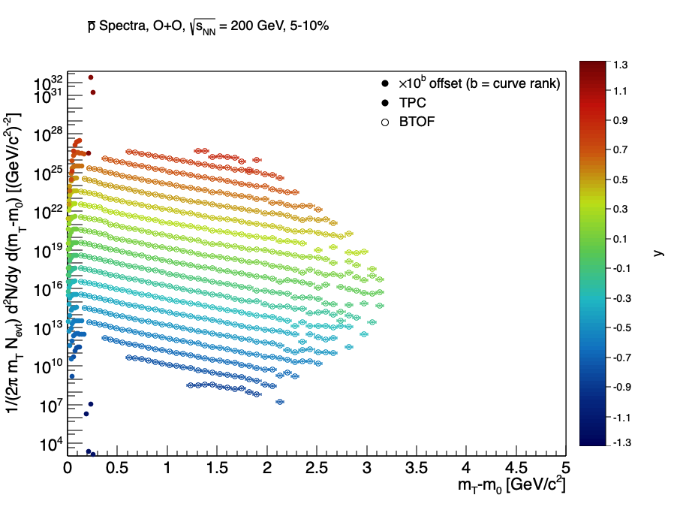
BACKUP
Antiproton: 5-10% Centrality
BTOF-corrected antiproton mT-m0 spectra, 5-10% centrality, TPC+BTOF, all rapidity bins.
Andrew Liggett • August 24, 2026
56

Slide 58
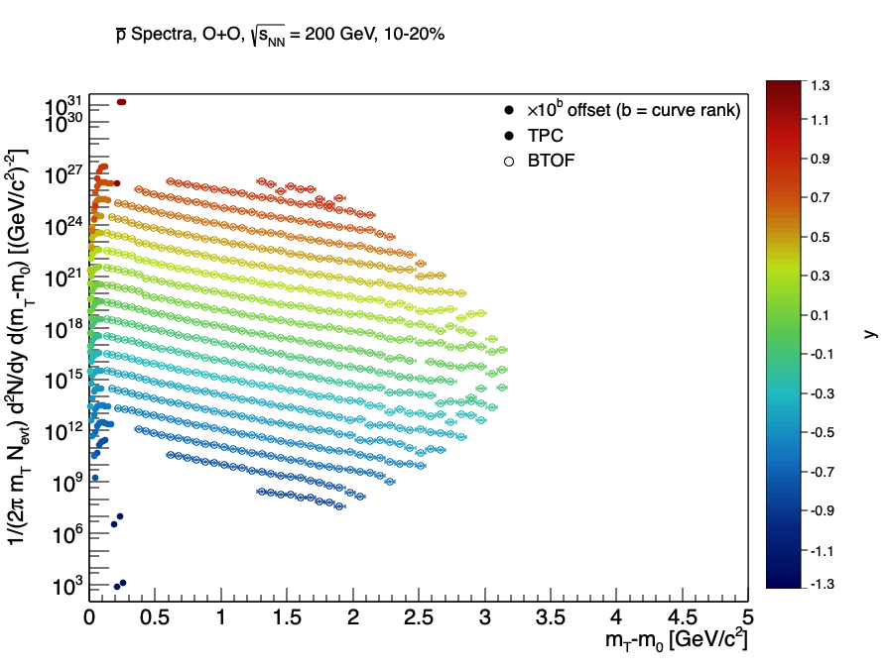
BACKUP
Antiproton: 10-20% Centrality
BTOF-corrected antiproton mT-m0 spectra, 10-20% centrality, TPC+BTOF, all rapidity bins.
Andrew Liggett • August 24, 2026
57

Slide 59
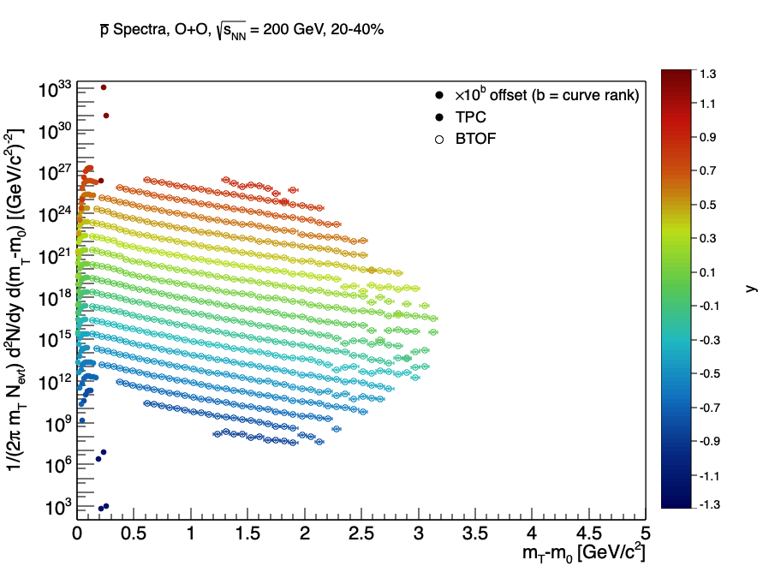
BACKUP
Antiproton: 20-40% Centrality
BTOF-corrected antiproton mT-m0 spectra, 20-40% centrality, TPC+BTOF, all rapidity bins.
Andrew Liggett • August 24, 2026
58

Slide 60

BACKUP
Antiproton: 40-80% Centrality
BTOF-corrected antiproton mT-m0 spectra, 40-80% centrality, TPC+BTOF, all rapidity bins.
Andrew Liggett • August 24, 2026
59

Slide 61
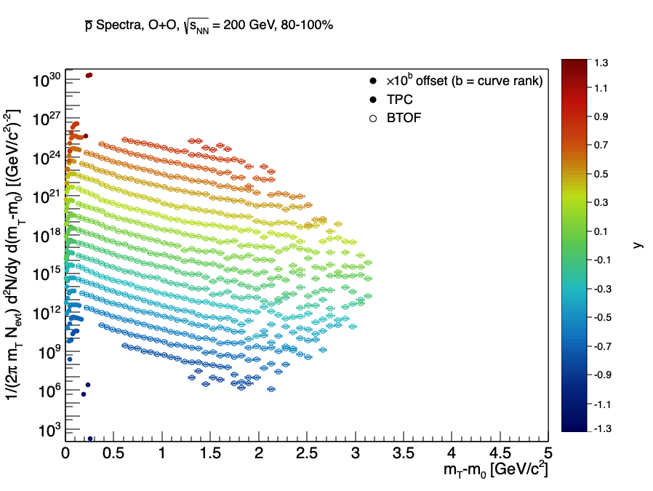
BACKUP
Antiproton: 80-100% Centrality
BTOF-corrected antiproton mT-m0 spectra, 80-100% centrality, TPC+BTOF, all rapidity bins.
Andrew Liggett • August 24, 2026
60

Slide 62
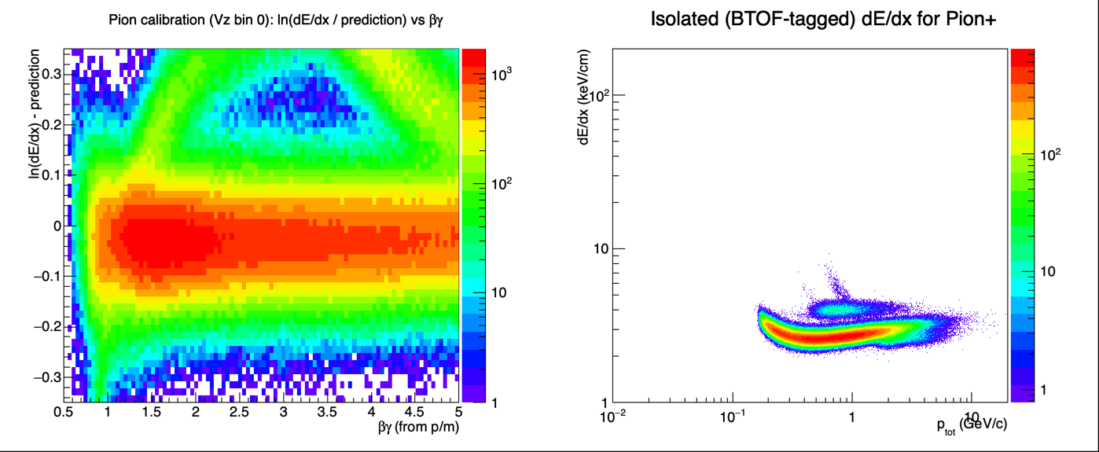
BACKUP
dE/dx Calibration QA
Pion dE/dx calibration residual vs beta-gamma (left) and isolated BTOF-tagged pion+ dE/dx (right) -- calibration is flat and centered.
Andrew Liggett • August 24, 2026
61

