Slide 1


NPG GROUP MEETING • THURSDAY, JULY 23, 2026
π/K/p Spectra Analysis
Status Update: O+O Collisions & Space Radiation Physics
Andrew Liggett

Slide 2
THIS WEEK'S UPDATES
Summary of Key Updates
1.
NHitsMax vs eta anomaly explained
Hit-loss bump and ceiling/spikiness dip both traced to the TPC corner (|eta|~0.9) and inner/outer sector boundary (N_hits^max=40) -- full story on the next slides.
2.
Sector-by-sector check rules out hardware
All 12 azimuthal TPC sectors show the identical trapezoid shape, confirming an eta-only geometric effect rather than a single bad sector.
3.
Charge-sign split test added
eta_nHitsMax_chargePlus/chargeMinus pushed to PicoBinner.cxx to test whether the diagonal streaks are curvature-driven; pending SDCC rebuild + rerun.
4.
Proton + antiproton spectra now included
Corrected proton and antiproton mT-m0 spectra, all 6 centrality bins, now shown -- see the two dedicated slides after this one.
Andrew Liggett • July 23, 2026
2

Slide 3
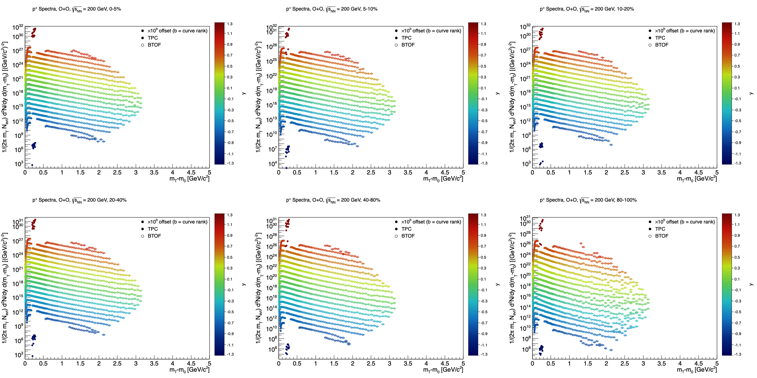
CURRENT STATUS
Proton Spectra: All Centrality Bins
Corrected proton (p+) mT-m0 spectra, all 6 centrality bins (0-5% through 80-100%), TPC+BTOF, all rapidity bins -- not shown at yesterday's meeting.
Andrew Liggett • July 23, 2026
3

Slide 4
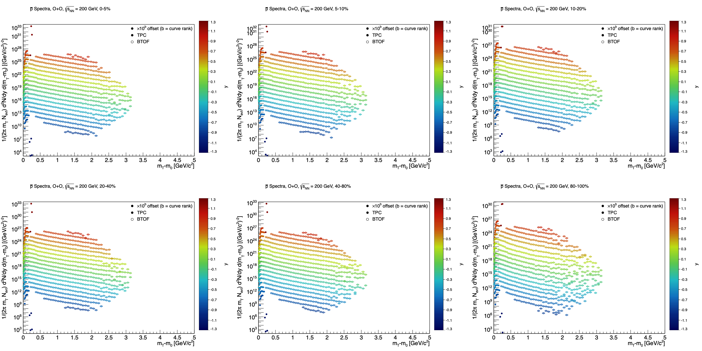
CURRENT STATUS
Antiproton Spectra: All Centrality Bins
Corrected antiproton (p-bar) mT-m0 spectra, all 6 centrality bins (0-5% through 80-100%), TPC+BTOF, all rapidity bins -- not shown at yesterday's meeting.
Andrew Liggett • July 23, 2026
4

Slide 5
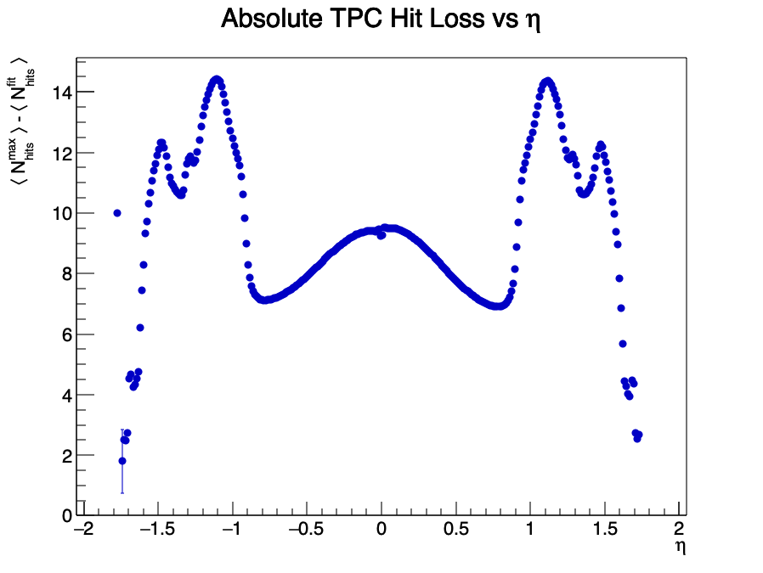
NHitsMax DEEP DIVE
Diagnosing the Hit-Loss Bump
Absolute hit loss vs eta shows a non-monotonic double bump at |eta|~1.1 and 1.4, ruling out a uniform beampipe effect.
Andrew Liggett • July 23, 2026
5

Slide 6
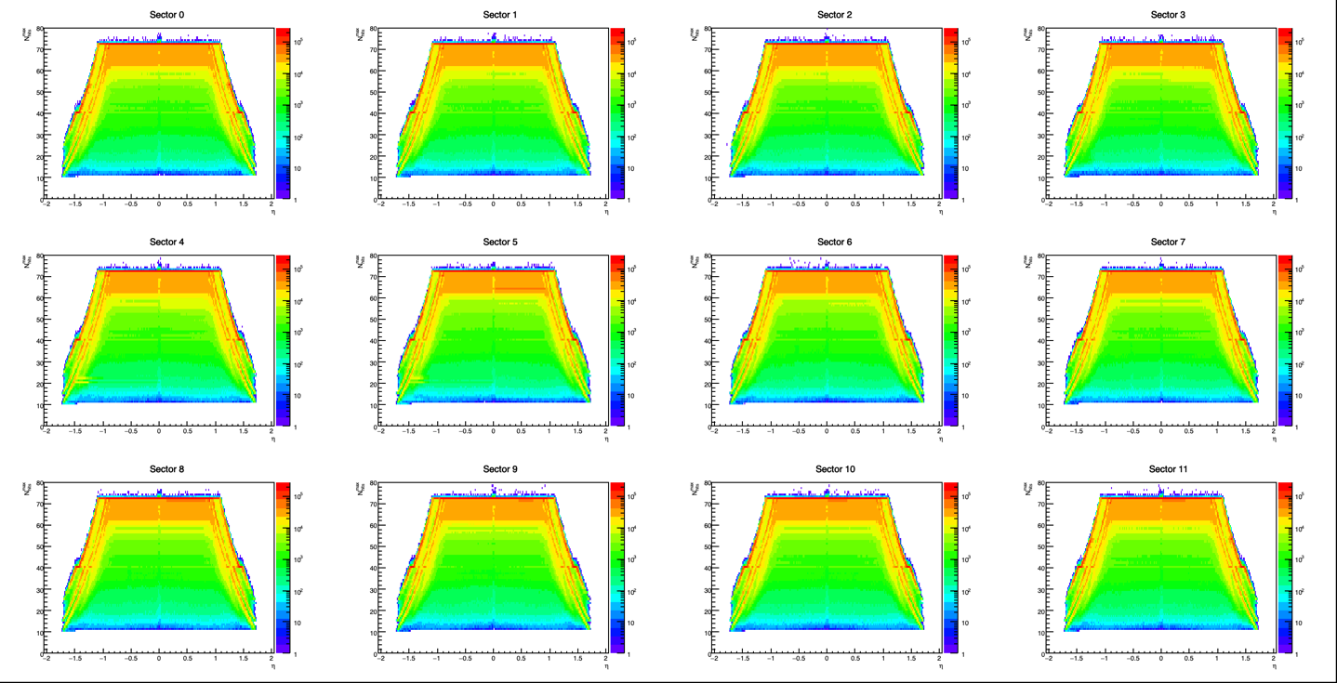
NHitsMax DEEP DIVE
Sector Check: Geometric, Not Hardware
N_hits^max vs eta, split into the 12 azimuthal (30-degree) TPC sectors -- all 12 show the same trapezoid shape, pointing to an eta-only geometric effect (e.g. barrel/endcap crossover) rather than a single bad sector.
Andrew Liggett • July 23, 2026
6

Slide 7
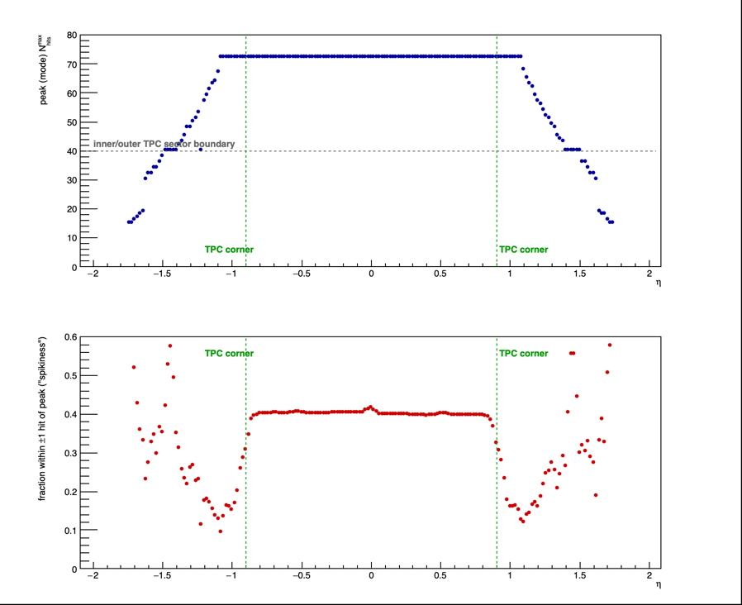
NHitsMax DEEP DIVE
Ceiling & Spikiness vs Eta
Full Story, End to End
Full ceiling (72 = 40 inner + 32 outer padrows, post-iTPC) holds flat to |eta|~1.0, smears through the corner transition, briefly shelves at the 40-hit inner-only boundary, then declines to the acceptance edge.
Peak & spikiness vs eta -- TPC-corner and boundary markers shown.
Two independent measurements agree: the hit-loss bump and the ceiling-spikiness dip both center on the same eta region -- a strong cross-check for a real TPC-corner transition.
Andrew Liggett • July 23, 2026
7

Slide 8
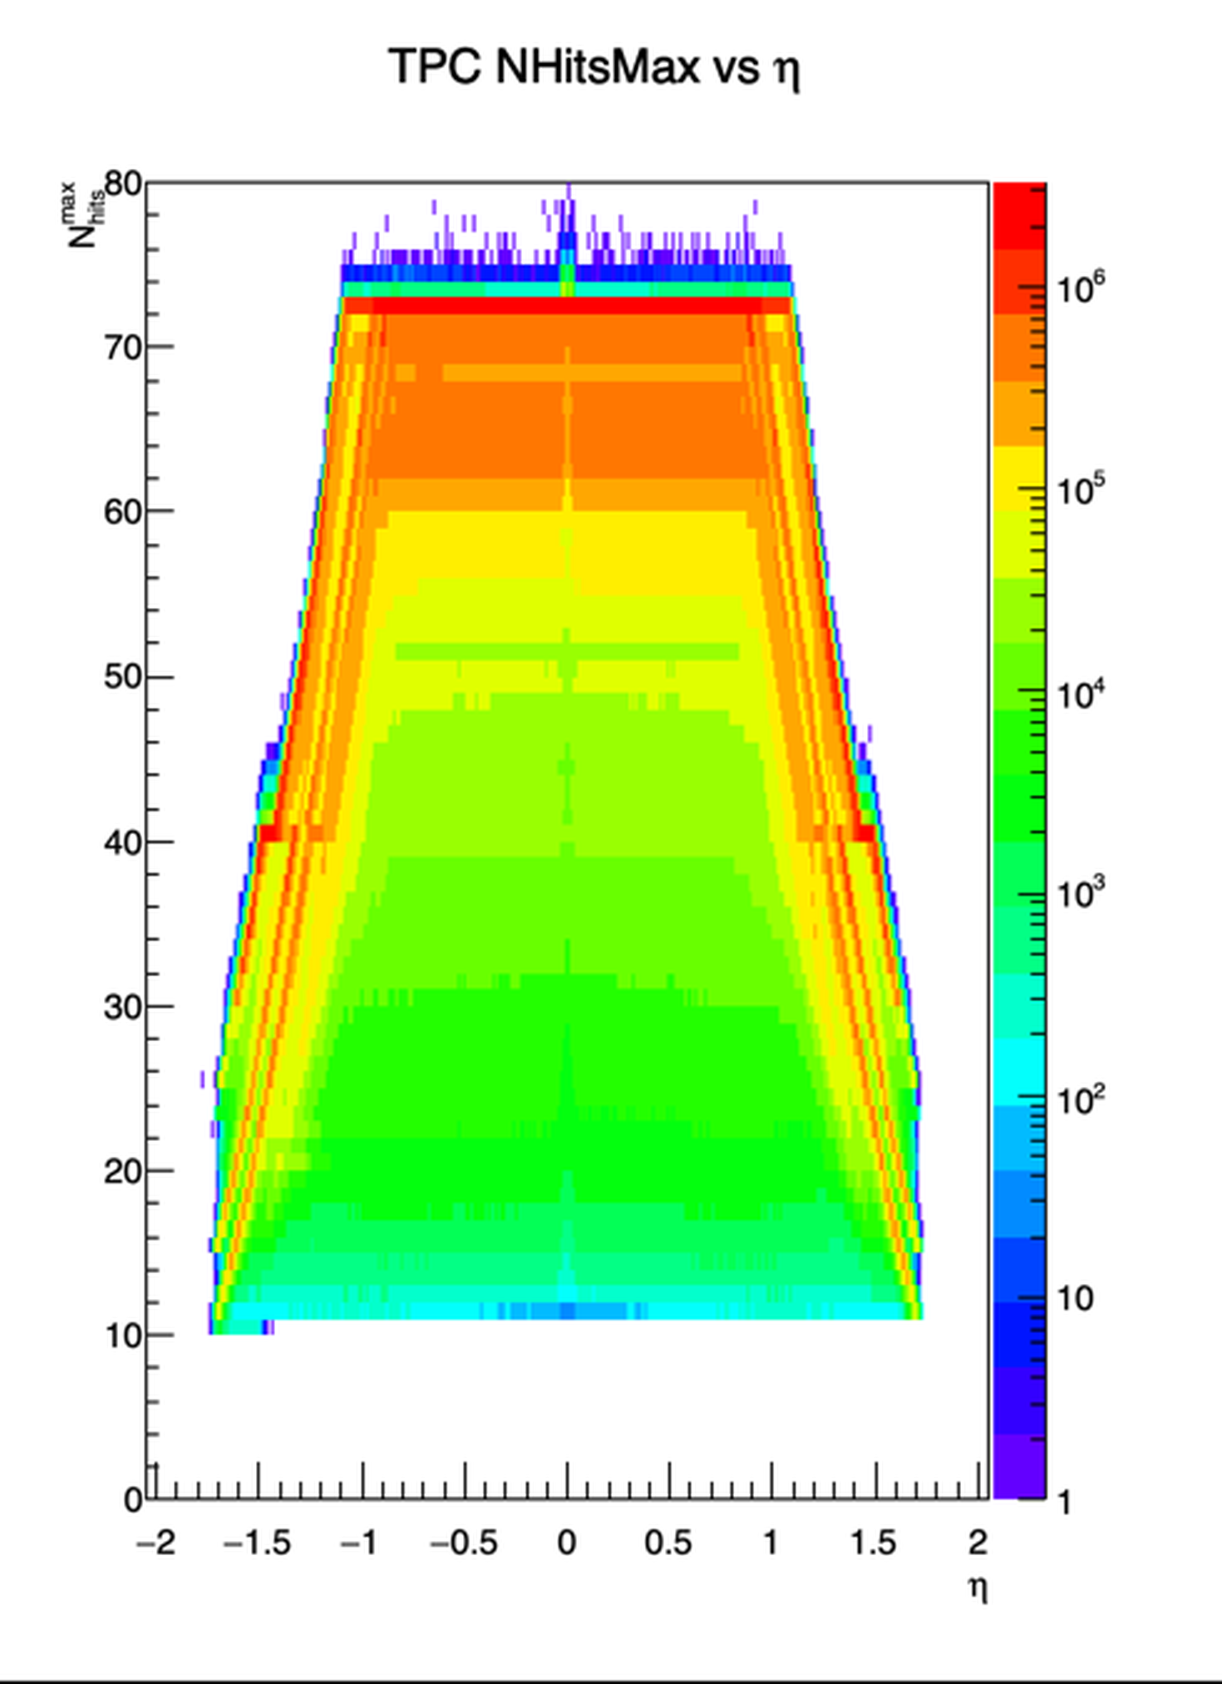
NHitsMax DEEP DIVE
What Are the Diagonal Streaks?
Leading Hypothesis
A small number of fixed TPC structural crossings (e.g. field-cage support ribs), each smeared from a vertical line into a diagonal streak by track curvature -- opposite-charge tracks bend oppositely, so they should cross the same boundary at a shifted eta.
Zoomed trapezoid edge: streaks beyond the ceiling line.
Do you know of specific TPC structural features in this eta range -- beyond the corner and inner/outer boundary -- that could explain 2-3 distinct crossings?
Andrew Liggett • July 23, 2026
8

Slide 9
FOLLOW-UP
Charge-Split Test: Confirming the Streak Hypothesis
1.
Charge-split histograms added
eta_nHitsMax_chargePlus/chargeMinus added to PicoBinner.cxx and pushed to GitHub -- splits the NHitsMax ceiling by track charge sign to test the curvature hypothesis.
2.
Pending: SDCC rebuild + rerun
Rebuild bin/PicoBinner_cxx.so on SDCC, resubmit the PION job, then run CompareNHitsMaxByCharge.C locally -- if the streaks separate in eta between charge signs, that confirms curvature-driven boundary crossing.
Andrew Liggett • July 23, 2026
9

Slide 10
NEXT STEPS
Spectra Corrections Complete -- Next: mT-m0 Cuts
1.
Determine mT-m0 cuts
Next step is picking the mT-m0 range for the finalized spectra fits, for pion, kaon, and proton alike.
Andrew Liggett • July 23, 2026
10

