Slide 1

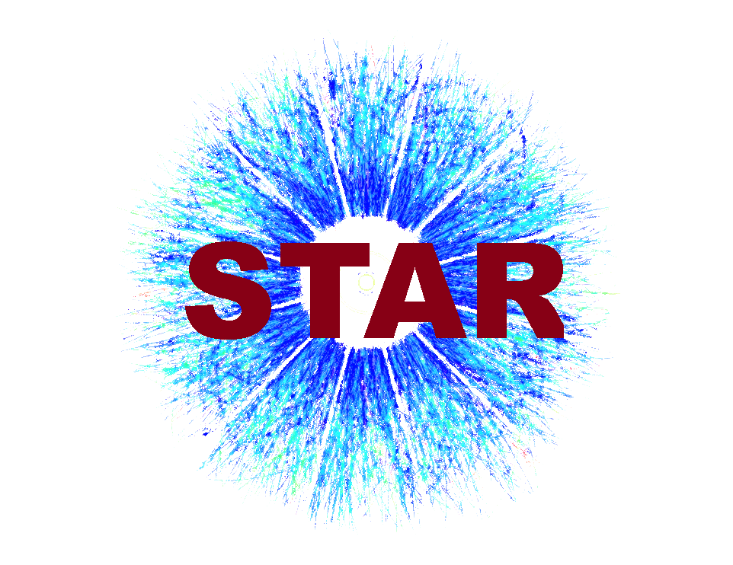
NPG GROUP MEETING • WEDNESDAY, JULY 15, 2026
π/K/p Spectra Analysis
Status Update: O+O Collisions & Space Radiation Physics
Andrew Liggett

Slide 2
THIS WEEK'S UPDATES
Summary of Key Updates
1.
Centrality: 6-bin scheme
Six bins: 0-5%, 5-10%, 10-20%, 20-40%, 40-80%, 80-100%.
2.
Track quality: NHitsFit & NHitsMax QA
NHitsFit cut lowered to 10 (from 20) in order to recover forward tracks; restored the graduated split-track cut (fitMaxRatio=0.52), fixing an all-or-nothing integer-division bug found via QA.
3.
DCA & vertex: tightened cut under test
DCA tightened to 1cm to better match the TPC's own ~1mm DCA resolution; the radial (XY) vertex cut was also tightened, from 2cm to 1cm.
Andrew Liggett • July 15, 2026
2

Slide 3
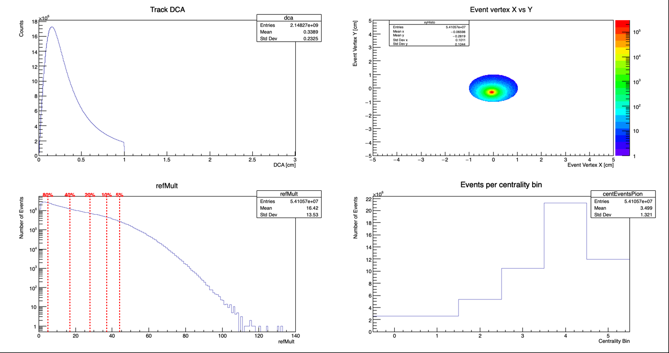
OUTPUT PREVIEW
Event QA: Vertex, Multiplicity, Centrality
Confirms the event sample looks reasonable before trusting any physics built on top of it.
Andrew Liggett • July 15, 2026
3

Slide 4
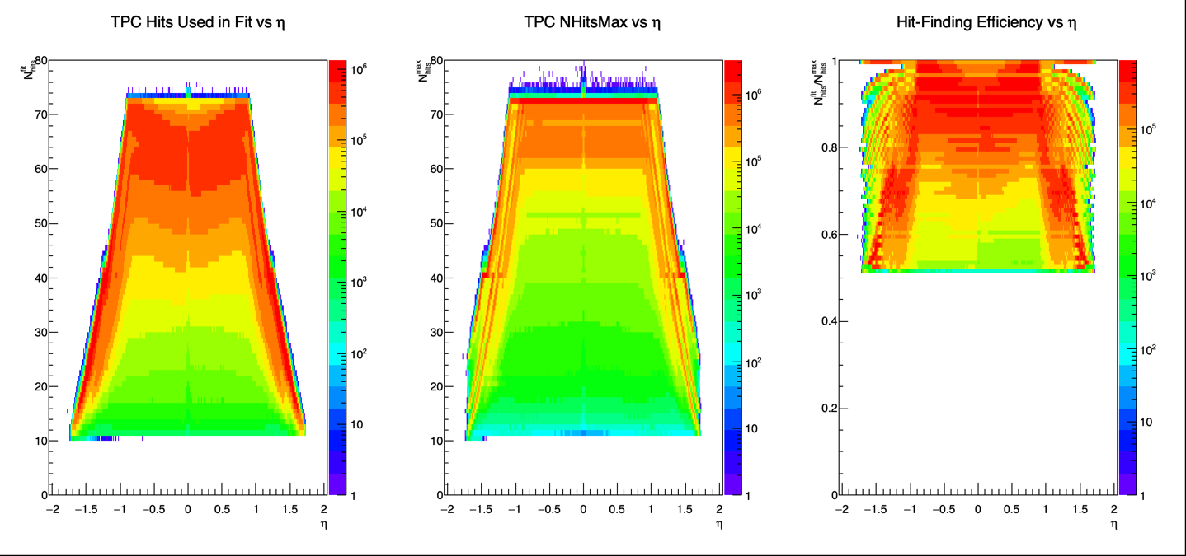
OUTPUT PREVIEW
NHitsFit, NHitsMax & Efficiency vs Eta
NHitsFit, NHitsMax, and their ratio vs eta -- isolates hit-finding efficiency loss from pure acceptance falloff.
Andrew Liggett • July 15, 2026
4

Slide 5
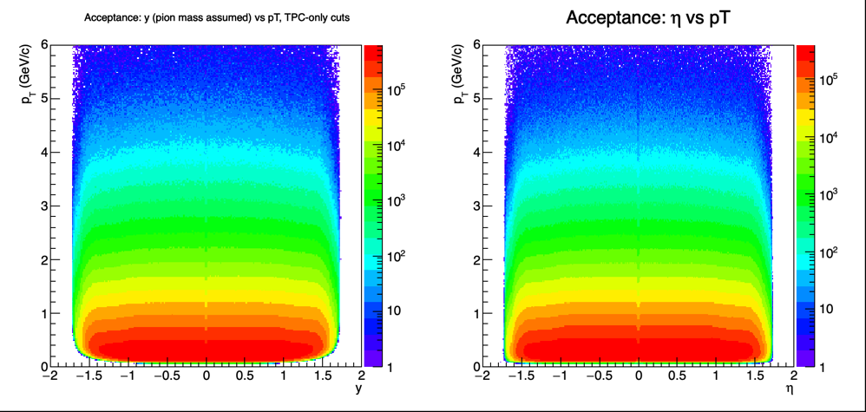
OUTPUT PREVIEW
Detector Acceptance: y & Eta vs pT
Shows where the detector has rapidity-pT coverage -- explains which fitted-spectra bins end up empty.
Andrew Liggett • July 15, 2026
5

Slide 6
NEXT STEPS
Finalizing Cuts & Moving to ZFitter
1.
Finalize track & event cuts
Polish up the current NHitsFit, fitMaxRatio, DCA, and radial vertex cuts in order to be finalized.
2.
Begin ZFitter spectra fits
Fit bin-by-bin in y and mT-m0: Gaussians for TPC dE/dx yields, Student's t distributions for TOF mass-squared yields.
Andrew Liggett • July 15, 2026
6

Slide 7
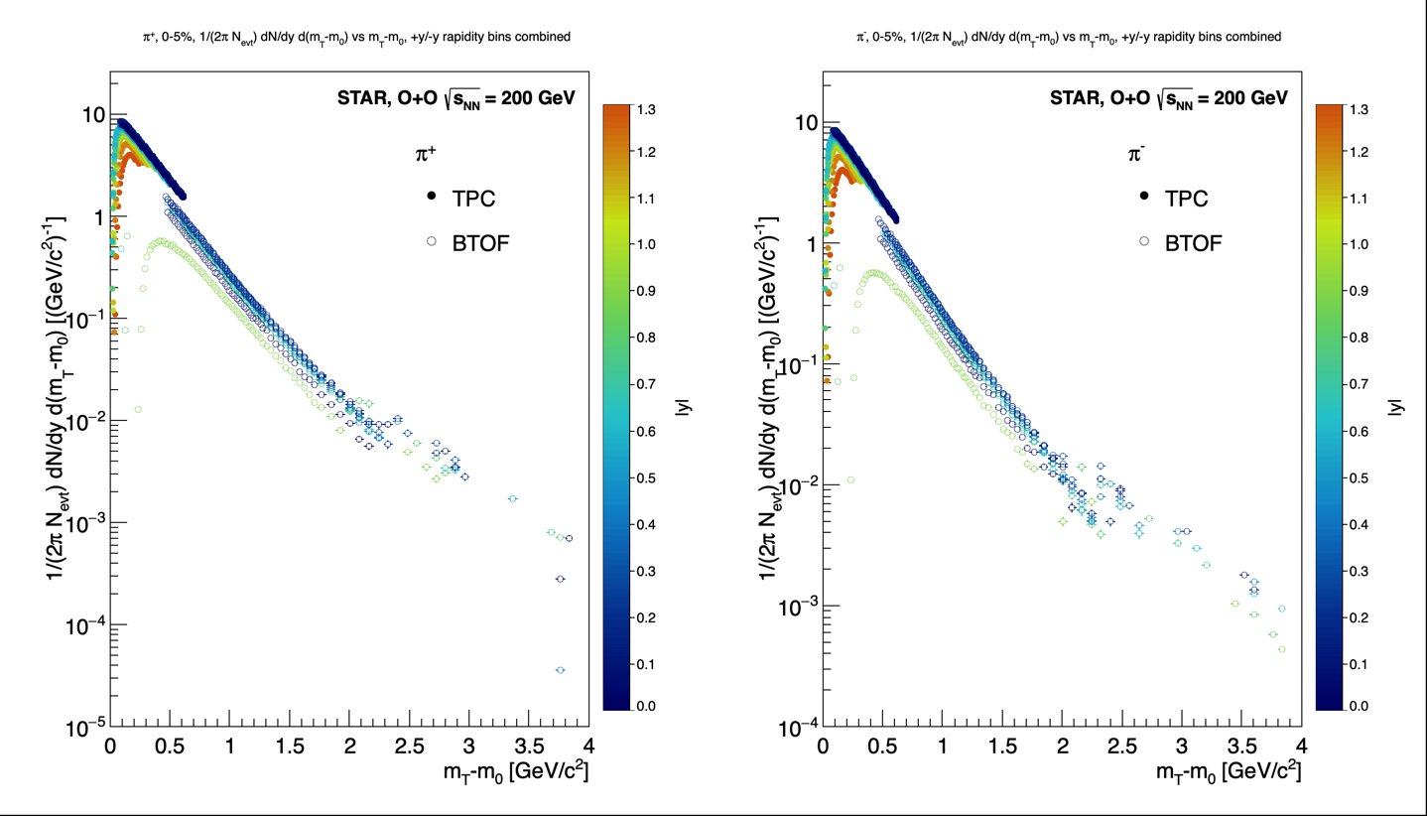
PION SPECTRA STATUS
Cut-Tuning Story: Where Things Stand
Tighter significance & χ²/ndf
Applied min significance ≥10σ and max χ²/ndf ≤10 — cleaned up most of the spectra.
Pion spectra, Cent00. Cuts: significance ≥10σ, χ²/ndf ≤10 (applied 2026-07-20).
Are these cuts (χ²/ndf ≤10, significance ≥10σ) good enough for finalized raw data, or is more tuning needed?
Andrew Liggett • July 20, 2026
7

