Slide 1
School Management System
Nurlybek Bekmukhanbet, Anna Belousova, Cezmi Aktepe
Humber College
Data Structure and Design Patterns - ITE-5231-RNA

Slide 2
OUTLINE
Diagrams
Execution
Summary

Slide 3
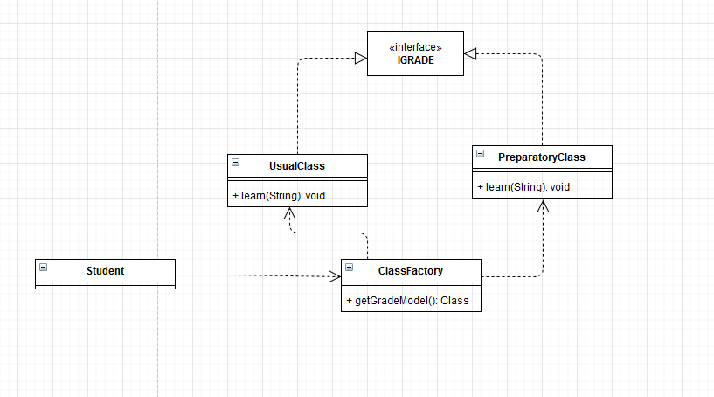
Acceptance of a new student to the school. Check the grades and behavior. If grades are not good then enroll in the preparatory group. (Singleton and Factory patterns, dictionary and ArrayList)
1

Slide 4
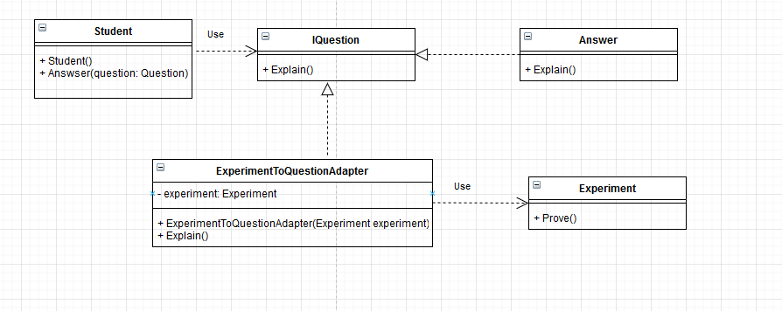
Participate in competitions. For example, the competition consists of 2 stages. The first stage is the scientific part where you need to answer questions, the second is the proving part where student need to prove the question . Here we use the Adapter Pattern.

Slide 5
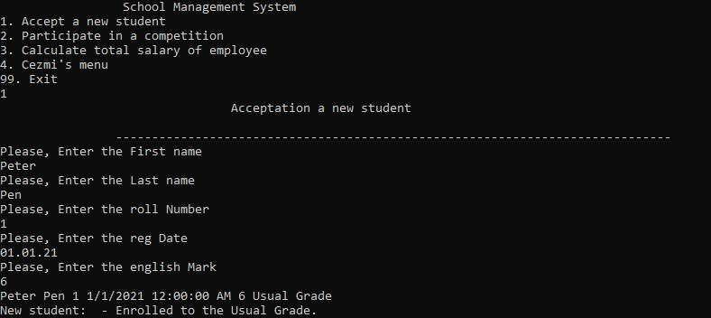
Execution.
Here we used factory method to get the grade for the student and singleton for that grades. Used ArrayList to store the current student data.

Slide 6
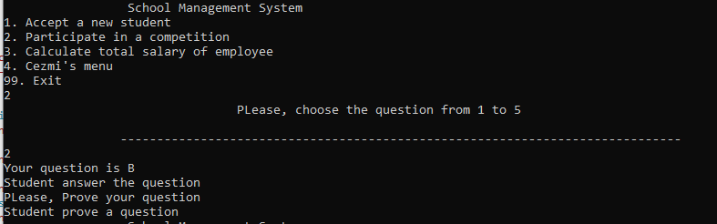
Adapter Pattern used to prove the question. Student could explain but with adapter student could prove the question. Here we used dictionary for the questions.

Slide 7
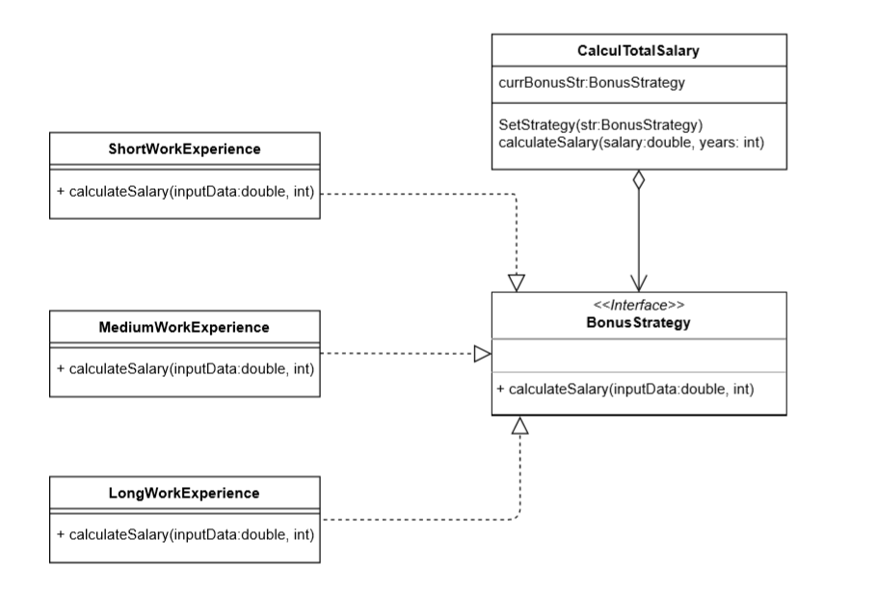
2
Strategy Pattern
Strategy Pattern used for calculation the total salary of employee. The user have to provide the name of employee, salary rate and hire date. The first it will count the total work experience of employee(SYSDATE –hire date), from which will depend the bonus of current employee. We have three strategy of calculation, also we apply the Dictionary and List data structure.

Slide 8
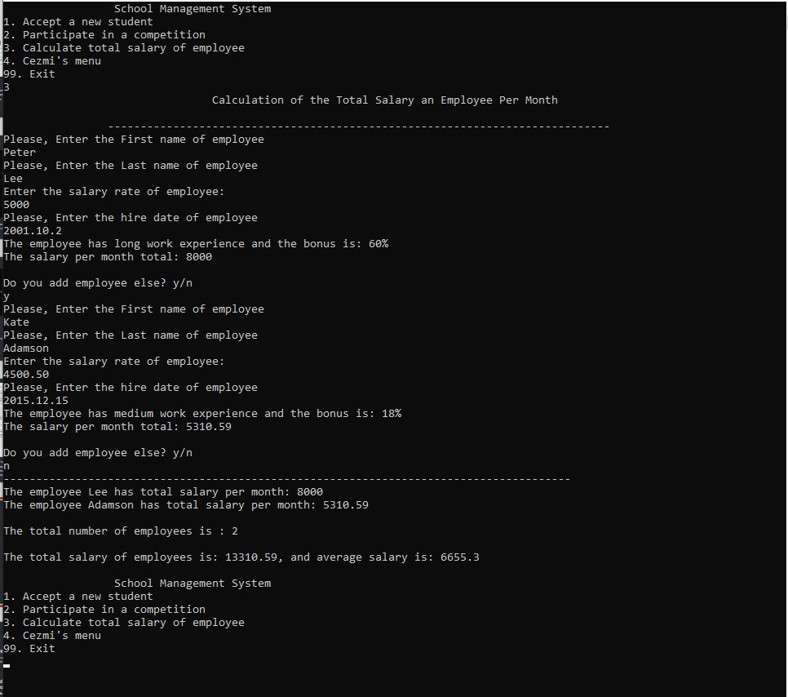
.

Slide 9
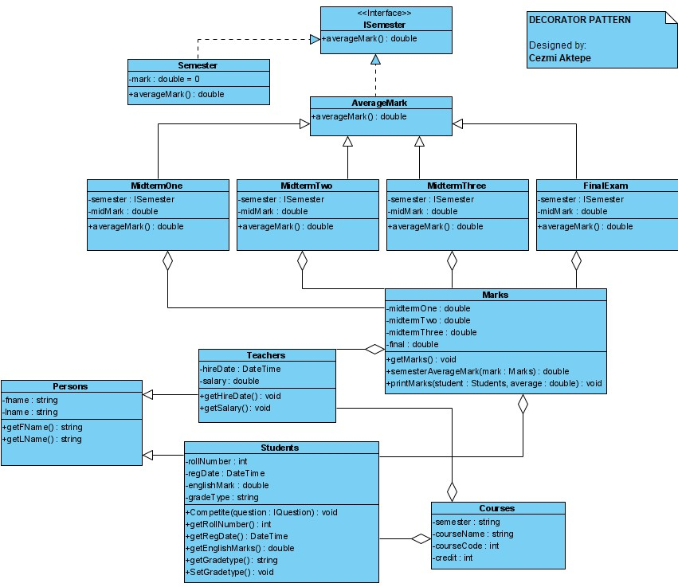
This pattern is used to calculate average mark of a student in one course.
It includes various classes and an Interface.
This module collects input data from user and calculate average mark.
It automatically displays the average mark
3
Decorator Pattern

Slide 10
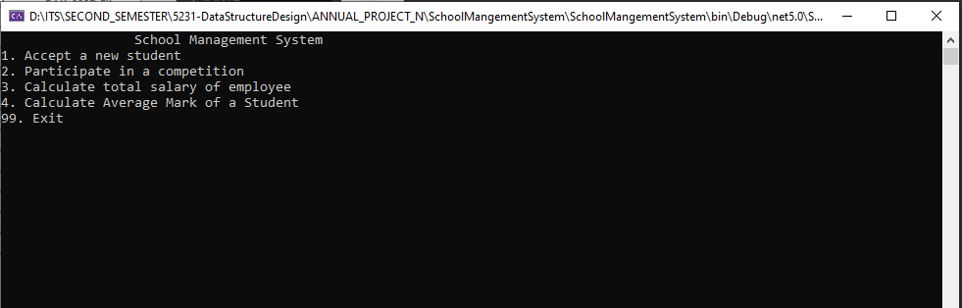
The app asks user to select one of the options

Slide 11
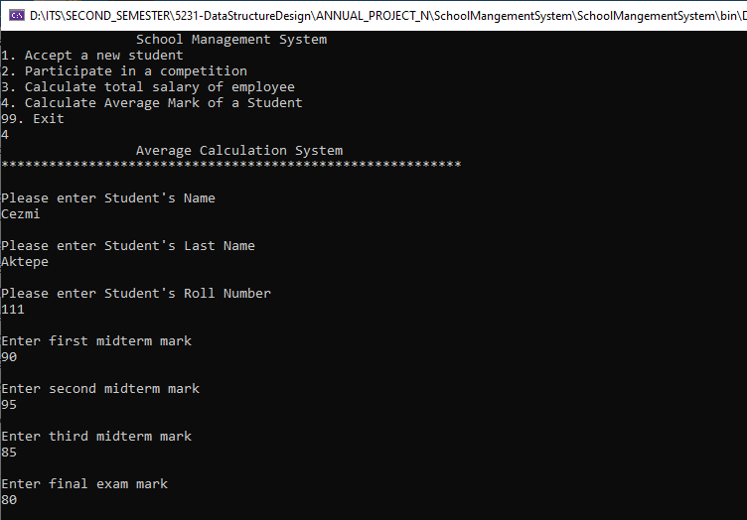
If user selects 4 , the Average Calculation System will be executed.
This system will ask some data input from user.

Slide 12
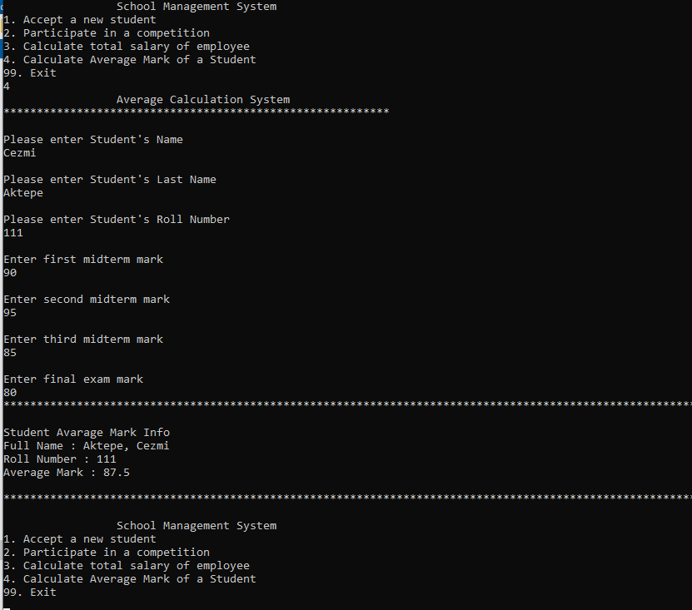
After collecting all data, The app will calculate the average and display a proper message to the users.

Slide 14
Summary
Factory and Singleton Patterns
Used to get Grade for the new Student.
Adapter Pattern
Used to prove the question when student participated in the competition.
Dictionary
Used to store question numbers and questions.
ArrayList
Used to store Student’s data.
Decorator Pattern
Used to calculate average mark of a student.

