Slide 1
School Management System
Nurlybek Bekmukhanbet, Anna Belousova, Cezmi Aktepe
Humber College
Data Structure and Design Patterns - ITE-5231-RNA

Slide 2
OUTLINE
Diagrams
Execution
Summary

Slide 3
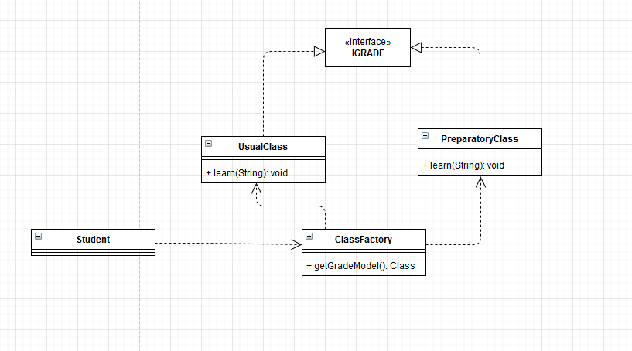
Acceptance of a new student to the school. Check the grades and behavior. If grades are not good then enroll in the preparatory group. (Singleton and Factory patterns, Dictionary and ArrayList)
1
Factory, Singleton Patterns

Slide 4
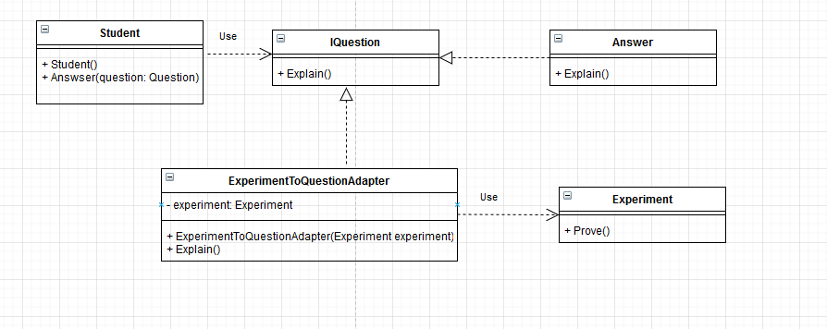
Participate in competitions. For example, the competition consists of 2 stages. The first stage is the scientific part where you need to answer questions, the second is the proving part where student need to prove the question . Here we use the Adapter Pattern and Dictionary as well.
Adapter Pattern

Slide 5
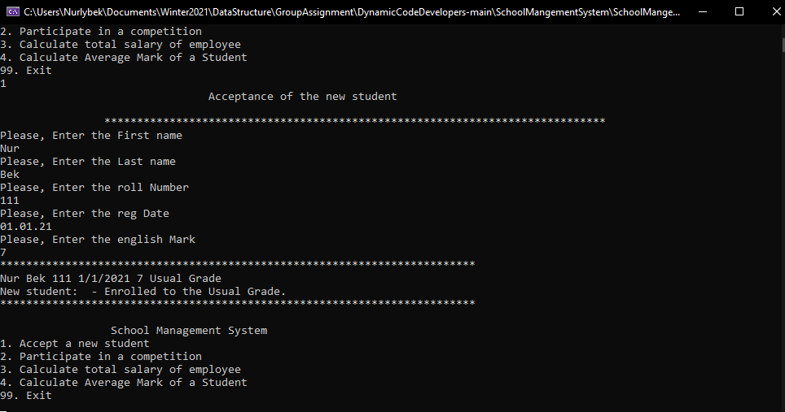
Execution.
Here we used Factory method to get the grade for the student and Singleton for that grades. Used ArrayList to store the current student data.

Slide 6
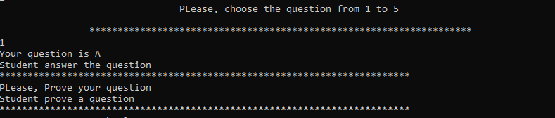
Adapter Pattern used to prove the question. Student could explain but with adapter student could prove the question. Here we used dictionary for the questions.

Slide 7
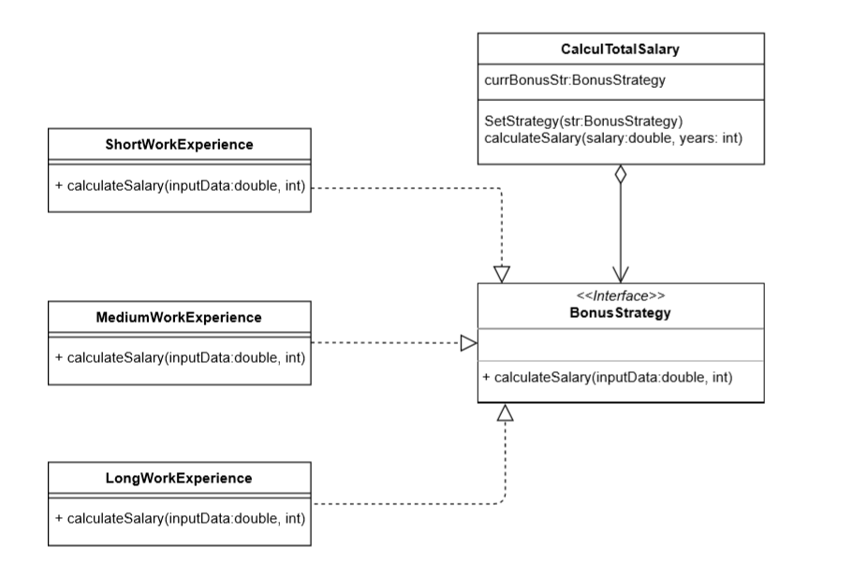
Strategy Pattern used for calculation the total salary of employee. The user have to provide the name of employee, salary and hire date. The first it will count the total work experience of employee(SYSDATE –hire date), from which will depend the bonus of current employee. We have three strategy of calculation, also we apply the Dictionary and List data structure.
2
Strategy Pattern

Slide 8
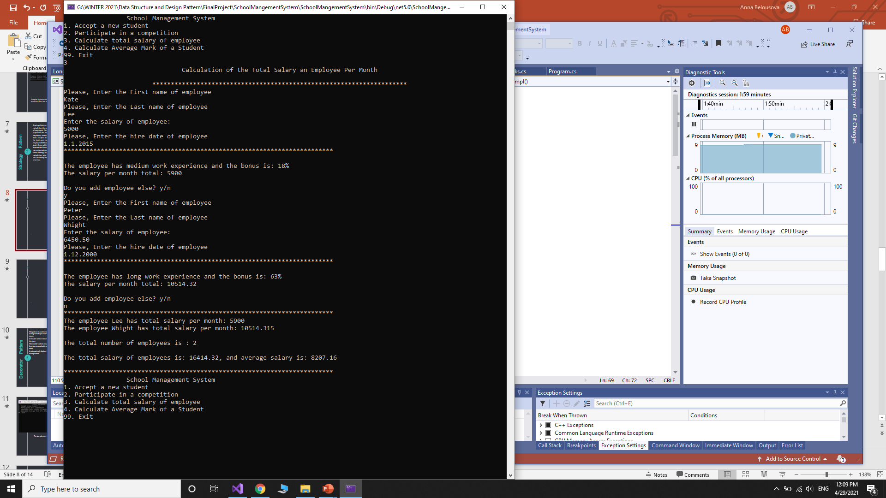
If the user’s choice is 3, the program will ask to enter information about the employee, salary, and hire date, and after it will display the bonus (which will be calculated based upon the hire date) and total salary of the employee. Then, the program will offer to add employee yet.

Slide 9
After adding employees it will display the list of employees with total salary(we used Dictionary in this case), the total salary of all employees, and average salary as well. For storing salary of each employee we have used the List.

Slide 10
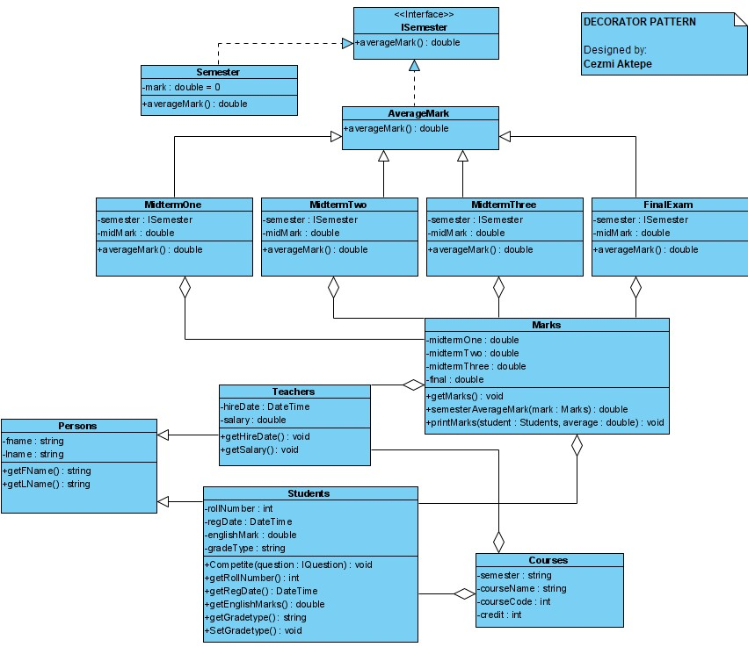
This pattern is used to calculate average mark of a student in one course.
It includes various classes and an Interface.
This module collects input data from user and calculate average mark.
It automatically displays the average mark
3
Decorator Pattern

Slide 11
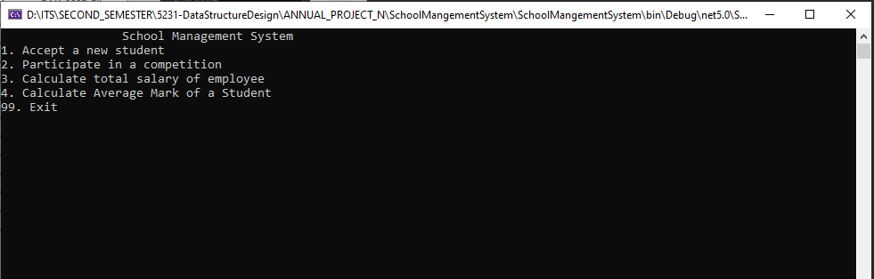
The app asks user to select one of the options

Slide 12
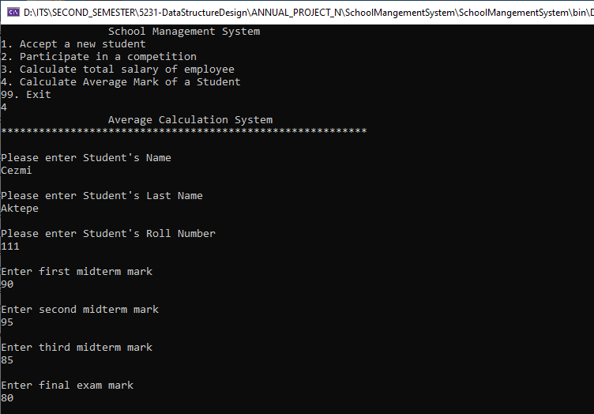
If user selects 4 , the Average Calculation System will be executed.
This system will ask some data input from user.

Slide 13
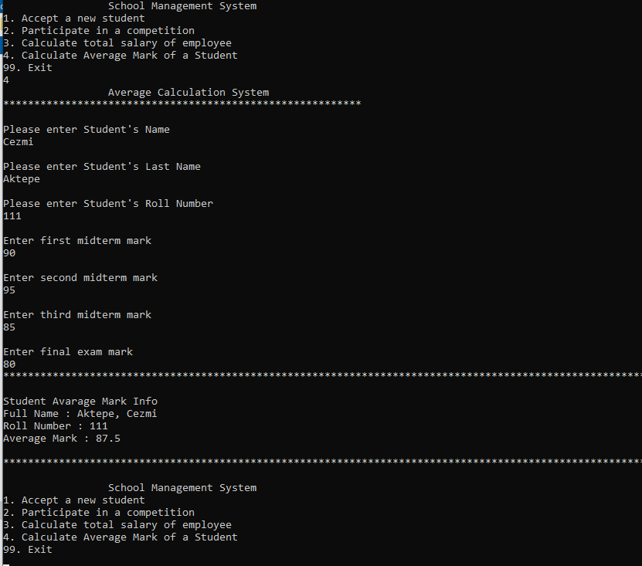
After collecting all data, The app will calculate the average and display a proper message to the users.

Slide 14
Summary
Factory and Singleton Patterns
Used to get Grade for the new Student.
Patterns
Adapter Pattern
Used to prove the question when student participated in the competition.
Strategy Pattern
Used to calculate bonus and total salary of employees.
Decorator Pattern
Used to calculate average mark of a student.
Data Structure
Dictionary
1. Used to store question numbers and questions.
2. Used to store last name of employee(key) and total salary(value)
List
Used to store total salary of employees
ArrayList
Used to store Student’s data.
14

