Slide 1
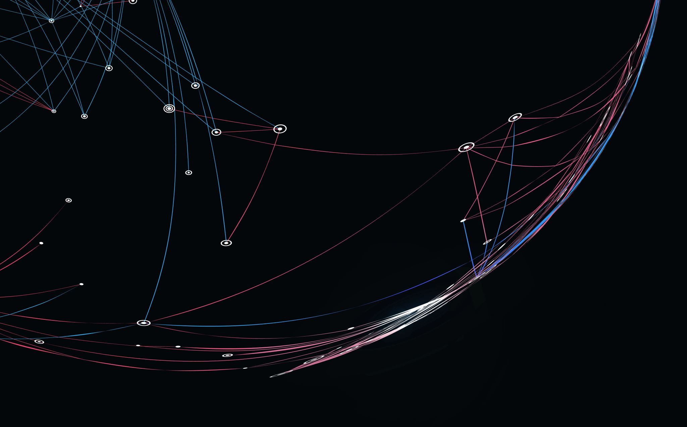
Using CnNs on X-rAys to DiAGNOSE COVID-19
By Nicolas Michellsi and Guangyu Zhang

Slide 2
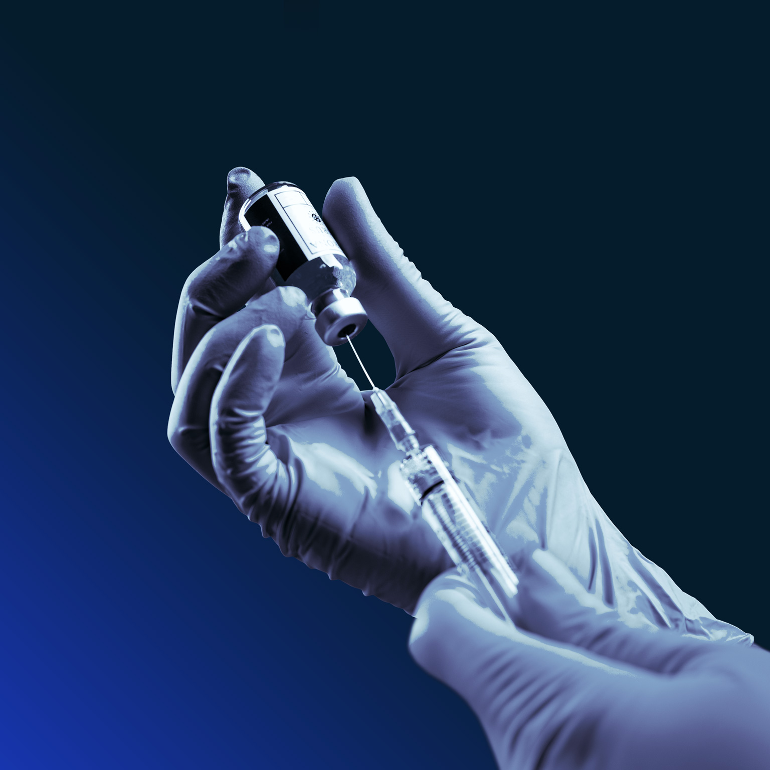
Problem and significance
More than 160 million COVID cases globally
Places enormous burden on hospital system
Efficient triaging of patients essential
Pneumonia and COVID-19 share similar symptom profile
Need effective form of discrimination in cases where direct testing is too slow

Slide 3
Goals
Develop a CNN to classify between normal, pneumonia and COVID-19 lungs

Slide 4
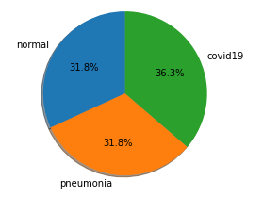
Data preparation
Train:
COVID Chest X-ray Dataset
Cov19 images (all of the images in this data set are used for train) (300)
Chest X-ray Dataset (Pneumonia)
Normal and pneumonia images (300 each)
0.2 for validation
Test:
Chest X-ray Dataset (Pneumonia)
Normal and pneumonia images (100)
COVID-19 Radiography Database
Cov19 images (100)
Classes in the train data

Slide 5
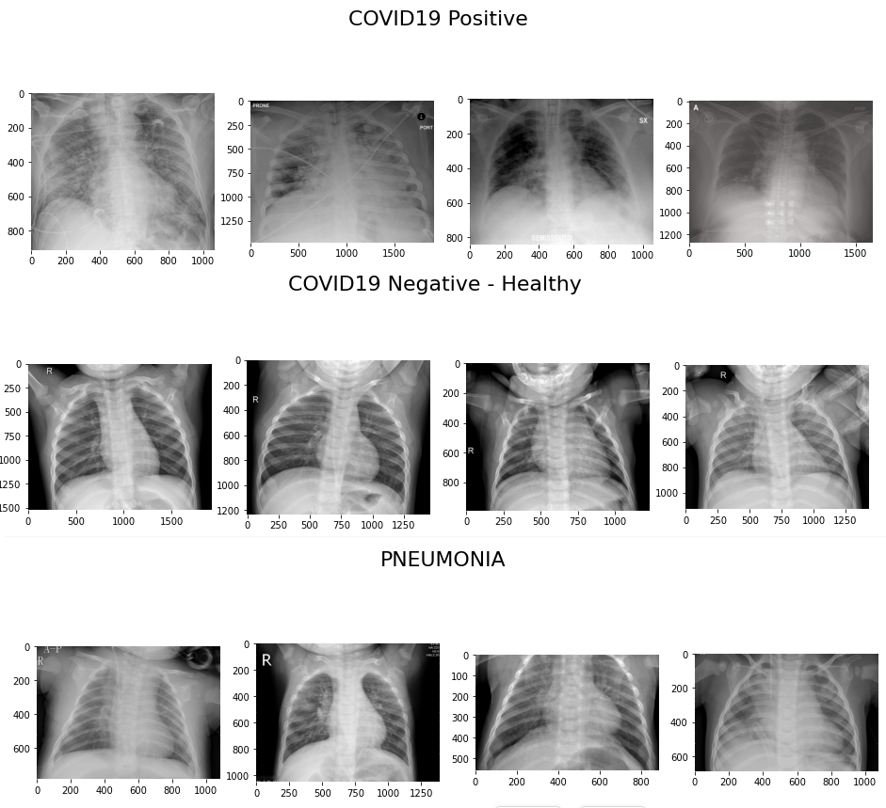
Data overview
To get a brief idea how data looks like:

Slide 6
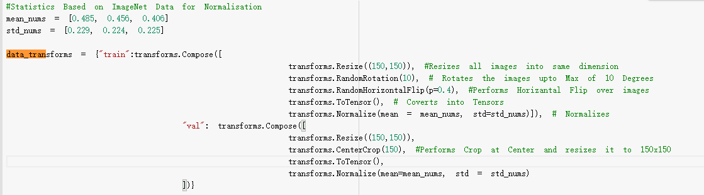
Data preprocess
For both training data and test data we resize images into 150*150 and centralize them.
For the training data, we do a random rotation and horizontal flip to make the images more general. (prevent the network learning irregularity)
For the test data, we do not rotate or flip the images.

Slide 7
Normalization is used to prevent the model facing vanishing gradients.
mean_nums = [0.485, 0.456, 0.406]
std_nums = [0.229, 0.224, 0.225]
This is a normally used value for mean and std for each RGB channel.
Ref: https://forums.fast.ai/t/is-normalizing-the-input-image-by-imagenet-mean-and-std-really-necessary/51338

Slide 8
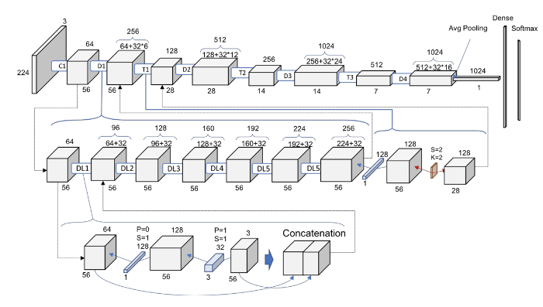
CNN Design choices
https://arxiv.org/pdf/1608.06993.pdf

Slide 9
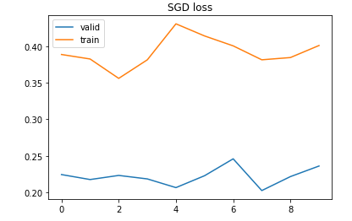
training
SGD
Batch size = 8
Epoch =10
Best epoch=8

Slide 10
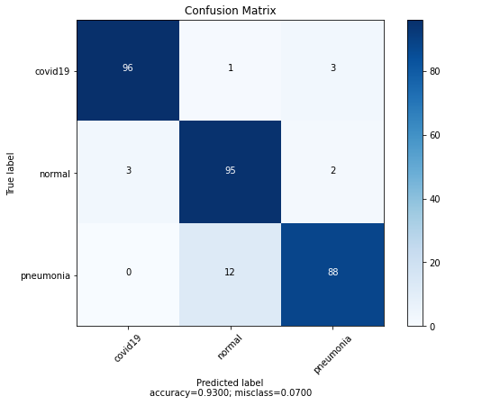
Network performance
print(classification_report(y_true_list, y_pred_list))
precision recall f1-score support
0 0.97 0.96 0.96 100
1 0.88 0.95 0.91 100
2 0.95 0.88 0.91 100
accuracy 0.93 300
macro avg 0.93 0.93 0.93 300
weighted avg 0.93 0.93 0.93 300

Slide 11
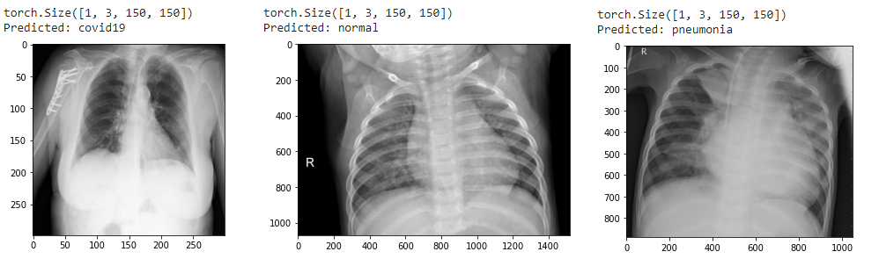

Slide 12
EXAMPLE Application

Slide 13
Model limitations

Slide 14
Limitations and ISSUES

Slide 15
Conclusions

