Slide 1
SMART IRRIGATION SYSTEM

Slide 2
Details Team Members
Sr. No. | Name | Degree program | Year | Institution
1 | Harshit | Mechanical engineering | 2020 | IIT Jammu
2 | Sauhaard Batra | CSE | 2020 | IIT Jammu
3 | Kshitij Gera | Mechanical engineering | 2020 | IIT Jammu
4 | Hardik Choudhary | Mechanical engineering | 2020 | IIT Jammu
5. | Ashutosh Chauhan | Electrical Engineering | 2020 | IIT JAMMU

Slide 3
The Problem
The irrigation system in India is more or less underdeveloped. It is natural that richer farmers will not compromise in investments for better crop yields, and the poor will try to find the cheapest way out, however, even then, the methods being employed do not deliver to their full potential, resulting in a loss of time and energy. The water distribution among the crops might not be equitable as well.
We are thus trying to develop a smarter irrigation system to minimise energy losses and water consumption along with optimising the water flow rate according to the requirement of the crops.
Along with this, we are adding a few additional tweaks which will detect both the presence of weeds on our field as well as the presence of birds which might damage our crop. This will make our system more versatile and further reduce the pressure on the farmers.

Slide 4
Idea
The traditional irrigation systems require the farmers’ attention at all times. This is an inefficient system and even then, the possibility of over-irrigation and under-irrigation remains which can ruin the healthy growth of the crop. Eventually, sensors were introduced for irrigation schedule and the innovation was largely successful.
However, irrigation scheduling using sensors is both a temporary and a costly solution. The sensors, as they are kept exposed to the outside environment, remain vulnerable to climatic factors as well as external interference from animals. Hence we decided to do the irrigation scheduling on an image-based algorithm. The camera which will be taking the pictures of the field will be cheaper as the wider scope of resolution will mitigate the requirement for multiple sensors. Aside from that, the camera will be placed on a movable platform and therefore will be less affected by external factors. Hence the system will have a longer life than the sensor-based system.

Slide 5
Target Market & Opportunity
This is where you tell the story about the scope and scale of the problem you are solving.
User segments: People involved in the agricultural sector
Geographical regions: The regions where water scarcity and lack of electricity become a serious hindrance to efficient farming methods, for example, Rajasthan.
Idea of potential market size – Nearly every farmer will get benefit from this product, Expected market size = 10 million.

Slide 6
WORK DONE
Dataset of soil moisture from images, we have 60 different images with the soil moisture
Model to detect the presence of bird from the image, which will be used to trigger the repelling system based on a certain “frequency”.
Model for irrigation scheduling, using xgboost with score of 0.94 . Dataset is taken from kaggle (trained for paddy)
Weather api is used to take temperature and humidity data.
Web app has been developed to display various parameters.
Detection of weeds for paddy.
PCB Consisting of sensors (not to be included in the final prototype)

Slide 7
DESCRIPTION OF DESIGN
The board will have the following devices:
a) Camera: A wide scale and high resolution camera which will capture images of crops over a big area. It will also detect the presence of unidentified crops and birds in the field, whose existence is a threat to the proper growth of the crop.
b) ESP32: To do communication, send signals through WIFI.
The structure will be mounted using 2 PVC pipes, each 5 m in length, separated by an approximate distance of 100 m. One nylon rope (100 m again) will join the upper ends of the two pipes. The board will be joined to the conveyor nylon rope using another nylon rope which will have free movement in the z direction because of an attached pulley. A DC motor powered by electromagnets will be attached to the end connecting the rope to the conveyor rope to allow for the free movement of the board along the x direction.
The overall structure will be place somewhat diagonally across the field to allow the camera to capture the crops in the maximum area.

Slide 8
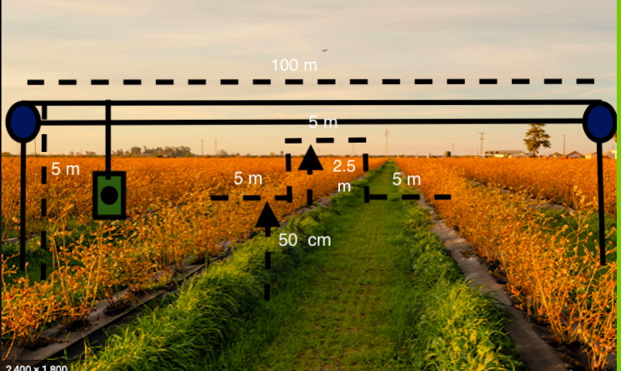
DESIGN OF PROTOTYPE ON FARM

Slide 9
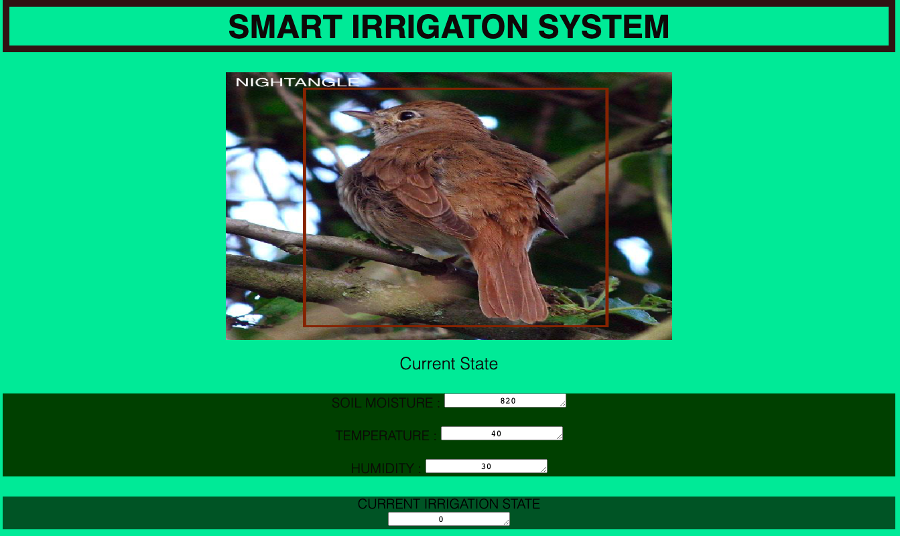
WEB APP

Slide 10
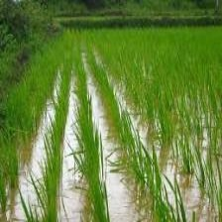
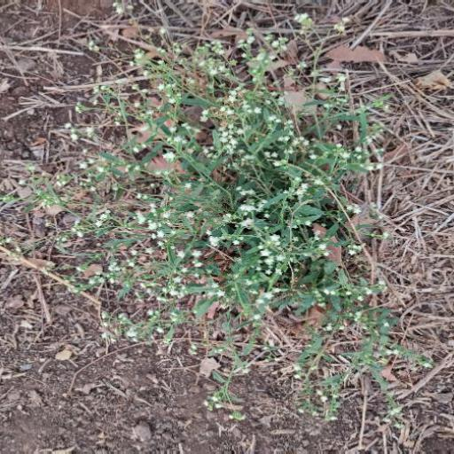
WEED DETECTION FROM RICE
Rice
Weed
THE LABELS ARE FROM MODEL, THAT WE HAVE TRAINED

Slide 11
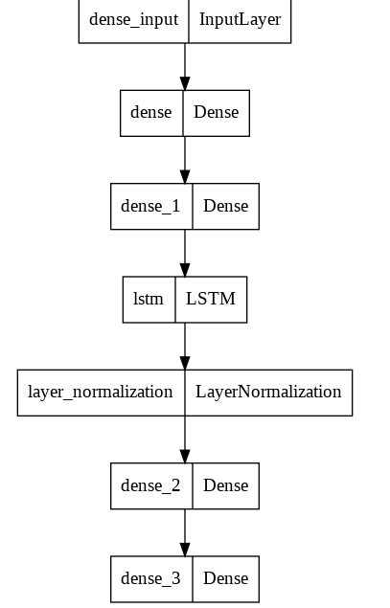
IRRIGATION SCHEDULING MODELS
Xgboost
SVMs
LSTM Based Architecture

Slide 12
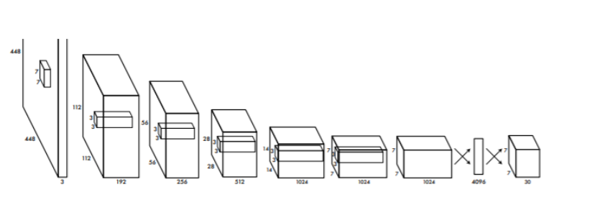
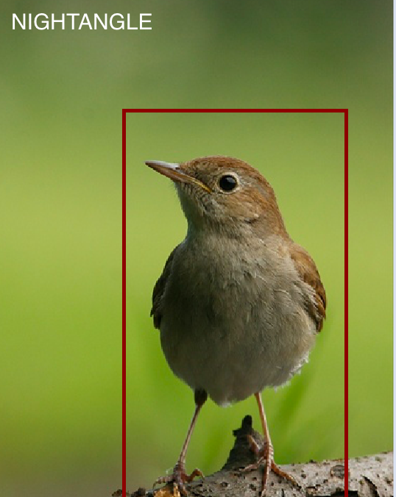
YOLO-V5 TO DETECT BIRDS

Slide 13
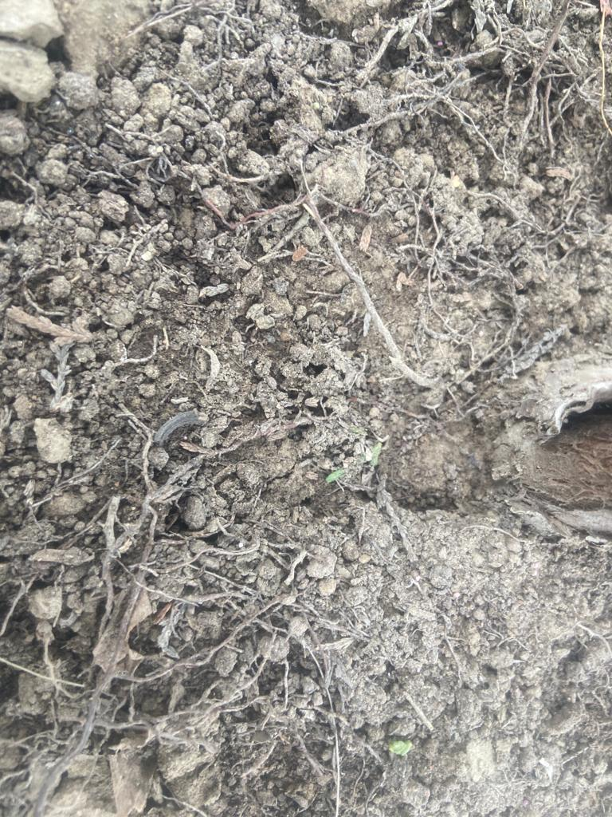
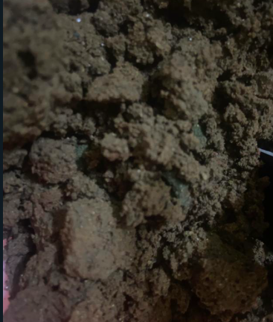
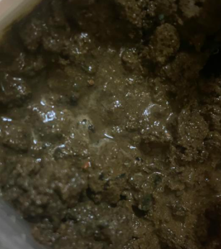
DETECTING SOIL MOISTURE FROM IMAGES
A neural network was trained, to predict soil moisture from different images.
Soil_moisture: 1 (Low) Soil_moisture : 2 (Mid) Soil_moisture: 3 (high)

Slide 14
Additional Work Yet To Be Undertaken in future
Data Collection for the following :
Soil Moisture for images
Bird Repelling
Irrigation Scheduling
Irrigation and harvesting of the farm based on the leaf moisture.
This project is giving satisfactory results according to batch scale. However, we plan to continue working on it so that we can scale up the solution to commercialize it and make it more feasible for the farmers. We also plan on developing a frequency-based bird-repelling device from the dataset we have.

Slide 15
Challenges Faced
Weed detection is only possible for two rows of a plants; one directly in front and one directly behind the conveyor belt . As the camera is constrained to move only in the xz plane (above/below the plane and along the length of the field), hence the weed detection, which is being done by inputting the images of the crops, will be done for only the row which the camera is observing, and not the other rows.
We were unable to prepare a sufficient irrigation scheduling dataset because of lack of expertise in the field of horticulture and lack of time.
We are assuming that the conveyor belt we will be setting up will be resistant to wear and tear.
We will be developing a system for repelling the birds which will emit sounds based on the frequency which they despise. However, a very limited dataset is available for bird repelling.

