Slide 1
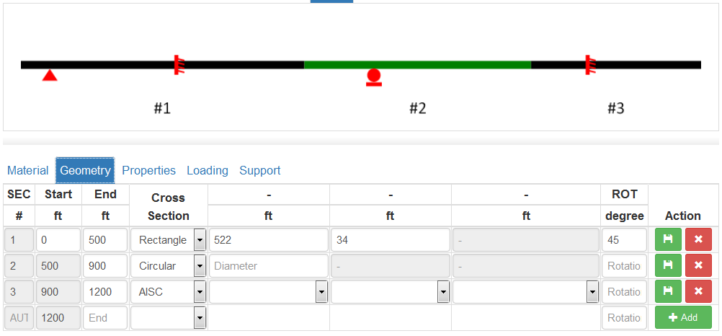
Beam_analysis – data processing
Z
Y
X

Slide 2
Input (provided): four db tables:
ba_g,
ba_mat,
ba_loading,
ba_spt
el_max: maximum element length
Get all rows for each db table using given value for field “userscalcPK” = 104 (i.e.),
Save all retrieved data to an array $data with “geometry”, “material”, support”, and “loading”.

Slide 3
Output:
array $nodes having fields: id, x, y, z.
id: the Node ID;
x/y/z, the x/y/z coordinates of an node. y/z=0 in this case.
Needs to log nodes from the given db tables and generate nodes by dividing sections defined between two nodes.
array $ele having fields: id, node_s, node_e, PK4ba_mat, PK4ba_g
Id: the element id – one element connecting two nodes;
Node_s, Node ID of the starting node of the element;
Node_e: Node ID of the ending node of the element;
PK4ba_mat : the value of the field matID in ba_g which is the primary key value of ba_mat;
PK4ba_g: the value of the field rcdNo in ba_g

Slide 4
Output:
array $loading having fields: id, fx, fy, fz, mx, my, mz
id: the node ID;
fx / fy: 0
fz:
Case “geometry” = “Point” and “type” = “Force”, fz = startValue for id (node ID) whose x = startLocation;
Case “geometry” = “Distributed” and “type” = “Force”, fz = see LAST pages
mx / mz: 0
my:
Case “geometry” = “Point” and “type” = “Moment”, my = startValue for id (node ID) whose x = startLocation;
Case “geometry” = “Distributed” and “type” = “Moment”, my = see last pages.
Mx / mz: 0

Slide 5
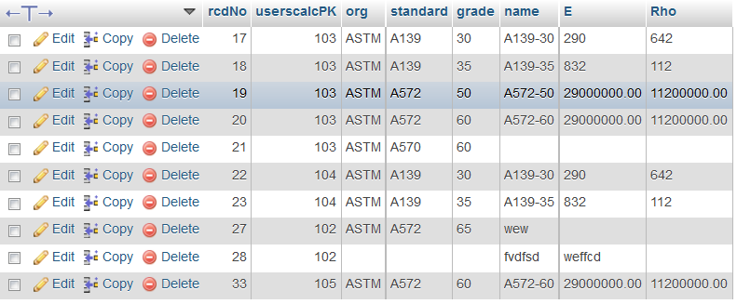
ba_mat

Slide 6
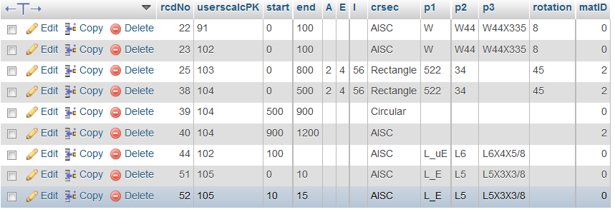
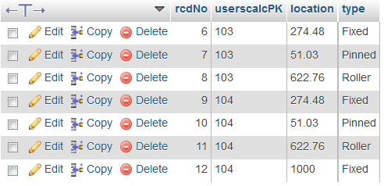
ba_g
ba_spt

Slide 7
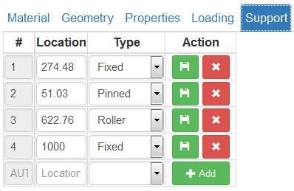
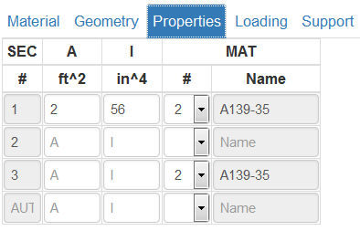
Every “start” and “end” should be a node;
- db table: ba_g
Every support “location” should be a node;
- db ba_spt
Z
Y
X

Slide 8
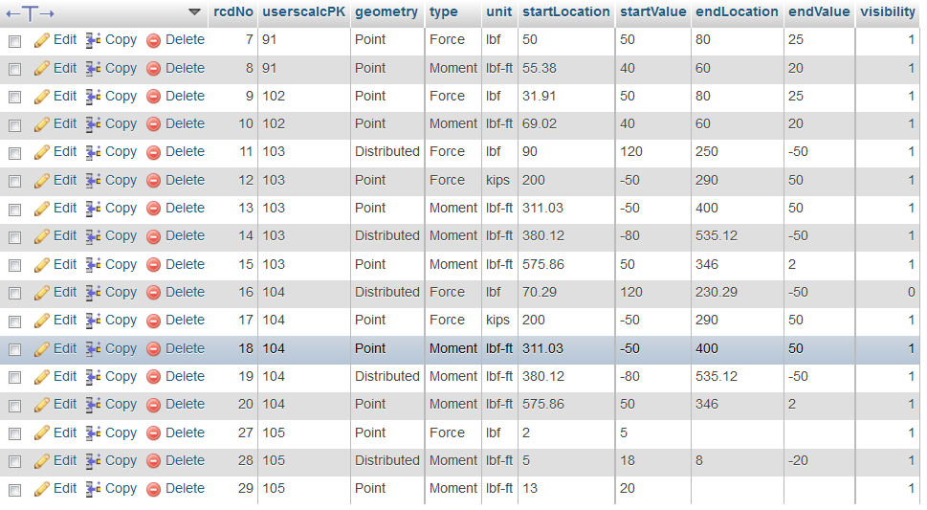
ba_loading

Slide 9
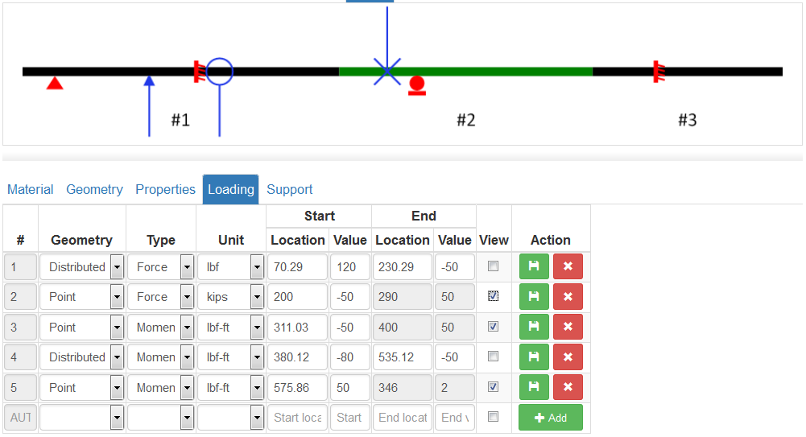
Between given/known locations (HARD NODE locations) where a node is a must, equally divide sections between HARD NODES into many small sections so that the length of each section is less or equal to given “el_max” . If the length between HARD NODES is less than “el_max” , then no need to divide.
Z
Y
X
The Start/End Locations of loading with Geometry = Distributed, Type = Force / Moment are HARD NODES as well.

Slide 10
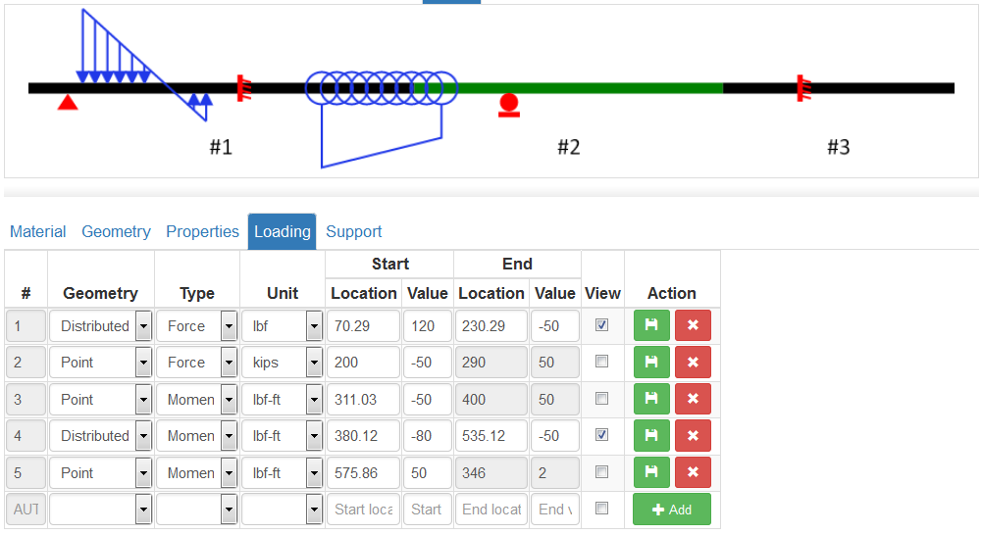
Z
Distributed Force
Y
X
Distributed Moment

Slide 11
HARD NODES are nodes at locations along the beam where they are:
Start and End of a beam section;
Start or End of a distributed loading;
Location with value = zero of a distributed loading;
Supports
loading point of point forces/moments
The coordinates of most HARD NODES (except the cross NODE of distributed loading with opposite values at two ends) are given in the provided db tables.
HARD NODES

Slide 12
Equally divide into sections so that the length of sections is less than or equal to “el_max”
Need to consider the case having a Point Force/Moment OR support located within Distributed Force/Moment
v2
v1
b
For Distributed Force, if the start and end values are of different sign, there will be a ZERO node – need to find that node’s location
x1
a
x2
X3/N = l_sec <= el_max
x3
l_sec = X3 – x2 = x2 – x1 <= el_max
v1 = b + (a-b)/x3*x1
v2 = b + (a-b)/x3*x2
Ma = (a - (a-b)/x3 * l_sec/4)* l_sec/2
M2 = v2*l_sec
M1 = (v1 + (a-b)/x3 * l_sec/4)* l_sec/2
+ (v1 - (a-b)/x3 * l_sec/4)* x1/2
Mb = (b + (a-b)/x3 * x1/4)* x1/2
Ma + M2 + M1 + Mb = (a + b)*x3
$loading

Slide 13
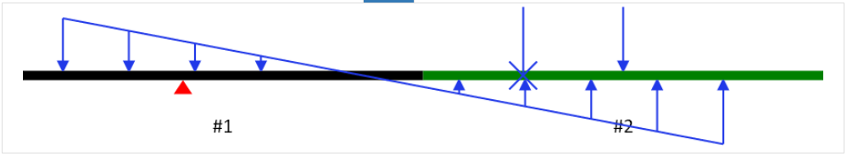
HARD NODES
Sections between neighboring HARD NODES
Equally divide each section between two neighboring HARD NODES into multiple sections so that the length of sub-sections between all neighboring HARD NODES is less than or equal to given “el_max”
If the distance between two neighboring HARD NODES is less than “el_max”, no division is needed.

Slide 14
Suggested logic steps:
Find all HARD NODES and create elements connecting neighboring nodes
Beside all HARD NODES explicitly defined in the db tables, need to loop through all distributed loading: Distributed Force/Moment by checking if it has opposite signs at start and end.
Loop through all elements defined by HARD NODES, determine the length of each element,
If the length > el_max, equally divide the element into several sections until the length of each section is <= el_max
Logging the support on nodes
Logging the point load on nodes
Loop through all Distributed Force/Moment
Find the nodes for the start and end locations of the Distributed Force/Moment
Determine the FZ - foce (MY - moment) of all nodes from start to end.

Slide 15
HARD NODES: N1, N3
NODES by division: N2
f1, f3 is known.
Objective: to discretize distributed loading to concentrated loading at NODES.
N1
N2
N3
N4
el12
el23
el34
f4
f3
f1
f2
N1
N2
N3
V3
V1
V2
V1/2/3 is fz or my for each node in $loading array

Slide 17
