Slide 1
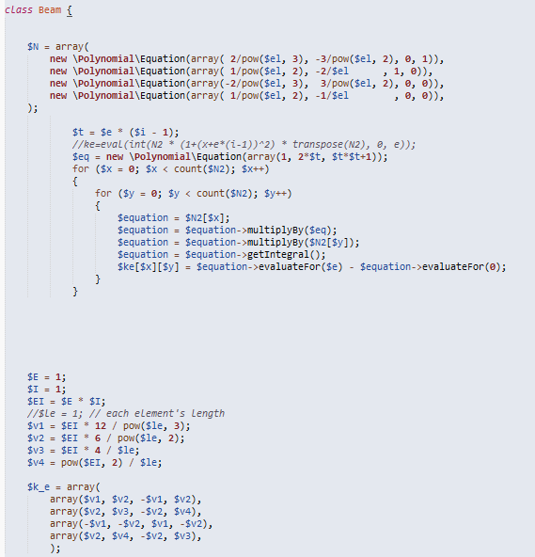
There are two different approaches to get the “ke” – a matrix for each single beam element connecting two nodes. Returned variabel is ke for current element.
$el is the length of each beam element.
$E and $I are to be determined using PK4ba_mat and PK4ba_g by reading tables: ba_mat and ba_g

Slide 2
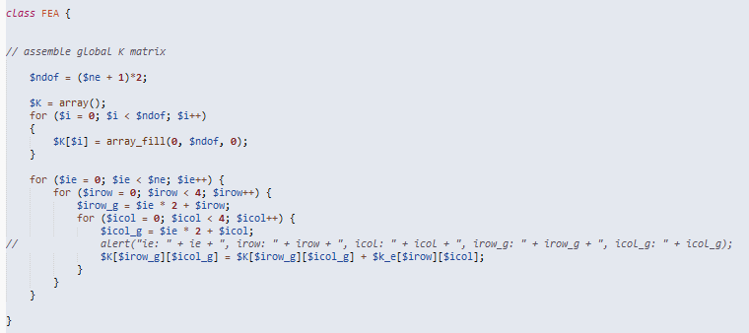
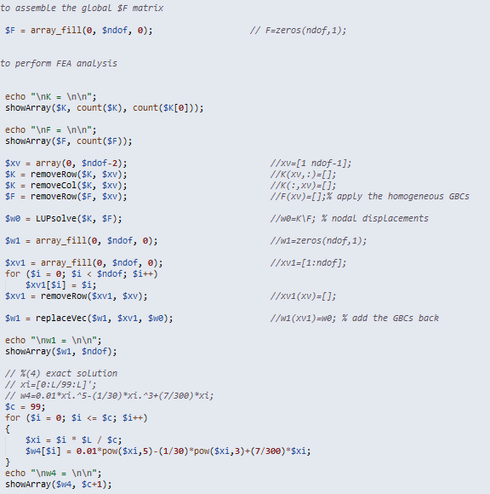
F basically is putting the $loading’s values together in one column, fx, fy, fz, mx, my, mz for each node one after another
Do not worry about this part now, just get matrix K and vector F ready.
This part is to assemble the ke for all elements together to get the global K for the whole beam.
K*X = F ➔ X = K\F

