Slide 1
Machine Learning with TensorFlow
https://github.com/lightcycle/MachineLearningWithTensorFlow
Mike Davis (mike.davis@asynchrony.com)

Slide 2
What is Machine Learning?
Methods for finding structure in or making predictions from data without explicitly programmed logic
Examples:
  Image classification
  Speech to text
  Natural language processing
  Spam detection
  Recommendation engines
We’ll focus on supervised learning, finding predictive functions that fit provided input and output data

Slide 3
Components of a Supervised Learning Solution
Supervised learning setups commonly include these components:
A model function mapping inputs to outputs, including configurable parameters that alter how the model works.
A loss function that quantifies how accurate the model is for given parameters, inputs, and outputs
An optimization algorithm that repeatedly tweaks the parameters and evaluates the loss function to improve the accuracy of the model

Slide 4
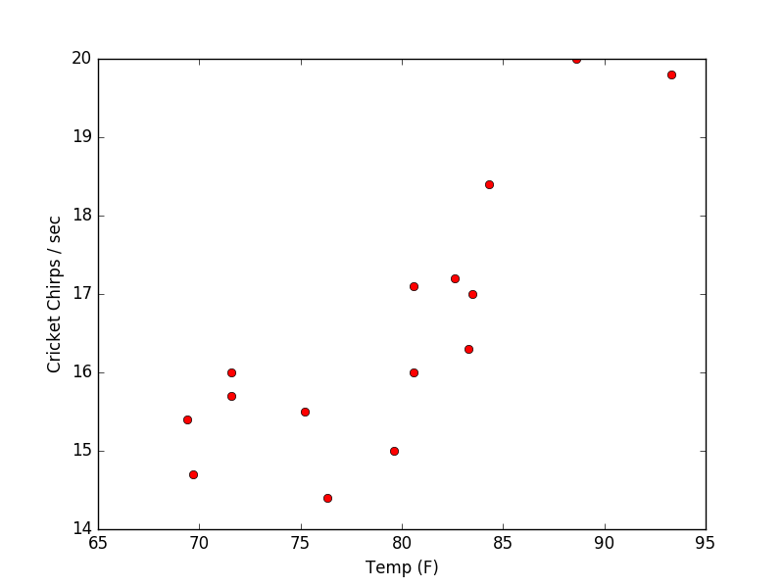
Example: Linear Regression
Imagine we have these measurements of cricket chirp frequency at certain temperatures:

Slide 5
Example: Linear Regression
Model
Since we think there's a linear relationship, our model is the equation for a line:
predicted_outputs = weight * inputs + bias
Parameters
weight controls the slope of the line
bias shifts the line up and down

Slide 6
Example: Linear Regression
Loss Function
Mean squared error (MSE) is a common choice for regression loss functions. For each input temperature, we'll square the difference between the model's predicted chirp frequency and the measured chirp frequency. Then we'll take the average of those squared differences.
loss = average of (predicted_output - output)²
Squaring the differences has the effect of:
Ensuring that the loss is positive
Penalizing outliers

Slide 7
Example: Linear Regression
Optimization Algorithm
Our optimization algorithm needs to determine the weight and bias values that result in a line best fitting our data.
Gradient descent is a common strategy:
Start from a reasonable, random set of parameter values
Determine the direction most likely to result in improvement, using partial derivatives of the loss function over each parameter
Update the parameters slightly in the determined direction and repeat at step 2.
Note: Linear regression is a silly example for machine learning, since we could simply solve for the minimum of the loss function. But this isn't practical for more complex models with thousands of parameters.

Slide 8
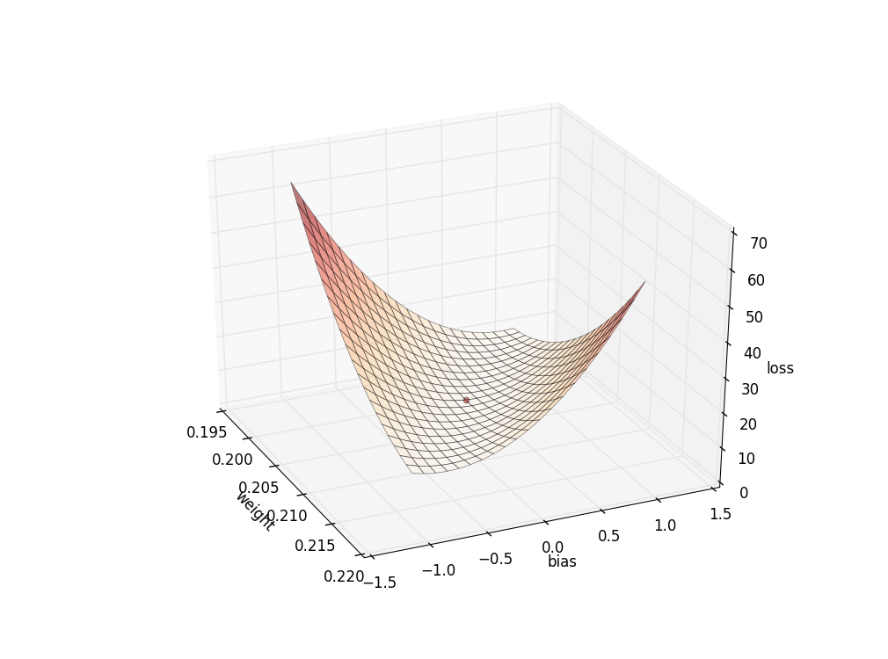
Example: Linear Regression
Starting from a random spot on this surface, gradient descent will eventually discover the optimal parameters.

Slide 9
TensorFlow Introduction
TensorFlow is Google's open-sourced library for these kinds of computations, first released Nov 2015.
Similar popular libraries are Theano, Torch, and Caffe. More recently released libraries include CNTK (Microsoft) and DSSTNE (Amazon).

Slide 10
TensorFlow Introduction
Data is stored in n-dimensional arrays called tensors
  0-dim for scalars
  1-dim for vectors
  2-dim for matrices
  etc
Computations are defined as a data flow graph passing tensors between mathematical operations
  Graph defined in a high-level language (only Python currently)
  Graph computed by native code for performance

Slide 11
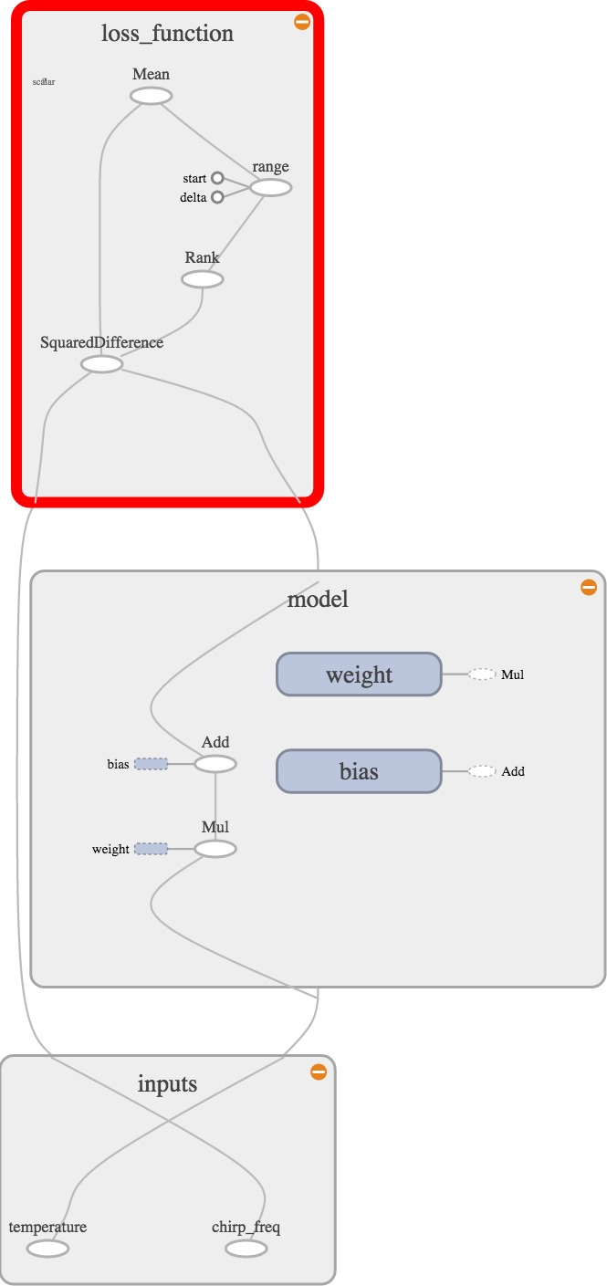
Example: Linear Regression
Defining the data flow graph:
# Placeholders for providing data to graph
X = tf.placeholder(tf.float32,
name = "temperature")
Y = tf.placeholder(tf.float32,
name = "chirp_freq")
# Model (Linear)
weight = tf.Variable(0., name = "weight")
bias = tf.Variable(0., name = "bias")
modeled_Y = tf.add(tf.mul(X, weight), bias)
# Loss Function (Mean Squared Error)
loss = tf.reduce_mean(
tf.squared_difference(Y, modeled_Y))

Slide 12
Example: Linear Regression
Input to be fed to the graph for training:
temp_f = [88.6, 71.6, 93.3, 84.3, 80.6, 75.2, 69.7, 71.6, 69.4,
83.3, 79.6, 82.6, 80.6, 83.5, 76.3]
cricket_chirps_per_s = [20, 16, 19.8, 18.4, 17.1, 15.5, 14.7,
15.7, 15.4, 16.3, 15, 17.2, 16, 17, 14.4]
Creating the optimizer operation with set learning rate:
training_op = tf.train.GradientDescentOptimizer(0.0001).minimize(loss)
Training the model for 50 steps:
with tf.Session() as session:
tf.initialize_all_variables().run()
for step in range(50):
session.run([training_op],
feed_dict={X: temp_f, Y: cricket_chirps_per_s})

Slide 13
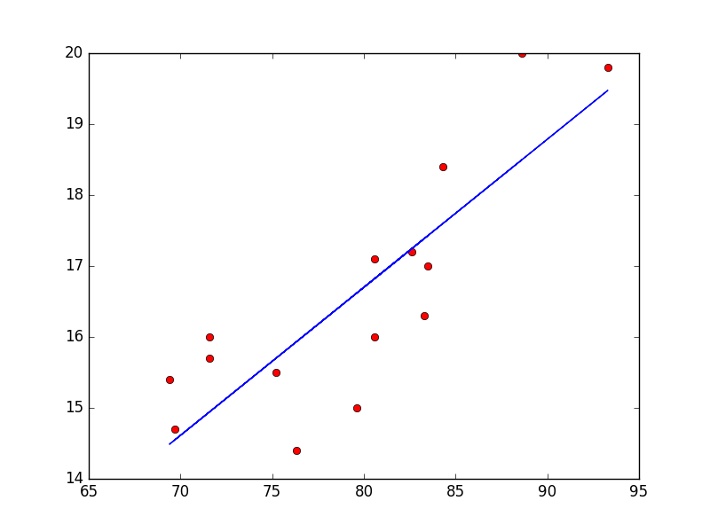
Example: Linear Regression
Trained linear model results:

Slide 14
Example: Linear Regression
TensorFlow takes care of several details for us, by examining the data flow graph:
  Identifying the trainable weight and bias parameters we created with tf.Variable()
  Performing automatic differentiation to support gradient descent optimization
  Distributing execution of the graph over available CPUs and GPUs
Additional features that take advantage of the graph include:
  Saving and restoring all parameter values
  Operations for logging values, images, and audio to Tensorboard
  Distributing execution over multiple machines
  Exporting trained model for use in production

Slide 15
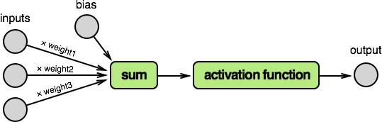
Example: Neural Net
Neural net models are composed of nodes inspired by biological neurons:
Each input node's value is multiplied by a separate weight parameter, and the result is summed together with a bias parameter.
Finally, the result is transformed by an activation function.
Note: The activation function introduces non-linearity. Without it, the math performed by the node (or even a network of nodes) could be algebraically reduced to a simple linear equation. Which would produce a convoluted linear regression model.

Slide 16
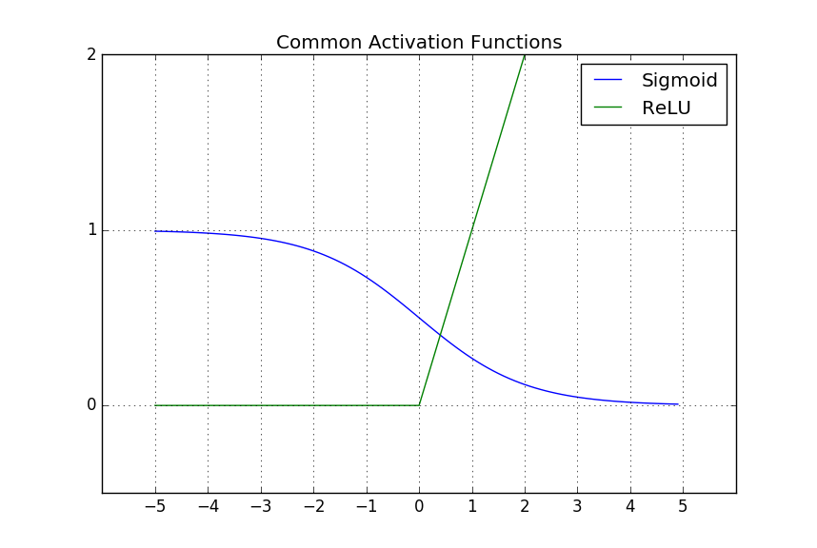
Example: Neural Net
The activation function can be anything, but two common choices are the sigmoid and rectified linear units (ReLU) functions.

Slide 17
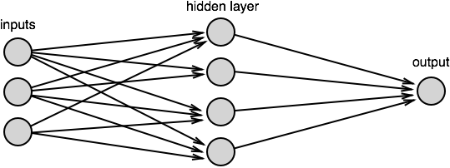
Example: Neural Net
Neural networks are constructed with one or more hidden layers of nodes between the input nodes and output nodes.
With enough nodes and an appropriate activation function, a single layer can approximate any function.

Slide 18
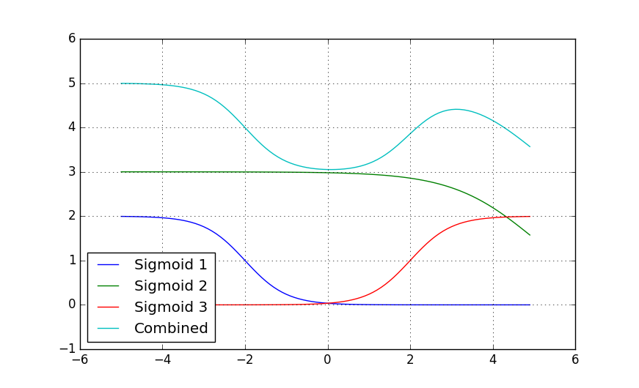
Example: Neural Net
Each hidden layer essentially combines instances of the activation function shape, scaled and shifted by node weights and bias.

Slide 19
Example: Neural Net
Model
Neural net data flow graph definition (weight() and bias() functions generate variables):
# Model (Neural Net with one hidden layer)
input_layer = tf.expand_dims(X, 1)
hidden_layer_nodes = 10
hidden_layer_weight = weight([1, hidden_layer_nodes])
hidden_layer_bias = bias([1, hidden_layer_nodes])
hidden_layer = tf.nn.sigmoid(tf.matmul(input_layer, hidden_layer_weight)
+ hidden_layer_bias)
output_layer_weight = weight([hidden_layer_nodes, 1])
output_layer_bias = bias([1])
modeled_Y = tf.matmul(hidden_layer, output_layer_weight)
+ output_layer_bias

Slide 20
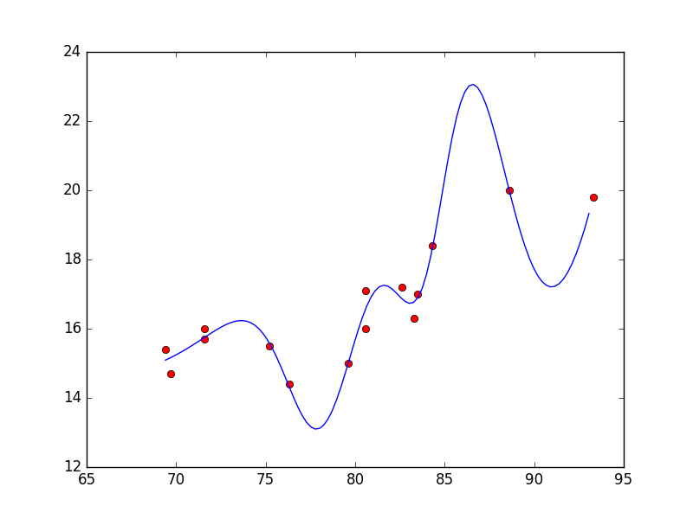
Example: Neural Net
Trained neural net model results:

Slide 21
Overfitting and Testing
The neural net model fit the data more closely, but that doesn’t make it a better choice of model for this data.
Our goal is to train a model that makes reasonable predictions.
There’s always the risk of training a model that overfits the data. Such models essentially memorize the answers to the test, but can’t answer new questions.

Slide 22
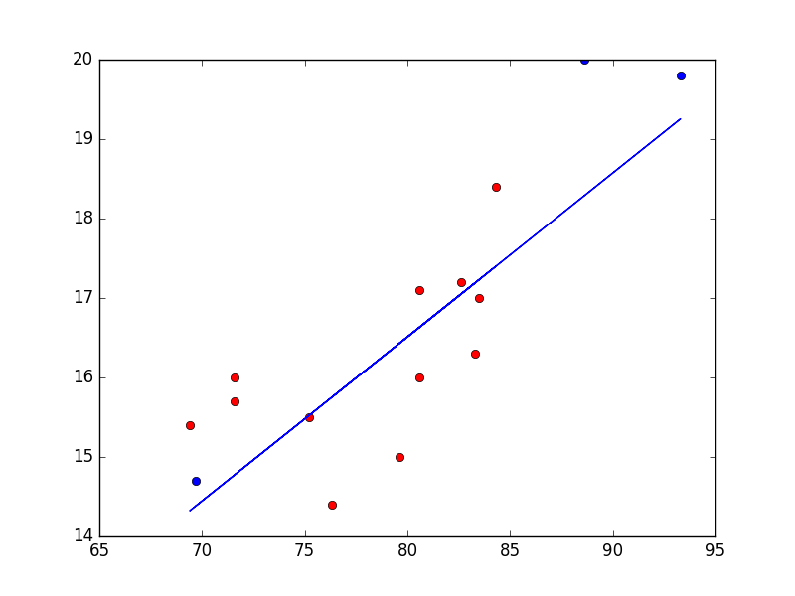
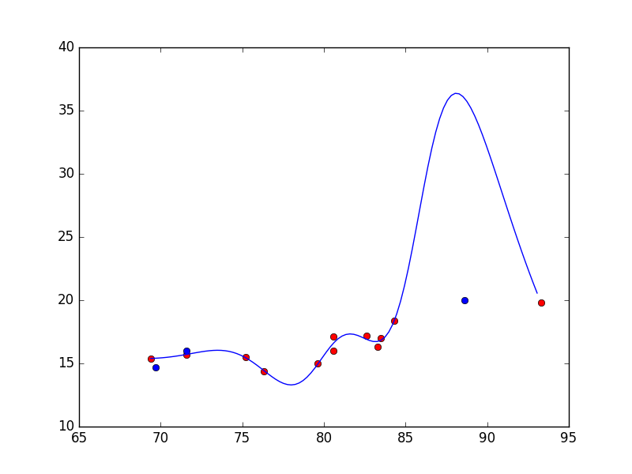
Overfitting and Testing
To detect overfitting, split the available data into training and testing data sets. After training the model with the training data, we can check to loss on the testing data to determine how well the trained model is generalizing.

Slide 23
Example: Convolutional Neural Net
Machine learning can be applied to computer vision problems as well.
For this example, we’ll train a model that can determine which direction is upwards in an input photograph.
This problem has a couple of significant differences from the previous two examples:
The output needs to be a selection from a set of classes (up, right, down, left), rather than a number. This is a classification problem.
The input needs to be an image.

Slide 24
Example: Convolutional Neural Net
The model will have four output numbers, one for each class. The classes will be encoded as one-hot vectors:
[1, 0, 0, 0] is up
[0, 1, 0, 0] is right
[0, 0, 1, 0] is down
[0, 0, 0, 1] is left
Our model is likely to output wide-ranging numbers. The softmax function is commonly used for normalization in classification problems. After normalization, we’ll consider the closest class match to be the model’s selection.
softmax([1,2,3,4]) = [0.0320586, 0.08714432, 0.23688284, 0.64391428] →
[0, 0, 0, 1] → left

Slide 25
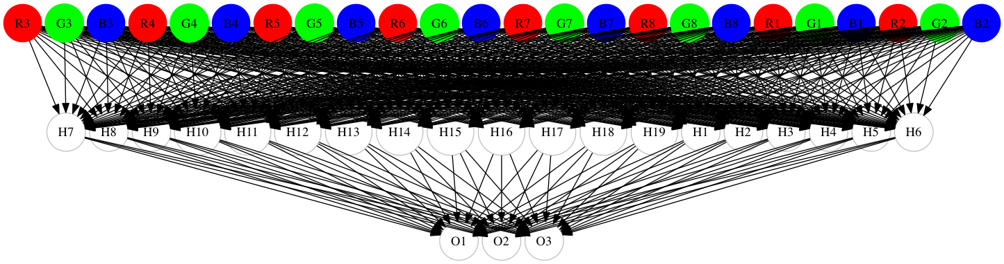
Example: Convolutional Neural Net
To process images, we could have a separate input for the color channel value at each pixel. But this approach has disadvantages:
Many inputs (width × height × 3 for color) means more computational complexity
Discards information about the values’ relative locations to each other
For a tiny 3 × 3 RGB image input to a neural net:

Slide 26

Example: Convolutional Neural Net
Convolutional neural nets are a newer approach to handling images:
Sweep (convolve) across the input image’s layers (R, G, and B initially), multiplying with small matrices called kernels to create a new set of images
Optionally, scale the new images.
Either repeat step 1 with the new images and additional kernels, or
Flatten the remaining images into numeric inputs, and pass them into a regular neural net.

Slide 27
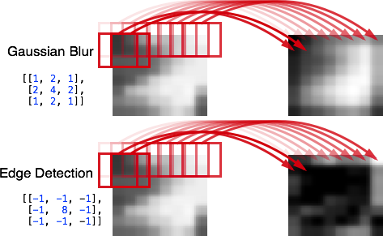
Example: Convolutional Neural Net
Many of the filters in graphics programs like Photoshop are implemented as convolutions using 2D matrix kernels applied to each color channel.

Slide 28
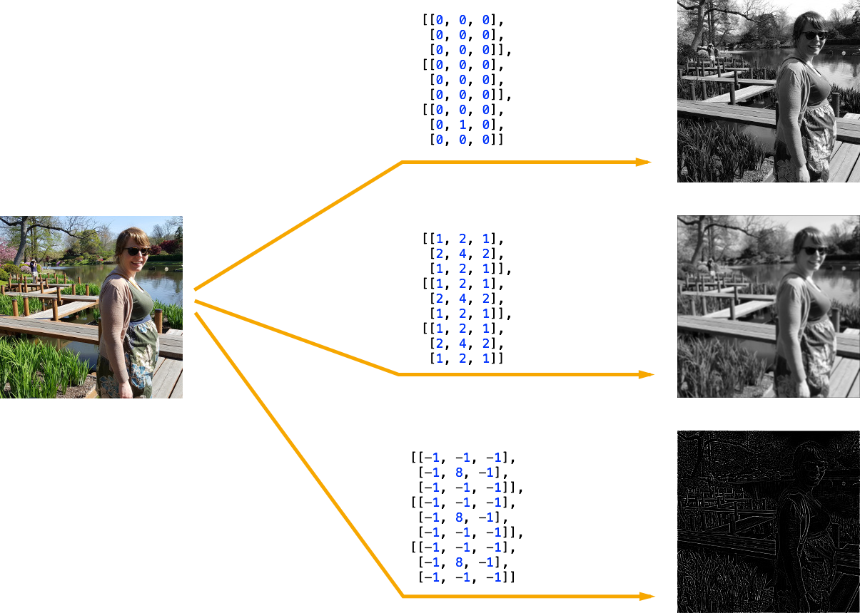
Example: Convolutional Neural Net
We’ll be using 3D matrix kernels, to produce a new grayscale image from multiple input images. Below the input images are the RGB components. But they could be multiple grayscale images as well.

Slide 29
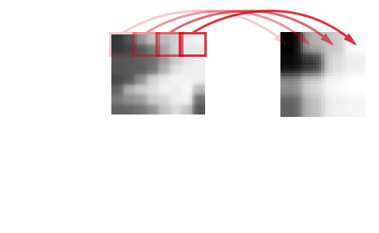
Example: Convolutional Neural Net
Pooling is commonly used after convolution to scale down the output images. Pooling converts each n×n block of values to a single value, often by taking the maximum or average.
Pooling offers two major benefits:
Reducing the size of the inputs to the next layer reduces computational cost
Adds some translation invariance

Slide 30
Example: Convolutional Neural Net
Convolution and pooling layers are typically stacked together. As images pass through the multiple filters, complex features can be identified. This is where the term deep learning comes from.

Slide 31
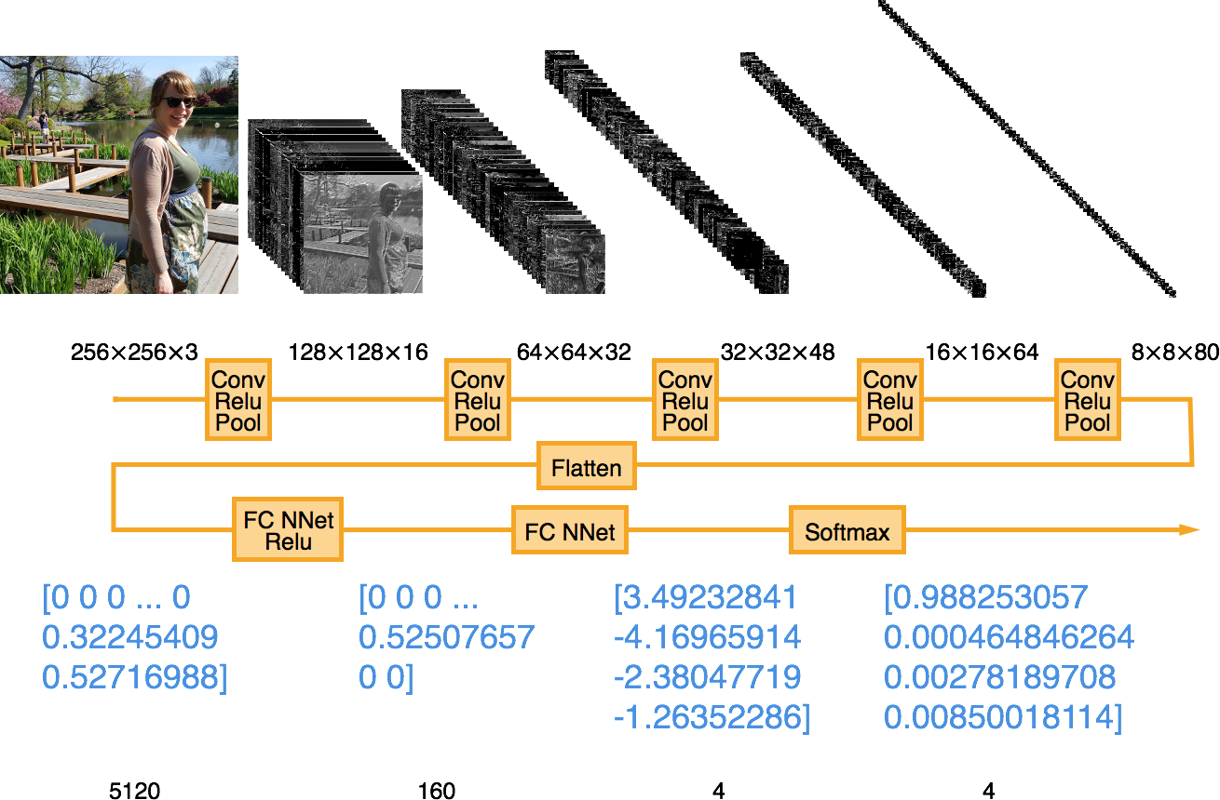
Example: Convolutional Neural Net

Slide 32
Example: Convolutional Neural Net
Training a model this complex requires a great deal of training data. I used 195000 images from the Microsoft COCO datasets.
Processing that many images during each training step isn’t feasible. So we use batching instead, shuffling the image order and using 100 for each training step.
The full training dataset can be used multiple times. Each full use is called an epoch.

Slide 33
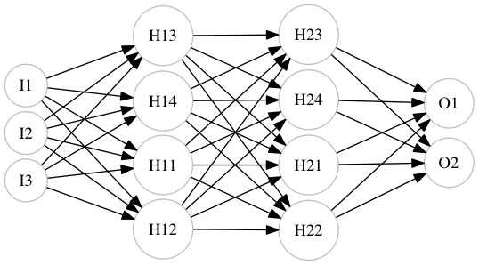
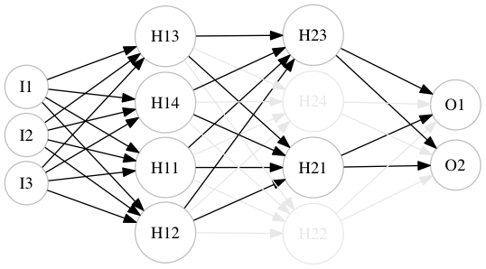
Example: Convolutional Neural Net
One last trick is to apply dropout to a layer of the neural net.
Dropout disables a random subset of neurons during each training step. This ends up having a protective effect against overfitting.

Slide 34
Example: Convolutional Neural Net
Some convenience methods for building the model data flow graph:
# Create weight tensor, with random initial normal values
def __weight_variable(cls, shape):
initial = tf.truncated_normal(shape, stddev=0.1)
return tf.Variable(initial)
# Create bias tensor, with constant initial values
def __bias_variable(cls, shape):
initial = tf.constant(0.1, shape=shape)
return tf.Variable(initial)

Slide 35
Example: Convolutional Neural Net
Some more convenience methods for building the model data flow graph:
def __conv_layer(cls, input_shape, input,
k_width, k_height, num_outputs):
weight = cls.__weight_variable([k_width, k_height,
input_shape[2], num_outputs])
bias = cls.__bias_variable([num_outputs])
return tf.nn.conv2d(input, weight, strides=[1, 1, 1, 1],
padding='SAME') + bias,\
(input_shape[0], input_shape[1], num_outputs)
def __relu_layer(cls, input_shape, input):
return tf.nn.relu(input),\
input_shape

Slide 36
Example: Convolutional Neural Net
Even more convenience methods for building the model data flow graph:
def __maxpool_layer(cls, input_shape, input, pool_size):
return tf.nn.max_pool(input, ksize=[1, pool_size, pool_size, 1],
strides=[1, pool_size, pool_size, 1],
padding='SAME'),\
(input_shape[0] / pool_size, input_shape[1] / pool_size,
input_shape[2])
def __fully_connected_layer(cls, input_shape, input, num_outputs):
flattened_size = reduce(mul, input_shape, 1)
weight = cls.__weight_variable([flattened_size, num_outputs])
bias = cls.__bias_variable([num_outputs])
input_flat = tf.reshape(input, [-1, flattened_size])
return tf.matmul(input_flat, weight) + bias,\
(num_outputs,)

Slide 37
Example: Convolutional Neural Net
Last of the convenience methods for building the model data flow graph:
def __dropout(cls, input_shape, input, keep_prob):
return tf.nn.dropout(input, keep_prob), \
input_shape
def __softmax(cls, input_shape, model):
return tf.nn.softmax(model), \
input_shape

Slide 38
Example: Convolutional Neural Net
def create_graph(cls, input, keep_prob):
# Normalize [0,255] ints to [0,1] floats
input_float = tf.div(tf.cast(input, tf.float32), 255)
# Build model
model = input_float
shape = (256, 256, 3)
model, shape = cls.__conv_layer(shape, model, 3, 3, 16)
model, shape = cls.__relu_layer(shape, model)
model, shape = cls.__maxpool_layer(shape, model, 2)
model, shape = cls.__conv_layer(shape, model, 3, 3, 32)
model, shape = cls.__relu_layer(shape, model)
model, shape = cls.__maxpool_layer(shape, model, 2)
model, shape = cls.__conv_layer(shape, model, 3, 3, 48)
model, shape = cls.__relu_layer(shape, model)
model, shape = cls.__maxpool_layer(shape, model, 2)
model, shape = cls.__conv_layer(shape, model, 3, 3, 64)
model, shape = cls.__relu_layer(shape, model)
model, shape = cls.__maxpool_layer(shape, model, 2)
model, shape = cls.__conv_layer(shape, model, 3, 3, 80)
model, shape = cls.__relu_layer(shape, model)
model, shape = cls.__maxpool_layer(shape, model, 2)
model, shape = cls.__fully_connected_layer(shape, model, 160)
model, shape = cls.__relu_layer(shape, model)
model, shape = cls.__dropout(shape, model, keep_prob)
model, shape = cls.__fully_connected_layer(shape, model, 4)
model, shape = cls.__softmax(shape, model)
return model
Building the model data flow graph:

Slide 39
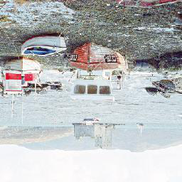
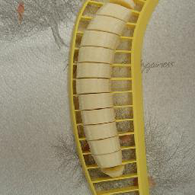
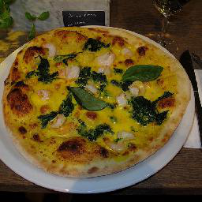
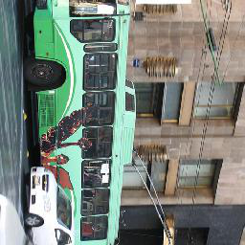

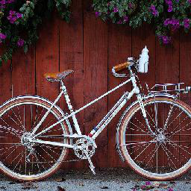


Example: Convolutional Neural Net
After training this model with 40 epochs of 195000 images, the model’s accuracy is roughly 83% when testing with 40000 new images.
Pass
Fail

Slide 40
Performance Considerations
Machines with one or more GPUs with CUDA support (specifically Nvidia chips) greatly reduce the training time for complex models. GPUs have hundreds or thousands of cores capable of performing calculations in parallel.
If you have a gaming rig at home, you may be well equipped to try machine learning with complex models.
I’m on a MacBook, so I used an Amazon EC2 instance with a single, modest GPU. With a g2.2xlarge instance, training took approximately 12 hours. Many ABI images that include TensorFlow are available; I used “Bitfusion Ubuntu 14 TensorFlow”.

Slide 41
Building New Models
Throughout these examples, several “magic number” values have been left unexplained:
Learning rate
Number of training steps or epochs
How many and which layers to use in a convolutional neural network
Which activation function to use
Which loss function to use
How much training data is needed
These choices are referred to as hyperparameters.
How do we know what to do?

Slide 42
Building New Models
A few strategies for building new models:
Copy Research published models
  Numerous working models for computer vision, language processing, audio processing, and other problems are available in public academic papers
Rules of thumb and current fashion
  These change rapidly, but as interest grows there are more sources than ever
  E.g. convolutional neural net best practices:
    Deeper models and more training data always help
    Use small kernels, ReLU, small pooling, softmax, and cross-entropy
Experiment, in parallel if possible
  During model development, try different sets of hyperparameters

Slide 43
Applying Machine Learning to Customer Problems
The most expensive part of building a supervised learning solution is often collecting enough data for training and testing.
In academic settings, hordes of unfortunate graduate students can be exploited to manually label data.
In business settings, look for situations where ample data is already available:
Identifying abusive / pornographic social media content based on user reporting
Flagging spam based on user deletion
Predicting user behavior based on browsing statistics
Recommendations based on users’ past choices
Any case where a lot of data is available!

Slide 44
Ethical Considerations
We need to be especially cautious when building predictive models that have a significant, real-life impact on individuals.
For example, imagine if HR requested a model that filter new candidates by comparing their resumes to the resumes of existing employees.
Without care, the trained model might make unintended inferences and perpetuate unfortunate biases in an attempt to make the hiring pool homogenous:
Inferring age based on education dates
Inferring nationality or race based on name
Inferring gender based on name
Inferring socio-economic status based on location

Slide 45
Resources
Links
  https://www.oreilly.com/learning/hello-tensorflow
  http://cs231n.github.io/convolutional-networks/
  https://github.com/jtoy/awesome-tensorflow
Books
  TensorFlow For Machine Intelligence (Sam Abrahams, Danijar Hafner, Erik Erwitt, Ariel Scarpinelli
  Data Science from Scratch: First Principles with Python (Joel Grus)
  Programming Collective Intelligence (Toby Segaran)

