Slide 1
Lightgame4kids
Efstathios Lymperidis
Thodoris Bais

Slide 2
Preview
Introduction
Lightgame4kids
Hardware Design
Functionality
UML
Game description
Advantages

Slide 3


Introduction

Slide 4

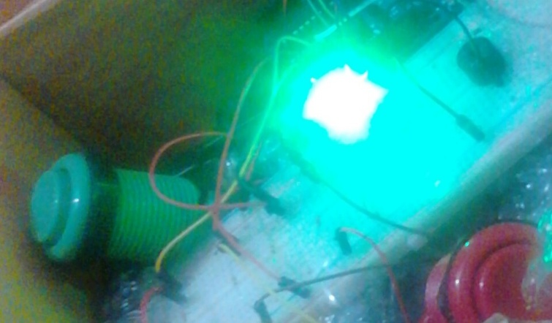
Lightgame4kids

Slide 5
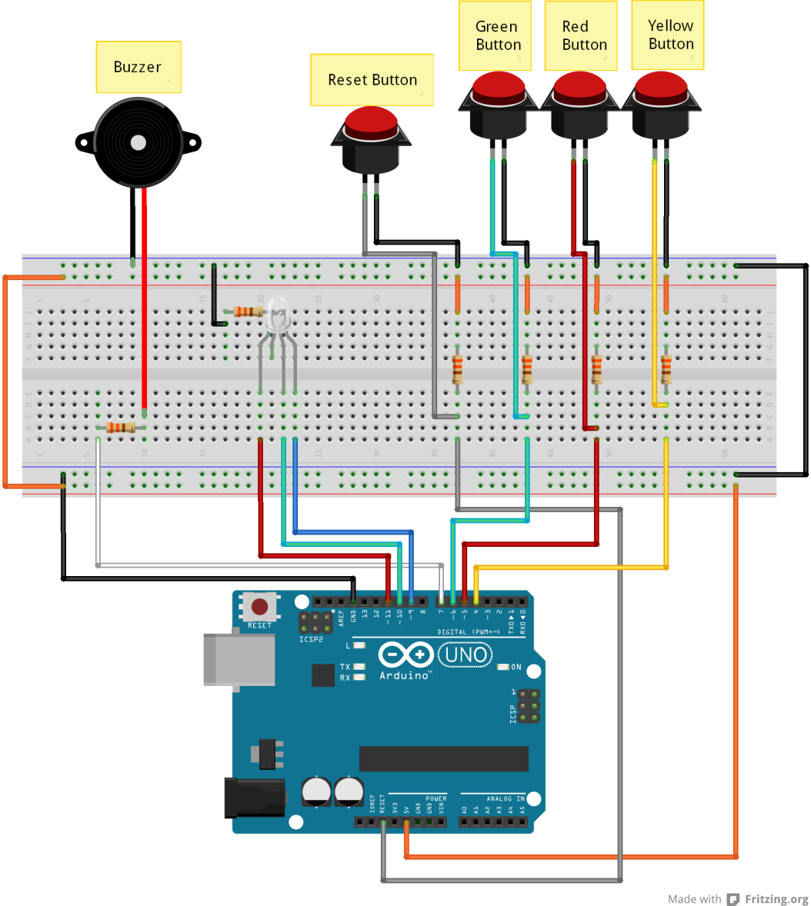
Hardware Design

Slide 6
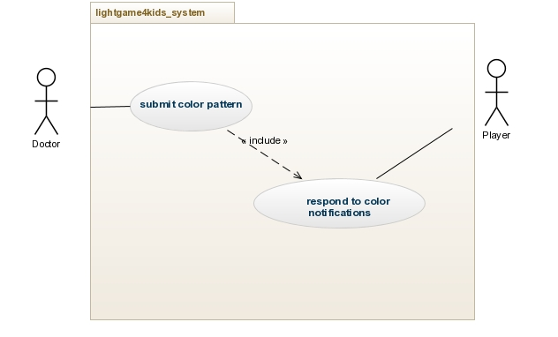
Use Case Diagram

Slide 7
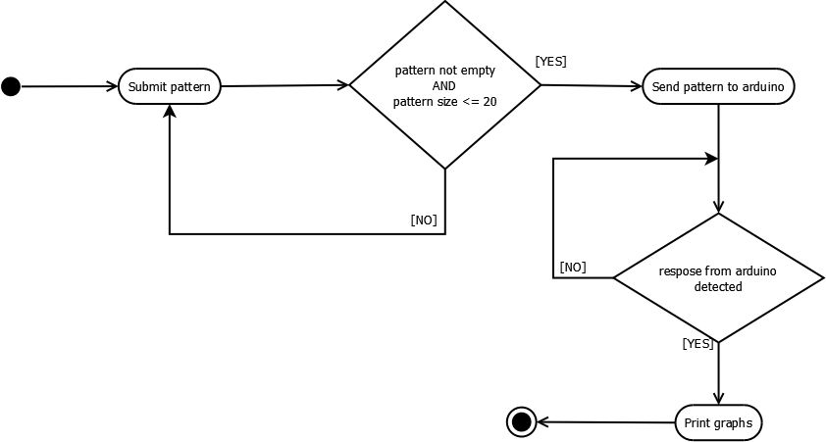
Activity Diagram

Slide 8
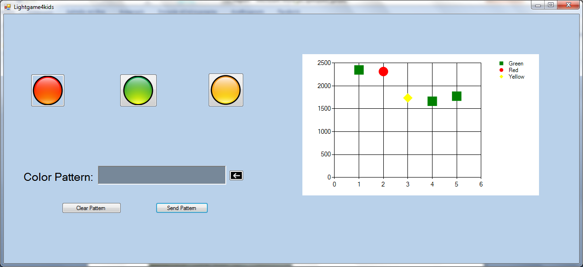
Game Description - I

Slide 9
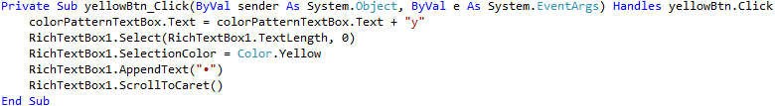
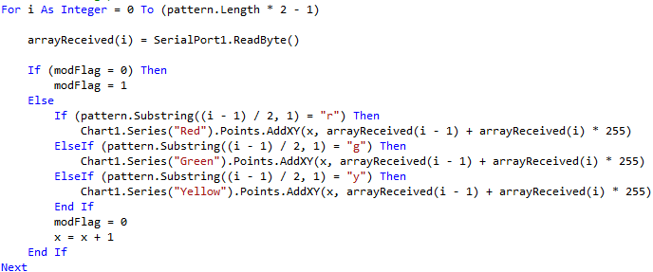
Game Description - II
Colorful pattern creation
How is the graph generated

Slide 10
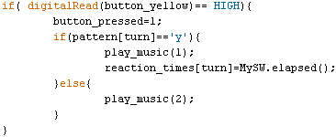
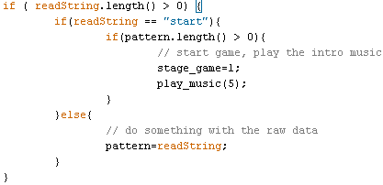
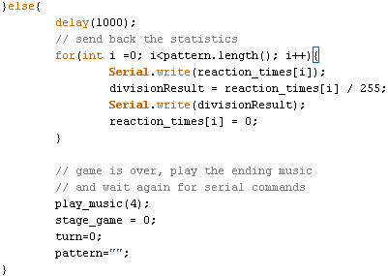
Game Description - IV
Receiving data from VB Event buttons management
Results transmission

Slide 11

Advantages
Game sounds
Interactive treatment system
Instant results to doctor
User-friendly
Optimized source code

Slide 12
Future enhancements
Android app
Database
More analytical statistics
VCS
GUI optimizations

Slide 13
Thank you!

