Slide 1
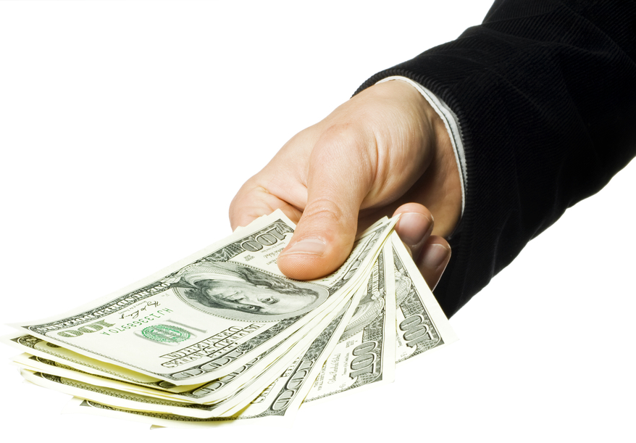
Welcome to the Investment Study!
- space bar to continue -

Slide 2
In this study you will work on an investment task. During the task, you will repeatedly invest in one of two securities: A risky security (i.e., a stock with risky payoffs) and a riskless security (i.e., a bond with a known payoff).
You will also be asked to provide estimates as to how good an investment in the stock is, after observing its payoffs.
- space bar to continue -

Slide 3
In the task, there are two types of conditions you can face: the GAIN condition and the LOSS condition.
In the GAIN condition, the two securities will only provide POSITIVE payoffs. In the LOSS condition, the two securities will only provide NEGATIVE payoffs.
- space bar to continue -

Slide 4


In the GAIN condition, on any trial, if you choose to invest in the bond, you get a payoff of $6 for sure at the end of the trial. If you choose to invest in the stock, you will receive a dividend which can be either $10 or $2.
The stock can either be good or bad, and this will determine the likelihood of its dividend being high or low. In the GAIN condition, if the stock is good then the probability of receiving the $10 dividend is 70% and the probability of receiving $2 is 30%.
The dividends paid by this stock are independent from trial to trial, but come from this exact distribution. In other words, once it is determined by the computer that the stock is good, then on each trial the odds of the dividend being $10 are 70%, and the odds of it being $2 are 30%.
Stock
Bond
Example
Payoff
$10 or $2
Payoff
$6
- space bar to continue -

Slide 5
In the GAIN condition, if the stock is bad then the probability of receiving the $10 dividend is 30% and the probability of receiving the $2 dividend is 70%.
Once the computer determines that the stock is either good or bad, that is maintained on each trial within the block.
- space bar to continue -

Slide 6
In the LOSS condition, on any trial, if you choose to invest in the bond, you get a payoff of -$6 for sure at the end of the trial. If you choose to invest in the stock, you will receive a dividend which can be either -$10 or -$2.
The stock can either be good or bad, and this will determine the likelihood of its dividend being high or low. In the LOSS condition, if the stock is good then the probability of receiving the -$10 dividend is 30% and the probability of receiving the -$2 dividend is 70%.
The dividends paid by this stock are independent from trial to trial, but come from this exact distribution. In other words, once it is determined by the computer that the stock is good, then on each trial the odds of the dividend being -$10 are 30%, and the odds of it being -$2 are 70%.
Stock
Bond
Example
Payoff
-$10 or -$2
Payoff
-$6
- space bar to continue -

Slide 7
In the LOSS condition, if the stock is bad then the probability of receiving the -$10 dividend is 70% and the probability of receiving -$2 is 30%.
Again, once the computer determines that the stock is either good or bad, that is maintained on each trial within the block.
- space bar to continue -

Slide 8
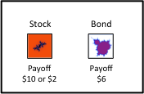
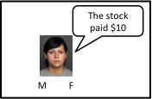
Choice Phase
At the beginning of each block of 6 trials, you will not know which type of stock the computer selected for that block. You may be facing a good stock or the bad stock, with equal probability. On each trial’s choice phase, you will decide whether you want to invest in the stock (and accumulate the dividend paid by the stock), or the bond (and add the sure-thing payoff to your earnings).
Stock Payout Phase
Then, a stockbroker will tell you the dividend amount paid by the stock – no matter if you chose the stock or the bond. To show us you’re paying attention to this phase, we ask that you tell us the gender of the stockbroker by making a button response.
Example
Example
- space bar to continue -

Slide 9
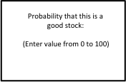
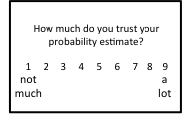
Good Stock Probability Estimation Phase
Then, we’ll ask you to estimate the probability that the current stock is a good one. Your answer must be a value from 0% to 100%.
*Remember that:
In the GAIN condition, a good stock gives $10 payouts 70% of the time and $2 payouts 30% of the time.
In the LOSS condition, a good stock gives -$2 payouts 70% of the time and -$10 payouts 30% of the time.
Estimation Confidence Phase
Finally, we want to know how much you trust your ability to come up with the correct probability estimate that the stock is good. In other words, we want to know how confident you are that the probability you estimated is correct. You’ll be asked to make a confidence rating on a 1-to-9 scale (1=lowest confidence, 9=highest confidence).
Example
Example
- space bar to continue -

Slide 10
There is always an objective, correct probability that the stock is good, which depends on the history of dividends paid by the stock already. For instance, at the beginning of each block of trials, the probability that the stock is good is exactly 50%, and there is no doubt about this value.
As you observe the dividends paid by the stock you will update your belief whether it is good. How much you trust your ability to calculate this probability could vary. Sometimes you may not be too confident in the probability estimate you calculated and some times you may be highly confident in this estimate.
- space bar to continue -

Slide 11
Payment
From good stock probability estimates: We will pay you 10 cents for every probability estimate that is within 5% of the true probability. Earnings from accurate probability estimates will be added to your $15 base payment.
From investment choices: On each trial, you will see a running total of accumulated earnings from your investment choices. At the end of the study, we will add 10% of your final accumulated earnings to your base payment.
*Note, if you have a negative investment total, will we will subtract 10% of this amount from your base payment, but the minimum subject payment is $10.
- Tell the experimenter when you’re ready to begin -

Slide 12
This is a LOSS condition
The two securities will only provide NEGATIVE payoffs
- space bar to continue -

Slide 13
This is a GAIN condition
The two securities will only provide POSITIVE payoffs
- space bar to continue -

