Slide 1
FOOTBALL PITCHES BOOKING
GROUP 10

Slide 2
About us
Supervisor
Lại Đức Hùng
Leader
Nguyễn Duy Phương
Member
Nguyễn Hữu Hoàng Giang
Member
Nguyễn Đức Thịnh
Member
Nguyễn Quốc Khánh

Slide 3
Contents
»
Problems
»
Solutions
»
Football Pitches Booking
»
Demonstration
»
Questions & Answers

Slide 4


Problems
» What do users need?
Customer
Service provider
Problems are
solved?
Services
- Improving the health
- Saving time
- Football pitches system
- Hold football awards

Slide 5

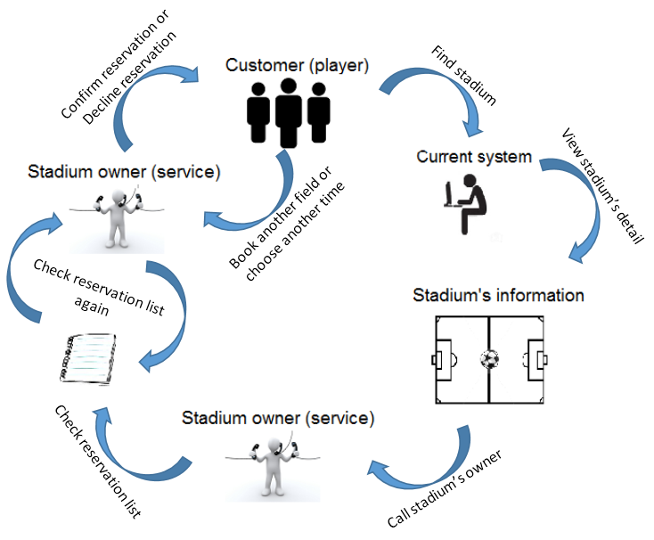



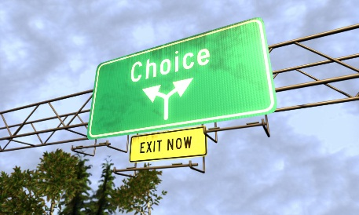
» Current system
Complicated process
Wasting time
Ineffective management
Example: tuyensonsport.vn, datsan.com.vn, webbongda.net,...
Limited choices

Slide 6


Solutions
» New system with more improvement
More choices
Simple process
Saving time
Easy to manage
More chances to promote and advertise

Slide 7
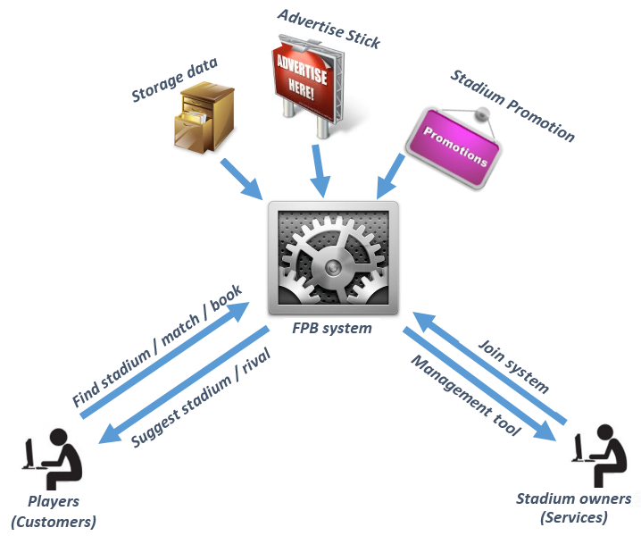
Football Pitches Booking
» B2B2C business model

Slide 8









» Tools and Technologies

Slide 9
» User roles
Website Manager
Stadium Manager
User

Slide 10
» Core flow
Find available pitches
Book a pitch
Update booking detail

Slide 11
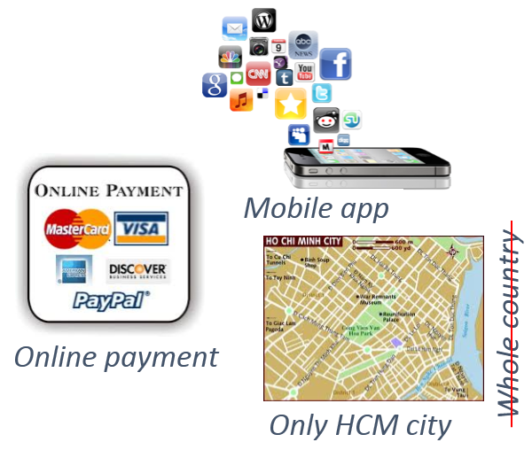
» Limitations

Slide 12



» Future plan
Upgrade system to operate in whole country
Support online payment
Develop mobile applications on others platform, such as: Android, iOS, Windows Phone

Slide 13

Demonstration

Slide 14

Questions & Answers
Thanks for your listening

