Slide 1
FOOTBALL PITCHES BOOKING
GROUP 10

Slide 2
About us
Supervisor
Lại Đức Hùng
Leader
Nguyễn Duy Phương
Member
Nguyễn Hữu Hoàng Giang
Member
Nguyễn Đức Thịnh
Member
Nguyễn Quốc Khánh

Slide 3
Contents
»
Problems
»
Solutions
»
Football Pitches Booking
»
Demonstration
»
Questions & Answers

Slide 4


Problems
» What do users need?
Customer
Service provider
Problems are
solved?
Services
- Improving the health
- Saving time
- Football pitches system
- Hold football awards

Slide 5

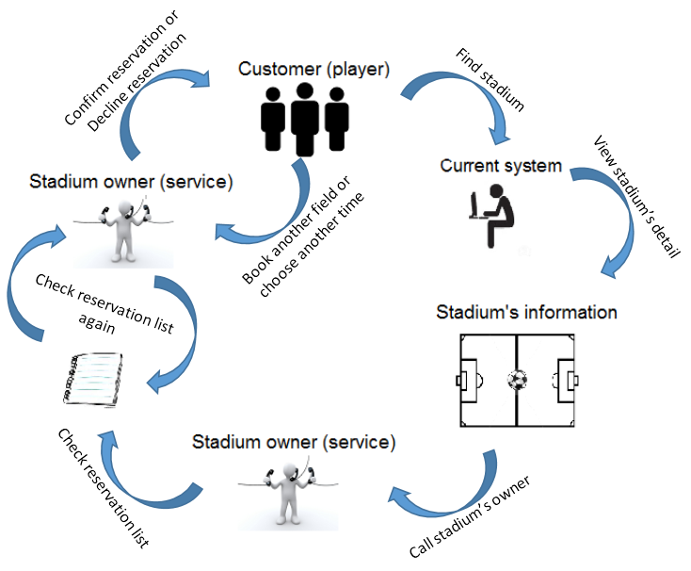



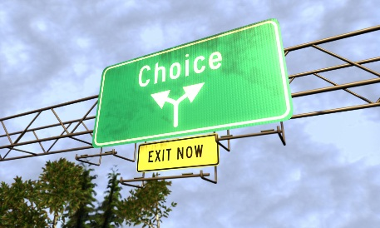
Current system
Complicated process
Wasting time
Ineffective management
Example: tuyensonsport.vn, datsan.com.vn, webbongda.net,...
Limited choices

Slide 6


Solutions
» New system with more improvement
More choices
Simple process
Saving time
Easy to manage
More chances to promote and advertise

Slide 7
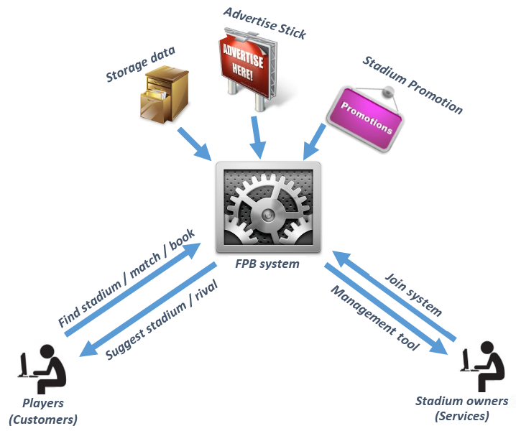
Football Pitches Booking
B2B2C business model

Slide 8









Current system

Slide 9
Current system
Website Manager
Stadium Manager
User

Slide 10
Core flow
Find available pitches
Book a pitch
Update booking detail

Slide 11
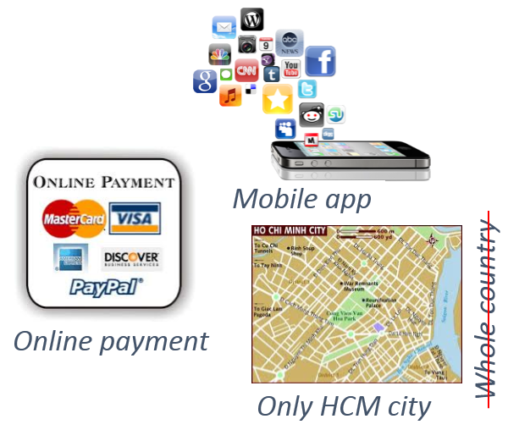
Limitations

Slide 12




Future plan
Upgrade system to operate in whole country
Support online payment
Develop mobile applications on others platform, such as Android, iOS, Windows Phone

Slide 13

Demonstration

Slide 14

Questions & Answers
Thanks for your listening

