Slide 1
THE WEST NILE VIRUS:
WHEN AND WHERE TO SPRAY
Philip Bradfield
Parisa Yarandi
Ritika Bhasker

Slide 2
Agenda
What is the problem?
Background and literature review
Our approach
Exploring the data
Modelling the data
Results and Recommendation

Slide 3
What is the problem?
West Nile Virus
Vector : Mosquitoes
Chicago: Mosquito traps
Data: Trap location, weather
Provide where and when

Slide 4
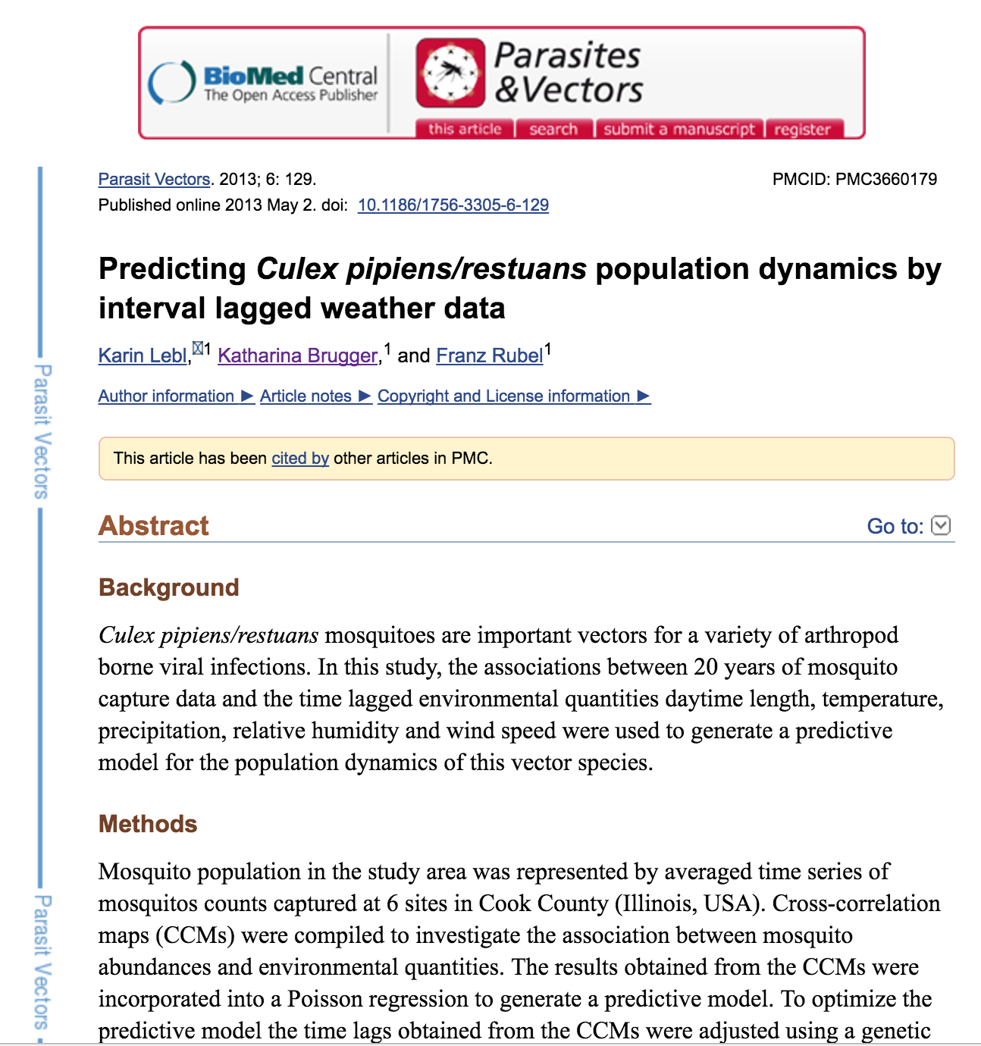
Reference:

Slide 5
Our approach:
Model used: XGBoost classifier
Variables for the model: precipitation, wind speed, species, length of day, trap location (long./lat.), temperature variance and maximum temperature.
Target: If trap has a WNV mosquito - yes or no.

Slide 6
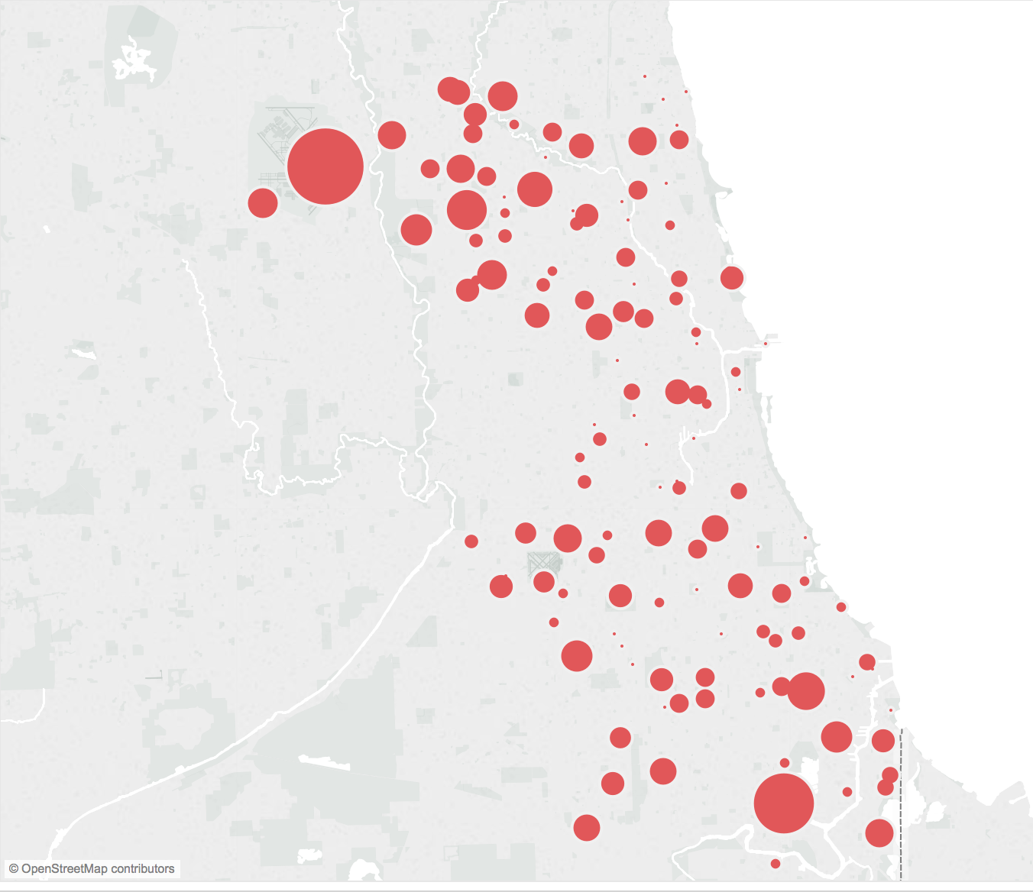
Locations of mosquito traps across Chicago. The size of the circle relates to the number of WNV mosquitoes captured.

Slide 7
Data
Train
Weather
Test
Spray
Data we used to make our model
Data provided to test our model
Data we use for recommendation

Slide 8
Train Dataset
The train dataset includes information about traps (address of the trap, species/number of mosquitoes and if West Nile Virus is present.)
Looking at Tableau:

Slide 9
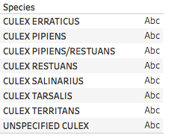
Test Data
Test dataset columns have also different Trap information includes (address of the Trap, Species of mosquitoes.
Test dataset does not have any information for the number of mosquitoes.
Test dataset has 8 type of species.

Slide 10
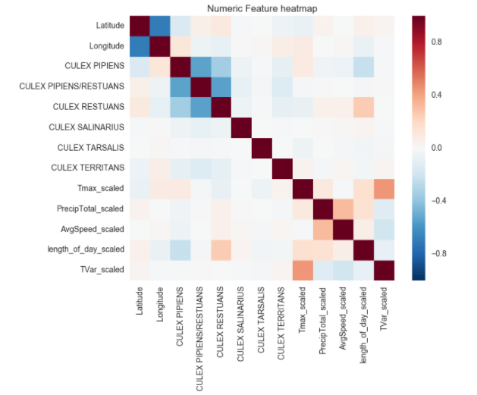
Data used to make a model
Train + weather
Latitude, Longitude, Species, Max Temperature,
Precip, Wind Speed, Length of Day,
Temperature Variance
Correlation matrix

Slide 11
Model selection
Ran our training data through several classification models:
Logistic Regression, Random Forest, Gradient Boosting Classifiers, XGBoost
We split our training data into two sections: one to train the initial model, and another to test it (while we had a target we could test against).
Found Gradient Boosting and XGBoost to be the best classifiers of when and where West Nile virus would be present.
Decided to use both models.
Notes:
Quick intro on what gradient boosting and XGBoost are
Our initial model did incredibly well. It had a 94% accuracy and we

Slide 12
Confusion Matrix
 | Model predicted present | Model predicted not present
WNV Present | 147 | 35
WNV Not Present | 908 | 2377
Notes:
Confusion matrix, deliberately tweaked the threshold to err on the side of caution. So we asked our model to predict cases of WNV if it thought there was even a 10% chance of it occurring.

Slide 13
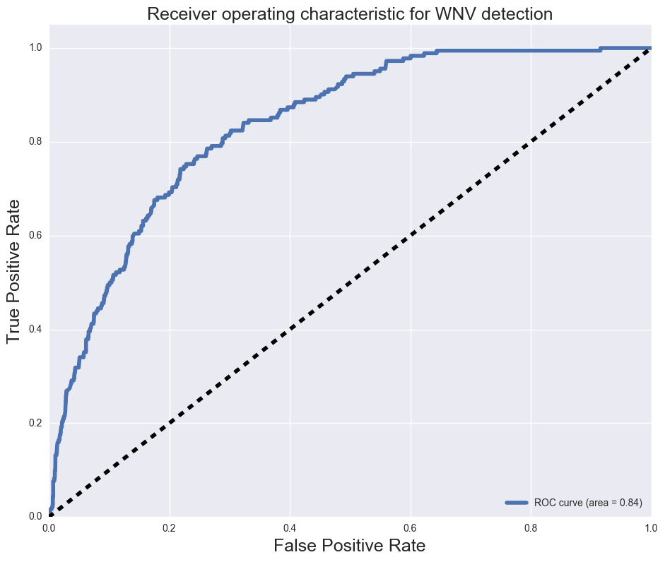
Notes:
Out of 100 cases, 84 times it was predicted correctly. If we had a perfect model..
Tried to push that line as close to 1.0 as we could

Slide 14
Feature Importance
Length of day
Location
Average wind speed
Maximum temperature

Slide 15
Recommendations
Let’s take a look at Tableau
Future research could look into:
The effect of still water locations on mosquito populations (including lakes, ponds, sewers, etc.)
Number of mosquitoes in a given trap.
Looking at how spraying affected mosquito populations over time.
Looking at changing annual temperature and how it affects mosquito population density.

Slide 16
QUESTIONS?

Slide 17
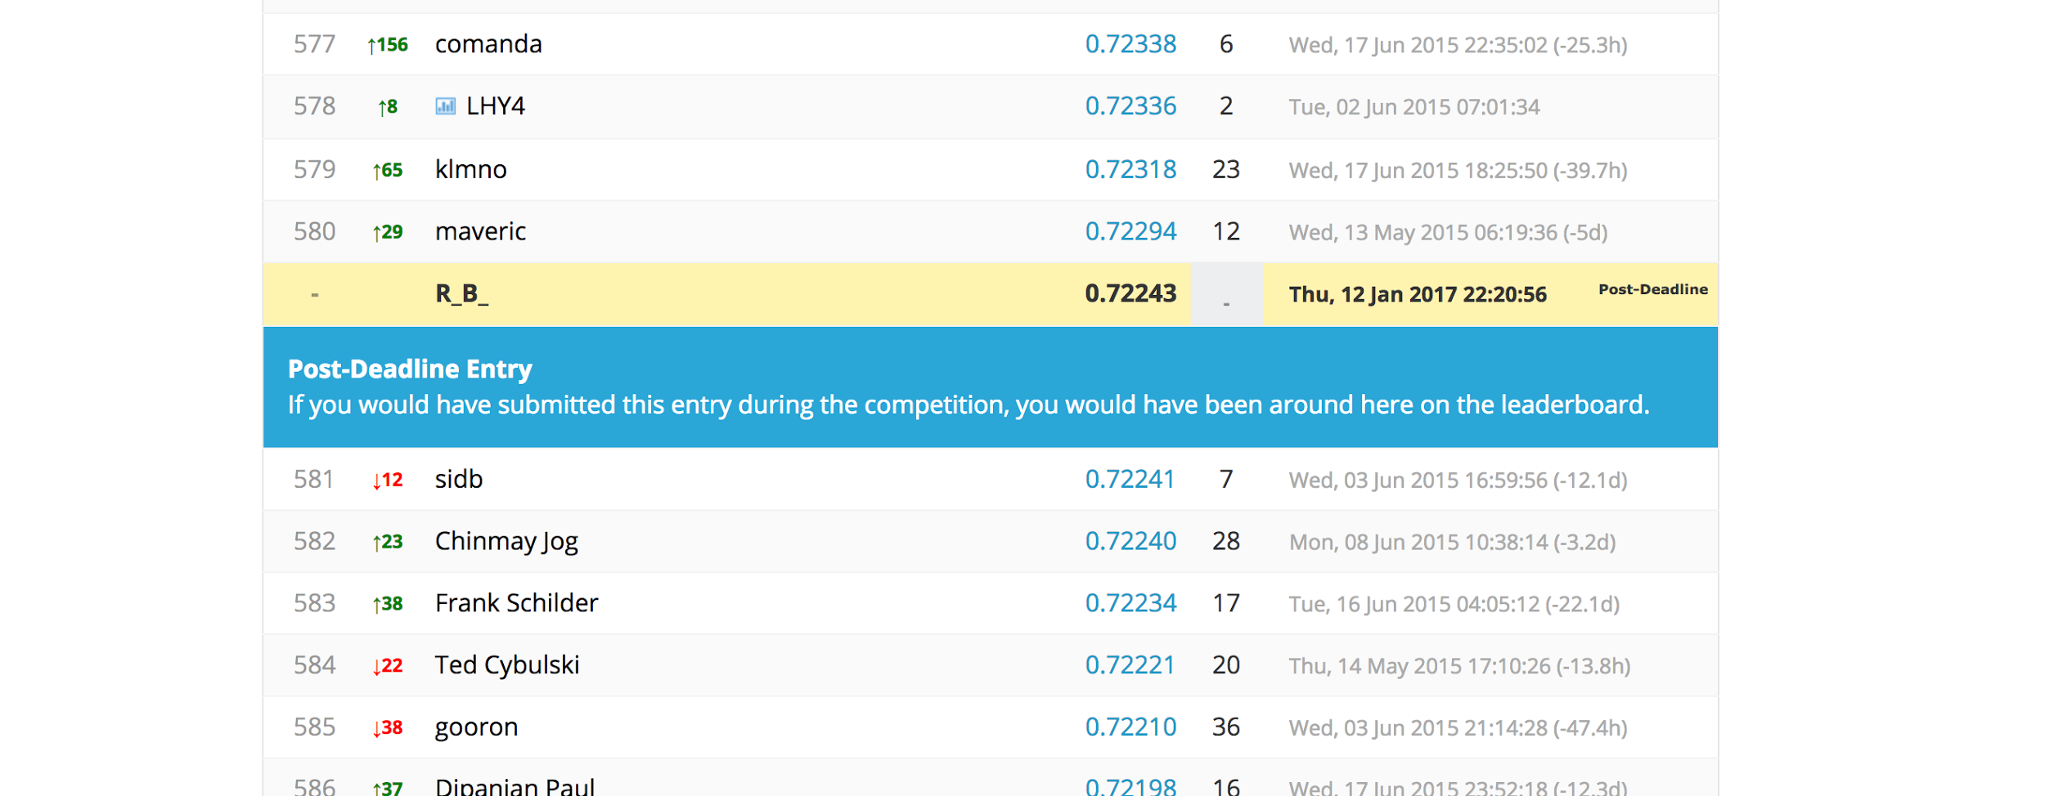
How we did

