Slide 1

CPSC, 5021
Milestone 3
Anothay Rassavong, Kai Ying Chan, Denis Rajic

Slide 2

OUR MISSION
Simplifies Schecduling
Easy organization
Information access
Patient tracking
HealthLink
Our mission is to simplify and streamline office procedures by combining automated online scheduling with patient health and billing records in a database. This will simplify administrative operations and ensure accuracy and secure backup for patient records. A unified software experience will be simpler for office staff to learn.

Slide 3
Problem Detail
Apart from scheduling, another problem without a database is dealing with the data. Without a database, patients have to write their information on paper for their first visit. It will take the staff some time to search for the patient‘s data, and they might even mix up patient files. Also, the more patients and staff there are, the more data there is to store. Security and backup of the information is difficult - a file with identifying information could be stolen, or the whole file room could be damaged in a flood. This could lead to severe consequences to the practice or the patients.

Slide 4
Solutions
The solution to all that is a database including online scheduling functionality and appointment note-keeping.
A solution to time management, office staff could save time on making appointments by phone and searching for paper files.
While for patients, they would have a way of quick and easy way of checking their appointment times and locations and get their doctor’s notes through a unified portal.
This extends from patients to physicians as well, both can check their appointment times and locations physician can create doctor’s for patients to access using the application through a unified portal.

Slide 5
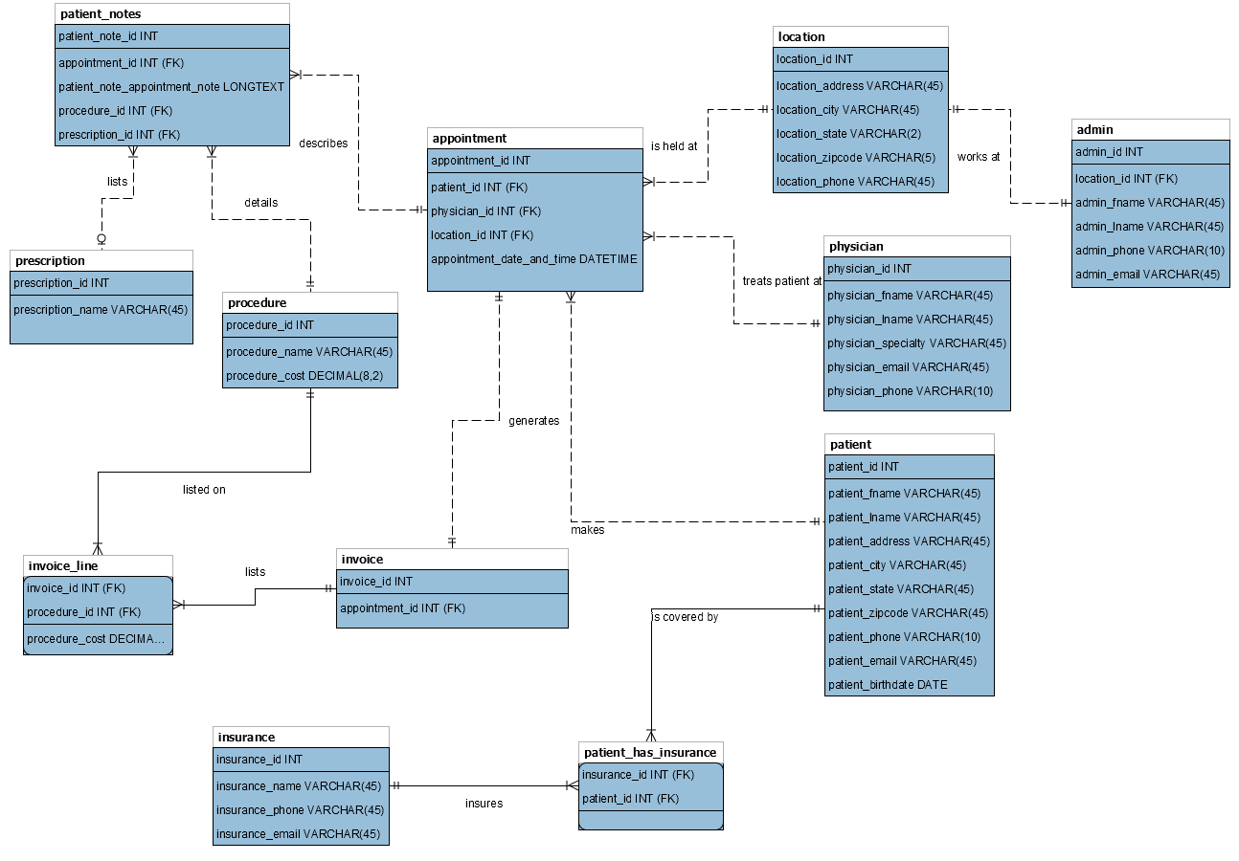
Conceptual view

Slide 6
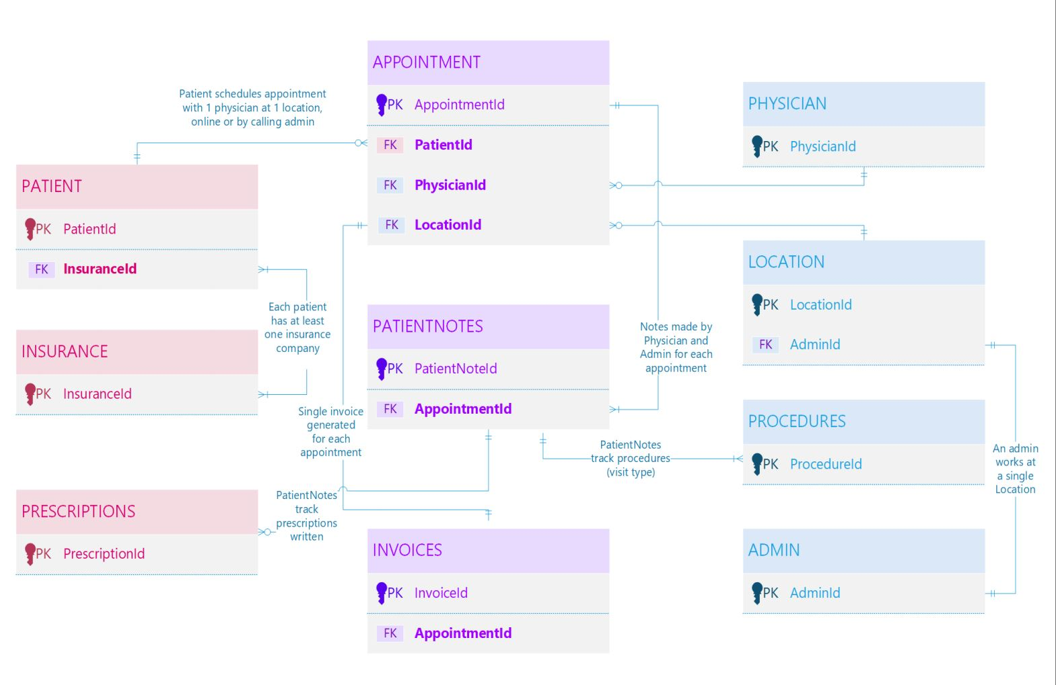
CEO/CTO view

Slide 7
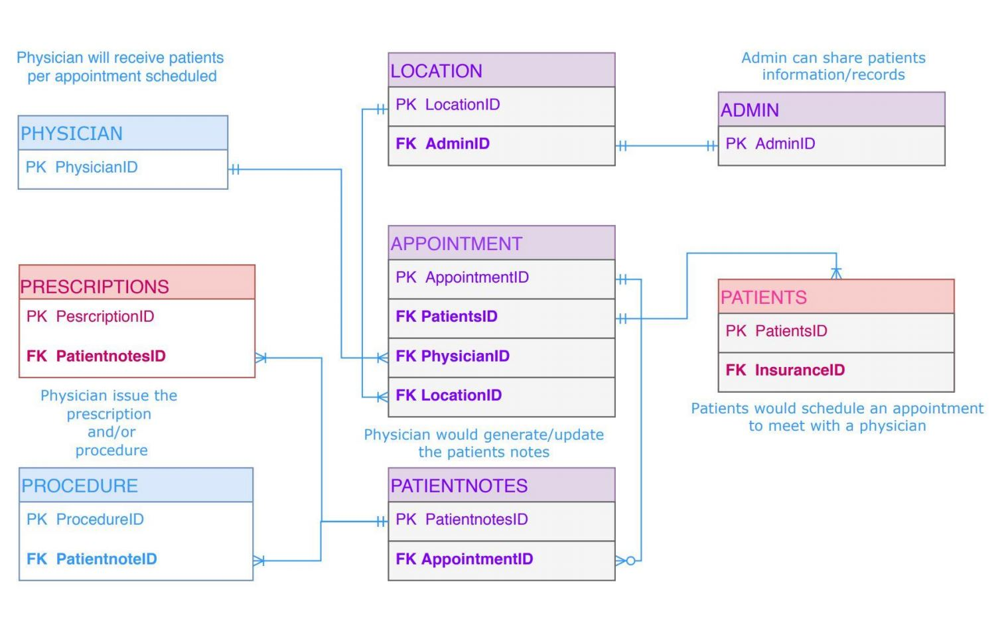
Physician view

Slide 8
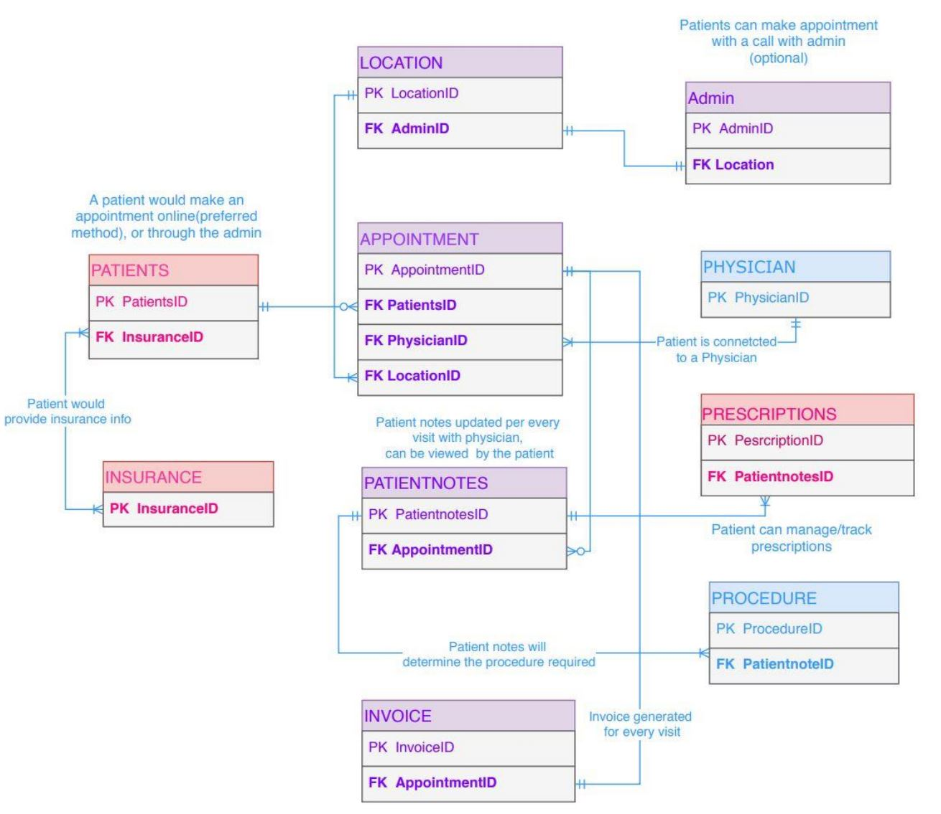
Patient view

Slide 9

Application Demo
Group 9

Slide 10
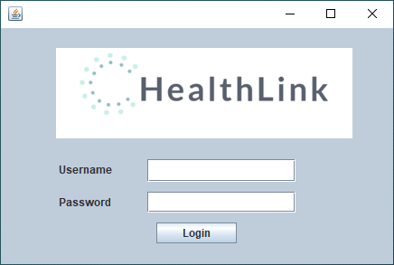
Supporting Content
Username: name
Password : password

Slide 11
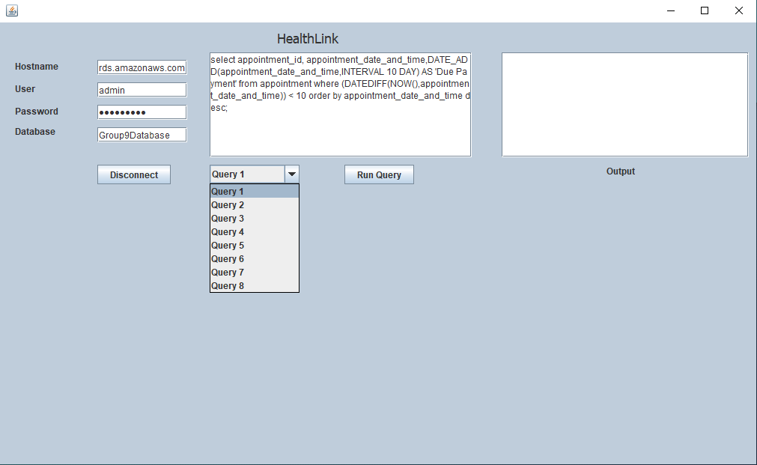
Supporting Content
Query features
1. Show recent appointments in 10 days
2. Show Due date of a Patient's appointment
3. Add patient
4. Show the patient list
5. Add a physician
6. Show physician list
7. Create appointment
8. Show patient notes

Slide 12
Future Improvements
Create separate views in application for:
Patient: View appointments, invoices
Physician: View patients, view patient notes
Admin: View appointment info, update appointment times
CEO: View financial info
Improvements to user interface

