Slide 1
Python tutorial for scientific computing
Steve Byrnes
16 March 2012

Slide 2
Terminology
Python is a general-purpose programming language
From NASA to YouTube…
Python “package”/ “module” / “library” is what you download (or write) to get additional functions and definitions. Examples:
NumPy for fast array computations and manipulations and linear algebra.
SciPy for optimization, image-processing, interpolation, numerical integration, etc.
Matplotlib for making graphs.
“Python distribution” is a way to download Python and various packages, either a la carte or all at once.
There’s a standard one, “Cpython”, at python.org. Others include EnThought, SAGE, Python(x,y), PortablePython, …

Slide 3
Terminology
“Python 2” and “Python 3” are different versions, not compatible with each other. NumPy only exists in Python 2 [so far], so use that.
“Integrated development environment” (IDE) is a program for writing programs: Text-editor, debugger, etc.
e.g. “Spyder”
Python IDEs are often, themselves, written in Python, i.e. they are Python packages.

Slide 4
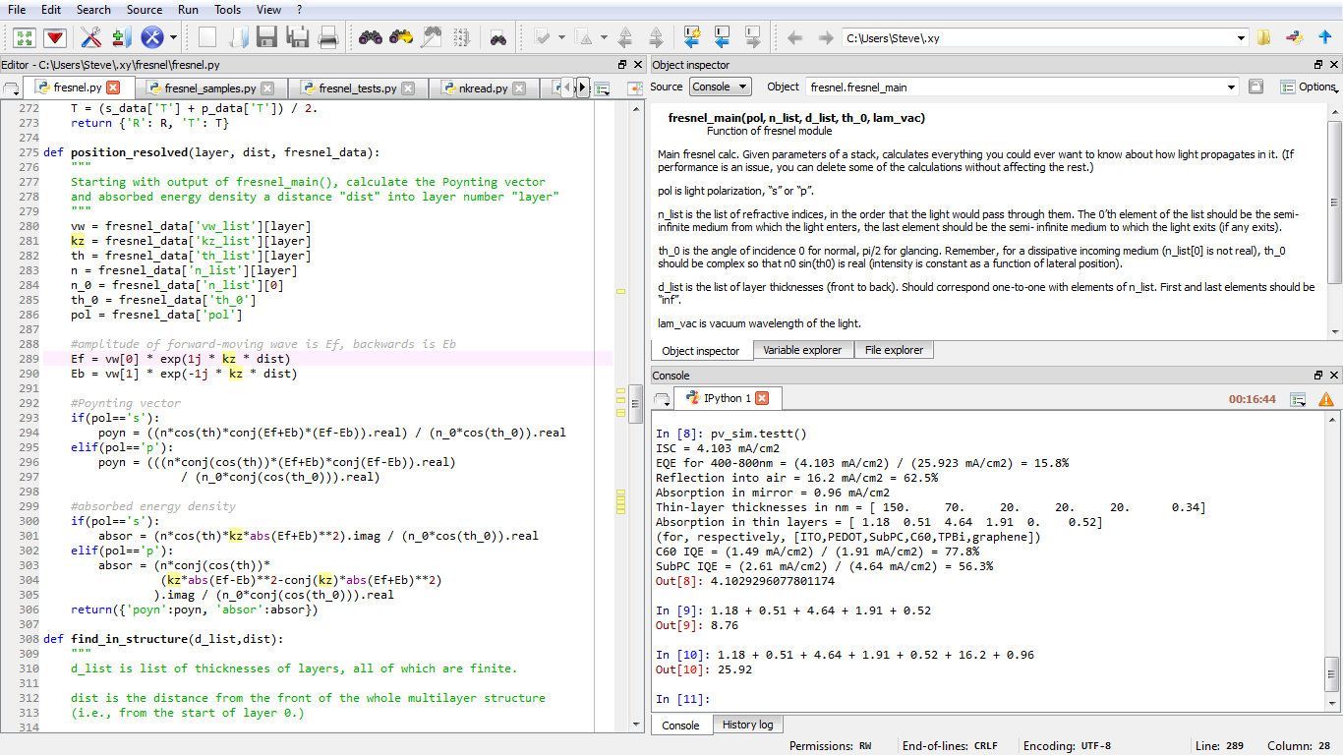
Spyder, an IDE

Slide 5
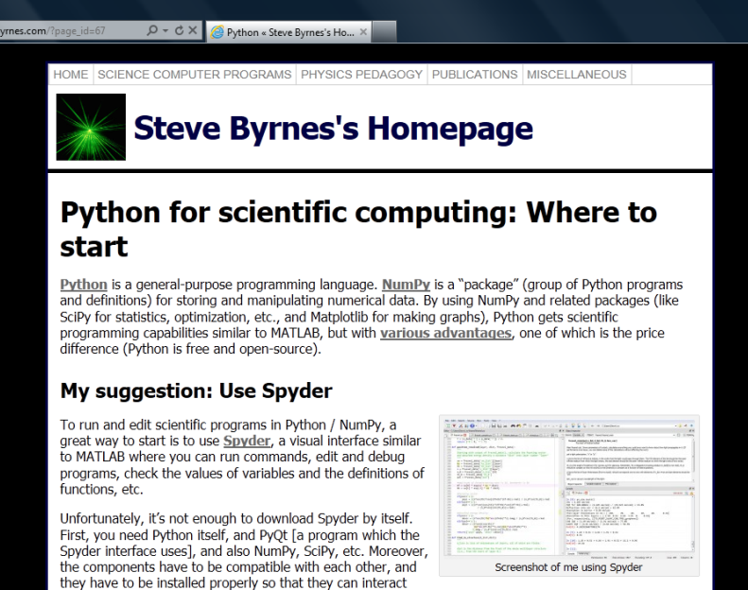
Installation
As with everything open-source, installation is one of the most confusing parts for beginners (at least, it was for me.)
http://sjbyrnes.com/?page_id=67
Watch out Mac OS X users: NumPy is incompatible with your built-in Python.

Slide 6
Nice things about Python (vs MATLAB)
Lots of little things…
You don’t have to end every command with a semicolon
If you want to write a function, it doesn’t need to be in its own file, where the filename is the same as the function name.
etc. etc.…
Free

Slide 7
Nice things about Python (vs MATLAB)
MATLAB becomes increasingly useless as you get farther away from matrices. Python is equally good at everything.
Someday maybe I’ll want to…
turn something into a stand-alone program with a GUI
pull data out of a pdf
interface with hardware and instruments
draw a 3D picture
write a script to reorganize files on my computer
put some interactive feature on my website
…
Python always has a professional-quality module for it!

Slide 8
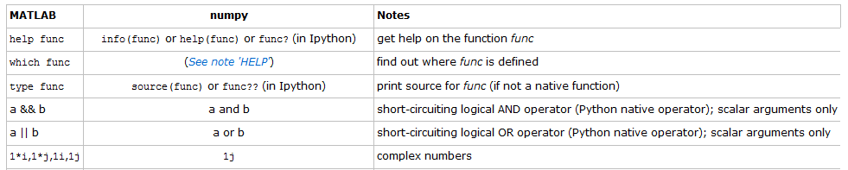
NumPy
Google search “numpy matlab” to find this chart.

Slide 9
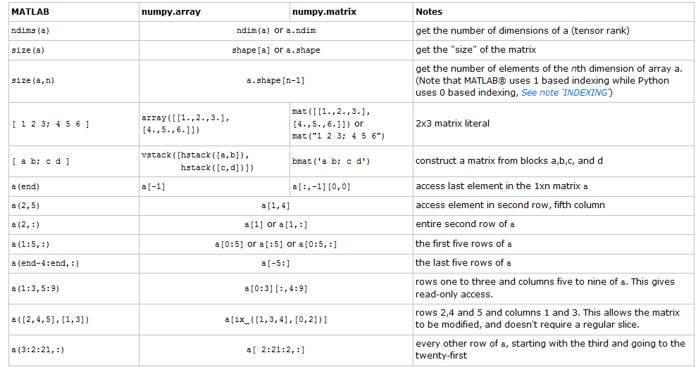
NumPy

Slide 10

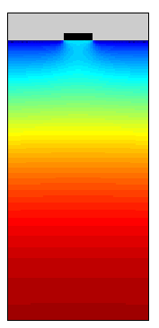
Pretty graphics with Matplotlib
Awfully similar to Matlab, even down to arbitrary details like terminology, default color-scheme, etc.
Matplotlib
Matlab
I couldn’t (at the time) figure out how to refine the colormap in Matlab, although I got it later. Main reason I ported: Matlab SVG output wasn’t working for me. [Not built-in.]

Slide 11
Define a function
Define a function
Use a function
def f(a,b):
c = a * b
return abs(c**2)
x = f(3,5)

Slide 12
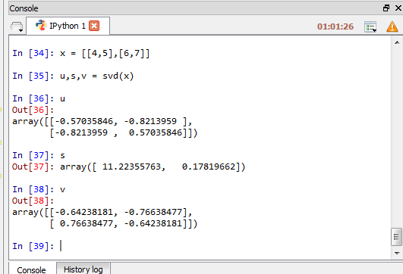
Console versus Modules
Simplest calculations can be done directly in an interactive console. (“Consoles” are usually powered by “IPython”.)

Slide 13
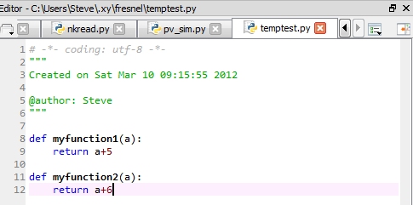
Modules
For more complicated things, you write one or more programs / functions in a “module”, “filename.py”
In: from temptest import *
In: myfunction1(10)
Out: 15
In: myfunction2(10)
Out: 16
In: reload(temptest); myfunction1(10)
Out: Error…
In: reload(temptest); myfunction1(10)
Out: 15
Saving isn’t enough! Also need to reload the module every time you change it.

Slide 14
Modules
Most normal math stuff like cos, conjugate, pi, etc., are actually in NumPy, not Python itself. Can use…
“Best practices”
(Avoids the risk that you’ll accidentally define a function with the same name as a numpy function you forgot about; Easier for other people to identify the functions.)
Everyday use
In: from numpy import *
In: cos(0)
Out: 1.
In: import numpy
In: numpy.cos(0)
Out: 1.
In: import numpy as np
In: np.cos(0)
Out: 1.
In Spyder, “from numpy import *” is run automatically every time you open the program. So you can use cos, pi, etc., in the console. But inside a module, you still have to import these functions yourself.

Slide 15
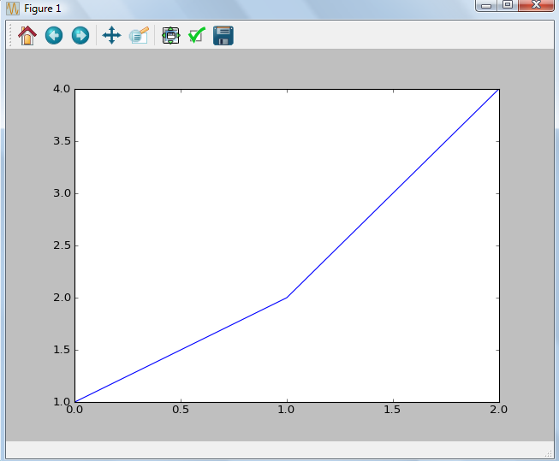
Modules
The functions you usually want for plotting are in the module matplotlib.pyplot [a “submodule” of matplotlib].
Again, in the Spyder console, you don’t need the first line, because Spyder runs it automatically every time you open the program.
In: from matplotlib.pyplot import *
In: plot([1,2,4])
Actually I think Spyder runs:
from matplotlib.pylab import *
instead of importing pyplot and numpy functions separately.

Slide 16
Scripts
Scripts are an alternative to modules, good for everyday use.
The command is “run” (in IPython) or “execfile” (in general).
In the console…
In: run testscript.py
4
In: run testscript.py
5
In: run testscript.py
6
In the file testscript.py…
a += 1
print a

Slide 17
NumPy arrays versus Python lists
Python lists: Very general
a = [1,2]
b = [[1,2],[3,4]]
c = [[1,2, ’duh’],[3,[4]]]
NumPy arrays:
x = array([1,2])
y = array([[1,2],[3,4]])
All rows must have same length, etc.
All entries must have same data-type, e.g. all real or all complex.
Always use NumPy arrays when you’re doing something with the data:
Math – Matrix addition, dot-product, conjugation…
Manipulating elements of the array – Reshaping, rearranging, combining, pulling out a sub-array, etc.

Slide 18
Warning: Integer division
In: 7/3
Out: 2
In: 7./3
Out: 2.3333333
In: 7/3.
Out: 2.3333333
Integer division is rounded down (towards negative infinity).
This unfortunate default gets fixed in Python 3. In the meantime, start every module and console session with:
from __future__ import division

Slide 19
Warning: Array copying
In: a=array([[1,2],[3,4]])
In: b=a
In: b[0,0] = 100
In: a
Out: array([[100,2],[3,4]])
The behavior makes sense if you think of “a” as NOT a list of numbers but INSTEAD as a description of where I should look, in the computer’s RAM, to find a certain list of numbers.
In the bottom-left example, b is a “view” of the data in a.
In: a=array([[1,2],[3,4]])
In: b=a[:,0]
In: b
Out: array([1, 3])
In: b[0] = 100
In: a
Out: array([[100,2],[3,4]])
FIXED
In: a=array([[1,2],[3,4]])
In: b=a.copy()
In: b[0,0] = 100
In: a
Out: array([[1,2],[3,4]])

Slide 20
Warning: Arrays in functions
FIXED
def messwitharray(a):
a[0] = 57
return a[1]+a[2]
In: a = array([1,2,3])
In: b = messwitharray(a)
In: b
Out: 5
In: a
Out: array([57,2,3])
def messwitharray(a_temp):
a = a_temp.copy()
a[0] = 57
return a[1]+a[2]
........OR........
In: b = messwitharray(a.copy())
The behavior makes sense if you think of “a” as NOT a list of numbers but INSTEAD as a description of where I should look, in the computer’s RAM, to find a certain list of numbers.
Solution: Put a2=a.copy() at the start of the function, then you can freely mess around with a2.

Slide 21
When in doubt, copy()!!
#define an array
a = array([[1,2],[3,4],[5,6]])
#pull out the first two rows
b = a[0:2].copy()
#also need the transpose
c = b.T.copy()
#run a function
d = f(b.copy(), c.copy())
You can always take them out later on!
The exact same warnings and suggestions apply to any “mutable object”, including built-in python arrays.

Slide 22
Define a function with multiple return values. A few options:
Return a “Python list”
Return a “Python tuple”
import numpy as np
def polar(z):
phi = np.angle(z)
abs_val = abs(z)
return [phi, abs_val]
[t,r] = polar(4+8j)
import numpy as np
def polar(z):
phi = np.angle(z)
abs_val = abs(z)
return (phi, abs_val)
t,r = polar(4+8j)
import numpy as np
def polar(z):
phi = np.angle(z)
abs_val = abs(z)
return {’angle’:phi, ’abs’:abs_val}
results = polar(4+8j)
t = results[’angle’]
r = results[’abs’]
My favorite: Return a “Python dictionary”. Code is easier to understand and less prone to error.
[Even fancier options: Return an “object” in a custom “class”; return a “named tuple”]

Slide 23
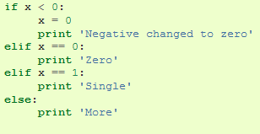
Python programming: if

Slide 24

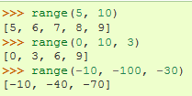
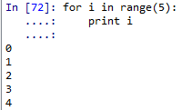
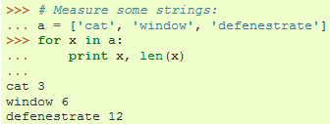
Python programming: for, range
There are “continue” and “break” commands for for loops too.

Slide 25
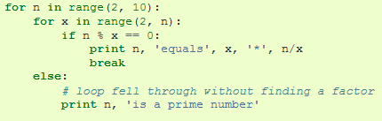
Python programming: “White space”
For “if”, “for”, “def”, “else”, etc. [commands ending in ‘:’ ], the associated code is whatever is indented afterwards.
“else” goes with “for” not “if”.

Slide 26
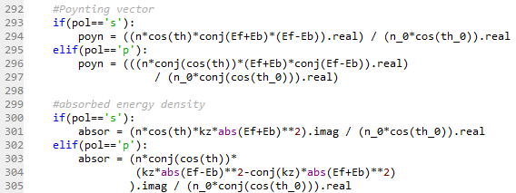
Python programming: “White space”
The end of a line is the end of a command.
For longer commands, use parentheses…when there’s dangling parentheses / brackets, Python assumes the command is continuing to the next line. [Alternative: End a line with a backslash.]

Slide 27
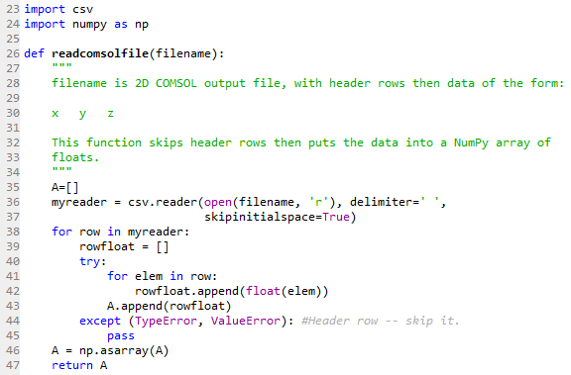
Importing data – an example. [File has unknown number of header rows.]
“csv” is a standard Python package for reading data-files.
Good practice: Start each function with a block-quote describing it.
Consecutive spaces are treated as just one separator.
Convert each item to a real number and put it in a list, then append the list as a new row in “A”.
If you can’t convert to a real number, then it’s a header row. Don’t do anything.
Convert “A” from a list-of-lists to a NumPy 2D array.

Slide 28
More information
http://sjbyrnes.com/?page_id=67 has links at the bottom to the standard Python and NumPy tutorials, and also listings of Python packages you can freely use.

