Slide 1
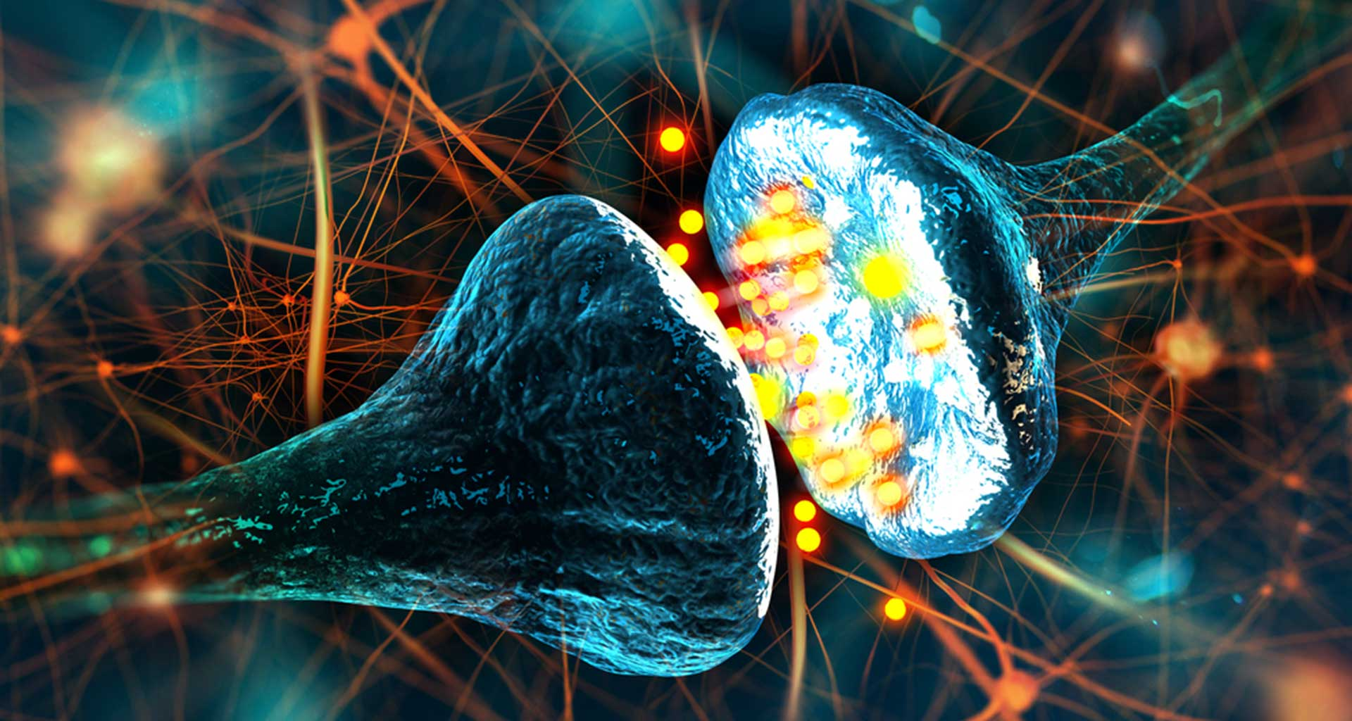
ZCP301 Anti-seizure Drugs & Epilepsy
Dr J. McCartney
Dept Pharmacy
Nelson Mandela University

Slide 2
Recommended reading
Pathophysiology:-
Hammer and McPhee -Pathophysiology of Disease 7e – “diseases of the nervous system”
Di Piro’s “Pharmacotherapy: a pathophysiologic approach 10e” - Chapters 56 (Epilepsy) and 57 (Status epilepticus)
Pharmacology:-
Katzung 14e – Chap 24 Antiseizure drugs
Rang & Dale 8e – Chap 45 Antiepileptic drugs
SAMF 12th edition for individual drug monographs
Recommended articles on ZCP301 Moodle site
EPILEPSY SOUTH AFRICA
http://www.epilepsy.org.za/
Patient information
http://www.Epilepsy.com

Slide 3
PATHOPHYSIOLOGY OF SEIZURES

Slide 4
Pathophysiology - Learning Outcomes
Be able to identify possible causes of seizures and their common signs and symptoms
Be familiar with the classification of seizures
Be able to identify factors which can lower the seizure threshold
Be able to identify drugs which are used clinically for their anticonvulsant action

Slide 5
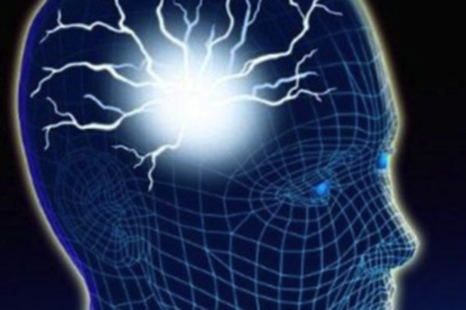
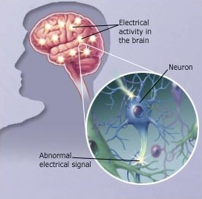
Seizures are caused by abnormal electrical activity in the brain

Slide 6
Definitions….
Seizure (convulsion)
Seizures ≈ episodic, high frequency discharge of impulses by a group of neurons in the brain (focus)
Detect abnormal electrical activity with EEG recording Electroencephalography
Brain imaging techniques, like MRI (magnetic resonance imaging), PET (positron emission topography)
Symptoms - a disturbance of consciousness, behaviour, emotion, motor function or sensation
Epilepsy
Chronic neurological disorder, recurrent seizures
Diagnosed after the appearance of ≥ 2 unprovoked, clearly witnessed or described seizures within a 12 month period

Slide 7
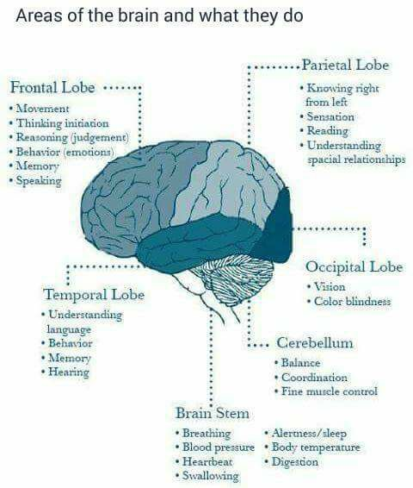
Motor cortex
Convulsions
Hypothalamus
Peripheral autonomic discharge
Reticular formation in brain stem
Loss of consciousness

Slide 8
Incidence
Epilepsy is the third most common neurological disorder (after stroke and dementia)
About 0.5 to 1% of the world’s population has epilepsy
Developed countries:-
estimated 400-600 /100 000
In developing countries:-
doubles!
Highest incidence is in children
roughly half of all first seizures occur < 20 years age

Slide 9

Classification of seizures

Slide 10
FOCAL ONSET SEIZURES (was known as partial onset)
Focal aware seizure (formerly simple partial seizure)
Focal impaired awareness seizure (formerly complex partial seizure)
Focal-to-bilateral tonic-clonic seizure (formerly partial seizure with secondary generalized seizures)
GENERALISED ONSET SEIZURES
Generalised tonic-clonic seizures (formerly primary generalized tonic-clonic seizure / grand mal )
Generalised absence seizures (formerly petit mal seizures)
Myoclonic seizures
Atonic seizures (also known as drop seizures / astatic seizures such as Lennox-Gastaut syndrome)
Epileptic spasms

Slide 11
CLASSIFICATION OF SEIZURES (ILAE – International League against Epilepsy)
PARTIAL or FOCAL SEIZURES ± 60% and characteristically preceded by an aura
Focal aware (simple partial seizures) | - Presence of aura, no altered consciousness
Focal impaired awareness (complex partial seizures) | - Presence of aura, impaired consciousness - Impaired consciousness alone or with involuntary automatic behaviour eg chewing, involuntary utterances
Focal – to – bllateral (partial seizures with secondary generalization) | - Simple or complex partial seizures, evolving to secondary spread and generalised seizures
GENERALISED SEIZURES characteristically not preceded by aura / warning
Tonic-clonic seizures (grand mal) ± 30% | - Initial short sustained muscle contraction (tonic) followed by cycle of repetitive muscle contraction & relaxation (clonic jerks)
Absence seizures (petit mal) ± 5% | - ≤ 10 secs, empty stare, interrupted consciousness, eyes rotate upwards. Clear consciousness immediately after attack.
Myoclonic Seizures ± 5 – 10% | - Sudden, brief, shock-like contractions, generalised or confined to an area (face, trunk, extremeties)
Others: Atonic Seizures; Myoclonic Seizures; Clonic Seizures; Tonic Seizures

Slide 12
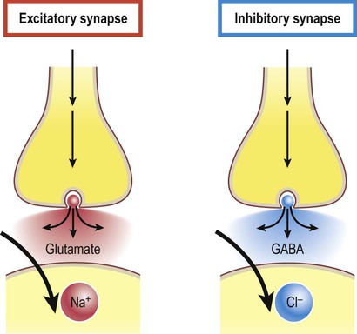
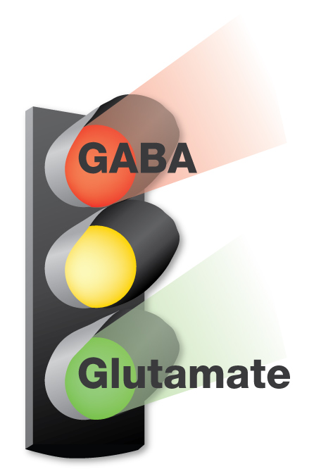
Pathophysiology

Slide 13
Cellular Mechanisms involved in Seizure Activity
↓↓↓ GABA mediated INHIBITORY transmission
ABNORMAL NEURONAL ACTIVITY
Membrane INSTABILITY (altered K⁺, Na⁺, T-type Ca⁺⁺ channel activity)
↑↑↑ EXCITATORY amino acid neurotransmitter activity (glutamine)

Slide 14
Refer to Katzung – 14th edition (AccessPharmacy
Fig 24.1 – Excitatory synapse – glutaminergic
Fig 24.2 –Inhibitory synapse – gabinergic

Slide 15
Common Causes of Seizures
MECHANICAL
Head trauma
Malformations
Tumours
Birth injury – hypoxia / asphyxia
Vascular abnormalities
Stroke
METABOLIC
Electrolytes
Water
Glucose
Amino acids
Lipids
pH
SUDDEN WITHDRAWAL OF DRUGS
Alcohol
Street Drugs
Antipsychotics
Antidepressants
Antiepileptics
TOXINS
Fever
Infection
eg syphilis, rubella, toxoplasmosis, bacterial meningitis, TB meningitis, viral encephalitis, HIV infection, neurocysticercosis (pork tapework Taenia solium)
HEREDITARY
IDIOPATHIC

Slide 16
SEIZURE MANAGEMENT
TREATMENT OF ACUTE SEIZURES

Slide 17
Acute Seizure Management
GOAL: stop seizure activity
Status epilepticus
medical emergency, risk of increased morbidity and mortality)
Defined as
……. any recurrent or continuous seizure activity lasting longer than 30 minutes in which the patient does not regain baseline mental status.
Any seizure that does not stop within 5 minutes should be aggressively treated as impending SE.

Slide 18
Status epilepticus (SA MANAGEMENT GUIDELINES; SAMF 2012; Di Piro Chap 57)
Minutes
0
Diazepam IV or Lorazepam IV or Clonazepam IV
5
Phenytoin IV
10
20 - 30
ICU for intubation & ventilation support
IV Thiopentone (Phenobarbitone or Pentobarbitone) or Midazolam or Propofol

Slide 19
SEIZURE MANAGEMENT
Prevention of Recurrent Seizures
ANY Underlying EPILEPTOGENIC CONDITION? (eg head trauma, meningitis, neurosurgery)
OR
Epilepsy? (chronic NEUROLOGICAL disease)

Slide 20
Treatment of Epilepsy
Mainstay = pharmacological
Successful drug treatment depends on:
Correct diagnosis and seizure classification
Patient education (60 – 80% patients non-compliant = most common cause of treatment failure)
Aim for monotherapy @ lowest dose, fewest side-effects
Initiate with single drug – OPTIMISE use, then consider a second agent if no improvement

Slide 21
PHARMACOLOGY - Learning Outcomes
Be familiar with the older anti-epileptic drugs (phenytoin, carbamazepine, phenobarbitone, sodium valproate, ethosuximide, benzodiazepines):-
Pharmacokinetics
Proposed mechanism of action
Adverse effects (dose-related vs idiosyncratic)
Contraindications
Clinical indications
Drug interactions

Slide 22
Year of development of AEDs
OLDER AEDs
Phenobarbitone 1912
Phenytoin 1938
Primidone 1952
Ethosuximide 1960
Carbamazepine 1962
Na⁺ valproate 1973
NEWER GENERATION AEDs
Vigabantrin 1989
Lamotrigine 1991
Gabapentin 1993
Topiramate 1995
Tiagabine 1998
Oxcarbazepine 2000
Levetiracetam 2000

Slide 23
Epanutin®
PHENYTOIN
(diphenylhydantoin)

Slide 24
PHENYTOIN – Mechanism of Action
Use dependent blockade of sodium channels
Preferred binding to inactivated state of channel – prolonged duration of inactivation
↓ ↓ ↓ repetitive action potentials and
↓ neuronal excitability

Slide 25
Phenytoin’s mechanism of action
Use dependent blockade of sodium channels
Presynatically - reduce calcium influx across cellular membranes (inhibit calcium mediated release of hormones and neurotransmitters eg reduced glutamate release)
Presynaptically – may increase GABA release
much less sedating

Slide 26
Phenytoin - Pharmacokinetics
ABSORPTION
Well absorbed orally BUT highly variable bioavailability depending on formulation
Need to stabilise patient on ONE formulation
DISTRIBUTION
Accumulates in brain. Liver, muscle and fat
PLASMA PROTEIN BINDING
90 - 95% bound to albumin (TDM – TOTAL phenytoin)
HEPATIC METABOLISM
Phenytoin INDUCES hepatic mixed function oxidases (CYP450)
Metabolised by CYP2C9, CYP2C19, CYP3A4 and hydroxylation
Inactive metabolites (glucuronide); < 5% excreted unchanged in urine

Slide 27
Phenytoin - Pharmacokinetics
DOSE-DEPENDENT ELIMINATION (saturation kinetics)
Unpredictable variations in plasma levels when changing doses
Variable t_{½} - averaging 24 hrs (12 – 36 hrs)
t_{½} increases as the dose increases
TDM (Therapeutic Drug Monitoring)
Narrow therapeutic range 40 – 100 µmol/l
Considerable inter-individual variations in plasma concentration from same dose

Slide 28
Phenytoin dosing
K 14e
As dose increases, saturation of metabolism occurs (shift from first-order to zero-order elimination kinetics)
Small increase in dose produces large increase in Cp
Increase doses by no more than 25 to 30mg/day, and allow time for new Cp_{ss} to be achieved
Narrow therapeutic index!
Notes:
Relationship between dose and exposure for antiseizure drugs (ASDs). Most antiseizure drugs follow linear (first-order) kinetics, in which a constant fraction per unit time of the drug is eliminated (elimination is proportional to drug concentration). In the case of phenytoin, as the dose increases, there is saturation of metabolism and a shift from first-order to zero-order kinetics, in which a constant quantity per unit time is metabolized. A small increase in dose can result in a large increase in concentration. Orally administered gabapentin also exhibits zero-order kinetics, but in contrast to phenytoin where metabolism can be saturated, in the case of gabapentin, gut absorption, which is mediated by the large neutral amino acid system L transporter, is susceptible to saturation. The bioavailability of gabapentin falls at high doses as the transporter is saturated so that increases in blood levels do not keep pace with increases in dose.

Slide 29
Phenytoin – Adverse Effects
Dose-dependent (predictable)
Nausea
Nystagmus
Diplopia
Ataxia
Tremor
Headache
Vertigo
Speech disturbances
Confusion / lethargy / drowsiness
Cognitive Impairment
Independent of dose (idiosyncratic)
Gingival hyperplasia
Hirsutism
Coarsening of features
Skin rashes
Megaloblastic anaemia
Hepatotoxicity
Mild peripheral neuropathy
Increasing
plasma
concentrations

Slide 30
Therapeutic Uses
Partial / focal
Generalised tonic –clonic seizures
(Worsens absence / myoclonic seizures)
Status epilepticus (parenteral form)
Anti-arrhythmic

Slide 31
Drug interactions (refer to SAMF 2012)
Drugs which will increase phenytoin serum levels
Acute alcohol intake, cimetidine, isoniazid, sulphonamides ……
Drugs which decrease phenytoin levels
Chronic alcohol abuse, folic acid, rifampicin
Interactions with other AED’s
Antiretrovirals – try to avoid concurrent use (why?)
Avoid dosing at the same time as calcium containing supplements and antacids
Reduced therapeutic effectiveness of drugs
corticosteroids, oral contraceptives

Slide 32
(Tegretol®)
CARBAMAZEPINE

Slide 33
Carbamazepine – Mechanism of Action
Use dependent blockade of sodium channels
↓↓↓ high frequency repetitive neuronal firing (membrane stabilising effect)
Presynaptically - ↓ Ca⁺⁺ entry , ↓ neurotransmitter release

Slide 34
Carbamazepine - Pharmacokinetics
ABSORPTION
Complete but variable absorption (f=80%)
DISTRIBUTION
70% plasma protein bound (interactions not clinically significant
METABOLISM
Hepatic biotransformation (CYP450)
Active metabolite carbamazepine-10,11-epoxide
Potent hepatic CYP450 enzyme inducer
Auto inducer (t^{1/2} 30hrs, after 1 month t^{1/2} = 15 hrs)
RENAL EXCRETION
< 1 % excreted renally unchanged

Slide 35
https://www.pharmgkb.org/pathway/PA165817070
CBZ’s metabolic pathway
Stylized liver cell depicting candidate genes involved in the pharmacokinetics of carbamazepine.

Slide 36
Carbamazepine – Adverse effects
Dose-dependent
Drowsiness
GIT upset (nausea / vomiting)
Diplopia
Ataxia
Vertigo / dizziness
Headache
Idiosyncratic
Hepatotoxicity
Blood dyscrasias (aplastic anaemia, agranulocytosis, mild, persistant leucopenia)
Skin rashes
Hyponatremia
Therapeutic Range: 17 – 51 µmol/l

Slide 37
Therapeutic Uses
Newly diagnosed partial seizures
Primary generalised convulsive seizures
NOT for absence or atonic seizures
Adjunct – chronic pain management
trigeminal neuralgia, peripheral neuropathy, multiple sclerosis, nerve trauma
Bipolar disorder (alternative to lithium)
Diabetes insipidus

Slide 38
Drug interactions (SAMF 2012)
Drugs which increase CBZ levels
Drugs which decrease CBZ levels
Other AED’s
ARVs and CBZ
CBZ and contraceptive use

Slide 39
Epilim®
SODIUM VALPROATE / VALPROIC ACID

Slide 40
Sodium Valproate -Mechanism of Action
Not really understood
? Use dependent blockade of Na⁺ channels
Blocks sustained high frequency repetitive firing of neurones
Increased GABA activity
inhibit breakdown of GABA by inhibition of GABA-T
Inhibits GAT-1 activity (increased GABA synaptic levels)
promote synthesis of GABA via GAD (glutamic acid decarboxylase)

Slide 41
Sodium Valproate --- Pharmacokinetics
Absorption
Oral bioavailability > 80; ** parenteral form **
sodium valproate valproic acid
Distribution
Highly ionised, Vd confined to extracellular water
90-95% bound to albumin * saturation binding
Metabolism
Hepatic biotransformation (CYP450)
Variable t_{1/2} – varies from 6 to 18 hours
CYP450 enzyme inhibitor
INTESTINE
Therapeutic range: 280 – 700 µmol/ml

Slide 42
VPA is metabolized by | VPA inhibits | VPA induces
CYP2A6, 2B6, 2C9, 2C19, 2E1 | CYP2C9 & 2C19 (weak), 2D6 (weak), 3A4 (weak) | CYP2A6 (weak)

Slide 43
Drug interactions
Drugs which INCREASE VPA clearance – LOW Cp
Phenytoin
Lamotrigine
Rifampicin
Carbamazepine
Barbiturates
Carbapenem antibiotics (eg ertapenem)
Drugs which DECREASE VPA clearance – HIGHER Cp
Cimetidine
Chlorpromazine
VPA INHIBITS clearance of
Clonazepam
Carbamazepine
Phenytoin
Lamotrigine
Zidovudine
Amitriptyline

Slide 44
Carbapenems & valproate
FACT
Co-treatment with carbapenem while on VPA lowers VPA levels
May cause 60% to 80% decrease in serum concentration of valproate within the first few days.
20% of patients have recurrent seizures.
Increasing VPA dose DOESN’T counteract drop in VPA levels
Notes:
Bede, Peter. Epilepsia Open Volume: 2 Issue 1 (2017) ISSN: 2470-9239
Bates, Parkin, Duggan Can J Hosp Pharm. 2010 Jul-Aug; 63(4): 315–322 Ertapenem-Induced Reduction in Valproate Levels: Case Report and Review of the Literature

Slide 45
Sodium Valproate – Adverse effects
Dose related
GIT distress (nausea/vomiting, diarrhoea or constipation)
Fine tremor
Drowsiness / fatigue
Ataxia
Hepatotoxicity (1 in 20000) – especially < 2 years OR on multiple AED’s
Monitor for symptoms of tiredness, weakness, anorexia and jaundice
Thrombocytopenia
Appetite/weight gain
Alopecia / curly hair
Menstrual irregularities
Inc
reas
Ing
l
eve
l
s

Slide 46
Theraputic uses – Sodium Valproate
Partial seizures
Generalised tonic-clonic seizures
Absence seizures
______________________________
Migraine prophylaxis
Acute manic phase of bipolar disorder

Slide 47
Drug interactions (SAMF 2012)
Drugs which increase VALP levels
Drugs which decrease VALP levels
Other AED’s
ARVs and VALP
VALP and oral contraceptives ** no reduction in OC efficacy

Slide 48
Zarontin®
ETHOSUXIMIDE

Slide 49
Ethosuximide
Mechanism of Action
?? Inhibits low-threshold Ca++ currents (T-currents)
Therapeutic Use
Absence seizures

Slide 50
Ethosuximide - Pharmacokinetics
Absorption
Good, complete oral absorption
Plasma protein binding
Low
Metabolism
Hepatic, via hydroxylation
T_{1/2} = 40 hrs
Excretion
10 – 20% excreted unchanged in urine
Therapeutic Range: 40 – 100 µg/ml

Slide 51
Ethosuximide – Adverse effects
Nausea / vomiting
Anorexia
GIT – abdominal pain, gastric irritation
Dizziness
Headache
Sleep disturbances
Inability to concentrate
Rashes
Blood dyscrasias

Slide 52
BARBITURATES

Slide 53
Phenobarbitone (Barbiturate)
[thiopentone, phenobarbitone, pentobarbitone, mephobarbitone, primidone]
Enhanced inhibitory pathways & diminished excitatory activity
Agonist at GABA receptor (allosteric regulatory site)
Decreased glutamate action (AMPA receptor)

Slide 54
Phenobarbitone - Pharmacokinetics
Absorption
Good oral bioavailability
Parenteral use (thiopentone, phenobarbitone)
Plasma protein binding
50% protein bound
Metabolism
Hepatic biotransformation – long t^{1/2} ± 40 hrs
Potent (CYP450) enzyme inducer
Excretion
25% excreted unchanged in urine
Alkaline urine increases excretion rate

Slide 55
Phenobarbitone - Adverse effects
Sedating
Impaired cognitive function
Children – paradoxical hyperactivity
Respiratory failure in high doses
Skin rashes
Megaloblastic anaemia
Osteomalacia
Tolerance develops
Therapeutic Range: 65 – 175 µmol/l

Slide 56
BENZODIAZEPINES

Slide 57
Benzodiazepines
Lorazepam
Diazepam
Clonazepam
Midazolam – unresponsive status epilepticus
Mechanism of action – facilitates central GABA activity

Slide 58
Anti-seizure activity
DIAZEPAM
LORAZEPAM
MIDAZOLAM
CLONAZEPAM

Slide 59
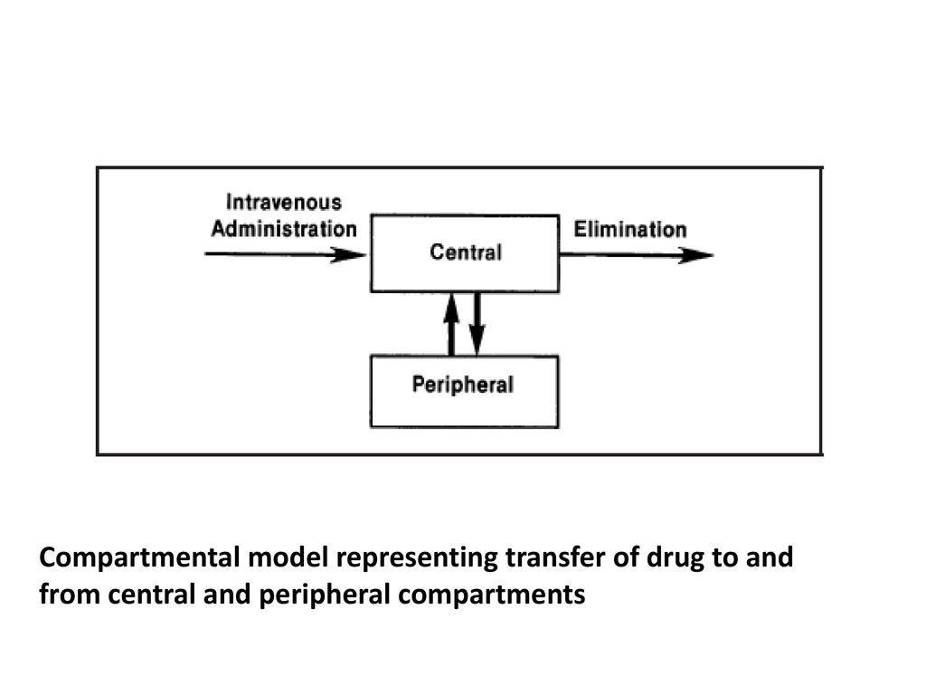
Acute seizure control
1. IV LORAZEPAM or DIAZEPAM lorazepam less lipophilic than diazepam, (slower re-distribution from brain to peripheral tissues AND lower peripheral tissue uptake * clinical effective concentrations are achieved in brain for longer
clinically effective concentrations of diazepam fall rapidly as drug leaves central compartment and moves into peripheral fat
2. IV PHENYTOIN (or SODIUM VALPROATE)
loading dose is usually given to saturate the albumin binding sites
3. REFRACTORY SEIZURES treated with IV midazolam or propofol or thiopentone

Slide 60
Benzodiazepines
ADVANTAGES
Injectable forms (acute seizure management)
Diazepam or lorazepam for acute seizures
Clonazepam – long acting potent antiseizure drug – indicated for absence, atonic, myoclonic
Midazolam – short-acting – administered as infusion * easy to titrate dose
DISADVANTAGES
Sedation
Tolerance

Slide 61
Lecture 3 - Learning Outcomes
Be familiar with the newer anti-epileptic drugs
Pharmacokinetics
Proposed mechanism of action
Common adverse effects
Clinical indications and place in therapy
Drug interactions
Vigabantrin (Sabril®)
Lamotrigine (Lamictin®)
Gabapentin (Neurontin®)
Oxcarbazepine (Trileptal®)
Levetiracetam (Kippra®)
Topiramate (Topamax®)
Also …. Pregabalin, felbamate, tiagabine zonisamide

Slide 62
Why the need for more AED’s?
Older AED’s associated with:
Lack of efficacy in certain epilepsies
Unfavourable pharmacokinetics
Narrow therapeutic index
Adverse CNS effects
Significant idiosyncratic reactions
Numerous drug interactions

Slide 63
Enhanced GABA action
Mechanisms of action

Slide 64
Neurontin®
GABAPENTIN

Slide 65
GABAPENTIN (Neurontin®)
MOA
GABA-analogue
Appears to alter synaptic release of GABA
Increasing synaptic GABA concentrations
BUT does not act directly on GABA receptors
Presynaptic – decrease glutamate release (and other neurotransmitters)
Due to binding to α2δ subunit of T-type voltage –gated Ca++ channels

Slide 66
Gabapentin
Adverse effects
Common – drowsiness, ataxia, headache, dizziness, nystamus, tremor, fatigue, visual disturbances, peripheral oedema, N&V
DI’s
Antacids reduce absorption by 25%
No interaction with other AED’s or OC’s
Used as monotherapy OR as add-on treatment of focal (partial) seizures
Not for absence seizures
Neuropathic pain
Renal elimination (parallels CrCl)
T ½ = 6 hrs
Does not induce CYP450
Low potential for DI’s

Slide 67
Lyrica®
PREGABALIN

Slide 68
PREGABALIN (Lyrica®)
GABA analogue
Structurally similar to gabapentin (and GABA) (Kp413)
More potent
Presynaptic – decrease glutamate release (and other neurotransmitters)
Due to binding to α2δ subunit of T-type voltage –gated Ca++ channels
IN SA – registered for neuropathic pain (post-herpetic neuralgia and diabetic neuropathy) ** use SAMF & compile a note in your PAIN section
Off label use - focal (partial) epilepsy

Slide 69
Sabril®
VIGABANTRIN

Slide 70
VIGABANTRIN (Sabril®)
MOA
Enhances GABA effects
Irreversible inhibitor of GABA-T (GABA aminotransferase / GABA transaminase)
GABA-T breaks down GABA presynaptically
So increasing synaptic GABA concentrations

Slide 71
Vigabantrin
USE as add-on therapy for simple or complex partial seizures
Used for infantile spasm & Lennox-Gestaut syndrome
Predominantly renal elimination (70%)
Abrupt withdrawal can ppt seizures & psychotic features
Drowsiness, fatigue, dizziness, weight increase, nystagmus, visual field constriction
* these significant irreversible visual defects limit its use
avoid if pre-existing mental illness – can cause aggression, agitation, amnesia, depression, psychosis or behaviour problems

Slide 72
?? ®
TIAGABINE

Slide 73
TIAGABINE
Inhibits GABA uptake in neurones & glia
Selective inhibitor of presynaptic reuptake transporter GAT1
Increases extracellular GABA (forebrain & hippocampus)
Prolonged GABAnergic effects

Slide 74
Tiagabine ..
Well tolerated
Dose related – nervousness, tremor, dizziness, concentration difficulties, depression
Discontinue IF excessive confusion, drowsiness, ataxia
RARE – psychosis, rash
USES – partial seizure
PHARMACOKINETICS
Hepatically metabolised by CYP3A4
DI with enzyme inducers

Slide 75
Sodium channel blockade
Mechanisms of action

Slide 76
Lamictin®
LAMOTRIGINE

Slide 77
LAMOTRIGINE (Lamictin®)
MOA
Causes a voltage and use-dependent block of sodium channels
Suppresses sustained rapid neuronal firing
?? Blocks voltage gated Ca++ channels to decrease glutamate release into synapse

Slide 78
Lamotrigine .....
USES – monotherapy OR add-on therapy for focal seizures and primary generalised seizures
Absence /myoclonic seizures
Bipolar affective disorders
DOSES differ if monotherapy vs add-on (SAMF)
Auto-inducer (weak)
Elimination – hepatic
Drug interactions ** SAMF ** eg valproate
Dizziness, headache, diplopia, nystagmus, ataxia, nausea, somnolence, maculopapular skin rash (hypersensitivity reaction)
Rare – haematological disturbances

Slide 79
ADVERSE EFFECTS - lamotrigine
Dizziness, headache, diplopia, nausea, somnolence
Serious life-threatening RASHES
Steven-Johnson syndrome, toxic epidermal necrolysis
Occur within first few months of use
Patients at risk – also on valproate, excessively high starting dose, rapid escalation of doses (faster than every 1 to 2 weeks)
Paradoxical insomnia (not drowsiness)

Slide 80
DRUG INTERACTIONS - LAMOTRIGINE
Lamotrigine + valproate
clinically proven effective combination
valproate INCREASES lamotrigine’s t_{1/2}
need to lower lamotrigine dose if adding valproate

Slide 81
Trileptal®
Oxcarbazepine

Slide 82
Oxcarbazepine (Trileptal®)
Similar chemical structure to carbamazepine (ie carboxamide deriv)
Equivalent anti-seizure activity
Less adverse effects and drug interactions
Minimal CYP450 induction / no auto-induction
USES – primary generalised tonic-clonic seizures and partial seizures
Hyponatremia
Dermatological reactions (eg Stevens Johnson, toxic epidermal necrolysis)

Slide 83
Multiple or unknown mechanisms of action

Slide 84
Topamax®
TOPIRAMATE

Slide 85
TOPIRAMATE (Topamax®)
Thought to block the spread of seizures via multiple actions
Blockade of voltage gated sodium channels
Potentiates inhibitory effects of GABA
(? Binding site)
Suppresses excitatory pathways – blocking kainate activity at glutamate receptors

Slide 86
Topiramate ...
USES – monotherapy or add-on for primary generalised seizures, partial seizures, absence seizures, Lennox-Gastaut syndrome
Migraine prophylaxis
DRUG INTERACTIONS – refer SAMF 2012
Main route of elimination = renal (>65%)
Dose-related – drowsiness, fatigue, dizziness, ataxia, cognitive slowing, nervousness, confusion, parathesias
Discontinue if glaucoma or myopia ** counsel re acute ocular effects
Nephrolithiasis (carbonic anhydrase inhibitor) – maintain good hydration levels

Slide 87
®
FELBAMATE

Slide 88
FELBAMATE
Third line agent for refractory partial seizures (Problems!! - aplastic anaemia / severe hepatitis)
Multiple MOA’s
Use-dependent block of NMDA receptors
Enhanced GABA_{A} receptor effects

Slide 89
Keppra®
LEVETIRACETAM

Slide 90
LEVETIRACETAM - pharmacodynamics
MECHANISM OF ACTION
Still to be determined ☺
Binds to synaptic vesicle protein 2A (SV2A)
Indications
Antiepileptic, anxiolytic, and cognitive enhancing properties
S-enantiomer of levetiracetam provides anticonvulsant activity
> 16 years of age - used alone or add-on therapy for focal seizures, with or without secondary generalized tonic-clonic seizures
> 16 years of age – add on therapy for primary generalized tonic clonic seizures
> 12 years of age – add on therapy for myoclonic seizures
Notes:
Analogue of the nootropic agent piracetam (Nootropil®)
Nootropic drugs including levetiracetam stimulate several neurochemical systems, including dopaminergic, cholinergic, and glutamatergic neurotransmission

Slide 91
Pharmacokinetic OVERVIEW – LEVETIRACETAM
ABSORPTION
Oral formulations only (tablets / oral solution)
Bioavailability unaffected by food - close to 100%
DISTRIBUTION
Minimal protein binding – 3 to 4%
Volume of Distribution - 0.7 L/kg (readily distributes into CSF fluid)
t_{1/2} levetiracetam is three times longer in the CSF than the plasma = longer duration of action at desired site
Twice daily administration.

Slide 92
Pharmacokinetic OVERVIEW – LEVETIRACETAM
ELIMINATION
Half life of 7 hours +/- 1 hour (affected by repeated dosing)
TDM - Therapeutic range:
Drug level monitoring for levetiracetam (assess compliance or overdose)
Reference range = 12 to 46 mg/L (70 to 270 mcmol/L)

Slide 93
ELIMINATION OF LEVETIRACETAM
EXTRA -HEPATIC elimination (NO metabolism by hepatic CYP450 isoenzymes)
RENAL:-
≈ 67% of levetiracetam is eliminated unchanged (by glomerular filtration with subsequent partial tubular reabsorption)
Levetiracetam elimination ≈ creatinine clearance
Dose adjustments in moderate-to-severe renal impairment (elderly patients; patients on hemodialysis)
BLOOD:-
≈ 33% undergoes enzymatic hydrolysis in blood (inactive metabolites)

Slide 94
Adverse effects - levetiracetam
Common
Somnolence, fatigue, dizziness
Uncommon
Headache, loss of appetite, diarrhea, dydpepsia, nausea, amnesia, ataxia, convulsions, depression, emotional lability, hostility, insomnia, …….

Slide 95
New developments ..
PERAMPANEL
= AMPA-type GLUTAMATE RECEPTOR ANTAGONIST
Highly selective, non-competitive antagonist
Partial seizures (phase III trial – 706 pts)
Adverse effects
dizziness, somnolence, headache

Slide 96
Lecture 4 - Learning Outcomes
Be able to discuss the management of epilepsy and the selection of appropriate anticonvulsant drugs.
Be aware of special considerations when treating epilepsy: i.e.
Contraception and Pregnancy
Withdrawal
Drugs to be avoided in epilepsy, Non-compliance
Drug interactions, Ketogenic diet
Understand the role of drug level monitoring (TDM) when individualising therapy
Be able to develop a monitoring plan in order to optimise seizure control in an epileptic patient

Slide 97
Contraception
Phenytoin / phenobarbitone / carbamazepine / topiramate
hepatic enzyme inducers
Low-dose combined contraceptive pill or progesterone only OC
PILL FAILURE
Contraception in women taking hepatic enzyme inducers
OC with higher oestrogen content (> 50 µg)
or use alternative contraception

Slide 98
Pregnancy
3 – 4 in 1000 pregnant women are epileptic
Concern – teratogenic effects of anti-epileptic drugs
Risk of major congenital malformations is 2x to 3x greater in epileptic women
BUT 90% of women with epilepsy have healthy, normal babies despite taking AEDs
Pregnancy and epilepsy **specialist care**
Pregnancy can alter seizure frequency
Drug selection – benefit vs risk – must control seizures and minimise foetal risk

Slide 99
Incidence of Birth Defects….
Incidence of spontaneous malformations in neonates = 2 - 3% (1:40 live births)
Incidence of spontaneous miscarriage rates = 10 - 20%
Incidence of drug-induced birth defects estimated to be < 1% (conservatively 2 - 3%)
??? Exaggerated risk of drug-induced teratogenicity
??? Underestimated benefits of drug due in pregnancy

Slide 100
Pregnancy continued
Phenytoin
Carbamazepine
Phenobarbitone
Sodium Valproate
*neural tube defects – exposure bet days 17 and 30 post-fertilisation
Newer generation anticonvulsants
Recommendation:
Folic acid supplementation before and during pregnancy
Drug use & lactation – encourage breastfeeding

Slide 101
3. Withdrawal of Anti-Epileptic Therapy
If seizure free for 2 years (absence seizures) or 4 years (partial / tonic-clonic)
Achieved complete seizure control within first year of onset
Normal EEG
Inappropriate use of anticonvulsants
Not recommended if mixed / myoclonic seizures
DO NOT STOP ABRUPTLY – PPT SEIZURES
Withdrawal must be gradual – e.g. reduce dose by 25% every 3 months

Slide 102
Factors affecting the extent of plasma protein binding
*Several antiepileptics are highly protein bound*
Chronic renal failure
Liver disease
Hypoalbuminaemia
Burns
Pregnancy
Malnutrition
Extremes of age – neonates / elderly
Concomitant use of other highly protein bound drugs

Slide 103
Drugs to be avoided in Epilepsy
Alcohol
Antibiotics (eg penicillin, imipenem, nalidixic acid, quinolones)
Antimalarials (e.g mefloquine, chloroquine)
Antihistamines (cough, cold & flu remedies)
Drugs of Abuse (eg cocaine, amphetamines)
Evening primrose oil
Isoniazid
Lignocaine
Lithium
Phenothiazines (eg thioridazine)
Theophylline
Tricyclic antidepressants
Vincristine

Slide 104
Factors leading to Non-compliance
Limited access to medicine
Transport difficulty / driving inability
Lack of time
Financial restrictions
Increased complexity of dosage regimen
- inconvenience
- frequent / complicated dosage regimens
- polytherapy
- anxiety / confusion
- misunderstanding instructions

Slide 105
Factors leading to Non-compliance
Poor education
Unclear / lack of instructions on how to use medicine
Lack of patient information re epilepsy
Poor understanding of reason for medication use
Medical aspects
- adverse effects (impaired cognition, “cosmetic” ADR’s)
- cognitive effects of seizures
- other comorbid conditions
- memory loss due to brain damage
- forgetfulness

Slide 106
Factors leading to Non-compliance
Psychosocial factors
- weak emotional support by family / friends
- poor relationship with health care providers
- fear of addiction / adverse effects
- denial of disease
- financial distress (unemployment)
- discontinuing AED’s to check if “cured”
- not coping
- decreased seizure frequency (ie seizure control!) – patient develops a lax attitude to medication

Slide 107
TDM (Therapeutic Drug Monitoring)
Use serum drug levels to:-
Confirm that the dose is optimal (i.e. therapeutic serum levels achieved)
Confirm AED-induced toxicity
Establish ineffectiveness (ie lack of seizure control despite therapeutic drug levels)
Only applies to those AEDs
with established relationship
between serum level and clinical effect.

Slide 108
CNS Adverse effects of AEDs
BEHAVIOURAL / MOTOR
Phenytoin
Tiredness, ataxia, involunary movements, alteration of emotional state
Phenobarbitone
Hyperactivity, lethargy, irritability, fussiness, disobedience, altered sleep
Carbamazepine
Irritability, difficulty in sleeping, agitation, emotional liability
Sodium Valproate
Drowsiness
COGNITIVE
Phenytoin
Impaired cognitive functioning, decreased attention, decreased problem solving
Phenobarbitone
Impaired cognitive functioning, impaired short-term memory, decreased concentration
Carbamazepine
Minimal
Sodium Valproate
Minimal

Slide 109
Ketogenic Diet
Controversial use – refractory epilepsy (paediatics)
Trial if patient experiences unacceptable toxicity or shows no response to drugs
Patient must have already tried 3 or more AED’s, very compliant and good support system
Ketogenic diet = high fat, low protein & carbohydrate – ↑↑↑↑ ketones

