Slide 1


PANIMALAR ENGINEERING COLLEGE
DEPARTMENT OF COMPUTER SCIENCE AND ENGINEERING
CS8811 PROJECT WORK
AUTONOMOUS VULNERABILITY SCANNER
FOR NETWORK SECURITY
Guide Name: Dr.S.BALAJI,BTech,M.E,Ph.D
ASSOCIATE PROFESSOR
TEAM MEMBERS
1.MUKUNTH VENKATESH N G – 211418104161
2.SANTHOSHKUMAR A -211418104228
3.MATHESWARAN K K -211418104149
BATCH NO: D1

Slide 2
INTRODUCTION
Vulnerability Scanning is more important to devise new strategies and methodologies,To help Software developer to security breaches to which the user is prone to.
Not only the software developed with flaws makes the user vulnerable to attacks, most often network also becomes a key factor by compromising the security aspect of the users. The use of vulnerability scanners to detect the vulnerabilities is quite prominent today.
Vulnerability scanner offers a much faster and experience when comes to vulnerabilities ,however the speed and functions of Automated vulnerability can affect by following factors.
Type of connection:Remote and local
Authentication:Unauthoried scan

Slide 3
LITERATURE SURVEY
TABLE:
Evaluation of web vulnerability scanner
A cost-effective approach to evaluating security vulnerability scanner
An Automatic Vulnerability Scanner for Web Applications
A Systematic Literature Review on the Characteristics and Effectiveness of Web Application Vulnerability Scanners

Slide 4
PROBLEM STATEMENT
The progressive development of technology and the urgent requirement of network security, vulnerability scanner has been particularly emphasized, which is regarded as a fundamental component for network security assurance.
Various scanners are developed with the intention of that discovering the possible vulnerabilities in advance to avoid malicious attacks.
However most of them focus on a single target. In this project, an effective network vulnerability scanner that integrates the information collection with the vulnerability detection is proposed to verify whether the the IP which is available globally are vulnerable or not.
The experimental results show that, by guiding the detection process with the useful collected information, our tool achieves great web vulnerability detection capability with a large scanning scope.

Slide 5
DEVELOPMENT ENVIRONMENT
HARDWARE REQUIREMENTS
SOFTWARE REQUIREMENTS
STORAGE REQUIRED | 500MB
PROCESSOR | INTELi5
SYSTEM TYPE | 64bit
RAM | >4GB
OPERATING SYSTEM | LINUX
PROGRAMMING LANGUAGE (BACKEND) | PYTHON
PROGRAMMING LANGUAGE (FRONTEND) | HTML,CSS
DATABASE | MONGO DB
APPLICATION PROGRAMMING INTERFACE(API) | FLASK

Slide 6
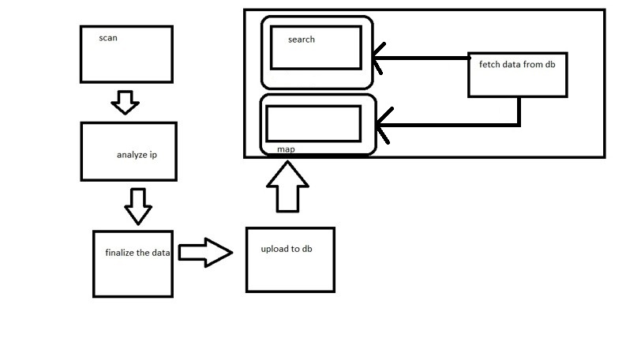
SYSTEM ARCHITECTURE

Slide 7
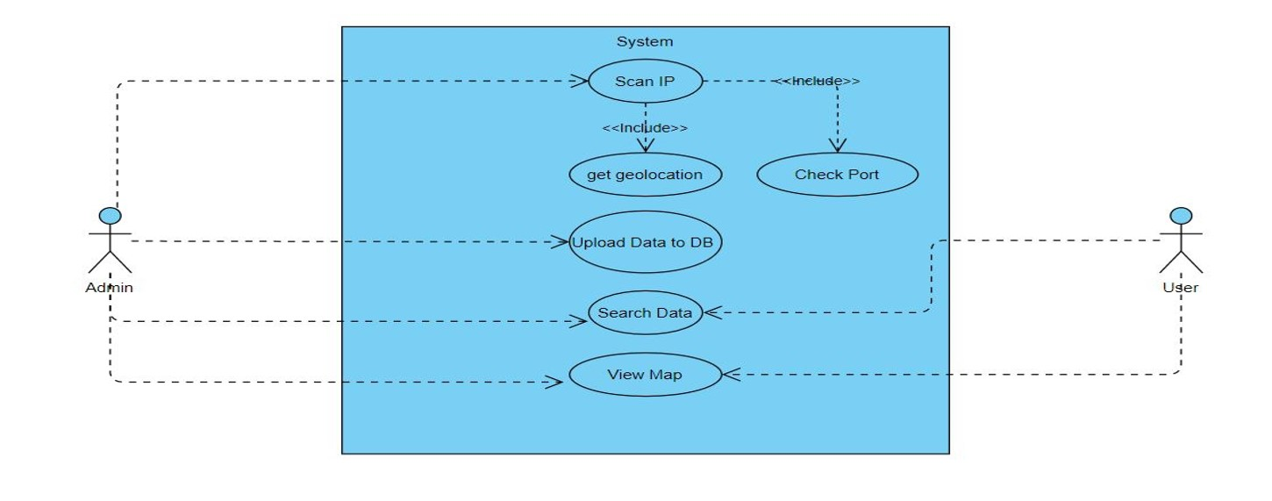
SYSTEM DESIGN
USE CASE DIAGRAM

Slide 8
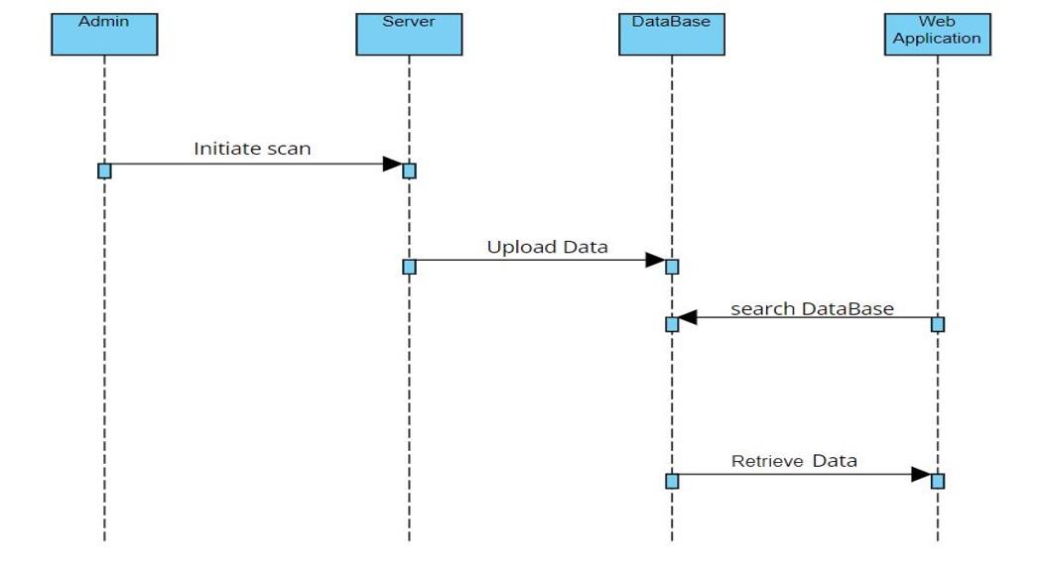
SEQUENCE DIAGRAM

Slide 9
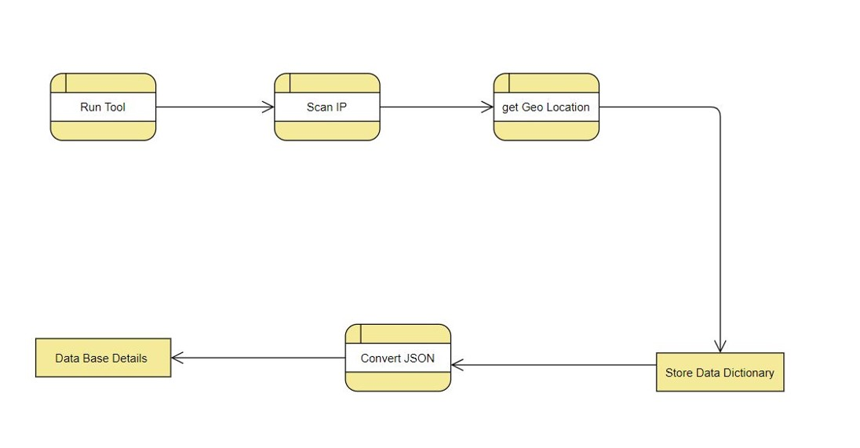
DATA FLOW DIAGRAM

Slide 10
MODULE DESCRIPTION
1.JSON
JSON (JavaScript Object Notation), is an open standard file format and data interchange format that uses human-readable text to store and transmit data objects consisting of attribute-value pairs and arrays(or other serializable values).
JSON is a language-independent data format.
It was derived from JavaScript, but many modern programming languages include code to generate and parse JSON-format data. JSON filenames use the extension .json .

Slide 11
2. ASYNCIO
asyncio is a library to write concurrent code using the async/await syntax.asyncio is used as a foundation for multiple Python asynchronous frameworks that provide high-performance network and web-servers, database connection libraries, distributed task queues, etc.
asyncio is often a perfect fit for IO-bound and high-level structured network code.
asyncio provides a set of high-level APIs.

Slide 12
3. FOLIUM
Folium is a powerful Python library that helps you create several types of Leaflet maps.By default, Folium creates a map in a separate HTML file.
Folium builds on the data wrangling strengths of the Python ecosystem and the mapping strengths of the Leaflet.js library.
Using Folium, you can manipulate your data in Python, then visualize it in a Leaflet map.Folium enables you to generate a base map of specified width and height with either default tilesets (i.e., map styles) or a custom tileset URL.

Slide 13
4. URLLIB
Urllib package is the URL handling module for python.
It is used to fetch URLs (Uniform Resource Locators).
It uses the urlopen function and is able to fetch URLs using a variety of different protocols.

Slide 14
5. REGEX
A Regular Expressions (RegEx) is a special sequence of characters that uses a search pattern to find a string or set of strings.
It can detect the presence or absence of a text by matching with a particular pattern, and also can split a pattern into one or more sub- patterns.
Python provides a re module that supports the use of regex in Python. Its primary function is to offer a search, where it takes a regular expression and a string.

Slide 15
6. TELNET
The telnetlib module provides a Telnet class that implements the Telnet protocol. In addition, it provides symbolic constants for the protocol characters,and for the telnet options.
The symbolic constants for the telnet commands are: IAC, DONT, DO, WONT, WILL, SE (Subnegotiation End), NOP (No Operation), DM (Data Mark), BRK (Break), IP (Interrupt process), AO (Abort output), AYT (Are You There), EC (Erase Character), EL (Erase Line), GA (Go Ahead), SB (Subnegotiation Begin).

Slide 16
7. FTPLIB
This module defines the class FTP and a few related items. The FTP class implements the client side of the FTP protocol.
It is used to write the Python programs that perform a variety of automated FTP jobs, such as mirroring other FTP servers.
It is also used by the module urllib.request to handle URLs that use FTP.

Slide 17
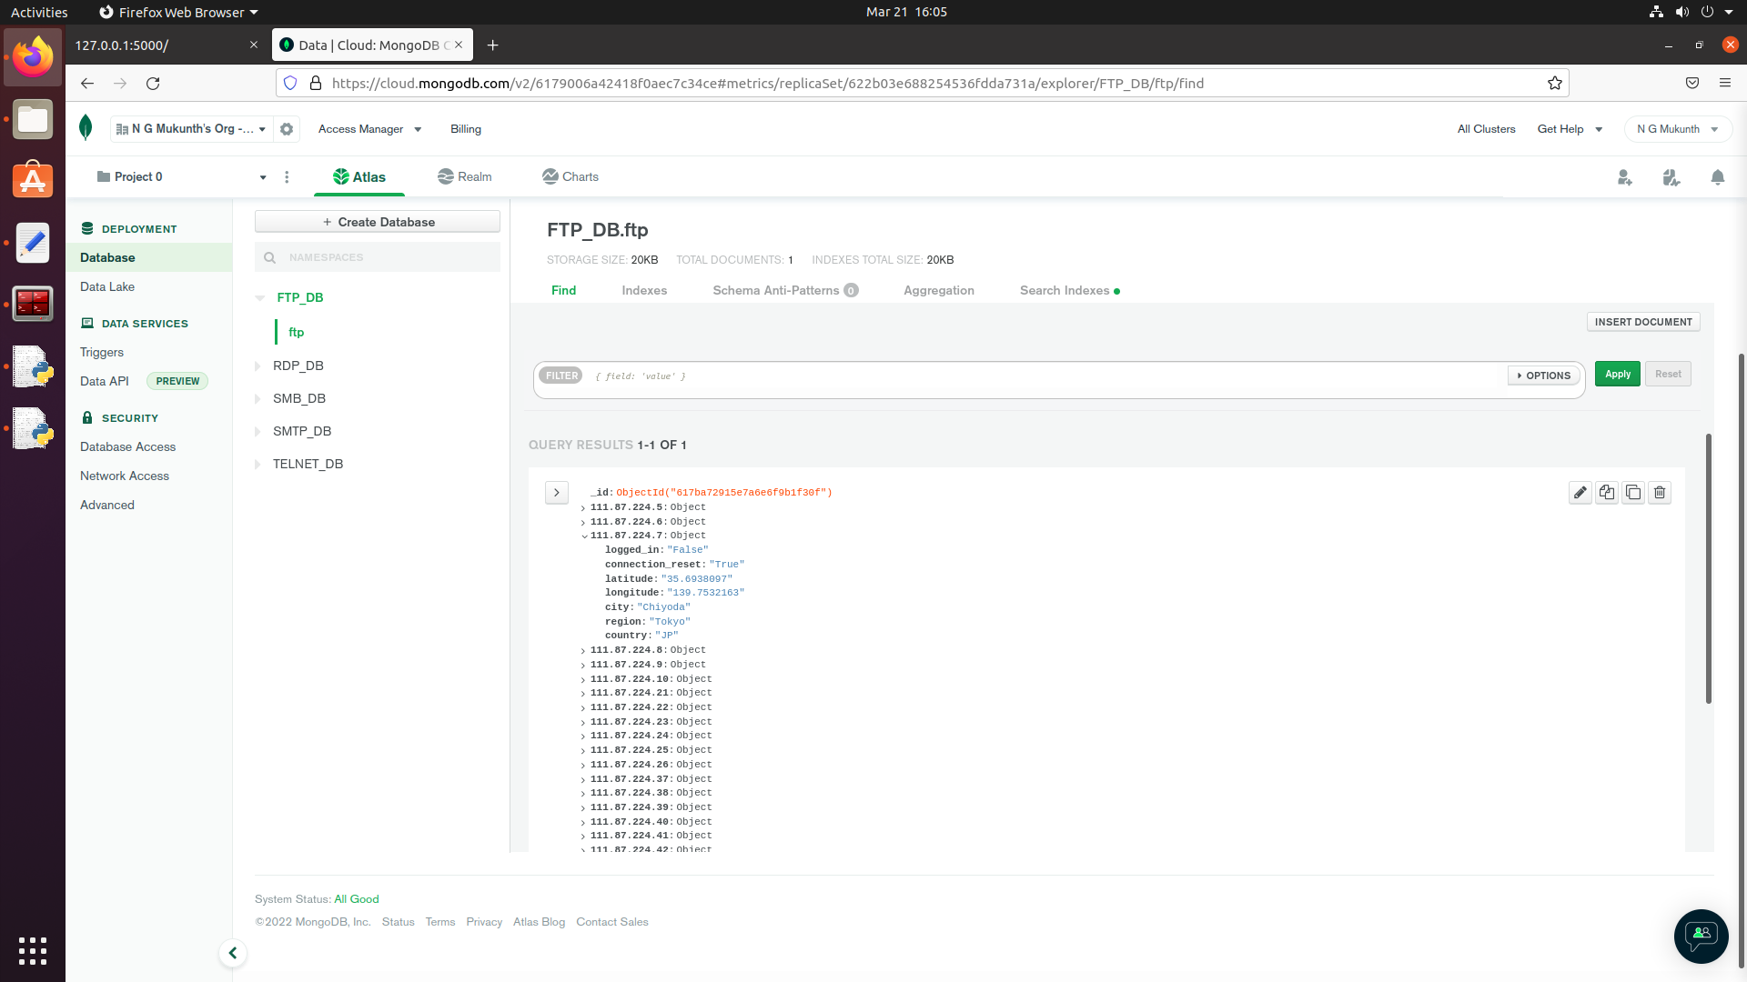
SCREENSHOTS

Slide 18
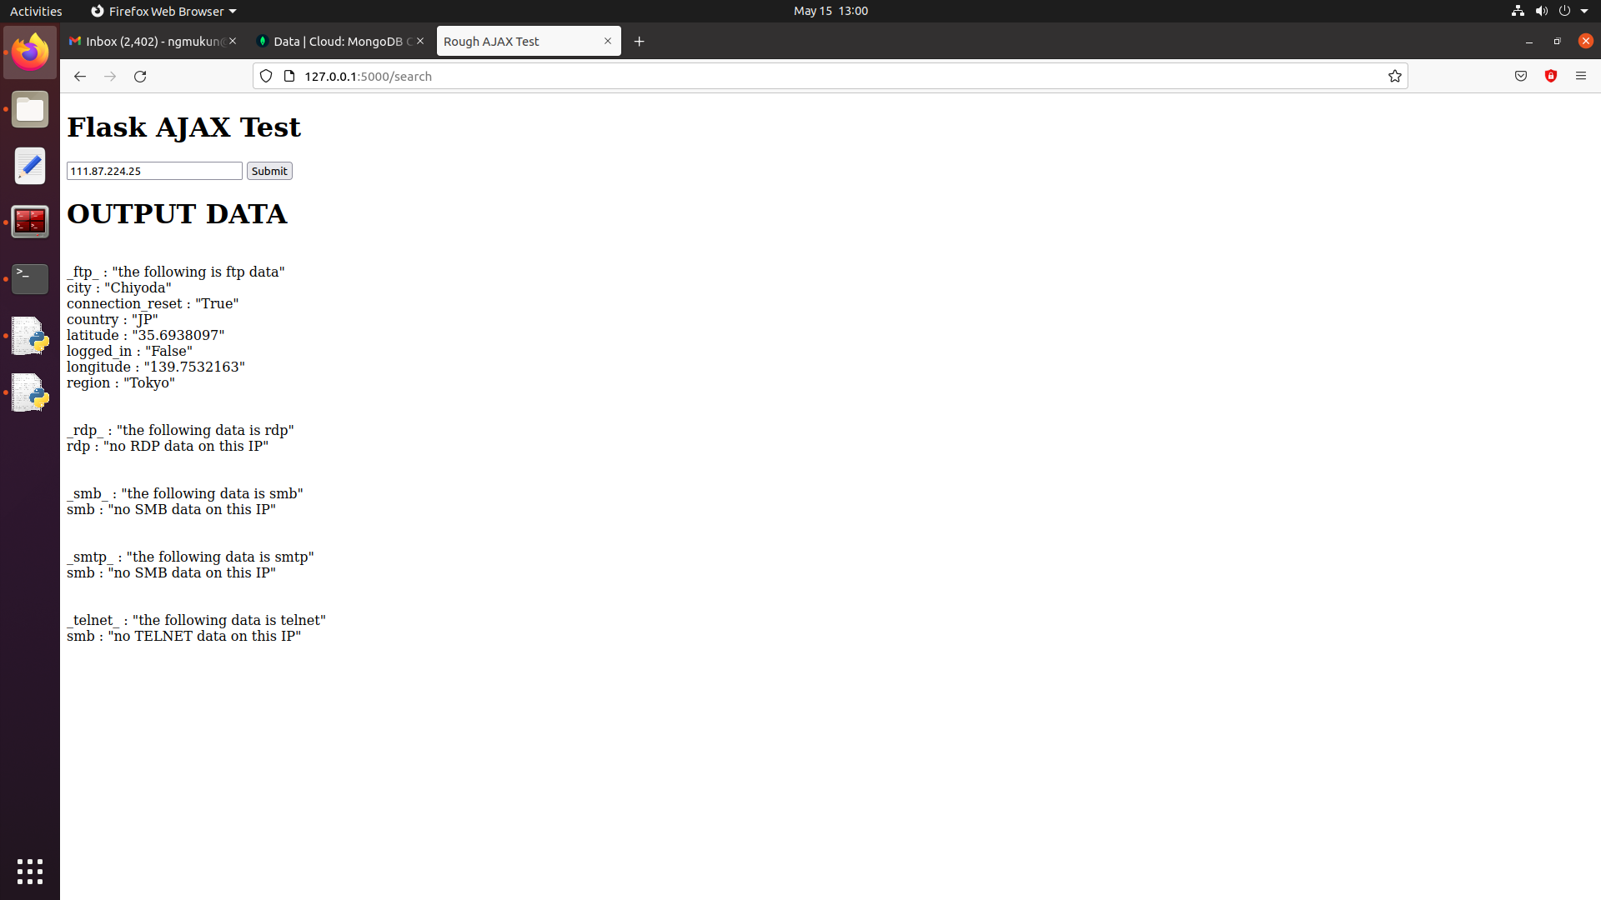

Slide 19
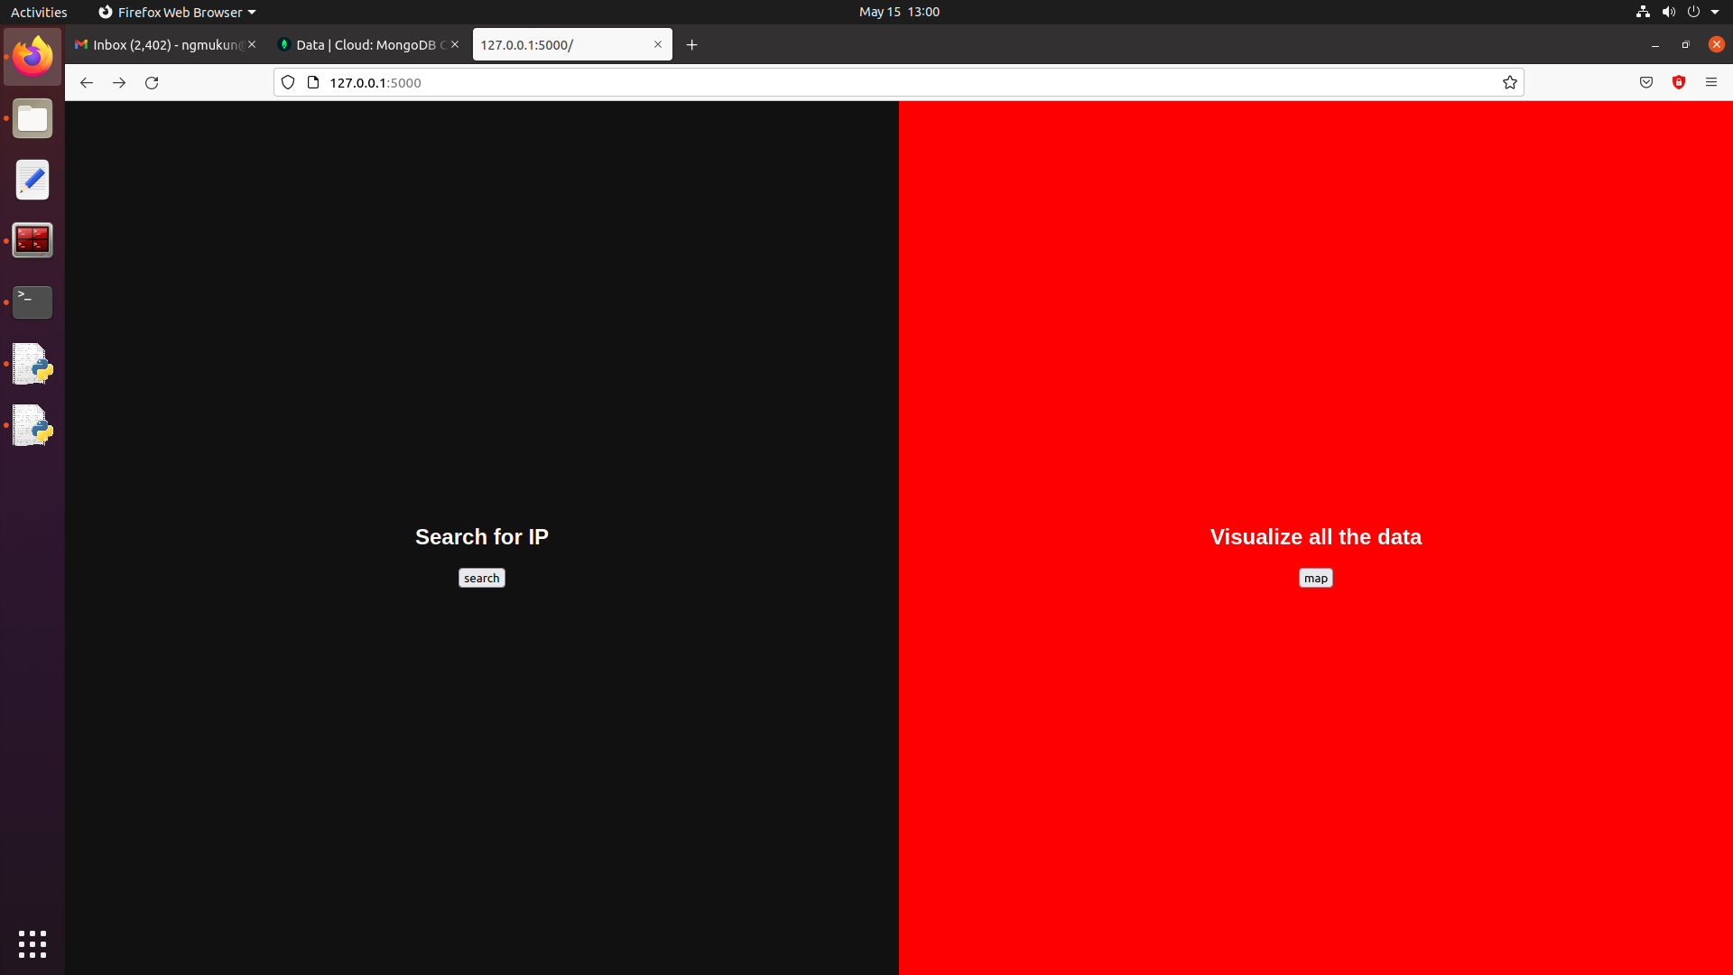

Slide 20
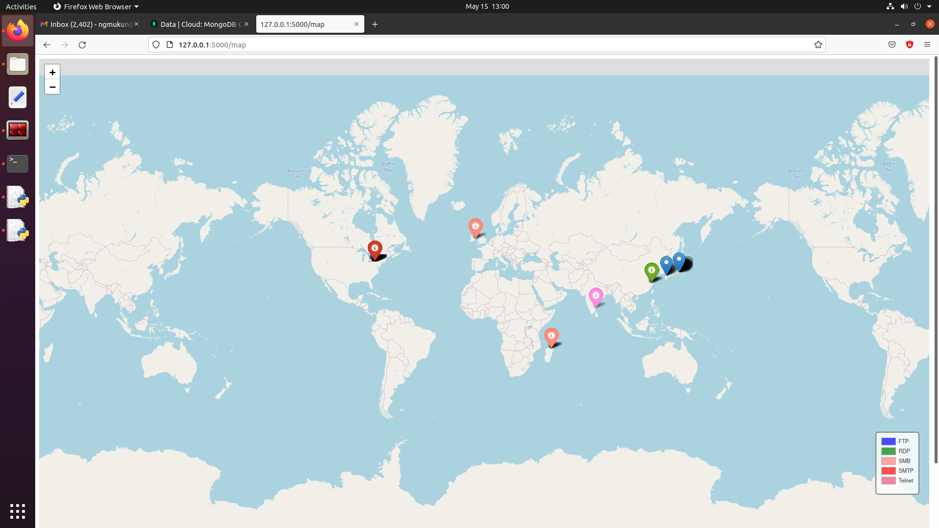

Slide 21
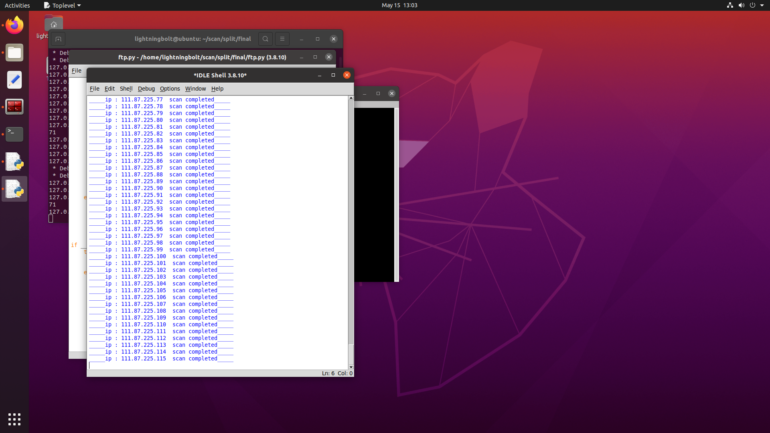

Slide 22
CONCLUSION
In our project, We scan the IP address and update the data to the public whether the IP address is vulnerable or not.
The IP addresses are scanned and then stored in a database (Mongodb).
When the user enters a specific IP address and submits the IP address,the scanned data is retrieved from the database.
The compiled data from the database can be viewed in the map and it shows whether the IP is vulnerable or not.
At last it displays the message that the scan is completed.

Slide 23
REFERENCES
1. Indian Computer Emergency Response Team (CERT-In), “Annual Report-2017”, Ministry of Electronics & Information Technology, Government of India, 2018.
2. Z. Li, et Al., “VulPecker: an automated vulnerability detection system based on code similarity analysis”, ACM, Proc. of the 32 Annual Conference on Computer Security Applications, pp. 201- 213, 2016.
3. S. O. Uwagbole, W. J. Buchanan, & L. Fan, “Applied machine learning predictive analytics to SQL injection attack detection and prevention”, IEEE, Symposium on Integrated Network and Service Management (IM), 2017 IFIP/IEEE, pp. 1087-1090, 2017.
4. I. Medeiros, N. Neves, & M. Correia, “Detecting and removing application vulnerabilities with static analysis and data mining”, IEEE, IEEE Transactions on Reliability, Vol 65, Issue 1, pp. 54-69, 2016.
5. S. S. Alqahtani, E. E. Eghan, & J. Rilling, “SV-AF—A Security Vulnerability Analysis Framework”, IEEE, 27th International Symposium on Software Reliability Engineering (ISSRE), pp. 219- 229, 2016.

