Slide 1
Competing GPUs: A Connect 4 Showdown
A project for the Peer-Graded Assignment
By: Akash Mohapatra

Slide 2
Project Description
Project Goal:
To develop a simple game where at least two GPUs compete against each other, as per the assignment requirements.
Implementation: Connect 4
- A classic two-player strategy game.
- The game is built in C++ using the NVIDIA CUDA Toolkit.
- Two GPU-controlled players compete with different strategies.

Slide 3
The Competitors
Two AI Players, One GPU
Player 1 (X): The Offensive Strategist
- Goal: To create its own winning lines of four.
- Prioritizes moves that build strong attacking formations.
Player 2 (O): The Defensive Strategist
- Goal: To block the opponent from winning.
- Prioritizes moves that prevent Player X from getting four-in-a-row.

Slide 4
Code Architecture
Host-Device Model
Host (CPU):
- Runs the main game loop.
- Manages the board state and player turns.
- Checks for win/draw conditions.
- Selects the final move based on GPU scores.
Device (GPU):
- Performs the heavy lifting and decision-making.
- Analyzes all 7 possible moves in parallel.
- Calculates a 'score' for each potential move.
- Returns the array of scores to the CPU.

Slide 5
The CUDA Kernel: findBestMoveKernel
Parallel Thinking
- The core of the AI logic resides in this single CUDA kernel.
- 7 Threads are launched in parallel, one for each column.
- Each thread evaluates its assigned column:
- Simulating a piece drop.
-Scoring the resulting board state.
-Simulating the opponent's best reply.
Example:
findBestMoveKernel<<<1, 7>>>(d_board, player, d_scores, is_offensive);

Slide 6
AI Strategy Implementation
The Deciding Factor: Score Weighting:
Offensive Player:
final_score = (my_score * 2) - opponent_score
Defensive Player:
final_score = my_score - (opponent_score * 2)
This small difference creates two distinct personalities.

Slide 7
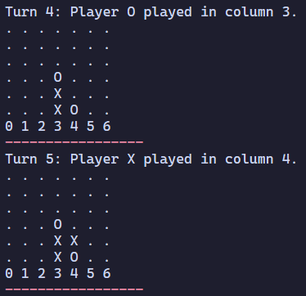
Game Replay & Analysis
The game_log.txt provides a turn-by-turn replay.
Game Log Snippet:

