Slide 1





Semantic-Enhanced Differentiable Search Index Inspired by Learning Strategies
Yubao Tang¹, Ruqing Zhang¹, Jiafeng Guo¹, Jiangui Chen¹,
Zuowei Zhu², Shuaiqiang Wang², Dawei Yin², Xueqi Cheng¹
{tangyubao21b, zhangruqing, guojiafeng, chenjiangui18z, cxq}@ict.ac.cn
{zhuzuowei,wangshuaiqiang}@baidu.com
yindawei@acm.org
Notes:
Hello everyone
My name is Yubao Tang, and I am a doctoral student at UCAS. I am excited to share our research with you today
let’s begin

Slide 2



Document Retrieval
1. Information needs
2. Query
3. Relevance matching
4. Relevant documents
User
Search engine
Corpus
Notes:
document retrieval is a vital IR task.
They employ relevance matching to sort relevant documents from the large-scale corpus.

Slide 3
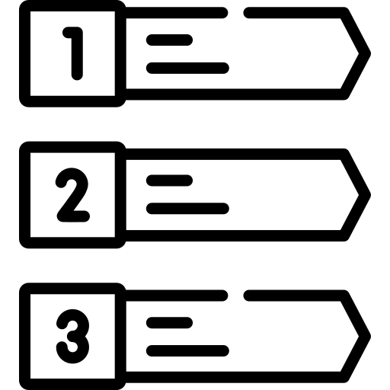

Document Retrieval
Dense retrieval
Bi-encoder architecture maps queries and documents into dense representations
Similarity functions are utilized to compute relevance scores
Limitations
Difficulty in end-to-end optimization
Simplistic functions overlook the potential for fine-grained interactions
Suffering from large memory footprint
Query
Encoder
Query
Representation
Score
A consolidated model
Ranked list
Documents
Encoder
Index
Corpus
Notes:
The mainstream approach is dense retrieval.
However, it still has limitations.
It cannot achieve the end-to-end optimization
And it needs high computational costs and memory footprint.
We can observe that this process can be formalized as a sequence-to-sequence problem, and we may consider using a consolidated model to address it.
It is similar to the human thinking process, where we don't rely on matching but rather answer questions through a similar associative approach.

Slide 4
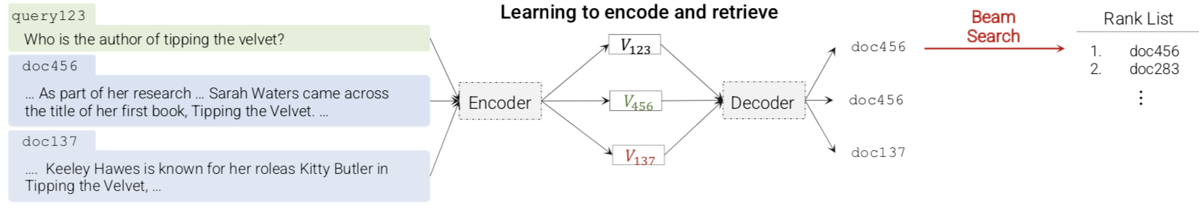
Differentiable Search Index (DSI)
The information of all the documents within a corpus is encoded into the model parameters.
Formalizing the document retrieval task as a Seq2Seq problem
Directly mapping string queries to relevant document identifiers (docids)
Advantages
Enabling the end-to-end optimization
Supporting fine-grained interaction with the model parameters
The autoregressive decoding significantly reduces the memory space and computational cost
Transformer Memory as a Diﬀerentiable Search Index, 2021, NeurIPS
Notes:
Recently, An alternative retrieval paradigm is proposed, that is Differentiable Search Index (DSI)
The information of the corpus is encoded into the model parameters.
The model can directly map queries to relevant document identifiers
This paradigm can overcome the limitations of dense retrieval

Slide 5


Two basic tasks of DSI
The indexing task
Learning a mapping from the document content to its identifier (docid).
The index is stored in model parameters, and indexing is simply another kind of model training.
The retrieval task
Mapping queries to relevant docids
Notes:
DSI achieves this functionality by jointly optimizing two basic tasks

Slide 6
Challenges for DSI
How to assign an identifier to each document
A single token (arbitrary unique integer) or a string of tokens which can be arbitrary numeric string or semantic numeric string via hierarchical clustering, as the identifiers
How to learn the associations between a document and its identifier
Taking the documents as inputs and generates identifiers as outputs
Transformer Memory as a Diﬀerentiable Search Index, 2021, NeurIPS
Notes:
And It needs to further consider two problems

Slide 7
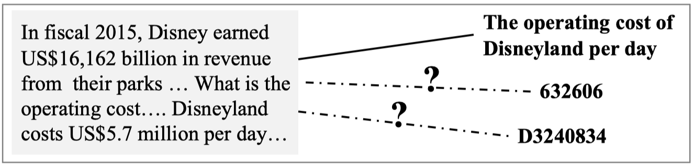

Memory and recall for humans
How does the human mind remember documents
Learning Strategies in Cognitive Psychology are intended to influence learner’s encoding process
The teaching of learning strategies, 1983, Innovation abstracts
Notes:
These problems can be related to the process of human memory and recall.
How does human remember an document and recall it better
Cognitive psychology offers various learning strategies to address the question

Slide 8
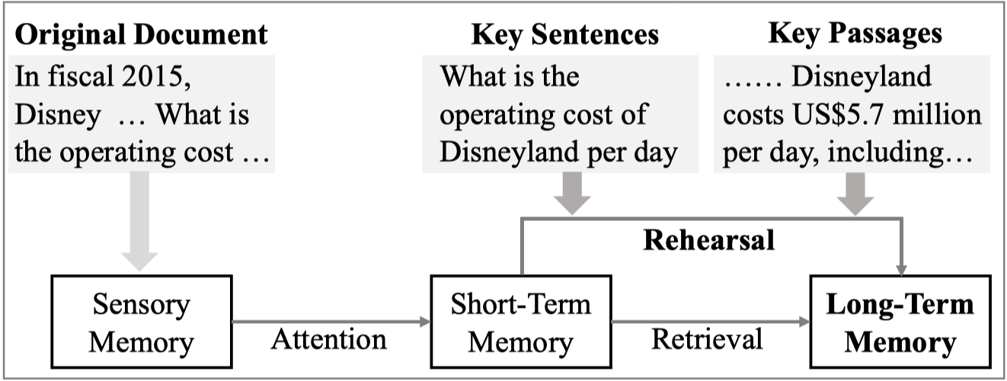
Memory and recall for humans
Elaboration Strategies
Naming a document with natural language words which have semantic relationships with it, would contribute to better encoding and recall for human brain
Rehearsal Strategies
Ones who underline the important contents in a document are able to recall substantially more information and higher long-term
Cognition: Exploring the science of the mind, 1997, WW Norton & Co
Cognitive psychology, 2005, Pearson Education New Zealand
Notes:
Such as Elaboration Strategies
And Rehearsal Strategies

Slide 9
Approach
Notes:
And, our approach has demonstrated better retrieval performance in both offline and online experiments.

Slide 10
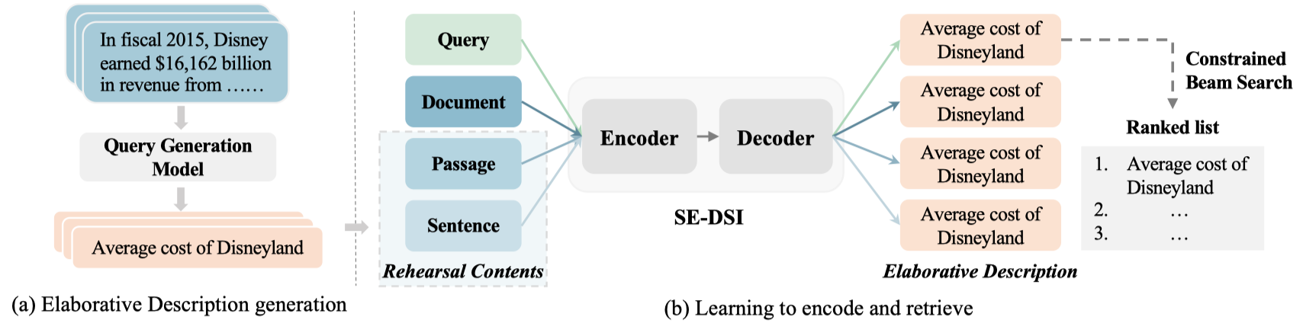
Approach
A novel Semantic-Enhanced DSI model (SE-DSI)
Elaborative Description(ED): describes the identifiers in natural language. We propose to generate ED for each document by off-the-shelf DocT5query Model.
Rehearsal Contents(RCs): we propose to select multiple important parts in a document as RCs, and the original document augmented with RCs are used to memorize the original document.
Notes:
Inspired by learning strategies, we propose A novel Semantic-Enhanced DSI model (SE-DSI)
And it has exhibited better retrieval performance in both online and offline experiments than strong baselines.

Slide 11



Approach
Rehearsal Contents(RCs)
Informative
Fluency
Diversity
Notes:
Inspired by learning strategies, we propose A novel Semantic-Enhanced DSI model (SE-DSI)
And it has exhibited better retrieval performance in both online and offline experiments than strong baselines.

Slide 12
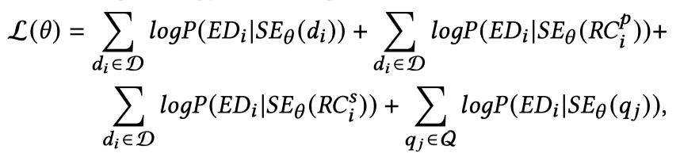
Approach
Rehearsal Contents(RCs)
Leading-style
directly use the leading passages and sentences of each original document as RCs
Summarization-style
leverage the document summarization technique to highlight multiple important parts that can reveal the essential topics of the document
Notes:
Inspired by learning strategies, we propose A novel Semantic-Enhanced DSI model (SE-DSI)
And it has exhibited better retrieval performance in both online and offline experiments than strong baselines.

Slide 13
Offline and online experiments
Notes:
And, our approach has demonstrated better retrieval performance in both offline and online experiments.

Slide 14
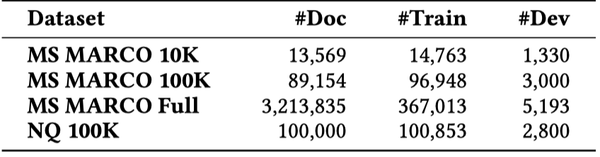
Offline experiments settings
Datasets
Baselines
Traditional document retrieval methods
BM25, RepBERT
DSI methods
DSI-ARB(arbitrary unique integer), DSI-SEM(semantic structured number)
DSI-QG
Notes:
And, our approach has demonstrated better retrieval performance in both offline and online experiments.

Slide 15
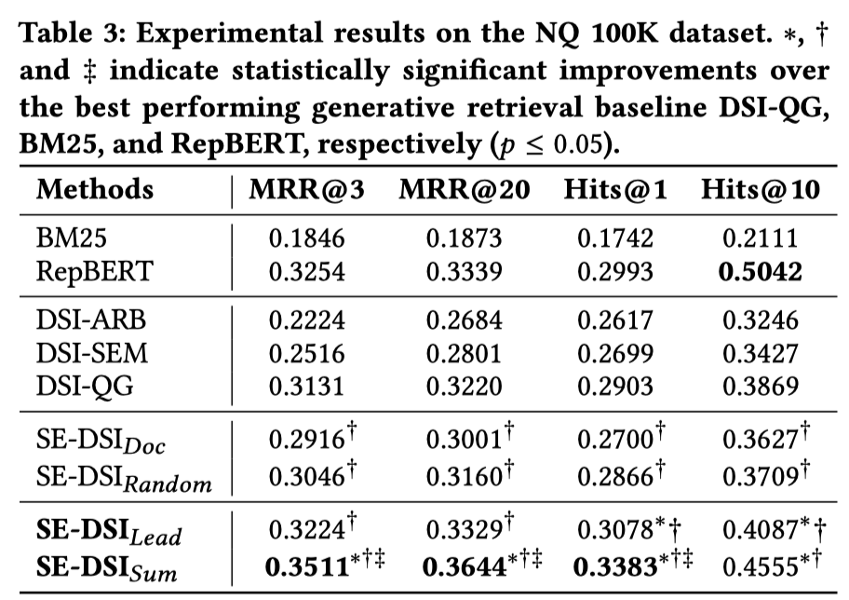
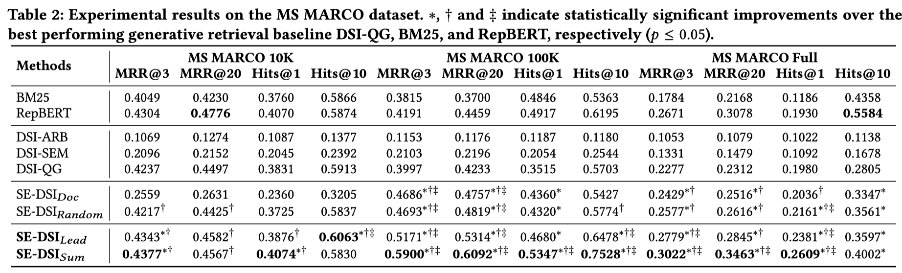
Offline Experimental results
Main results
SE-$DSI_{Lead}$and SE-$DSI_{Sum}$can perform significantly better than strong baseline solutions
Notes:
And, our approach has demonstrated better retrieval performance in both offline and online experiments.

Slide 16
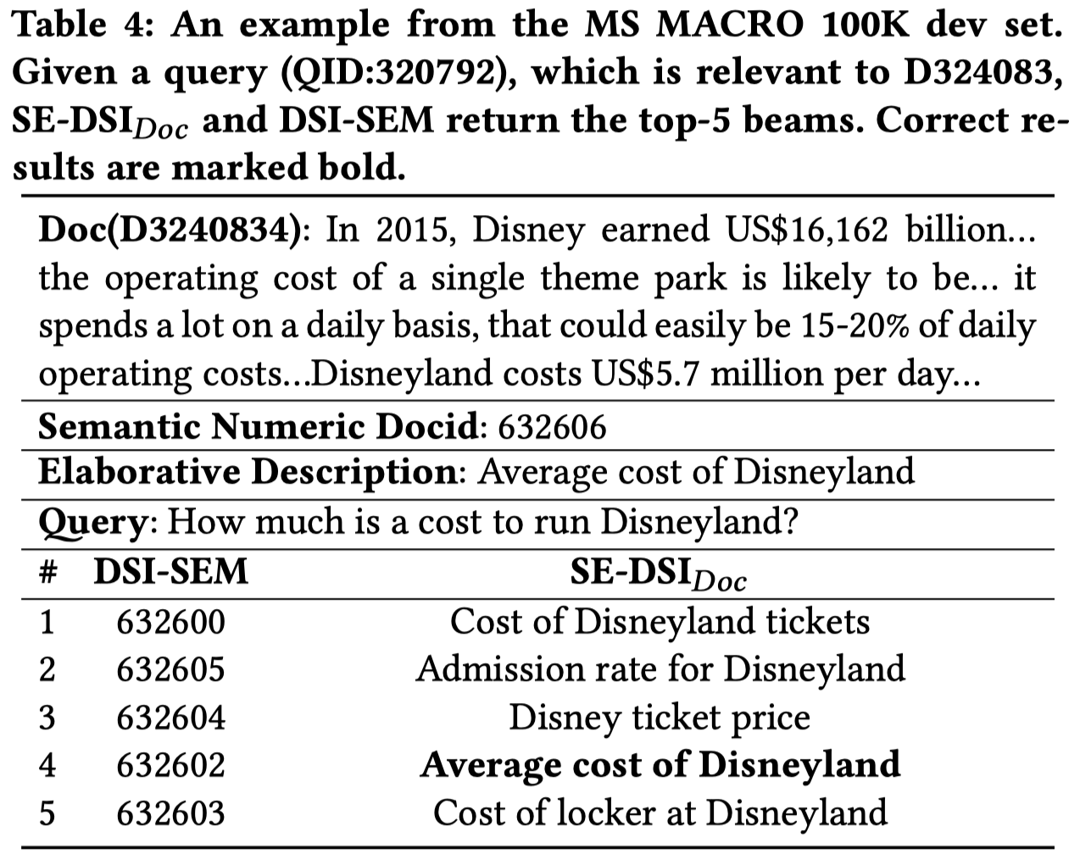
Offline Experimental results
Analysis on elaborative description
These results indicate the effectiveness of representing a document with our proposed ED as the docid, which is a natural language text containing enhanced semantic meanings.
Notes:
And, our approach has demonstrated better retrieval performance in both offline and online experiments.

Slide 17
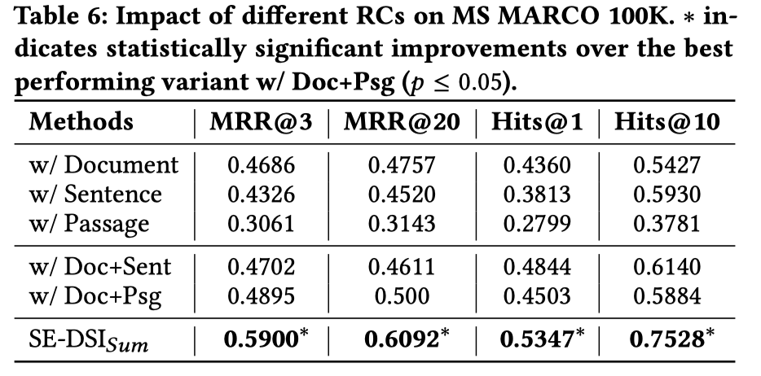
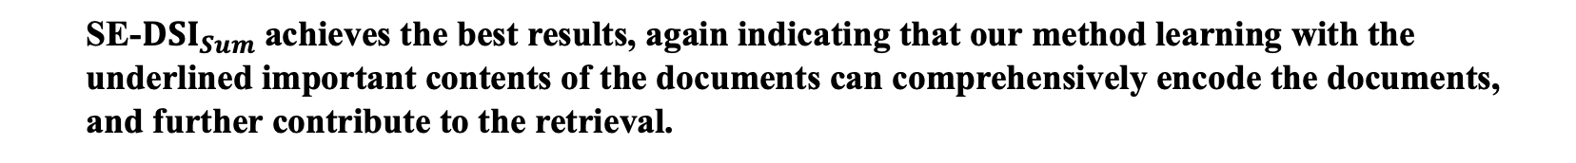
Offline Experimental results
Analysis on rehearsal contents
SE-$DSI_{Sum}$achieves the best results, again indicating that our method learning with the underlined important contents of the documents can comprehensively encode the documents, and further contribute to the retrieval.
Notes:
And, our approach has demonstrated better retrieval performance in both offline and online experiments.

Slide 18
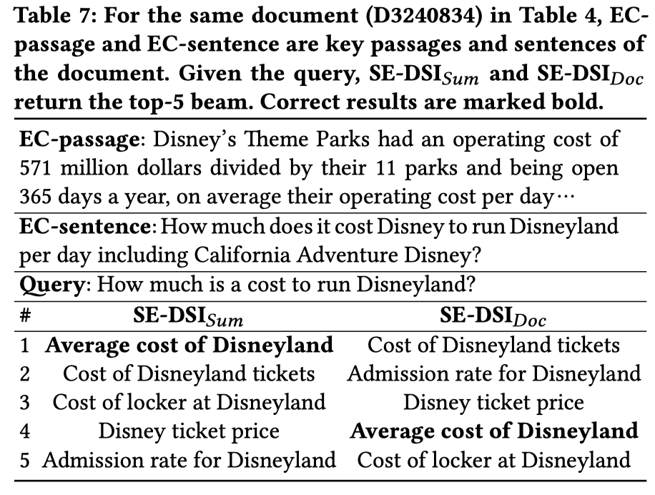
Offline Experimental results
Analysis on rehearsal contents
Augmenting key information does help document memorization and distinguish similar documents.
Notes:
And, our approach has demonstrated better retrieval performance in both offline and online experiments.

Slide 19
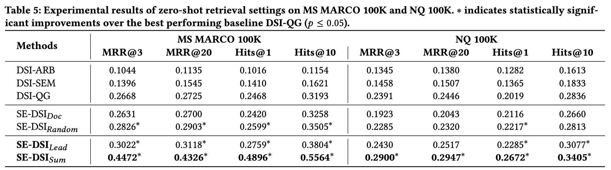
Offline Experimental results
Zero-shot setting
only performing indexing without the retrieval task
ED and RCs help the model to encode all the information about the corpus into the model parameter and SE-DSI works like a human with a knowledgeable brain.
Notes:
And, our approach has demonstrated better retrieval performance in both offline and online experiments.

Slide 20

Online A/B Experiments
Site Retrieval task (Applied in Baidu search)
The user may specify his/her information needs through a query for official sites.
Official sites are defined as Web pages that have been operated by universities, departments, or other administrative units
Notes:
And, our approach has demonstrated better retrieval performance in both offline and online experiments.

Slide 21
Online A/B Experiments
Datasets
Site URL
Site name
Site Domain
ICP record ( a registration name)
Web page
Evaluation Metrics
Site-level Recall@k: the predicted site URL is completely consistent with the ground-truth site URL.
Domain-level Recall@k: the predicted site URL and the ground-truth site URL are in the same site domain.
www.apple.com
Apple official site
apple.com
Notes:
And, our approach has demonstrated better retrieval performance in both offline and online experiments.

Slide 22
Online A/B Experiments
Baselines
DualEnc
An Ernie-based dual-tower architecture model
It needs to learn a query encoder and a site encoder with (query, site attributes) pairs, where the site attributes use the site name, ICP record, and web page contents.
SingleTow
A single-tower method, including an Ernie-based encoder and a feed-forward layer, in which the weight is initialized with the site representations learned from DualEnc.
During training, it takes the query as input, and the output logits of the feed-forward layer are passed through a softmax function, generating a probability distribution of sites.
The probability of each site serves as the relevance score.
Notes:
And, our approach has demonstrated better retrieval performance in both offline and online experiments.

Slide 23
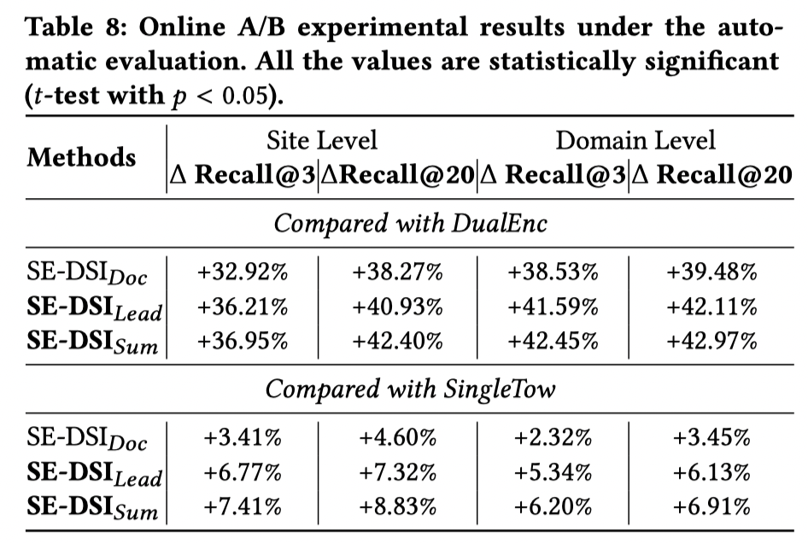
Online A/B Experiments Results
For SE-DSI, the site representation is in the form of model parameters, making the query interact with global information, which is more flexible and deeper than explicit similarity functions.
Notes:
SE-DSI$_{Sum}$ and SE-DSI$_{Lead}$ work better than SE-DSI$_{Doc}$, which shows that learning with important contents of the web pages facilitates the process of encoding the corpus, and further contributes to the retrieval.

Slide 24
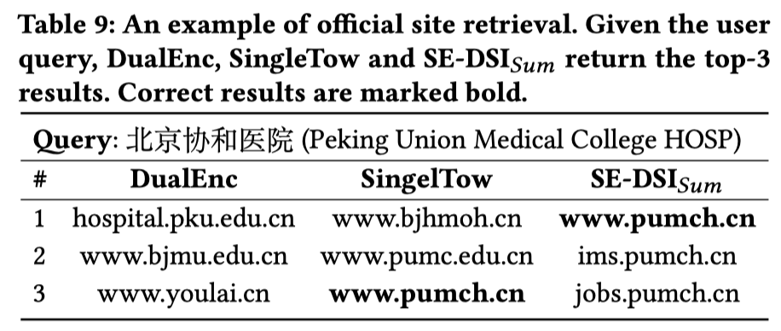
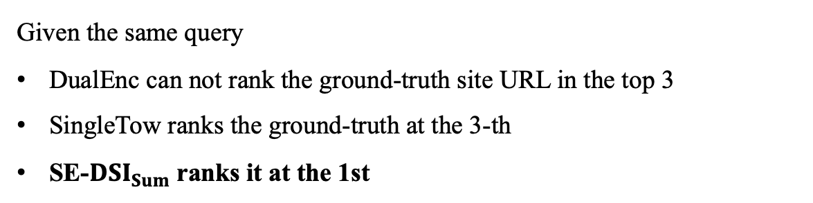
Online A/B Experiments Results
Given the same query
DualEnc can not rank the ground-truth site URL in the top 3
SingleTow ranks the ground-truth at the 3-th
SE-$DSI_{Sum}$ranks it at the 1st
Notes:
And, our approach has demonstrated better retrieval performance in both offline and online experiments.

Slide 25
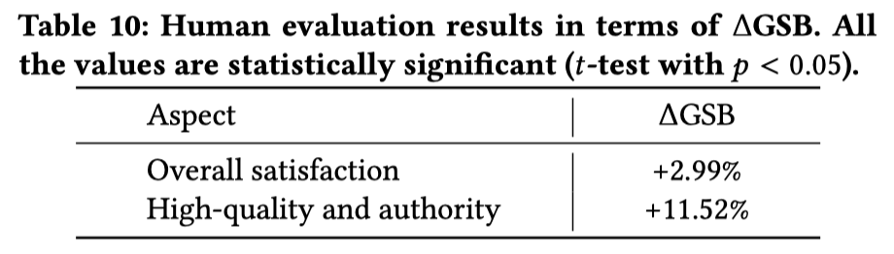
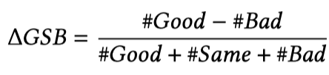
Online A/B Experiments Results
Side-by-side comparison
SE-DSI has achieved significant positive gains in terms of both aspects
Notes:
And, our approach has demonstrated better retrieval performance in both offline and online experiments.

Slide 26
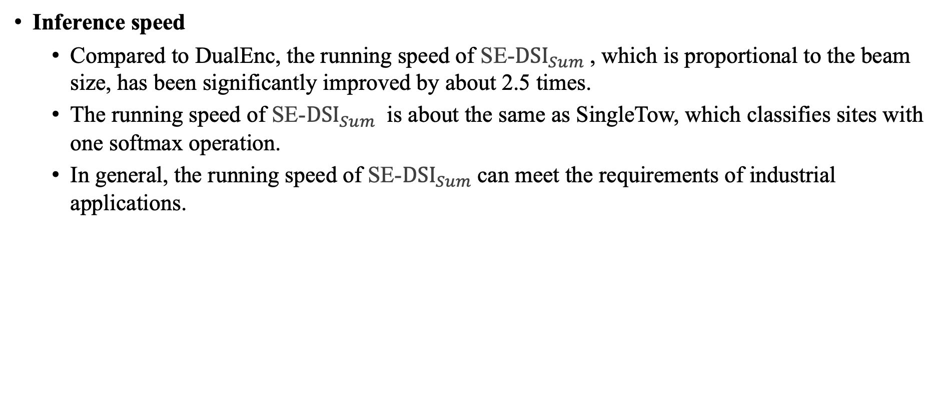
Online A/B Experiments
Inference speed
Compared to DualEnc, the running speed of SE-$DSI_{Sum}$, which is proportional to the beam size, has been significantly improved by about 2.5 times.
The running speed of SE-$DSI_{Sum}$ is about the same as SingleTow, which classifies sites with one softmax operation.
In general, the running speed of SE-$DSI_{Sum}$can meet the requirements of industrial applications.
Notes:
And, our approach has demonstrated better retrieval performance in both offline and online experiments.

Slide 27
Conclusion
Designing a proper generative model to“memorize”the whole corpus for document retrieval remains a challenge.
Inspired by learning strategies, we have proposed SE-DSI to advance the original DSI, which takes the input of the original document augmented with RCs containing important parts and outputs the ED with explicit semantic meanings.
The offline experimental results on several representative retrieval datasets demonstrated the effectiveness of our SE-DSI model.
The online evaluation again verified the value of this work.
Notes:
And, our approach has demonstrated better retrieval performance in both offline and online experiments.

Slide 28



Future work
Dynamic Corpora
New Architecture
Learning
Notes:
Scenario: the document corpus is usually dynamic in real-world search engines;
Architecture: there is potential in exploring to use other model architectures or yet to come larger autoregressive models;
Learning: how to define learning strategies and identifiers, etc.

Slide 29
Thank you!
Notes:
For more detailed information, please stay tuned for our upcoming presentation.
Thank you

