Slide 1




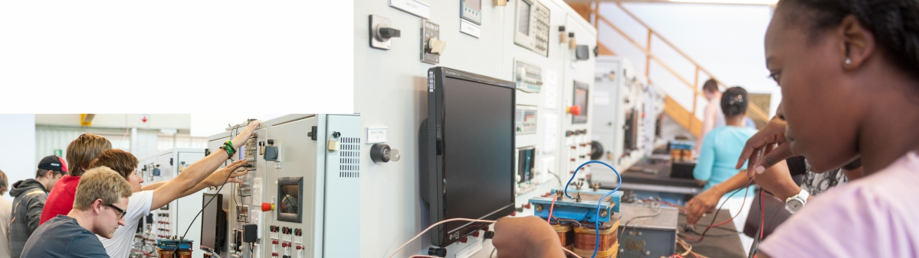
Presenter: Dr. Brenda van Wyk
Do More Complete Dissertations’ Metadata Get More Engagement?

Slide 2
Agenda
Research problem
MIT Case Study
Nature and types of Metadata
Factors impeding quality
Methods and data
Findings
Conclusion
Recommendations
© National Geographic

Slide 3
Research Problem
Information resources, including Electronic Theses and Dissertations (ETD), are described through metadata;
ETD metadata quality and its recognized importance - a gap exists in empirical studies on the impact of metadata completeness on ETD impact;
This study aims to bridge this gap by investigating the relationship between ETD metadata completeness and the number of views/downloads in institutional repositories (IRs).
Notes:
Despite extensive research on ETD metadata quality and its recognized importance, a gap exists in empirical studies on the impact of metadata completeness on ETD impact

Slide 4

Context of this study - A case of MIT DSpace
Dissertations archived on DSpace@MIT for the case study
Established in the early 2000s, DSpace@MIT - Massachusetts Institute of Technology (MIT) IR
In addition to providing metadata for ETDs, DSpace@MIT leverages IRUS (Institutional Repository Usage Statistics) to track and report the number of views and downloads for each item within the repository
April 26, 2024, DSpace@MIT - 22,353 dissertations, 30 distinct collections

Slide 5
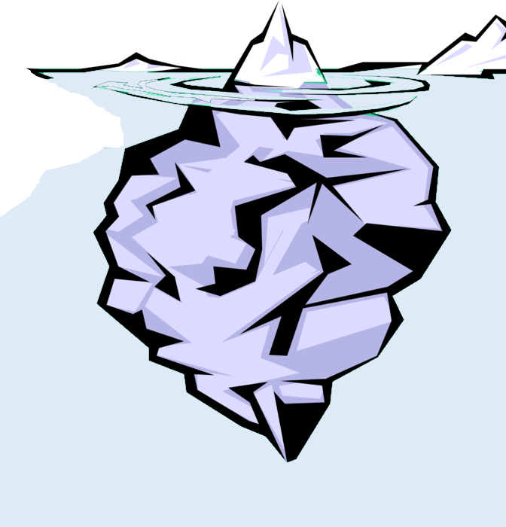
The nature of meta data
Oversimplified definition is widely criticized
Quality, comprehensive metadata - provide adequate, correct and relevant information to enhance visibility and discoverability
Systematically structured – recognized meta data schema
Manage security
The nature of information objects may vary from discipline to discipline

Slide 6
Types of meta data
Structural
Administrative
Technical
Provenance
Notes:
some authors refer to six or eight different types of metadata in ETDs. They add statistical metadata, also known as process metadata, and reference metadata, as well as preservation and rights metadata. These types of metadata serve different roles in the management, discovery, and preservation of digital and physical resources

Slide 7

Metadata standards and the completeness of metadata are deeply connected!
Completeness
Accuracy
Timeliness
Metadata
Quality
Consistency
Provenance
Accessibility
Conformance

Slide 8
Rationale for this study
Increasing importance of ETDs: the transition to digital formats for theses and dissertations has become a significant trend;
Role of metadata quality: metadata serves as the backbone for the discoverability of ETD;
More metadata fields: comprehensive metadata fields facilitate better indexing by search engines and IRs, making it easier for users to locate and use relevant works;
Informed user engagement: complete metadata fields offer users detailed information about ETDs, enabling them to assess relevance and quality, which leads to more informed decisions and higher engagement rates, such as views and downloads.

Slide 9
Research Process
1
2
Collect data on 22,276 doctoral theses from the DSpace@MIT
from August 10 to August 21
https://dspace.mit.edu/handle/1721.1/XXXXX?show=full
Data Extraction
Record ID, Department, Date availability, Number of unique/duplicate metadata fields, Abstract/Title word count, Number of downloads/visits, DDR, and DVR
Data Organization
Excel file/SPSS
Data Analysis
SPSS; correlation between metadata completeness and usage statistics
Unique ID for each dissertation
3
4
Notes:
The following steps outline the data collection methodology:
1. Data Source: The primary source of data was the DSpace@MIT repository, specifically the URL format: https://dspace.mit.edu/handle/1721.1/XXXXX?show=full, where XXXXX represents the unique ID for each dissertation. To extract the IDs, the Doctoral Theses collection in DSpace@MIT (https://dspace.mit.edu/handle/1721.1/131022/recent-submissions) was browsed, and all submitted records until August 21, 2024, were retrieved.
2. Metadata Fields: The study focused on metadata fields that begin with "dc." (Dublin Core), which are standard fields used for describing digital resources.
3. Data Extraction: The data extraction process was conducted from August 10 to August 21, 2024. Each dissertation's metadata and usage statistics were retrieved and recorded.

Slide 10
Departments

Slide 11
Distribution of Dissertations by Year at DSpace@MIT

Slide 12
Distribution of Completed Unique and Duplicated Metadata Fields in Doctoral Dissertations at DSpace@MIT
Notes:
The minimum number of unique metadata fields completed is 14, while the maximum is 26. However, the majority of dissertations, totaling 7,709, have 22 unique metadata fields completed. On the other hand, the number of duplicated metadata fields varies significantly, with a minimum of 15 fields and a maximum of 41 fields completed. Notably, the highest frequency of duplicated fields occurs at 24 fields, with 4,512 instances recorded. This suggests that many dissertations include multiple entries for certain metadata categories, which may enhance the detail and context of the information provided.

Slide 13
Distribution of Completed Unique and Duplicated Metadata Fields in Doctoral Dissertations at DSpace@MIT

Slide 14
Findings
Dissertations with a greater number of unique metadata fields tend to have higher visibility (DVR) and download performance (DDR) compared to their peer
The stronger correlation with DVR suggests that unique metadata may be particularly effective in attracting views, which could lead to increased downloads
A positive correlation exists between the number of duplicated metadata fields and both DVR (rs = 0.116 and Sig. = <0.001) and DDR (rs = 0.052 and Sig. = <0.001), although the correlation is weaker than that of unique metadata

Slide 15
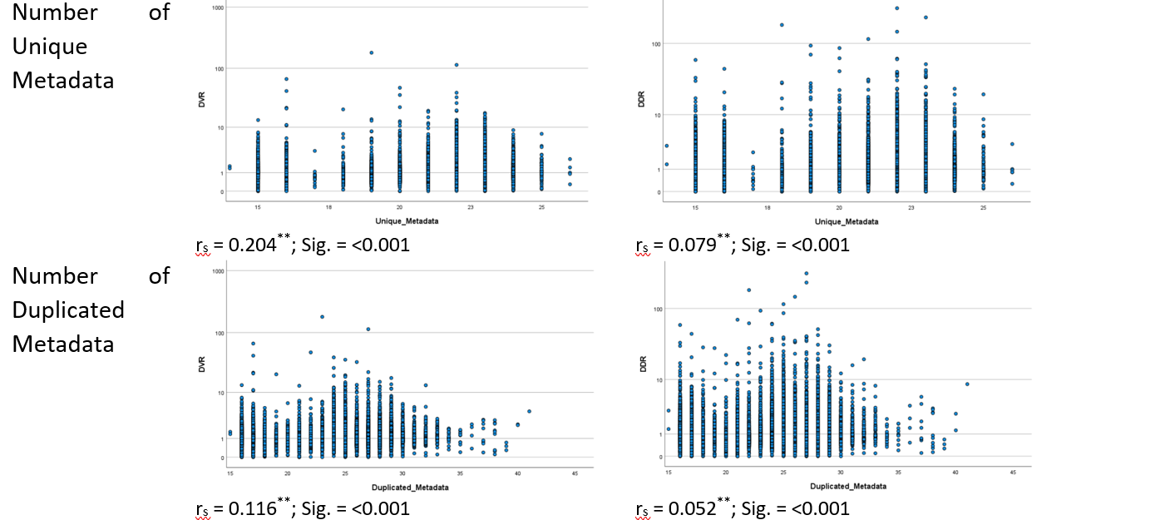
Findings

Slide 16
Findings
Number of words in the abstract shows a strong positive correlation with DVR (r_{s} = 0.317 and Sig. = 0.000) and a moderate correlation with DDR (r_{s} = 0.148 and Sig. = <0.001) - indicates that dissertations with longer abstracts are likely to have higher visibility and download performance
Longer titles may be associated with slightly lower download rates relative to the number of documents
Longer titles may be associated with slightly lower download rates relative to the number of documents

Slide 17
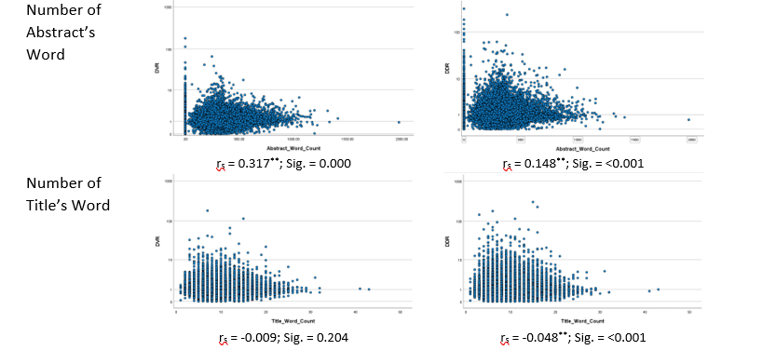
Findings

Slide 18
Findings
Out of the 129 metadata fields in the Dublin Core schema:
44 fields are utilized to describe MIT’s dissertations
The average completeness of unique fields across the records is 21,
While the average for duplicated fields is 24
These results indicate that the metadata for dissertations in DSpace@MIT is not fully complete, suggesting potential areas for improvement in metadata quality

Slide 19
Discussion and Recommendations
Metadata serves as a fundamental pillar in our information-centric society, facilitating the efficient organization, retrieval, and utilization of information
To keep ETDs usable, it is essential to have high-quality metadata for these digital items
Out of the 129 metadata fields in the Dublin Core schema, 44 fields are utilized to describe MIT’s dissertations
The average completeness of unique fields across the records is 21, while the average for duplicated fields is 24
These results indicate that the metadata for dissertations in DSpace@MIT is not fully complete, suggesting potential areas for improvement in metadata quality

Slide 20
Conclusion
Study showed the key role of metadata completeness in enhancing user engagement within the DSpace@MIT repository.
Well-structured and comprehensive metadata significantly influences the visibility and accessibility of dissertations, ultimately impacting their retrieval and usage

Slide 21


Thank You
Behrooz Rasuli
Michael Boock
Joachim Schöpfel
Brenda Van Wyk
We would like to thank the MIT Libraries for their help with our research.

