Slide 1
A Pre-Processing Pipeline for Improved ETD Metadata Quality in Downstream Services
Elijah Chileshe¹, Chilufya Chanda², Chileshe Kamfwa², Chuulu Mainda², Lighton Phiri² ¹Department of Computer Science
²Department of Library and Information Science
Notes:
gtgtgtgtg

Slide 2
Outline
Introduction to the Zambia National ETD Portal
Overview of Metadata Harvesting Process
Motivation for Consistent Metadata
Challenges with Current Metadata in ZNETD Portal
Proposed Solution
Anticipated Results
Conclusion

Slide 3
Introduction to the Zambia National ETD Portal
Purpose: Provides centralized access to Electronic Theses and Dissertations (ETDs)
Helps students, researchers, and institutions access Zambia’s academic work
Metadata Harvesting: Gathers ETD metadata from individual Institutional Repositories (IRs)
Streamlines access by pulling information from multiple sources into one portal
Goal: Improve consistency and reliability of metadata for a better user experience
Addressing challenges in quality and formatting of data collected

Slide 4
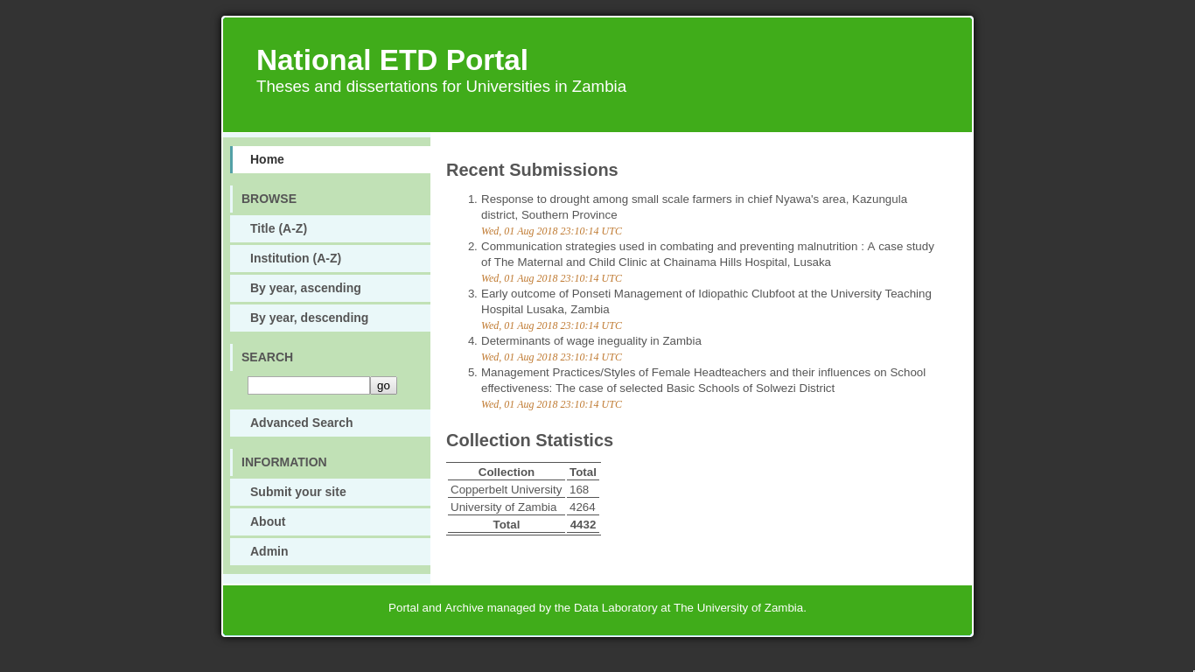
Introduction to the Zambia National ETD Portal
We are working towards implementing a national ETD portal for The Republic of Zambia
Presently, only two institutions have Institutional Repositories

Slide 5
Overview of Metadata Harvesting Process
What is Metadata Harvesting?
Metadata includes information like title, author, date, and keywords
Essential for categorizing and retrieving academic documents
Process for ZNETD Portal:
Uses protocols (OAI-PMH) to pull metadata from each HEI’s IR
Automatically consolidates data from different sources into the ZNETD system
Benefit of Centralized Access:
A single access point for academic records across all participating institutions

Slide 6
Motivation for Consistent Metadata
Diverse Data Practices in IRs:
Different HEIs have varied standards for metadata entry and formatting
Some institutions may lack formal policies for data consistency
Challenges of Inconsistent Metadata:
Makes it harder for users to find relevant research in ZNETD
Incomplete or inaccurate metadata reduces the usability of the portal
National Significance:
Ensures research from Zambia’s HEIs is accurately represented and accessible

Slide 7
Challenges with Current Metadata in ZNETD Portal
Inconsistent Formatting:
Different ways of recording data create confusion and inefficiency
Data fields might be missing or presented differently across institutions
Varied Quality of Metadata:
Incomplete entries, spelling issues, lack of standardization
Impacts data retrieval and the portal’s credibility as a national resource
Lack of Uniform Metadata Standards:
Some institutions lack policies on metadata quality, affecting overall data integrity

Slide 8
Proposed Solution: Pre-Processing Pipeline
What is a Pre-Processing Pipeline?
Automated system to clean, format, and standardize metadata before it enters ZNETD
Ensures consistent formatting, reduces errors, and completes missing data fields
Steps in the Pipeline:
Data Cleaning: Corrects errors like spelling and formatting inconsistencies
Standardization: Aligns metadata fields with a uniform format (e.g., ETD-ms standard)
Completion: Fills in missing metadata where possible
Outcome:
High-quality metadata that enhances searchability, accessibility, and user experience

Slide 9
Anticipated Results of the Pre-Processing Pipeline
Improved Metadata Quality:
Enhanced consistency and completeness across all entries in ZNETD
Better User Experience:
Easier to find and retrieve relevant research documents
Increases portal’s utility for students, researchers, and policy-makers
Strengthening Zambia’s Research Visibility:
Accurate representation of academic contributions from HEIs
Positions Zambia’s ETD portal as a reliable academic resource

Slide 10
Conclusion
The pre-processing pipeline improves metadata quality in ETD repositories by standardizing and addressing inconsistencies. This leads to better discoverability and reliability of scholarly resources, benefiting researchers and enhancing the overall quality of academic archives. Future improvements in metadata automation and standardization will continue to support accessible and efficient digital repositories for the academic community.

