Slide 1
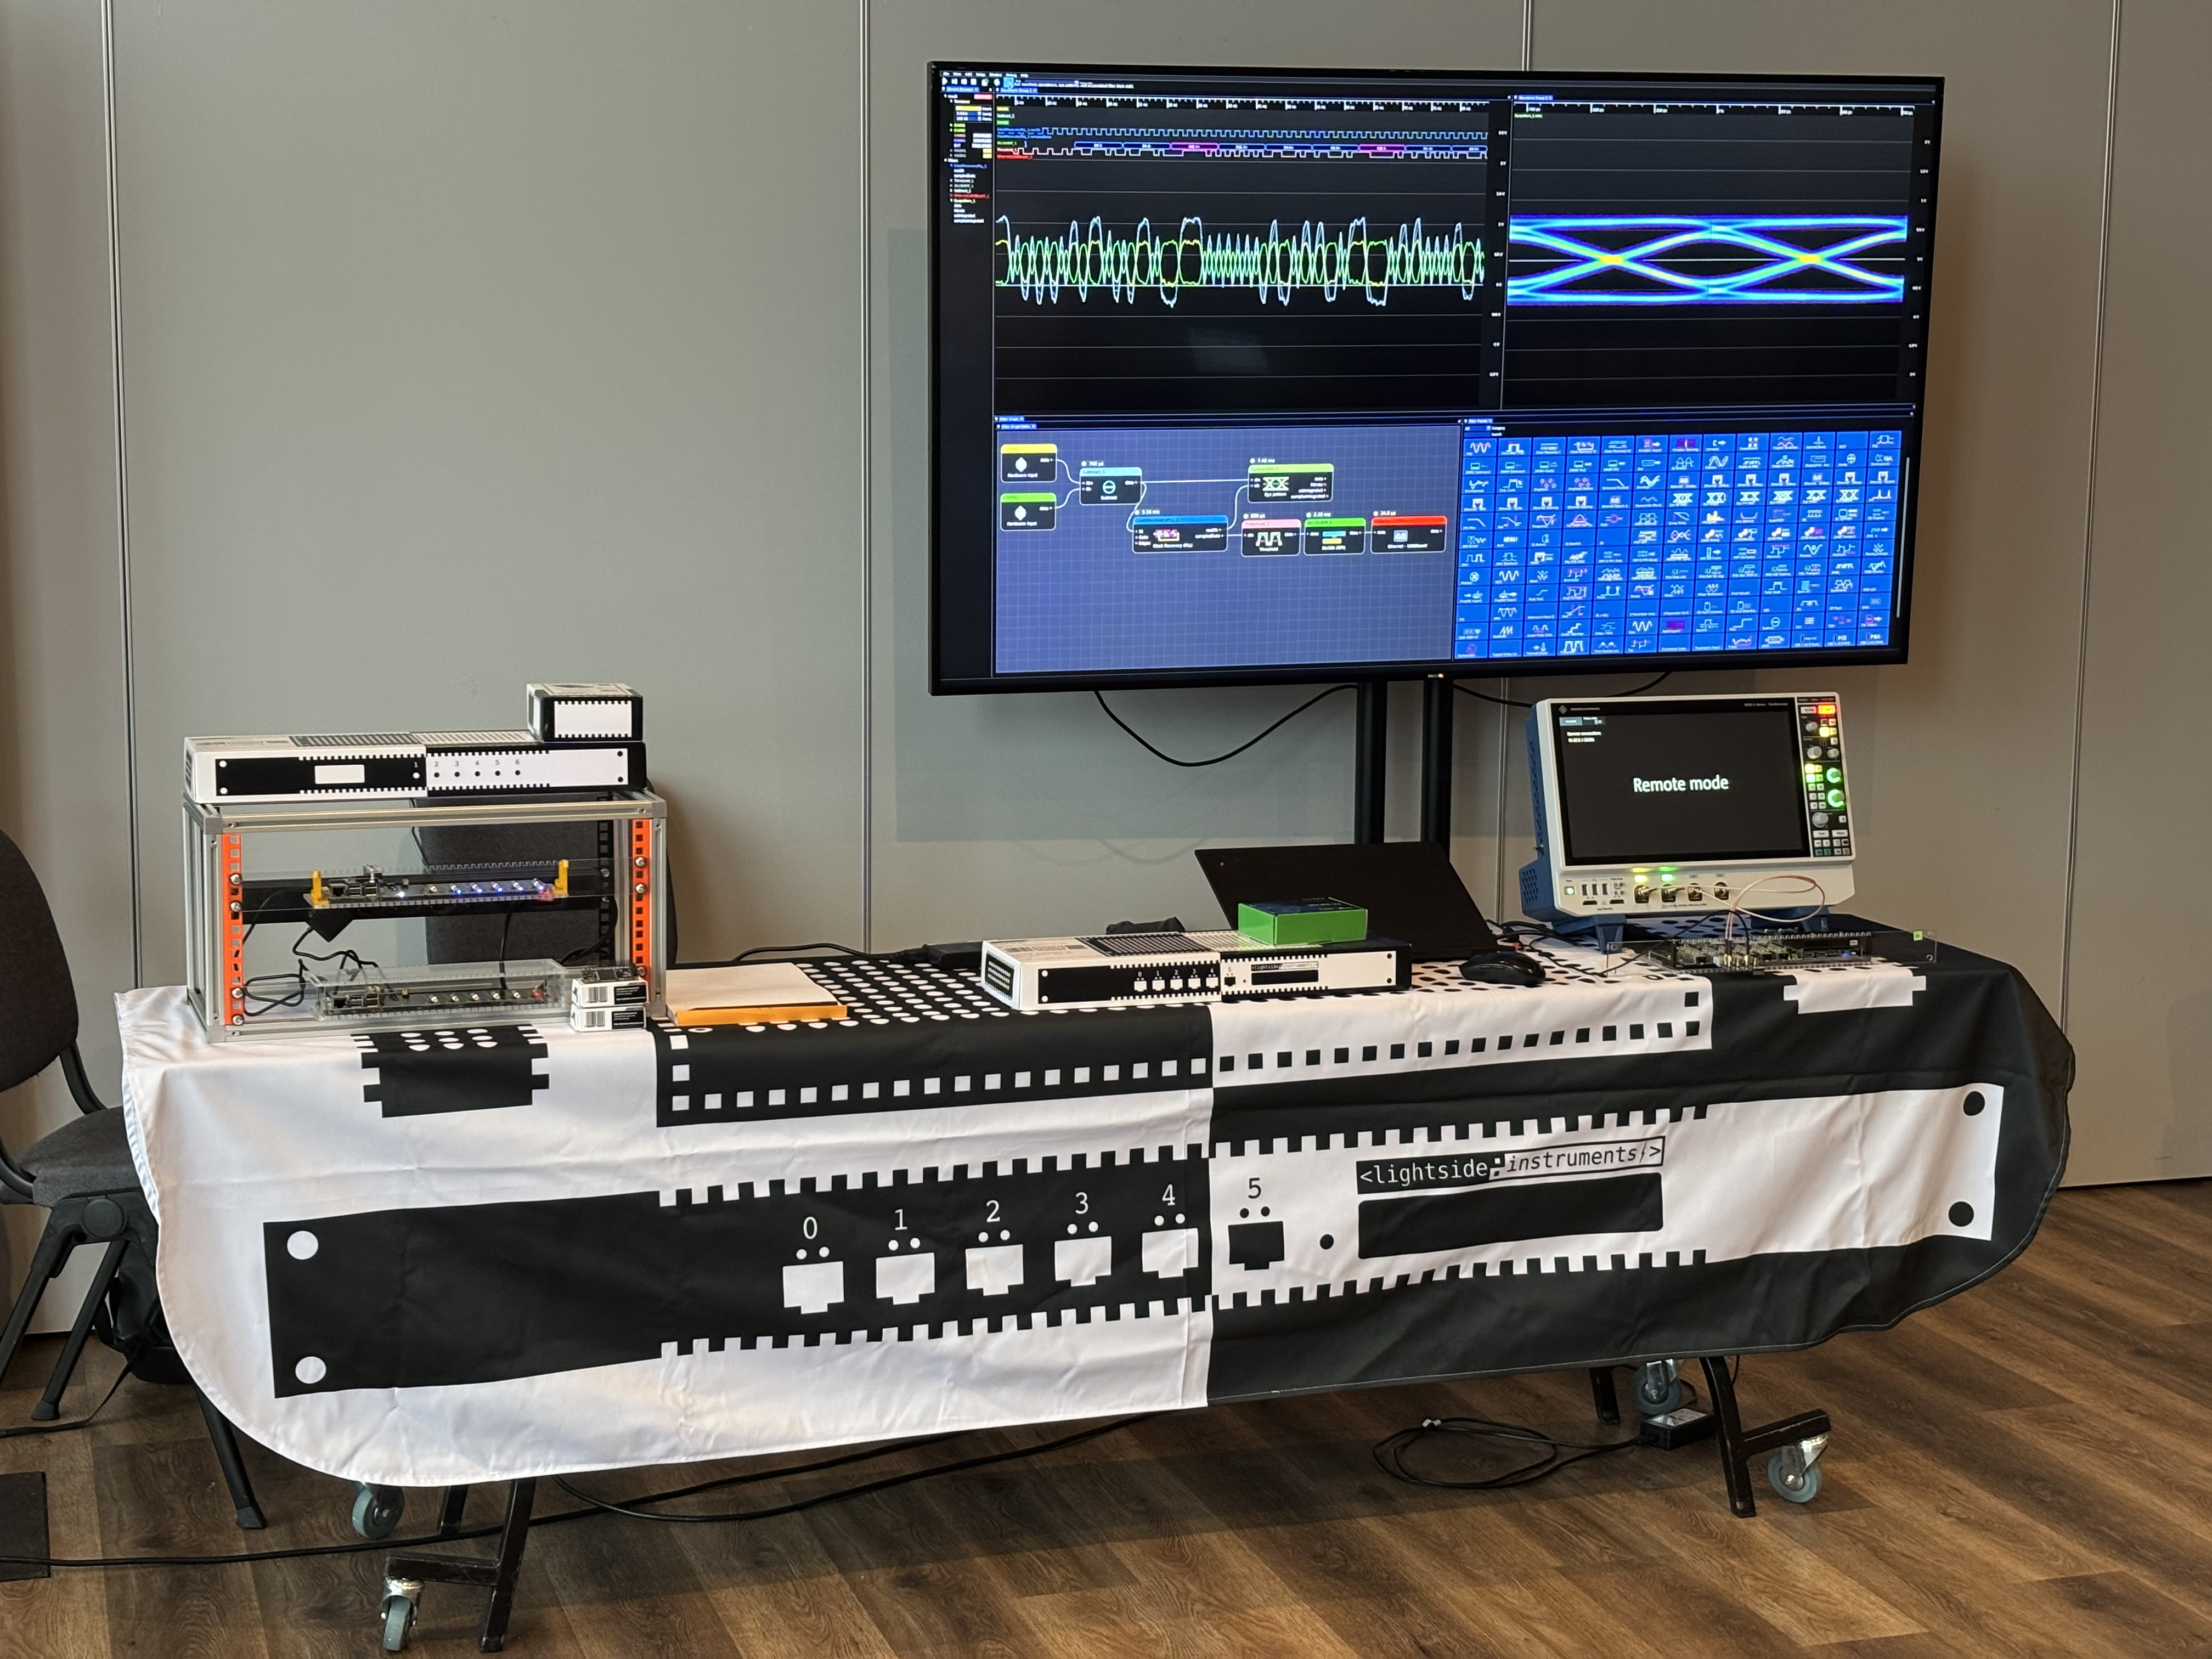
Single-board computer designs based entirely
on FPGA and soft-core CPU as replacement for
Raspberry Pi and Ultra96 boards
Vladimir Vassilev, Lightside Instruments AS
FPGA Forum 2026, Trondheim 11-12 February

Slide 2
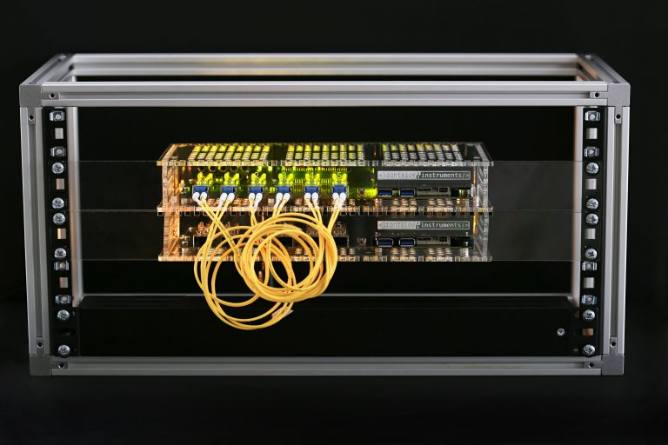
Lightside Instruments AS
Established 2019, Oslo
https://lightside-instruments.com
Specializes in model defined test and measurement instruments for network interconnect device testing.
* yuma123 package in Debian
* draft-ietf-bmwg-network-tester-cfg
* IP core reference implementation of the draft
* OSHWA no000002 - no000007
* Open source RFC2544 implementation based on the above

Slide 3
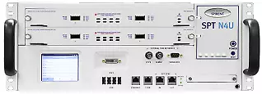
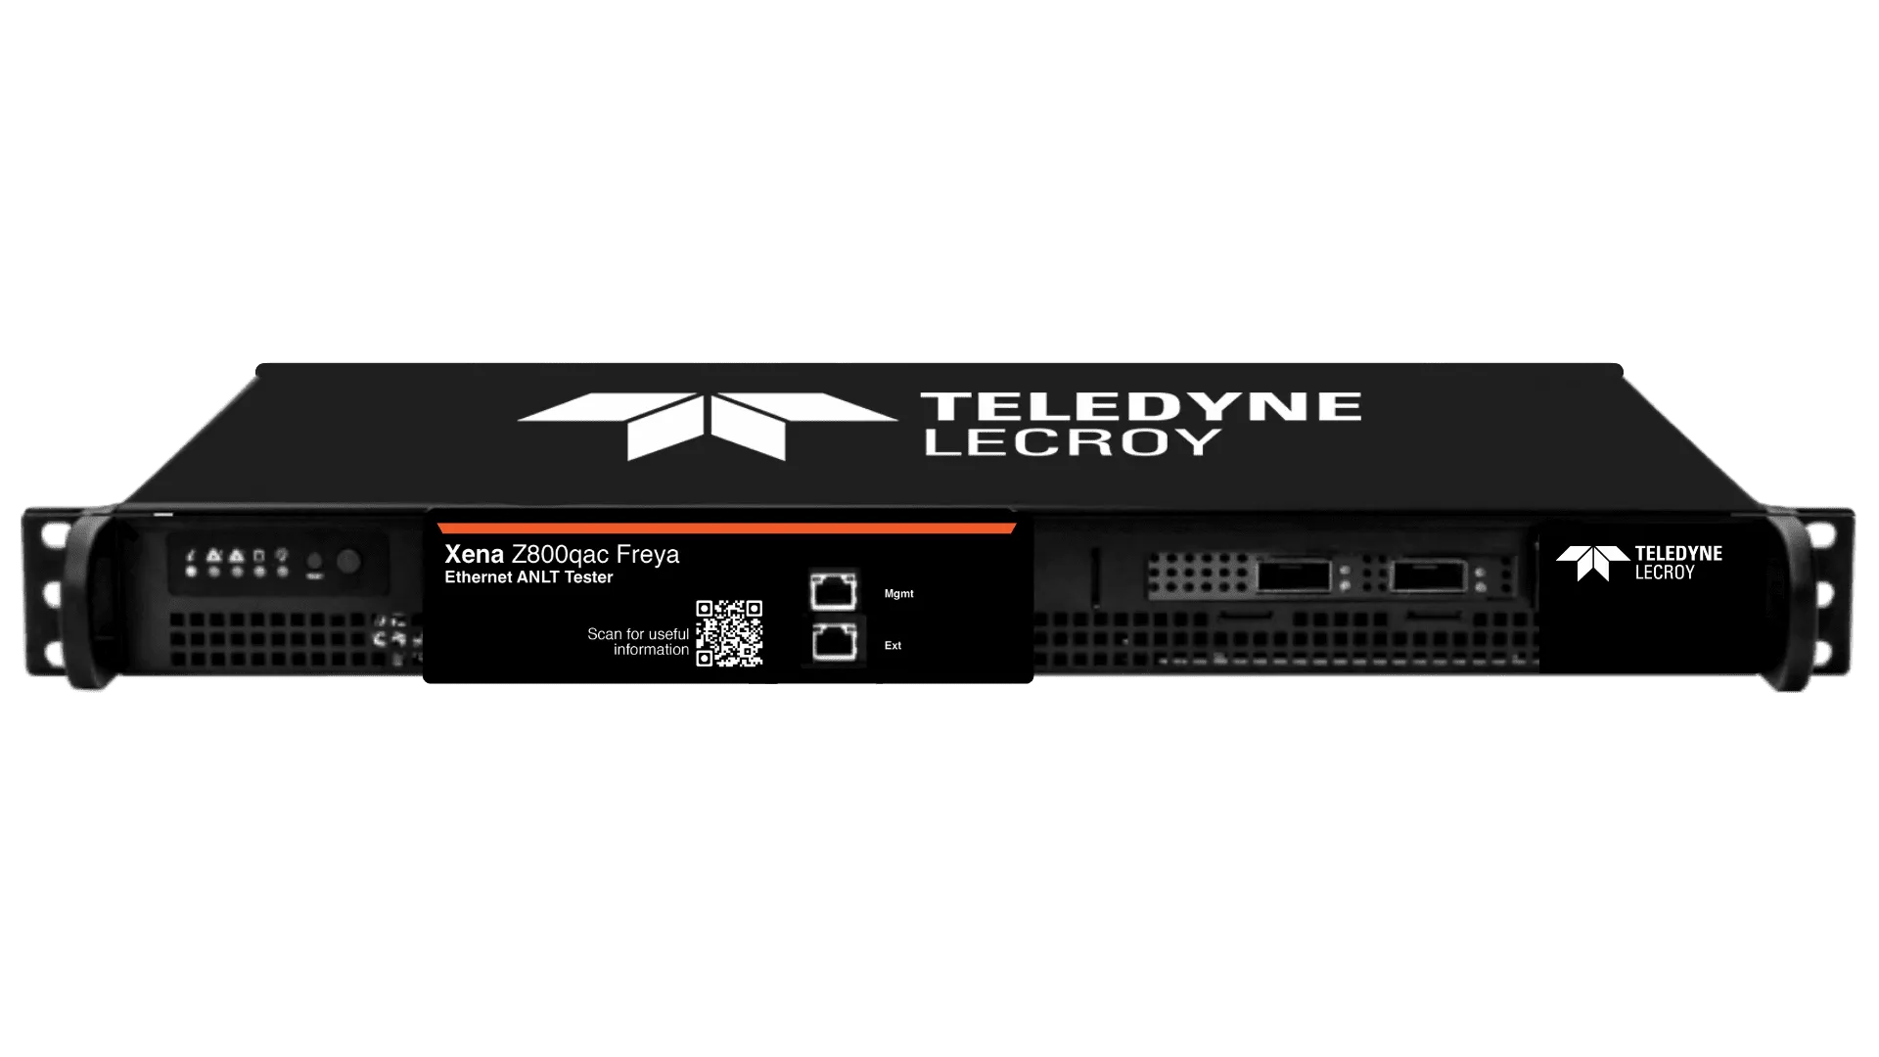
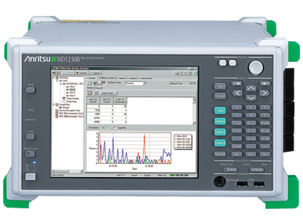
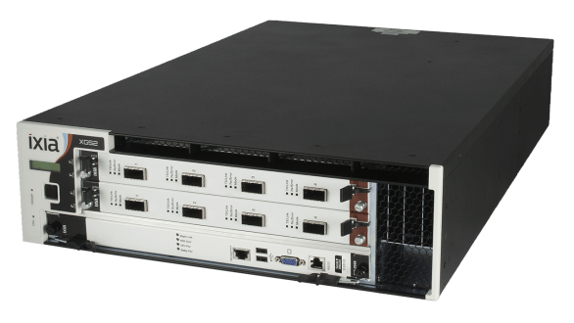
Network testers (traffic-generator and traffic-analyzer).
Proprietary or draft-ietf-bmwg-network-tester-cfg
A
D
B
C
E

Slide 5
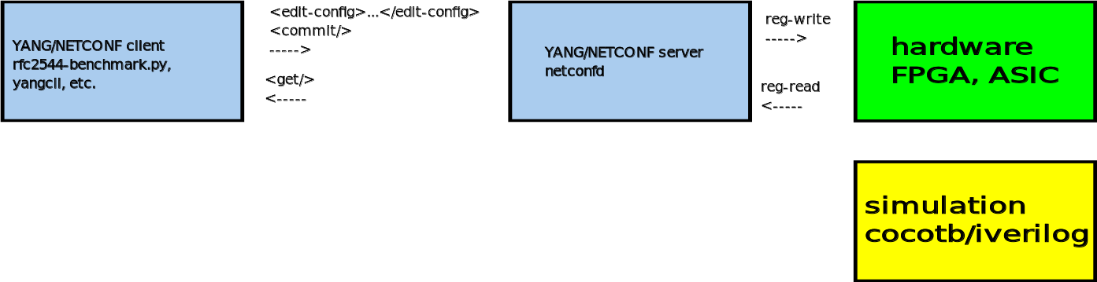

Slide 6
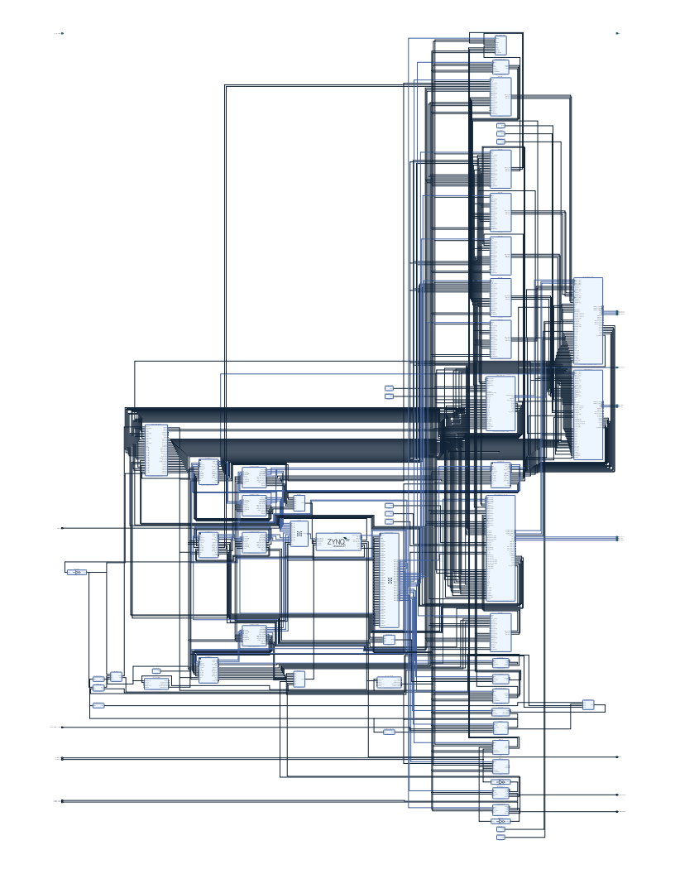
IP cores used
Cores:
* 1 xilinx.com:ip:zynq_ultra_ps_e
* 4 xilinx.com:ip:gig_ethernet_pcs_pma
* 8 lightside-instruments.com:ip:gmii_mux
* 2 lightside-instruments.com:ip:traffic_generator_gmii
* 2 lightside-instruments.com:ip:traffic_analyzer_gmii
* 2 lightside-instruments.com:ip:rtclock
* 6 xilinx.com:ip:axi_ethernet
* 6 xilinx.com:ip:axi_dma axi_ethernet_0_dma
* 1 xilinx.com:ip:axi_intc:4.1 axi_intc_0
* 3 xilinx.com:ip:clk_wiz:6.0 clk_wiz_1
* 3 xilinx.com:ip:axi_uart16550
* 1 xilinx.com:ip:axi_gpio
<number>

Slide 7
Getting Started
https://www.hackster.io/lightside-instruments/network-programmability-kit-for-ultra96-07435c

Slide 8
Targets
Ultra96 (Vivado)
Simulation (presented 2025)
LiteX boards (presenting now) - https://github.com/lightside-instruments/network-interconnect-tester-cores/tree/master/systems/litex

Slide 9
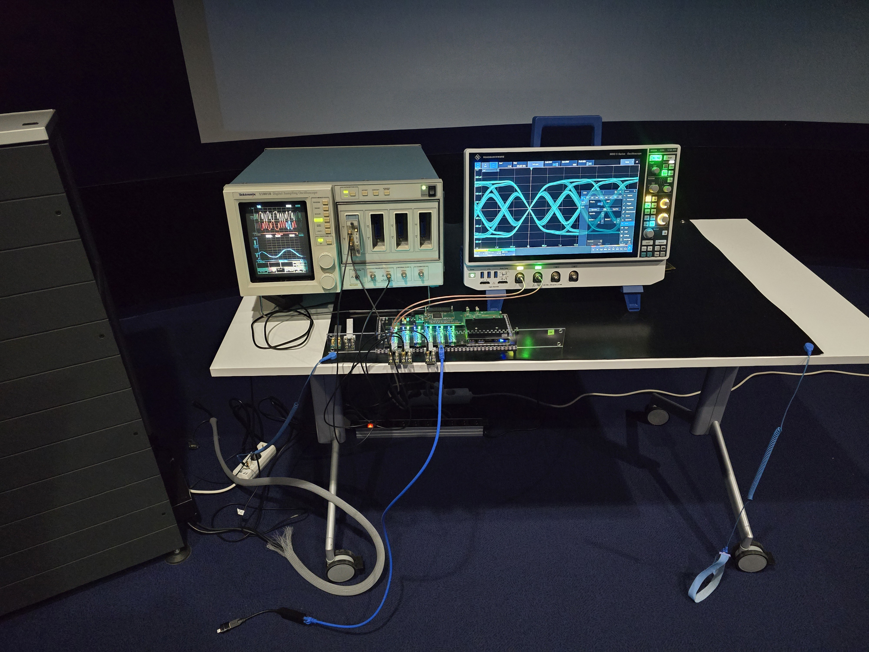

Slide 10
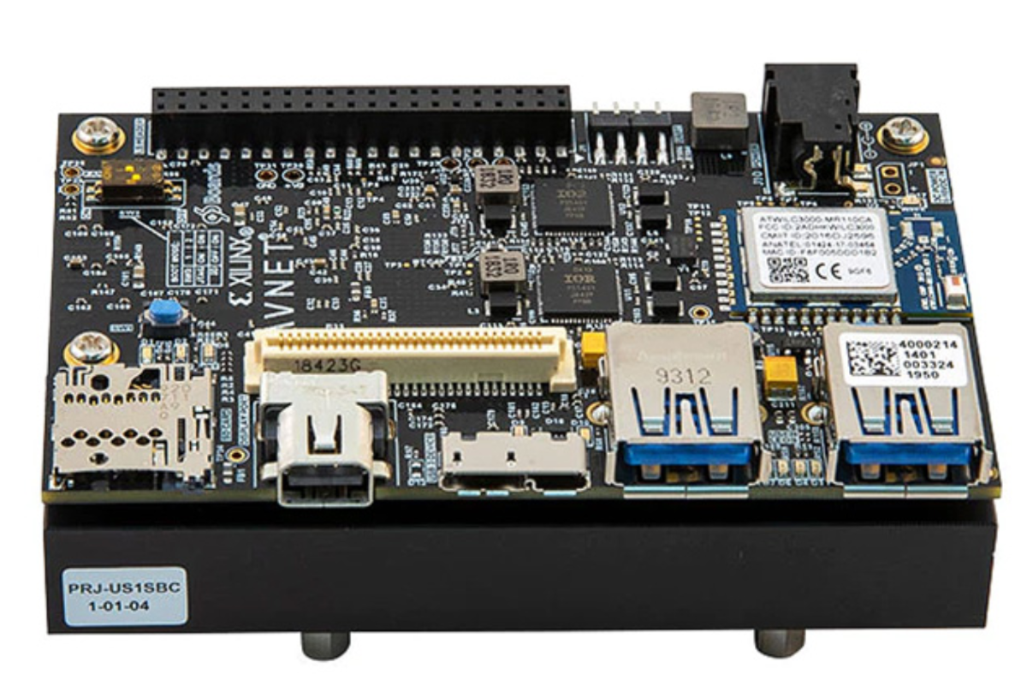
The problem
Ultra96 module discontinued

Slide 11
Why was Ultra96 so good?
96boards modular design with 11GHz High speed connector
Forever license for Vivado (for designing with Ultra96)
Nice price < $300
SerDes 6x pairs +1 (6x SFP+ 1Gb Ethernet)
Runs Debian
Enough programmable logic resources for the network tester cores

Slide 12
The good news
We designed our system around 96boards specification and not Ultra96
https://www.96boards.org/specifications/
Good progress has been made on forging LiteX, yosys and they can replace Vivado for our specific needs.
We still have the cocotb simulation target so that our standardization effort has a fallback reference design implementation

Slide 13
The solution
Design 2 independent open-source hardware substitution boards supported in Litex and Yosys (Lattice ecp5um-85f and Colognechip gatemate)
96boards form factor
Use softcore CPU
Can run Debian (ideally).

Slide 14
Selecting reference hardware designs
OrangeCrab (ECP5-85F) – KiCAD 0.5 mm BGP
Olimex (Gatemate) – KiCAD
Colognechip Eval Board – SerDes SMA
Lattice Versa ECP5 – SerDes SMA

Slide 15
Why use FPGA with softcore CPU?
100% transparent
Easy to deploy on different platforms
Scalable
Independence from proprietary components

Slide 17
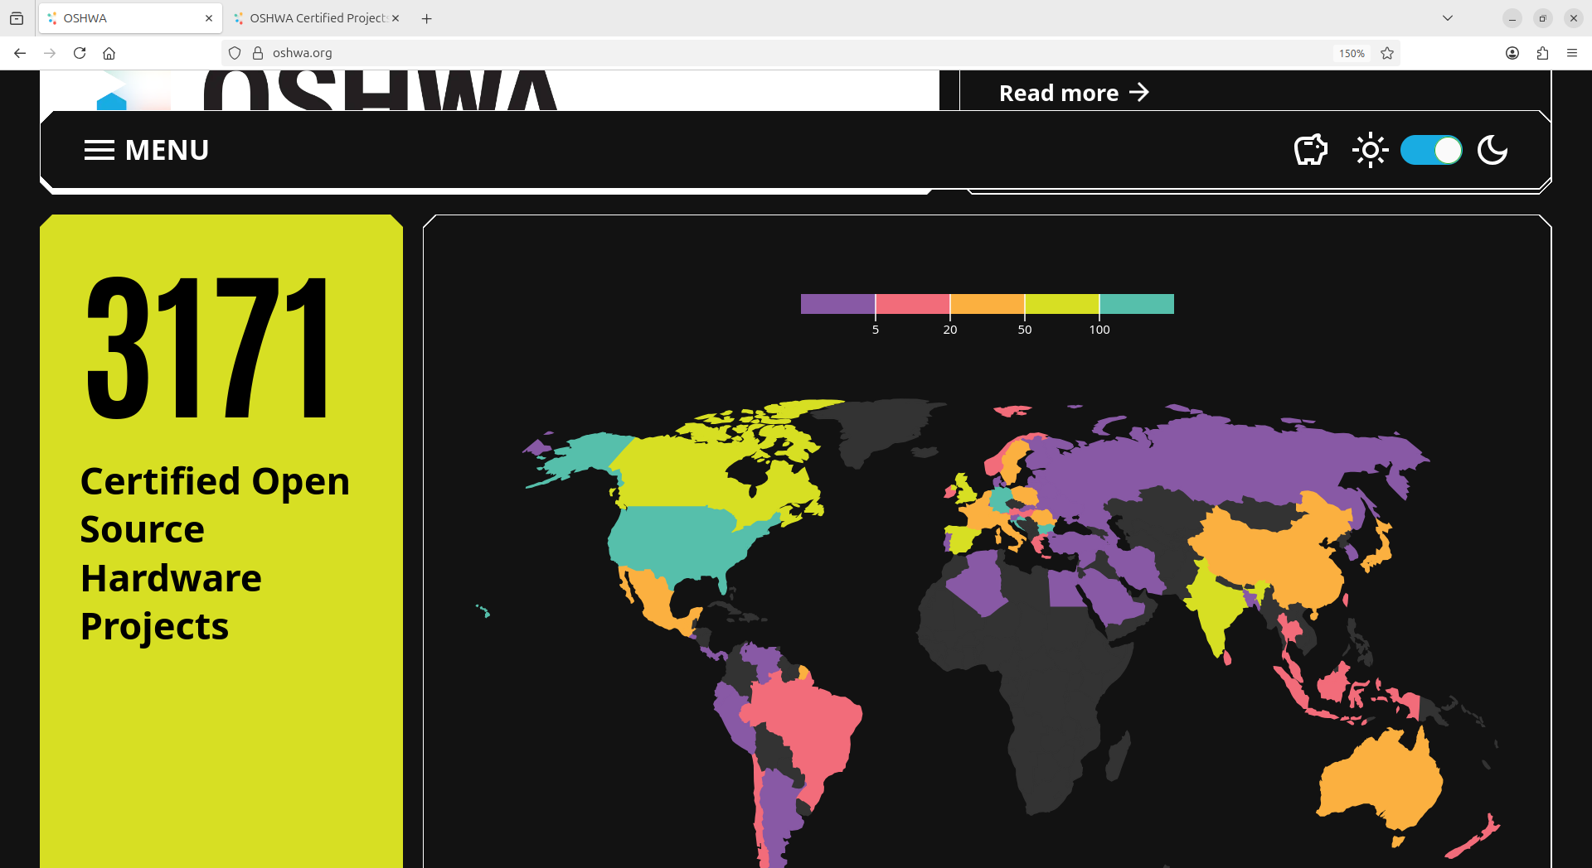

Slide 18
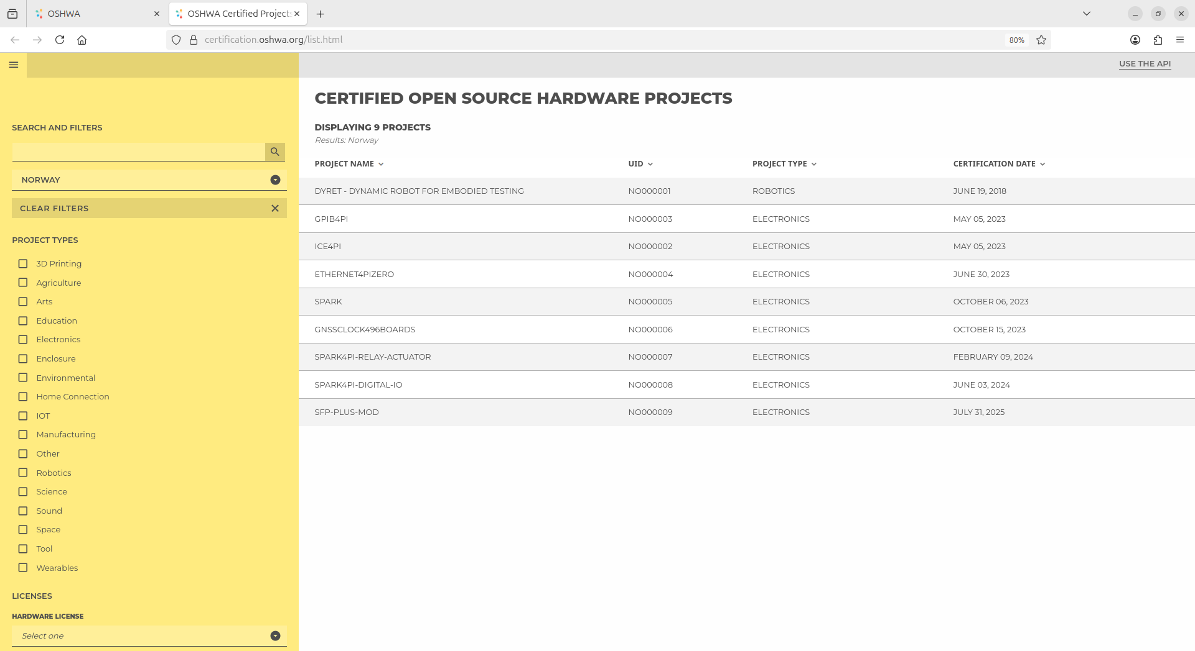

Slide 19
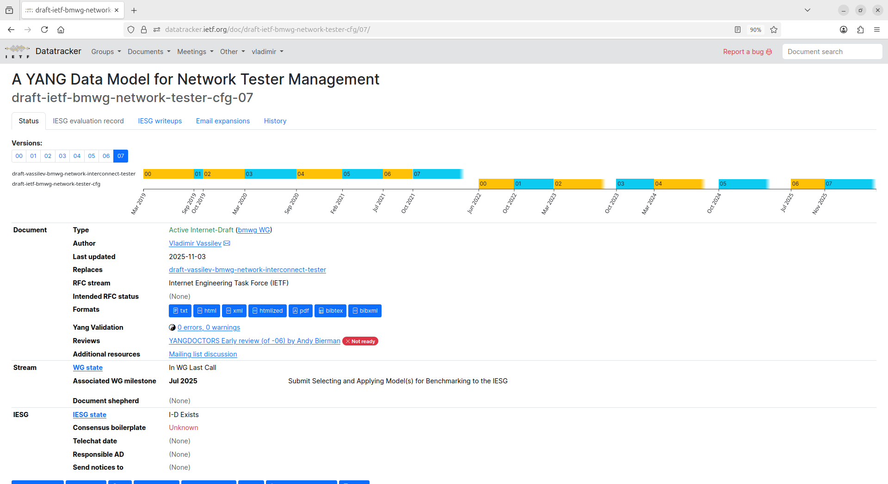

Slide 20
Design and implementation
NETCONF Server (Model (YANG), Implementation Generator module (C), Analyzer module (C))
TRAFFIC-GENERATOR-SW (C) TRAFFIC-ANALYZER-SW (C)
| |
Socket API Socket API
| \ | / |
Kernel Sync ->{RTCLOCK}(Verilog) Kernel
| PPS / | \ |
DMA DMA
| [AXI] | [AXI]
MAC TRAFFIC-GENERATOR-HW (C,Verilog) MAC TRAFFIC-ANALYZER-HW (C,Verilog)
\ / | |
\ / | |
GMII_MUX +---+---+
| [GMII] | [GMII]
PHY PHY
| |
SFP+ TX SFP+ RX
| |
+->----------------------------------->-+
* - underlined text has links to repositories
<number>

Slide 21
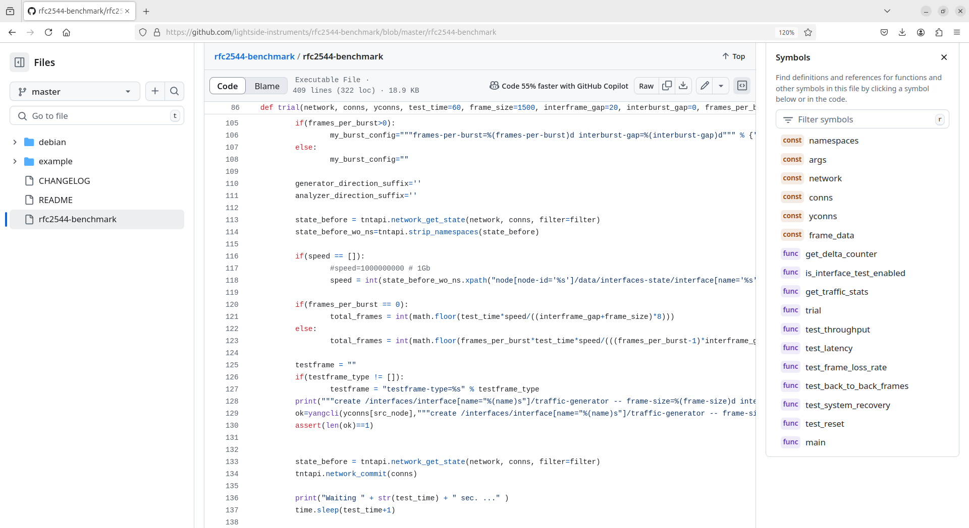

Slide 22
user@xps:~/lsi/code/rfc2544-benchmark/example$ ../rfc2544-benchmark --config=config.xml --dst-node=tester0 --dst-node-interface=eth1 --src-node=tester0 --src-node-interface=eth0 --dst-mac-address="70:B3:D5:EC:20:10" --src-mac-address="70:B3:D5:EC:20:11" --dst-ipv4-address="192.168.1.145" --src-ipv4-udp-port=49184 --src-ipv4-address="192.168.0.145" --frame-size=64 --trial-time=2 --speed=10000 --simulation | tee rfc2544-benchmark-report-full.log | grep ^# | tee rfc2544-benchmark-report.log
#===Throughput===
#1 14.880952 pps, 20 octets interframe gap, 100.00% ... 15 / 29
#2 7.911392 pps, 94 octets interframe gap, 53.16% ... 15 / 15
#3 11.363636 pps, 46 octets interframe gap, 76.36% ... 22 / 22
#4 13.020833 pps, 32 octets interframe gap, 87.50% ... 26 / 26
#5 13.888889 pps, 26 octets interframe gap, 93.33% ... 27 / 27
#6 14.367816 pps, 23 octets interframe gap, 96.55% ... 28 / 28
#7 14.534884 pps, 22 octets interframe gap, 97.67% ... 29 / 29
#8 14.705882 pps, 21 octets interframe gap, 98.82% ... 29 / 29
#Result: 14.705882 pps
#===Latency===
#Measurement style - bit forwarding
#1 24 ns (min=24 ns, max=24 ns) ... 29 / 29
...
#20 24 ns (min=24 ns, max=24 ns) ... 29 / 29
#Result: 24.000000 nanoseconds
#===Frame loss rate===
#1 100% rate, 48% loss, (100.000000% rate actual), 14.880952 pps (14.880952 pps actual), 20 octets interframe gap ... 15 / 29
#2 90% rate, 0% loss, (89.361702% rate actual), 13.392857 pps (13.297872 pps actual), 30 octets interframe gap ... 26 / 26
#3 80% rate, 0% loss, (80.000000% rate actual), 11.904762 pps (11.904762 pps actual), 41 octets interframe gap ... 23 / 23
#===Back to back frames===
#1 2 back-to-back frames ... 1 / 2
#Result: 1
sim_time_ns=1565330

Slide 23
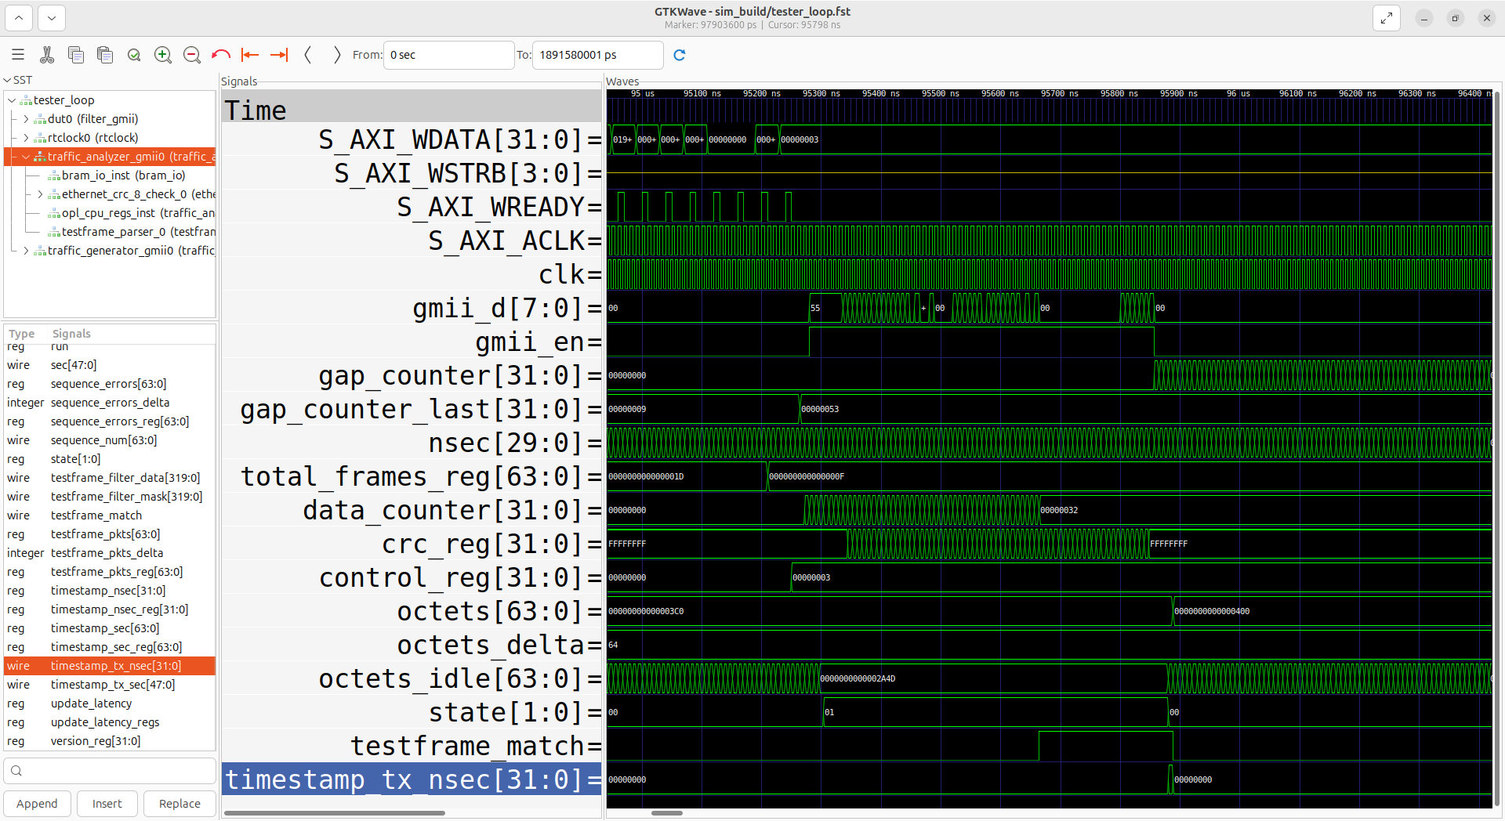

Slide 24
Model defined pre-silicon testing environment
Alternatives:
*Cadence/Spirent
... sim-run 1000 ns
sim-finish

Slide 25
Topology
Control plane - (Configuration and state data -> register read/write -> AXI bus transactions)
Data plane - (GMII)
eth0 NETCONF Server (YANG Model) eth1
| |
| AXI | AXI
| (GMII) (GMII) |
TRAFFIC-GENERATOR (HW) -- DUT0 -- TRAFFIC-ANALYZER (HW)
\ /
\ /
RTCLOCK
* DUT0 is FILTER0 when we the actual DUT is the TRAFFIC-GENERATOR or the TRAFFIC-ANALYZER

Slide 26
How it works (abstract)?
Dependencies cocotb, cocotb-bus, cocotb-axiext
Topology instantiation tester_loop.v
User defined cocotb socket loop handler in tester_loop.py
Test program (reg-read, reg-write, sim-run, sim-finish)

Slide 27
How it works (details)?
https://github.com/lightside-instruments/network-interconnect-tester-cores/blob/master/systems/simulation/README.md tested on Debian bookworm
Repository with simulation output files (log files and trace file tester_loop.fst) https://github.com/lightside-instruments/network-interconnect-tester-cores/tree/0.54-simreport/systems/simulation

Slide 28
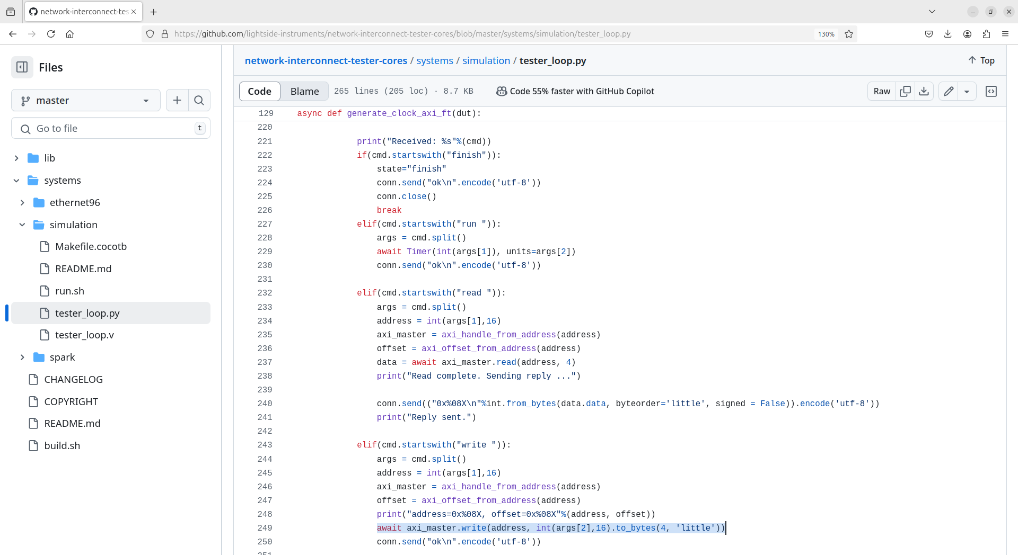

Slide 29
...
traffic_generator_gmii #(
.C_S_AXI_DATA_WIDTH(C_S_AXI_DATA_WIDTH),
.C_S_AXI_ADDR_WIDTH(C_S_AXI_ADDR_WIDTH),
.C_BASEADDR(TG_BASEADDR)
) traffic_generator_gmii0
(
.clk(clk),
.resetn(resetn_),
.gmii_d(gmii_d_tg),
.gmii_en(gmii_en_tg),
.gmii_er(gmii_er_tg),
.sec(sec_),
.nsec(nsec_),
// AXI Lite ports
.S_AXI_ACLK(S_AXI_TG_ACLK),
.S_AXI_ARESETN(S_AXI_TG_ARESETN),
...
.S_AXI_WDATA(S_AXI_TG_WDATA),
.S_AXI_WSTRB(S_AXI_TG_WSTRB),
.S_AXI_WVALID(S_AXI_TG_WVALID),
.S_AXI_BREADY(S_AXI_TG_BREADY),
.S_AXI_ARADDR(S_AXI_TG_ARADDR),
.S_AXI_RVALID(S_AXI_TG_RVALID),
.S_AXI_WREADY(S_AXI_TG_WREADY),
.S_AXI_BRESP(S_AXI_TG_BRESP),
.S_AXI_BVALID(S_AXI_TG_BVALID),
.S_AXI_AWREADY(S_AXI_TG_AWREADY)
);
...
tester_loop.v

Slide 30
tester_loop.py
import cocotb
from cocotb.triggers import FallingEdge, Timer
from cocotbext.axi import AxiLiteMaster, AxiLiteBus
...
# open simulation control socket
server = socket.socket(socket.AF_UNIX, socket.SOCK_STREAM)
server.bind("/tmp/simulation")
...
conn, addr = server.accept()
...
data = await axi_master.read(address, 4)
...
await axi_master.write(address, int(args[2],16).to_bytes(4, 'little'))
...
await Timer(int(args[1]), units=args[2])

Slide 31
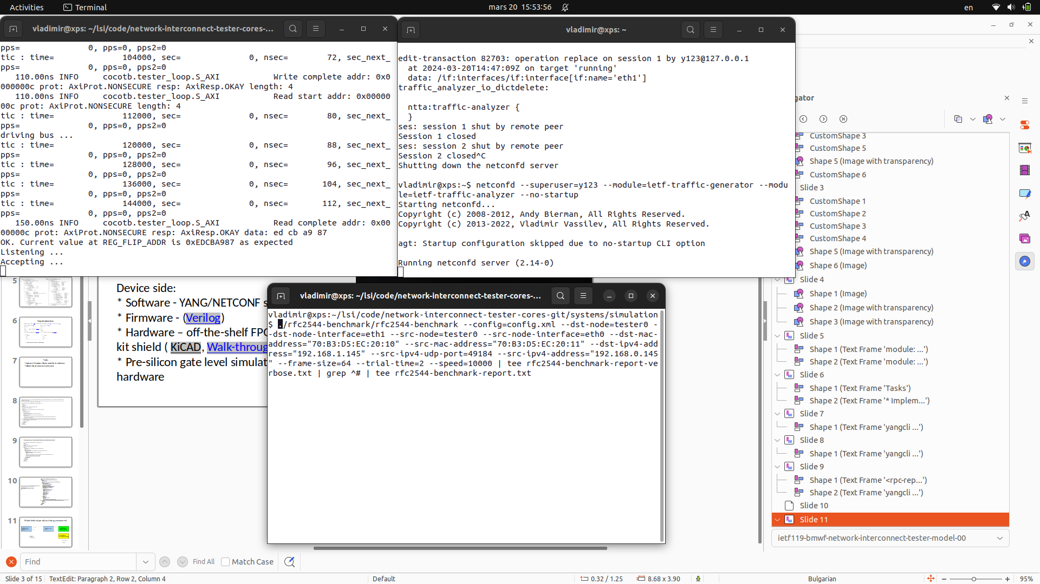

Slide 32
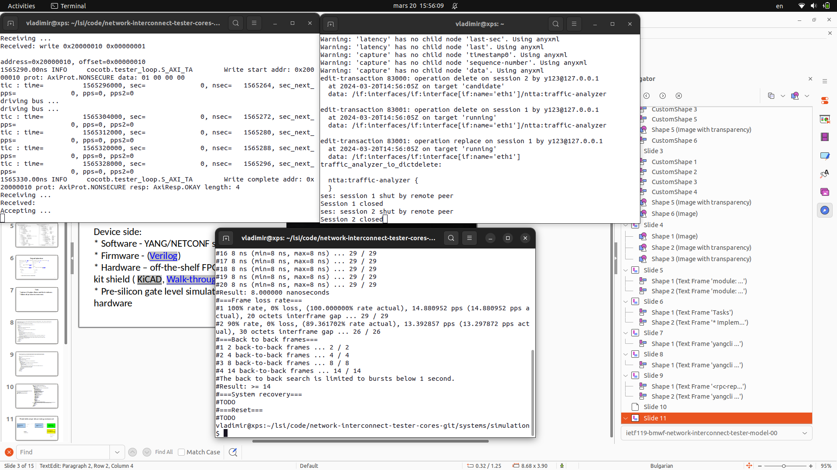

Slide 34
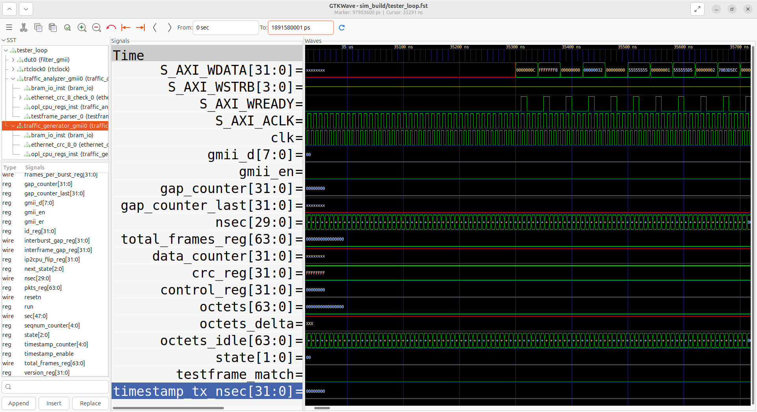

Slide 35
Running the simulation
user@xps:~/lsi/code/network-interconnect-tester-cores-git/systems/simulation$ make -f Makefile.cocotb MODULE=tester_loop WAVES=1
...
Receiving ...
Received: write 0x10000054 0x00000004
address=0x10000054, offset=0x00000054
1868320.00ns INFO cocotb.tester_loop.S_AXI_TG Write start addr: 0x10000054 prot: 2 data: 04 00 00 00
tic : time= 1868320000, sec= 0, nsec= 1868288, sec_next_pps= 0, pps=0, pps2=0
...
tic : time= 1868352000, sec= 0, nsec= 1868320, sec_next_pps= 0, pps=0, pps2=0
1868360.00ns INFO cocotb.tester_loop.S_AXI_TG Write complete addr: 0x10000054 prot: 2 resp: 0 length: 4
Receiving ...

Slide 36
How stable is this framework
cocotb - 156 contributors
cocotb-axiext - 3 contributors (Alex Forencich)
awaiting adoption in Debian

Slide 37
The End

Slide 38
The End

Slide 39
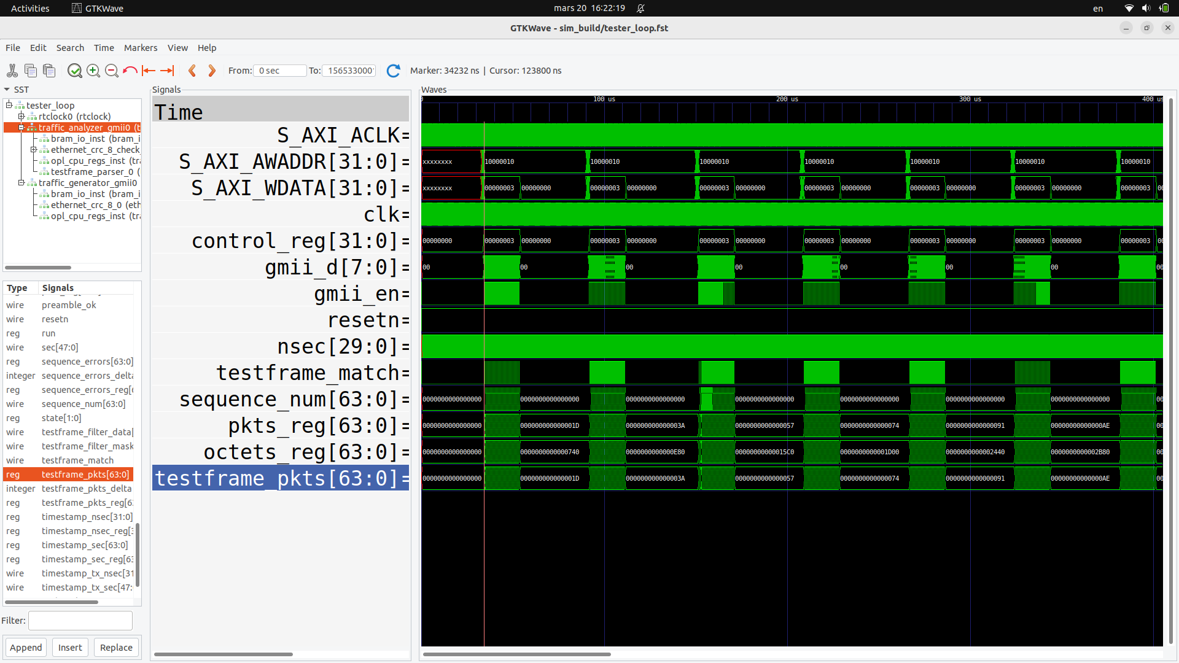

Slide 40
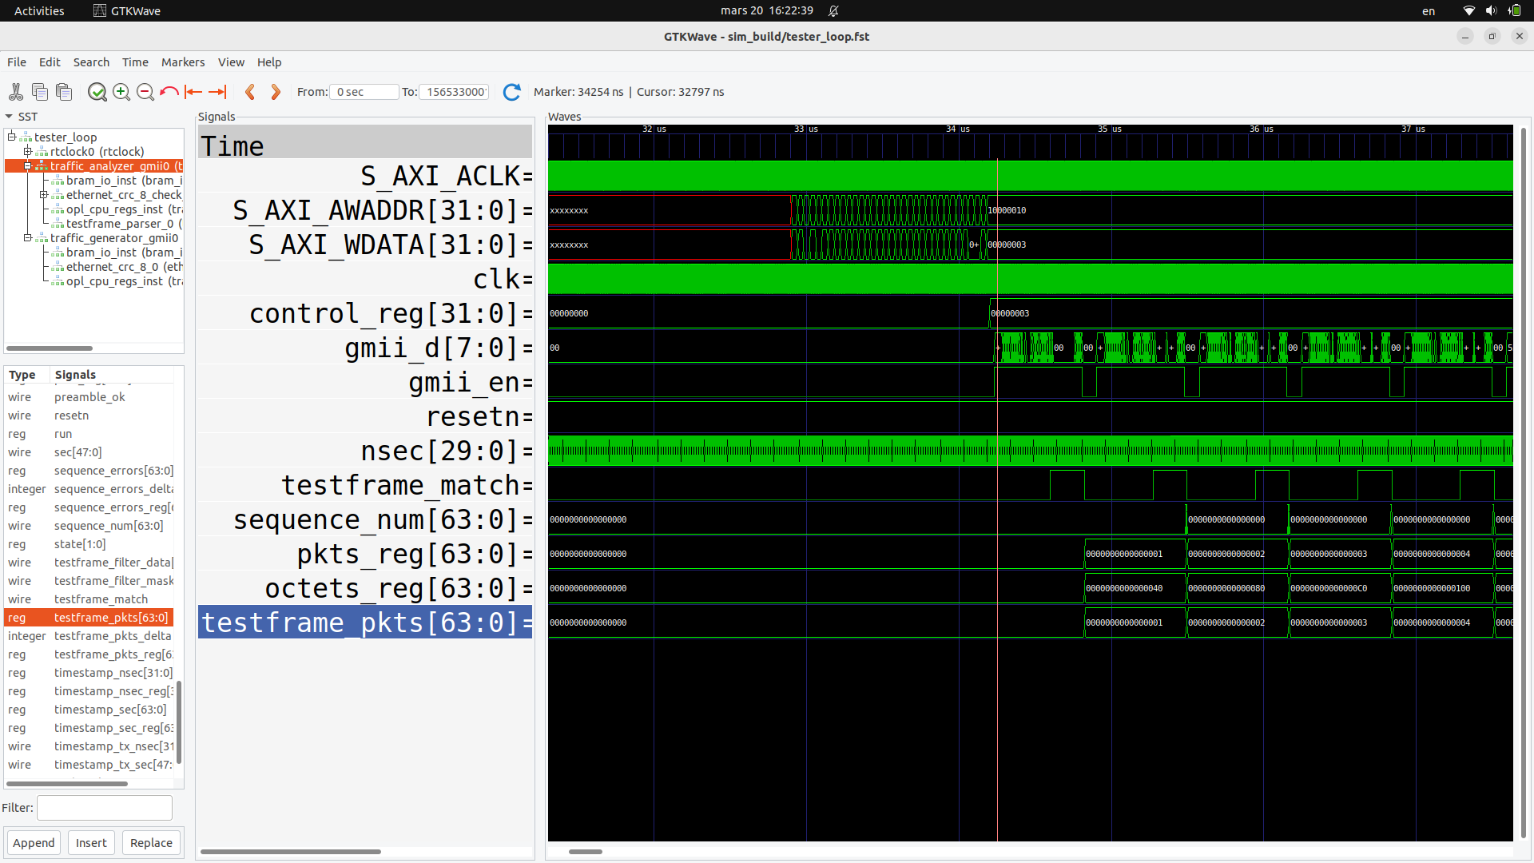

Slide 41
