Slide 1


E-Commerce
- Manoj Phuyal
Suman Bhatta
Suman Dangol
Sagar Khanal
Sagar Ghimire

Slide 2

Introduction
OYO stands for “On Your Own”
Age at 21 when built the OYO.
OYO started with one city and one hotel in Gurgaon in January 2013.
Mr. Ritesh Agarwal
Founder and CEO of OYO

Slide 3
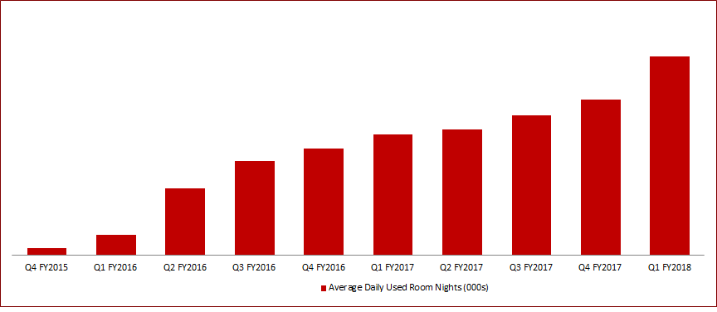
Revenue
More than 8500 hotel.
More than 50000 rooms .
2400crore Rupees capital.

Slide 4
Business Model
OYO room is actually a chain of modified budget hotel.
Pay a lot lessor than other normal budget hotel.
Follows the Aggregator business model.
Which model is the same model used by Uber.

Slide 5
Business Model Cont.…
India’s largest aggregator of the branded network of hotel.
Room is unique in comparison to it’s competitors like Yatra, makemytrip.
Now it is distributed to all the countries like Nepal, China, USA etc.

Slide 6
Aggregator Business Model
Electronic commerce business model where a firm (that does not produce or warehouses any item) collects (aggregates) information on goods and/or services from several competing sources at its website.
Aggregator gets the commission.
Bookings are made through the Oyo Rooms website and mobile application.

Slide 7
BUSINESS MODEL OF OYO ROOMS
Oyo Rooms Business Model is a hotel aggregator model.
The services are bought by the users under the name of Oyo rooms.
Just like Uber, Oyo provides rooms with standardized quality and price.
Oyo Rooms provide visitors with quality hotel room stays at different places around India.
They have partnered with hotels and made them work with them under their name.

Slide 8
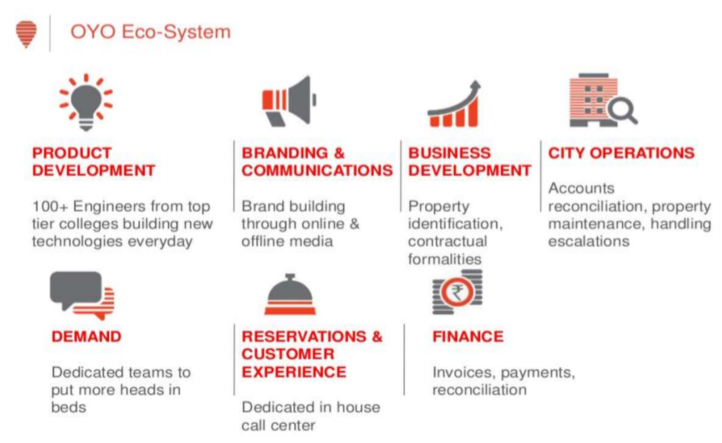

FUNCTIONAL DEPARTMENTS OF OYO ROOMS

Slide 9
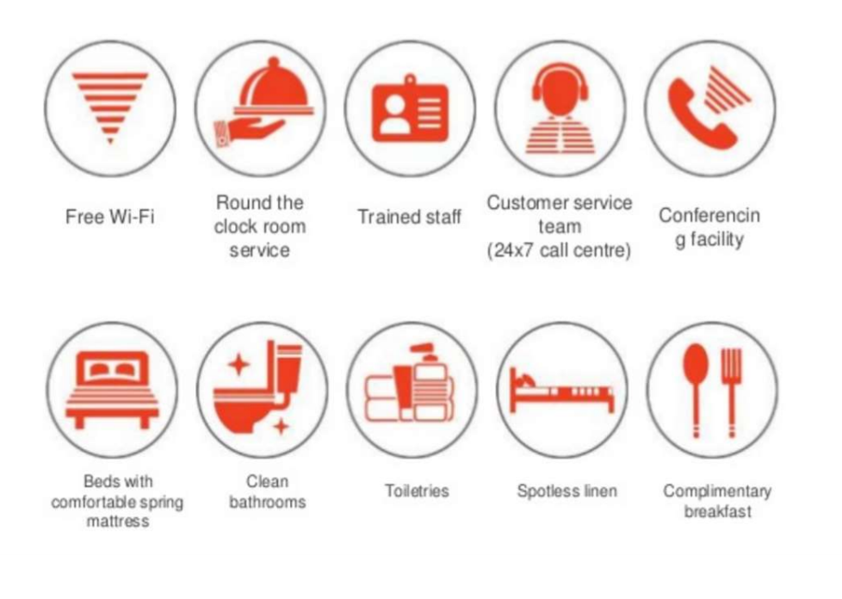
FACILITIES PROVIDED IN OYO ROOMS

Slide 10
Any Question ??

Slide 11
Thank You…

