Slide 1


OLX
- Group 6

Slide 2

Members
Indira Songmi (Leader)
Amir Maharjan
Ashok Chhetri
Durpin Thapa Magar

Slide 3
Topics
Introduction
History
How OLX Works?
OLX Business Model
How does OLX make money?
Screenshot

Slide 4

Introduction
OLX is a global online marketplace.
It is short for Online Exchange.
It is headquartered in Amsterdam, and owned by South African media and technology group Naspers.
It is operating in 45 countries.
It was founded in 2006.
It is the largest online classified ads company in Pakistan, Brazil, India, Bulgaria, Poland, Portugal and Ukraine

Slide 5
History
2006
Fabrice Grinda and Alec Oxenford started the company as a Craigslist alternative.
Acquired Mundoanuncio.com
Notes:
2006
Fabrice Grinda and Alec Oxenford started the company as a Craigslist alternative for the world outside of the United States.
It acquired Mundoanuncio.com, a classifieds site targeting the Hispanic market
Online network, which provides users with a central database for classified ads and forums from across the world. Some of the items included in the database are: for sale advertisements, personal ads, job opportunities, and subject-related forums. Users are able to view all the classified ads for free and are only required to pay if they want to post a job opportunity; all other postings are free as well.

Slide 6
History
2007
It made an investment Chinese classifieds site in Edeng.cn
2008
Its growth in the Philippines was attributed to its partnership with Friendster.
The company invested in "Web 2.0"
Notes:
2007 It made an investment Chinese classifieds site in Edeng.cn
its growth in the Philippines was attributed to its partnership with Friendster
2008 The company invested in "Web 2.0" features in 2008, such as social network widgets, improved search, Ajax-based editors, interactive maps, and mobile versions

Slide 7
History
2009
The company partnered with Hi5, a social network, which implemented OLX features, such as displaying ads and sharing ads with friends, and OLX enabled video, image and mobile features, in 39 languages and 90 countries.
Notes:
2009
the company partnered with Hi5, a social network, which at the time had 60 million users. Hi5 implemented OLX features, such as displaying ads and sharing ads with friends, and OLX enabled video, image and mobile features, in 39 languages and 90 countries.

Slide 8
History
2010
South African media group Naspers, bought out the existing investors.
2014
OLX's global traffic was 240 million unique monthly visits, 54% of which came from mobile.
Notes:
2010
a majority of the company was acquired by the South African media group Naspers, which bought out the existing investors.
2014
OLX's global traffic was 240 million unique monthly visits, 54% of which came from mobile

Slide 9
History
2016
Launched Tradus as a heavy machinery classifieds site which listed ads for used, heavy machinery and vehicles.
2018
OLX announced the shut down of its Nigerian office and a complete pullout from Nigeria.
Notes:
2016
it launched Tradus as a heavy machinery classifieds site. It lists ads for used, heavy machinery and vehicles in the fields of construction, transport, and farming, and also spare parts for such machines
2018
OLX announced the shut down of its Nigerian office and a complete pullout from Nigeria.

Slide 10
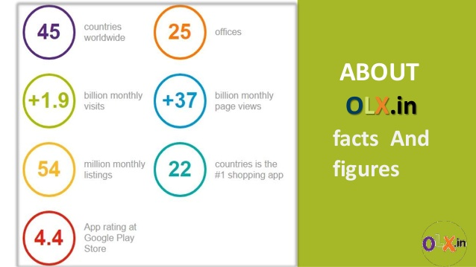
History
Present

Slide 11
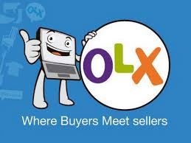
How OLX Works?
Sellers need to upload pictures of their goods, along with a title and description of and the expected sales price of the commodity.
Buyers are allowed to browse through the several alternatives, contact the seller, negotiate with them one-to-one and then purchase the item.

Slide 12
How OLX Works?
The surprising fact is that OLX doesn’t act as a liaison between the buyer and the seller.
It acts as a mere catalyst for connecting the two online through a classifieds portal.
The conversation, bargaining, advances, and transactions remain between the buyer and seller only.

Slide 13
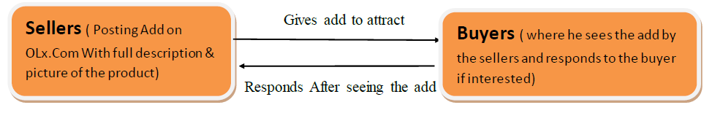
OLX Business Model
Basically OLX is Consumer to Consumer model (C2C) where in there are many offerings made, options and forums where individuals can buy and sell things through online payment systems like Paypal etc.

Slide 14

How does OLX make money ?
The prime source of revenue for OLX is through
Google Adsense
Google Custom Search Engine
Featured Listings

Slide 15
How does OLX make money ?
Google Adsense
A major part of OLX’s revenue comes from Google Adsense Monetization.
Google Adsense is an advertisement placement service by Google which lets publishers like OLX to serve media advertisements.

Slide 16
How does OLX make money ?
Google Custom search engine
The OLX page has a search bar for customers to look up products.
When they perform any search, the results obtained are an optimization with the Google Custom search engine monetization of Adsense, wherein the first two-three results are from Google.

Slide 17
How does OLX make money ?
Featured Listings
If a seller, for example, has posted a classifieds listing of a refrigerator he wishes to sell. After some time, the product is bound to go further below more recent listings, and would now appear on the second or third page and so on. To make it still appear on the top, the seller can pay to OLX to ‘feature’ his listing on the top of the site.
This featured listings is a source of profit to both the seller as well as OLX.

Slide 18
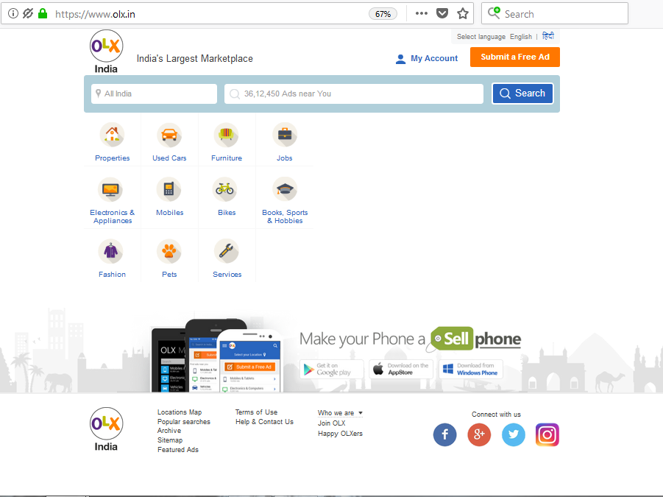
Screenshot

Slide 19

Any Questions ?

Slide 20

Thank You

