Slide 1
Asian School of Management & Technology Group II
Anil Mahajan
Bandana Adhikari
Rakshya Niraula
Siraj Lama

Slide 2

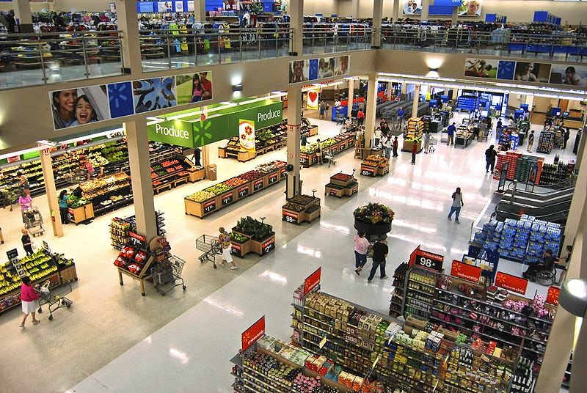

Walmart

Slide 3
Introduction
An American multinational retail corporation that operates a chain of hypermarkets, discount department stores and grocery stores.
World’s largest public corporation by revenue.
Largest private employer in the world.
Fourth largest utility or commercial employer.
Largest grocery retailer in United States(20%).
Largest toy seller in United States(22%).
World’s biggest retailer
Walmart sold same products as their competitors but kept prices lower by reducing profit margin . Walton’s EDLP strategy help to remain the foundation of Walmart.
Walmart thrives on 3 basic beliefs and values
1.respect for each individuals
2.service to our customer
3.striving for excellence

Slide 4
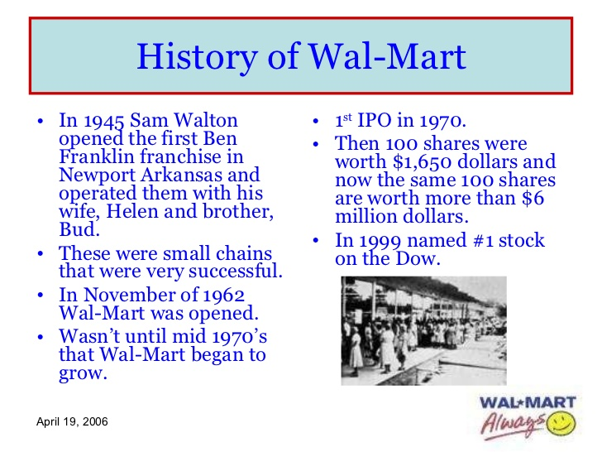
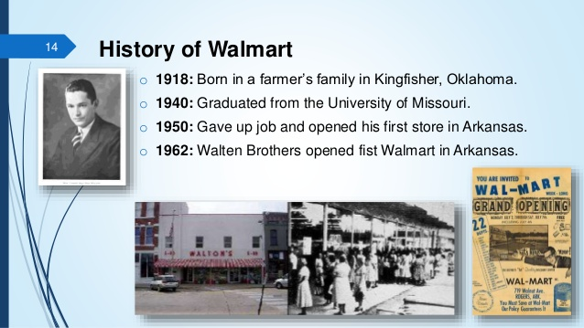
History
On July 2, 1962, Walton opened the first Walmart Discount City store at 719 W. Walnut Street in Rogers, Arkansas. Number of locations: ‎11,718 stores worldwide ...
Owner‎: ‎Walton family‎ (51%)
Number of employees: ‎: 2.3 million, Worldwide ...
Operating income‎: ‎US$20.437 billion (2018)

Slide 5
Business Model
follows affiliate model as it pays affiliate if one places product banners or links on their website to refer users to walmart.com
follows advertisement model as it allows sellers to place their ad in their site
walmart.com is committed to providing low prices every day, on everything. So if one finds a lower price from an online retailer on an identical, in-stock product, they'll match it. Additionally, if one recently bought something from Walmart.com and it is now listed at a lower price, then they will match that price and return the extra money

Slide 6
What countries have walmart stores?
Walmart operates more than 10,000 stores under 71 banners in 27 countries.
Argentina | Guatemala | Nicaragua
Botswana | Honduras | Nigeria
Brazil | India | South Africa
Canada | Japan | Swaziland
Chile | Lesotho | Uganda
China | Malawi | United Kingdom
Costa Rica | Mexico | United States
El Salvador | Mozambique | Zambia
Ghana | Namibia | Tanzania

Slide 7
Detail information regarding walmart
Revenue | US$ 476.294 billion(2014)
Operating income | US$ 26.872 billion(2014)
Net income | US$ 16.022 billion(2014)
Total assets | US$ 204.751 billion(2014)
Total equity | US$ 81.339 billion(2014)
Owner(s) | Walton family
Employees | 2.2 million (2013)

Slide 8
Features
Setting strong expectations for suppliers.
Establishing accountability through the adults and other tools.
Building capacity within the supply chain through training and worker well-being programs
Collaborating with industry stakeholders to promote supply chain responsibility

Slide 9
Overview of walmart
Physical sales of approximately $466billion in 2013
Retail stores in 27 countries
Ecommerce website in 10 of the countries

Slide 10
Conclusion
Even though Wal-Mart is the pioneer of its industry with about one-hundred million customers entering its stores each week it still continues to rise even further above its competition.
Many still consider Wal-Mart's pioneering, IT-driven supply chain to be the world's most efficient.
The technology aspect of the retail giant has kept Wal-Mart's prices lower than its competition.
Business intelligence helped Wal-Mart cut cost at every stage and achieve their goal of providing their customers with the ability to, “Save money, Live better.”

