Slide 1
D E S I R E
Dose Estimation by Simulation of the ISS Radiation Environment http://www.particle.kth.se/desire/
Geant4 simulations of
the Columbus/ISS radiation environment
T. Ersmark¹, P. Carlson¹, E. Daly², C. Fuglesang³, I. Gudowska⁴, B. Lund-Jensen¹,
R. Nartallo², P. Nieminen², M. Pearce¹, G. Santin², N. Sobolevsky⁵
¹Royal Institute of Technology (KTH) (Stockholm)
²ESA-ESTEC (Noordwijk)
³EAC/JSC (Cologne/Houston)
⁴Karolinska Institutet (Stockholm)
⁵Institute for Nuclear Research (Moscow)

Slide 2
Outline
The DESIRE project
Geant4 physics validation studies
Columbus and ISS geometries
Radiation environment models
Simulation results
Conclusions and future

Slide 3
The DESIRE project
”Dose Estimation by Simulation of the ISS Radiation Environment”
Aimed at accurate calculations of the radiation flux and doses to astronauts inside the European ISS laboratory Columbus.
Utilizes Geant4 for radiation transport.
Funded by ESA (15613/NL/LvH) and SNSB.
Validation and comparisons of Geant4 physics models to…
  Experiments
  NASA BRYN-/HZETRN programs
  SHIELD-HIT Monte Carlo program
Implementation of Columbus and ISS geometries in Geant4.
Evaluation of incident radiation environment models.
Full simulations of particle fluxes and doses inside Columbus.

Slide 4
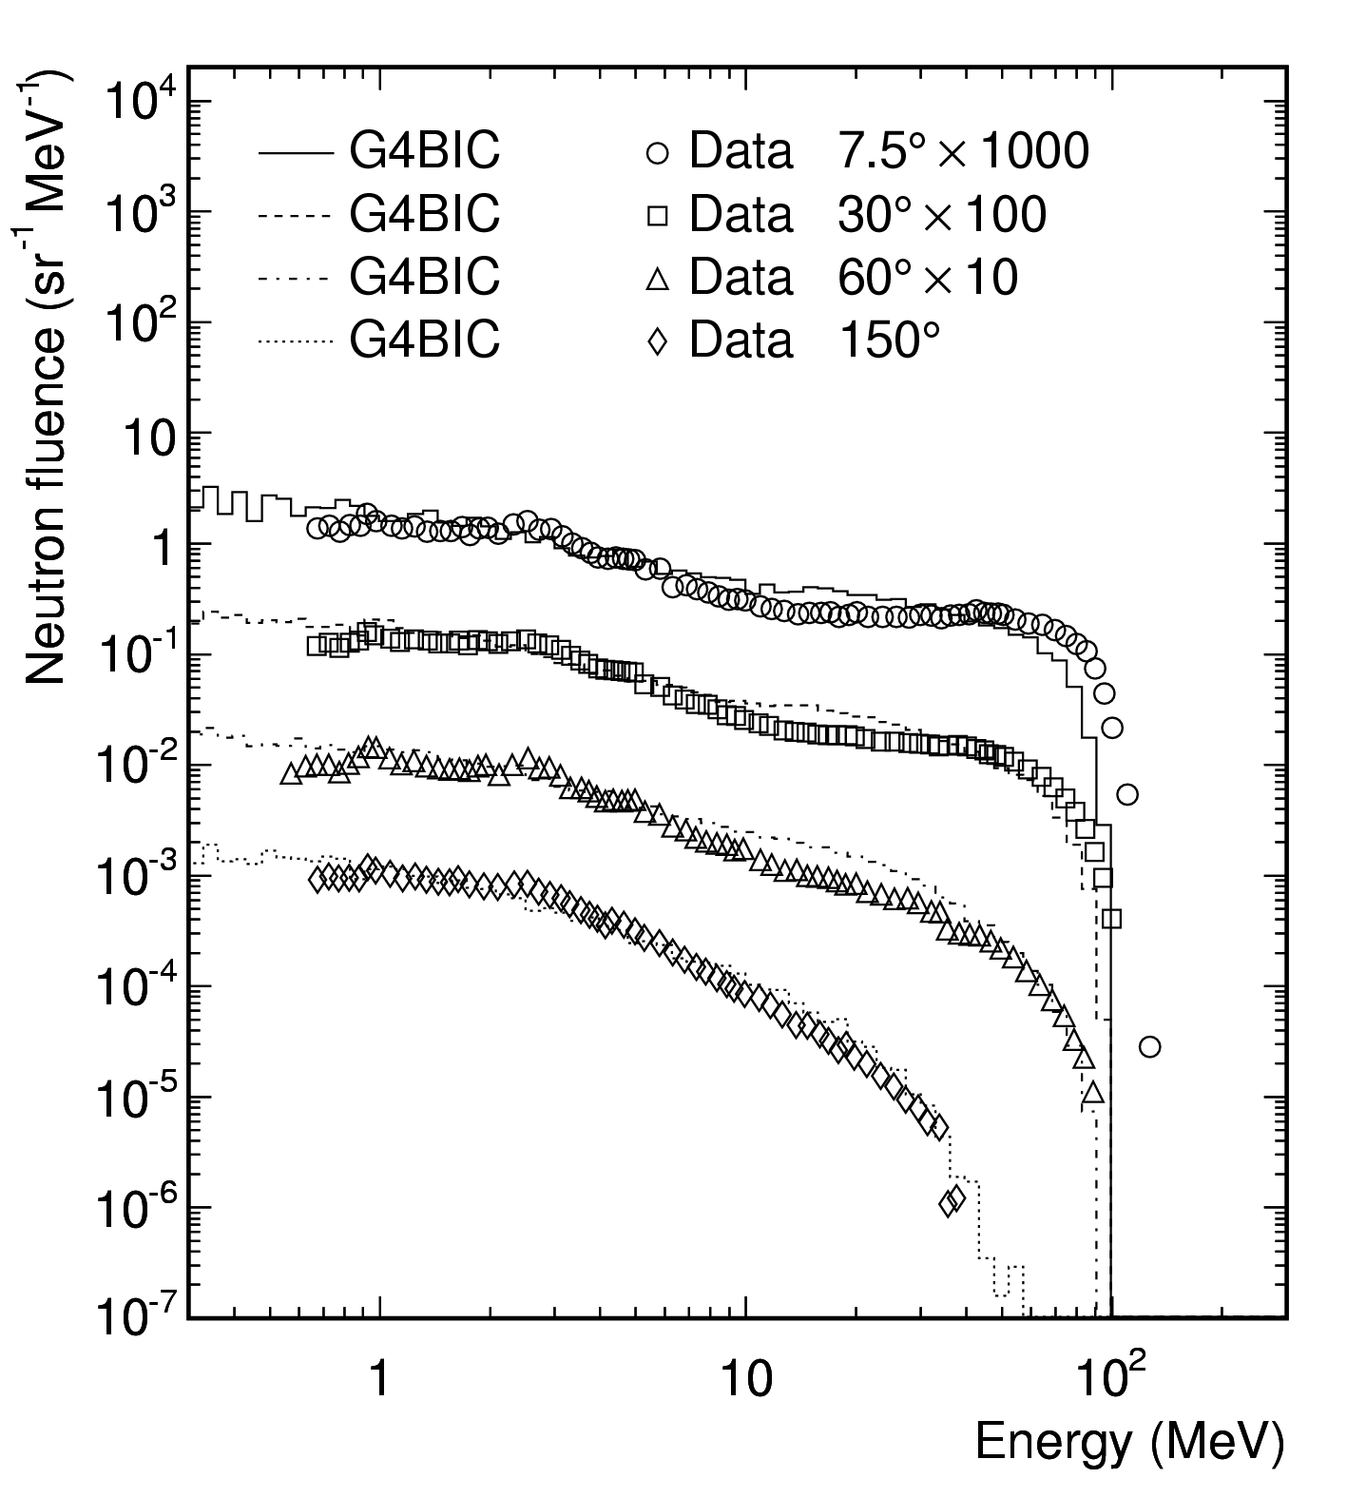
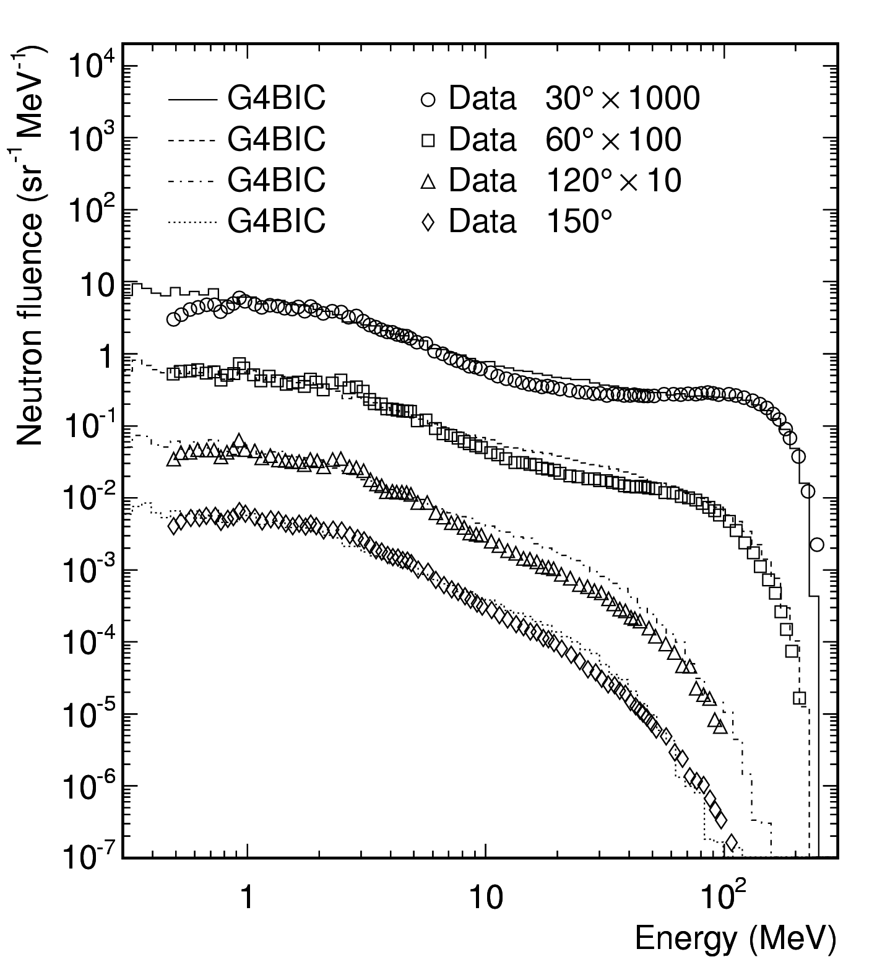
Geant4 physics validation studies
Incident protons with energies 10-1000 MeV.
  Neutron production
  Energy deposition
  Proton penetration
  Water, Beryllium, Carbon,
  Aluminum, Iron, Uranium
Comparisons to Los Alamos
experimental data (Meier,
Nucl. Sci. Eng. 102 and 104),
SHIELD-HIT, BRYNTRN.
Published in IEEE Trans. Nucl. Sci. 51,1378 (2004).
Summary: Energy deposition/proton penetration ok. Secondary neutron production ok after release of cascade models (since 2003).
113 MeV p on 4 cm Al
256 MeV p on 12 cm Al

Slide 5
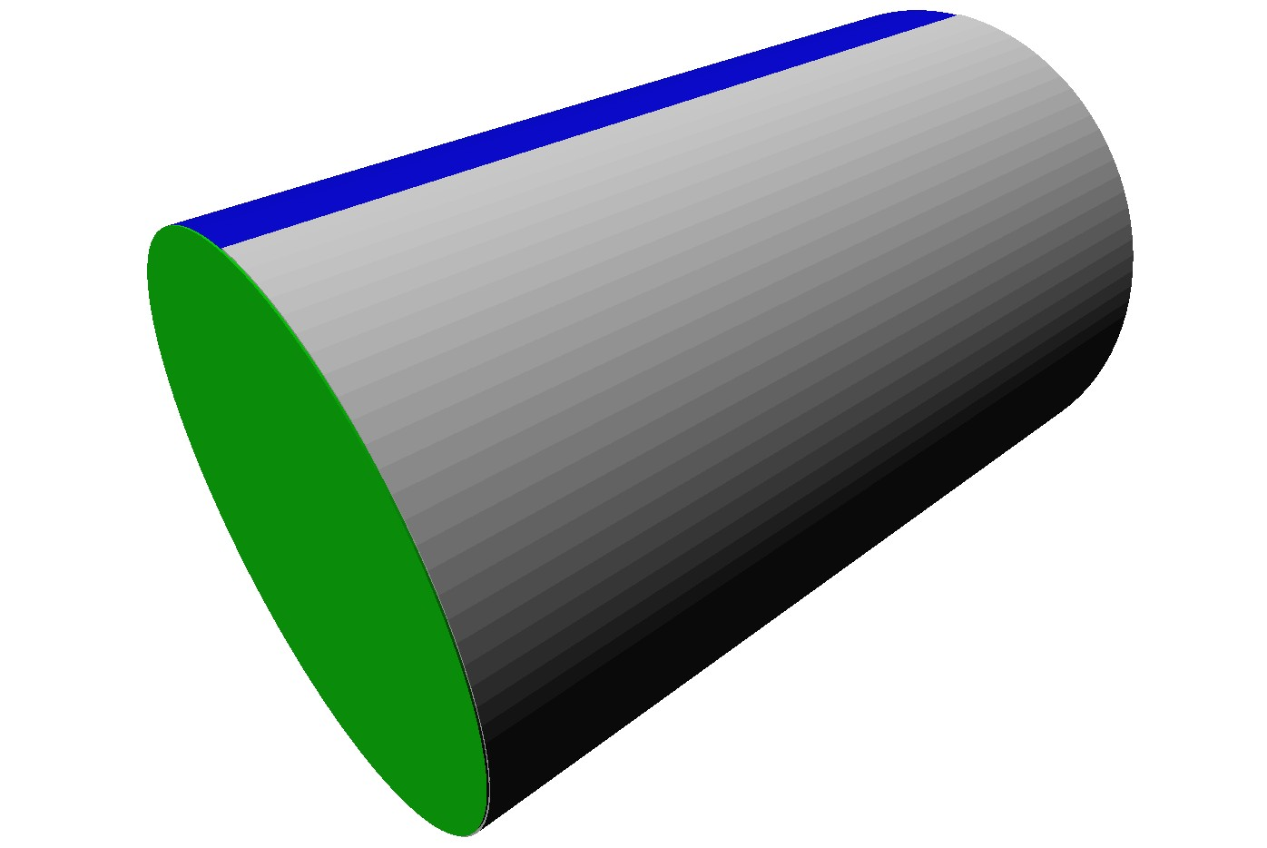
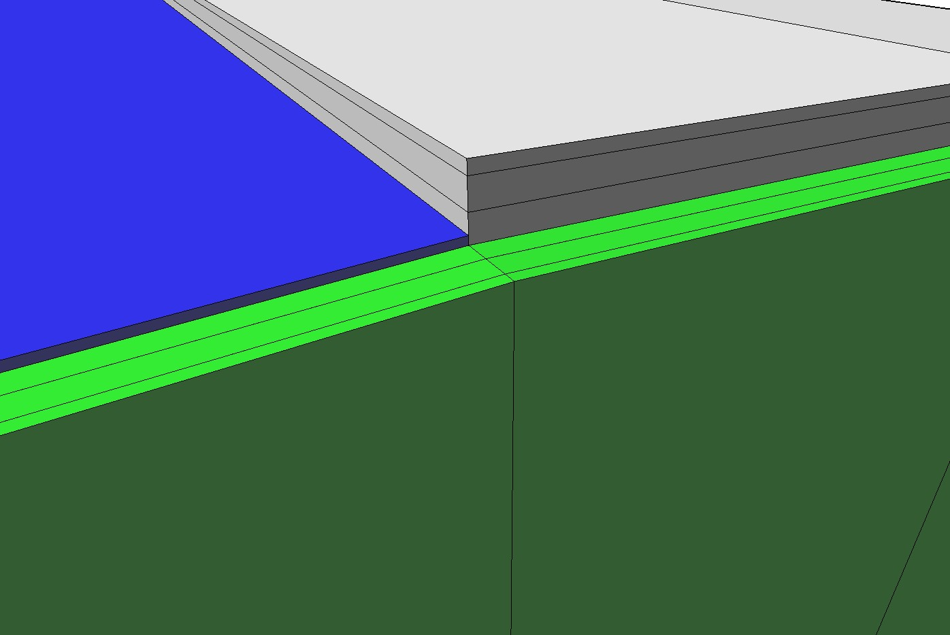
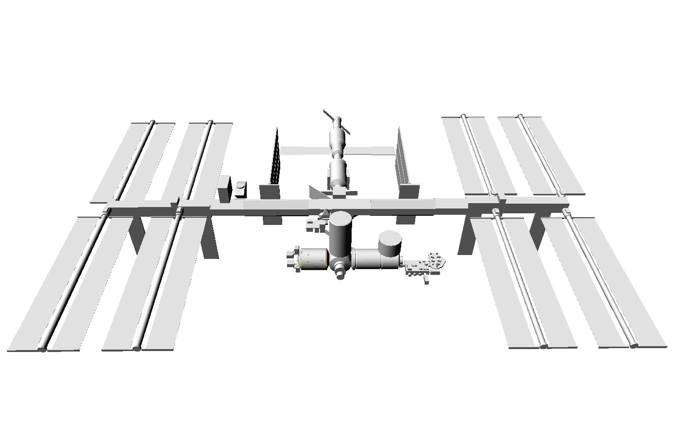
Columbus and ISS geometries
“Columbus1”
  Simple cylinder-like geometry
  10 volumes; MDPS1/2/3 + hull
  4200 kg
“Columbus3”
  Detailed geometry
  800 volumes
  16750 kg
ISS
  350-400 volumes
  352 tons (369 tons)
...so 4 combinations

Slide 6
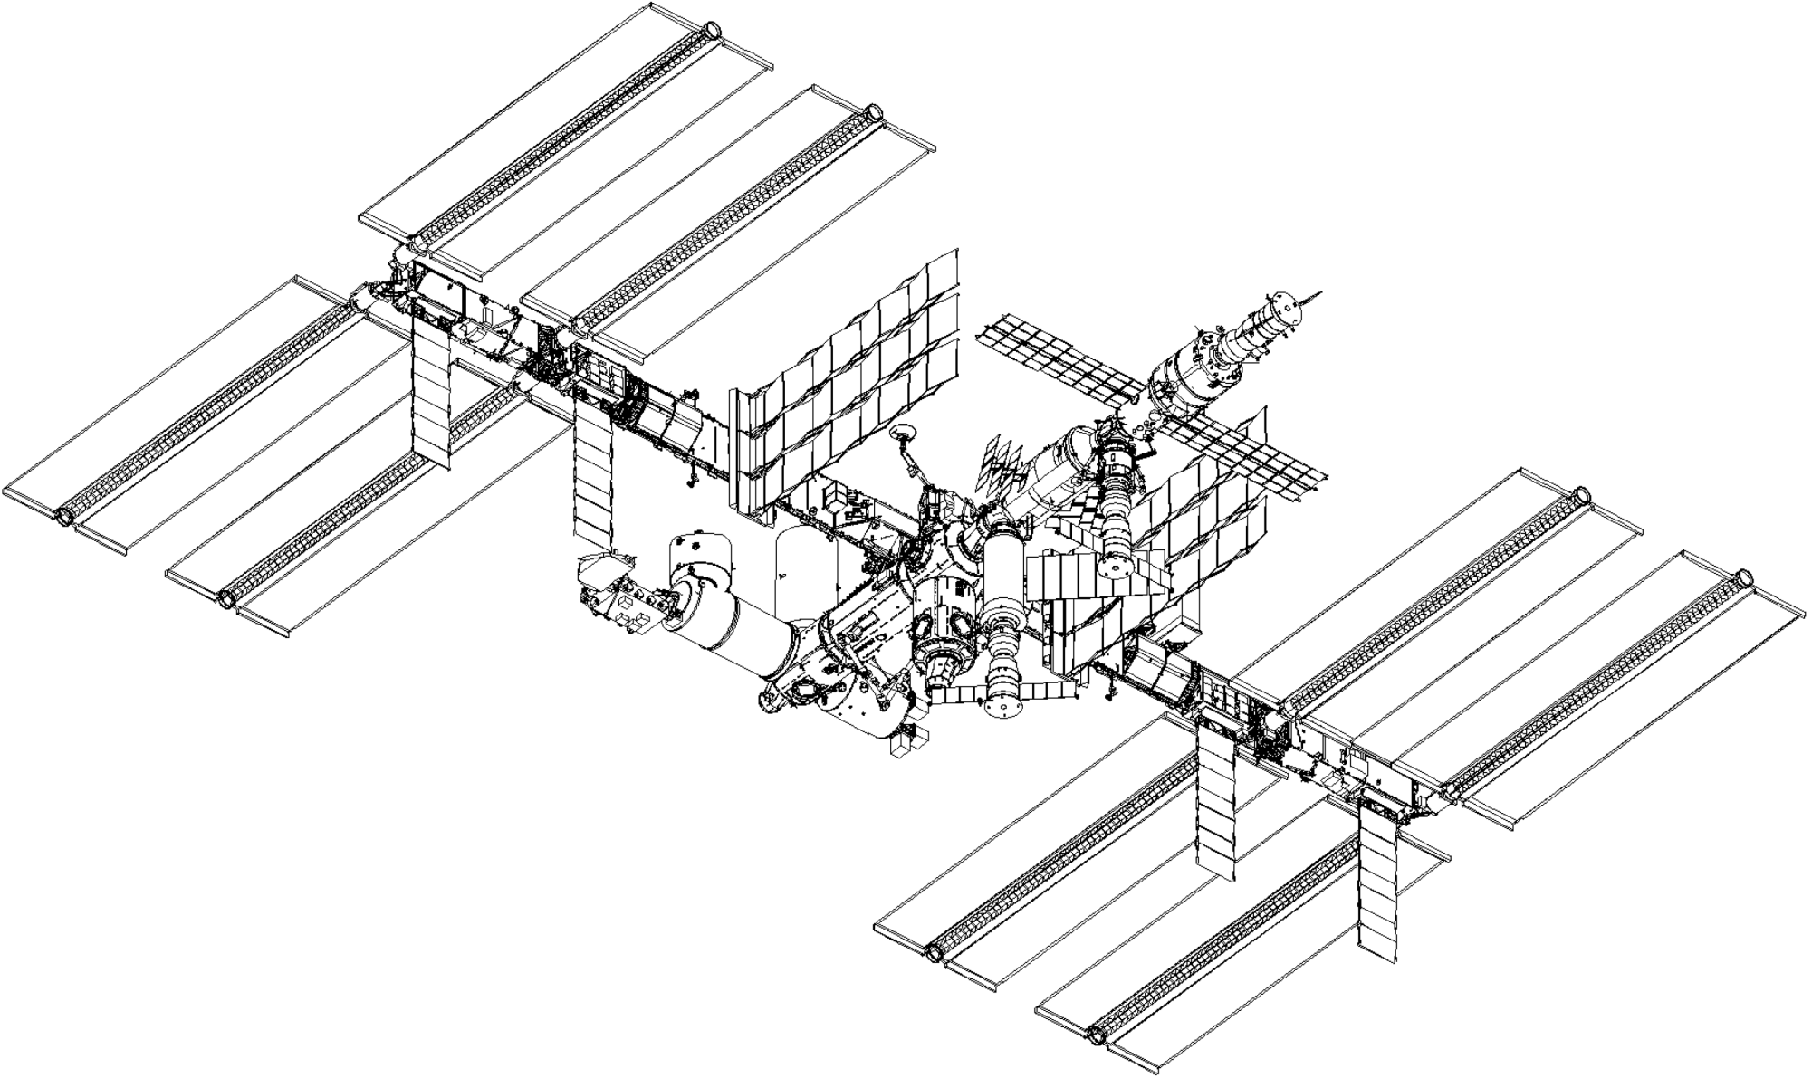
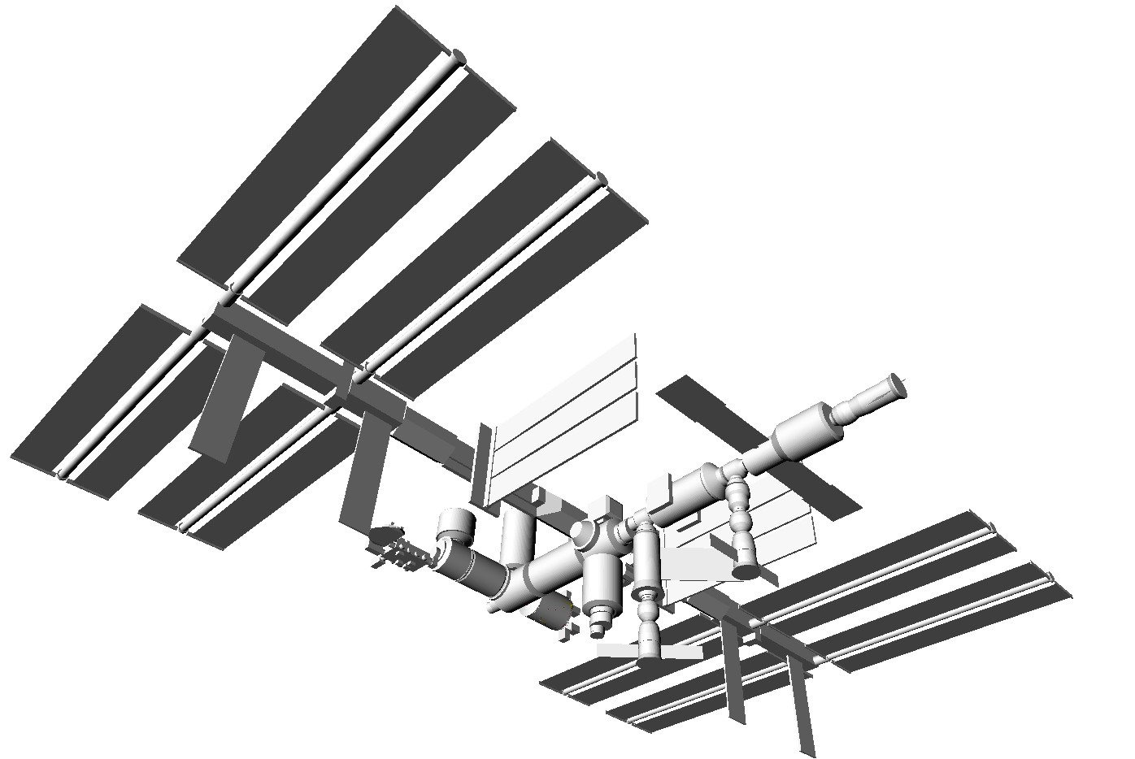
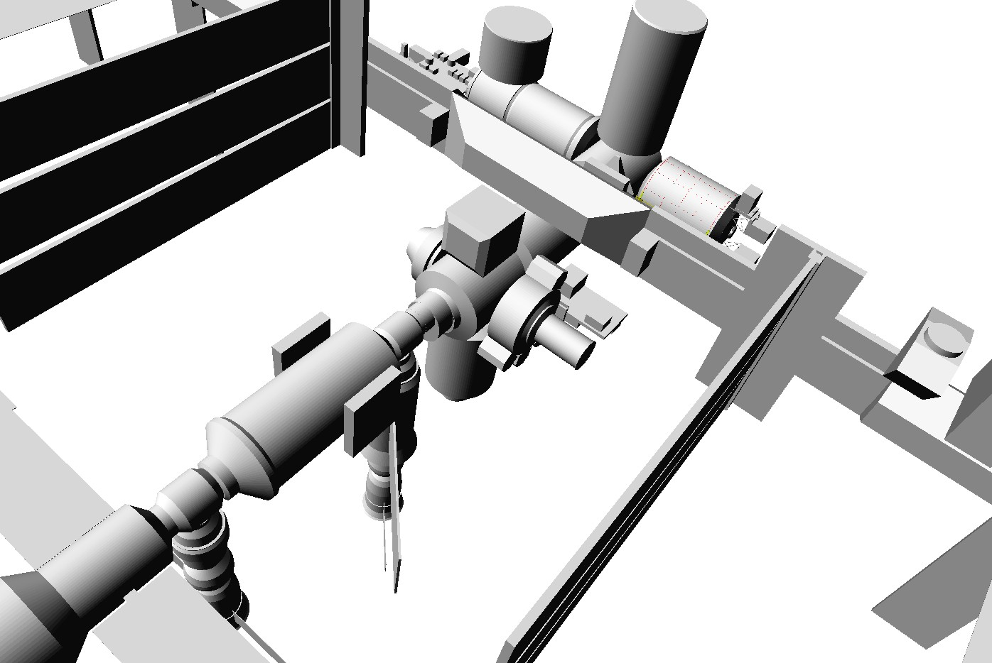
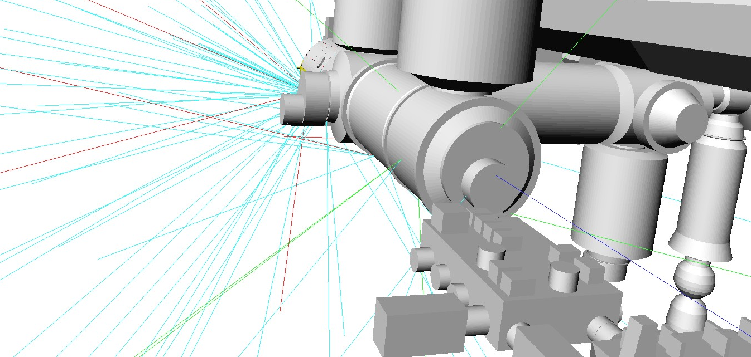
The ISS Geant4 geometry
JSC/SEMDA spec.
Hull ...
Interior ...
Cabin ...
Geant4
... (CAM)

Slide 7
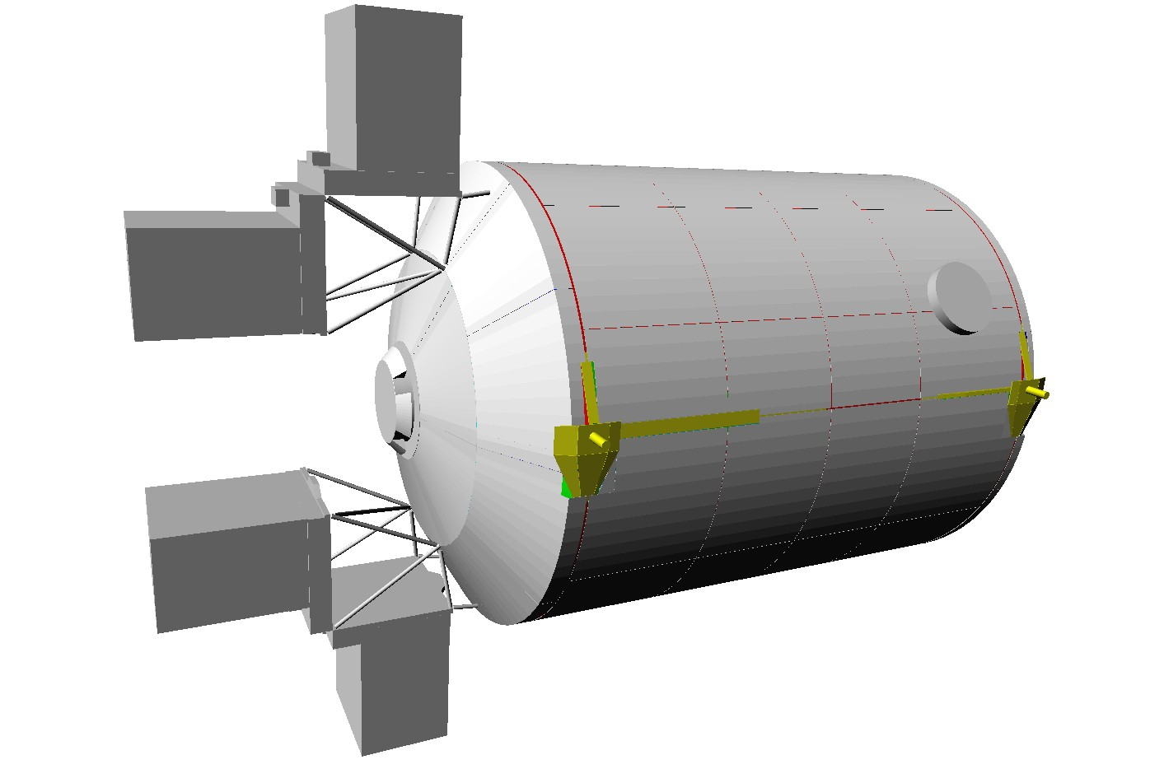
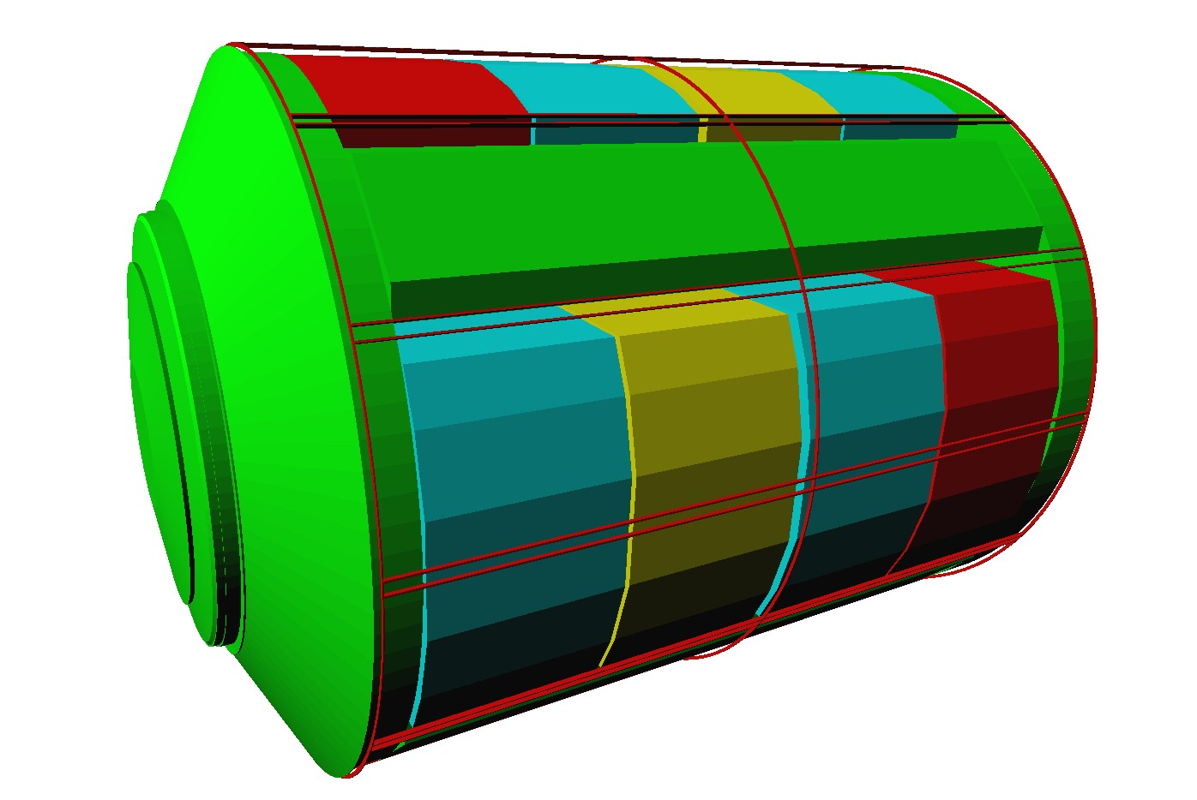
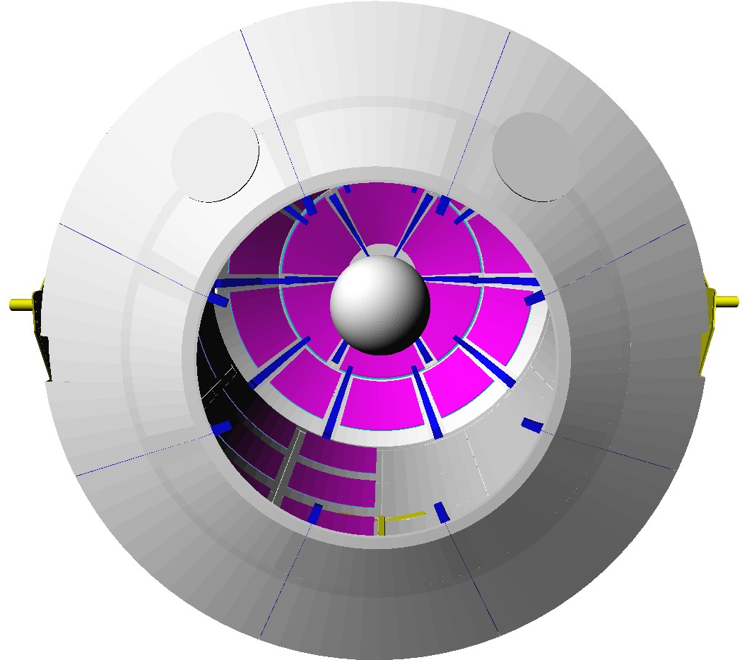
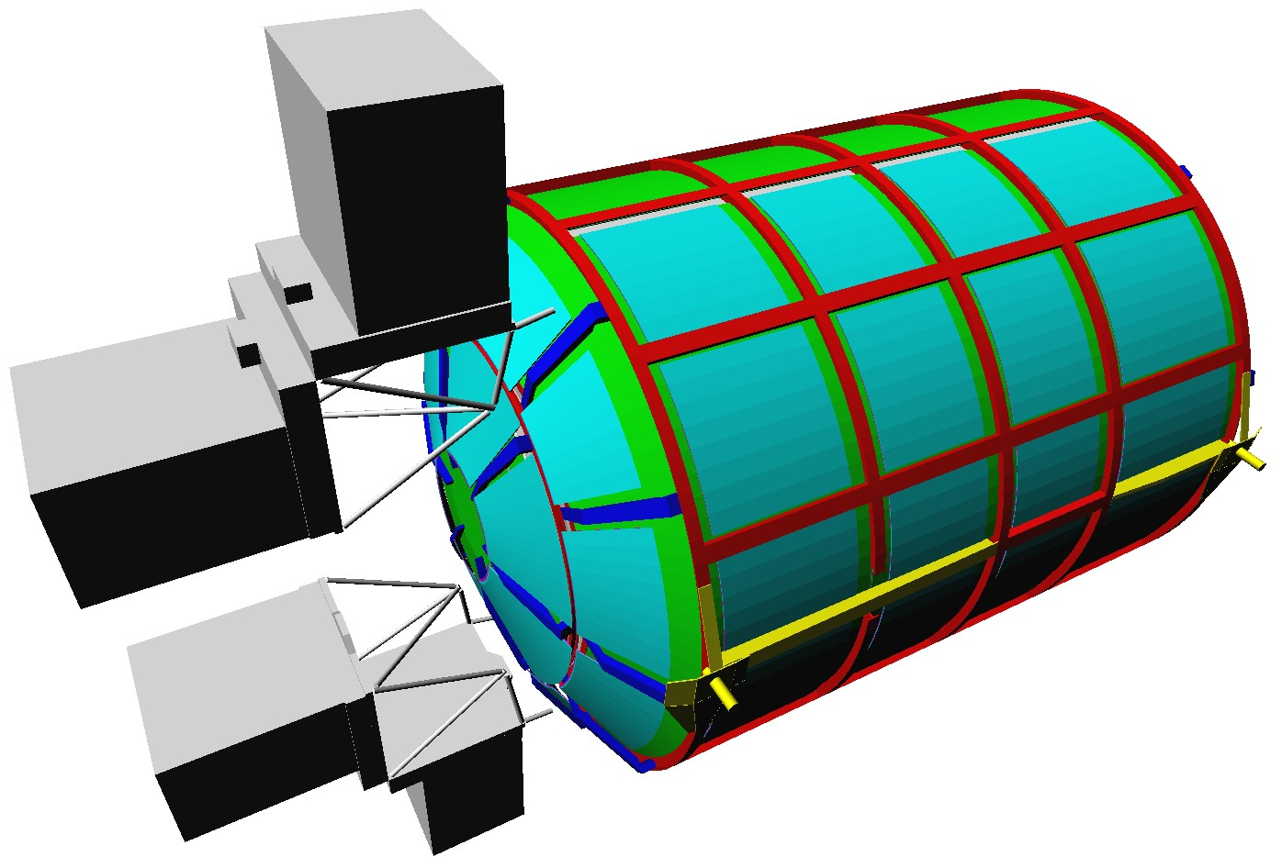
The “Columbus3” Geant4 geometry

Slide 8
Radiation environment models
Studied incident radiation fields
  Trapped protons (isotropic and anisotropic)
  GCR protons
  SPE protons
  (Cosmic ray albedo neutrons)
  (Trapped electrons)
Other radiation fields
  GCR ions
  Solar ions
51.6° × 330, 380, 430 km orbit
Web interfaces to models
  SPENVIS (”SPV”) (http://www.spenvis.oma.be/spenvis/)
  CREME96 (”C96”) (https://creme96.nrl.navy.mil)
  SIREST (”SRS”) (http://sirest.larc.nasa.gov)

Slide 9
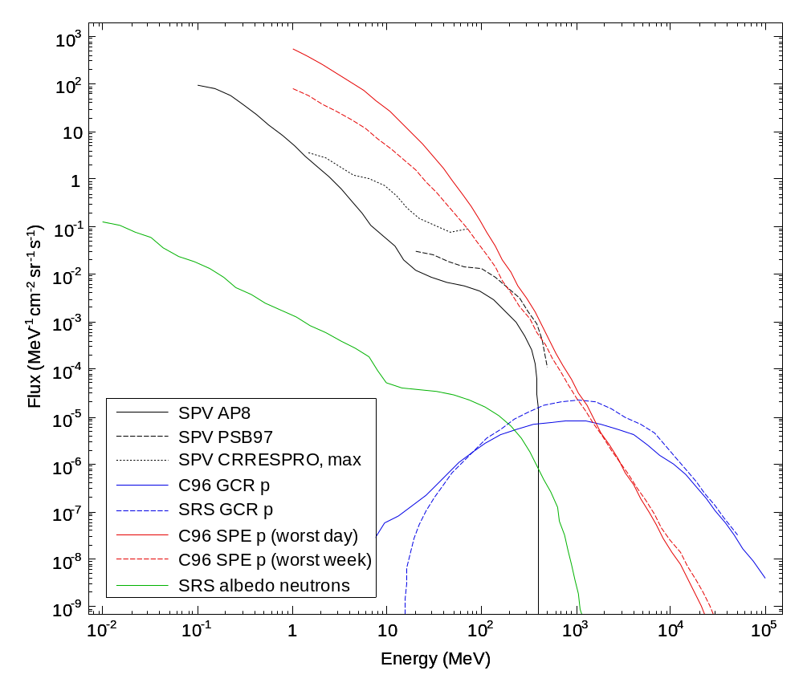
Incident spectra
Incident particle spectra at 380 km and solar min
Belt protons
GCR protons
SPE protons
CR albedo neutrons

Slide 10
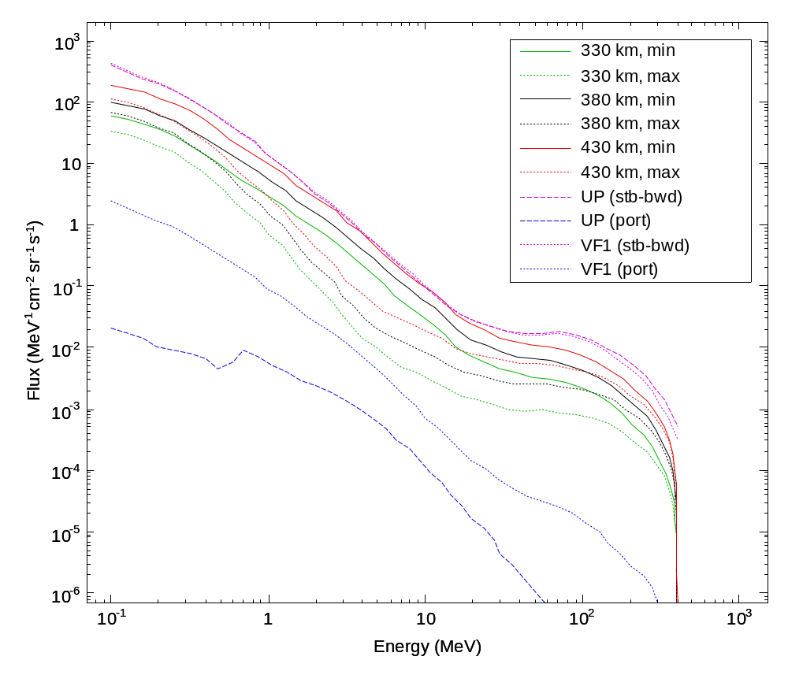
Belt proton altitude dependence and anisotropy
Incident proton spectra at 330 km, 380 km, 430 km
Solar minimum/maximum
Anisotropy; spectra for protons coming from port and startboard-backward (at solar-minimum and 380 km)

Slide 11
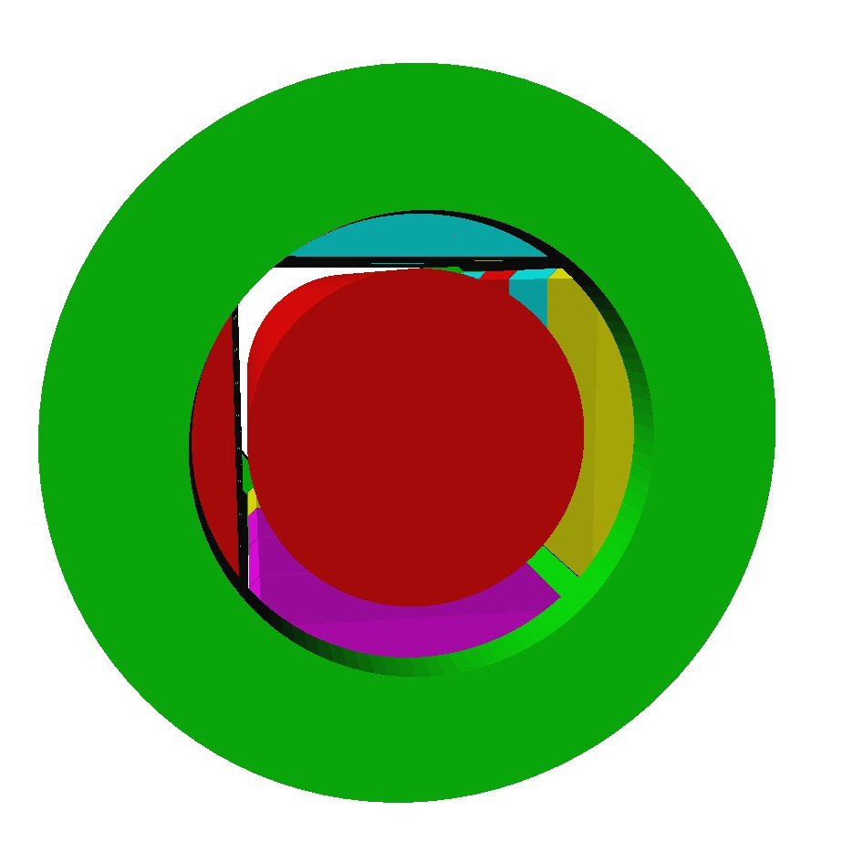
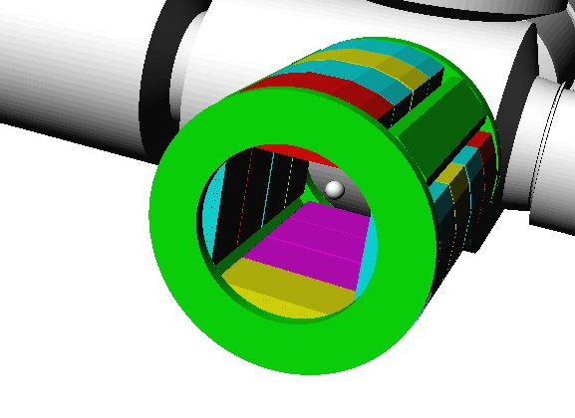
Simulation results
Spectra of particles entering
Columbus
Doses at 10 mm depth
in ICRU sphere
  Statistics...
380 km and
solar minimum
unless noted

Slide 12
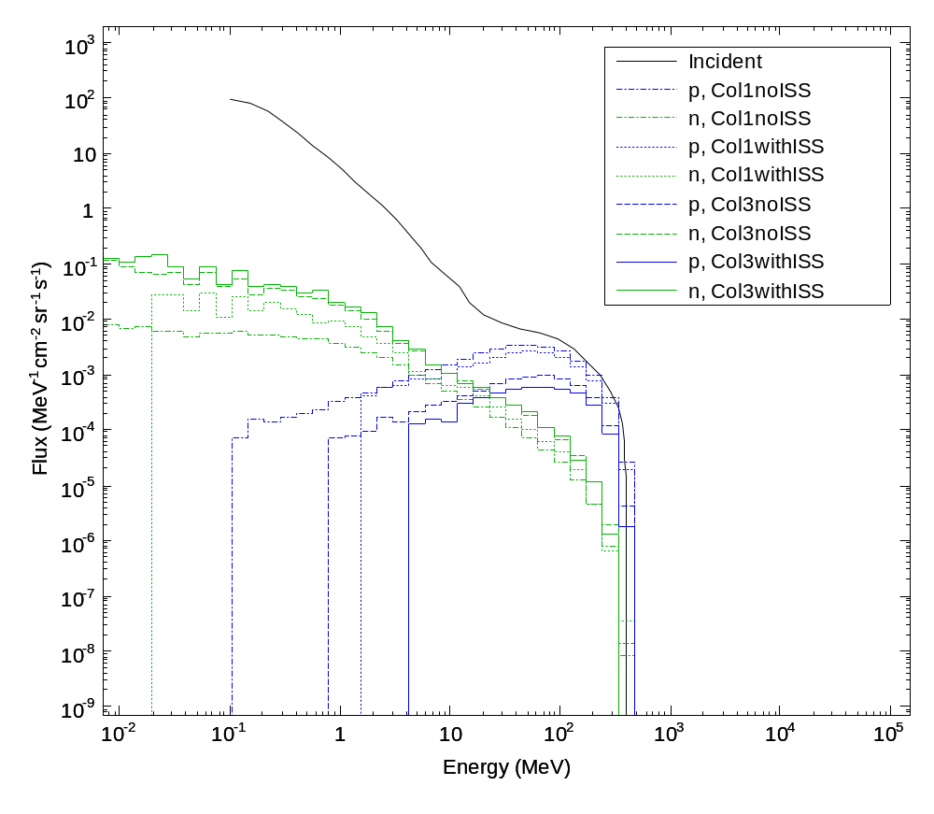
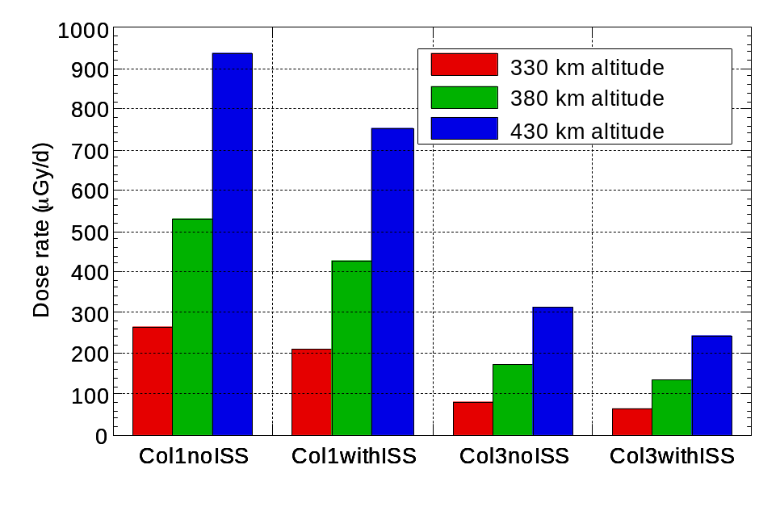
Belt protons
Incident belt (AP8-MIN) protons at 380 km. Penetrating protons and neutrons.
Belt proton doses at three altitudes for different geometry configurations.

Slide 13
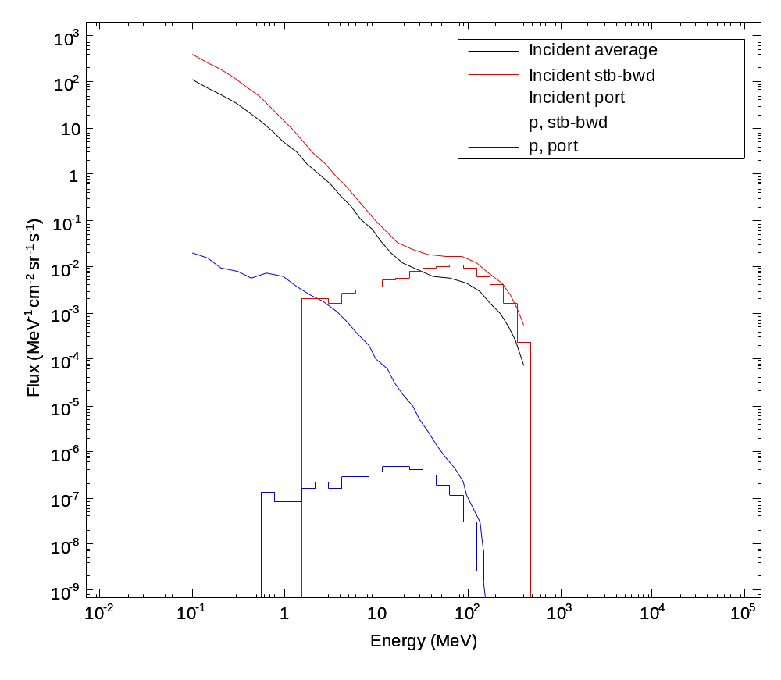
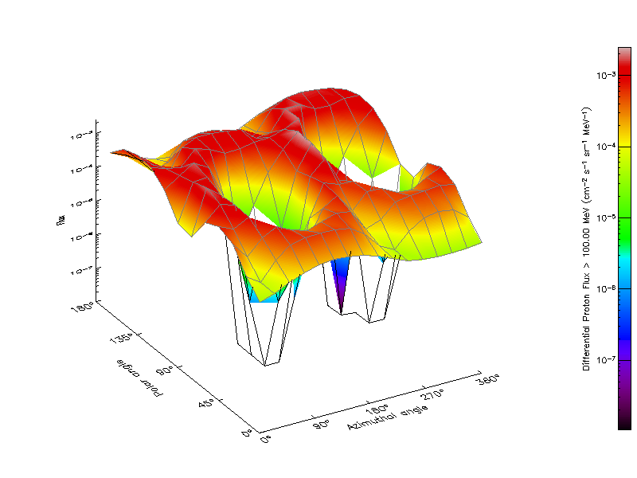
On-going study of belt proton anisotropy
Spectra for protons coming from
port
startboard-backward
SPENVIS AP8
Anisotropy model ”UP” (Badhwar/Konradi)

Slide 14
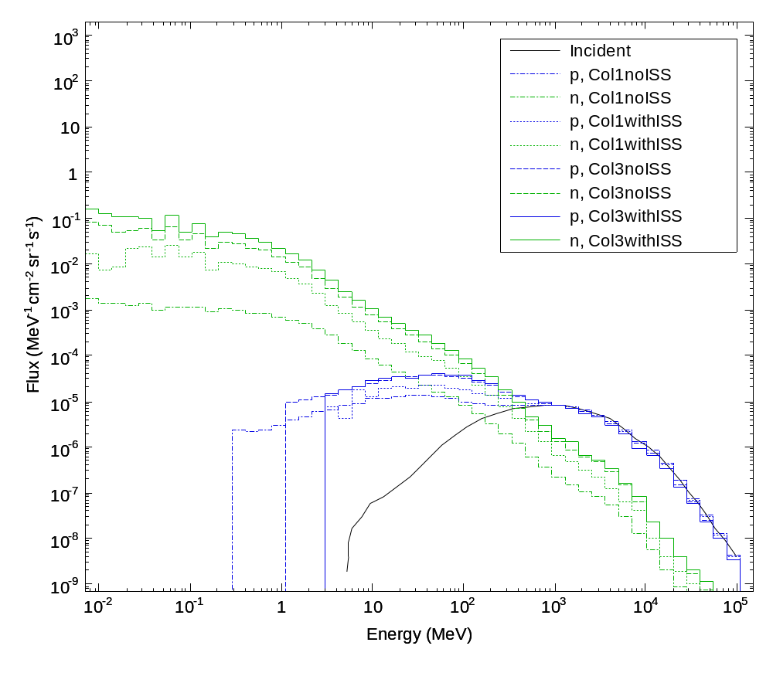
Cosmic ray protons
Penetrating primary/secondary protons and secondary neutrons due to incident cosmic ray protons (CREME96-min, 380 km)

Slide 15
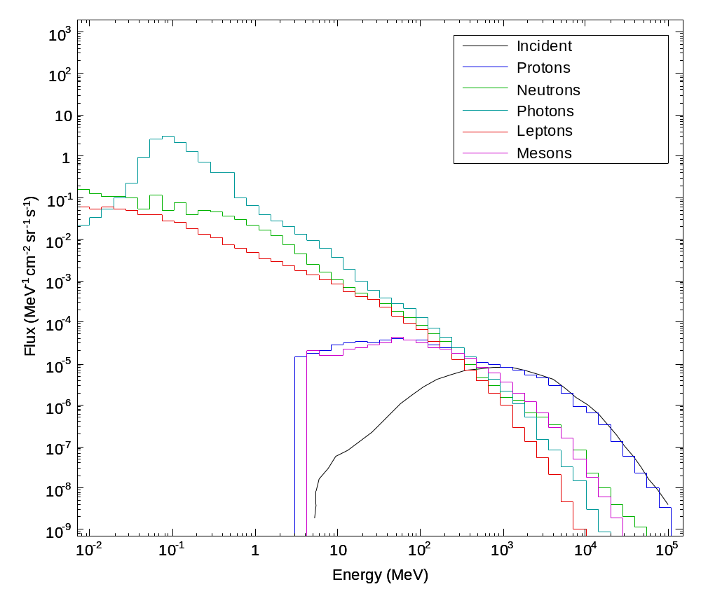
Cosmic ray protons; Col3withISS
Spectra of various particle species entering Columbus in the ”Col3withISS” geometry

Slide 16
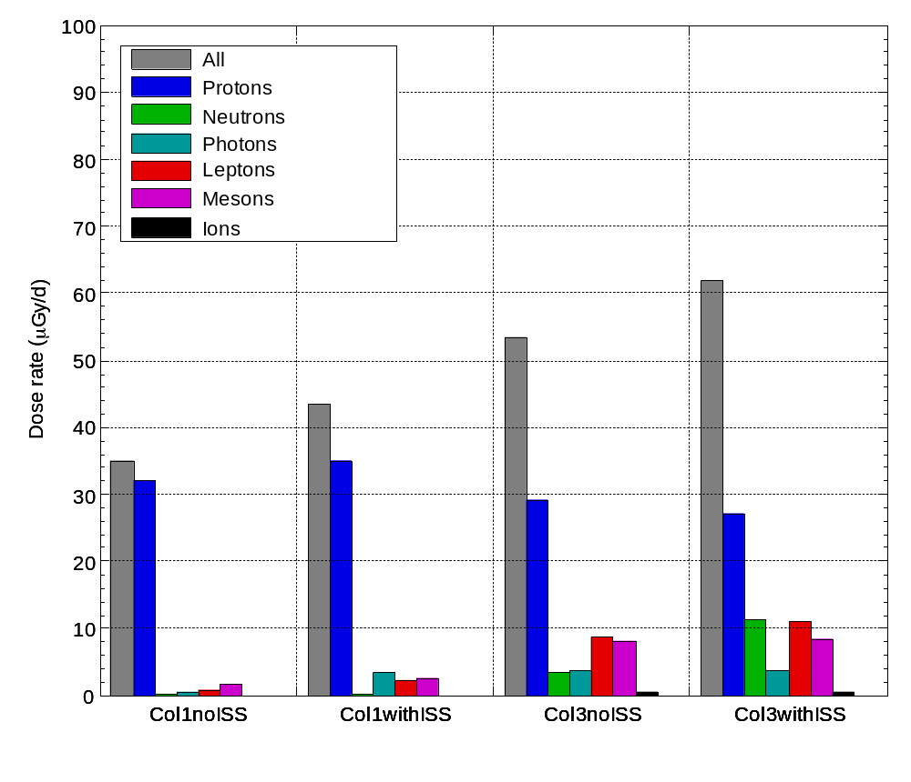
Cosmic ray proton doses
Dose rates in ICRU sphere due to incident cosmic ray protons;
itemized by geometry model and particle type at surface of sphere

Slide 17
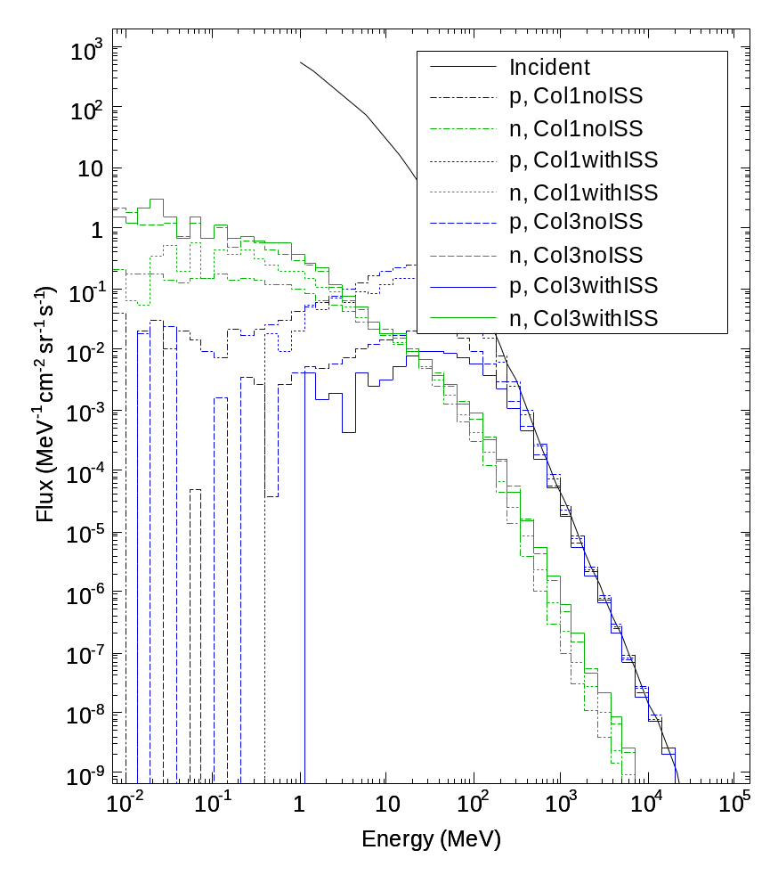
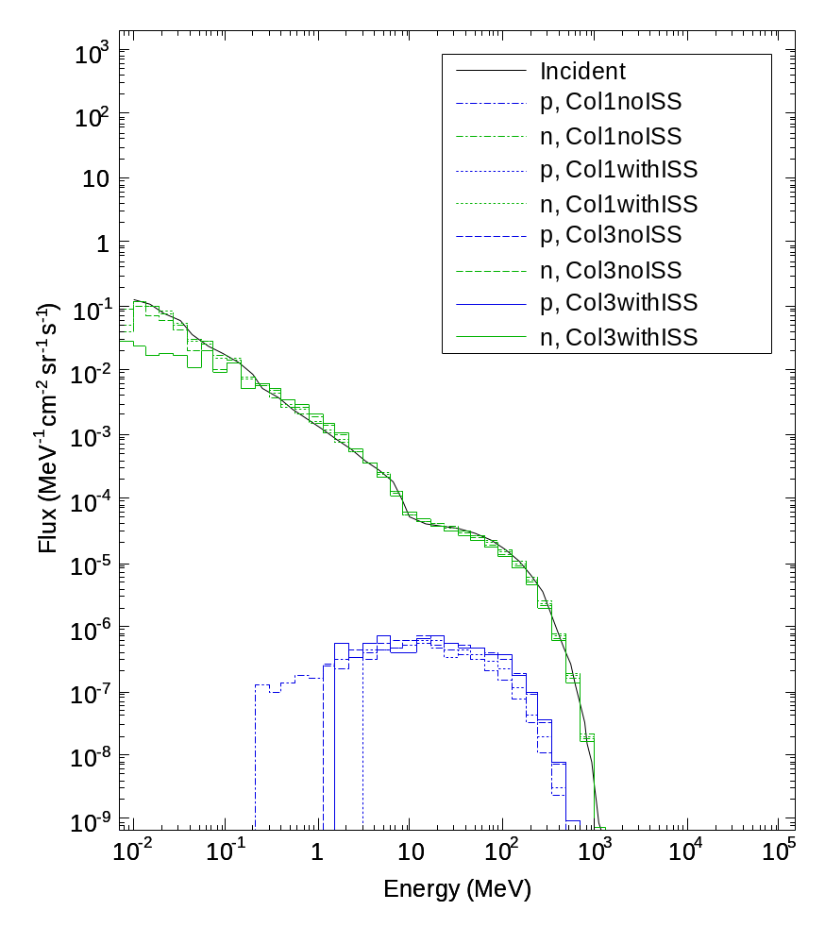
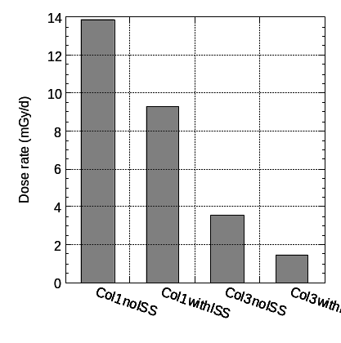
SPE protons & albedo neutrons
SPE particle spectra and resulting doses
Albedo neutron spectra and secondary protons

Slide 18
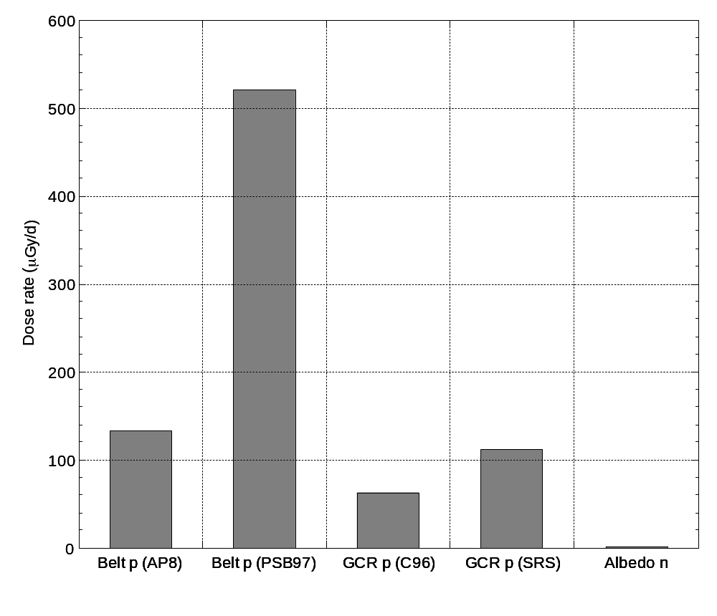
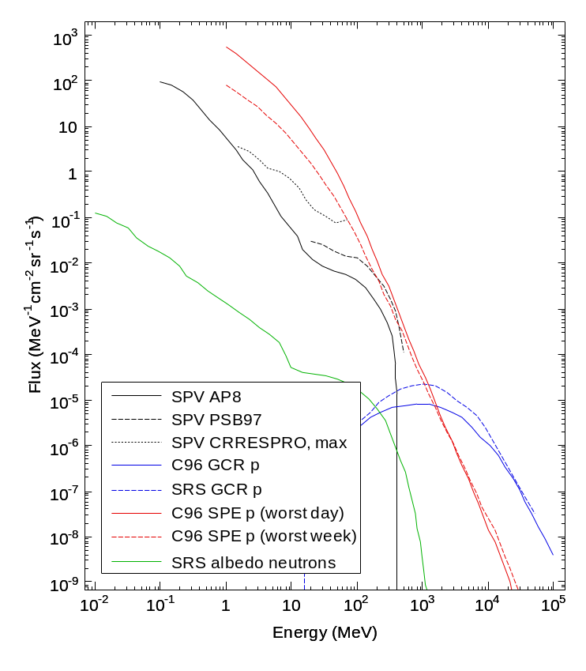
Modell comparisons; Col3withISS
Belt protons: 135 vs. 520 μGy/d (!)
CR protons: 60 vs. 115 μGy/d
Albedo neutrons unimportant (several previous studies)

Slide 19
Conclusions and future
A detailed model of Columbus and ISS (14A) has been implemented as Geant4 geometries.
Dose rates has been calculated for standard incident radiation field models
  Belt protons (AP8-MIN): 135 μGy/d
  Cosmic ray protons (CREME96, min): 60 μGy/d
  Cosmic ray albedo neutrons (SIREST): 0.5 μGy/d
Study of the influence of belt proton anisotropy in progress.
GCR- and solar ions will be studied the next few months.

