Slide 1
Interactive GUI for Geant4
by Victor Serbo, SLAC

Slide 2
Outline
Purpose
JAS3
Components and Status
Demo

Slide 3
Purpose
Create a “complete” user interface to Geant4: control of Geant4 application, data analysis, event visualization
  easy to use
  easy to customize
  easy to distribute and install
  for Windows and Linux systems

Slide 4
Java Analysis Studio (JAS3)
Interactive Analysis Tool (JAS3 talk tomorrow)
  easy to install: http://jas.freehep.org/jas3
  easy to customize by writing specific modules or “plugins”
Easy to learn/use GUI
Uses AIDA for analysis (http://aida.freehep.org)
WIRED plugin for Event Display
Record loop
  run, stop, step
Platform independent

Slide 5
Components
Geant4 control
  via GAG
Data Analysis
  AIDA (with remote capabilities)
Geometry builder
  using MOMO
Event Display
  WIRED, DAWN
Access to Geant4 physics quantities
  at event level for dynamic data analysis

Slide 6
Geant4 control I
Client/Server mode. Use Java RMI.
Use special G4UIrmi (extend G4VBasicShell)
  Starts Java VM and Java RMI Server
  Uses JNI to communicate between C++ and Java
JAS3 Plugin works as RMI client to pass commands to Geant4 and receive the output

Slide 7
Geant4 control II
Geant4 Application (C++)
Java RMI Server
JNI Layer
JAS3
(Java)
Geant4 Plugin
(Java RMI Client)

Slide 8
Advantages
Can connect/disconnect to running Geant4 application (local or remote)
Java multithreading
  Can use Geant4 “abort” command to stop the /run/beamOn command without exiting the application
  Can connect to multiple Geant4

Slide 9
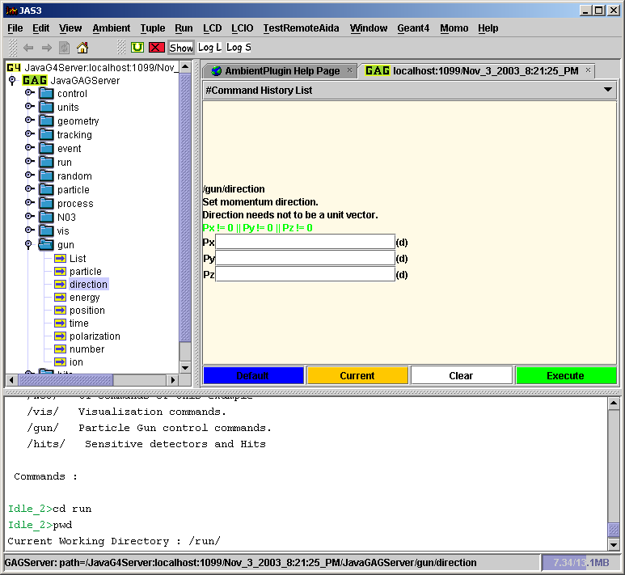
Command History List
Parameter Panel
GAG Command Tree
Console

Slide 10
Status
Issue Geant4 commands
  by typing them in a console (done)
  by clicking on a “command-tree” (done)
  by executing Macros (only server-side file)
  keep command history (done)
Redirect Geant4 output to JAS3 console, file (done)
  data
  error stream
Control Geant4 execution via the JAS3 Record Loop (not yet)
  run, stop, step

Slide 11
Data Analysis
Is based on AIDA standard and uses Java implementation of AIDA (JAIDA)
Ability to view predefined Geant4 histograms
  Using Remote Capability of JAIDA
  Histograms update in real time
  More work is needed
Ability to define new analysis objects from the client – is desirable but not easy. Currently under discussion.

Slide 12
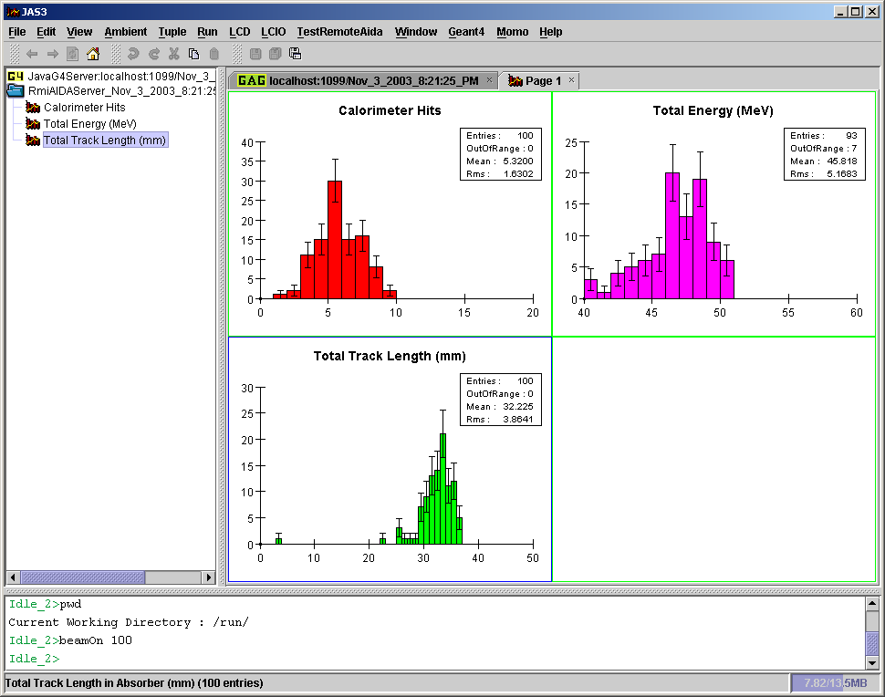

Slide 13
MOMO
Allows interactive creation of Geant4 geometries and physics.
Output is C++ code
Work in progress for XML output
Now runs as JAS3 Plugin
More information on MOMO: http://erpc1.naruto-u.ac.jp/~geant4/index.html

Slide 14
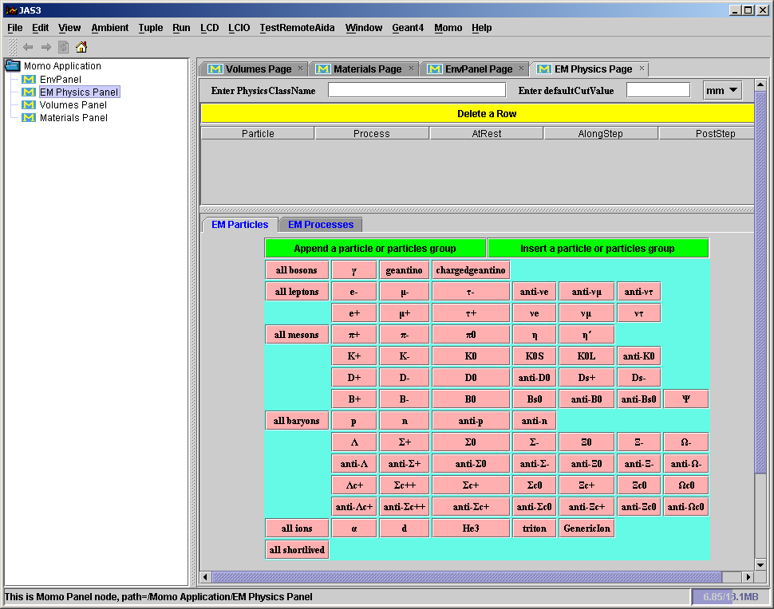

Slide 15
XML Output Status
Momo plugin can now save the table in the form of GDML (Geometry Description Markup Language) and load the GDML file to fill the Momo tables.
The following items are persistent now:
  Materials; from scratch and compound
  Solids (except HYPES, Polygons and Polycones which aren't defined in GDML yet)
  Logical volumes (except attributes which are lacking in GDML)
This is work in progress.

Slide 16
Event Display
Geant4 events can be viewed with WIRED and DAWN
  …but not in real time
JAS3 has a WIRED plugin
  Events can be displayed
    one at a time by stepping through the events
    at the end of a run
  Real-time visualization requires
    control of the Geant4 execution via the record loop
    streamlining of HepRep
    work in progress
DAWN plugin?
  Lack of manpower

Slide 17
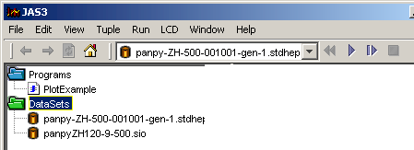
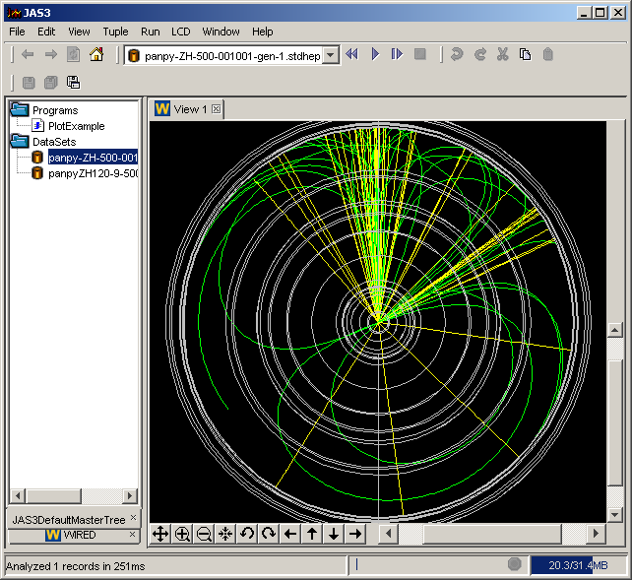
WIRED
Opening record (or event) based files causes the run control toolbar to appear
Supports random access and “tagged” data sets (mainly for event displays)

Slide 18
Demo

Slide 19
Conclusion
Working prototype of interactive GUI for Geant4
  Works on Windows and Linux
  Can be distributed as “addition” to Geant4
Still missing:
  Control of the Geant4 execution via JAS3 record loop
  Real-time event display
  Ability to define new analysis objects “on the fly”

Slide 20
JAS3 Links, More Info
Report Issues – http://bugs.freehep.org/
JAS3 – http://jas.freehep.org/jas3
JAIDA – http://java.freehep.org/jaida/
AIDA – http://aida.freehep.org
MOMO - http://erpc1.naruto-u.ac.jp/~geant4/index.html
FreeHEP Java Libraries - http://java.freehep.org
WIRED – http://wired.freehep.org

