Slide 1

Frieght buddy

Slide 2
Description
An app that allows people to help people (requesters) from overseas buy local products and ship them to the requesters.
Target products are small volume purchases where the store selling the products do not offer shipping services to the requester's country.

Slide 3
Key Technologies
Database: PostgreSQL
Back-end framework: Express (Node.js)
Front-end framework: React
AJAX: Axios
Other technologies: Sequelize, Webpack, Github, Heroku

Slide 4
User stories
1

Slide 5
1
Home page where user can perform different actions
Register
Login
Create request
View requests
of others
Selects a request
2
6
5
4
3
Requester receives product
Helper ships the product
Helper accepts the request
Completed delivery
Product on delivery
Accepted request
View / Edit Cancel Request
Notes:
1) The homepage where a user can login, register, view requests of others or create a request.
2) The user clicks on the register or login link in the homepage and is redirected to the registration or login page respectively.
3) The user clicks on a request in the homepage or creates a request and is redirected to a page that renders a request’s details. If the request was not created by the user, the user can accept the request. If the request was created by the user, the user can cancel the request.
4) The user decides to accept the request and is now a helper of that request.
5) After shipping the product, the helper updates the status of the request on the app.
6) After receiving the product, the requester updates the status of the request to complete the whole process.

Slide 6
Wireframes
2

Slide 7
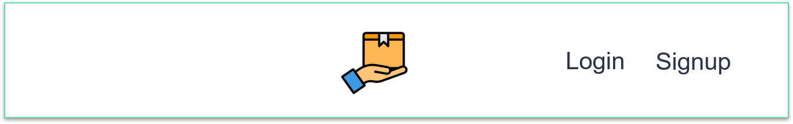
Navbar (not logged-in)
Contains links to log into the an account or register for one
Clicking the icon redirects to the home page

Slide 8
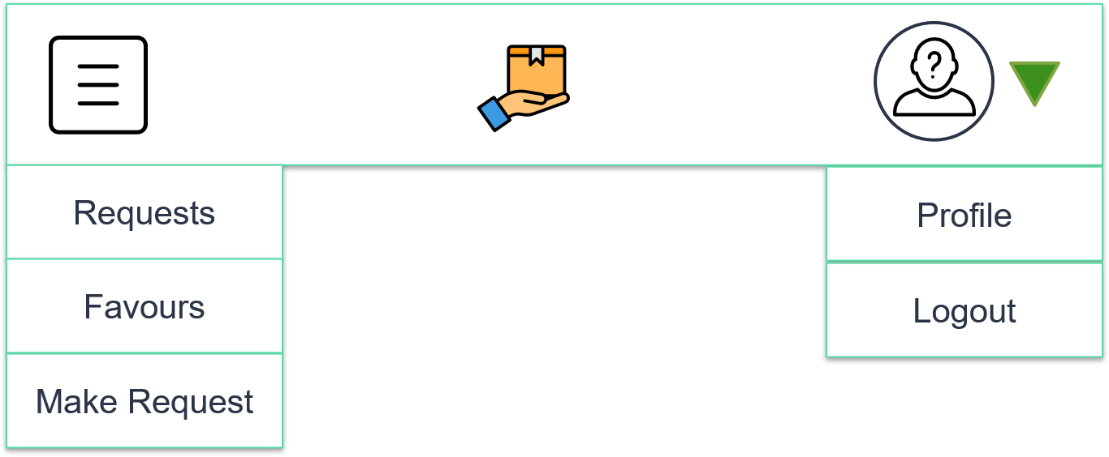
Navbar (logged-in)
Requests: requests made by user
Favours: favours made by user
Make request: create a request form

Slide 9
Home page
navbar
Requests
Clicking on a card redirects user to that request
Horizontal Scrolling to see more requests
See all requests: shows a list of all requests
Product
photo
Product
photo
Product
photo
Description
Price
Country
Description
Price
Country
Description
Price
Country
See all Requests

Slide 10
Home page (see all requests)
navbar
Requests
Product
photo
Product
photo
List of all requests
Vertical scrolling
Filter by country and category
Sort by price or date posted
Description
Price
Country
Description
Price
Country
Product
photo
Product
photo
filter
sort
Description
Price
Country
Description
Price
Country

Slide 11
Creating a request
navbar
Create Request
Product Name
___________
Photos (up to 3)
Product Link: a reference URL of where to purchase the product
photo
photo
photo
Product Link
___________
Country of purchase
Category

Slide 12

Creating a request
navbar
Create Request
Offered Price
___________
Delivery Address
___________
Continued…
Attached payment slip: User has to do a wire transfer of the offered price to the app before making a request
Clicking on ? symbol will show wire transfer instructions
Attached payment slip
photo
Upload slip
create

Slide 13
Creating a request
navbar
Create Request
Show a confirmation modal after creation of request
Clicking OK shows the created request
Request Created
Req. Id: xxxxx
OK

Slide 14
viewing a request (requester view)
navbar
Request id: xxxxx
Product Name
___________
Cancel request
Helper: user can click on helper’s name to view helper’s profile
Edit button: only show when status is requested
Confirm delivery: only show when status is sent out for shipping. Changes status to completed
Photos (up to 3)
photo
photo
photo
(etc)
Status
___________
Helper
xxxxx
Edit / Confirm Delivery

Slide 15
viewing a request (Helper view)
navbar
Request id: xxxxx
Product Name
___________
Offer help button: only show when status is requested. Changes status to accepted.
Sent for Shipping button: only show when status is accepted. Changes status to shipped.
Photos (up to 3)
photo
photo
photo
(etc)
Status
___________
Helper
xxxxx
Offer Help /
Sent for Shipping

Slide 16
Request Statuses
Requested
After a request is created and waiting for a helper to accept the request.
Accepted
After a helper has offered help.
Shipped
After the helper has sent the product for shipment.
Completed
When the requester has received the product.
Cancelled
When the requester decides to cancel the request before it is accepted by a helper.

Slide 17
editing a request
navbar
Edit Request
Product Name
___________
Photos (up to 3)
Save changes: save changes and show the edited request
photo
photo
photo
Product Link
___________
(etc)
Save Changes

Slide 18
Profile
navbar
Profile
photo
Edit profile
Requests button: shows a list of requests created by user
Favours button: shows a list of favours created by user
Name
___________
About
___________
Country
___________
Requests
Favours

Slide 19
Edit Profile
navbar
Profile
photo
choose photo
Page 1
Name
___________
About
___________
Email
___________
Password
___________
Password
___________
Country of residence
___________
Address
___________

Slide 20
Edit Profile
navbar
Payment Methods
Bank Name
___________
Page 2
Account No.
___________
Save profile

Slide 21
User’s Requests
navbar
Requests
Product
photo
Product name
Status
Helper
Clicking on a request redirects user to that request
Sorted from newest to oldest
View
Product
photo
Product name
Status
Helper
View
Product
photo
Product name
Status
Helper
View
Product
photo
Product name
Status
Helper
View

Slide 22
User’s favours
navbar
Favours
Product
photo
Product name
Status
Requester
Clicking on a request redirects user to that request
View
Product
photo
Product name
Status
Requester
View
Product
photo
Product name
Status
Requester
View
Product
photo
Product name
Status
Requester
View

Slide 23
login
Freight Buddy
Email
___________
Password
___________
Login

Slide 24
registration
Freight Buddy
Name
___________
About
___________
Page 1
Email
___________
Password
___________
Country of residence
___________
Address
___________

Slide 25
registration
Freight Buddy
Payment Methods
Page 2
Bank Name
___________
Account No.
___________
register

