Slide 1




SUTD Invested Venture
SMORPHI² TransfoBot
Reconfigurable Robot
Sri Sri Center for Robotic & Automation
Faculty of Engineering & Technology (FET)

Slide 2

~ Agenda ~

Slide 3
~ Introduction ~
Brief overview of reconfigurable robotics
Importance in modern automation

Slide 4

~ Video Demonstration ~
Insert Video from Local Storage

Slide 5
~ Hardware and Mechanism ~
Modular Design Concept
Components List: Sensors, Actuators, Motors
Adaptive Chassis and Configurable Joints
Mecanum Wheels for Omnidirectional Movement

Slide 6
~ Mechanism ~
Developed a robot capable of transforming into various shapes, including O, I, L, T, J, S, and Z.
Integrated Mecanum wheels for omnidirectional movement and a lock-latch mechanism for seamless shape transitions.
Added advanced features like a sound sensor and a camera module, enabling the robot to detect sound and follow human actions.

Slide 7
~ How the Robot Works ~
Reconfiguration Mechanism: Adaptive Modules
Real-time Processing and Decision Making
Control Algorithms and Motion Planning
Remote Control vs Autonomous Operation

Slide 8
~ Hardware & Software ~
Hardware: ESP32 / Arduino, Li-Po Battery, Wi-Fi/Bluetooth, Ultrasonic Sensor
Software: Arduino IDE, Compatible Compiler, GitHub Repository
Integration: Seamless hardware-software interaction

Slide 9
~ Applications of Robotics ~
Mecanum Wheels Inspired by Moon Landing Rovers
Industrial Applications: Warehouse Automation
Disaster Management: Search & Rescue Missions
Space Exploration & Adaptive Robotics

Slide 10
~ Experience Yourself in Simulation ~
SMORPHI IMAGINARY: Interactive Reconfigurable Robot Simulation
Hands-on Experience with Virtual Prototyping
Understand Motion Dynamics & Control Strategies

Slide 11
~ Join the Movement ~
Smorphi Imaginary Hackathon Opportunities.
Summer Workshop and Internship.
Collaboration & Research in Reconfigurable Robotics.

Slide 12
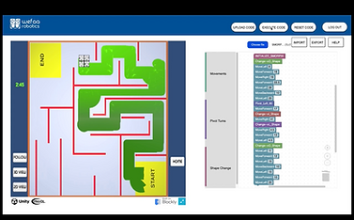

Slide 13
Join Us! Be a part of the next-gen robotic revolution!

