Slide 1




SCompression: Enhancing Database Knob Tuning Efficiency Through Slice-Based OLTP Workload Compression
Baoqing Cai, Yu Liu, Lin Ma, Pingqi Huang, Bingcheng Lian, Ke Zhou, Jia Yuan, Jie Yang, Xiaofan Cai, and Peijun Wu. Research 60: Database Engine Performance and Manageability II Speaker: Baoqing Cai
Notes:
Hello everyone good afternoon
Today I am introduce our research

Slide 2
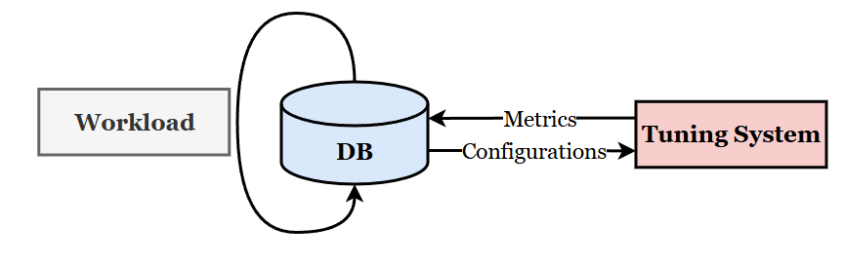
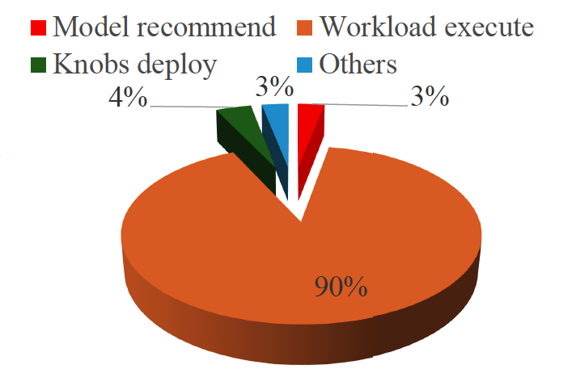
Background (Knob Tuning)
Hundreds of configuration knobs.
Machine learning tunes DB.
The process usually repeats three steps:
Suggest configurations. → Model recommendation
Test performance. → Workload execution
Update the model.
Workload execution is expensive but necessary.
Notes:
First, let me introduce some basic background about knob tuning on database.
Databases typically have hundreds of configuration knobs, and some knobs can influence DB performance significantly.
However, manually tuning these knobs is a difficult and time-consuming task for DBAs.
Thuerefore research has turned to using machine learning (ML) to automatically tune databases.
As shown in the diagram, the automatic knob tuning process usually repeats three steps: first, the tuning system suggests configurations (this step is referred to as “model recommendation”);
second, we test the performance by executing workloads on the DB with these configurations (that is “workload execution”);
third, the tuning system updates its model based on the metrics collected from the DB.
An important observation is that workload execution is expensive but necessary.
The pie chart on the slide shows that workload execution accounts for 90% of the total cost in the tuning process, while other steps only make up small portions (3%, 4%, and 3% respectively).
However, testing the performance of configurations is important because the tuning system needs to learn from samples to improve the quality of configurations. To improve tuning efficiency, many researchers focus on reducing the number of iterations in this process, but they barely pay attention to reducing the cost of workload execution. Inspired by this, we are trying to perform workload compression to cut down this expense.

Slide 3
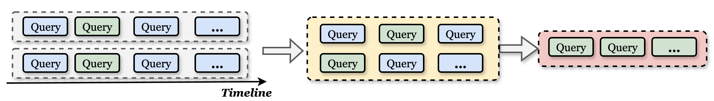
Background (Workload Compression)
Previous Workload Compression Methods (for OLAP):
Regard workload as a set of queries.
Sample from queries.
Workload
Query Set
Compressed Workload
Notes:
As for workload compression, there are lots of methods.
To save time. Let me go through the key design of previous workload compression methods.
Most of these workload compression methods are designed for OLAP workloads.
They follow two main steps:
First, they regard a workload as a **set of queries**.
Instead of considering the workload as time-dependent sequence, they simplify it by treating it as a collection of individual query instances.
Second, they **sample from these queries**. Typically, they select queries based on different metrics—such as query frequency, the resource consumption of queries, or how much each query contributes to the overall workload’s characteristics.

Slide 4
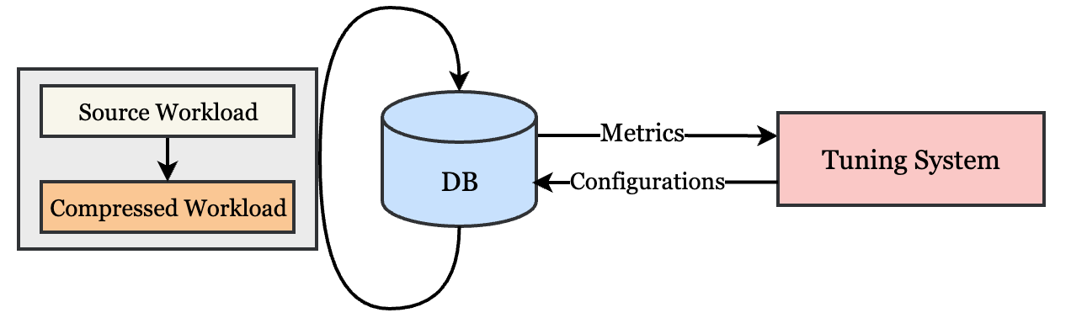
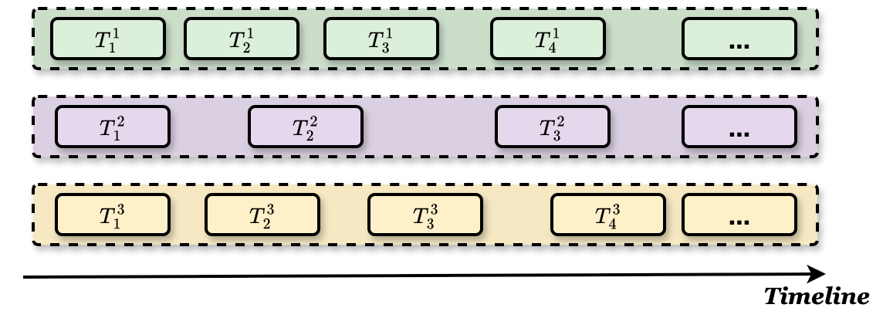
Challenges (Compression for OLTP Workload)
Contextual Information. (Sequence and Conflict)
Time-oriented Compression. (Compress for less execution time.)
A large number of queries of OLTP Workloads. (Compared to OLAP)
Replay Strategy.
Knob tuning with workloads
Workload with sequence and conflict
Notes:
Now, let's delve into the challenges of compressing OLTP workloads, which differs significantly from OLAP workload compression.
First, **Contextual Information** is critical—for example, the *Sequence and Conflict* of transactions.
Given OLTP’s high QPS，numerous queries execute concurrently. Their execution order and concurrency conflicts heavily influence database performance, so ignoring this context would make a compressed workload lose its fidelity to the original.
Second, we need **Time-oriented Compression**—it’s not just about reducing the *number* of queries, but compressing to achieve **less execution time**. In the context of knob tuning, “fewer queries” doesn’t equal “shorter execution time”: a small set of queries might still take a long time if their sequence or concurrency patterns are not preserved.
Thus, our goal is to cut down the *duration* the compressed workload takes to run, rather than just minimizing query count.
Third, OLTP workloads involve **a far larger number of queries** compared to OLAP. This higher volume makes compression more challenging—how do we sample or select from so many queries while retaining the workload’s key behavioral characteristics?
Fourth, the **Replay Strategy** is essential. Prior work barely focused on how to *replay* a compressed workload, but in our scenario, replaying the compressed workload accurately is important for the tuning system.

Slide 5
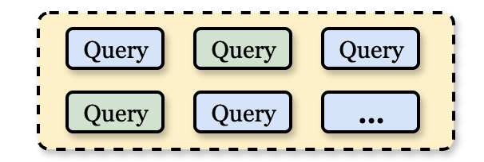


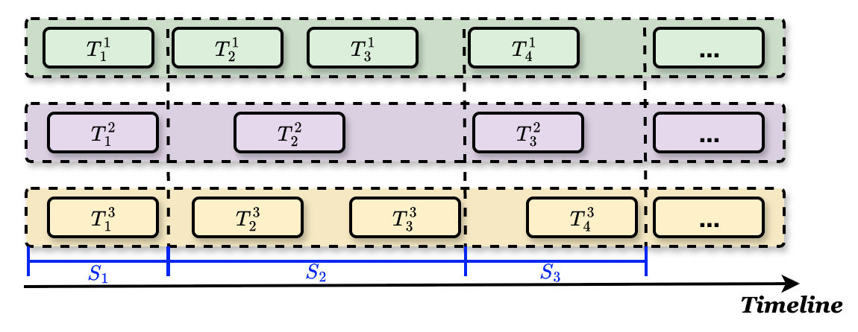
Key Idea: from queries to slices
Sample the queries.
Symbol | Details
 | The i-th transaction on connection j.
 | The j-th slice.
Sample the slices.
Slice: A small time interval of a workload that records complete transactions starting within it, while preserving contextual information (e.g., transaction sequence and conflicts) to support subsequent compression and replay.
Notes:
Now, let's move to our key idea: shifting from “sampling queries” to “sampling slices”.
So, what is a “slice”? A slice is a small time interval of a workload that records all complete transactions starting within that interval. it preserves contextual information—like transaction sequence within the slice and concurrency conflicts among those transactions—all to support compression and replay.
Previously, methods sampled directly from queries. But our approach samples from slices instead. Why does this help?
Because each slice contains all transactions inside it, so the conflicts within a slice are fully retained. Meanwhile, the sequence of transactions is preserved both inside each slice and between different slices (since slices are ordered along the timeline, as you can see in the diagram on the right).
By sampling slices, we can naturally reduce workload execution time: the total execution time of the compressed workload is just the sum of the execution times of the selected slices, so estimating the overall execution time becomes straightforward.
Moreover, replaying slices is much simpler. We only need to focus on two things: how to replay the transactions inside each slice, and when to start a new slice.
In short, slicing helps us tackle the OLTP compression challenges by preserving context, enabling time-oriented compression, and simplifying replay—all at once.

Slide 6
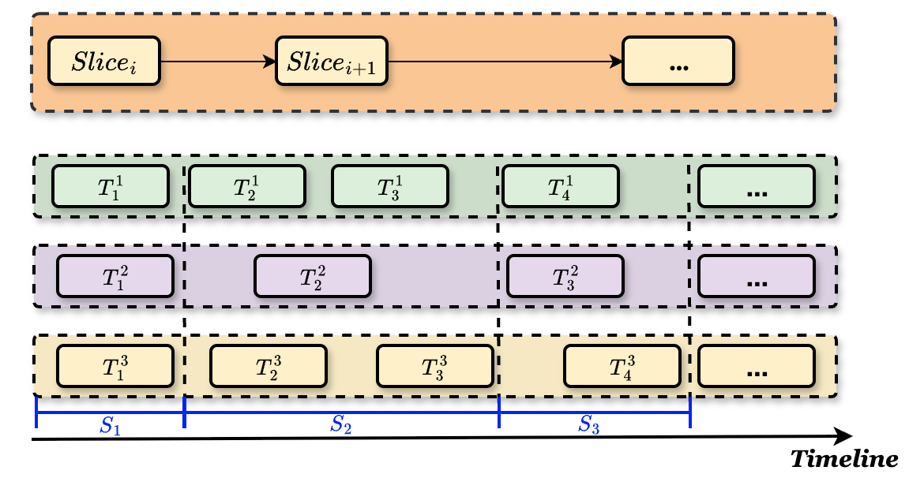
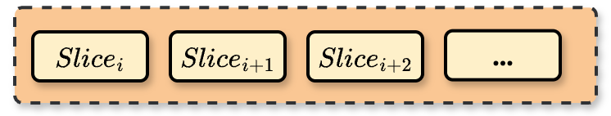
Key Design: Compression for Knob Tuning
Workload slicing lays the foundation by deciding how to split the workload into slices.
Slice sampling achieves compression by selecting representative slices.
Slice replay ensures the compressed workload can accurately mirror the performance of the source workload during knob tuning.
Workload Slicing
Slice Sampling
Slice Replaying
Notes:
In SCompression, we have three modules to compress the workload. Let's walk through each of them one by one.
First, Workload slicing lays the foundation. It focuses on deciding how to split the source workload into slices along the timeline. As the left diagram shows, the source workload is divided into small time intervals. Each interval becomes a “slice”.
Second, Slice sampling achieves compression by selecting representative slices from the set of sliced intervals.
Third, Slice replay ensures the compressed workload can accurately mirror the performance of the source workload during knob tuning.

Slide 7

Workload Slicing
Key Idea: Set split points at moments when there are few concurrencies.
Instantaneous concurrency (IC):
The number of transactions being executed in an interval.
Source Workload
Workload with slices
Notes:
Now let's talk about Workload Slicing.
The key idea is: set split points at moments when there are few concurrencies.
To measure concurrency, we define Instantaneous Concurrency (IC): \(IC(t)\) counts how many transactions are being executed in the interval \([t, t + \Delta)\) (here, \(\Delta = 3\) ms).
To find these low-concurrency moments, we first sort all IC values. Then, we set split moments when \(IC(t)\) falls into the lowest 20% of all IC values
By splitting the source workload at these low-concurrency moments, we get slices. Each slice preserves transactions’ contextual info, laying the groundwork for compression and replay.

Slide 8
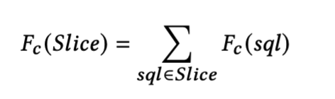
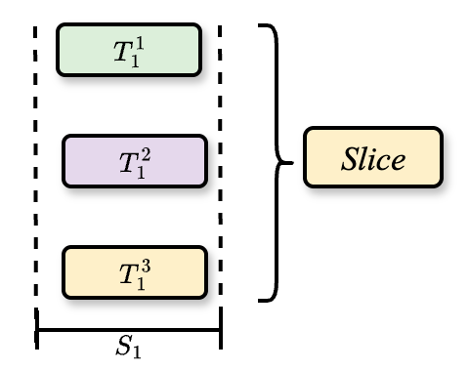
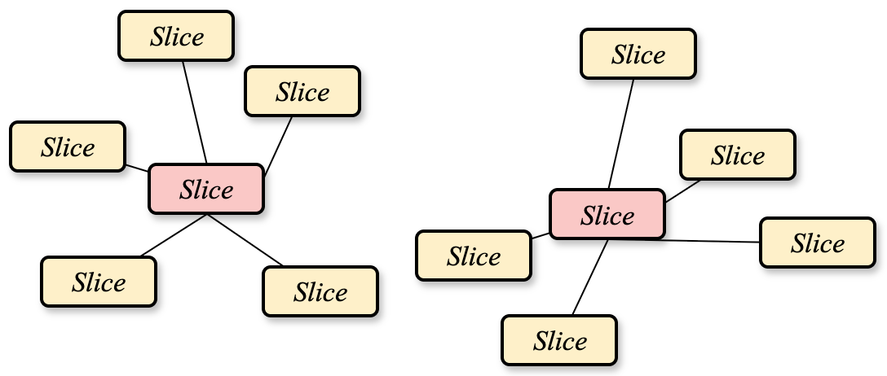
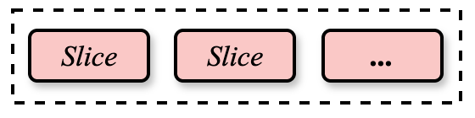
Slice Sampling
Name | Detail
Query Features | AffectRows, ExecTime, SentRows, CheckRows, CpuTime, IOWaitTime, LockWaitTime
Slice Features
Get Features.
Cluster by Hierarchical Cluster Analysis.
Sampling from different clusters.
Get Features
Cluster
Sampling from Clusters
Notes:
After gathering the slices, we need to find representative slices for compression. To achieve this, we follow three key steps.
First, we get features of the slices. Since a slice is constructed from transactions within a small time interval, we extract features from the queries inside each slice. For a slice’s overall feature, we use a simple operation—summing the corresponding features of all queries in that slice.
Second, we cluster slices using Hierarchical Cluster Analysis..
Third, we sample from different clusters. We select slices from each cluster, and we do this while respecting a constraint on total workload execution time.

Slide 9
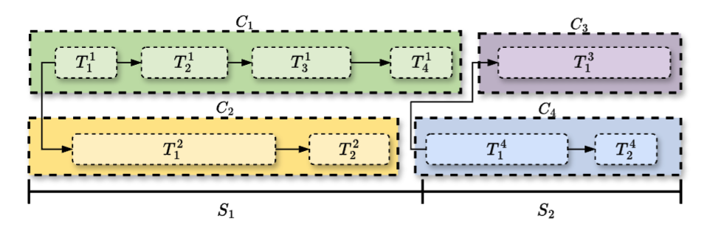
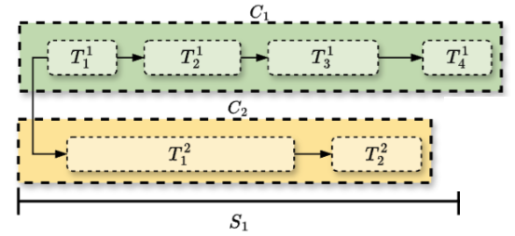
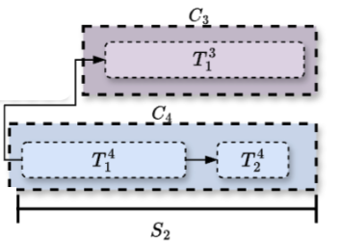
Slice Replaying
 | Strategy
Within a Slice | Preserve original sequence of connections & transactions.
Between Slices | Query-based triggering: Next slice starts after N queries (N from source workload).
Within a slice
Between slices
Within a slice
Notes:
Now, let's talk about Slice Replaying. We define strategies for within a slice and between slices.
within a slice: we preserve the original sequence of connections and transactions. As the lower-left diagram shows, for a slice, the order of transactions stays intact. This preserves the concurrency and sequence patterns inside the slice.
between slices: we use query-based triggering: the next slice starts after N queries, where N is determined from the source workload.

Slide 10
Experiments
Compared with two methods: 1. Query Configuration Sensitivity Analysis (QCSA).
2. Index-based Workload Summarization (ISUM).
Workloads:
YCSB
TPC-C
Synthesis
Production (real world workload)
Notes:
Now let's move to the Experiments part. We compare our approach with two existing methods:
Query Configuration Sensitivity Analysis (QCSA).
Index-based Workload Summarization (ISUM).
We use four workloads including a real world workload

Slide 11
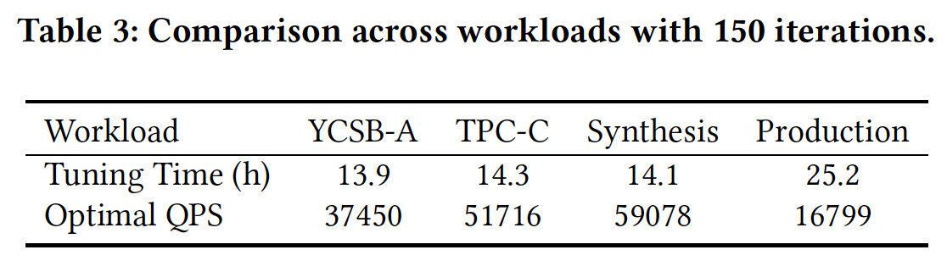
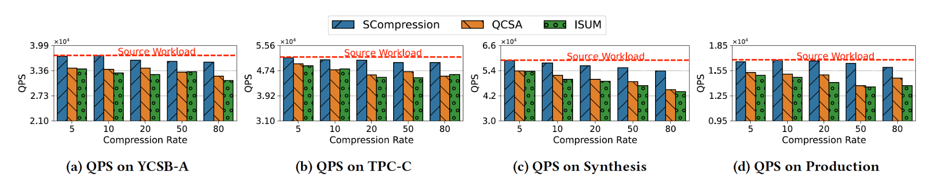
Experiments
The QPS of source workload when deploy optimal knobs tuning on compressed workload.
Higher is better.
Notes:
Table presents the optimal performance—including Tuning Time and Optimal QPS—when knob tuning on the source workload.
Then, the figure show The QPS of source workload when deploy optimal knobs from compressed workload.
Across all workloads, our SCompression achieves QPS far closer to source workload.
This shows SCompression preserves enough of the workload’s core characteristics.

Slide 12
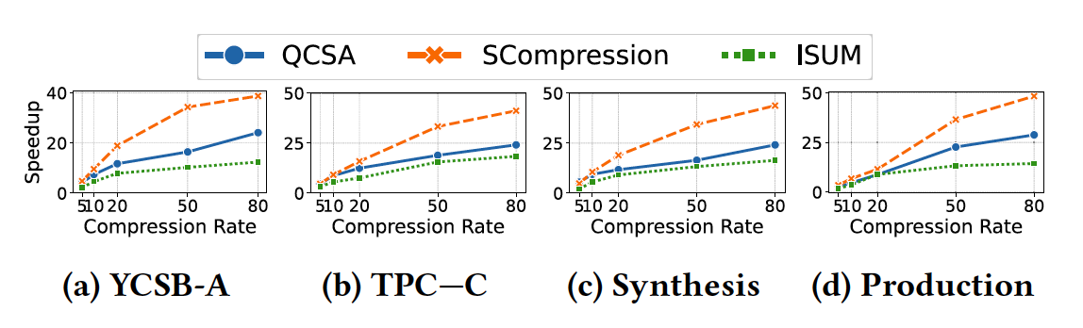
Experiments
The speedup of tuning time when tuning on compressed workload compared to tuning on source workload.
Higher is better.
SCompression is a cost-effective solution for knob tuning, accelerating tuning by up to 40 times with only a 5% performance reduction.
Notes:
Across all workloads, our SCompression achieves best results.
Based on these two experiments, the results show that SCompression is a cost-effective solution for knob tuning, accelerating tuning by up to 40 times with only a 5% performance reduction.
We also have more experiments you can found on our paper, including more analysis and ablation studies.

Slide 13
Notes:
Finally, let me introduce Tencent Cloud‘s next-generation data intelligence platform. It provides capabilities such as agents, insight, computation, scheduling, storage, and so on.
Our research (including the workload compression and efficient knob tuning methods) will be integrated into this platform, enabling it to deliver high-speed database knob tuning for more effective performance optimization.

Slide 14
Thanks! Email: kellancai@tencent.com

Slide 15
Q&A

Slide 16
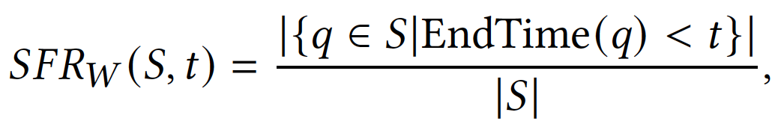
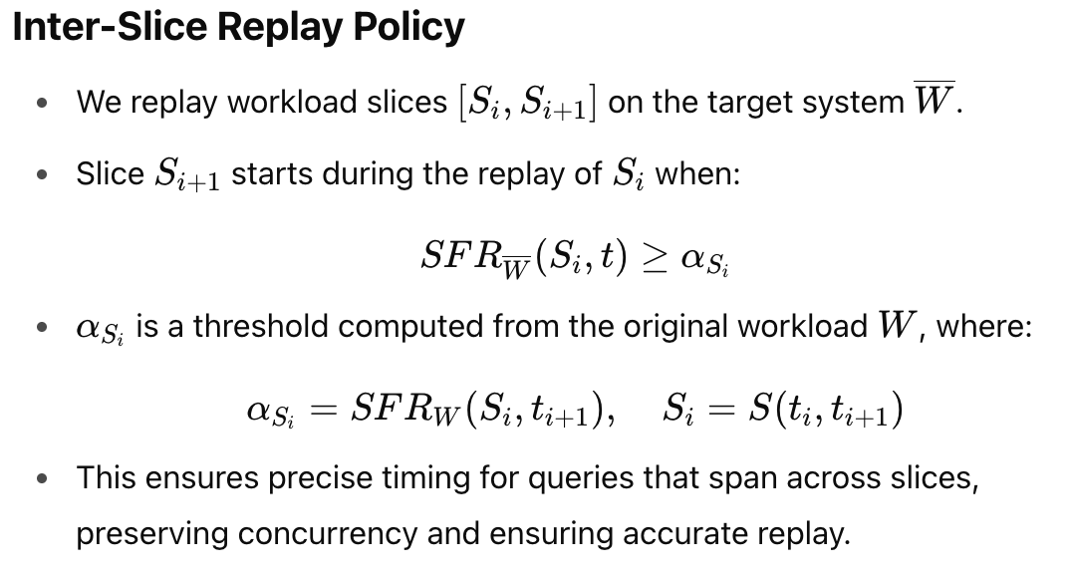
Replayer
Intra-slice replay strategy and the Inter-slice replay strategy.
The metric represents the proportion of queries in that have completed execution in workload by time.

Slide 17
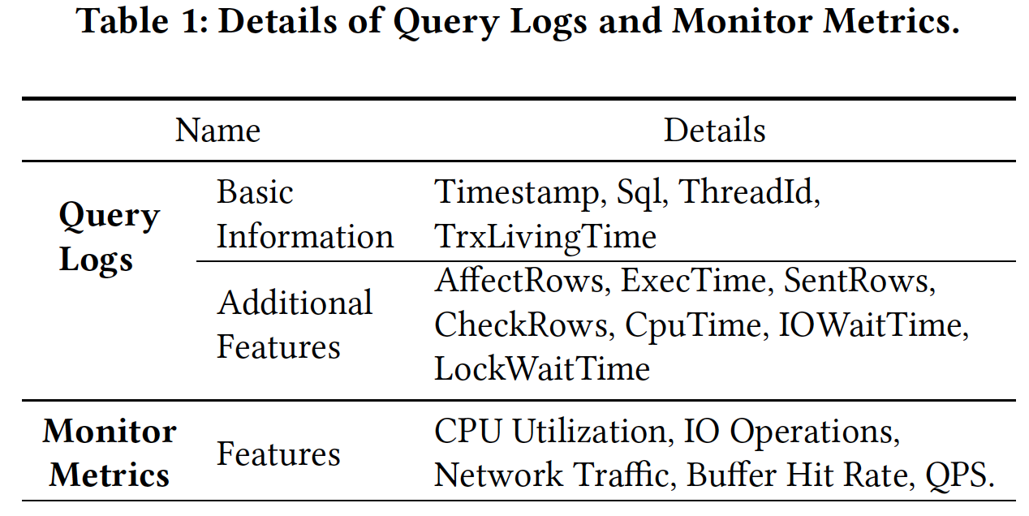
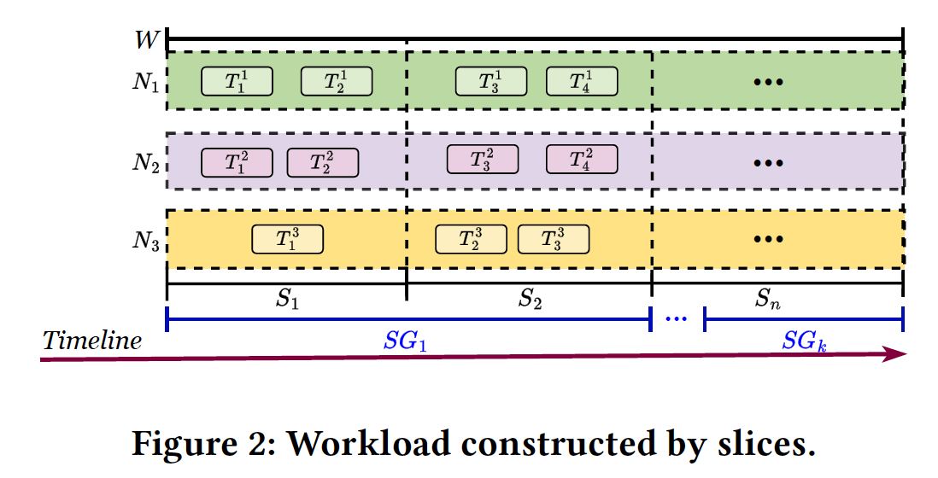
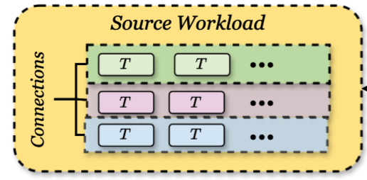
Name | Details
T | Transaction
N | Connection
S | Slice
SG | Segment
W | Workload
Sample the slices.
Notes:
Too many to ….. Simplify the slides, reduce figures.

Slide 18
Slice Replaying
Replay a slice:
For transactions in the same connection, replay them according to their origin sequence.
For connections in the same slice, start connection as it was.
Replay between slices: 1. When the running slice has finished N queries, the next slice will start. N is calculated from source workload.
Replay between slices
Replay a slice
Replay a slice

Slide 19
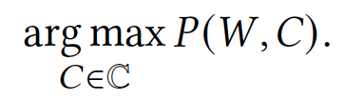
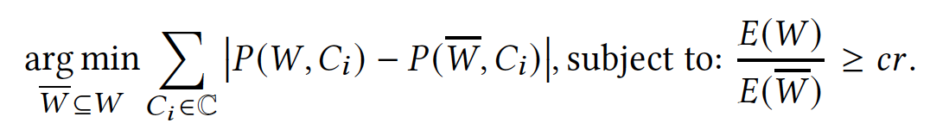
Background
The target of knob tuning:
Find a compressed workload that is similar to the original workload, constrained by execution time. (cr refers to compression rate.)

Slide 20
Name | Details
T | Transaction
N | Connection
S | Slice
SG | Segment
W | Workload
Sample the slices.
Notes:
Too many to ….. Simplify the slides, reduce figures.

Slide 21
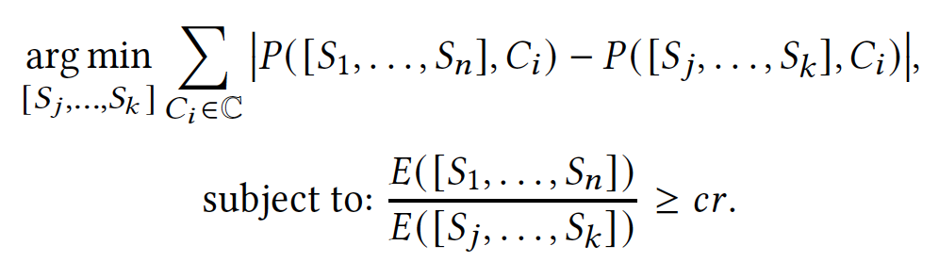
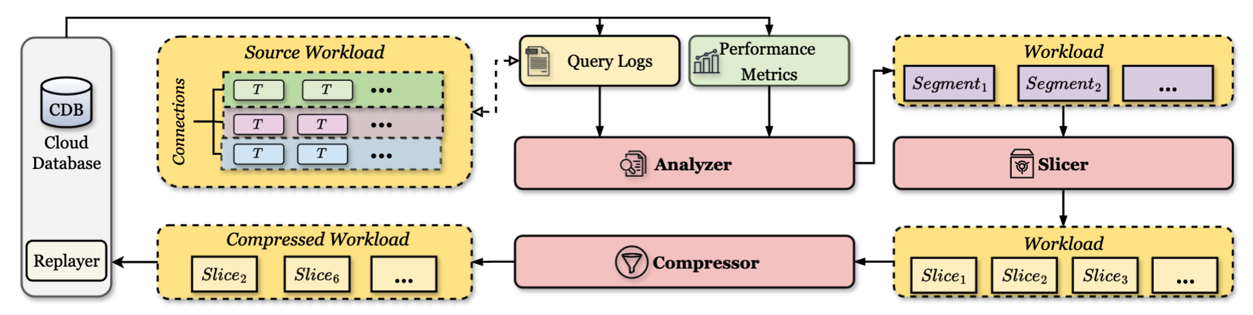
Overview

Slide 22
Key Designs(Too hard to follow)
Segment the source workload using the Greedy Gaussian Segmentation algorithm to handle workloads with irregular fluctuations.
Divide each segment into numerous slices using a dynamic slice strategy to maintain the integrity of query contexts.
Sample slices under the constraint of the expected workload execution time, employing a clustering-based technique to ensure that the sampled slices are representative of the workload by sampling from different clusters.
Replay strategy based on slices to produce performance that mirrors the source workload.

Slide 23
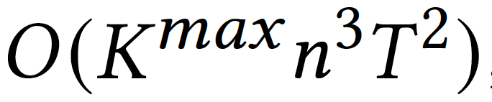
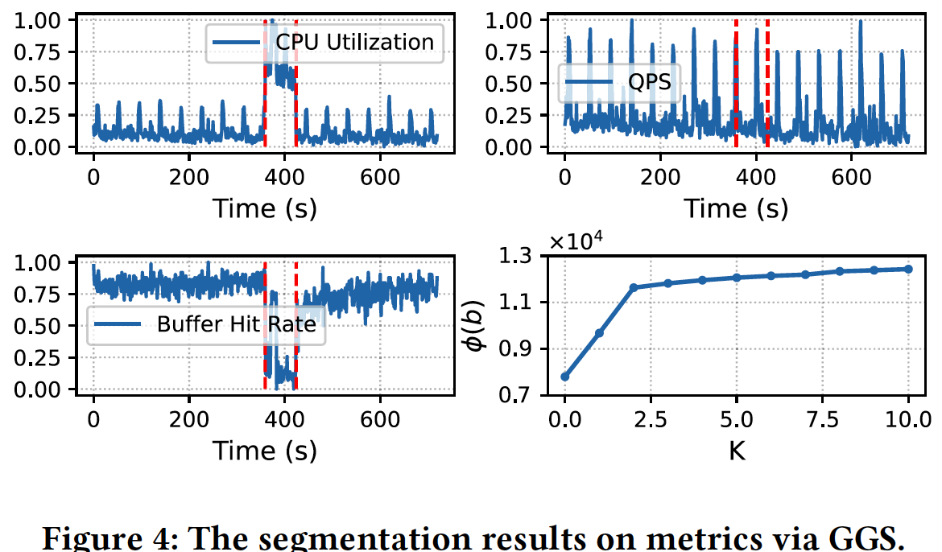
Analyzer – Segment.
Greedy Gaussian Segmentation (GGS)
n is the dimension of the metrics.
T is the number of points of metrics. K is the number of breakpoints.
In this paper, n = 5 because there are five features in the monitor metrics.

Slide 24
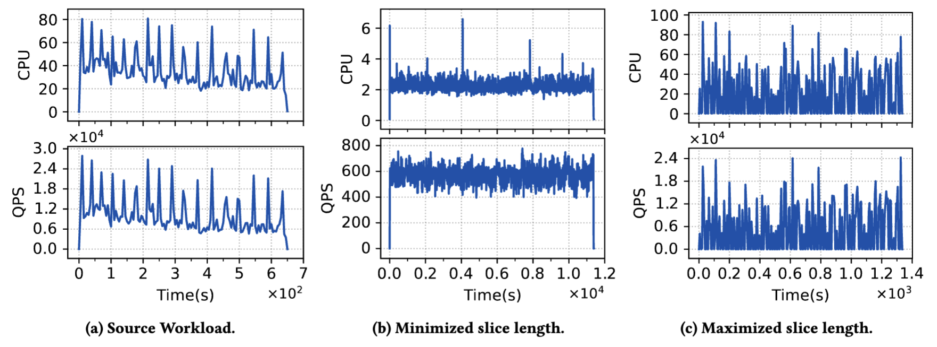
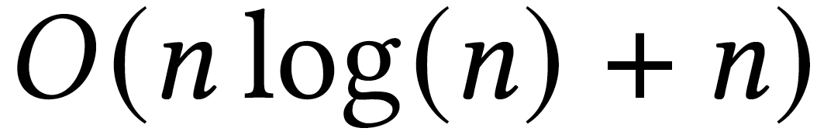
Slicer – Dynamic Slice Length.
Set split points at moments when there are few concurrencies.
Instantaneous concurrency (IC):
the number of transactions being executed in an interval

Slide 25
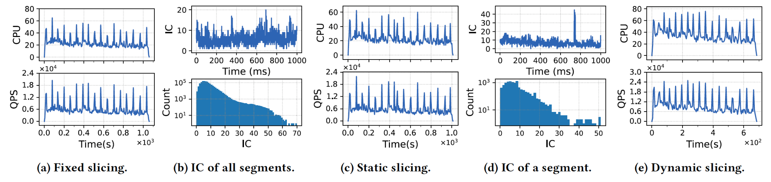
Slicer – Dynamic Slice Length.
Set split points at moments when there are few concurrencies.

Slide 26
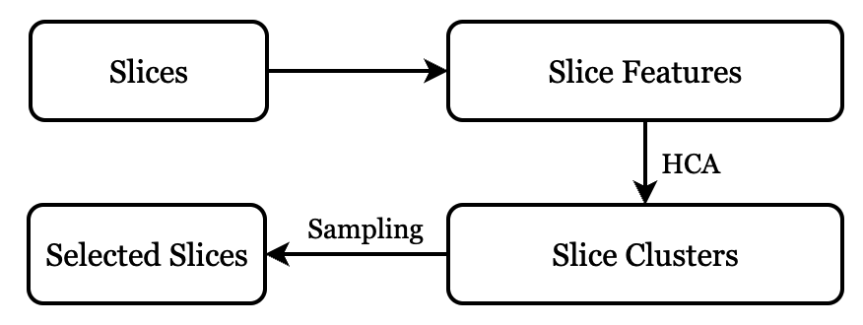
Compressor
Get Features
Cluster by Hierarchical Cluster Analysis
Sampling from different clusters.

Slide 27
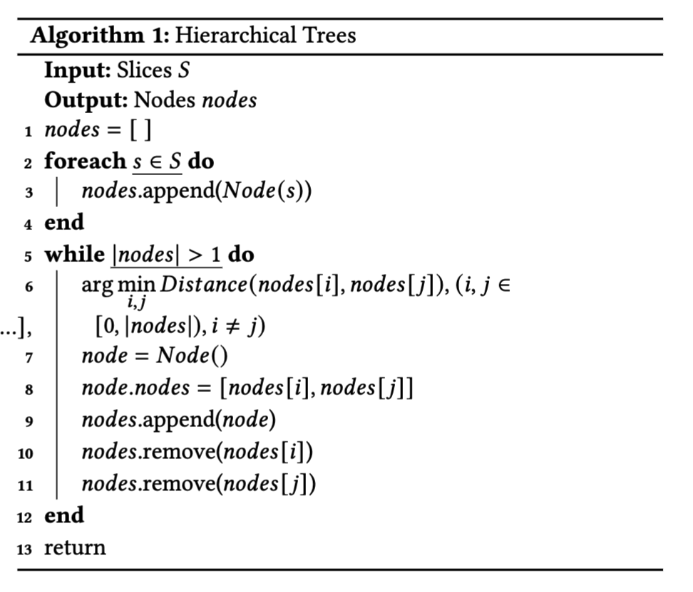
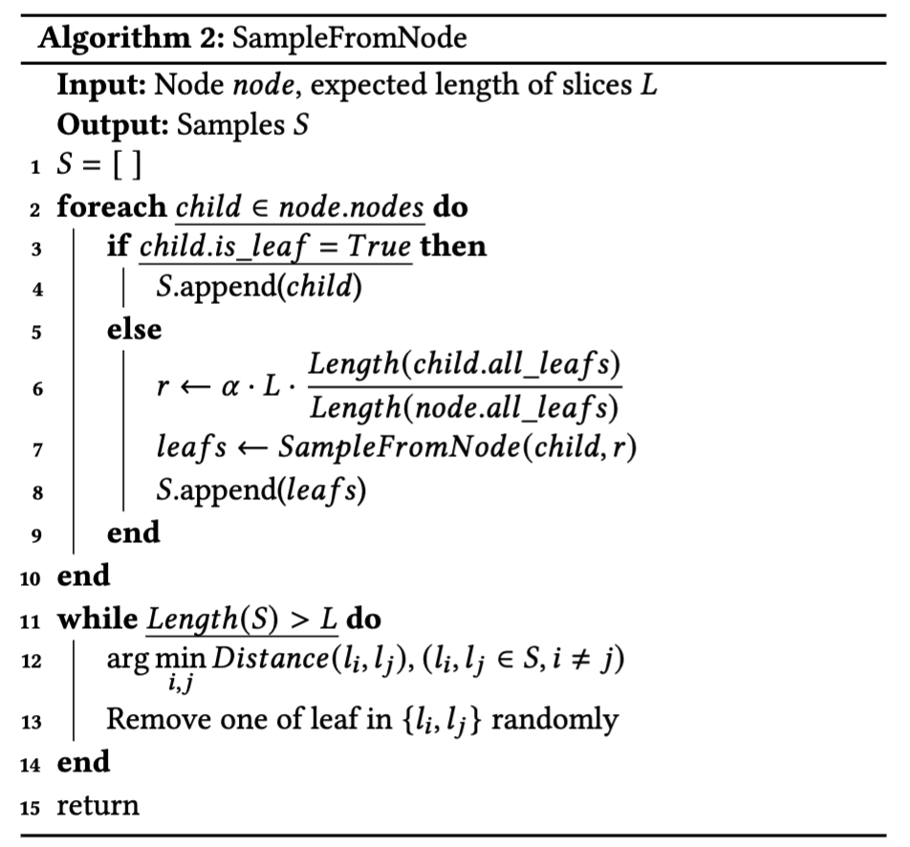
Compressor
Get Features
Cluster by
Sampling

