Slide 1




TopTune:Tailored Optimization for Categorical and Continuous Knobs Towards Accelerated and Improved Database Performance Tuning
${\text{Rukai} \text{Wei}}^{1,2}$, ${\text{Yu} \text{Liu}}^{1}$, ${\text{Yufeng} \text{Hou}}^{1}$, ${\text{Heng} \text{Cui}}^{1}$, ${\text{Y}\text{ongqiang} \text{Zhang}}^{2}$, ${\text{Ke} \text{Zhou}}^{1}$
$1$Huazhong University of Science and Technology
² $\text{Wuhan} \text{Dameng} \text{Database} \text{Co}\text{.,}\text{Ltd}$

Slide 2


Database tuning is important!
Realizing high performance requires finding optimal values for configuration knobs
ADAPTIVE_NPLN_FLAG = 1 BDTA_SIZE = 1000 BUFFER = 100 BUFFER_POOLS = 19 CACHE_POOL_SIZE = 20 CASE_WHEN_CVT_IFUN = 1 CKPT_DIRTY_PAGES = 1 TRX_VIEW_MODE= 0 CKPT_RLOG_SIZE = 0 COMM_VALIDATE = 1
UPD_DEL_OPT= 2
……
ADAPTIVE_NPLN_FLAG = 2 BDTA_SIZE = 16 BUFFER = 80000 BUFFER_POOLS = 136 CACHE_POOL_SIZE = 675 CASE_WHEN_CVT_IFUN = 3 CKPT_DIRTY_PAGES = 0 TRX_VIEW_MODE= 1 CKPT_RLOG_SIZE = 0 COMM_VALIDATE = 0
UPD_DEL_OPT= 2
……
Knob Tuning
Dameng V8 Default Configuration
Dameng V8 Default Configuration
Properly tuned database systems can achieve significant higher throughput (or lower 95-tile latency) compared to default configuration

Slide 3
Database tuning is hard…
-Too many knobs: MySQL>500, Dameng > 800
ADAPTIVE_NPLN_FLAG = 2 BDTA_SIZE = 16 BUFFER = 80000 BUFFER_POOLS = 136 CACHE_POOL_SIZE = 675 CASE_WHEN_CVT_IFUN = 3 CKPT_DIRTY_PAGES = 0 TRX_VIEW_MODE= 1 CKPT_RLOG_SIZE = 0 COMM_VALIDATE = 0
UPD_DEL_OPT= 2
……
-Unknown interactions among knobs
-Configuration evaluation is expensive
- Poor generalization on varying workload
- …….
- Continuous and categorical knobs coexist
Dameng V8 Default Configuration
Configuration heterogeneity - in type, scale, and effect - complicates building universal optimization solutions across diverse systems and workloads.

Slide 4
Heterogeneity
Continuous and categorical knobs have different optimization properties.
Type | Knob Example | Domain | Order | Sensitivity
Continuous | WORKER_CPU_PERCENT | [0,100] | √ | low
Categorical | PARALLEL_POLICY | {0,1,2} | × | high
Order and Gradient :
Continuous knobs have an ordered relationship with performance, and their search space is continuous and differentiable.
Categorical knobs lack such order, and their search space is discrete and non-differentiable.
Knob Sensitivity :
Continuous knobs span a wide range and have limited impact on performance with small changes.
Categorical knobs, with few options, can significantly affect performance even with minor changes.

Slide 5


Motivation
Some optimizers, e.g., naïve GP, are based on the assumption of continuous search spaces ——perform poorly on categorical knobs.
Many optimizers use a one-size-fits-all approach for tuning continuous and cate-gorical konbs, assuming uniform exploration is equally effective for both types.
Optimize continuous and categorical knobs in different ways while considering the dependence between knobs
Find near-optimal configurations with fewer tuning iterations than state-of-the-art methods.

Slide 6
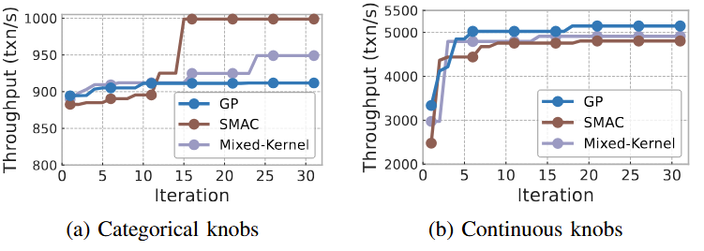
Challenges
Optimizer performance varies across different configuration spaces.
SMAC outperforms
GP leads in performance
(C1) Limited ability of the model to optimize continuous and categorical knobs simultaneously.

Slide 7
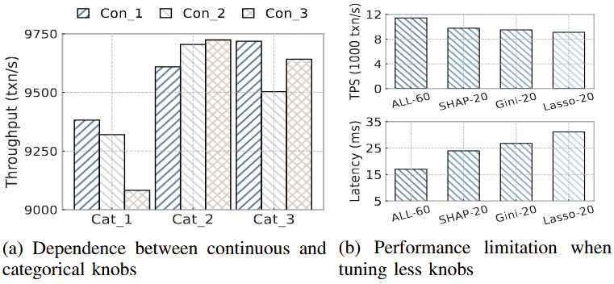
Challenges
Tuning one type of knob affects the optimal setting of the other.
Changing categorical knobs from Cat_1 to Cat_2 shifts the optimal continuous setting from Con_1 to Con_3.
(C2) Complex dependence between categorical and continuous knobs during the exploration for near-optimal configurations.

Slide 8
Challenges
Fewer knobs: faster but risk missing gains
More knobs: better performance but slower.
Tuning all 60 knobs yields better performance than Top-20, but requires more time.
(C2) Tricky balance between efficiency and effectiveness.

Slide 9
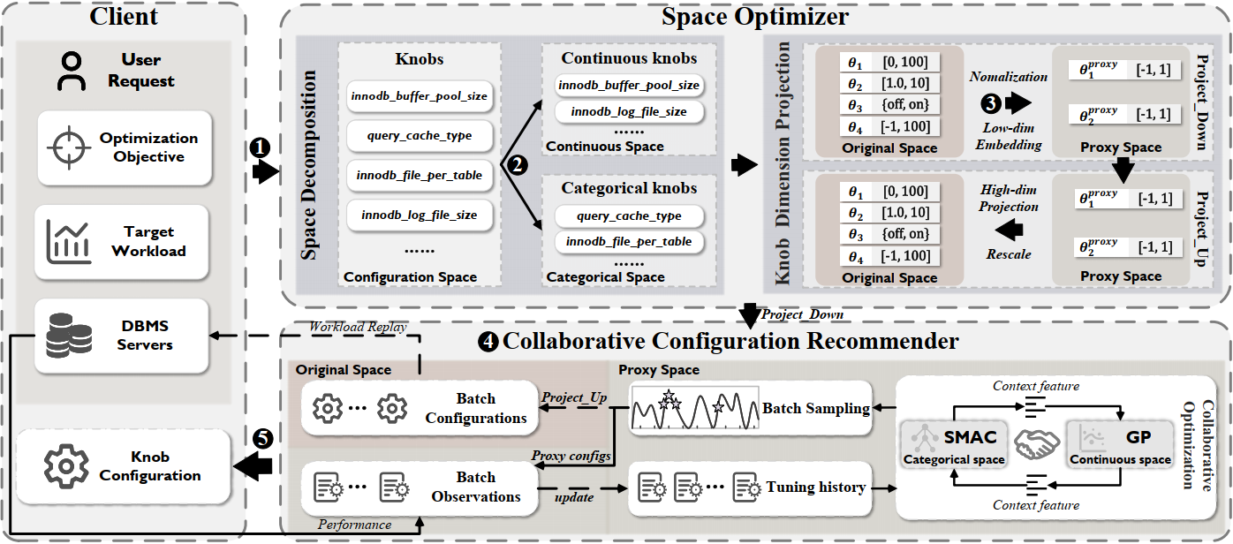
TopTune-Overview
Tailored Optimization + Dimensionality Reduction + Parallel Tuning
= Efficiency ↑ | Performance ↑

Slide 10
TopTune-Overview
1
User defines DBMS & Obj. (e.g., latency/TPS); Client clones DB instance for configuration evaluation

Slide 11
TopTune-Overview
2
Decompose config space into con & cat parts, then apply specialized surrogates (GP, SMAC)

Slide 12
TopTune-Overview
3
Knob Dimension Projection reduces high-dimensional space to low-dimensional proxy space

Slide 13
TopTune-Overview
4
The collaborative optimization framework alternately invokes GP and SMAC to iteratively explore the continuous and categorical sub-spaces

Slide 14
TopTune-Overview
5
Identify the best configuration from the tuning history and recommends it once the process completes

Slide 15
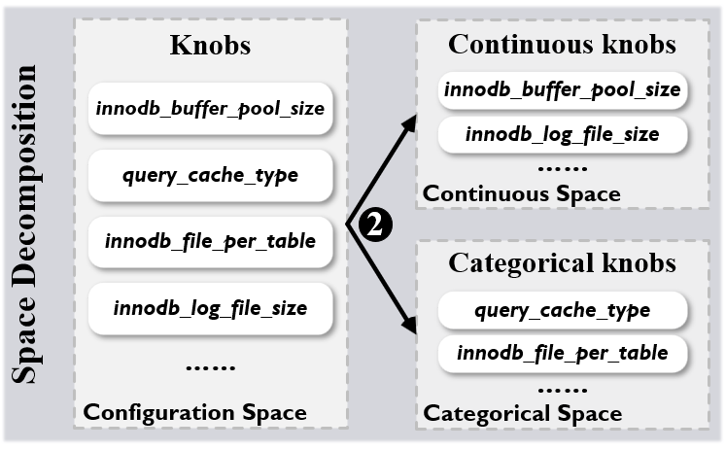
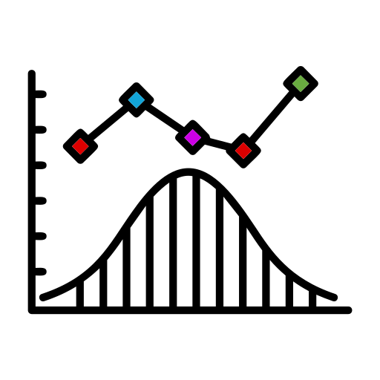
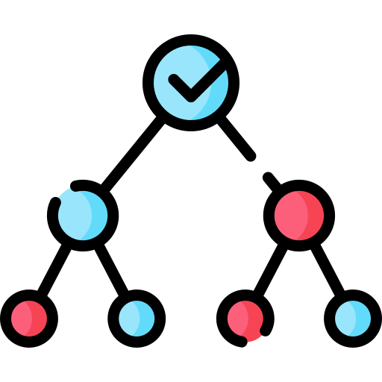
TopTune-Space Decomposition
Decompose the entire configuration into continuous and categorical knobs
Continuous: Integer, float…(innodb_buffer_pool_size [0, 2**64-1])
Categorical: Enum… (enable_memorize {on, off})
Assumes smooth, continuous space
Leverages kernels to measure similarity
Uses gradients for efficient acquisition
Models uncertainty for smart exploration
GP
Uses RFs to model non-smooth spaces
Robust to noisy or abrupt performance changes
No gradient — ideal for discrete choices
……
SMAC

Slide 16
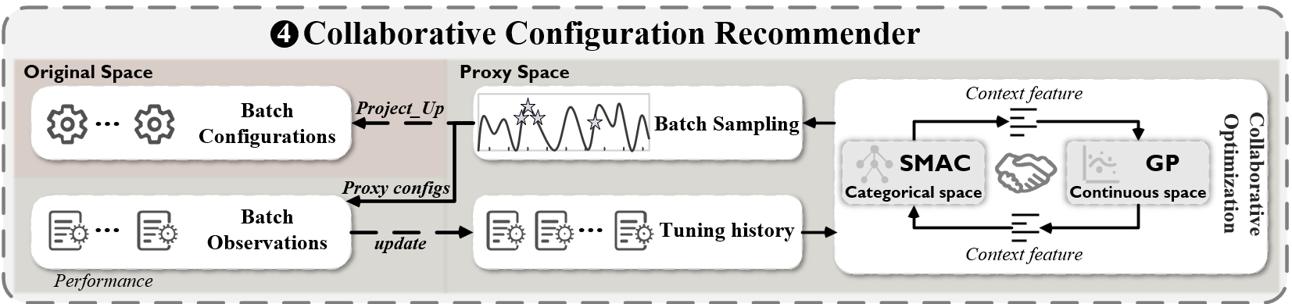
TopTune-Collaborative Optimization
Coordinate two agents to capture continuous-categorical dependencies
Alternating Tuning
GP and SMAC run iteratively, each optimizing one subspace while fixing the other. After each iteration, the best configuration is applied, and the next model begins tuning the alternate subspace.
Communication with Context Feature
Context features encode past optimal configurations as vectors, which are shared between GP and SMAC to enable warm-start and cross-model learning during alternating tuning.

Slide 17
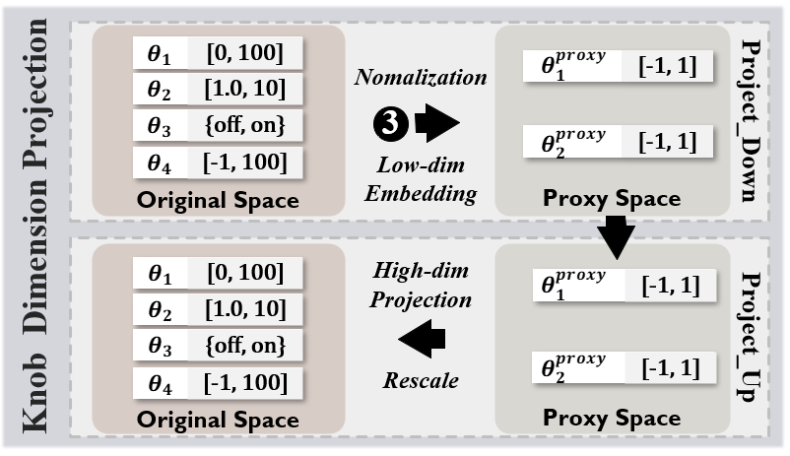
TopTune-Dimensional Projection
Uses HeSBO to project high-D config space into a low-D proxy space
Project Down maps high-dimensional database configurations into a lower-dimensional proxy space by combining selected knobs into virtual knobs using a sparse random matrix.
Project Up reconstructs high-dimensional database configurations from a lower-dimensional proxy space by mapping virtual knobs back to real ones using inverse projection and rescaling techniques.
Project Down
Initialize and
Warm up Model
Configuration
Evaluation
Run tuning
models
Project Up

Slide 18
TopTune-Parallel Tuning
Speeding Up DB Tuning with Batch Sampling and Parallel Evaluation
Batch Bayesian Optimization:
Local Penalization → Diverse, high-quality config batches
Distributed Evaluation → Speed up stress testing

Slide 19
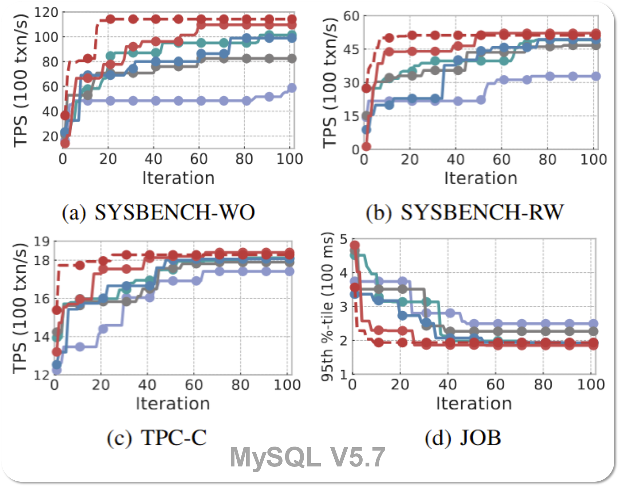
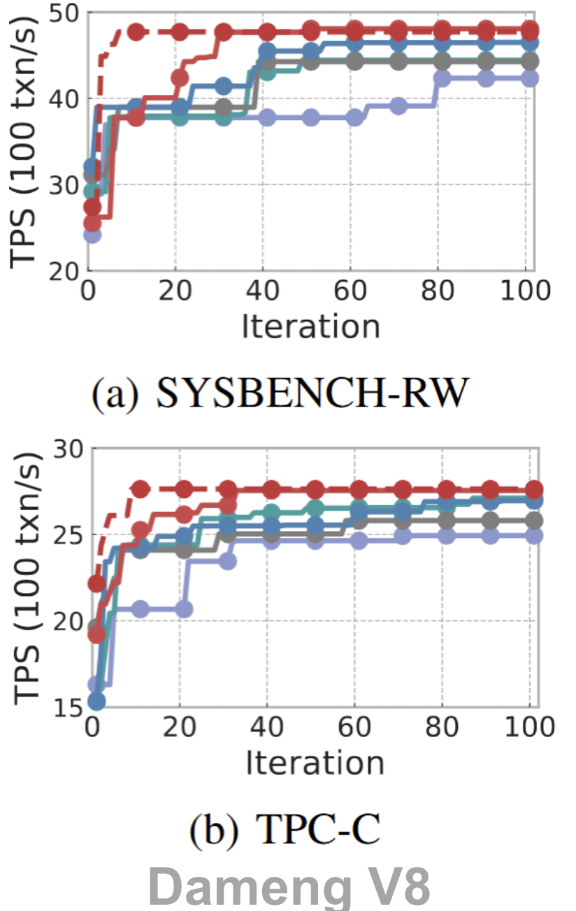
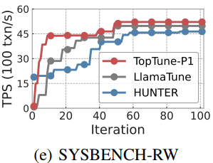
Experiments
Performance
Outperforms SOTA optimizers (e.g., SMAC, GP, MBO) and tuning systems (e.g., HUNTER)
Up to 10.7% throughput improvement on MySQL benchmarks
3.9% improvement on TPC-C , and 3.9% latency reduction on JOB
Effective on different DBMSs — e.g., up to 3.4% improvement on Dameng

Slide 20
Experiments
Efficiency
1.4×–2.6× faster tuning speed than SMAC on MySQL
TOPTUNE-P4 achieves near-optimal config in just 20 iterations
Speedups up to 12.2× with batch + parallel optimization
Consistent gains on both MySQL and Dameng DBMS

Slide 21
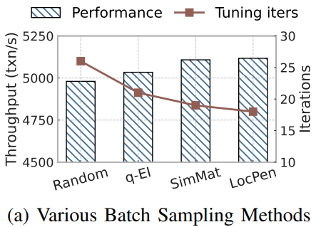
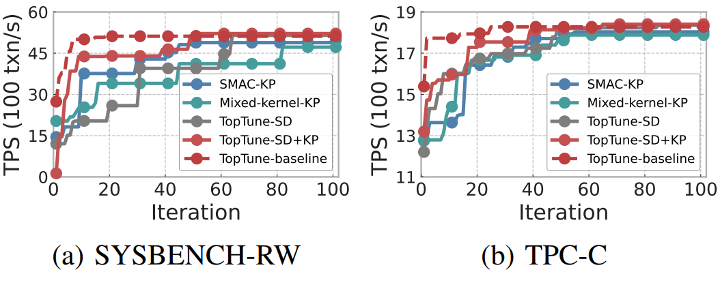
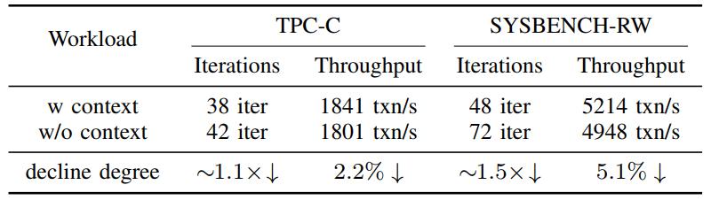
Experiments
Space Decomposition (SD) → Improves TPS by up to 4.5% and speeds up tuning by 1.2×
Knob Projection (KP) → Reduces tuning iterations by 1.5× via dim reduction
Context-based Communication → Without it: ↓ throughput by up to 5.1%, ↑ iterations by 1.5×
Batch Sampling (BP) → Local penalization outperforms random, q-EI, and simulation matching

Slide 22
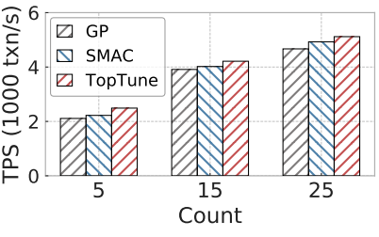
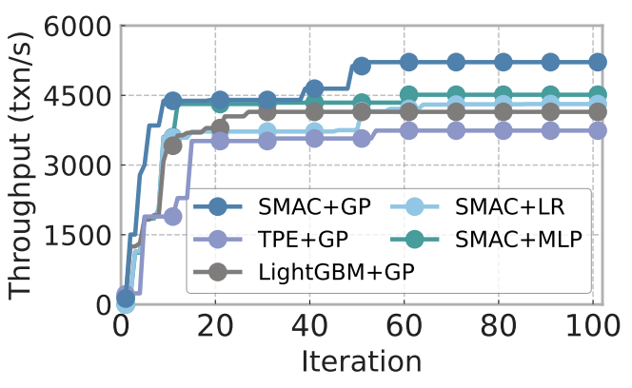
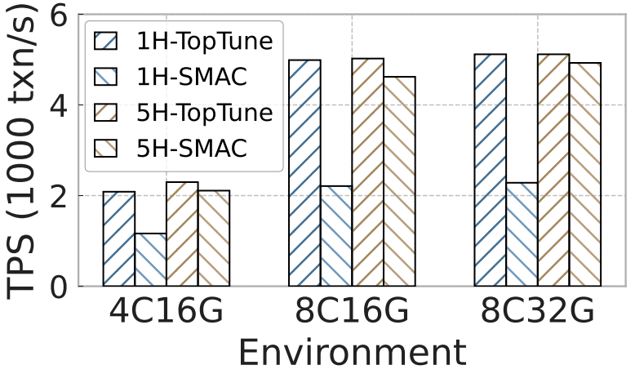
Experiments
1. TOPTUNE outperforms GP/SMAC with 5, 15, and 25 categorical knobs → Up to 12.1% throughput improvement
2. SMAC (categorical) + GP (continuous) performs best → Other models suffer from underfitting or data limits
3. TOPTUNE consistently beats SMAC on all hardware Envs → Reaches same performance in 1 hour vs. 5 hours for SMAC

Slide 23
Conclusion
Key Idea: Tailored optimization for continuous & categorical knobs
Key techniques: space decomposition, collaborative optimization , dimensional projection , and batch BO
Outperforms SMAC by up to 10.7% in throughput and 12.2× in tuning speed
Future work: extend to file systems , OS , and big data frameworks tuning
Thank You! Q&A
Reach me at weirukai@hust.edu.cn

