Slide 1

A Lightweight and Adaptive Cache Partitioning
Scheme for Content Delivery Networks
Peng Wang∗, Zhelong Zhao∗, Yu Liu†, Ke Zhou∗, Zhihai Huang‡, Yanxiong Chen‡ ∗WLNO, Huazhong University of Science and Technology, Wuhan, China
†Huazhong University of Science and Technology, Wuhan, China
‡Tencent Technology (Shenzhen) Co., Ltd., Shenzhen, China
ICCD 2022
Notes:
Hello，everyone:
It’s very great pleasure indeed for me to attend this meeting. And I would like to present my paper “a lightweight and adaptive cache partitioning scheme for content delivery networks”.

Slide 2



CDN Caching Goal: Maximize Hit rate
Requests
Requests
Hit
User
shared Cache
Miss
The sheer number of applications occupy large-capacity shared cache in content delivery networks.
Those mixed workloads often suffer from significant performance degradations due to resource contention.
Allocating exclusive resources for different applications in CDNs allows for a higher overall hit ratio.
Notes:
CDN delivers those content to users through networks of caching servers. With the increasing traffic, traditional schemes are difficult to obey the request rules of workloads consisting of applications sharing caches. Those workloads often suffer from significant performance degradations due to resource contention, which makes cache partitioning an important solution.

Slide 3
Partitioning Algorithms Remains Challenging
High Computational Overheads Caused by Mass Applications.
Due to mass applications, the overheads of partition methods based MRC is high.
Performance Fluctuations Caused by Different Item Sizes.
Due to different item sizes, the cache must pass through a time window where the items are needed to replenish the expanded partition after partition resizing.
Since MRC-based judgments are scarcely sensitive to both quantity and size, inefficient resource utilization with performance fluctuations may occur during this window.
Notes:
Partitioning Algorithms Remains Challenging.
Since the number of threads and the size of LLC in CPU are small, the overheads using MRC are acceptable. Nevertheless, as for CDN, these approaches may have some limitations. Compared to the small computation complexity of partitioning in LLC, the partitioning overheads are large in CDN.
Another challenge comes from different item sizes. After partition resizing, the cache must pass through a time window where the items are needed to replenish the expanded partitions. Since MRC-based judgments are sensitive to both quantity and size, inefficient resource utilization with performance fluctuations may occur during this window.

Slide 4
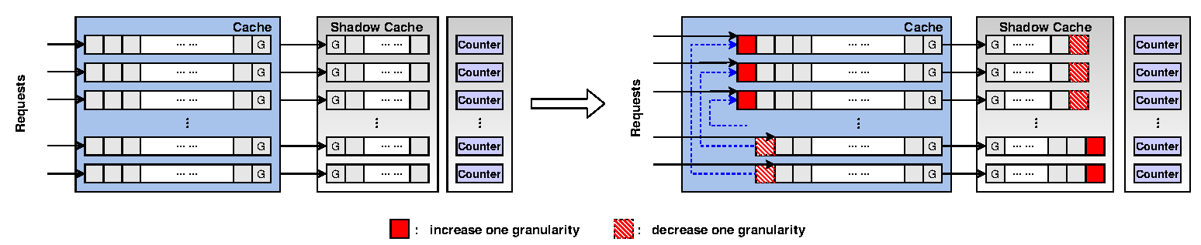
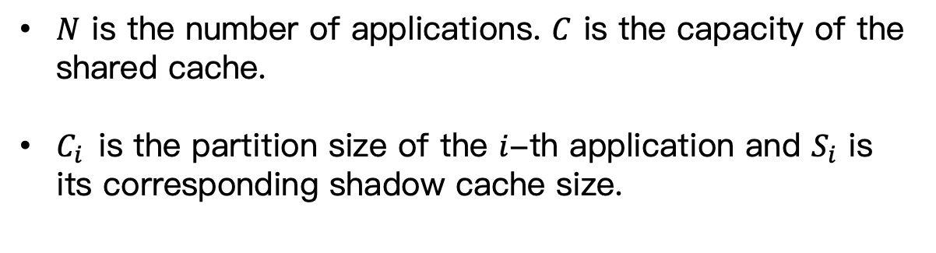
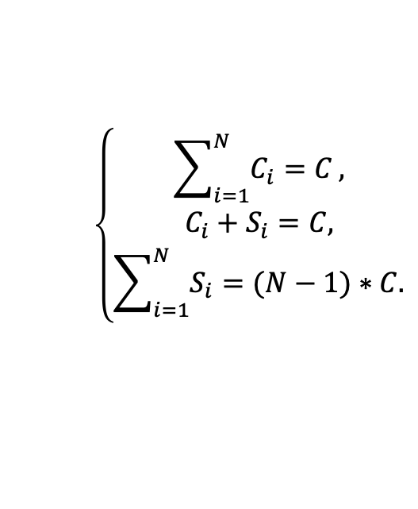
Lightweight and Adaptive Cache Partitioning Scheme
$$\left\{\begin{aligned}\sum_{i=1}^{N}{C_{i}=C}, \\ C_{i}+S_{i}=C, \\ \sum_{i=1}^{N}{S_{i}=(N−1)∗C.}\end{aligned}\right.$$
$N$ is the number of applications. $C$ is the capacity of the shared cache.
$C_{i}$is the partition size of the $i$-th application and $S_{i}$ is its corresponding shadow cache size.
Notes:
Then to our solution.
Assume that there are N apps in the cache. The capacity of G-size is G. The partition size for the i-th app is Ci, and its corresponding shadow cache size is Si. These pa’rameters satisfy the following relationship:
As shown in figure each application occupies a cache space resource with a shadow cache. Since the in-memory shadow cache only stores the metadata of the app data, the shadow cache consumes a limited amount of memory resources. We set a Counter, used to record the number of hits in the shadow cache.

Slide 5
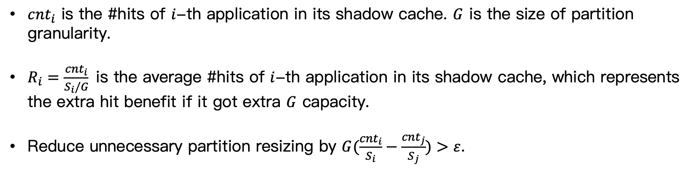
Lightweight and Adaptive Cache Partitioning Scheme
${cnt}_{i}$ is the #hits of $i$-th application in its shadow cache. $G$ is the size of partition granularity.
$R_{i}=\frac{{cnt}_{i}}{S_{i}/G}$is the average #hits of $i$-th application in its shadow cache, which represents the extra hit benefit if it got extra $G$ capacity.
Reduce unnecessary partition resizing by $G(\frac{{cnt}_{i}}{S_{i}}−\frac{{cnt}_{j}}{S_{j}})>ε$.
Notes:
In the process of the adjustment, LAP first calculates Ri and arranges Ri in descending order. Then, LAP transfers a capacity of G-size as shown in figure, where the order of partitions is based on the order of Ri. In addition, we cut the G-size from the tail of the cache queue to improve performance in the implementation, since the LRU algorithm pushes items that may not be reused to the end of the queue.
In the process of resizing partitions, we find that some resizing operations between these partitions cannot bring benefits but consume the computational resources. We set a threshold and update sizes of partitions only when the difference between the pair applications is greater than the threshold. Under this constraint, we can reduce updates and save time without a reduction in performance.

Slide 6
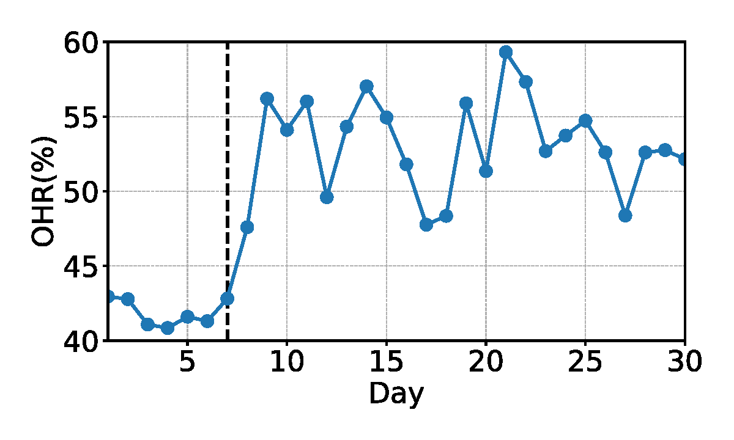
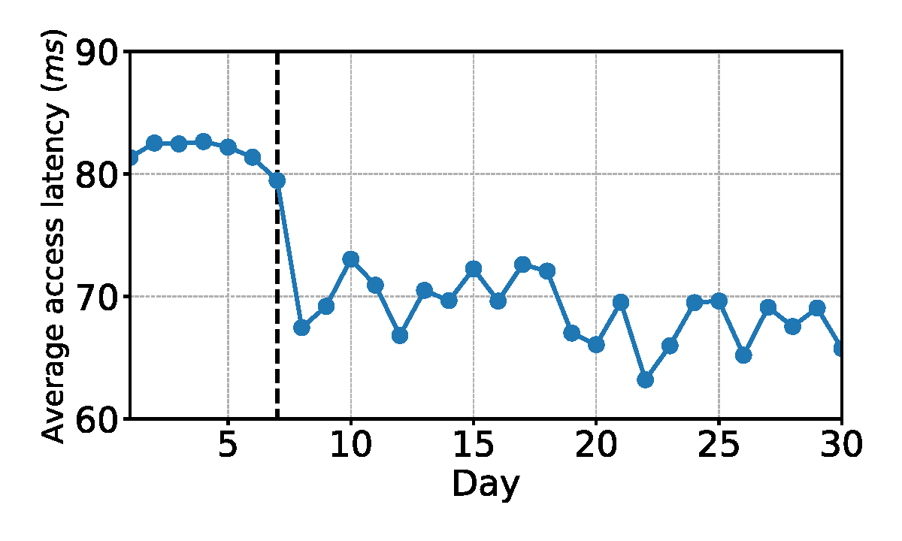
Deploy LAP at the OC Layer of PicCloud
the LAP algorithm was deployed online at 24:00 on day-7.
the OHR of PicCloud increased by 9.34% on average, and the average access latency dropped by 12.5ms.
Notes:
We have deployed LAP at the OC layer of PicCloud since most requests concentrate on the OC layer so that LAP can take advantage of the situation. Through the monitoring system, we gathered the metrics for one month, where the one-month time span includes the week before the deployment of LAP and about three weeks after the completion of the deployment. We can see that the object hit ratio of PicCloud increased and the average access latency dropped.

Slide 7
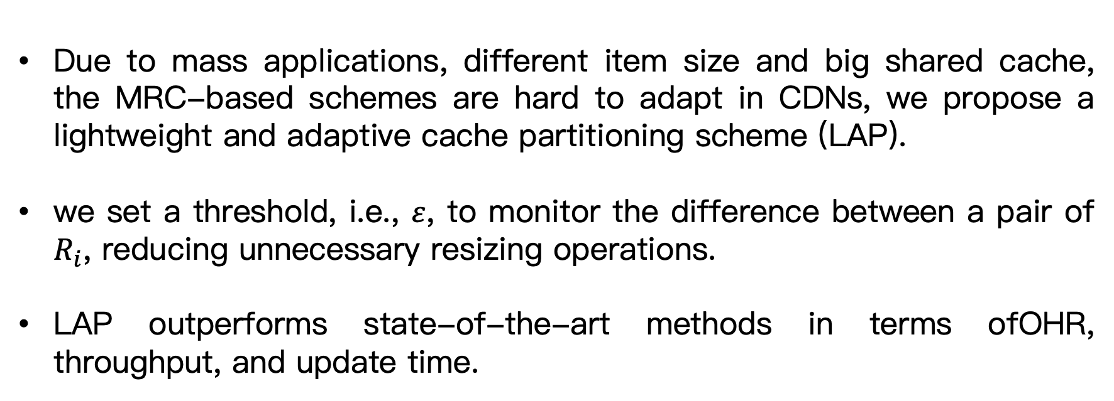
Conclusion
Due to mass applications, different item size and big shared cache, the MRC-based schemes are hard to adapt in CDNs, we propose a lightweight and adaptive cache partitioning scheme (LAP).
we set a threshold, i.e., $ε$, to monitor the difference between a pair of $R_{i}$, reducing unnecessary resizing operations.
LAP outperforms state-of-the-art methods in terms ofOHR, throughput, and update time.
Notes:
Finally, to summary. Due to mass applications, different item size and big shared cache, the MRC-based schemes are hard to adapt in CDNs, we propose a lightweight and adaptive cache partitioning scheme (LAP).
we set a threshold, to monitor the difference between a pair of 𝑅_𝑖, reducing unnecessary resizing operations.
LAP outperforms state-of-the-art methods in terms of OHR, throughput, and update time.

