Slide 1



CGHit: A Content-oriented Generative-hit
Framework for Content Delivery Networks
Peng Wang∗, Yu Liu†, Kai Han†, Ziqi Liu†, Ke Liu ∗, Mingyang Wang†, Ke Zhou∗, Zhihai Huang‡
∗WNLO, HUST †SCST, HUST ‡Tencent
International Conference On Networking, Architecture and Storage 2024

Slide 2



Challenges in CDN: Cache Miss Problem
Requests
Requests
Hit
User
Edge Cache
Miss
High bandwidth resource costs
Increased server load from excessive back-to-origin traffic
Significant latency difference:
Cache hit: ~2ms
Data center fetch: ~230ms
Notes:
### Page 1. CDN现状Cache Miss成本高昂
- 带宽资源成本高
- 过多的回源流量也会导致服务器压力增大
- 数据中心获取延迟(~230ms)远高于缓存命中(~2ms),严重影响用户体验
- 以腾讯CDN为例,Cache Miss情况下P99延迟达218.06ms,是Cache Hit的22倍

Slide 3
Content Redundancy Problem
Caching strategies fail to consider content locality, leading to redundant storage
Measurements show redundant content occupies >40% storage in 512GB CDN nodes
Impact:
Each cache miss generates ~2MB back-to-end traffic
User experience suffers, especially in mobile networks
Notes:
- 缓存策略未充分考虑内容局部性,导致相似内容重复存储
- 经测量,在512GB容量的CDN节点中,重复内容占用超过40%存储空间
导致：
- 带宽资源消耗增加,每次Cache Miss产生约2MB的回源流量
- 用户体验受影响,尤其在移动网络环境下更为明显

Slide 4
Data vs Content Locality
Traditional CDNs heavily rely on data locality, with URL-based caching strategies dominating
This leads to redundant storage of identical content:
Same images stored in multiple formats (JPEG/PNG/…)
Same videos stored in different resolutions for varying network conditions
Identical documents duplicated in different formats (TXT/DOC/…)
This redundancy not only wastes storage space but also increases system maintenance costs
Notes:
- Traditional CDNs overly rely on data locality
- URL-based caching strategies predominate
- Results in redundant storage of identical content
- Example: Same image stored in JPEG/PNG/WebP formats

Slide 5
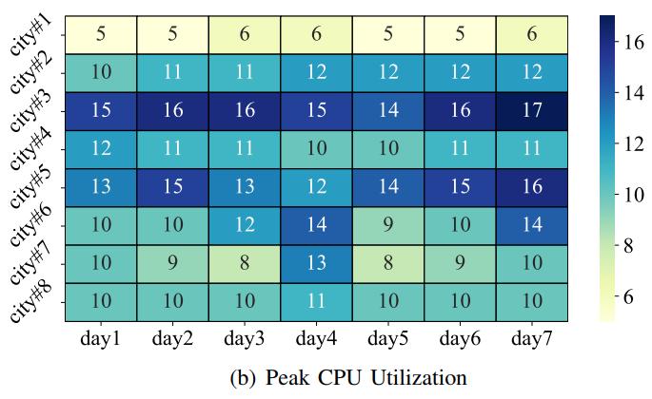
Generation vs. Fetching
1. Idle Computing Resources at CDN Edge Nodes:
Surveys from multiple CDN providers (Akamai, Google, Alibaba, Tencent) show CPU utilization <20%
Substantial memory resources available for complex tasks
Notes:
## 2.关键观察
1. CDN边缘节点计算资源闲置(idle computing resources):
- 多家CDN提供商(Akamai、Google、阿里巴巴、腾讯)的调查显示CPU利用率<20%
- 边缘计算资源丰富而云端CPU资源稀缺
2. 生成替代获取的可行性(replacing "fetching" with "generation"):
- 获取数据延迟(fetching time)约230ms,是缓存命中的100多倍
- 图像格式转换约40ms,数据块转换<10ms
- 时间差足够支持生成式命中(generative hit)

Slide 6
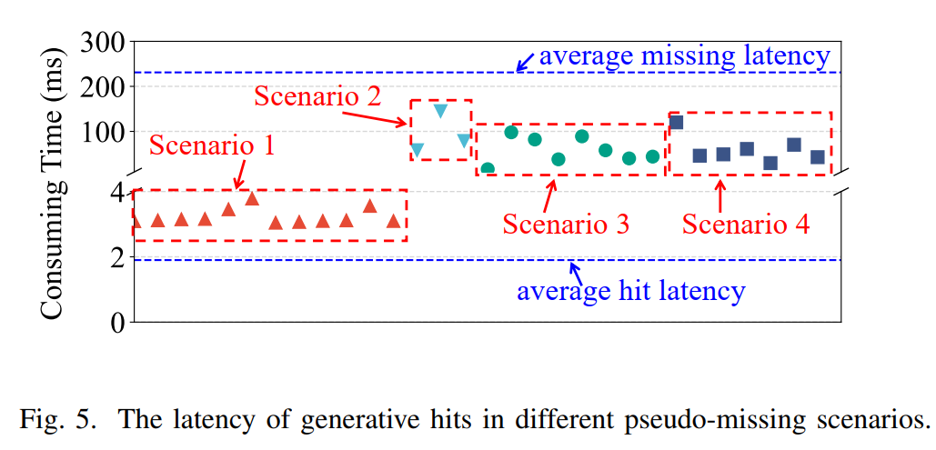
Generation vs. Fetching
2. Feasibility of Replacing Fetching with Generation:
Data fetching time is around 230ms, over 100 times longer than cache hits
Image format conversion takes about 40ms, data block conversion <10ms
The time difference is sufficient to support generative hits
Notes:
- Average data center fetch latency: ~230ms
- Common operations performance:
- Image format conversion: 40ms (JPEG->PNG)
- Video transcoding: 100ms/second
- Data block conversion: <10ms (1MB)
- 95% of conversion tasks complete within 150ms
- Edge generation saves >50% time compared to fetching

Slide 7
Core Concepts: Pseudo-missing
Pseudo-missing
Definition: Data not in cache but can be generated from existing content
Criteria:
Similar content exists (similarity >0.8)
Generation cost < Fetching cost
Verifiable results
Benefits:
Reduces back-to-origin traffic
Improves response time
Saves storage space
Notes:
提出新的概念
### Page 6. Generation vs. Fetching 生成替代获取的可行性
### Page 7. 伪缺失(Pseudo-missing)
- 定义:数据不在缓存但可基于相似内容生成的情况
- 判断标准:
- 存在相似内容(相似度>0.8)
- 转换代价小于获取代价
- 生成结果可验证

Slide 8
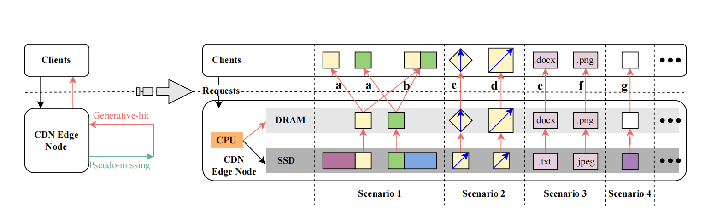
When to Generate: 4 Four Key Scenarios
Generative Hit Scenarios
Scenario 1: Request data is a segment or combination from cached data.
Scenario 2: Requested data matches cached content but differs in form (shape, size, resolution).
Notes:
场景1： 请求的数据是来自缓存数据的一个段或多个段的组合。
场景2： 请求的数据在内容上与缓存数据相同，但这些数据的形式不同（例如，形状、大小、分辨率等）。
场景3： 内容上与缓存数据相同，但这些数据的编码格式不同（即，例如，.txt变为.docx，.jpeg变为.png等）。
场景4： 内容上与缓存数据相似或相关。
1. 数据分段/组合(Data Segmentation/Combination):
- 从已缓存数据中提取或拼接所需部分
- 适用于大文件分块存储场景
3. 内容相同但形式不同(Same Content Different Form):
- 图像旋转、缩放、增强等处理
- 保持内容不变,调整呈现形式
5. 内容相同但格式不同(Same Content Different Format):
- 文件格式转换(.txt到.docx)
- 图像格式转换(.jpeg到.png)
7. 内容相似或相关(Similar or Related Content):
- 图像对象移除/修改
- 文档主题更新
- 基于随机向量生成新内容
1. Data Segmentation/Combination:
- Extract or concatenate required parts from cached data
- Suitable for large file block storage scenarios
2. Same Content Different Form:
- Image rotation, scaling, enhancement, etc.
- Maintain content while adjusting presentation form
3. Same Content Different Format:
- File format conversion (.txt to .docx)
- Image format conversion (.jpeg to .png)
4. Similar or Related Content:
- Image object removal/modification
- Document theme updates
- Generate new content based on random vectors

Slide 9
When to Generate: 4 Four Key Scenarios
Generative Hit Scenarios
Scenario 3: Content matches but varies in coding formats (.txt to .docx, .jpeg to .png).
Scenario 4: Requested data is similar or related in content to cached data.
Notes:
场景1： 请求的数据是来自缓存数据的一个段或多个段的组合。
场景2： 请求的数据在内容上与缓存数据相同，但这些数据的形式不同（例如，形状、大小、分辨率等）。
场景3： 内容上与缓存数据相同，但这些数据的编码格式不同（即，例如，.txt变为.docx，.jpeg变为.png等）。
场景4： 内容上与缓存数据相似或相关。
1. 数据分段/组合(Data Segmentation/Combination):
- 从已缓存数据中提取或拼接所需部分
- 适用于大文件分块存储场景
3. 内容相同但形式不同(Same Content Different Form):
- 图像旋转、缩放、增强等处理
- 保持内容不变,调整呈现形式
5. 内容相同但格式不同(Same Content Different Format):
- 文件格式转换(.txt到.docx)
- 图像格式转换(.jpeg到.png)
7. 内容相似或相关(Similar or Related Content):
- 图像对象移除/修改
- 文档主题更新
- 基于随机向量生成新内容
1. Data Segmentation/Combination:
- Extract or concatenate required parts from cached data
- Suitable for large file block storage scenarios
2. Same Content Different Form:
- Image rotation, scaling, enhancement, etc.
- Maintain content while adjusting presentation form
3. Same Content Different Format:
- File format conversion (.txt to .docx)
- Image format conversion (.jpeg to .png)
4. Similar or Related Content:
- Image object removal/modification
- Document theme updates
- Generate new content based on random vectors

Slide 10
Core Concepts: Generative-hit
Generative-hit
Definition & Principles
Utilizes edge computing resources in pseudo-missing scenarios
Generates requested data from similar/related cached content
Reduces latency when generation is faster than fetching
Generated data only for response, not for storage
Key Technologies
Content similarity computation
Real-time generation algorithms
Quality assurance mechanisms

Slide 11
Core Concepts: Generative-hit
Security Framework
Based on SCD2:
Process isolation
Result integrity verification
Access control
Copyright protection:
Generated data for browsing only
No persistent storage
Copyright belongs to original data owner
Notes:
Security Framework
Based on SCD2:
Process isolation
Result integrity verification
Access control
Copyright protection:
Generated data for browsing only
No persistent storage
Copyright belongs to original data owner

Slide 12
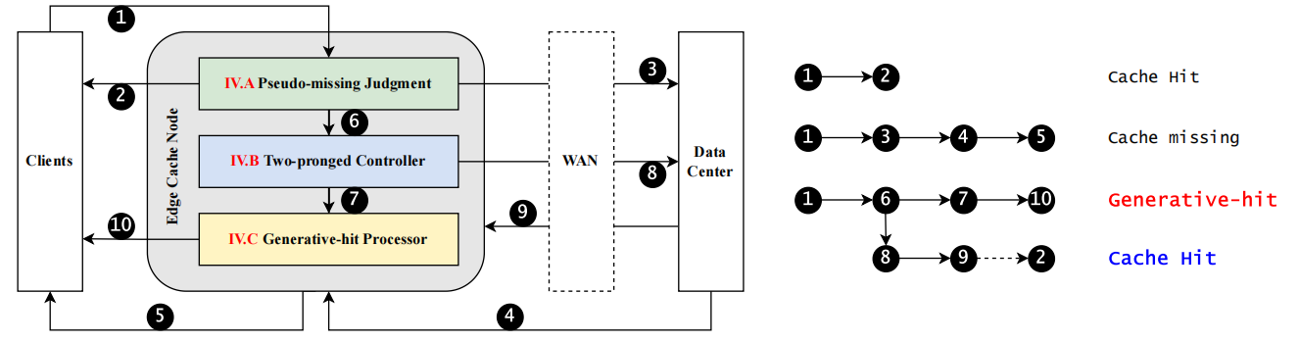
CGHit Design:
Request Processing Layer
Decision Control Layer
Generation Execution Layer
Notes:
1. 伪缺失判断模块(Pseudo-missing Judgment Module):
- 识别请求类型(命中/缺失/伪缺失)
- 基于URL和元数据进行判断 2. 控制器(Two-pronged Controller):
- 决策树模型预测访问模式
- 平衡生成和策略
3. 可扩展生成处理器(Extensible Generative-hit Processor):
- 支持图像处理和数据块操作
- 预留其他数据类型扩展接口
1. Pseudo-missing Judgment Module:
- Identifies request types (hit/miss/pseudo-miss)
- Makes judgments based on URL and metadata
2. Two-pronged Controller:
- Decision tree model predicts access patterns
- Balances generation and fetching strategies
3. Extensible Generative-hit Processor:
- Supports image processing and data block operations
- Reserves interfaces for other data type extensions

Slide 13
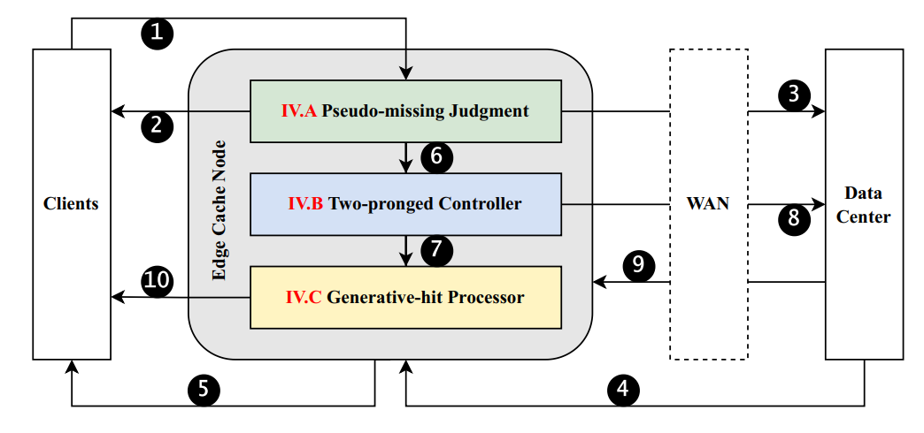
Core Modules
1. Pseudo-missing Judgment
Feature extraction
Similarity calculation
Cost evaluation
2. Two-pronged Controller
Decision tree prediction
Async data fetching
Resource scheduling
3. Generation Processor
Multi-type data support
Extensible architecture
Quality control
Notes:
1. 伪缺失判断模块(Pseudo-missing Judgment Module):
- 识别请求类型(命中/缺失/伪缺失)
- 基于URL和元数据进行判断 2. 控制器(Two-pronged Controller):
- 决策树模型预测访问模式
- 平衡生成和策略
3. 可扩展生成处理器(Extensible Generative-hit Processor):
- 支持图像处理和数据块操作
- 预留其他数据类型扩展接口
1. Pseudo-missing Judgment Module:
- Identifies request types (hit/miss/pseudo-miss)
- Makes judgments based on URL and metadata
2. Two-pronged Controller:
- Decision tree model predicts access patterns
- Balances generation and fetching strategies
3. Extensible Generative-hit Processor:
- Supports image processing and data block operations
- Reserves interfaces for other data type extensions

Slide 14
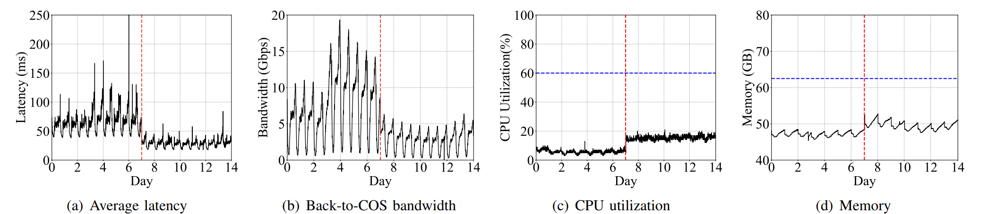
Evaluation:
Real System Deployment (Tencent PicCloud)
Average Access Latency: Reduced by 56.04%
Origin Bandwidth: Reduced by 60.28%
CPU Utilization: Increased from 5.73% to 15.23%
Memory Usage: Increased from 47.16GB to 49.49GB
Notes:
红色虚线表示CGHit部署时间点
蓝色虚线表示系统预设的资源使用上限
1. 平均访问延迟：降低56.04%
2. 回源带宽：减少60.28%
3. CPU利用率：从5.73%增加到15.23%
4. 内存使用：从47.16GB增加到49.49GB
When the requested data is not available on the CDN, it must be fetched from a remote data center, increasing latency.
当请求的数据在CDN上不可用时，需要从远程数据中心获取，增加了延迟。
CDN services may overlook the locality of content, leading to underutilized performance enhancement potential.
CDN服务可能忽视了内容的局部性，导致性能提升的潜力未被充分利用。

Slide 15
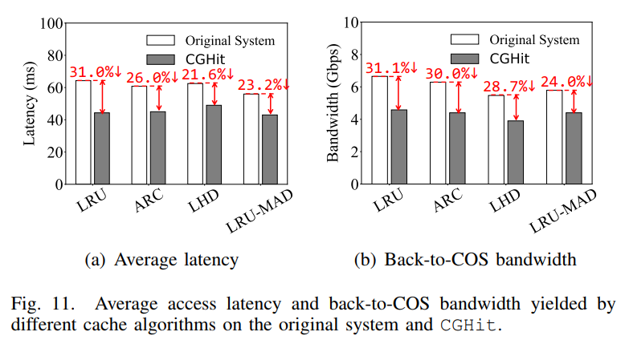
Evaluation:
1. Access Latency Comparison:
All algorithms achieved significant latency reduction on CGHitIncluding various algorithms like LRU, LRU-MAD, FIFO, etc.
Proves that CGHit framework can improve performance of caching algorithm
2. Origin Bandwidth Comparison:
All algorithms achieved bandwidth usage reduction on CGHit
Bandwidth reduction varies with algorithm type
Validates the universality of CGHit
Notes:
The figure shows the performance comparison of the same caching algorithms on the original system and CGHit:

Slide 16



Thanks！
mail: wp_hust@hust.edu.cn

