Slide 1

BASKETBALL
The Global Game: Speed, Skill & Passion
A Comprehensive Presentation in English
History • Rules & Court • Positions • NBA Legends

Slide 2
OVERVIEW & ESSENTIALS
What is Basketball?
The Core Game
• Two teams of 5 active players on the court.
• Objective: score by putting the ball through the opponent's hoop.
• Ball movement: dribbling (bouncing) or passing to teammates.
• Defense: blocking shots, stealing passes, grabbing rebounds.
• Paced by a 24-second shot clock in the NBA, requiring swift strategy.
450 Million+
Players worldwide participating at all levels
10 Feet (3.05 m)
Official regulation rim height from the hardwood floor
4 Quarters
12 minutes each in the NBA (10 mins in FIBA / Olympics)

Slide 3
ORIGINS & HERITAGE
The Birth of Basketball (1891)
December 1891
Dr. James Naismith
Invented at Springfield College, Massachusetts to keep students active indoors during cold New England winters.
The First Baskets
Peach Baskets & Ladders
Peach baskets were nailed to 10-foot gym balcony railings. Every made basket required a janitor with a ladder!
13 Original Rules
Passing Only
Early rules forbade running with the ball (no dribbling). The game was purely passing, positioning, and set shots.
1946 - 1949
Formation of the NBA
The Basketball Association of America (BAA) merged with the NBL to form the modern NBA.

Slide 4
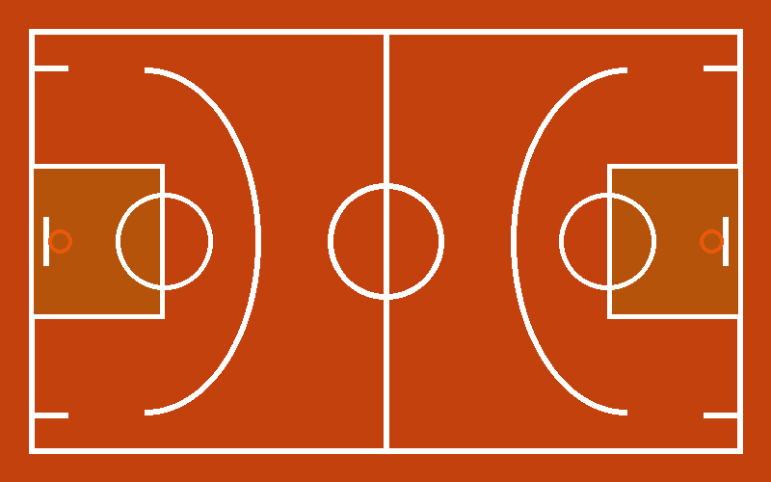
COURT & RULES
Court Anatomy & How Points are Scored
Scoring Breakdown
• 3-Point Shot:
Beyond the 3-point arc (23'9" / 7.24 m in NBA). Revolutionized by modern shooters.
• 2-Point Field Goal:
Any standard basket made inside the arc (layups, floaters, mid-range, dunks).
• 1-Point Free Throw:
Unopposed shot from 15 ft awarded after fouls. Highly crucial in clutch minutes.
• The Key / Paint:
Rectangular area under the hoop; offensive players cannot camp there > 3 seconds.

Slide 5
TEAM ROLES
The 5 Standard Basketball Positions
1 • PG
Point Guard
Floor General
Playmaker, ball handler, sets up the offense with passes.
Notable Players:
Steph Curry
Magic Johnson
2 • SG
Shooting Guard
Perimeter Scorer
Elite jump shooter and perimeter defensive specialist.
Notable Players:
Michael Jordan
Kobe Bryant
3 • SF
Small Forward
All-Around Threat
Versatile hybrid who scores inside/outside and defends.
Notable Players:
LeBron James
Kevin Durant
4 • PF
Power Forward
Paint Enforcer
Tough rebounder, rim finisher, and mid-range shooter.
Notable Players:
Tim Duncan
Giannis Anteto.
5 • C
Center
Rim Protector
Tallest player on floor, blocks shots and controls rebounds.
Notable Players:
Shaquille O'Neal
Nikola Jokić

Slide 6
HALL OF FAME
Greatest Basketball Legends of All Time
Michael Jordan #23 • Chicago Bulls
6× NBA Champion • 6× Finals MVP • 5× MVP
Widely celebrated as the GOAT for his fierce competitive drive, scoring mastery, and undefeated Finals record.
LeBron James #23 / #6 • Lakers / Heat / Cavs
4× NBA Champion • 4× Finals MVP • 4× MVP
NBA all-time top scorer (surpassing Kareem Abdul-Jabbar with 40,000+ points), unprecedented longevity and IQ.
Kobe Bryant #8 / #24 • Los Angeles Lakers
5× NBA Champion • 2× Finals MVP • 2008 MVP
The 'Black Mamba' defined relentless work ethic (Mamba Mentality) and recorded the iconic 81-point game in 2006.

Slide 7

THANK YOU!
Key Takeaways from the Presentation:
✓ Basketball has united millions globally since Dr. Naismith's 1891 invention.
✓ Fast-paced tactical game requiring teamwork, shooting precision, and athleticism.
✓ 5 distinct positions working in harmony to defend and score.
✓ Driven by legends whose work ethic and passion continue to inspire generations.
Any Questions? Let's Play the Quiz Game next!

