Slide 1
XR - Extended Reality
-The Future of Vision
Guided by:
THOMSON K VARGHESE
Assistant Professor
Dept.of Computer Applications
Presented by:
LIGIN THOMAS
Roll No: 15
St.Thomas College,Thavalappara

Slide 2
Contents
Introduction
XR- Extended Reality
History
Research
Advantages
Disadvantages
Conclusion
Reference

Slide 3
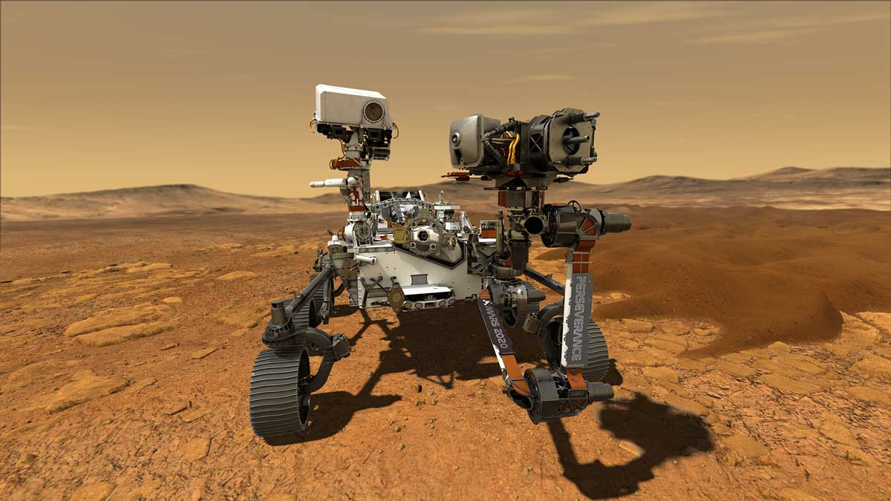
Introduction
2020 Lockdown Period and Virtual world
Preserverance Rover- NASA’s Mars Mission
XR is not a device but its a trending technology

Slide 4
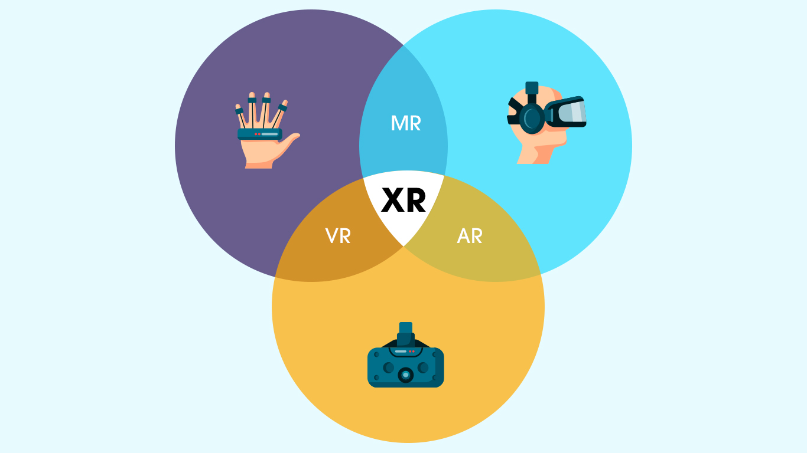
XR- Extended Reality
Emerging Technology
Combining AR, VR, MR, AI, ML
Virtual world entities in Real Environment

Slide 5
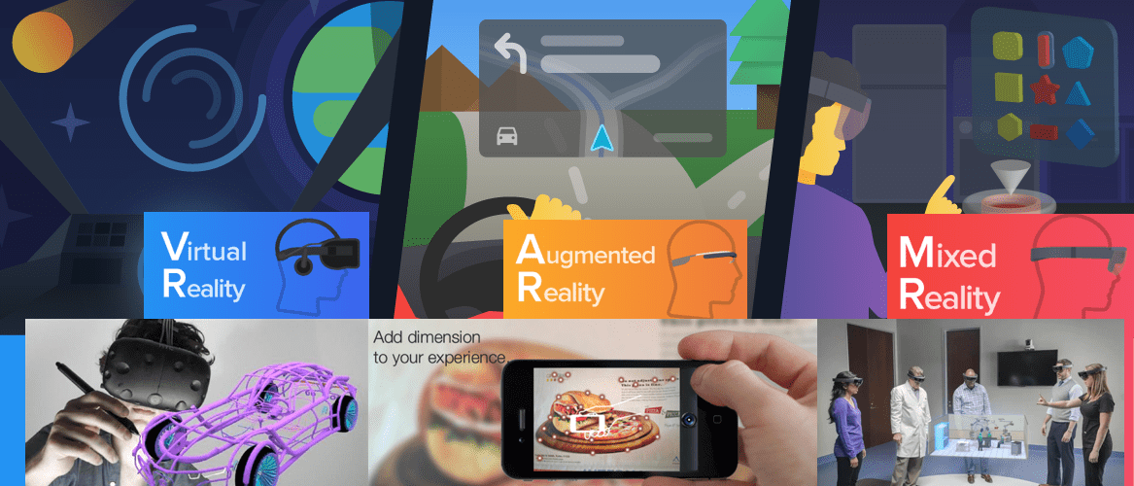
History
The history goes back a long time, a computer scientist in Sutherland creates a VR headset early 90’s.
Arrival of AR, VR & MR

Slide 6
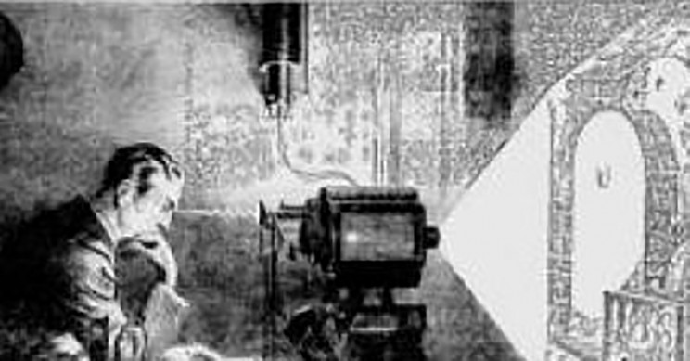
Research
Tesla’s Thought Machine
Environment with AI, ML, Connected Devices

Slide 7
Advantages
Connected world
Boost Online Trade and Business
Healthcare Development
Virtual environments and Prototype
Scientific Deployment
Educational World

Slide 8
Disadvantages
Reduced Social Engagement
Compromised Privacy
Physical Harm
High Cost

Slide 9
Conclusion
Almost every industry is using it to meet specific objectives around training, learning, marketing, and customer experience.
Thus, we can safely say that, as an emerging technology, XR or Extended Reality is proving to be a valuable asset to clients and organizations worldwide.

Slide 10
Reference
[1].http://www.wikipedia.com
[2].http://www.google.com
[3].http://www.forbes.com

Slide 11
Thank You

