Slide 1
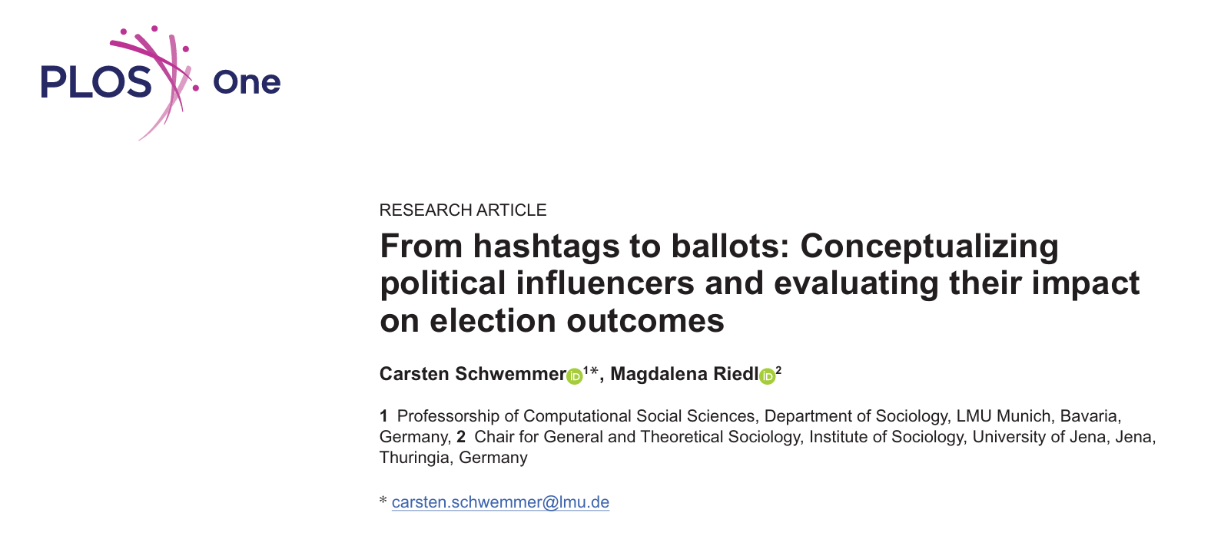
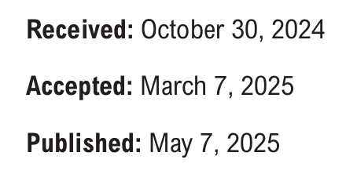
Replication Project
Hanyu Li
April 2, 2026
Notes:
I replicated the study by Carsten Schwemmer and Magdalena Riedl, published in 2025 in PLOSOne, Fromhashtags to ballots: Conceptualizing political influencers and evaluating their impact on election outcomes.

Slide 2

Content
Original Research
Background
Research Question
Methodology
Replication
Descriptive Analysis(Figures）
Logistic Regression Analysis
Extension
Likelihood Ratio Test
Multinomial Logistic Regression
Fit and Prediction

Slide 3
Background
Self-Selection in Online Politics
Traditional online political discourse is often "self-selected," dominated by institutional elite influencers
(e.g. politicians or journalists ) and highly interested citizens.
The Rise of Grassroots Political Influencers
A new class of grassroots influencers has emerged, building massive followings through daily lifestyle content rather than official political backgrounds.
The Dual Nature of Influencers
During election periods, these influencers reveal a dual nature :
strategically blending commercial monetization with political messaging to reach ordinary users.

Slide 4
Core Research Questions
Taking grassroots political influencers as research subjects, the researchers hoped to understand…
Instagram Post Analysis | Description
RQ2: Political Content Strategy To what extent do political influencers support or disapprove political actors or events?
RQ3: Commercial Monetization How much commercial advertisement is integrated into the posts of political influencers??
Questionnaire Survey | Regression
RQ4: Audience Reach Which voters follow these influencers? Can they reach audiences with low political interest?
Notes:
The objective is to analyze how these influencers manage the balance between their political and commercial posts through Instagram Post Analysis
and to evaluate whether they can successfully reach voters who normally have low interest in politics through logistic regression analysis

Slide 5
Data Source
Instagram Post Analysis | Description
Sample Size: 2,915 posts from 98 German grassroots influencers (after data cleaning).
Method: Data scraped via Instagram API and cross-coded by 357 human coders for accuracy.
Core Variables: Post categories (political vs. commercial) and weekly engagement/traffic metrics.
Questionnaire Survey | Regression
Sample Size: 2,891 individual respondents (N = 2,891) from the 2021 German Federal Election.
Method: An online follow-up survey measuring social media habits and political participation.
Core Variables: Demographics (age/edu), political interest, and motivations for using social media.

Slide 6
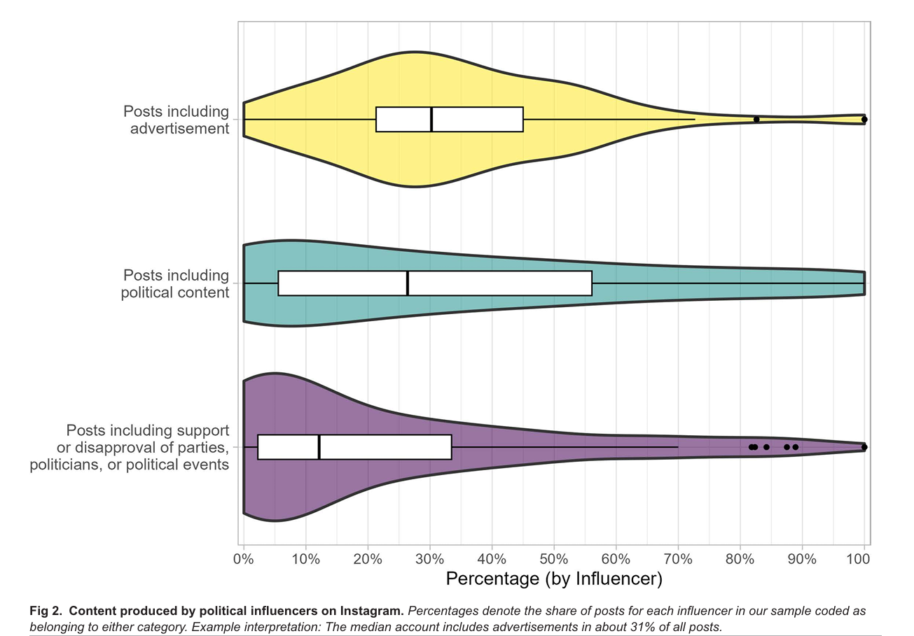
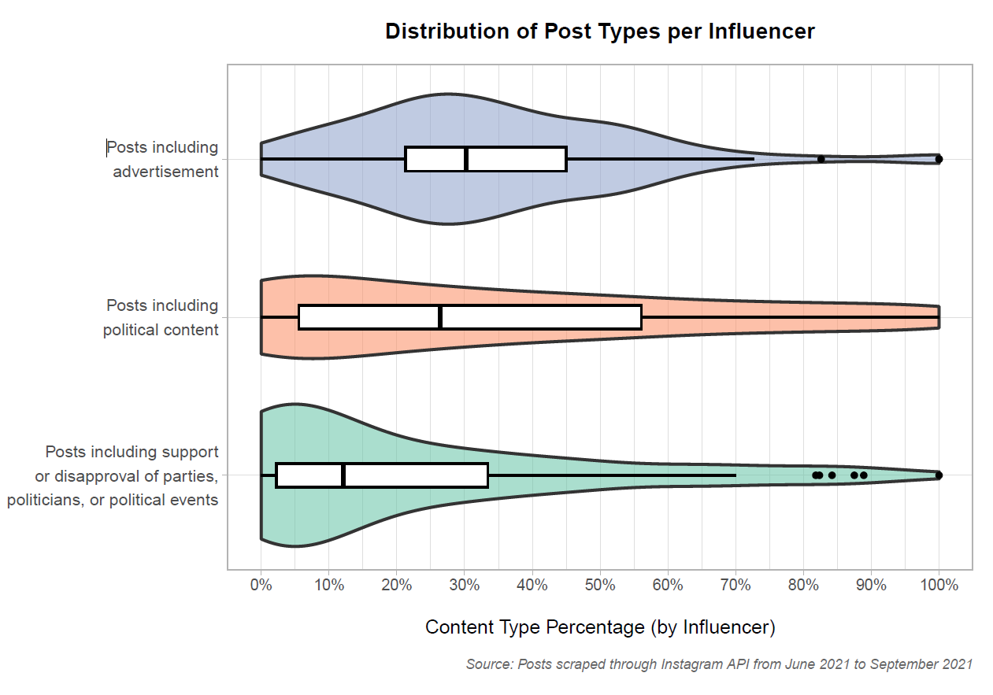
Replication: Descriptive Analysis
RQ2: Political Content Strategy
Balancing commercial monetization with political messaging.
Rarely taking an explicit stance of support or opposition toward political actors.
Original
Replication
Notes:
Influencer content exhibits a dual nature, strategically balancing commercial monetization with political messaging.
While frequently sharing political topics, influencers rarely take an explicit stance of support or opposition toward political actors.
The width of the violin represents influencer density at each level; a wider section indicates a higher concentration of influencers at that specific level.

Slide 7
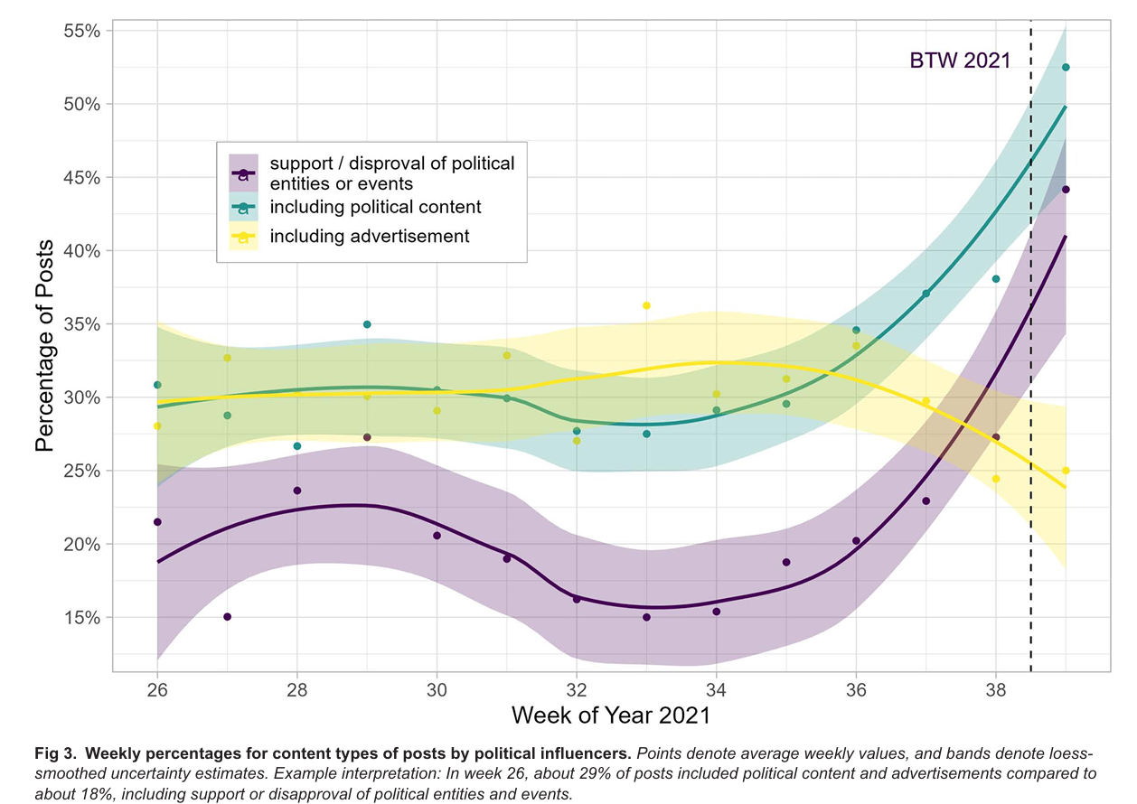
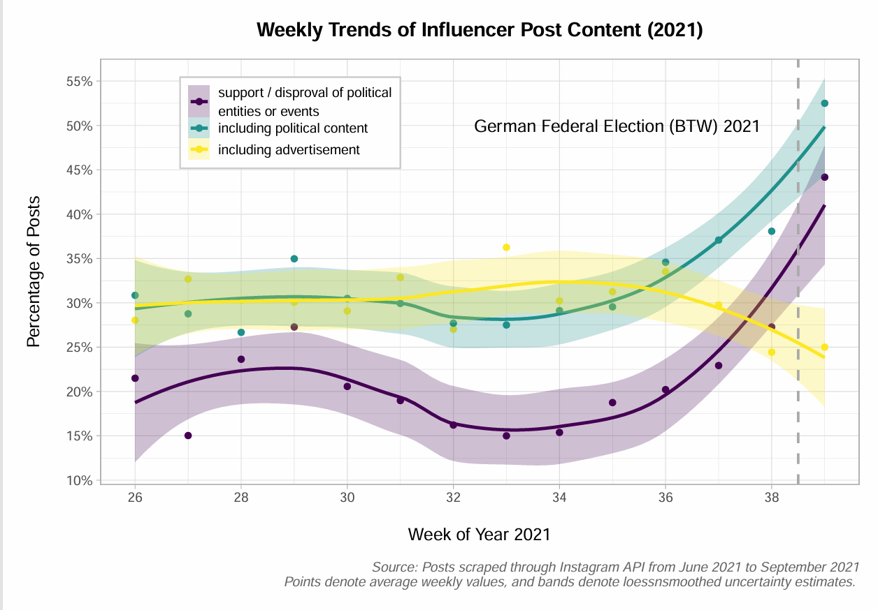
Replication: Descriptive Analysis
RQ2: Political Content Strategy
Time-series analysis reveals a sharp increase in political content as the BTW2021 approaches.
*Bands around the lines represent the 95% confidence intervals
Original
Replication
Notes:
Researchers also done a the temporal analysis to show these influencers don‘t just post political content randomly.
As the election date nears, they significantly increase their political messaging，especially those with a clear political stance.
bands around the lines represent the 95% confidence intervals, indicating the statistical uncertainty of the estimated trends.

Slide 8
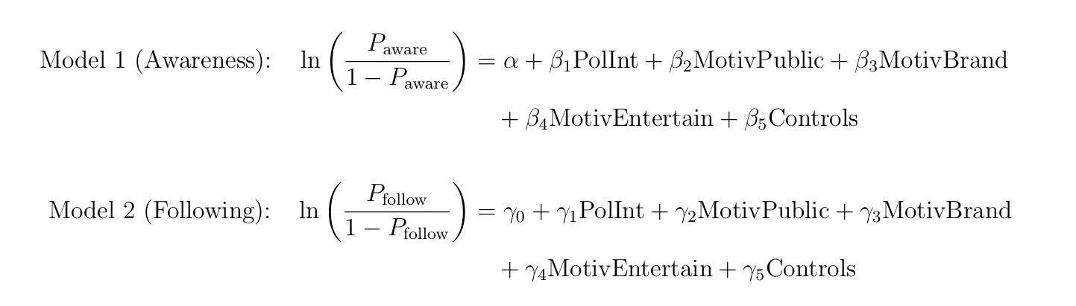
Replication: Logistic Regression
RQ4: Which voters follow these influencers? Can they reach audiences with low political interest?
Hypothesis: Users without political motivation also become aware of or follow political influencers (motivation coefficients > 0).
DV
Awareness: Binary (0 = unaware, 1 = aware), unawares the baseline.
Following : Binary (0 = not following, 1 = following), not following as the baseline.
IV
Political Interest: Continuous
Likert scale (1 = low, 5 = high).
Social Media Motivations: Continuous
3 separate Likert scale variables (1-5) measuring motivations for following① celebrities ② brands ③ entertainment.
Controls
Age: Continuous in years.
Education: Categorical (1 = low, 2 = mid, 3 = high), low as the baseline.
SM Platforms Used: Continuous ,measuring the count of active social media platforms
Notes:
1. To answer RQ4—who follows these influencers ,the researcherran two logistic regression models. They used different dependent variables: Model 1 predicts Awareness of Influencer, and Model 2 predicts Following. Both are binary variables, measured as 0 (No) or 1 (Yes).
2. Independent Variables include Political Interest: Both models share the same independent variables. Political Interest,is measured on a 1 to 5 Likert scale (from low to high).
3. Motivations of using social media. This is measured by three separate 1 to 5 Likert scales: the motivation to follow public figures, follow brands, and seek entertainment.
4. Control Variables are the user's Age, Education level, and the number of social media platforms they use.
5. The Core Hypothesis: core hypothesis is that users without political motivation can still become aware of, or follow, political influencers. Mathematically, this means we expect the coefficients for these non-political motivations to be greater than zero.

Slide 9
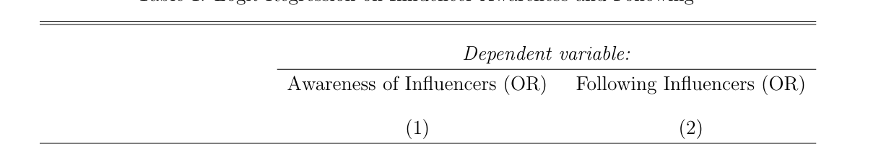
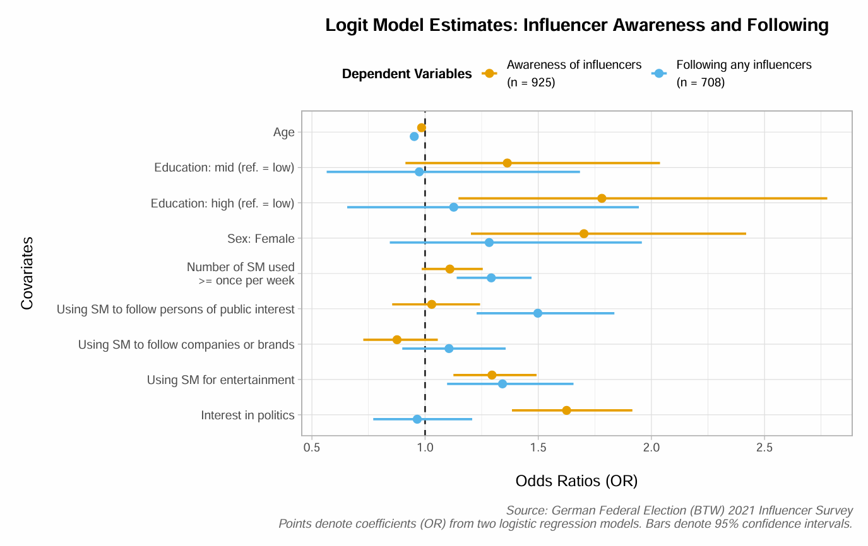
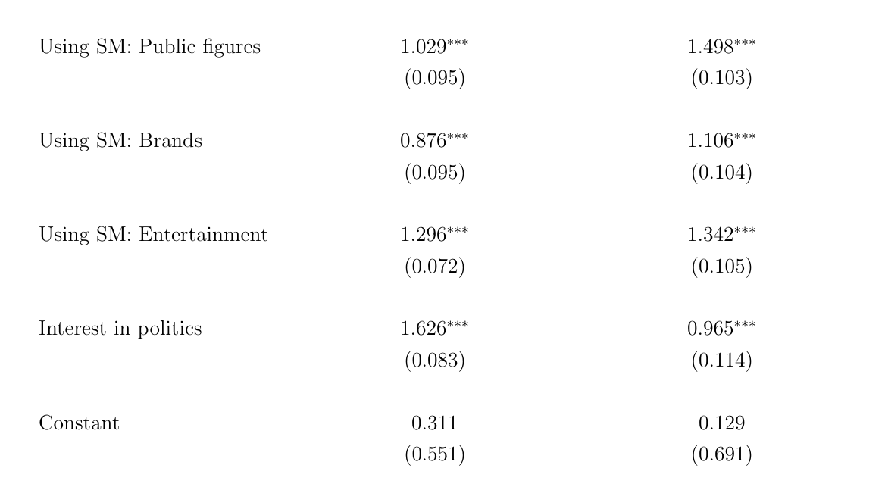
Replication: Logistic Regression
Non-political social media motivations are positively associated with being aware of and following political influencers.
Control Variables …… ……
e.g. Holding all other covariates constant, a one-unit increase in entertainment motivation multiplies the expected odds of following a political influencer by a factor of 1.34.

Slide 10
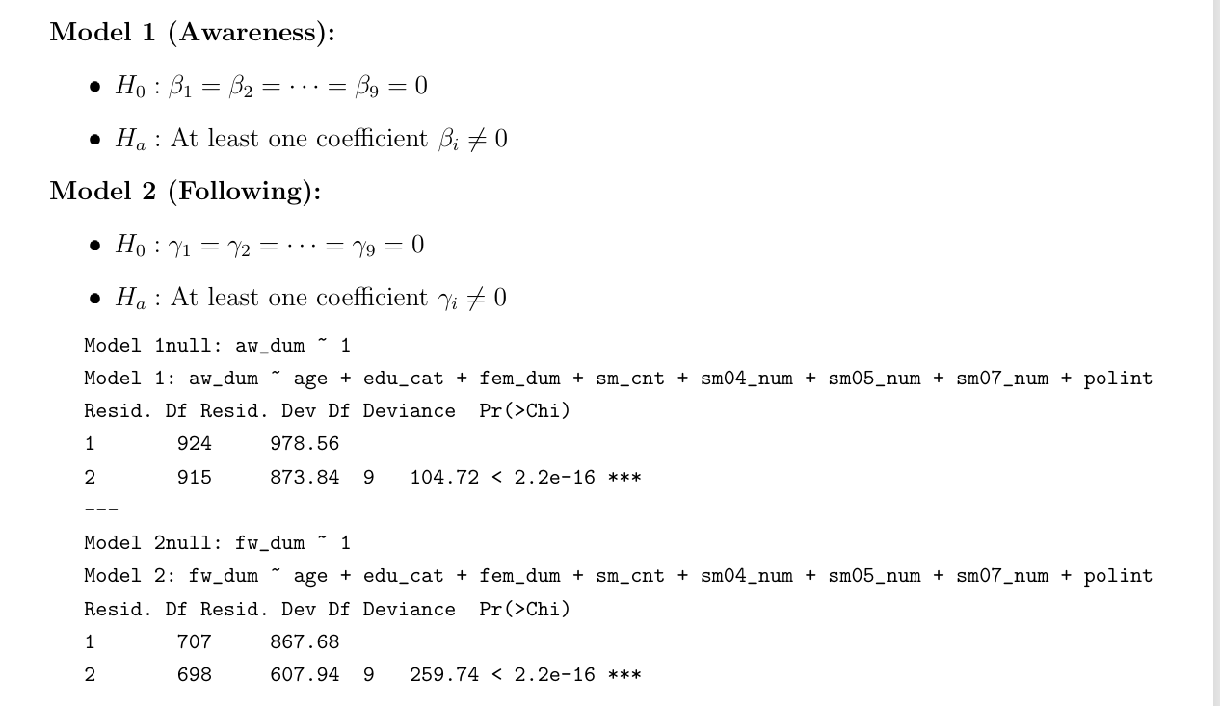
Extension 1
Likelihood Ratio Test (Evaluate model fitness)
The LRT results provide sufficient evidence to reject the null hypothesis (H0) for both models (p < 0.001).
In both cases, at least one independent variable has a non-zero effect.
The models with predictors possess significantly greater explanatory power than random intercept-only models.

Slide 11
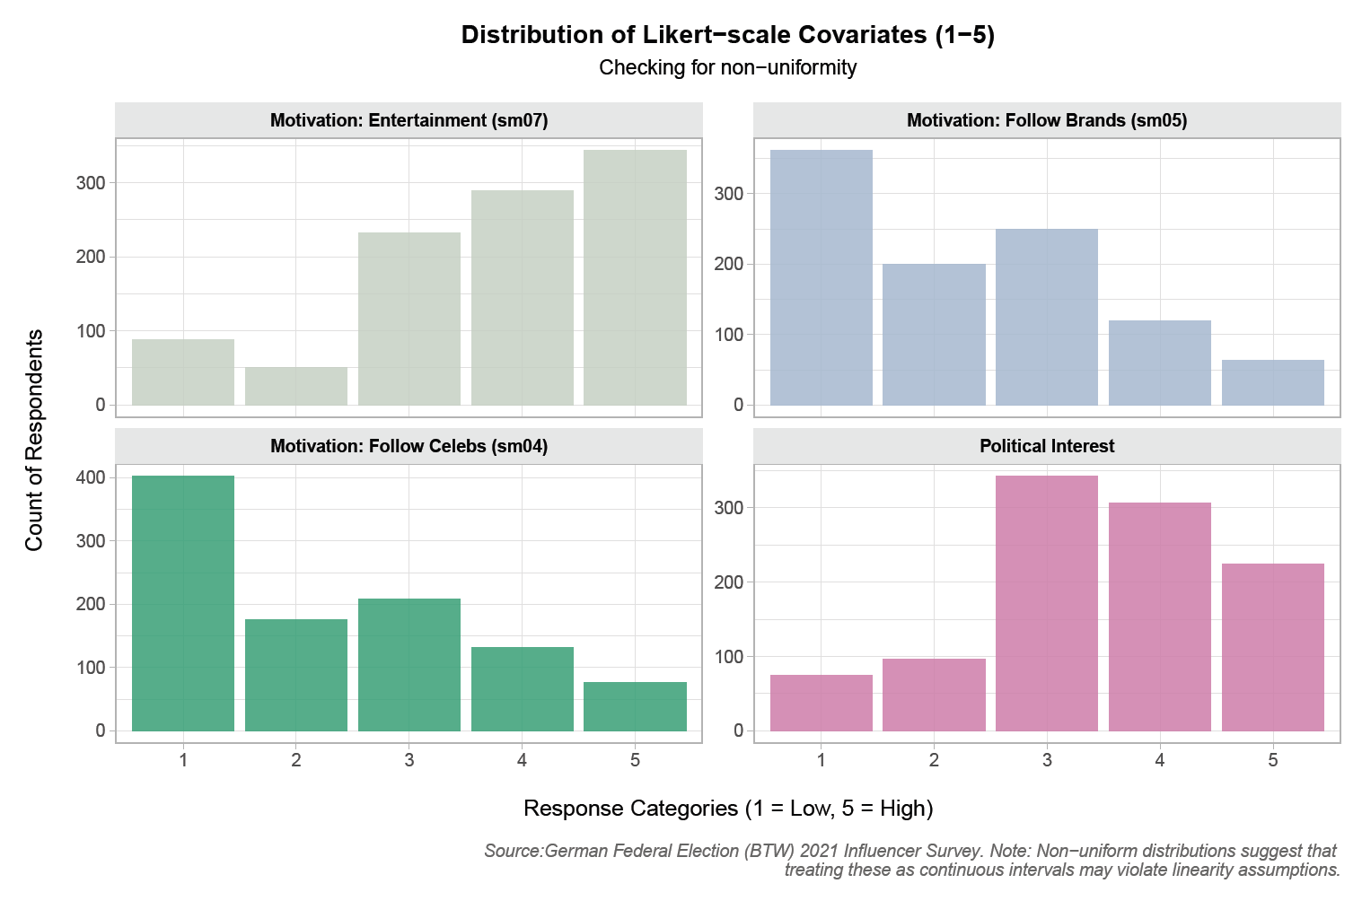
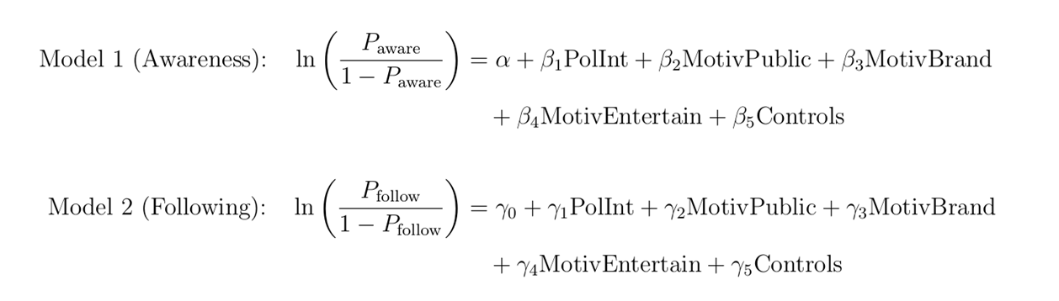
Extension 2
Multinomial Regression（variables recoding)
Linearity Violation
Modeling 1-5 Likert scales (e.g., political interest, SM use motivations) as continuous predictors violates the assumption of linearity.
Lack of Integration
Running separate models for conceptually similar outcomes (awareness vs. following) fragments the interpretation.

Slide 12
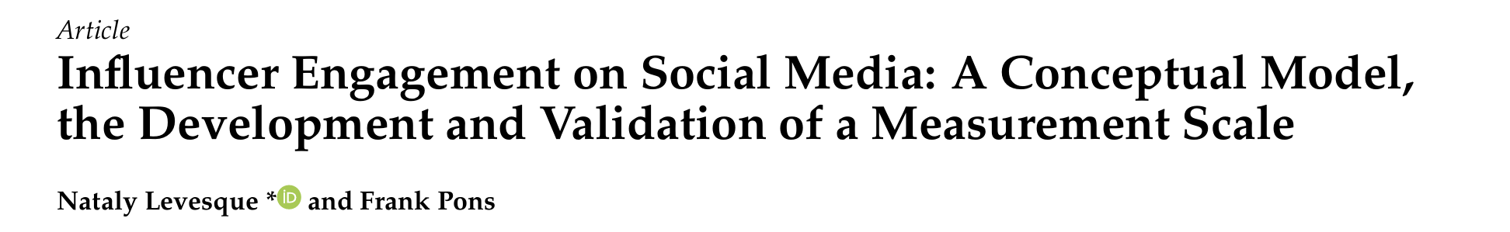
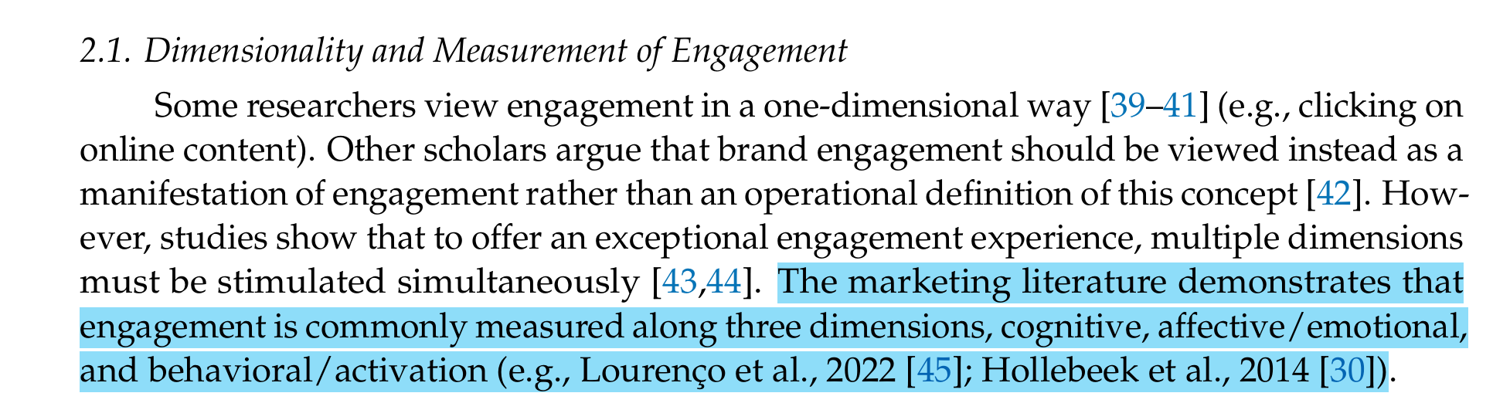
Extension 2
Multinomial Regression（variables recoding)
DV: Political Influencer Engagement
Original Status | → | New Category (Engagement Level)
Not Aware + Not Following | → | Level 0: None
Aware + Not Following | → | Level 1: Aware
Aware + Following | → | Level 2: Engaged
IV1:Entertainment and Consumption Motivation
Mean score of Public Figures , Brands ,Entertainment Motivation
→ Low (< 3) | Moderate (3–4) | High (≥4)
IV2:Political Interest
Recoded the 1–5 Likert scale into three levels
→ Low (< 3) | Moderate (3–4) | High (≥4)

Slide 13
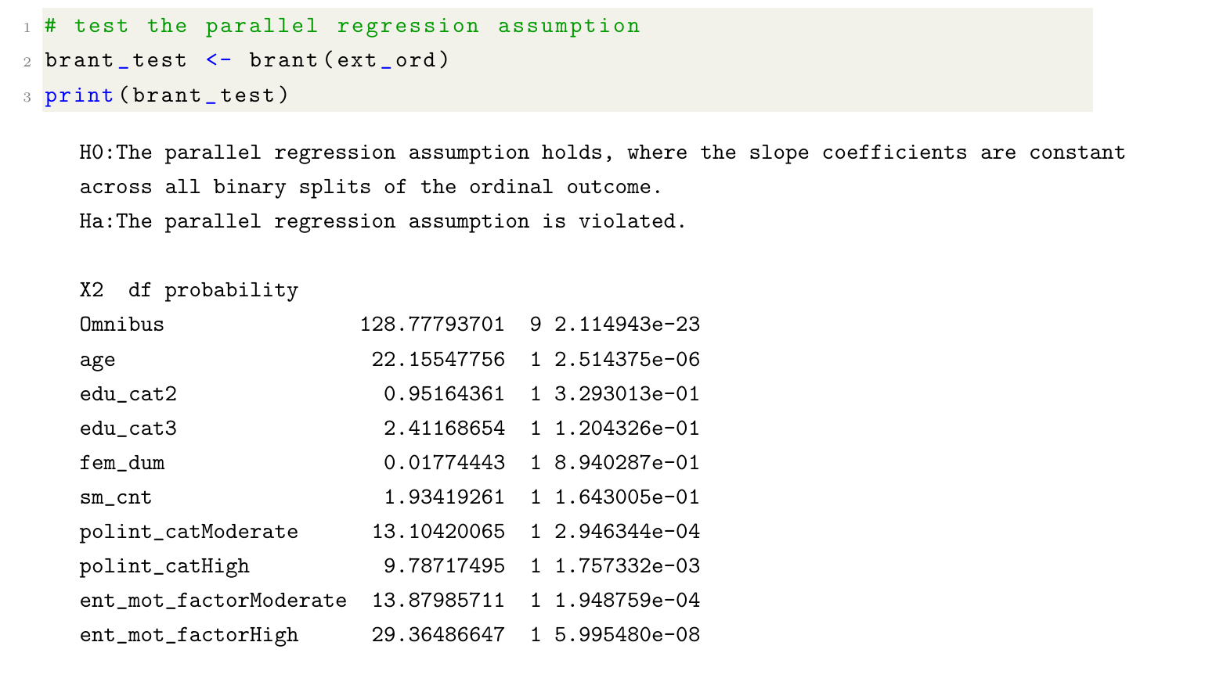
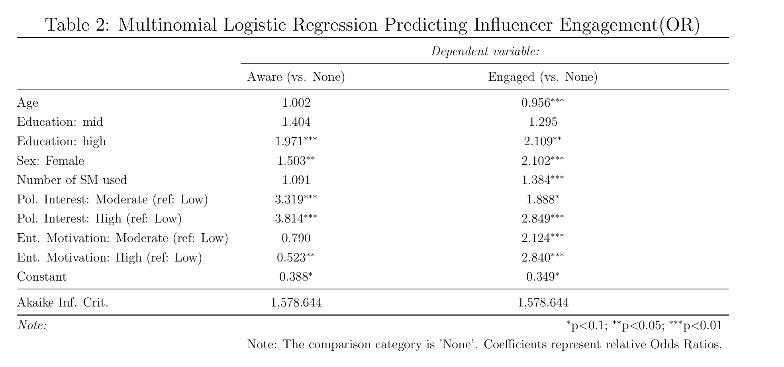
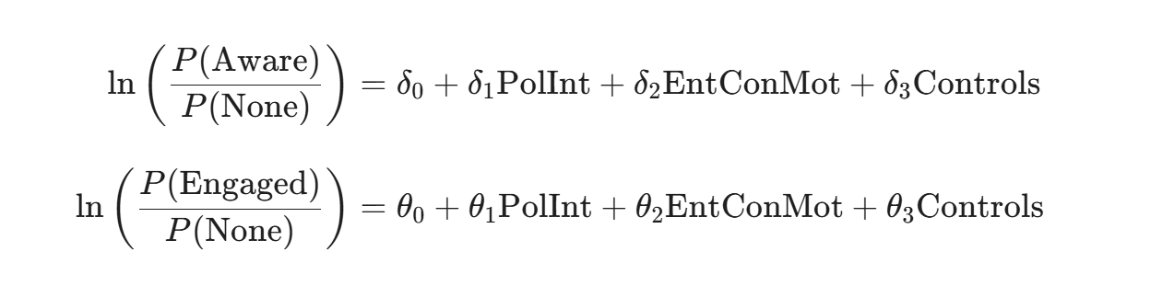
Extension 2
Multinomial Regression（variables recoding)
Violating parallel regression assumption
Using unordered multinomial regression
The general entertainment&consumption motivations are positively associated with political influencer engagement level ?

Slide 14
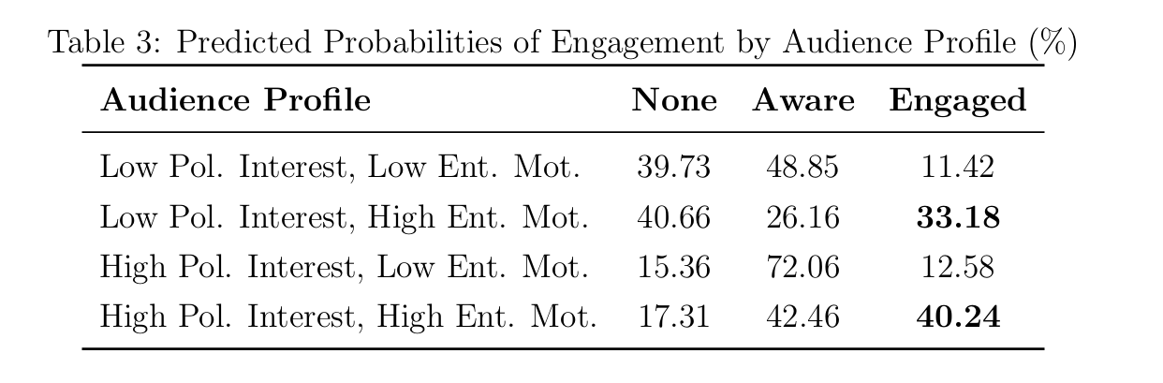
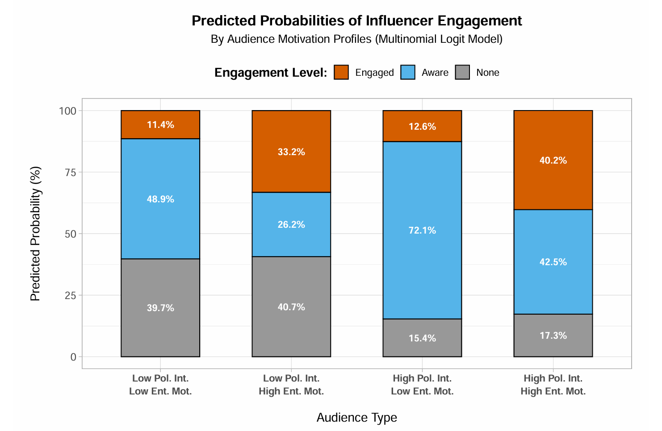
Extension 2
Interpretation by probability
Predicting Engagement Across Four Audience Profiles
Political Interest
(For People with High Entertainment/Consumption Motivation)
Shift: Low →High Political Interest
Awareness: increase16.3% (to 42.5%)
Engagement: increase 7.0% (to 40.2%)
Entertainment/Consumption Motivation
(For People with Low Political Interest)
Shift: Low →High Entertainment/Consumption Motivation
Awareness: decrease 22.7% (to 26.2%)
Engagement: increase 21.8% (to 33.2%)
Notes:
The Role of Political Interest: Among individuals with high entertainment/consumption motivation, a shift from low to high political interest increases the predicted probability of awareness by 16.3% (from 26.2% to 42.5%) and engagement by 7.0% (from 33.2% to 40.2%).
The Reach of Entertainment Motivation: Among those with low political interest, changing from low to high entertainment/consumption motivation results in a 22.7% decrease in predicted awareness (from 48.9% to 26.2%) but a significant 21.8% in crease in active engagement (from 11.4% to 33.2%).
This indicates that political influencers can effectively reach the general public by balancing political messag ing with non-political personal content, successfully capturing users who do not primarily use social media for political purposes.

Slide 15
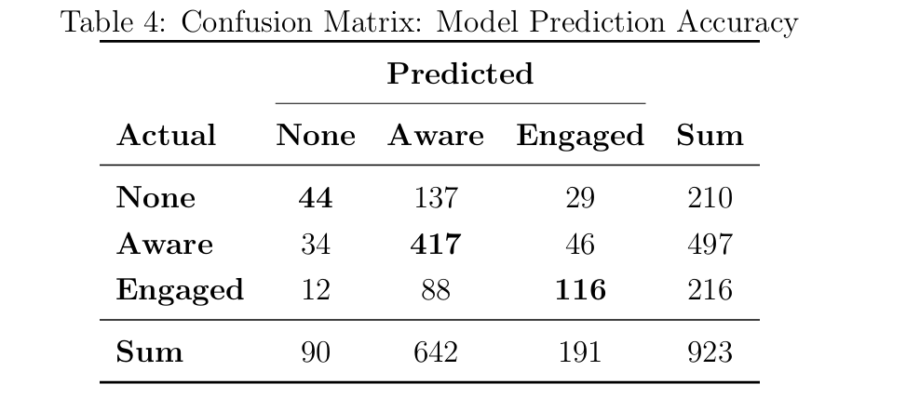
Extension 2
Fit Evaluation
Overall accuracy rate: 62.51%
Notes:
The overall accuracy rate was calculated 62.51%, outperforming the null model baseline.
This shows that the model possesses certain explanatory power and provides a robust fit for predicting different levels of political influencer engagement.

Slide 16

Q&A

