Slide 1
Chapter 1-2

Slide 2
Question1
( ) 1. From the view of computer architecture, the machine attributes that assembler programmer can see are _______.
A. the functions to be accomplished by computer software.
B. the organization of all computer hardware.
C. the hardware abstraction to be used when programming.
D. the hardware implementation of the various computer components
Notes:
C

Slide 3
Question2
( )2 . Which of the following descriptions about “Computer architecture” is true?
Computer architecture refers only to instruction set architecture design.
Computer architecture means the implementation of a machine, which has two components: organization and hardware.
Computer architecture design doesn’t need to provide support to compilers.
Computer architecture is intended to cover all three aspects of computer design ---- instruction set architecture, organization and hardware.
Notes:
D

Slide 4
Computer Design Engineering life cycle
Evaluating Existing
Systems for
Bottleneck(app.B)
Benchmarks(1.8)
User requirement
Analysis(1.2)
Quantitative Principles
1.9
Technology Trend 1.4
Power Trend 1,5
Cost Trend 1.6
Application Trend 1,7
Implement Next
Generation System
Simulate New
Designs and
Organizations
Workloads
Evaluating for price peformance(1.8)
Notes:
Requirement Analysis:
Market analysis: who you will sell 4-1.2
desktop, server, embedded system, HPC
Different markets has different driven motivations.
When design a desktop, it aims to obtain best price-performance.
For the servers, dependability is critical, then the scalability, and throughput.
For the embedded computer systems, price is a key factor, while real-time performance is important . And power efficiency and memory size is always under consideration.
2. Functional requirement: 4-1.3
3. Performance requirement:
4. Power
5. Unfuntional requirements: availability, dependibility 1.7
7. Cost/price

Slide 5
Topics in Chapter
1.1 Introduction
1.2 Classes of computers
1.3 Defining computer architecture and What’s the task of computer design?
1.4 Trends in Technology
1.5 Trends in power in Integrated circuits
1.6 Trends in Cost
1.7 Dependability
1.8 Measuring, Reporting and summerizing Perf.
1.9 Quantitative Principles of computer Design
1.10 Putting it altogether

Slide 6
Classification-market
Embedded system
2010s
19 billion
Mainframe
1960s
PC
2010
350 million
Mini-
Supercomputer
1970s
Mini-
Computer
1970s
Supercomputer
1970s
Work-
Station
1980s-2000s
personal mobile device
2010s
1.8 billion
Server
2010s
20 million
Massively Parallel Processors
1980s

Slide 7
5 computing markets
Feature | PMD | Desktop | Server | Clusters | Embedded
Price of system | $100-$1000 | $300-$2500 | $5000 -$10,000,000 | $100000-$200,000,000 | $10 -$100,000
Price of microprocessor module | $10-$100 | $50-$500 per proc. | $200 -$2,000 per proc. | $50-$250 | $0.01 -$100 per proc.
Critical system design issues | Cost, energy, Media perf. responsiveness | Price-perf., Energy, Graphics perf. | Throughput, availability, Scalability, energy | Price-perf., Throughput, energy proportionality | Price, energy, application-specific perf.
Notes:
Personal mobile device

Slide 8
Personal Mobile Devices
Wireless devices with multimedia user interfaces
Application
Web-based， media-oriented
Responsiveness， predictability
Requirement:
Cost, energy efficiency ( battery, no-fan)
Real-time performance
Minimize memory → flash memory

Slide 9
Desktop Computing
The first, and still the largest market in dollar terms, is desktop computing. （laptop > 50% market of desktop )
Requirement:
Optimized price-performance
highest-perf. & cost-reduced Microprocessor appear first in desktop systems
New challenges:
Web-centric, interactive application
How to evaluate performance ?

Slide 10
Servers
The role of servers to provide larger scale and more reliable file and computing services grew.
Requirement:
First, availability is critical.
A second key feature of server systems is an emphasis on scalability. →memory,storage and I/O bandwidth is crucial.
Lastly, servers are designed for efficient throughput.

Slide 11
Cost with downtime
Application | Cost of downtime per hour | 1% 87.6 hrs/yr | 0.5% 43.8 hrs/yr | 0.1% 8.8 hrs/yr
Brokerage operations | $6,450,000 | $565,000,000 | $283,000,000 | $56,500,000
Credit card authorization | $2,600,000 | $228,000,000 | $114,000,000 | $22,800,000
Package shipping services | $150,000 | $13,000,000 | $6,600,000 | $1,300,000
Home shopping channel | $113,000 | $9,900,000 | $4,900,000 | $1,000,000
Catalog sales center | $90,000 | $7,900,000 | $3,900,000 | $800,000
Airline reservation center | $89,000 | $7,900,000 | $3,900,000 | $800,000
Cellular service activation | $41,000 | $3,600,000 | $1,800,000 | $400,000
Online network fees | $25,000 | $2,200,000 | $1,100,000 | $200,000
ATM service fees | $14,000 | $1,200,000 | $600,000 | $100,000

Slide 12
Cluster/Warehourse-Scale Computers
SaaS (Search,social networking, video sharing, multiplayer games, online-shopping)
WSC—tens of thousands of servers act as one
Requirements:
Price-performance, Power ( 10% saves $7M )
Availability is critical
Scalability ( Note the difference with server )
(Note the difference with supercomputer)

Slide 13
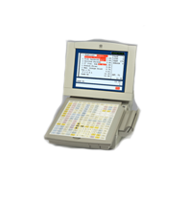
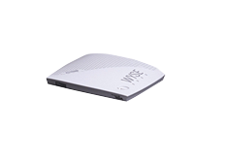


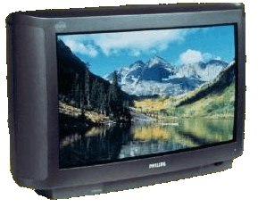
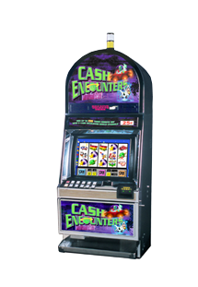
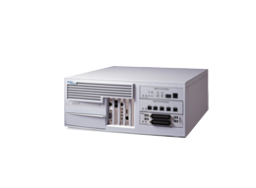
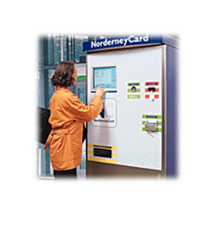
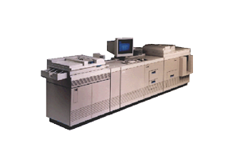
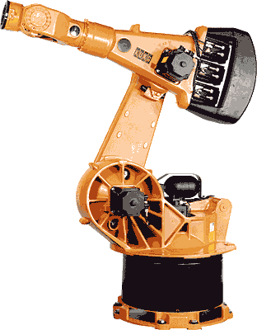
Embedded systems
Retail POS
Thin Clients
Set-Top-Box
Gateway/Media Store
Network Devices
Intel® Architecture
Intel® XScale™
Kiosk/ATM
Game Platforms
Office Automation
Industrial Automation

Slide 14
Embedded Computers
The fastest growing portion of the computer market with widest spread of processing power and cost.
Requirements
Real time performance (soft & hard)
Strict resource constraints
limited memory size, lower power consumption,...
The use of processor cores together with application-specific circuitry.
DSP, mobile computing, mobile phone, Digital TV

Slide 15
Other classification
Quantum computer vs Chemical computer,
Scalar processor vs Vector processor
Non-Uniform Memory Access (NUMA)/ UMA
Register machine vs Stack machine vs Accumulater machine
Harvard architecture vs Von Neumann architecture
/Non Von Neumann architecture （ 类脑芯片：达尔文2）
RISC vs. CISC
Cellular architecture
Notes:
Cellular architecture takes multi-core architecture design to its logical conclusion, by giving the programmer the ability to run large numbers of concurrent threads within a single processor. Each 'cell' is a compute node containing thread units, memory, and communication. Speed-up is achieved by exploiting thread-level parallelism inherent in many applications.

Slide 16
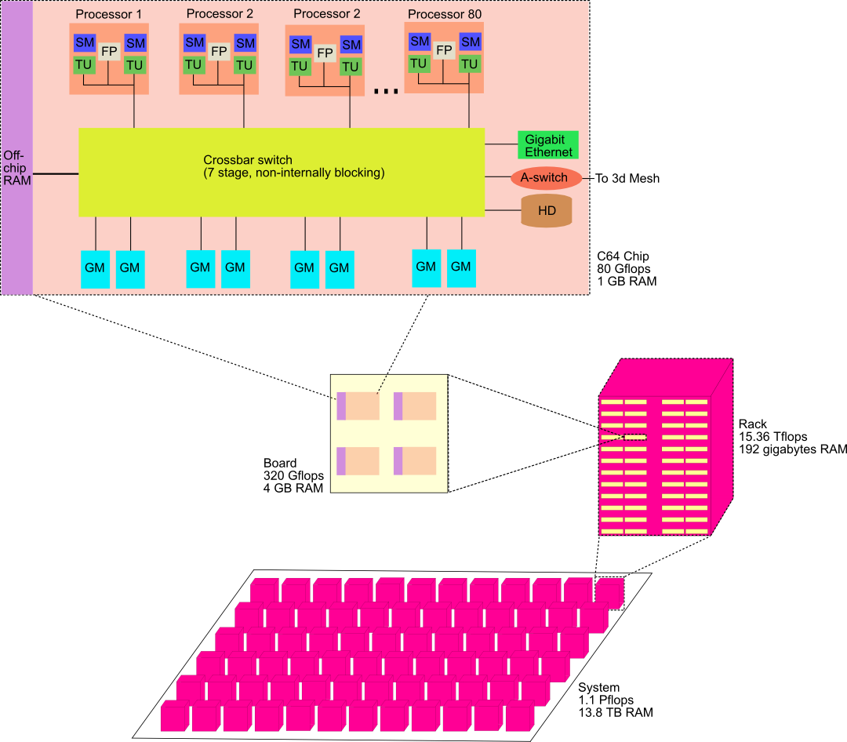
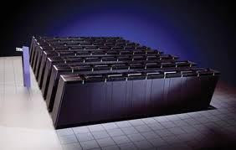
Cellular architecture
Cyclops64 (known as Blue Gene/C)
IBM's Cell microprocessor is the first one to reach the market.
Cellular architecture takes multi-core architecture design to its logical conclusion, by giving the programmer the ability to run large numbers of concurrent threads within a single processor. Each 'cell' is a compute node containing thread units, memory, and communication. Speed-up is achieved by exploiting thread-level parallelism inherent in many applications.

Slide 17
Classes of Parallelism and Parallel Architecture
Two kinds of parallelism in application
Data-level Parallelism（DLP）
Task-level Parallelism （TLP）
Hardware exploit in 4 major ways
Instruction level Parallelism
Vector Architecture and GPUs
Thread-Level Parallelism
Request-Level parallelism

Slide 18
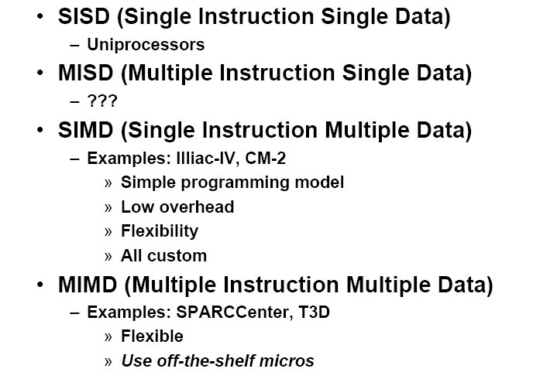

Classes of computers
Flynn’s Taxonomy: A classification of computer architectures based on the number of streams of instructions and data
Notes:
Proposed at 1966.
^ Flynn, M., Some Computer Organizations and Their Effectiveness, IEEE Trans. Comput., Vol. C-21, pp. 948, 1972.
^ Duncan, Ralph, "A Survey of Parallel Computer Architectures", IEEE Computer. February 1990, pp. 5-16.

Slide 19
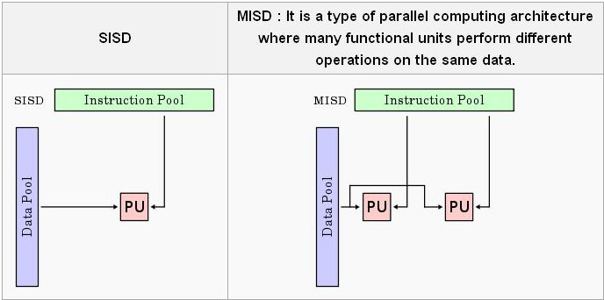
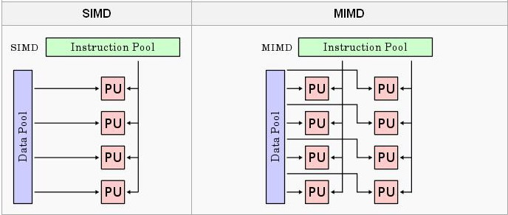
classification

Slide 20
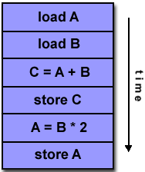
SISD
A serial (non-parallel) computer
Single instruction: only one instruction stream is being acted on by the CPU during any one clock cycle
Single data: only one data stream is being used as input during any one clock cycle
Deterministic execution
This is the oldest and until recently, the most prevalent form of computer
Examples: most PCs, single CPU workstations and mainframes

Slide 21
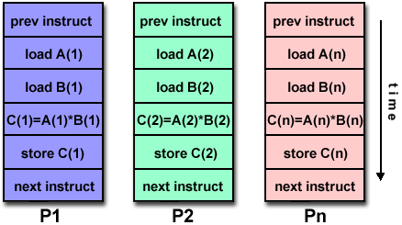
SIMD
A type of parallel computer
Single instruction: All processing units execute the same instruction at any given clock cycle
Multiple data: Each processing unit can operate on a different data element
This type of machine typically has an instruction dispatcher, a very high-bandwidth internal network, and a very large array of very small-capacity instruction units.
Best suited for specialized problems characterized by a high degree of regularity,such as image processing.
Synchronous (lockstep) and deterministic execution
Two varieties:
Processor Arrays: Connection Machine CM-2, Maspar MP-1, MP-2
Vector Pipelines: IBM 9000, Cray C90, Fujitsu VP, NEC SX-2, Hitachi S820

Slide 22
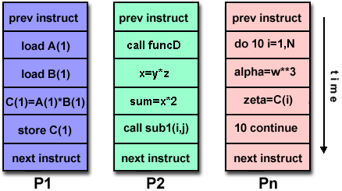
MIMD
Currently, the most common type of parallel computer. Most modern computers fall into this category.
Multiple Instruction: every processor may be executing a different instruction stream
Multiple Data: every processor may be working with a different data stream
Execution can be synchronous or asynchronous, deterministic or non-deterministic
Examples: most current supercomputers, networked parallel computer "grids" and multi-processor SMP computers - including some types of PCs.

Slide 23
Topics in Chapter
1.1 Why take this course ?
1.2 Classes of computers in current computer market
1.3 Defining computer architecture and What’s the task of computer design?
1.4 Trends in Technology
1.5 Trends in power in Integrated circuits
1.6 Trends in Cost
1.7 Dependability
1.8 Measuring, Reporting and summerizing Perf.
1.9 Quantitative Principles of computer Design
1.10 Putting it altogether

Slide 24
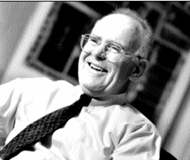

Technology Trends
Moore Law
In 1965 he predicted that the number of components the industry would be able to place on a computer chip would double every year. In 1975, he updated his prediction to once every two years. It has become the guiding principle for the semiconductor industry to deliver ever-more-powerful chips while decreasing the cost of electronics.
Gordon Moore

Slide 25
Gordon Moore on Moore’s law
Moore’s brief Bio
http://www.intel.com/pressroom/kits/bios/moore.htm
Gordon Moore on Moore’s law
http://www.sichinamag.com/Article/html/2007-09/2007919032802.htm
Video on conversation with Moore
http://you.video.sina.com.cn/b/7076856-1282136212.html

Slide 26
Technology Trends
Integrated circuit logic technoloty
Transistor(晶体管) Density: incr. 35% per year, (4x every 4 years)
Die size: 10%-20% per year
Transistor count per chip:40-55% per year or 2x 10 to 24 months
Semiconductor DRAM
Capacity per DRAM: 25%-40% per year (2x every 2-3 years)
Memory speed: about 10% per year
Might stop and may be replaced
Semiconductor Flash – standard storage device in PMDs
Capacity per flash chip：50-60% per year （ 2x every 2 years）
15-20 times cheaper than DRAM
Magnetic Disk tech.
Desnsity: 30% p.y. Before 1990; 60% p.y. 1990-1996
100 p.y. 1996-2004 ; 30% p.y. after 2004
capacity: about 60% per year
Network
bandwidth: 10Mb ⎯⎯⎯→ 100Mb ⎯⎯⎯→ 1Gb
10 years 5 years
Designers often design for the next technology.

Slide 27
Improvement of DRAM rate
AQA Edition | Year | DRAM growth | Characterization of impact on DRAM capacity
1 | 1990 | 60% / year | Quadrupling every 3 years
2 | 1996 | 60% / year | Quadrupling every 3 years
3 | 2003 | 40%-60%/ year | Quadrupling every 3 to 4 years
4 | 2007 | 40% / year | Doubling every 2 years
5 | 2011 | 25% - 40% / year | Doubling every 2 - 3 years
Notes:
4倍的

Slide 28
Import Notes
A rule of thumb
Cost decrease rate ~ density increase rate
Technology thresholds
Technology improves continuously, an impact of this improvements can be in discrete leaps.

Slide 29
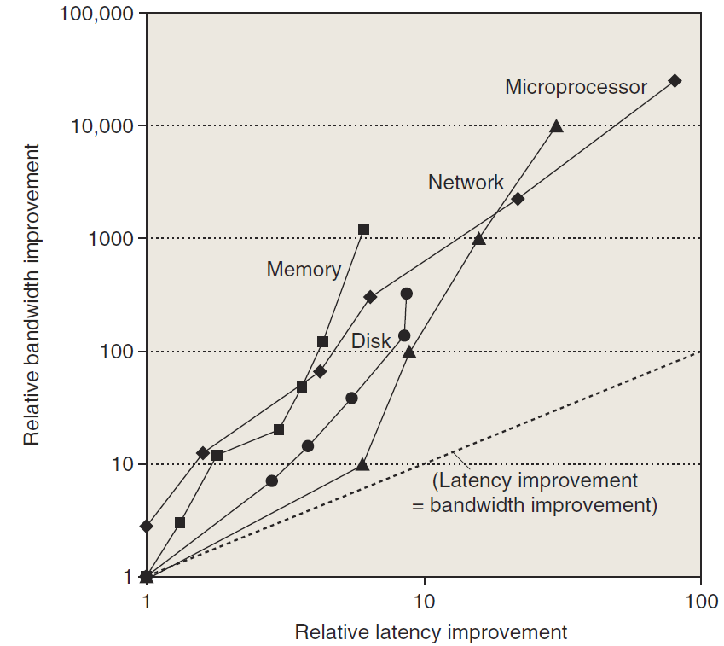
Perf. Trends: Bandwidth over latency
Bandwidth/throughput: total amount of work done in a given time
Latency/response time: the time between the start and the completion of an event.
Rule of thumb
Bandwidth grow rate ~ improvement in latency²
10，000X—25，000X in Bandwidth
30X—80X in latency

Slide 30
Performance milestones in microprocessor

Slide 31
Challenges for IC Tecnology
IC characteristic: feature size(特征尺寸）
10 microns in 1971 → 0.18microns in 2001
→ 0.09 microns in 2006 → 0.032 microns in 2011
7nm is under way.
Rule of thumb: transistor perf. Improves linearly with decreasing feature size.
IC density improvement is both opportunity and Challenge:
signal delay for a wire increase in proportion to the product of its resistance and capacitance.
Wire delay---major design limitation

Slide 32
Bad prediction with big guy
“There is no reason anyone would want a computer in their home.”
--Ken Olson, president,
Chairman and founder of Digital Equipment Corp., 1977

