Slide 1
Lecture3: Basic Pipeline
Appendix C Pipelining: Basic and Intermediate Concepts

Slide 2
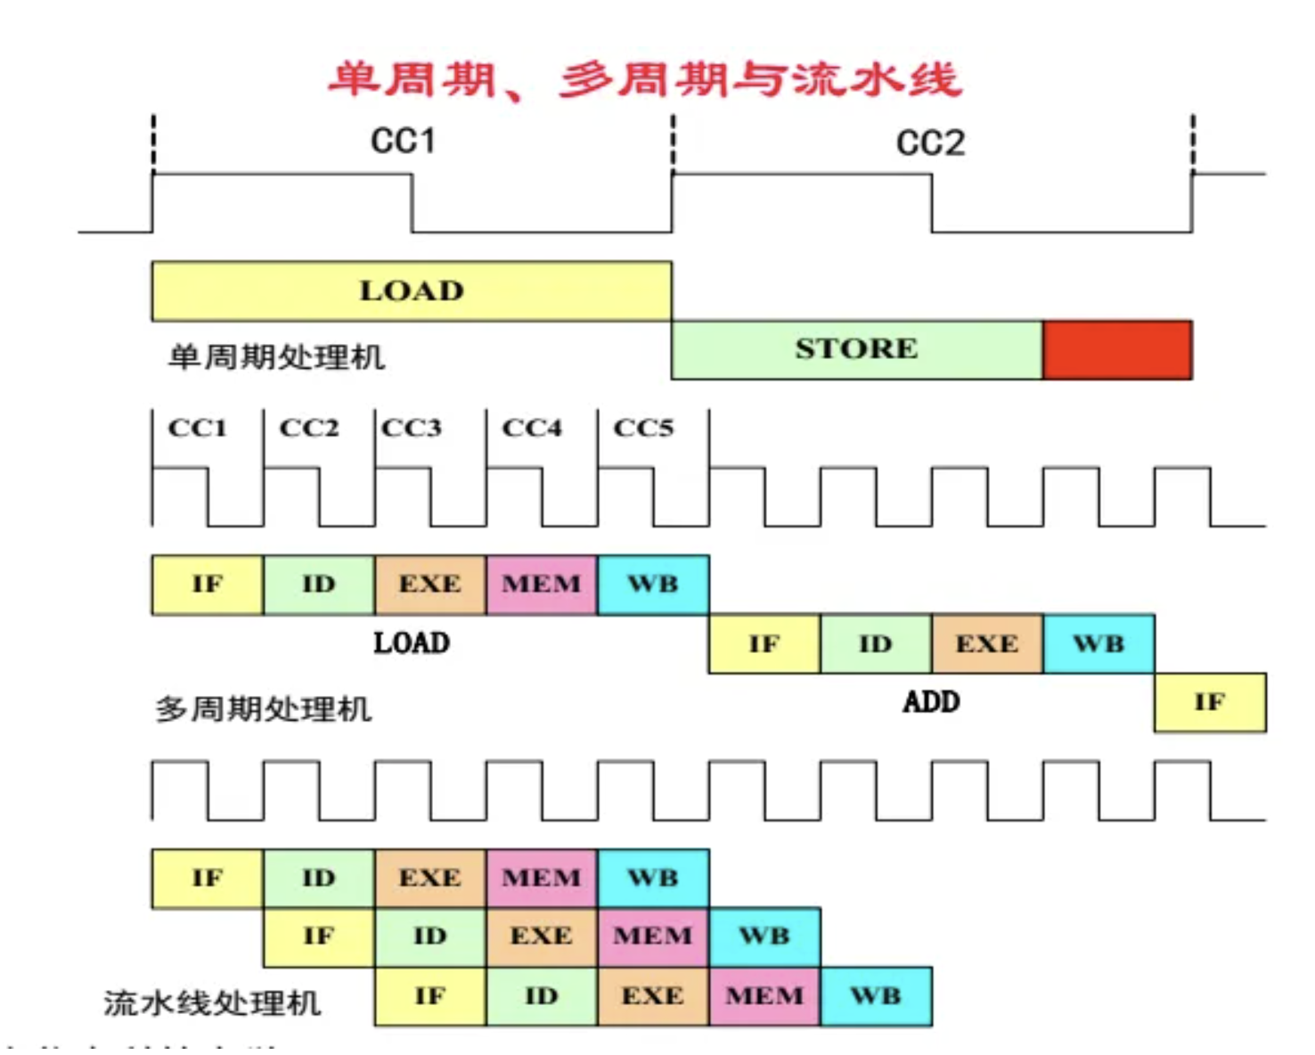
Single-cycle, multi-cycle, and Pipeline

Slide 3
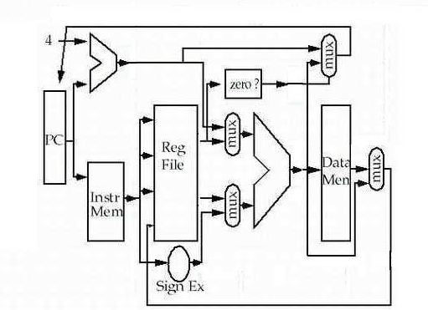
Single-cycle implementation
seldom used !

Slide 4
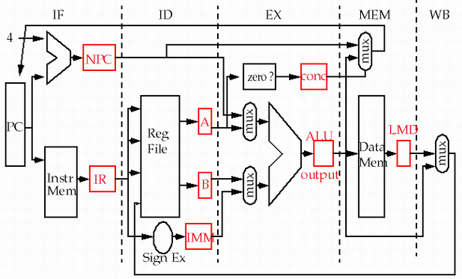
Multi-cycle implementation

Slide 5
Simplified 5 Stage Pipeline

Slide 6
How to make it fast ? Pipelining!
To decrease the clock cycle time ?
Sounds sensible, but almost reach the limitation of light speed.
What’s the problem?
Can’t do faster in sequential way, the same time the function units are always waiting doing nothing. (slow and inefficient, one instruction each time.)
Pipelining:
is a set of data processing elements connected in series, so that the output of one element is the input of the next one. The elements of a pipeline are often executed in parallel or in time-sliced fashion; in that case, some amount of buffer storage is often inserted between elements.

Slide 7
Instruction pipeline
Cycle 1
Cycle 2
Cycle 3
Cycle 4
Cycle 5
Cycle 6
Cycle 7
Cycle 8
Cycle 9
Cycle 10
Clk
I1
IF
ID
EX
MEM
WB
I2
IF
ID
EX
MEM
WB
I3
IF
ID
EX
MEM
WB
I4
IF
ID
EX
MEM
WB
I5
IF
ID
EX
MEM
WB
An instruction pipeline is a technique used in the design of computers and other digital electronic devices to increase their instruction throughput (the number of instructions that can be executed in a unit of time).
implementation technique whereby different instructions are overlapped in execution at the same time.
implementation technique to make fast CPUs

Slide 8
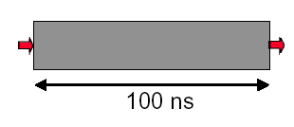
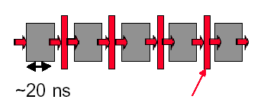
Why pipelining : overlapped
Only deal one task each time.
This task takes
“ such a long time”
Latches, called pipeline registers’ break up computation into 5 stages
Deal 5 tasks at the same time.
Can “launch” a new computation every 100ns in this structure
Can finish 10⁷ computations per second
Can launch a new computation every 20ns in pipelined structure
Can finish 5×10⁷ computations per second

Slide 9
Why pipelining : conclusion
The key implementation technique used to Make fast CPU: decrease CPU time.
Improving of Throughput ( rather than individual execution time)
Improving of efficiency for resources (functional unit)

Slide 10
What is a pipeline ?
A pipeline is like an auto assemble line
A pipeline has many stages
Each stage carries out a different part of instruction or operation
The stages, which cooperates at a synchronized clock, are connected to form a pipe
An instruction or operation enters through one end and progresses through the stages and exit through the other end
Pipelining is an implementation technique that exploits parallelism among the instructions in a sequential instruction stream

Slide 11
Pipeline Characteristics --latency vs. Throughput
Latency
Each instruction takes a certain time to complete. This is the latency for that operation.
It's the amount of time between when the instruction is issued and when it completes.
Throughput
Number of items (cars, instructions) exiting the pipeline per unit time.
The throughput of the assembly line is the number of products completed per hour.
The throughput of a CPU pipeline is the number of instructions completed per second.

Slide 12
Multi-cycle implementation vs. pipelining
Multip-Cycle Implementation: CPI=5,
Cycle 1
Cycle 2
Cycle 3
Cycle 4
Cycle 5
Cycle 6
Cycle 7
Cycle 8
Cycle 9
Cycle 10
Clk
Load
Store
R-type
IF
ID
EX
MEM
WB
IF
ID
EX
MEM
WB
Pipeline Implementation: CPI=1,
Cycle 1
Cycle 2
Cycle 3
Cycle 4
Cycle 5
Cycle 6
Cycle 7
Cycle 8
Cycle 9
Cycle 10
Clk
Load
IF
ID
EX
MEM
WB
Store
IF
ID
EX
MEM
WB
R-type
IF
ID
EX
MEM
WB
Ideal speedup equal to Number of pipe stages.

Slide 13
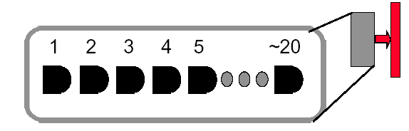
Why not just make a 50-stage pipeline ?
Those latches are NOT free, they take up area, and there is a real delay to go THRU the latch itself.
Machine cycle > latch latency + clock skew
In modern, deep pipeline (10-20 stages), this is a real effect
Typically see logic “depths” in one pipe stage of 10-20 “gates”.
At these speeds, and with this few levels of logic, latch delay is important
Notes:
Machine cycle（固定的） > latch latency（固定的） + clock skew
假设Machine Cycle是固定的，流水线都是这个周期内划分更多的步骤，所以必须满足这个条件。但N太多了，这个条件就破坏了。
负面影响：
（1）每一级流水线都由寄存器组成，更多的流水线级数意味着消耗更多的寄存器，产生更大的面积开销，功耗也会增大。
（2）每一级流水线需要握手，流水线的最后一级反压信号可能会一直串扰到最前一级造成严重的时序问题。
（3）流水线的取指阶段得知条件跳转的结果是到底跳还是不跳，因此只能进行预测，而到了流水线的末端才能通过实际运算得知该分支是真的该跳还是不该跳。如果发现真实的结果与预期的结果不一致，意味着预测失败，需要将所有的预取指令全部丢失。流水线越深，则意味着浪费和损失越严重；流水线越浅，则浪费和损失越少。

Slide 14
Simplified 5 Stage Pipeline

Slide 15
Important Notes:
What should be buffered in every stage latch ?
Data need to be used in the next stages.
Control signals need to be used in the next stages
Debug info when used in duration of design
The memory bandwidth changes !
1 instruction read + 1 data access / 5 cycle (multi-cycle implementation)
1 instruction read + 1 data access / cycle

Slide 16
Pipeline hazard: the major hurdle
A hazard is a condition that prevents an instruction in the pipe from executing its next scheduled pipe stage
Taxonomy of hazard
Structural hazards
These are conflicts over hardware resources.
Data hazards
Instruction depends on result of prior computation which is not ready (computed or stored) yet
Control hazards
branch condition and the branch PC are not available in time to fetch an instruction on the next clock

Slide 17
Hazards can always be resolved by Stall
The simplest way to "fix" hazards is to stall the pipeline. A pipeline stall is also called a pipeline bubble or simply bubble.
The stall delays all instructions issued after the instruction that was stalled, while other instructions in the pipeline go on proceeding.
How do we stall?
- Insert nop by compiler
- Add hardware Interlock（互锁）. Detect stall situations and push bubbles thru pipe
Notes:
The stall delays all instructions issued after the instruction that was stalled, while other instructions in the pipeline go on proceeding.
互锁(interlock)技术 当指令需要的数据因为以前的指令没有执行完,将产生管道互锁。管道发生互锁时,硬件将停止该指令的执行,直到数据准备就绪为止

Slide 18
How do we stall ? Insert nop by compiler
Bubble
Bubble
Bubble
Bubble
Bubble
Bubble
Bubble
Bubble
Bubble

Slide 19
How do we stall? Add hardware Interlock !
Add extra hardware to detect stall situations
Watches the instruction field bits
Looks for “read versus write” conflicts in particular pipe stages
Basically, a bunch of careful “case logic”
Add extra hardware to push bubbles thru pipe
We can just let the instruction you want to stall GO FORWARD through the pipe…
…but, TURN OFF the bits that allow any results to get written into the machine state
So, the instruction “executes” (it does the work), but doesn’t “save”
Or we can just push a nop into the pipeline
Notes:
Interlock: 流水线互锁控制

Slide 21
How to Stall ? Add a stall control logic !
PC IF/ID ID/EX EX/MEM MEM/WB
M.Inst
D.Inst
E.Inst
F.Inst
Bubble
Bubble
Branch
Branch
Wreg
Wreg
Rd
Rd
Stall control logic
Rs
Rt
stall
To produce a stall signal. If stall ==1 then
Use stall to disable writing PC write and IF/ID latch.
Push a bubble into next stage.
Bubble = 1 and disable control signal Wreg and Wmem.
Push a nop forward into ID/EX

Slide 22
Structural hazard: Pipe Stage Contention
Structural hazards
Occurs when two or more instructions want to use the same hardware resource in the same cycle
Causes bubble (stall) in pipelined machines
Overcome by replicating hardware resources
Multiple accesses to the register file
Multiple accesses to memory
some functional unit is not pipelined.
Not fully pipelined functional units

Slide 23
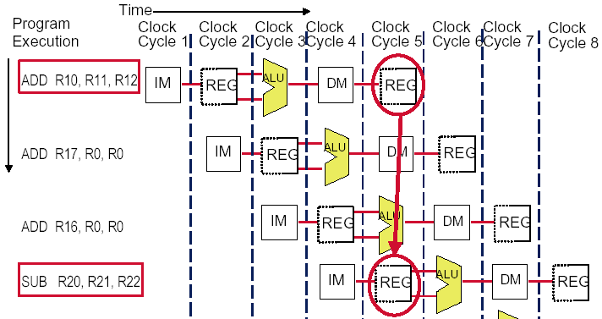
Multi access to the register file
Simply insert a stall , speedup will be decreased.
We can resolve it with “ double bump”

Slide 24
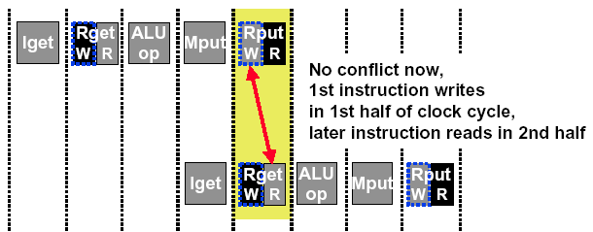
Double Bump Works !
allow WRITE-then-READ in one clock cycle (double bump)

Slide 25
Split instruction and data memory
Time (clock cycles)
I
n
s
t
r.
O
r
d
e
r
Ld/St
IM
Reg
ALU
DM
Reg
Instr 1
IM
Reg
ALU
DM
Reg
Instr 2
IM
Reg
ALU
DM
Reg
Instr 3
IM
Reg
ALU
DM
Reg
Split instruction and data memory / multiple memory port / instruction buffer means:
fetch the instruction and data inference using different hardware resources.

Slide 26
Not fully pipelined function unit : may cause structural hazard

Slide 27
Why allow machine with structural hazard ?
To reduce cost .
i.e. adding split caches, requires twice the memory bandwidth.
also fully pipelined floating point units costs lots of gates.
It is not worth the cost if the hazard does not occur very often.
To reduce latency of the unit.
Making functional units pipelined adds delay
(pipeline overhead -> registers.)
An unpipelined version may require fewer clocks per operation.
Reducing latency has other performance benefits, as we will see.

Slide 28
Data hazard
Data hazards occur when the pipeline changes the order of read/write accesses to operands comparing with that in sequential executing .
Let’s see an Example
ADD R1, R1, R3
SUB R4, R1, R5
AND R6, R1, R7
OR R8, R1, R9
XOR R10, R1, R11

Slide 29
Somecases “Double Bump” can do !
Stall? Too slow!

Slide 30
Forwarding(bypass, short-circuiting): reduce data hazard stalls
If the result you need does not exist AT ALL yet,
you are out of luck, sorry.
But, what if the result exists, but is not stored back yet?
Instead of stalling until the result is stored back in its “natural” home…
grab the result “on the fly” from “inside” the pipe, and send it to the other instruction (another pipe stage) that wants to use it
Mechanically, we add buses to the datapath to move these values around, and these buses always “point backwards” in the datapath, from later stages to earlier stages

Slide 31
Forwarding:reduce data hazard stalls
Data may be already computed - just not in the Register File
EX/MEM.ALUoutput → ALU input port
MEM/WB.ALUoutput → ALU input port

Slide 32
Hardware Change for Forwarding
NextPC
ID/EX
EX/MEM
MEM/WR
Registers
mux
ALU
Data
Memory
mux
mux
Immediate
EX/Mem.ALUoutput → ALU input
MEM/WB.ALUoutput → ALU input
MEM/WB.LMD → ALU input
MEM/WB.LMD → DM input
Notes:
LMD：load memory data

Slide 33
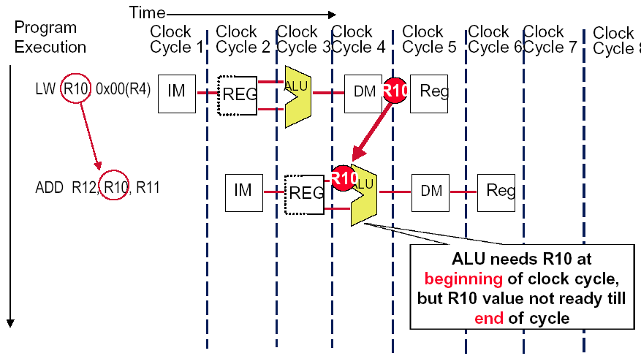
Forwarding Doesn’t Always Work

Slide 34
How to implement forwarding ?
PC IF/ID ID/EX EX/MEM MEM/WB
M.Inst
D.Inst
E.Inst
F.Inst
Bubble
Bubble
FwdA FwdB
Branch
Branch
Wreg
Wreg
Rd
Rd
Forwarding
logic
Stall
logic
Rs
Rt
stall
Think about Where is the logic function unit ?
If FwdA, FwdB are used in ID, then …
If FwdA, FwdB are used in EXE, then …
2) When to stall ? Load stall, control stall

Slide 35
When to use the forwarding path ?
EX/Mem.ALUoutput → ALU input
The previous instruction in EX/MEM is ALU
The instruction in ID/EX has rs1 or rs2 source register
EX/MEM.Rd == ID/EX.rs1 or EX/MEM.Rd ==ID/EX.rs2
MEM/WB.ALUoutput → ALU input
The previous instruction in MEM/WB is ALU
The instruction in ID/EX has rs1 or rs2 source register
MEM/WB.Rd == ID/EX.rs1 or MEM/WB.Rd == IF/ID.rs2
MEM/WB.LMD → ALU input
The previous instruction in MEM/WB is Load
The instruction in ID/EX has rs1 or rs2 source register
MEM/WB.Rd == ID/EX.rs1 or MEM/WB.Rd == ID/EX.rs2
MEM/WB.LMD → DM input
The previous instruction in MEM/WB is Load
The instruction in EX/MEM is Store
MEM/WB.Rd == EX/MEM.rs2

Slide 36
The performance influence of load stall
Example
Assume 30% of the instructions are loads.
Half the time, instruction following a load instruction depends on the result of the load.
If hazard causes a single cycle delay, how much faster is the ideal pipeline ?
Answer
CPI = 1+30%×50% ×1=1.15
The performance decrease about 15% due to load stall.

Slide 37
Deal with Control Hazards
虽然ALU已经生成了target地址，但是还没有写回PC寄存器，所以真正写PC寄存器是MEM周期
为啥不是44+24=68： 是用48+24，因为在取出地址为44的指令后，PC已经加4了
Notes:
beq r1, r3, 24 是一条汇编指令，通常出现在基于MIPS或类似指令集架构的汇编语言中。这条指令的含义是：
beq：Branch if Equal（如果相等则分支）
r1：寄存器1，这是指令中的第一个操作数，用于比较的源寄存器。
r3：寄存器3，这是指令中的第二个操作数，用于比较的另一个源寄存器。
24：偏移量，通常以字（word）为单位，告诉处理器从当前指令地址开始，向前或向后跳转24个字的地址。在MIPS架构中，一个字通常是4字节。
综合起来，beq r1, r3, 24 指令的作用是：如果寄存器r1和寄存器r3的内容相等，那么处理器将跳转到当前指令地址之后的第24个字（即跳过接下来的6条指令，假设每条指令4字节）处执行。如果不等，则继续顺序执行下一条指令。
这种类型的分支指令在程序中用于实现条件语句，如if-else语句或者循环控制。
这个地方为啥不是跳到68，而是72？为啥不是44+24=68： 是用48+24，因为在取出地址为44的指令后，PC已经加4了
为啥是3个周期：因为DM才能确定真正的目标地址。//但是上面的那个地址不是在ALU之后已经出现了吗？
这里的主要原因是：虽然ALU已经生成了target地址，但是还没有写回PC寄存器，所以真正写PC寄存器是MEM周期，还需要等一个周期才行，因此需要等待3个周期。（宋浩喆解答）

Slide 38
Flushing the pipeline
Simplest hardware:
Holding or deleting any instruction after branch until the branch destination is know.
Penalty is fixed.
Can not be reduced by software.
Problem:
With a 25% branch frequency and an ideal CPI of 1, how much the performance is by inserting stalls ?
Answer:
CPI = 1+25%×３＝1.75
this simple solution achieves only about half of the ideal performance.

Slide 39
Move the Branch Computation Forward

Slide 40
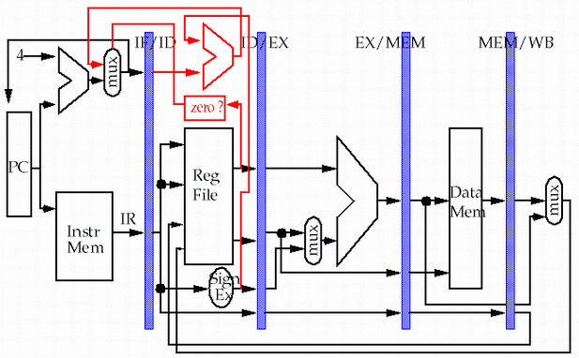
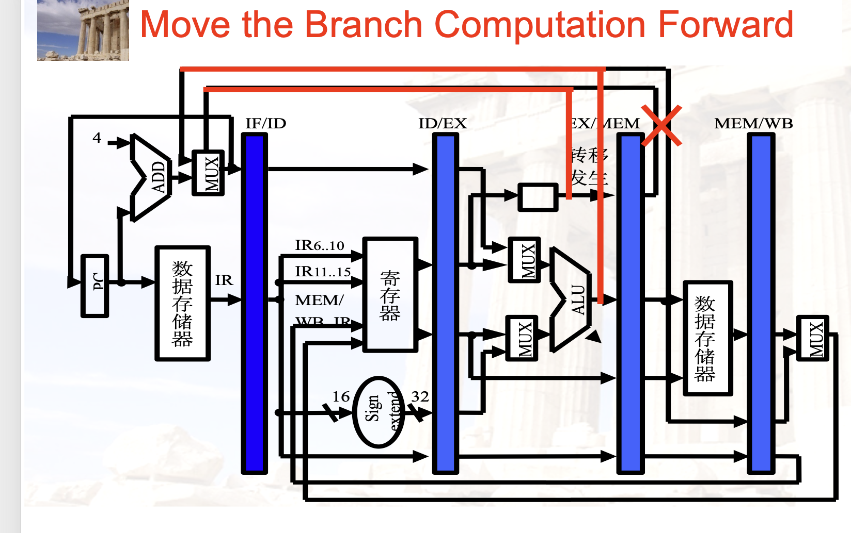
Move the Branch Computation more Forward//这种题目里需要明确指出。

Slide 42

Why “waste” the fetched instruction ?
Branch instruction | IF | ID | EX | MEM | WB
Branch Successor |  | IF | idle | idle | idle | idle
Branch successor+1 |  |  | IF | ID | EX | MEM | WB
Branch successor+2 |  |  |  | IF | ID | EX | MEM
Branch successor+3 |  |  |  |  | IF | ID | EX
We have fetched the instruction 48, why should we waste the delay slot ?
分支指令在ID才能确定是分支指令，这个时候后继指令已经取指令了，既然这样，就不应该浪费掉，因为它有可能取的是对的指令。
Notes:
延迟槽（delay slot）是流水线架构中的一种技术，用于优化分支和跳转指令的执行效率。在流水线处理中，分支指令通常需要等待直到流水线的某个阶段才能确定跳转目标，这会导致流水线在确定跳转地址期间出现停滞，即产生气泡或空闲周期。为了减少这种停滞，设计者引入了延迟槽技术。
延迟槽是紧跟在分支或跳转指令后的一条指令位置。无论分支是否发生，延迟槽中的指令都会被执行。这样可以确保流水线在分支指令完成后能够立即执行下一条指令，而不需要等待分支的跳转地址被确定。这种技术可以减少流水线的空闲周期，提高指令执行的连续性和CPU的整体效率。
在某些架构中，如MIPS，延迟槽是可见于软件的，编译器需要确保在延迟槽中放置合适的指令，以避免执行无效的操作。在其他一些现代架构中，如x86或ARM，可能不使用延迟槽，而是采用更高级的分支预测技术来提高流水线的效率。

Slide 43
Delayed branch
Good news
Just 1 cycle to figure out what the right branch address is
So, not 2 or 3 cycles of potential NOP or stall
Strange news
OK, it’s always 1 cycle, and we always have to wait
And on MIPS, this instruction always executes, no matter whether the branch taken or not taken. (hardware scheme)
Notes:
Just 1 cycle to figure out what the right branch address is：用一个周期计算分支地址？？（40页的图的方法）
So, not 2 or 3 cycles of potential NOP or stall：因此，不必像naïve方法需要等待2-3个周期。

Slide 44
MIPS pipeline with FP units

Slide 45
Pipeline supports multiple outstanding FP operations
EX
MEM
M1
M2
M3
M4
M5
M6
M7
WB
IF
ID
A1
A2
A3
A4
DIV

Slide 46
Specifications
Memory bandwidth: double words/one cycle
New pipeline latches are required:
M1/M2, M2/M3, M3/M4, M4/M5, M5/M6, M6/M7
A1/A2, A2/A3, A3/A4
New connection registers are required:
ID/EX, ID/M1, ID/A1, ID/DIV
EX/MEM, M7/MEM, A4/MEM, DIV/MEM
Because the divider unit is unpipelined, structural hazards can occur.
Because the instructions have varying running times, the number of register writes required in a cycle can be larger than 1
New data hazards: WAW is possible due to disorder WBs
Due to longer latency of operations, stalls for RAW hazards will be more frequent.
Problems with exceptions resulting from disorder completion

Slide 47
How to solve the write port conflict ?
Increase the number of write ports
Unattractive at all !
No worthy since steady state usage is close to 1.
Detect and insert stalls by serializing the writes
Track the use of the write port in the ID stage and to stall an instruction before it issues
Additional Hardware: a shift register+ write conflict logic
The shift register tracks when already-issued instructions will use the register file, and right shift 1 bit each clock.
The stalls might aggravate the data hazards
All interlock detection and stall insertion occurs in ID stage
To stall a conflicting instruction when it tries to enter the MEM or WB stage.
Easy to detect the conflict at this point
Complicates pipeline control since stalls can now occur in two places.

Slide 48
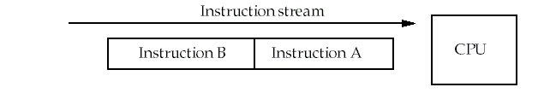
Types of data hazards
Consider two instructions, A and B. A occurs before B.
RAW( Read after write) true dependence
Instruction A writes Rx，instruction B reads Rx
WAW(Write after write) output dependence
Instruction A writes Rx，instruction B writes Rx
WAR( Write after read) anti-denpendence
Instruction A reads Rx，instruction B writes Rx
Hazards are named according to the ordering that MUST be preserved by the pipeline

Slide 49
RAW dependence
B tries to read a register before A has written it and gets the old value.
This is common, and forwarding helps to solve it.
Time
S(A)
D(A)
S(B)
D(B)
No hazard
S(A)
D(A)
If D(A)=S(B), hazard occur.
S(B)
D(B)

Slide 50
WAW dependence
B tries to write an operand before A has written it.
After instruction B has executed, the value of the register should be B's result, but A's result is stored instead.
This can only happen with pipelines that write values in more than one stage, or in variable-length pipelines (i.e. FP pipelines).
Time
S(A)
D(A)
S(B)
D(B)
No hazard
S(A)
D(A)
S(B)
D(B)
If D(A)=D(B), hazard occur.

Slide 51
WAR dependence
B tries to write a register before A has read it.
In this case, A uses the new (incorrect) value.
This type of hazard is rare because most pipelines read values early and write results late.
However, it might happen for a CPU that had complex addressing modes. i.e. autoincrement.
Time
S(A)
D(A)
S(B)
D(B)
No hazard
S(A)
D(A)
S(B)
D(B)
If S(A)=D(B), hazard occur.

Slide 52
Solving the WAW hazard
Stall an instruction that would "pass" another until after the earlier instruction reaches the MEM phase.
Cancel the WB phase of the earlier instruction
Both of these can be done in ID, i.e. when LD is about to issue.
Since pure WAW hazards are not common, either method works.
Pick the one that simplest to implement.
The simplest solution for the MIPS pipeline is to hold the instruction in ID if it writes the same register as an instruction already issued.

Slide 53
Checks are required in ID
Check for structural hazards .
The divide unit and Register write port.
Check for RAW hazards
The CPU simply stalls the instruction at ID stage until:
Its source registers are no longer listed as destinations in any of the execution pipeline registers (registers between stages of M and A) OR
Its source registers are no longer listed as the destination of a load in the EX/MEM register.
Check for WAW hazards
Check instructions in A1, ..., A4, Divide, or M1, ...,M7 for the same destination register (check pipeline registers.)
Stall instruction in ID if necessary.

Slide 54
The MIPS R4000 pipeline
IF－First half of instruction fetch. PC selection occurs. Cache access is initiated.
IS－Second half of instruction fetch.
－This allows the cache access to take two cycles.
RF－Decode and register fetch, hazard checking, I-cache hit detection.
EX－Execution: address calculation, ALU Ops, branch target calculation and condition evaluation.
DF/DS/TC
－ Data fetched from cache in the first two cycles.
－ The third cycle involves checking a tag check to determine if the cache access was a hit.
WB－Write back result for loads and R-R operations.

Slide 55
Possible stalls and delays
Load delay: two cycles
The delay might seem to be three cycles, since the tag isn't checked until the end of the TC cycle.
However, if TC indicates a miss, the data must be fetched from main memory and the pipeline is backed up to get the real value.

Slide 56
Load stalls – 2 stalls
Notes:
Load和ADD指令发生RAW冲突，所以ADD指令要等。

Slide 57
Branch delay: 3 cycles
Branch delay: three cycles (including one branch delay slot-后继的那个slot)
The branch is resolved during EX, giving a 3 cycle delay.
The first cycle may be a regular branch delay slot (instruction always executed-不跳转执行的那个指令) or a branch-likely slot (instruction cancelled if branch not taken-跳转的指令).
MIPS uses a predict-not-taken method presumably because it requires the least hardware.

Slide 58
Branch Delays: 3 stalls
Notes:
ALU之后才能取下一条指令，所以一共是3个周期。

